Slide 1
CONVENTION ON THE CONSERVATION OF EUROPEAN WILDLIFE AND NATURAL HABITATS 41th Standing Committee REPORTING UNDER RESOLUTION No. 8 (2012) Development of National Summary Dashboards Marc Roekaerts
Notes:
A few words on the Council of Europe and why the Convention was negotiated there.

Slide 2
2
Presentation Plan
Overview of the data available from the first reporting round under Resolution No. 8 (2012), see final report: 16809fad04 (coe.int)
Limitations and challenges
4 dashboards under development:
Number of habitats and species per Country Workbook: Number of Habitats and Species per Country (europa.eu)
Conservation status and trends of habitats and species (8 sub-dashboards) Workbook: Conservation status and trends of habitats and species (europa.eu)
Main pressures and threats (habitats / species) Workbook: Main pressures and threats (europa.eu)
Data completeness and quality

Slide 3
Limitations
The 8 countries having replied have performed a tremendous task of getting the data together in the correct format. This first reporting round proved to be an excellent capacity building exercise. Nevertheless, the amount of data and reporting countries is insufficient for a full Conservation Status Assessment (compared to the State of Nature Reports in the EU)
Data for (only) 46 features in 8 non-EU countries, complemented with the Art.17 and 12 data in the EU for the same subset of features: all together 36 countries, but only 46 features
No systematic QA/QC procedure are in place. Data are shown as delivered by countries
As a consequence, a Pan-European State of Nature report and data visualisation is rather difficult with this limited number of features.
Only national summary dashboards for the reported features can be considered, taking into account the 71 % delivery rate (no delivery indicated in light grey in the dashboards)

Slide 4
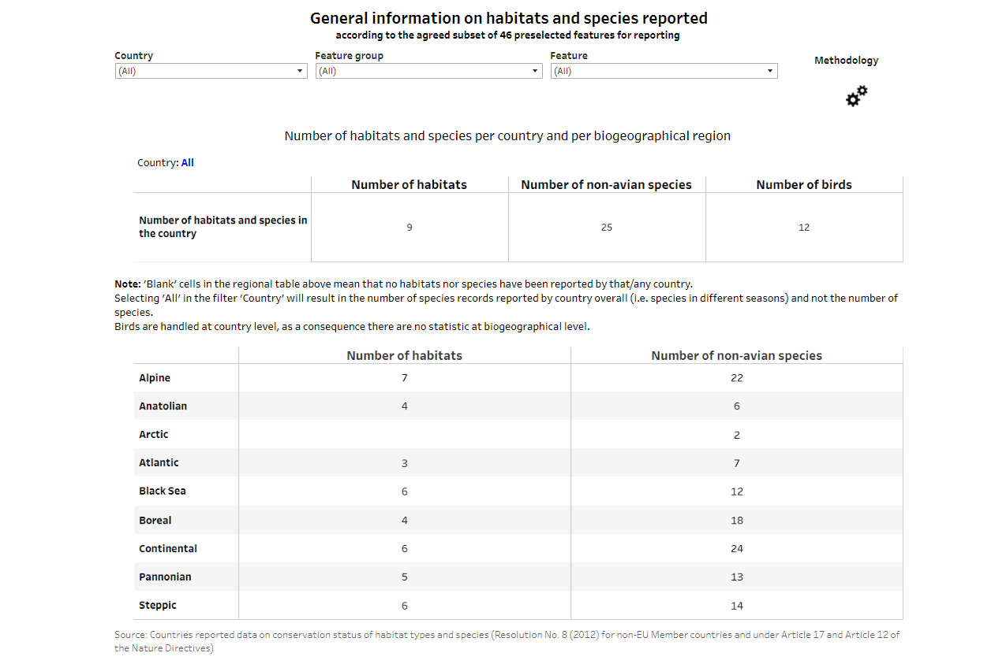

Slide 5
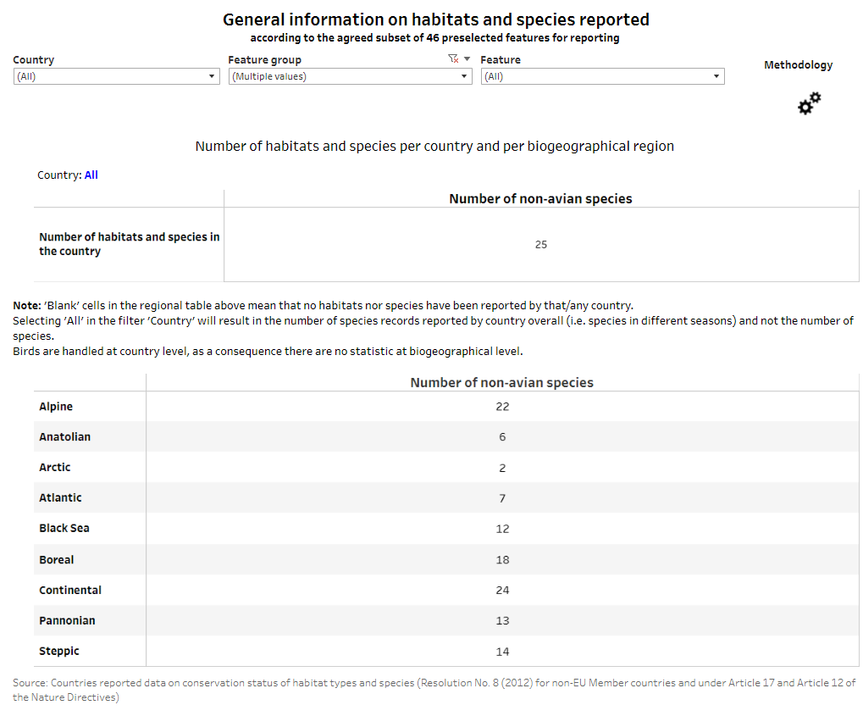

Slide 6
Conservation status and trends of habitats and species (8 sub-dashboards)
2.1 Conservation status
2.2 Features reported
2.3 Habitats – Regions
2.4 Non-avian species – Regions
2.5 Birds distribution long term trend
2.6 Birds population long term trend
2.7 Map – Habitats & non-avian species by country and biogeographical region
2.8 Map - Bird

Slide 7
Conservation status and trends of habitats and species (8 sub-dashboards)
2.1 Conservation status
2.2 Features reported
2.3 Habitats – Regions
2.4 Non-avian species – region
2.5 Birds distribution
2.6 Birds population
2.7 Map – Habitats & non-avian species by country and biogeographical region
2.8 Map - Bird

Slide 8
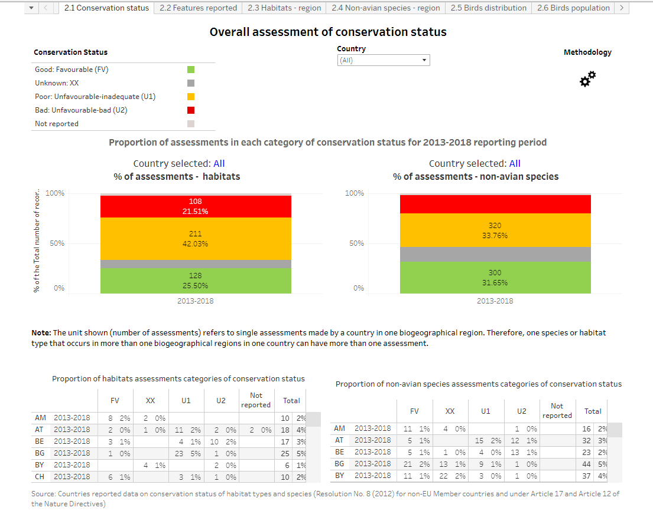

Slide 9
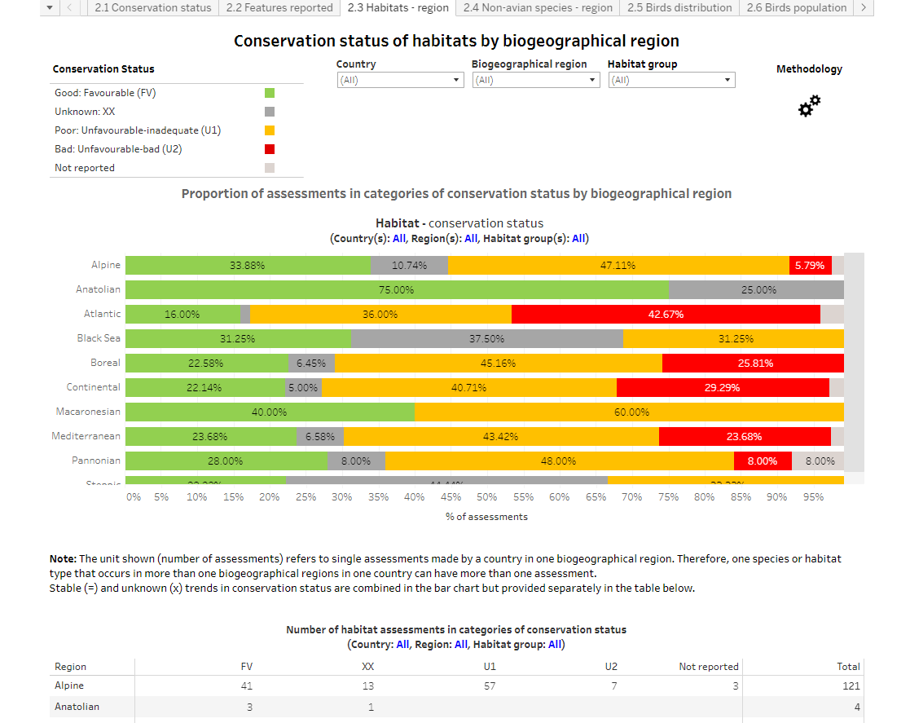

Slide 10
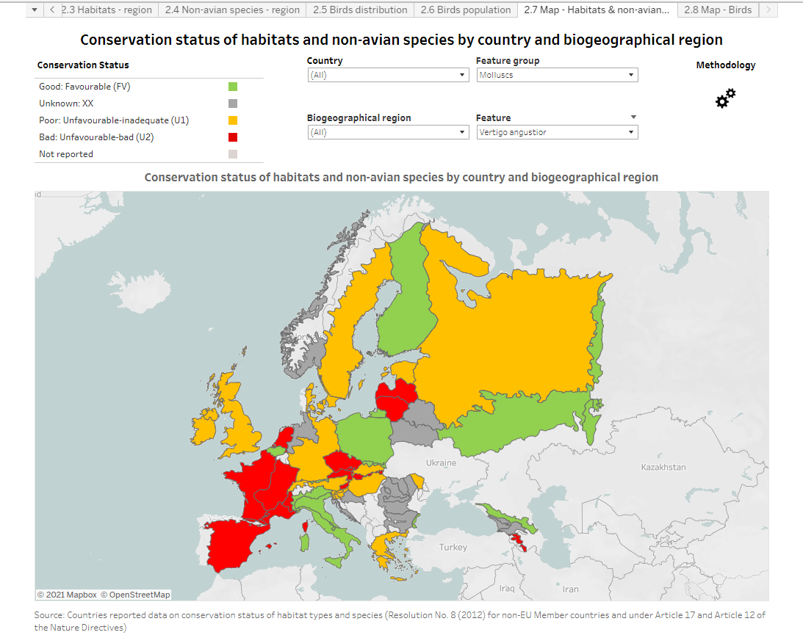
narrow-mouthed whorl snail

Slide 11
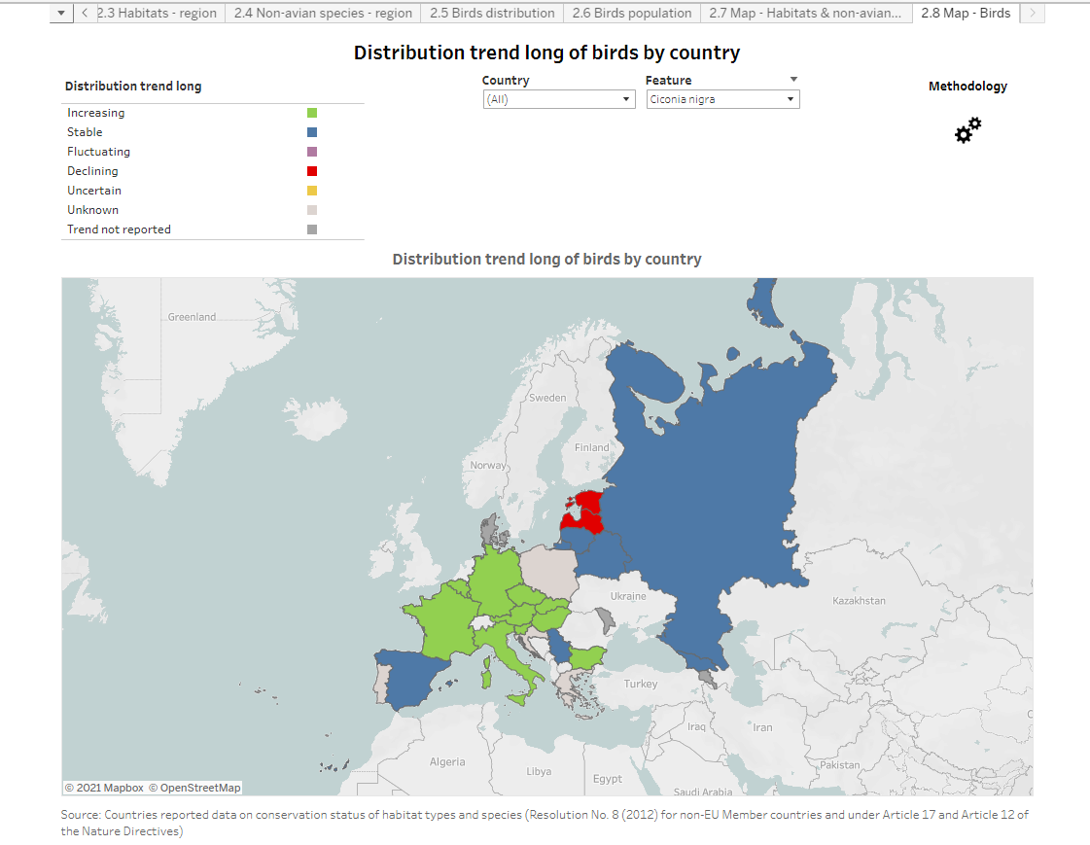
Ciconia nigra

Slide 12
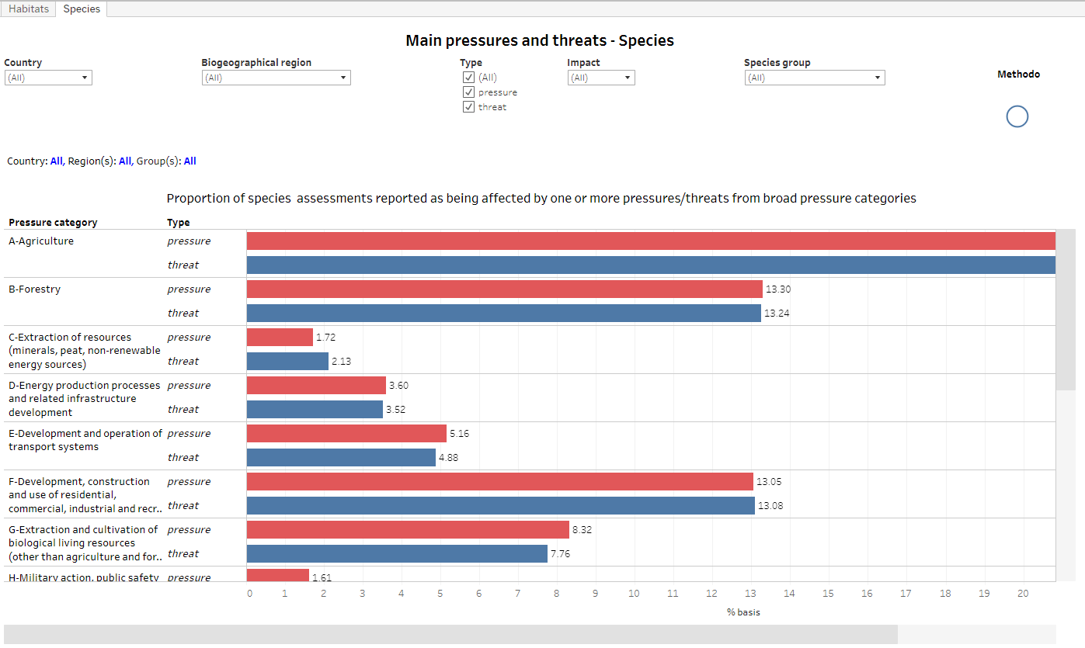

Slide 13
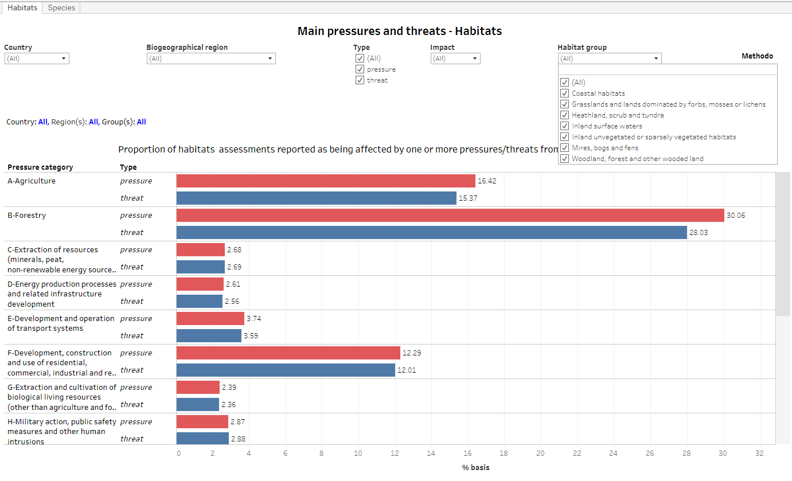

Slide 14
Concluding Remarks
Work on the dashboards has only recently started. Nevertheless and taking into account the limitations, a good impression of the results can be shown
The dashboards should be illustrative for the present data but at the same time be indicative for the future expectations and could assist the future Expert Group on Reporting on taking decisions for the next reporting round
The dashboards will give more visibility to the reporting data as requested by last years Standing Committee
The dashboards will be made public through a Council of Europe hosted webpage with links to the “Tableau” services of the EEA
Comments are welcome !!

Slide 15
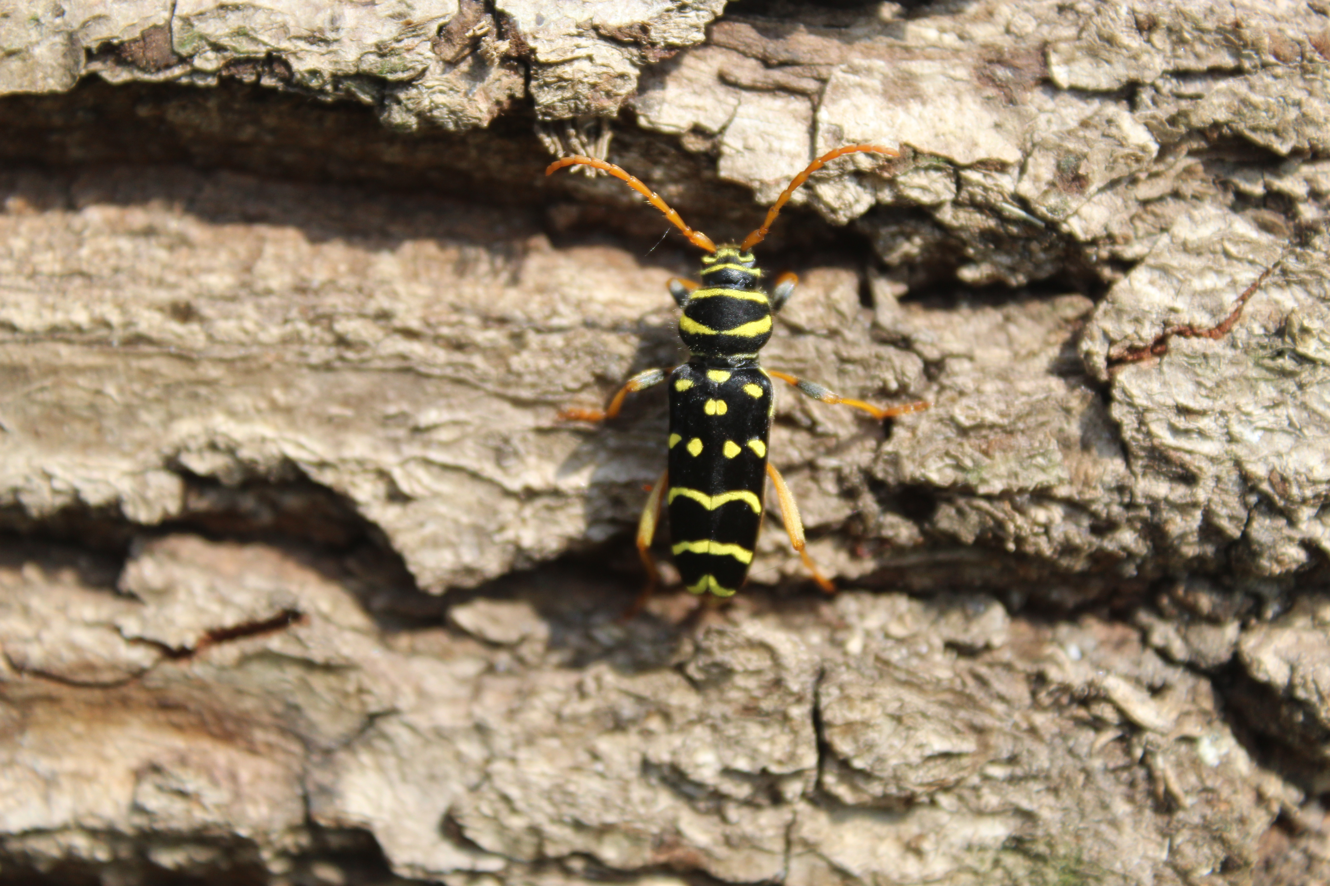
Thank you for your attention
Plagionotus arcuatus

