Slide 1
CONVENTION ON THE CONSERVATION OF EUROPEAN WILDLIFE AND NATURAL HABITATS 40th Standing Committee Emerald Network IT-Tools and Barometer Update Marc Roekaerts
Notes:
A few words on the Council of Europe and why the Convention was negotiated there.

Slide 2
Agenda Item 5.8.1b
Emerald Network Status end 2021
country | Number of Candidate Sites | Number of Adopted Sites | Number of proposed sites | Candidate sites Total Area (ha) | Adopted sites Total Area (ha) | Total number of sites
AD |  | 2 |  |  | 2622,60 | 2
AL | 25 |  |  | 522429,54 |  | 25
AM | 23 |  |  | 1033719,70 |  | 23
AZ | 17 |  |  | 1679533,00 |  | 17
BA | 29 |  |  | 250455,00 |  | 29
BY | 7 | 155 | 15 | 97368,27 | 2306470,06 | 177
CH |  | 37 |  |  | 64216,29 | 37
GE | 4 | 46 | 16 | 36654,07 | 1030491,58 | 66
LI |  |  | 2 |  |  | 2
MD |  | 61 |  |  | 325197,00 | 61
ME | 32 |  |  | 240077,10 |  | 32
MK | 35 |  |  | 754383,00 |  | 35
NO | 138 | 568 |  | 565382,30 | 4403342,81 | 706
RS | 61 |  |  | 1021077,60 |  | 61
RU | 1632 |  | 3 | 49947606,04 |  | 1635
UA |  | 377 | 161 |  | 8098240,48 | 538
UK |  | 943 |  |  | Overlap ??? | 943
 | 2003 | 2189 | 197 | 56182203,37 | (16250699,04) | 4389

Slide 3
5.8.1b
Introduction
IT-Tools are needed to streamline and enforce data quality
Thanks to (very) recent investments further developments are possible
3 levels considered:
CDR data delivery: QA/QC and CDR dashboard on deliveries (since 2008-2009)
International Emerald Network data management: WebApp
Making the data public: the Emerald Network Viewer
Emerald Network Barometer

Slide 4
Sufficiency evaluation cycle
but also data flow cycle
Homework for countries
to propose new sites and update the
Emerald database
Arrival of new
databases from
countries
Final agreements on
seminar conclusions
Should include
Change report
Report on SR conclusions from previous seminar
Preparations for
Seminar -
scientific
assessments
Bio-geographical
Seminar

Slide 5
Data flow cycle
Country Data
Standard Data Form
SDF (Tabular)
Site boundaries
Official Delivery on
Central Data Repository
CDR managed by EEA
European Dataset
Management
IT-Tool
SDF manager
IT-Tool
CDR
IT-Tool
Emerald Web App
Public version
Emerald Viewer
Emerald Barometer
Used for
Evaluation Seminars

Slide 6
Data flow cycle
Country Data
Standard Data Form
SDF (Tabular)
Site boundaries
Official Delivery on
Central Data Repository
CDR managed by EEA
European Dataset
Management
IT-Tool
SDF manager
IT-Tool
CDR
IT-Tool
Emerald Web App
Public version
Emerald Viewer
Emerald Barometer
Used for
Evaluation Seminars

Slide 7
Agenda Item 5.8.1b
Data Delivery on the CDR
Until today, the CDR is just a “mailbox” for “organised” data deliveries

Slide 8
Agenda Item 5.8.1b
Data Delivery on the CDR
From next year on: better use of the background tools behind the CDR
The delivery folder needs to be officially “released” by the country and the delivery needs to be “finished” before data can be harvested by CoE
Automated QA/QC rules will be implemented and a QA/QC report will be automatically available to the country
Deliveries with wrong formats or incomplete spatial layers will be automatically blocked by the system and a warning will be send to the country indicating a new delivery is needed
No content related blockers will yet be implemented, but warnings for wrong content for important fields will be listed

Slide 9
Agenda Item 5.8.1b
Data Delivery on the CDR
When a delivery is accepted, the system will generate a short report, available in the same folder. This report will need to be send to the secretariat, proving a correct delivery
From that moment, the Emerald Network WebApp will start harvesting the data for further integration into the European Dataset.

Slide 10
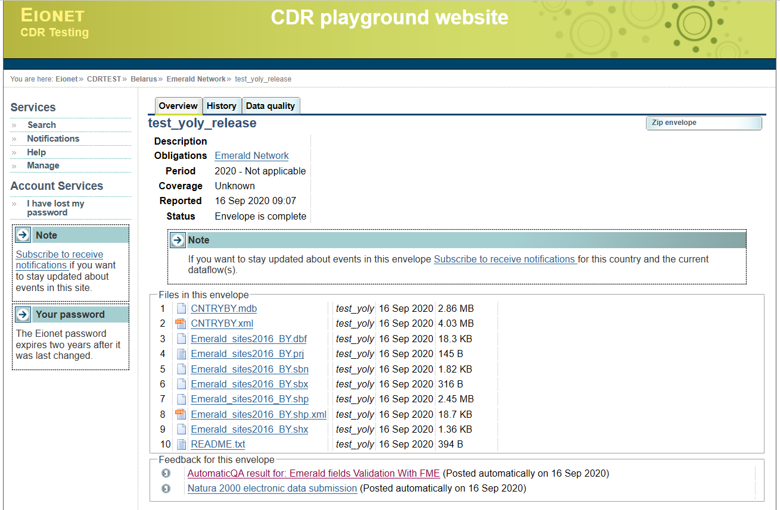
Agenda Item 5.8.1b

Slide 11
Agenda Item 5.8.1b
Emerald Network IntraNet (WebApp)
Includes:
Automated harvesting of country data from the CDR (every night)
Creation of change report for tabular as well as spatial data (to be able to independently verify the country report on changes)
Creation of the Lists of Adopted (ASCI-List) and Candidate site lists
From next year on, those lists will include reference to the accepted changes to the site boundaries and site tabular data
More elaborated QA/QC reports for tabular and spatial data
Historical release management (comparing two data sets from different years)
Will produce yearly a new release of the Emerald Network database to be used in the Emerald Viewer and be put available for the wider public (without sensitive species)

Slide 12
Agenda Item 5.8.1b
Emerald Network Public Viewer
https://emerald.eea.europa.eu/
Includes:
All types of Emerald Network sites: Adopted, Candidate and Proposed
Query options for sites, species and habitats
Use of different types of base maps, including the Natura2000 Network
Yearly updated according to the new releases of the Emerald Network database created by the Emerald Network WebApp (does not include sensitive species)

Slide 13
Agenda Item 5.8.1b
The Emerald Network Barometer
Includes the 3 phases of implementation of the Emerald Network
Indicators for each phase:
Phase I: All types of Emerald Network sites included: Adopted, Candidate and Proposed
Phase II: only Adopted sites included and additional indicator for Sufficiency
Phase III: Proportion of adopted sites with management plans (as recorded in the Emerald Network database

Slide 14
 | Phase I |  |  | Phase II |  |  |  | Phase III
 | Number of all site types | Area of all site types sites (km²) | National coverage of all site types [1] (%) | Sufficiency index* [2] (%) | Number of adopted sites | Area of adopted sites (km²) | National coverage of adopted sites [3] (%) | Proportion of adopted sites with management plans [4] (%)
AD | 2 | 26.2 | 5.6 | 11.9 | 2 | 26.2 | 5.6 | 100.0
AL | 25 | 5224.3 | 18.2 | 28.7 | 0 | 0 | 0 | 0
AM | 23 | 10337.2 | 34.8 | 68.7 | 0 | 0 | 0 | 21.7
AZ | 17 | 16795.3 | 19.4 | 21.7 | 0 | 0 | 0 | 0
BA | 29 | 2504.6 | 4.9 | 0.7 | 0 | 0 | 0 | 0
BF | - | - | - | - | - | - | - | -
BY | 162 | 24038.4 | 11.6↑ | 27.7 | 155 | 23064.7 | 11.1 | 8.0
CH | 37 | 642.2 | 1.6 | 1.4 | 37 | 642.2 | 1.6 | 21.6
GE | 58 | 12629.1 | 18.1 | 25.1 | 46 | 10401.9 | 14.9 | 1.7
IS | - | - | - | - | - | - | - | -
KZ | - | - | - | - | - | - | - | -
LI | - | - | - | - | - | - | - | -
MD | 61 | 3252.0 | 9.6 | 24.0 | 61 | 3252.0 | 9.6 | 47.5
ME | 32 | 2400.78 | 17.1 | 18.0 | 0 | 0 | 0 | 0
MK | 35 | 7543.8 | 29.3 | 16.1 | 0 | 0 | 0 | 0
MA | - | - | - | - | - | - | - | -
MC | - | - | - | - | - | - | - | -
NO | 706 | 49687.3 | 15.3 | 19.8 | 568 | 44033.4 | 13.6 | 0
RS | 61 | 10210.8 | 11.6 | 13.5 | 0 | 0 | 0 | 0
RU | 1635 | 499497.9 | 12.6 | 8.4 | 0 | 0 | 0 | 0
SN | - | - | - | - | - | - | - | -
UA | 377 | 80982.4 | 13.4 | 40.1 | 377 | 80982.4 | 13.4 | 2.1
TN | - | - | - | - | - | - | - | -
TR | - | - | - | - | - | - | - | -

Slide 15
Agenda Item 5.8.1b
The Emerald Network Barometer
Include graphical and thematic options (e.g.)
Distinction between marine and terrestrial part of the Emerald Network
Thematic sufficiency analysis according to feature groups
Yearly updated automatically according to the new releases of the Emerald Network database created by the Emerald Network WebApp
Unfortunately, not yet ready for presentation due to the late arrival of the funds and the quantity of developments to be made

Slide 16
Conclusion
Please take note of the renewed principles for data delivery on the CDR (next years deliveries)
Please be reminded to the need for change reports for each delivery
Please be reminded to the need for a report on Scientific Reservation Conclusions, before each new seminar
Need for a consolidated version of the dataflow guidelines is recognised: will be created next year
The Emerald Network Barameter will be announced as soon as it is ready

Slide 17
Thank you for your attention

