Slide 1


09 June 2021
European Federation for Hunting and Conservation (FACE)
Actions against poisoning Illegal Killing, Taking and Trade of Migratory Birds in the Mediterranean
- Progress and perspectives on IKB by European Hunters
Cy Griffin
Senior Conservation Manager

Slide 2
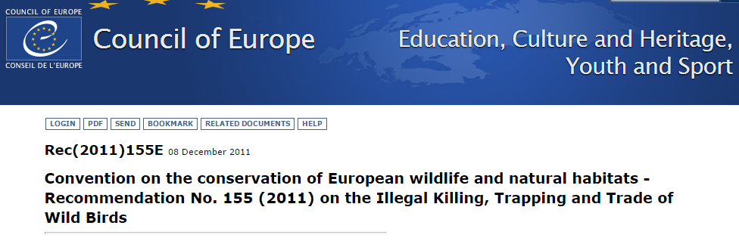
Develop and support national communication strategies, promoting dialogue between all relevant interest groups, and noting cultural sensitivities. These strategies should be aimed to the conservation of bird population and based on the following principles:
(i.) this is about illegal killing of birds, not legal hunting;
(ii.) zero tolerance of illegal killing of wild birds;
(iii.) recognition of legal hunting and sustainable use.

Slide 3
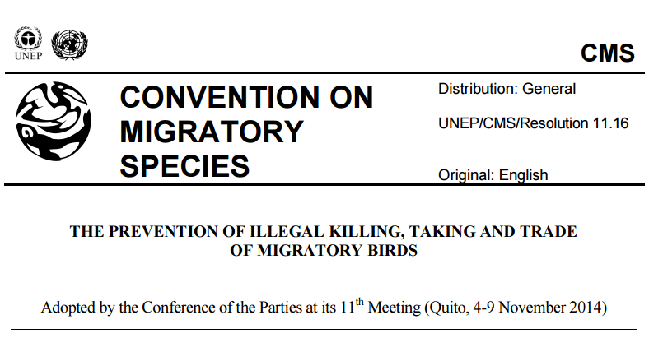

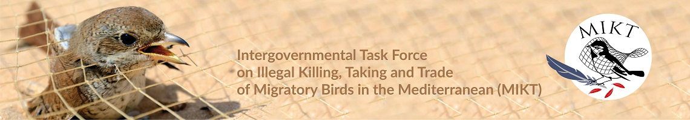

Slide 4
FACE position
FACE has a long-standing policy zero-tolerance towards illegal killing, as it is simply not hunting.
  It is a problem with a variety of motives, primarily illegal trade and smuggling, persecution (for competition or commercial reasons), indirect killing through poisoned baits – all committed by a large variety of actors.
For FACE, sustainable hunting is not a problem for illegal killing, but illegal killing is a problem for sustainable hunting!
Communication messages are key for peer pressure and encouraging reports of wildlife crime

Slide 5
Awareness &
Communication
Action 4.1.1 Encouraging hunting organizations to adopt codes of conduct including, where relevant, those based on traditional hunting principles, and by systematically condemning IKB.
Malta
Meetings, info on importance of eradicating IKB for the
hunting community
Cyprus
Articles, videos, photos, posters, …
Greece
Condemnation of poaching
Raising awareness of hunters
Education
Italy
Periodic publication of news on the activities undertaken within the Action Plan;
Condemnation of poaching cases;
Raising awareness of hunters on the damage of poaching to biodiversity and the community.
All Members condemning IKB using all channels:
  Social media
  TV
  Newspaper
  Magazines
  Websites
  Leaflets
  stickers

Slide 6
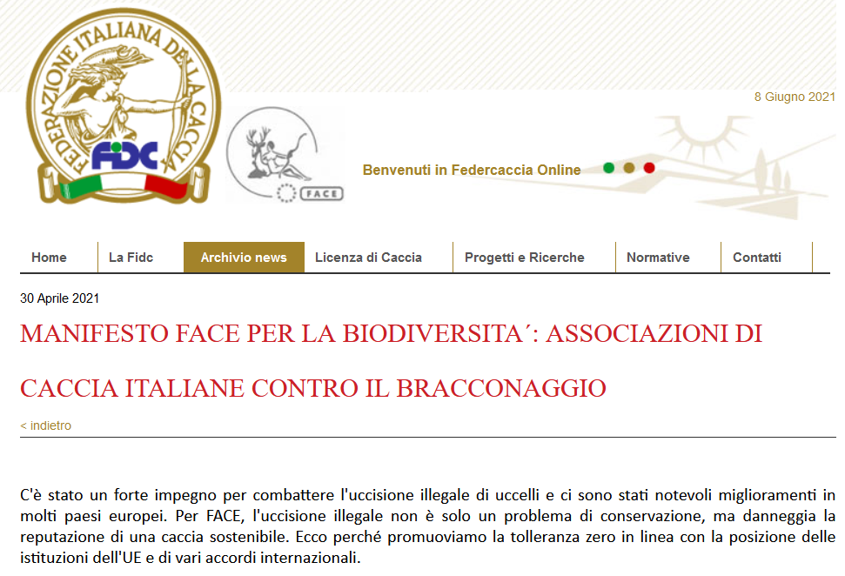
FACE Members communications and actions
For FACE, illegal killing is not only a conservation issue, but damages the reputation of sustainable hunting. This is why we promote zero tolerance… FIDC April 2021

Slide 7
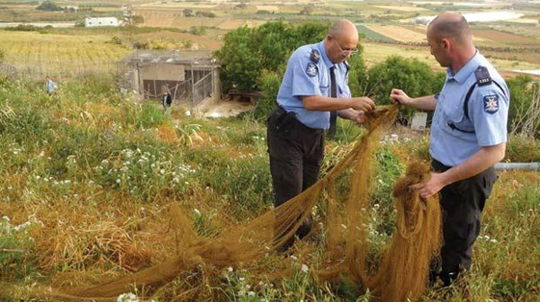
National & hunting org. enforcement
Action 4.1.1 Encouraging hunters to continue to participate in surveillance effort and to assist the authorities in detecting IKB
Malta
Active collaboration of FKNK to report any illegality so that such acts are immediately taken over by the local Env. Protection Unit.
  Marshals who continuously monitor vast areas throughout the hunting season.
  + Strict control of Police and WBRU personnel throughout the hunting season.
FKNK suspends/cancels memberships of convicted hunters depending on gravity.
Cyprus
MEPA, Wild Birds Regulation Unit, police & armed forces & others (voluntary).
High intensity of inspections and high penalties.
Greece
Greek Public Forest Service: more than 1000 Wardens.
Hunting Organizations: more than 300 Gamekeepers.
  Particular intensification of spring surveillance for the Turtle Dove
  in hotspots of migration.
Italy
Hunter’s associations: around 4000 Voluntary Hunting Guards.
  FIDC: around 2500
  Surveillance against IKB
Hunters' Associations actively participate in implementation of the National Action Plan to combat IKB adopted in 2017.

Slide 8
National & hunting org. enforcement
Action 4.1.1 Encouraging hunters to continue to participate in surveillance effort and to assist the authorities in detecting IKB
Malta
Marshals continuously monitoring vast areas and report
Enables real time report to the police
Cyprus
Hunters participate in detecting and reporting IKB to the competent authorities (Game & Fauna Service and the Police).
Greece
Hunters participate in detecting and reporting IKB to the competent authorities (Gamekeepers and Wardens)
Italy
Social management of “hunting grounds” makes hunters responsible against IKB and poaching.

Slide 9
Hunter’s training
Malta
Exam to get the licence:
  Identification of protected and game species
  Knowledge of legal parameters within which hunting can be practiced.
Cyprus
Hunting education lessons and exams
  For new hunters as well as convicted hunters
Greece
Production of a Hunting Guide
Italy
Regularly organized training courses for new hunters
Refresher courses for hunters
Production of documents on "look alike species"
Action 4.1.1
§ Encouraging states and hunting associations to organize national seminars to inform and train hunters on species identification, species protected by law, forbidden methods, etc.
§ Encouraging national administrations to improve regulatory systems concerning hunting education (e.g., licensing, examinations, hunter training, etc).

Slide 10

Actions
Malta
Continuous participation of the FKNK on the Malta Ornis Committee, meetings with ministry and WBRU officials to identify and overcome illegal activities.
Enforcement in the field ending up with the legislative fines/penalties/other punishment as directed by our Courts, successful in bringing IKB to a handful of incidents.
Final stages of officially setting up a Hunting Academy
  Make existing and prospective hunters aware of their role as leaders of conservation
  Make them understand the reason behind legislations.
  Results: Fully supportive hunters.
Italy
Supports the LIFE + “Reason for Hope - Reintroduction of the Northern Bald Ibis in Europe”
Partner beneficiary of the LIFE “PERDIX - Italian Gray partridge reintroduction in nature”
Awareness raising and prevention of IKB

Slide 11
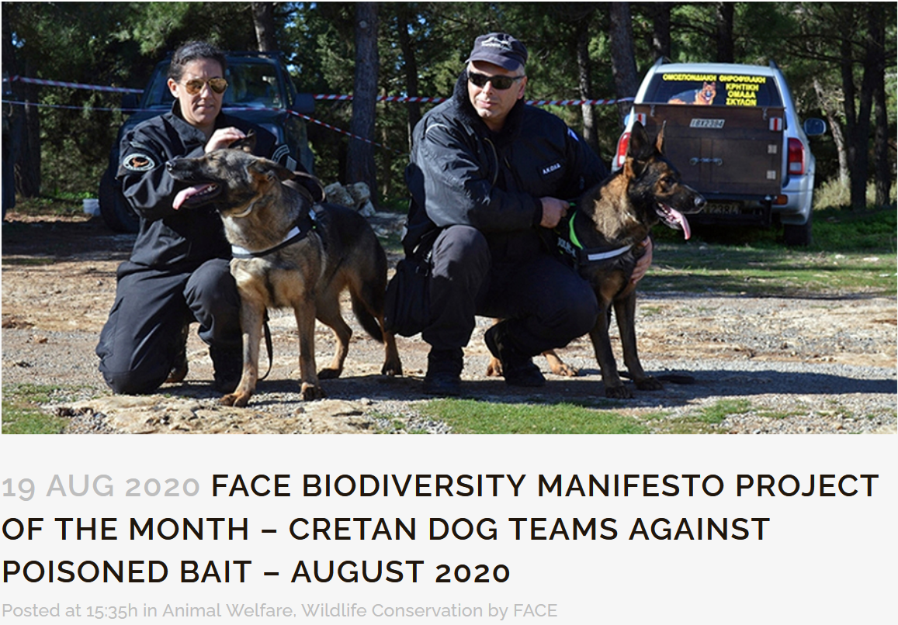

FACE project of the month

Slide 12
Thanks
https://www.face.eu/

