Slide 1
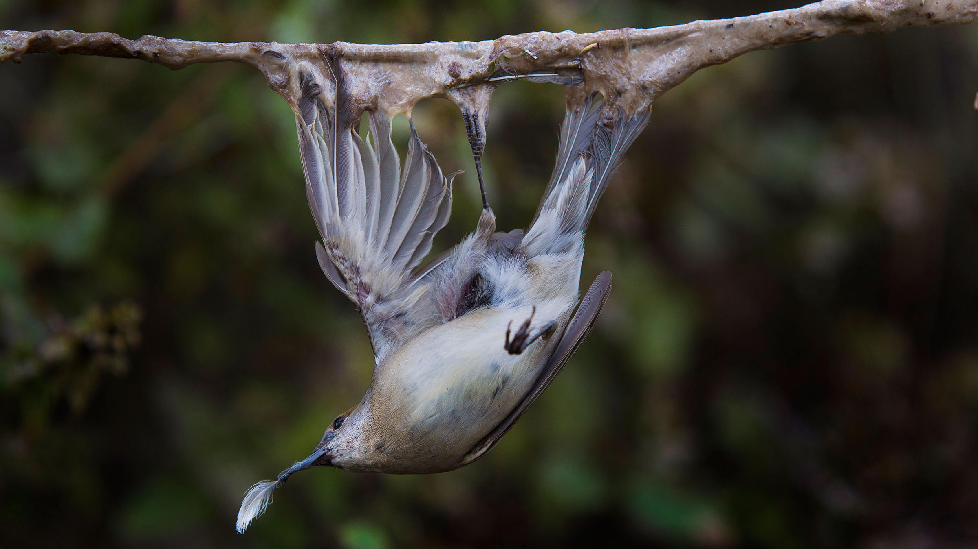
BirdLife International
Contributions to implementing the Rome Strategic Plan
MIKT Taskforce meeting – June 9-11th 2021
Jessica Williams
Conservation Officer
BirdLife International
© FlightforSurvival / BirdLife Europe
Notes:
I’m going to talk through some of the work that BirdLife partners are already doing that contributes to the action outlined in the Rome strategic Plan and the Programme of work. I’m also going to highlight the main challenges and areas where government action is needed most. The main message that I would like the national governments to take away : is BirdLife partners and NGOS are ready and willing to support governments!!

Slide 2
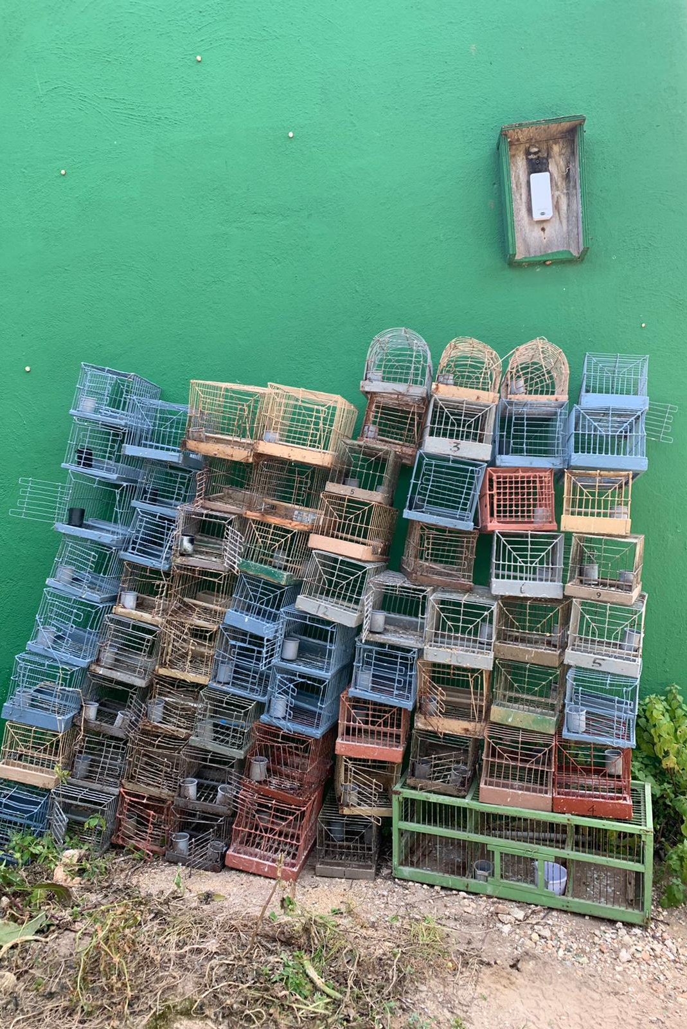
Under the RSP we have committed to an ambitious goal and to taking bolder action to achieve zero-tolerance and to scaling up efforts to eradicate IKB
But zero tolerance needs to be put into practice across the board – in legislation, enforcement, judicial process, education, communication
Promising signs in some countries, but in some, backward steps are being taken and in many, action needs to be up-scaled with far greater urgency
Multi-stakeholder National Action Plans and committees are the best framework and vehicle for driving implementation of the RSP
NOW is the time to ACT

Slide 3
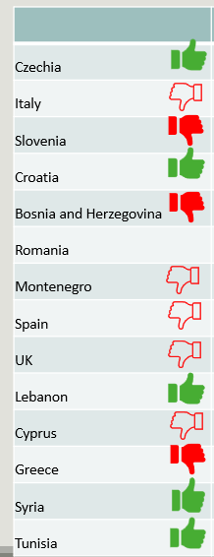
NGO response to Government Scoreboard Assessment
Scoreboard is a unique process in intergovernmental environmental monitoring - can be used as a best practice for other international fora
Overall positive engagement with Scoreboard process – good consultation by Czechia, Cyprus, Croatia governments etc.
Room for improvement – more governments engage with the process & involve stakeholders
Pleased to see vast majority made info available – encourage the remaining few to make these reports public
Notes:
But as the Scoreboard assessment shows that impact is poor – either stable or IKB increasing. Only 4 countries reporting a decreasing trend in IKB, 3 reporting increasing trend, 6 stable trend, 11 unknown trend. This does not yet suggest the upscaling of effort envisaged in the vision and goal of the RSP. It also underlines the need for systematic monitoring in order to fill knowledge gaps and reduce the number of countries with unknown trend.
more work needs to be done!!!

Slide 4
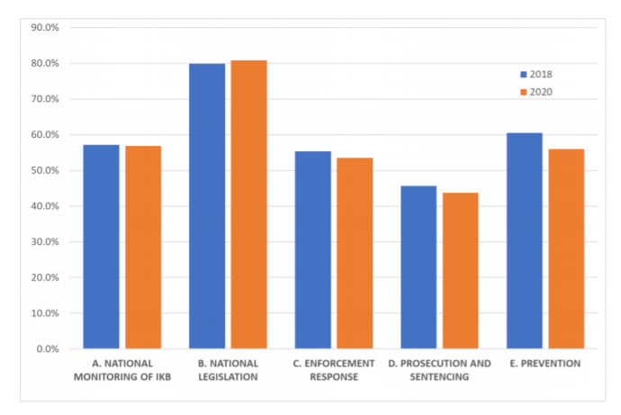
Scoreboard shows progress has been negligible
Figure 3 –Average score (percentage of maximum possible score) for each indicators’ group. Comparison from 2018 – 2020. Last available scores for each of the 35 countries with at least 1 score (not including the scoreboards completed by NGOs).
Impact is poor – either stable or IKB increasing. Only 4 countries reporting a decreasing trend in IKB, 3 reporting increasing trend, 6 stable trend, 11 unknown trend. This does not yet suggest the upscaling of effort envisaged in the vision and goal of the RSP. It also underlines the need for systematic monitoring in order to fill knowledge gaps and reduce the number of countries with unknown trend.
More work needs to be done!!!

Slide 5
How are NGOs contributing to the Rome Strategic Plan?​
birdLife organisations and other NGOs are here to HELP!
Notes:
Birdlife national partners/NGOs in general are undertaking at lot of the work identified as "gaps" by the review of PoW 2016-2020 And many - if not all - of the actions outlined in the Rome Stratgic Plan
We urge govs to reach out to NGOs to work with them and see what work has been already done by NGOs and what is still needed

Slide 6
Data collection, field monitoring, detection and surveillance, socio-economic studies
Supporting enforcement actions (e.g. joint missions, providing expertise on identification, anti-poaching camps, volunteer work)
Knowledge sharing (professional trainings, materials, guidance, database management)
Advocating to ensure that there is public support for these measures (including IKB hotlines)
Facilitating the development of National Action Plans & working closely with government authorities
Awareness raising among target groups (hunters, landowners, market traders, consumers etc.)
Working with communities to develop alternative livelihoods
Capacity building for authorities (professional trainings, knowledge sharing, materials, database management)
BirdLife are working
across all 5 of the objectives of the RSP
Notes:
NGOS are working in many of the gaps that the CMS has highlighted in the presentation this morning - across all 5 of the objectives of the RSP We urge governments to get in touch with the BirdLife partner in that country to take this forward

Slide 7
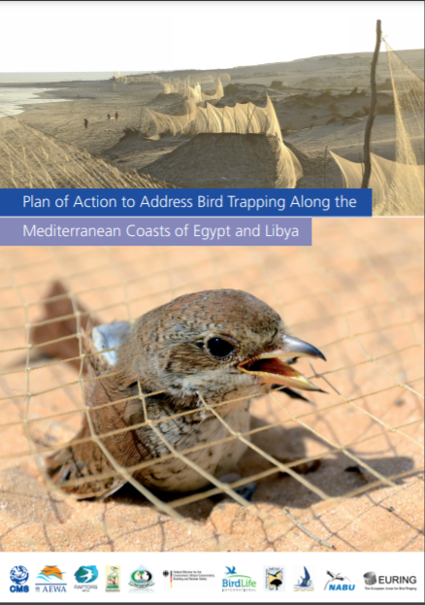
National Action Plans
National Action plans are the best method of delivering a reduction in IKB
Government-led, multi-stakeholder process – ensures both legitimacy and buy-in from all parties
BirdLife has developed NGO guidance document on how to help support governments to develop NAP
International workshop on National Action Plan development and implementation was held in March 2021
Several National Action Plans to tackle IKB are in place: Egypt, Libya, Cyprus, Lebanon, Italy, Montenegro – cannot be complacent!
NAP is a process – not a document that sits on a shelf

Slide 8
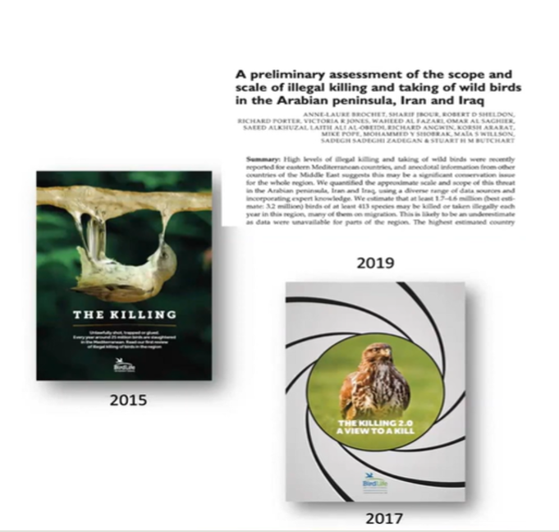
Data collection, socio-economic studies, field monitoring, detection and surveillance
Monitoring programmes are still running at national level in many countries – this information can be shared with governments
Ideally governments would focus on developing or continuing this systematic monitoring of IKB along with other stakeholders.
Sampling strategy can reflect capacity/ investment - doesn't have to be a huge undertaking if well designed.
Best Practice Guidelines for Monitoring IKB
Notes:
Game changing publications on the scale & scope of IKB (2015, 2017, 2019)

Slide 9
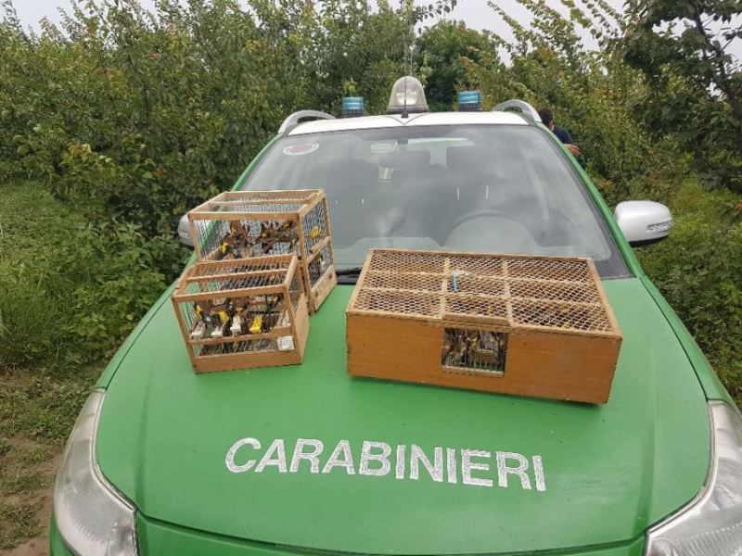
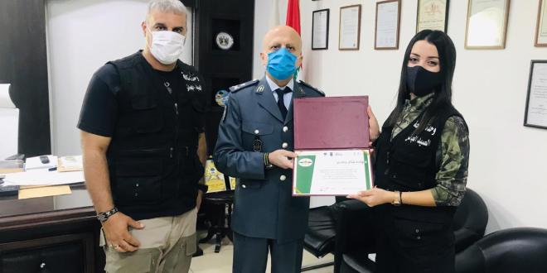
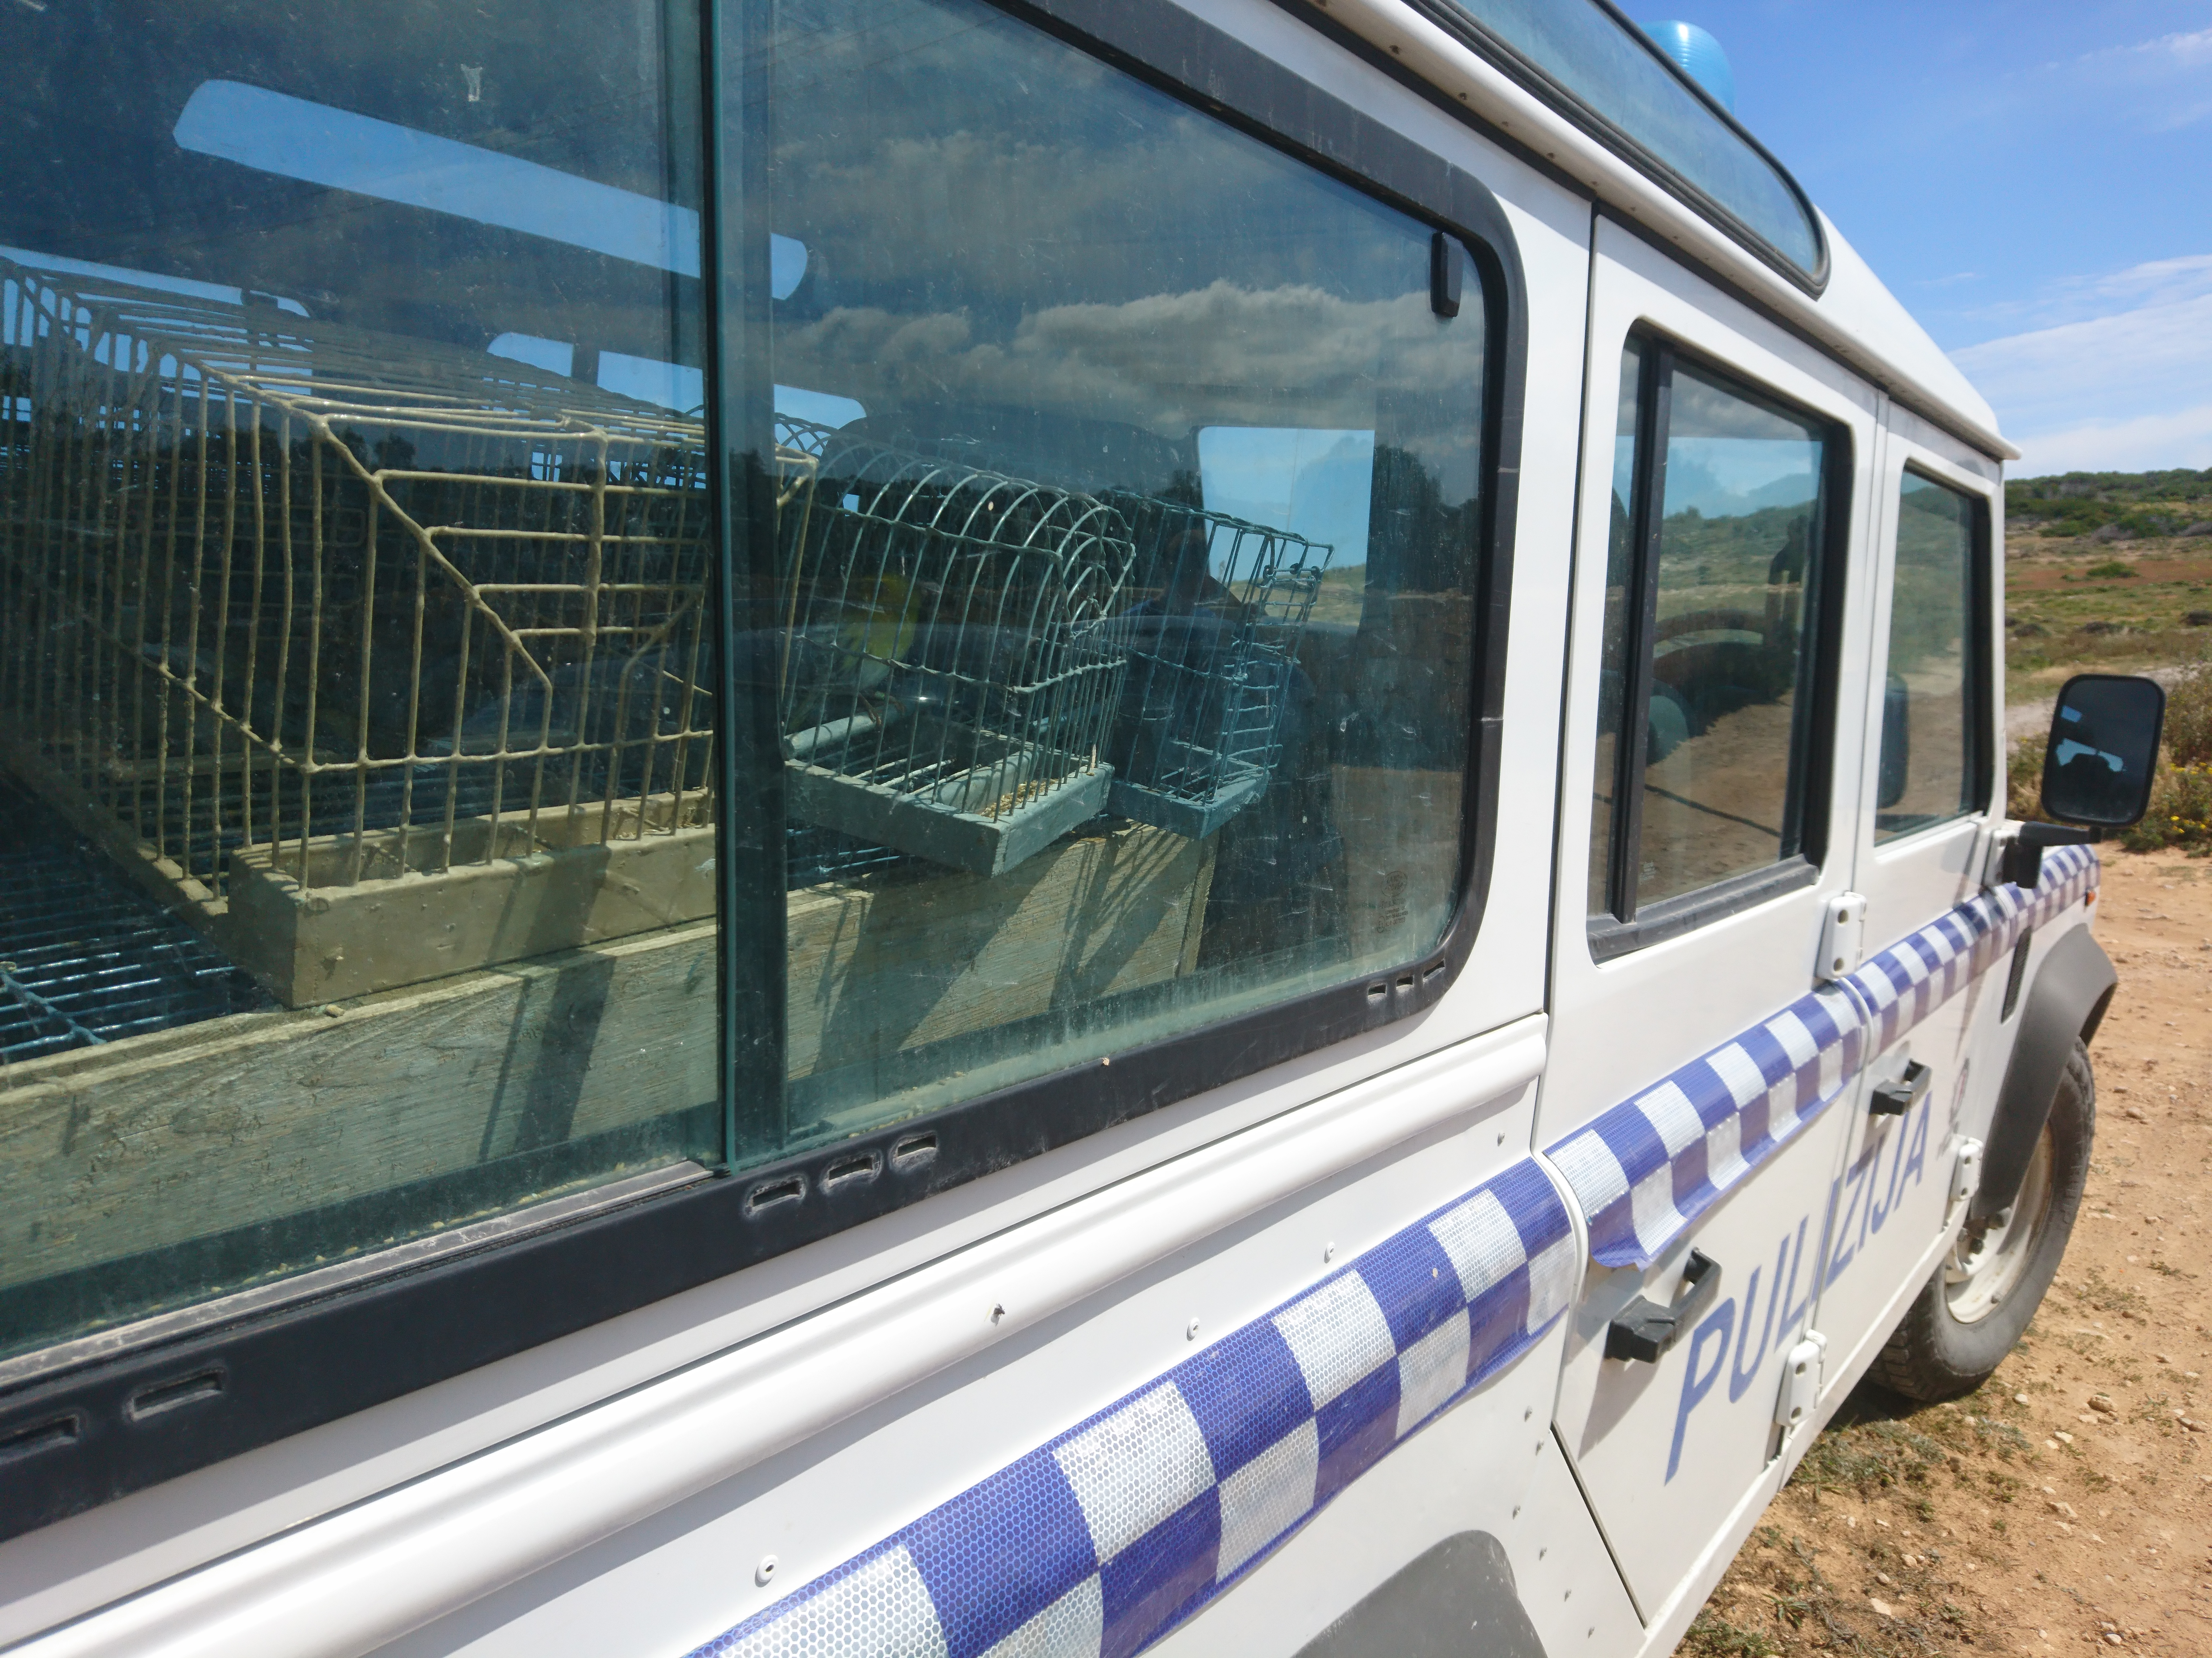
BirdLife support to LEAs - national enforcement activities
BirdLife partners are working directly with law enforcement authorities (LEAs) across Europe, the Middle East and North Africa to provide:
Materials & equipment
Joint surveillance missions & monitoring operations
Guidance & information sharing
Setting up and/or promoting wildlife crime hotlines for public
Reporting incidents and following up on reported incidents
Training volunteers
Anti-poaching camps (alongside LEAs)
Training (including organizing peer-to-peer international exchanges)

Slide 10
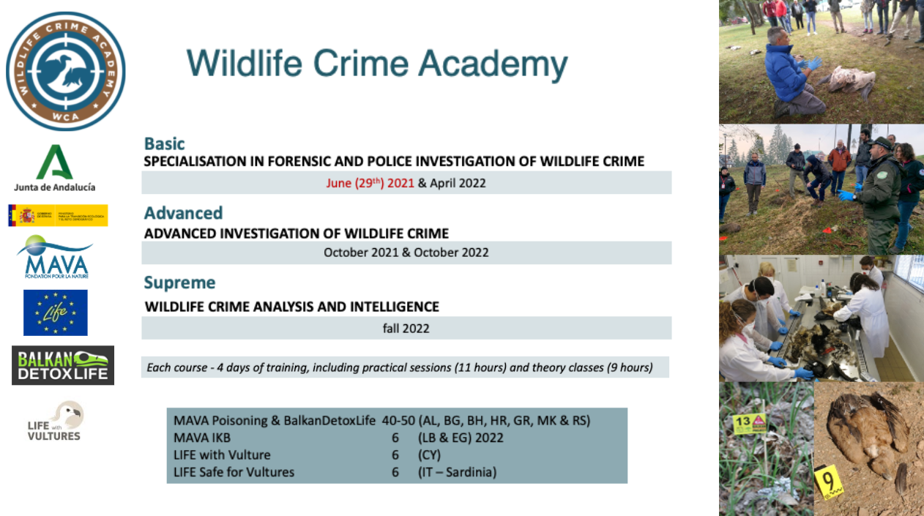
Capacity building in enforcement activities (e.g. anti-poaching camps, volunteer work)
Notes:
We have several examples of international peer-to-peer trainings organised by SEO BirdLife in Spain with the regional authorities, organised by LIPU in Italy for prosecutors and judiciary etc. but I wanted to highlight this international Academy that is being run by another NGO that BirdLife works closely with on a number of projects

Slide 11
EU-wide IKB Database Feasibility Report
First steps
141 organizations were contacted that were known or expected to hold bird crime data
26 agencies and organizations replied, covering 14 countries and 28 databases, mainly from the Mediterranean countries. 50-50% NGO vs. GOV, 50-50% offline vs. online
Biggest challenges:
DATA COLLECTION: Only 6 of these databases are public. Willingness to share data could be even lower than the response rate.
DATA HARMONIZATION: Not clear how comparable the data are – standardization would be a massive undertaking.
Action outlined in MIKT Programme of Work 1.1.e
Deliverable under BirdLife-led ‘LIFE Against Bird Crime’ project

Slide 12
Key Challenges and Successes
For both governments and NGOs

Slide 13
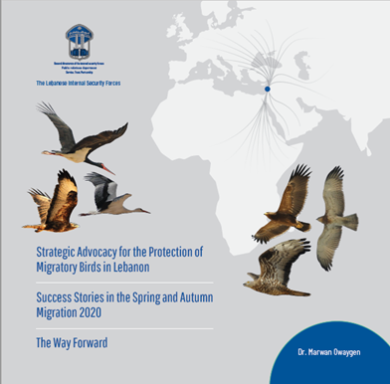
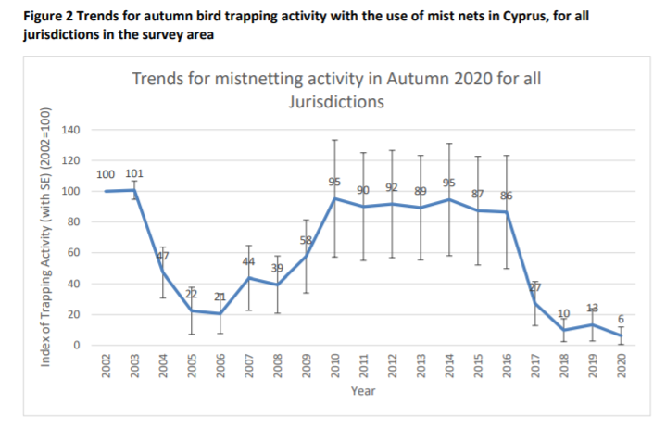
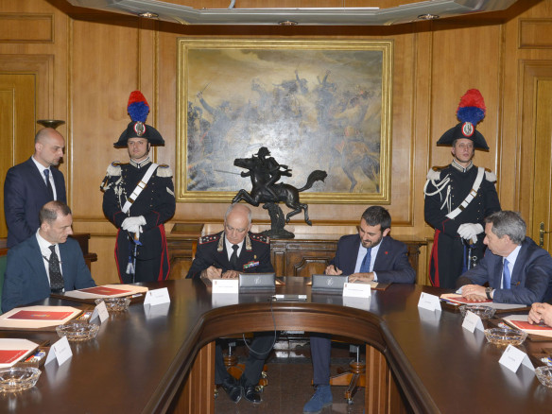
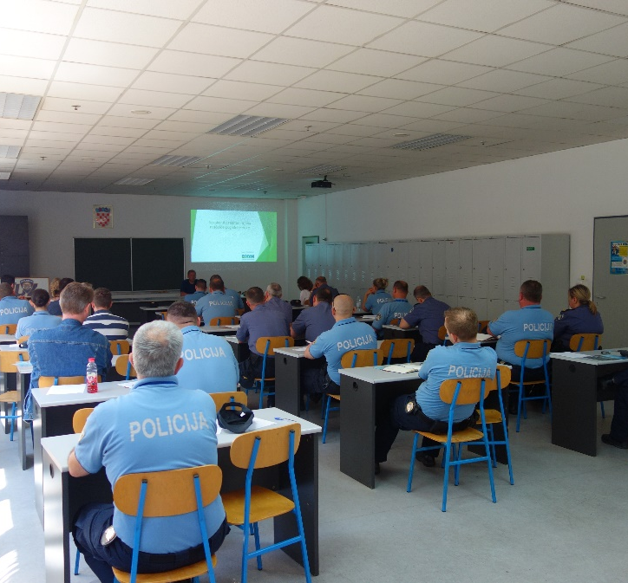
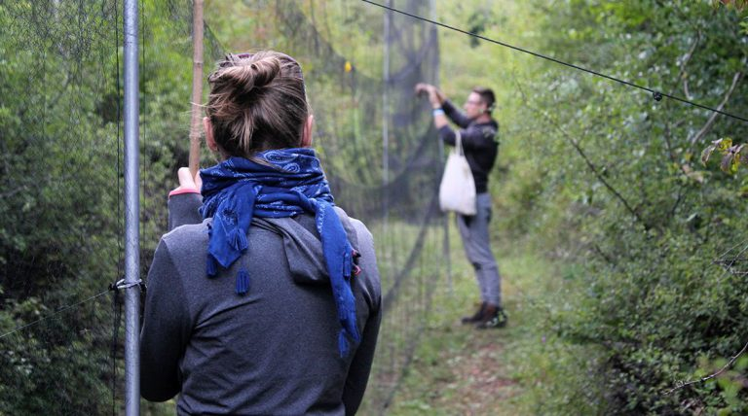
We have some great success stories!!
Notes:
Excellent to hear all of the really positive initiatives being reported by the governments today. We are seeing some successes!!! Lebanese Internal Security Forces have been really stepping up their enforcement missions leading to numerous arrests. The Lebanese Anti-Poaching Unit has been proactively undertaking field investigations and has launched an awareness raising-campaign targeting hunters
BirdLife welcomes the commitment of the Spanish Ministry of Ecological Transition to tackle wildlife poisoning and illegal trafficking in Spain and the excellent cooperation of highly trained public authorities and law enforcement officials to tackle IKB
In Croatia, with the help of BIOM (BirdLife Croatia) the Nature Protection Inspection has organized nation-wide trainings for more than 600 police officers on the topic of IKB.
In Cyprus with the cooperation of the Sovereign Base Area Police, mist netting activity for autumn 2020 was 94% lower compared to the 2002 (baseline) levels within the survey area. With a successful raid undertaken against one of the biggest, organised trapping sites in the Republic, issuing fines of nearly 12,000 euros to three trappers.
In Czechia, national IKB strategy adopted in Jan 2020, the first sentence for a case of illegal poisoning was issued in April 2021 and several trainings for prosecutors and judges have been held

Slide 14
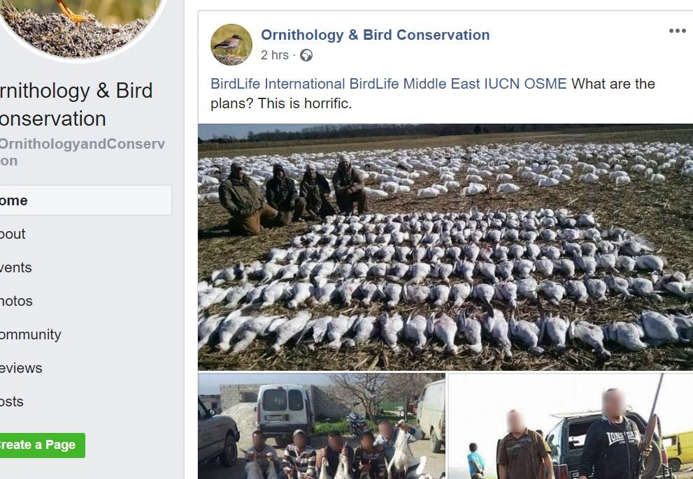
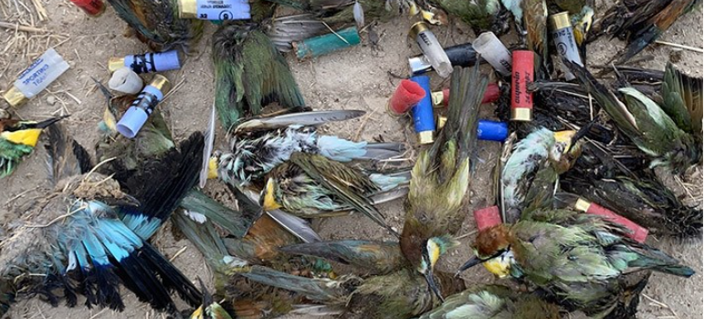
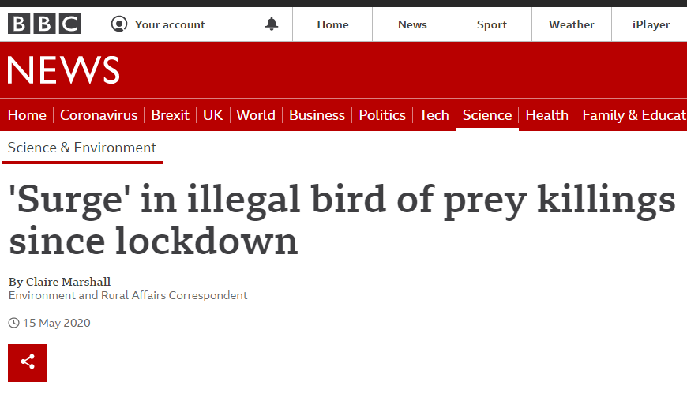
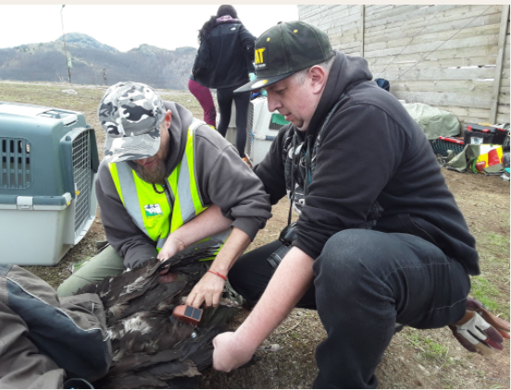
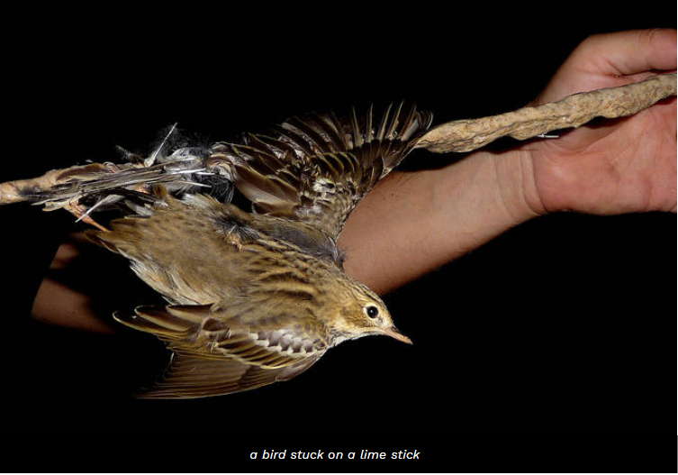
Notes:
While there are promising signs in some countries, we are still a far way from achieving our goal… the news is full of reports of mass slaughters. Backward steps are being taken and in many, action needs to be up-scaled with far greater urgency

Slide 15
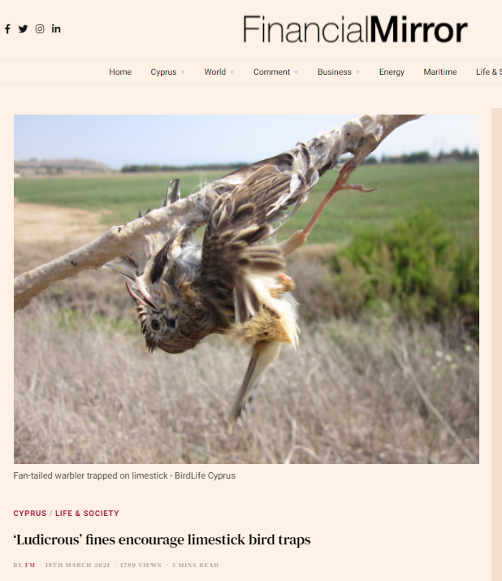
We cannot afford to back-slide – some advances by governments are being eroded
Italy leading the world in development of multi-stakeholder National Action Plan, real commitment to tackling this issue by creating the necessary coordinating bodies. Italian NAP process is exemplary
However....
Since the Rome meeting, progress on implementation of the NAP has been insufficient (this is reflected in the Scoreboard).
Lack of progress on the needed legislative changes and a lack of momentum on some crucial aspects, such as enforcement on the ground.
Cyprus, excellent collaboration with the SBA authorities has led to some of the biggest reductions in IKB in the Mediterranean! Increase in fines.
94% reduction compared to 2002 baseline...
But....
Worrying reversals in previously strong anti-poaching legislation/fines which is leading to a documented increase in use of illegal lime-sticks and jeopardizing a 20-year effort to save migratory birds from being illegally killed in Cyprus
Notes:
These are two examples of where really excellent advances by governments are being eroded

Slide 16
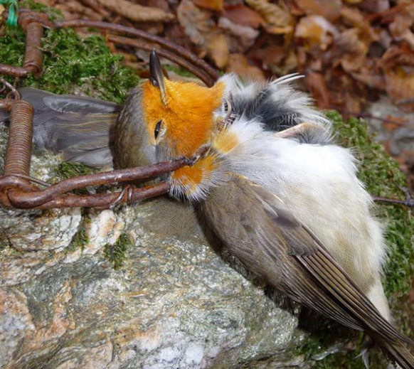
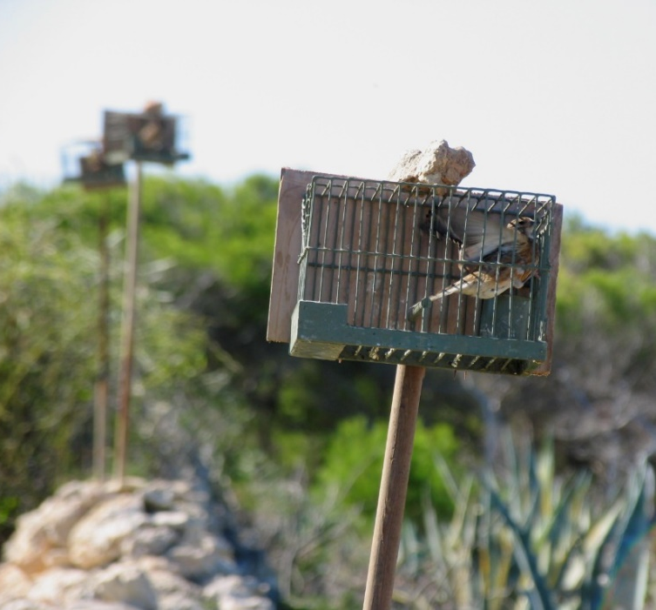
Where do governments need to step up most?
Political will to support LEAs to enforce the law and enforce sufficient penalties
Adequate investment and support in enforcement
Specialized training offered to enforcement officials and judiciary, creation of specialised wildlife police or units
Tackle the insufficient penalties and big delays in processing cases (enforcement and judiciary)
Need for government-led (or funded) systematic monitoring & detection combined with adequate national databases for both detection and prosecution
Ensure better cooperation between state institutions, and/or between regional competencies
Notes:
So where do we need Governments to step up most: On one side the are challenges to address primarily on the legislation, penalties and enforcement side…

Slide 17
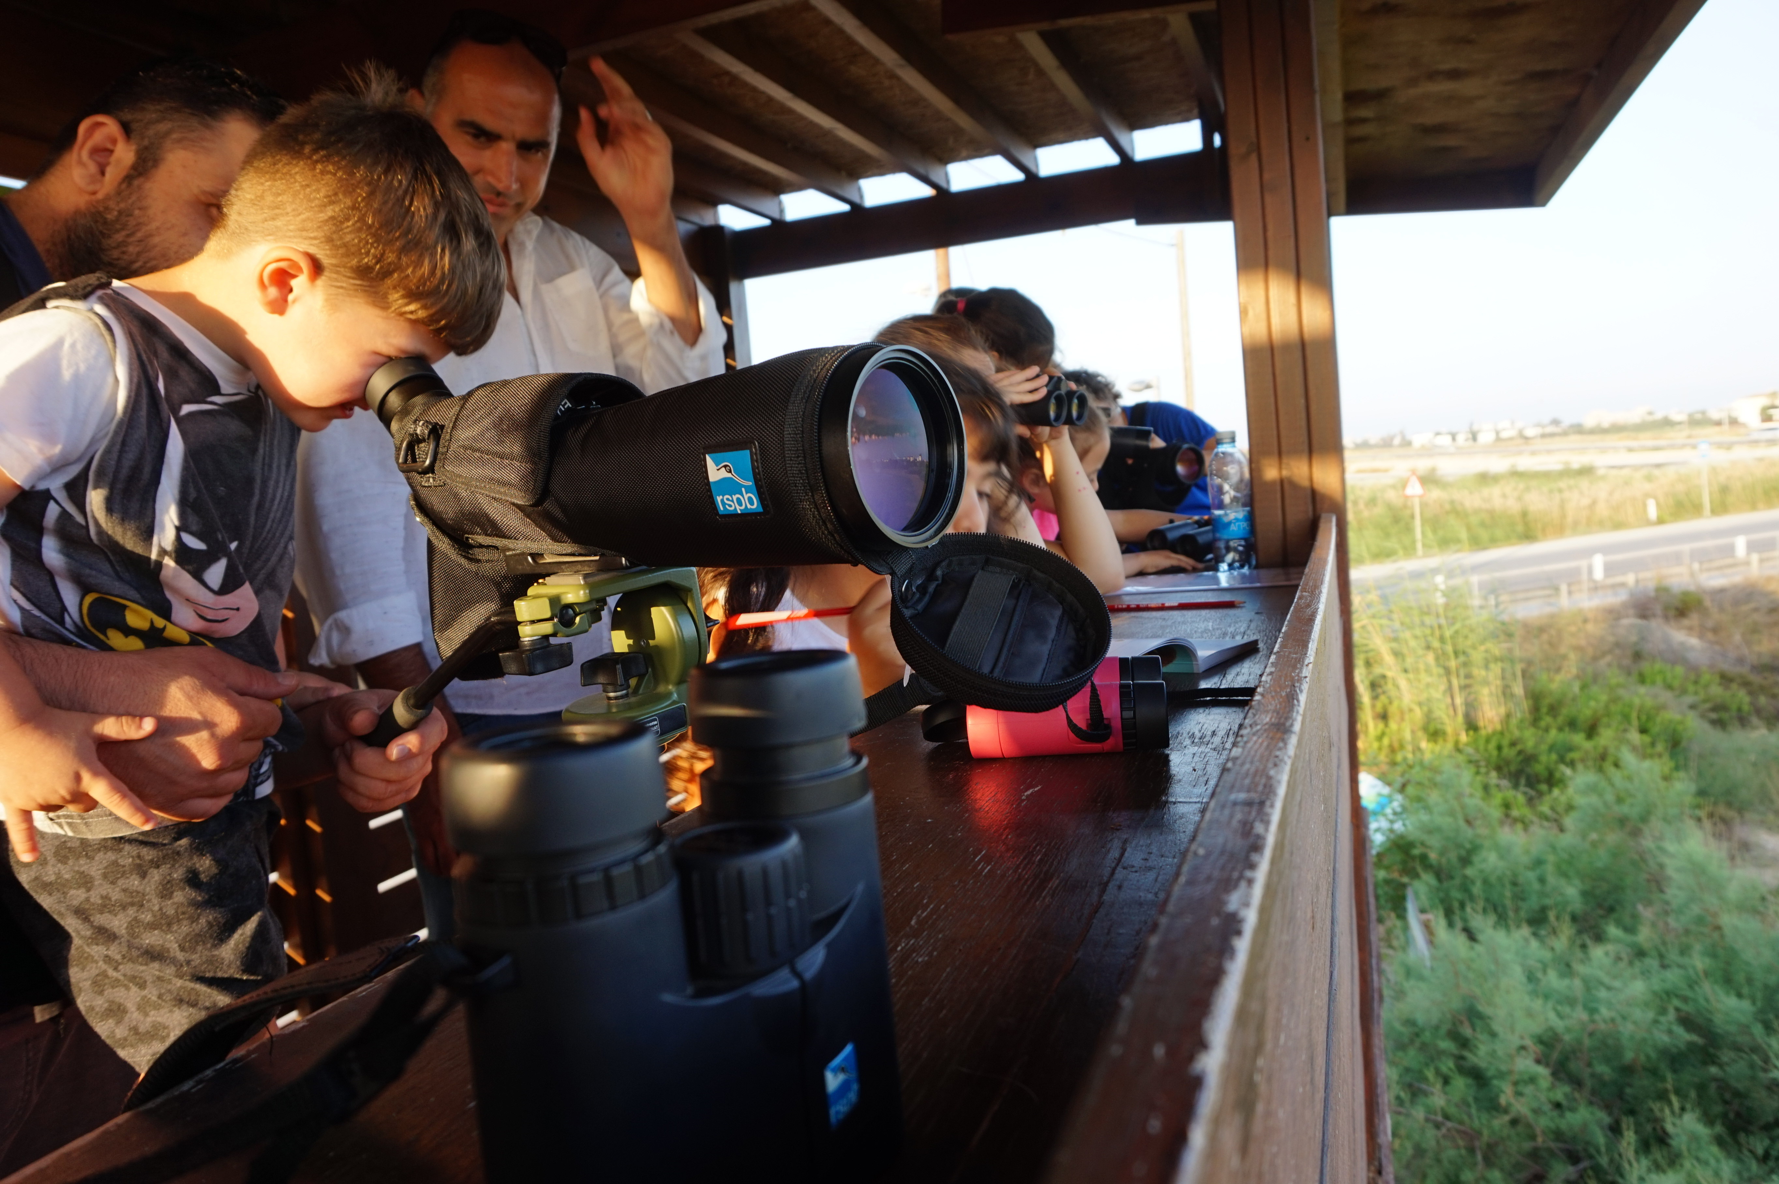
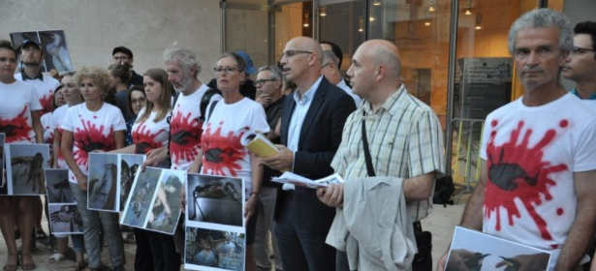
Government needs to lead on building public compliance
Different interventions adapted to local contexts
Public commitment to tackling IKB and government-led awareness campaigns at national and local level
Need for governments to recognise the socio-economic drivers of poaching & need for alternative livelihoods
Governments undertaking specific work with the hunting community to maximise compliance with the legislation
Work needed with communities and other key stakeholder groups to encourage compliance at the same time as enforcement
Notes:
But it’s not just about enforcement, governments also need to lead on building public compliance. soft interventions “information campaigns targeting stakeholders”

Slide 18
The goal: 50% reduction of illegal killing, taking and trade of wild birds by 2030
Tackling IKB is not easy - it is a complex social phenomenon that requires a multi-faceted approach
The BirdLife International network of national NGOs continues to assist national authorities in achieving this goal
We are committed to helping governments eradicate IKB and meet international commitments on this important issue
Notes:
To conclude – tackling IKB is not easy and our goal is ambitious. But we BirdLife is ready to support this process and with leadership from the governments we can get this done!

