Slide 1
Brief report from Israel for MIKT meeting
Dr. Simon Nemtzov
Wildlife Ecologist
Israel Nature and Parks Authority
simon@npa.org.il
June 2021

Slide 2
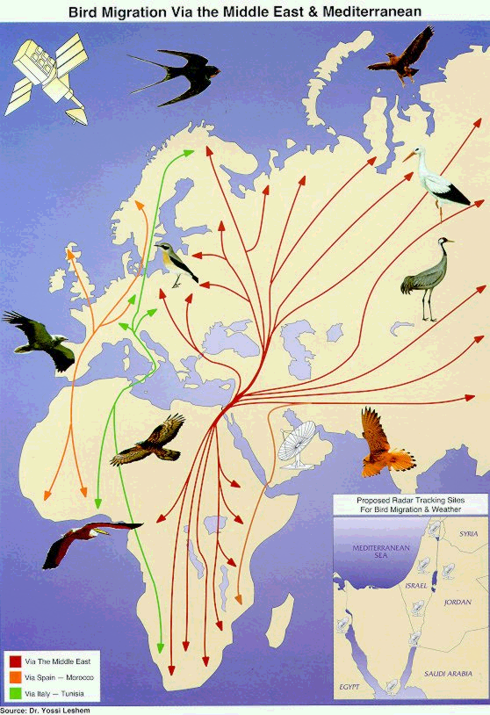
Israel is a major flyway for bird migration between Eurasia and Africa with many millions of migrating birds per year

Slide 3
Major threats noted on birds in Israel
Loss of habitat.
Invasive species (Indian house-crow, Indian mynah, Rose-ringed parakeet.
Conflicts with agriculture and aquaculture
Illegal poisoning.
New wind turbines.
Migratory birds are shot at outside of Israel, and arrive injured.
Poaching and trapping (European goldfinch, chukar partridge).

Slide 4
New advances
Action Plan for Turtledoves adopted – now protected.
Action plan for feeding migrating pelicans and cranes to reduce Human-Wildlife Conflicts (with agriculture)
Increased monitoring and enforcement with hi-tech technologies (thermal cameras, drones, FLIR, LIDAR)

Slide 5
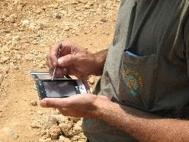
Wildlife Monitoring
Regular monitoring is done for many species
Cyber-tracker, camera traps, thermal imaging.
Goal: to indicate the state of populations (endangered or overabundant or stable).
The “Cyber-tracker” GPS monitoring system

