Slide 1






Situation of the IKB in TUNISIA
Joint Meeting of the Bern Convention Network of Special Focal Points on Eradication of Illegal Killing, Trapping and Trade in Wild Birds and the CMS Intergovernmental Task Force on Illegal Killing, Taking and Trade of Migratory Birds in the Mediterranean
Online from 09 - 11 June 2021
TAHRI Jamel

Slide 2
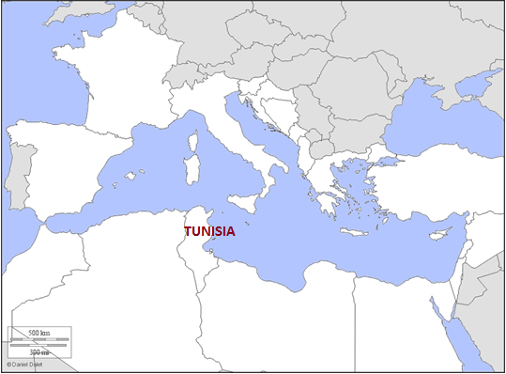
Tunisia has stepped up its efforts to meet the objectives of the MIKT 2016-2020 work program and the 2013-2020 Tunis action plan concerning the mitigation of the problem of illegal killing of birds (IKB) and better protect biodiversity , including migratory birds:

Slide 3
1) the key achievements in the implementation of TAP 2013-2020 and MIKT POW 2016-2020 since 2019, on
the revision of the law relating to the hunting of migratory birds; the aim of which is to ensure better protection of species; through
  setting a harvest quota per hunter per hunting day (Maximum Authorized Harvest: PMA)
  the reduction of the hunting period per year
  the decrease in the number of hunting days per week
conservation of bird migration routes; the aim of which is to conserve the migration routes of migratory birds between the two shores of the Mediterranean; Tunisia has banned hunting in wetlands of international importance and of great importance for birds in migration routes; with the organization of control tours by hunting brigadiers at these sites;
monitoring of the protection of migratory birds; by processing complaints recorded on the “Stop-braconnage” platform.

Slide 4
2) obstacles encountered
the lack of means of controls to cover all areas and to ensure the speed of interventions.
the lack of a rehabilitation center for seized species
the lack of a scientific basis for the establishment of harvest quotas (PMA) for migratory birds
the absence of judges trained in the protection and conservation of biodiversity to guarantee effective justice for IKB-related offens

Slide 5
3) priorities for the future in their work combating IKB.
continue to work for the protection and conservation of biodiversity and in particular birds
implement the Rome Strategic Plan by applying the recommendations of the Working Group regarding the development of a National Action Plan for the eradication of IKB.

Slide 6
Tunisia's requirements for the implementation of the Rome Strategic Plan:
a- organization of a workshop to provide technical and financial assistance for the development of a national action plan for the eradication of IKB
b- organization of training for judges in the protection and conservation of biodiversity to ensure effective justice for IKB-related offenses;
c- the organization of training for hunting brigadiers on the techniques of controlling infringements linked to the IKB.
d- Technical support for the establishment of the maximum authorized harvest quotas (PMA) for migratory birds.

Slide 7
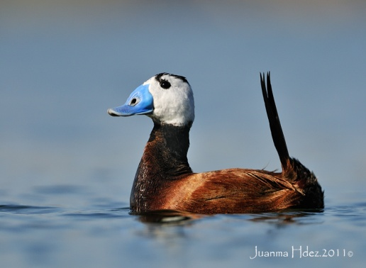
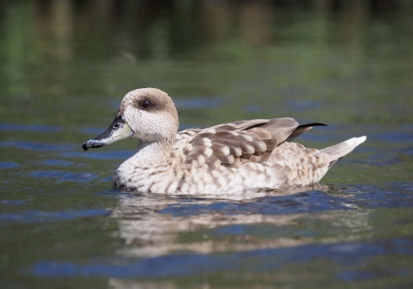
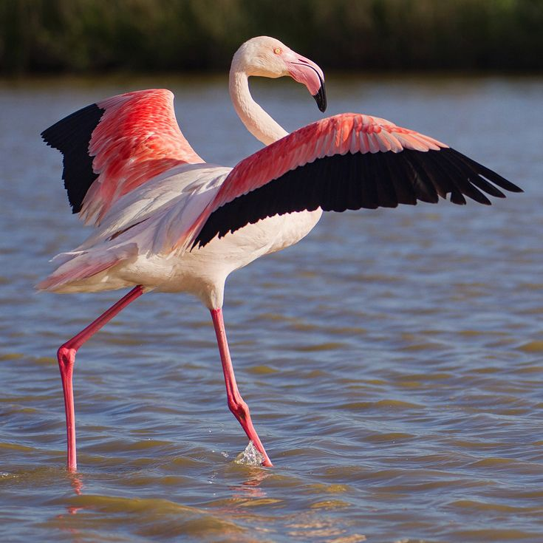
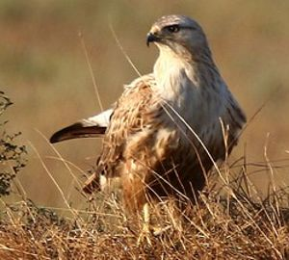
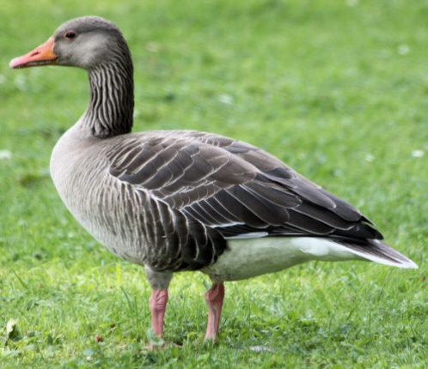
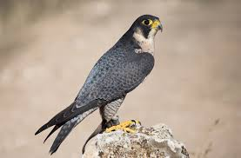
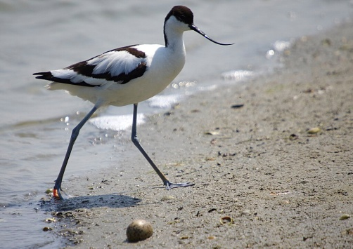
thank you for your attention

