Slide 1



Expert conference on the Conservation
of the lynx in west and central Europe
Urs Breitenmoser & Christine Breitenmoser-Würsten
IUCN SSC Cat Specialist Group
© L. Geslin

Slide 2
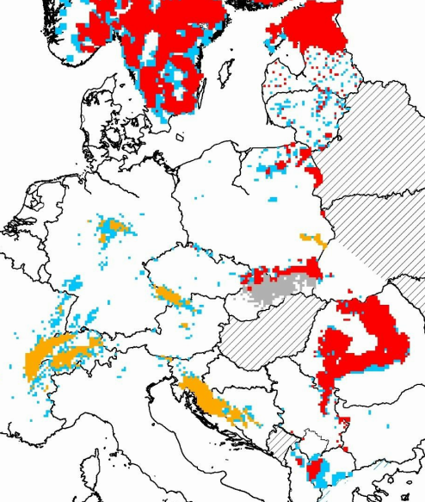
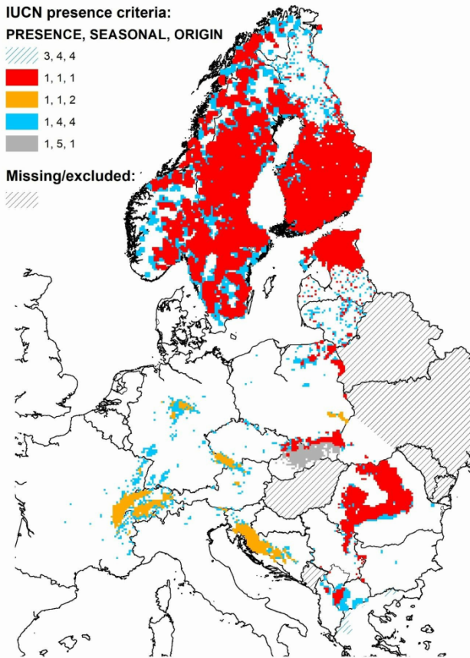
Situation of the lynx
3 autochthonous populations
IUCN Red List Mapping for regional assessment of Eurasian Lynx (Lynx lynx) in Europe
Petra Kaczensky, NINA – June 2018
11 reintroduced populations

Slide 3
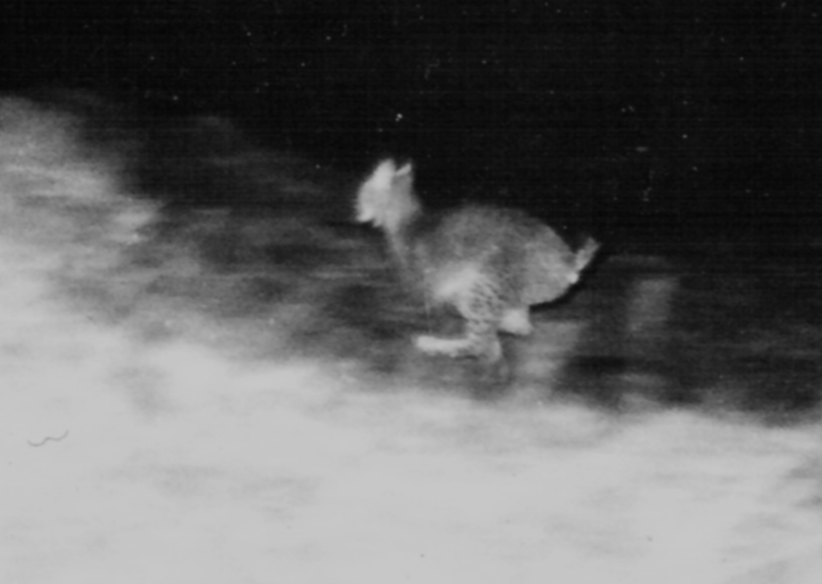
Situation of the lynx and challenges for its conservation
Three autochthonous, but fragmented populations: Baltic, Carpathian, Balkan
Three distinct subspecies: L.L. lynx / carpaticus / balcanicus
11 reintroduced populations, at least 2 additional projects ahead
All populations (autochthonous and reintroduced) need conservation interventions
Reintroductions and reinforcement (e.g. genetic remedy) need source animals
“Naïve” releases as in the 1970s and 1980s are
no longer possible. Today, we need to consider:
Phylogenetic and genetic aspects
Health considerations
Animal welfare regulations
Many new lynx projects in recent years (e.g. LIFE+)
Need for common goals, approaches and protocols
Need for coordination and synchronisation
Lynx release in central Switzerland 1973

Slide 4
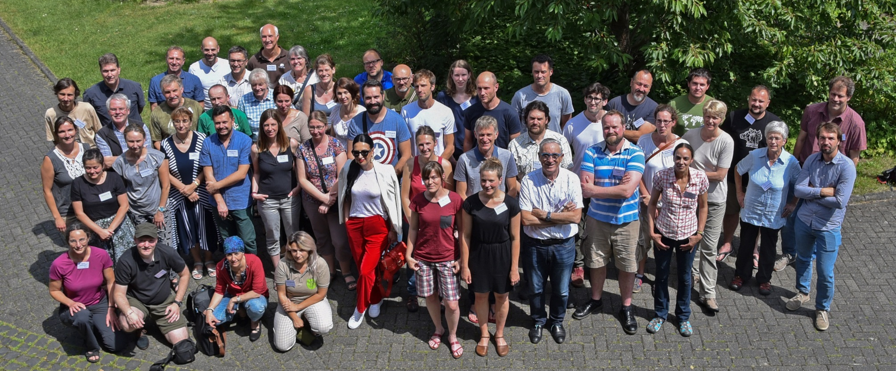
Situation of the lynx and challenges for its conservation
Approach:
Conference with 50 experts from all continental range countries:
Review of conservation status of all continental populations
Presentations on topical themes, e.g. connectivity, genetics, disease…
Workshop (plenary & working groups) to discussion recommendations
Expert workshop in Bonn, 17–19 June 2019

Slide 5







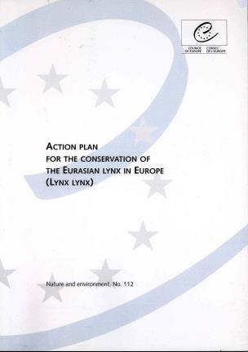
Situation of the lynx and challenges for its conservation
Approach:
Status review and strategic update for Western & Central Europe with practical recommendations on standards, procedures, and protocols.
2000

Slide 6
Strategic Preamble
Objectives:
To conserve all autochthonous populations, […] and to safeguard distinct evolutionary significant units of the Eurasian lynx on continental Europe.
To conserve all reintroduced populations of Eurasian lynx and to promote […] further reintroductions […] or “stepping stones” contributing to the functioning of a larger metapopulation.
To foster the natural or assisted connectivity between populations of the same phylogenetic units (e.g. subspecies or ESUSs) […].
To develop and implement management measures addressing the interactions concerning lynx in the human-dominated, multi-purpose landscapes of Europe.
To generate and provide objective information through monitoring and research […] to take the necessary measures to prevent local extinctions.
To reduce human-induced mortality of lynx, esp. by illegal killing and vehicle collisions.

Slide 7
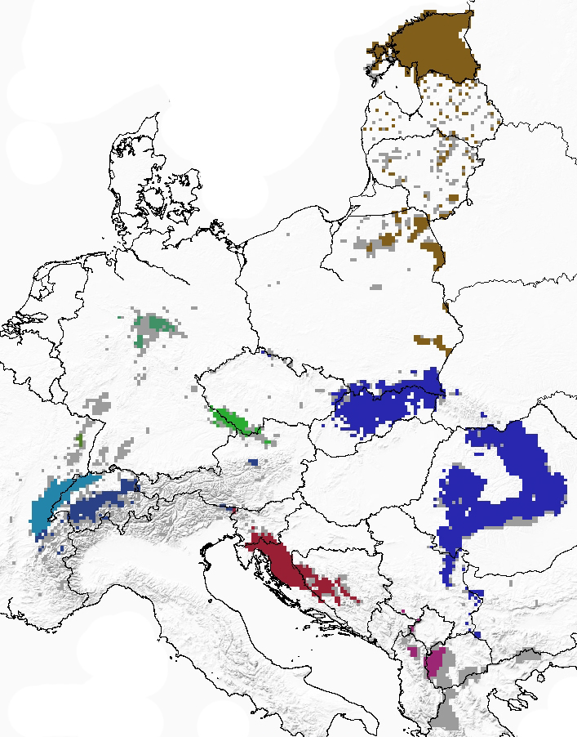
Recommendations 1: Phylogenetic delineation
Distribution of Eurasian lynx Lynx lynx
on continental Europe 2012–2016
Permanent presence (colours = populations)
Sporadic presence
Autochthonous population
Reintroduced population or stepping stones
Proposed delineation between ESUs
Northeast European lowland population
L. l. lynx
Baltic states, lowland Poland, all potential areas
north of the German “Mittelgebirge”
Carpathian lynx populations
L. l. carpathicus
Carpathians, Alps, northern Dinaric Range,
continental secondary mountain chains
Balkan lynx population
L. l. balcanicus
Southern Dinaric Range, Rhodope Range,
Greece

Slide 8
Recommendations 2–7:
Metapopulations of lynx in continental Europe and connectivity
  Establish and maintain a large continental metapopulation per ESU
Concepts for monitoring of the conservation status of lynx populations
  Standardise and synchronise demographic monitoring across Europe
Principles for the genetic monitoring and management of lynx populations
  Standards for genetic monitoring and genetic interventions (reinforcement)
Source populations for reintroductions or reinforcement
  Autochthonous population and correctly bred and managed EAZA lynx
Protocols for translocation of lynx
  Standards for capture, health-check, quarantine, and transport
Cooperation in lynx conservation in Europe
  Establish a permanent Eurasian lynx expert working group affiliated with the IUCN SSC Cat SG and LCIE
The recommendations base on the current legislation and consider the present conservation status of all populations, the up-to-date information on genetics and health, the newest available monitoring techniques, and the combined experience of the participants of the Bonn conference.

Slide 9
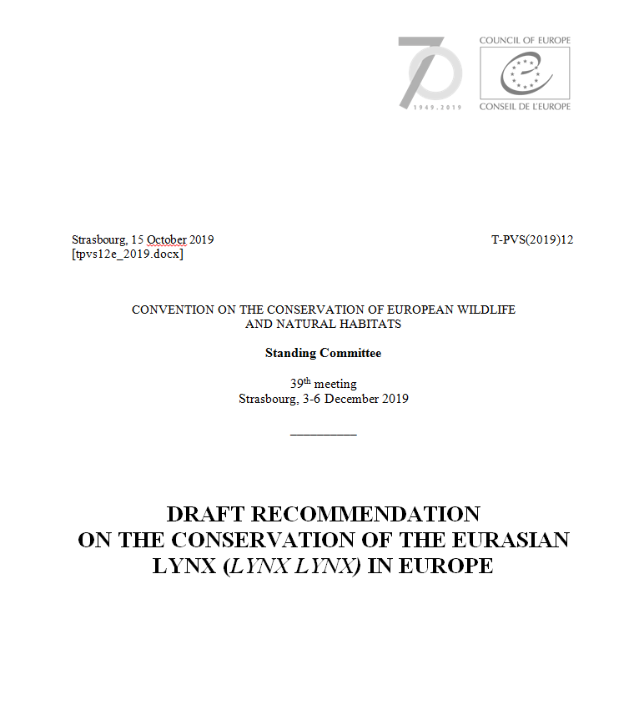
Recommendations
Submit to Standing Committee of the Bern Convention for review and endorsement
Publish Proceedings and Expert Recommendations as a Special Issue of Cat News
Submit to International Con-ventions and to the relevant agencies of all continental Range Countries
Thank you for your support!

