Slide 1
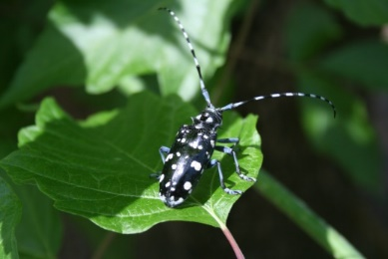
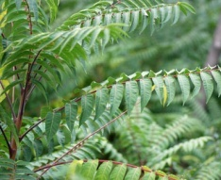
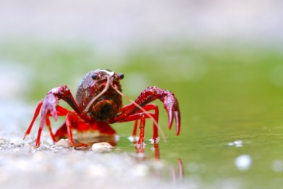
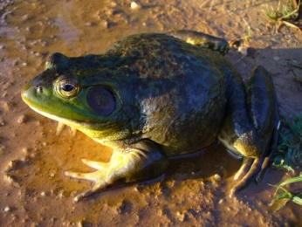
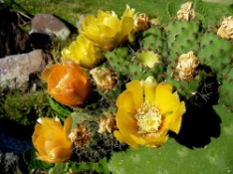
Bern Convention
41st meeting of the Standing Committee
30 November 2021
Guidance on e-commerce and IAS
Andrea Monaco
ISPRA/Lazio Region (Italy)
IUCN SSC Invasive Species Specialist Group

Slide 2
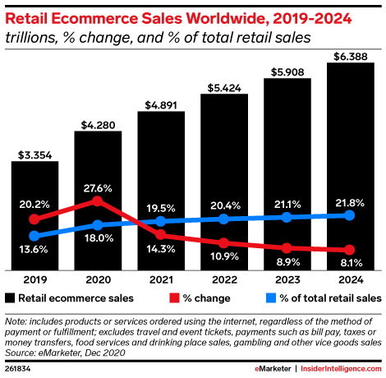
E-commerce and IAS
In the last decades internet has become an invaluable tool for facilitating commerce and communication worldwide, therefore the opportunities to trade in live animals and plants have hugely increased.
Internet sellers can directly approach a global clientele and commodities are often marketed by means of small and uneasily recognizable consignments, entailing the risk of bypassing border controls and biosecurity regulations
The rise of internet-based commerce in living organisms can be considered among the main driver of IAS introduction and a major biosecurity concern (Ricciardi et al., 2017).

Slide 3
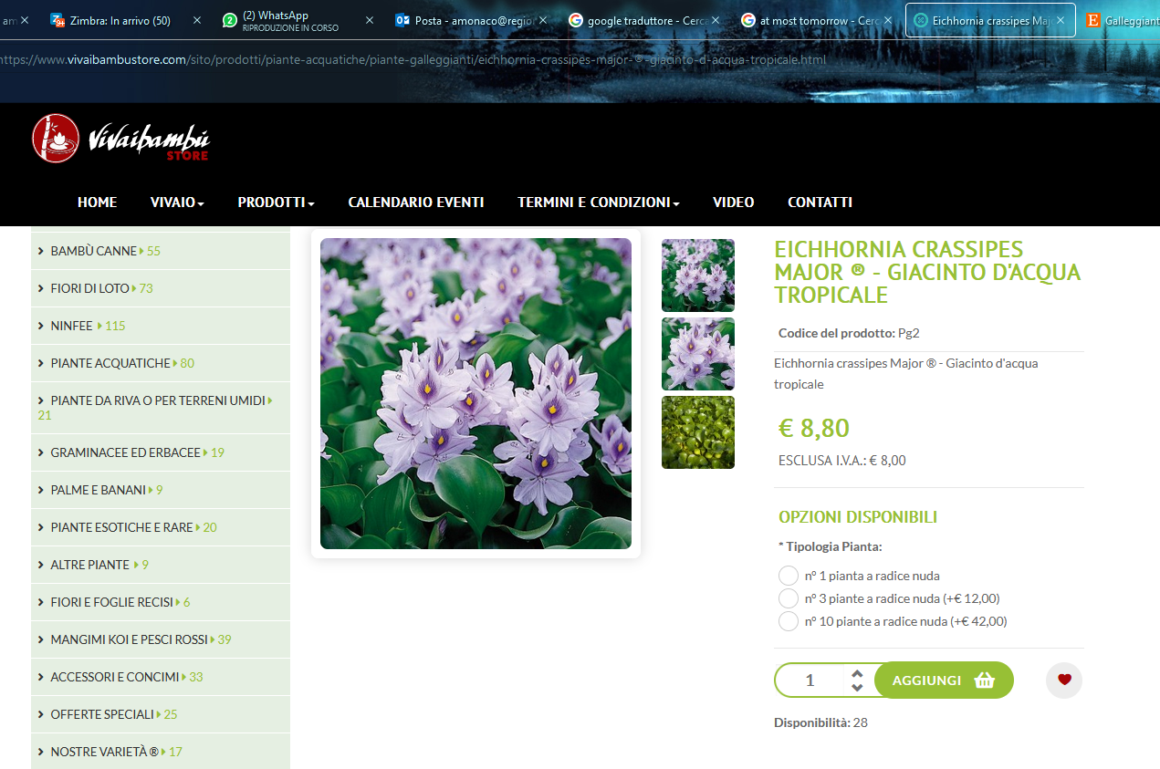
E-commerce and IAS
The online trade is poorly regulated and, being accessible to all, has increased considerably in recent years, making the purchase of invasive species just a mouse click away from any home.
E-commerce is not a physical pathway, but rather simply serves as a mechanism for processing commercial and non-commercial transactions
Growing diversity and complexity of the trade market, more and more difficult to approach with prevention and control strategies
Increase in non-experts in the plant and animal trade who may be ignorant or misinformed on risks and regulations or incorrectly identify their products

Slide 4
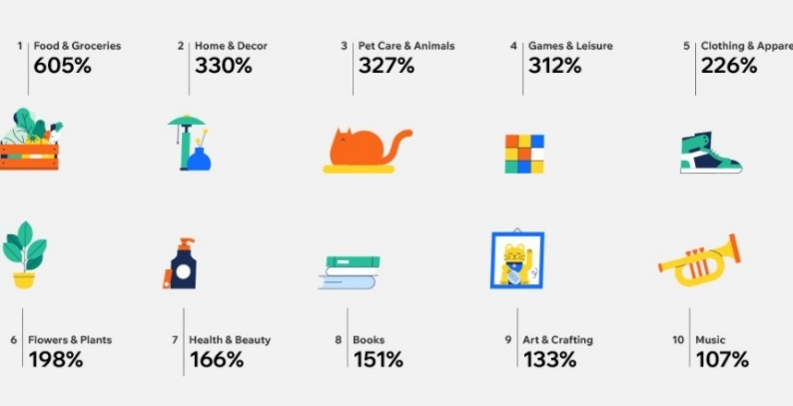
E-commerce, IAS and COVID 19
The recent COVID-19 pandemic has had a marked impact on consumer’s purchasing behaviour, encouraging people to online shopping and causing an increase from 16% (2019) to 19% (2020) in its share of all retail sales.
The increase in online sales during the pandemic affected many product categories, including pets and ornamental plants (and related products)
It is likely that this shift towards online shopping will consolidate in the future, increasing the risk of introduction and spread of pest and IAS worldwide by this pathway.

Slide 5
E-commerce and IAS
According with the existing international recommendations and positions statements the major ways of addressing the risk associated with e-commerce are:
development of national regulations, to assist national customs agencies to enforce halting entries of invasive alien species.
data sharing and information flow
the need to engage with national Customs authorities to raise the issue of invasive alien species, in collaboration, among the users and operators of e- commerce

Slide 6
What happened after the last Standing Committee (December 2020)
Integrated the Chapter 2 with the issue of COVID and e-commerce
Reviewed and updated scientific and technical literature as well as the new available guidance documents
Integrated the draft after reciving comments, suggestions and inputs from the Group of Expert on IAS (14th meeting, July 2021)
Prepared the present draft of the Guidance document

Slide 7
Aim and target
of the Guidance document
to provide a set of key recommendations to be adopted to limit the role of e-commerce as pathway for the introduction of invasive alien species at both a national and regional scale
to raise awareness on this threat, and to improve the information on this issue
The Guidance document is addressed to all the fifty countries which are signatories of the Bern Convention
The Guidance document is specifically addressed by national authorities and institutions, and by different subjects or stakeholders that can contribute to the enforcement of an effective management and regulation of this pathway

Slide 8
The five Guiding principles
GP 1: Raise awareness on biological invasion risks associated with e-commerce, among all relevant subjects and institutions
GP 2: Adopt and enforce national legislations regulating invasive alien species, and make the lists of regulated species easily accessible to all subjects (sellers, buyers, platforms, custom organisations, environmental protection agencies, etc.).
GP 3: Collaborate with the main platforms and actors of e-trade of plants and animals to prevent the e-commerce of invasive alien species
GP 4: Ensure that sellers and buyers are provided with the key information and warnings on the species they sell or buy, including on their potential invasiveness
GP 5: Monitor e-commerce of invasive alien species at all scale

Slide 9
Acknowledgments
Many experts contributed to the present document with helpful comments, suggestions and information.
Among them, a special thank to Spyridon Flevaris and Myriam Dumortier (European Commission), Piero Genovesi, Riccardo Scalera and Kevin Smith (IUCN), Ilaria di Silvestre (Eurogroup for Animals), Wojciech Solarz, Juan Luis Rodriguez Luengo and Stephanie Morelle (GoE IAS Bern Convention).
Thanks also to Clare Watson and Sarah Webster (UK Government),
and to Nadia Saporito (Bern Convention) for revising the final draft
and improving the English language

