Slide 1
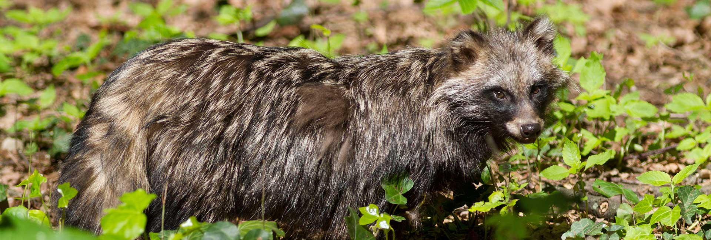
The role of hunters in the management of IAS - Cooperation with the Bern Convention Sabrina Dietz Wildlife Policy Officer European Federation for Hunting and Conservation (FACE)

Slide 2
FACE: who we are and what we do
International non-profit-making non-governmental organisation (iNGO)
Members from 37 European Countries
Representation in the EU institutions and stakeholder platforms
Member of the International Union for Conservation of Nature (IUCN) since 1987

Slide 3
FACE Biodiversity Manifesto
The Biodiversity Manifesto is a substantial database of hunting-related conservation projects
Dedicated section on IAS

Slide 4
2013 – THE EUROPEAN CODE OF CONDUCT ON HUNTING AND IAS
Developed by the Bern Convention with support from FACE
Adopted at the 33rd Standing Committee of the Bern Convention
Based on 7 principles
Improve the sustainability of hunting by supporting IAS management and preventing the release of IAS

Slide 6
2021 – REPORT ON THE IMPLEMENTATION OF THE CoC ON HUNTING AND INVASIVE ALIEN SPECIES
Third implementation report
11 countries (DE, DK, FI, FR, IE, IT, NL, RO, SL, SE, UK)
Range of practical solutions and concrete examples
Detailed chapter by IAF on principle 5

Slide 7
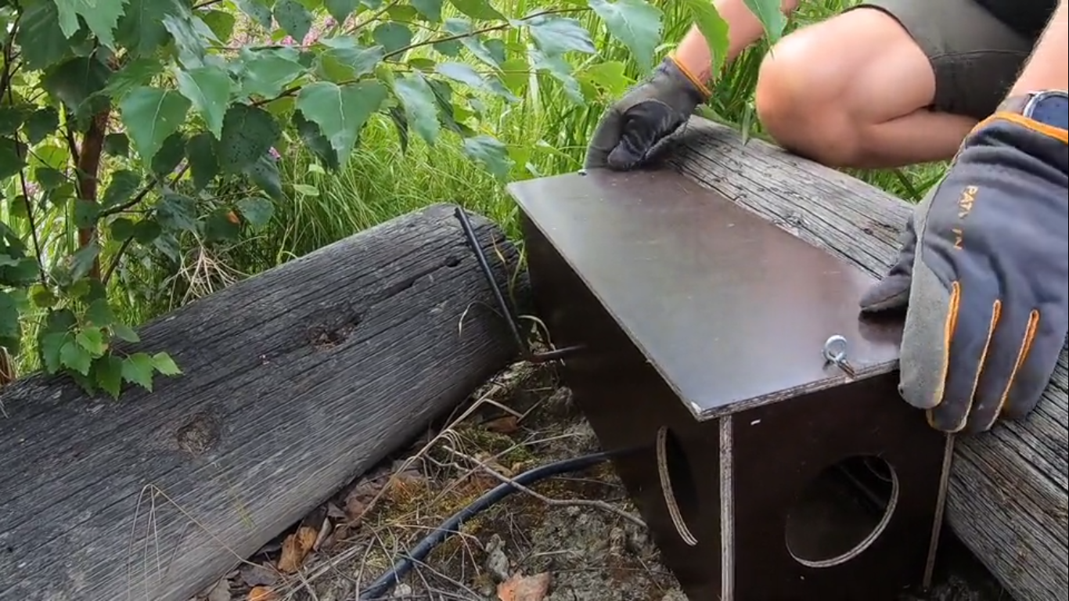
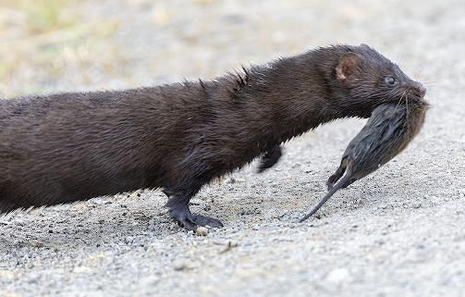
Example 1: CONTROL OF INVASIVE ALIEN PREDATORS IN FINLAND
2-year project for summer cottage owners
Aim: awareness raising & effective control of IAS in in Finland’s lake and seaside areas

Slide 8
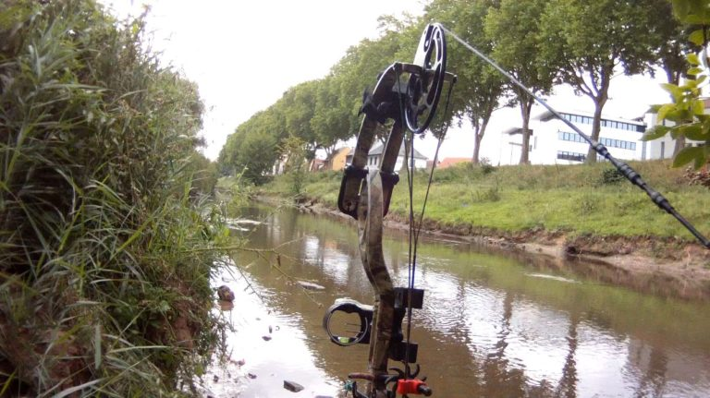
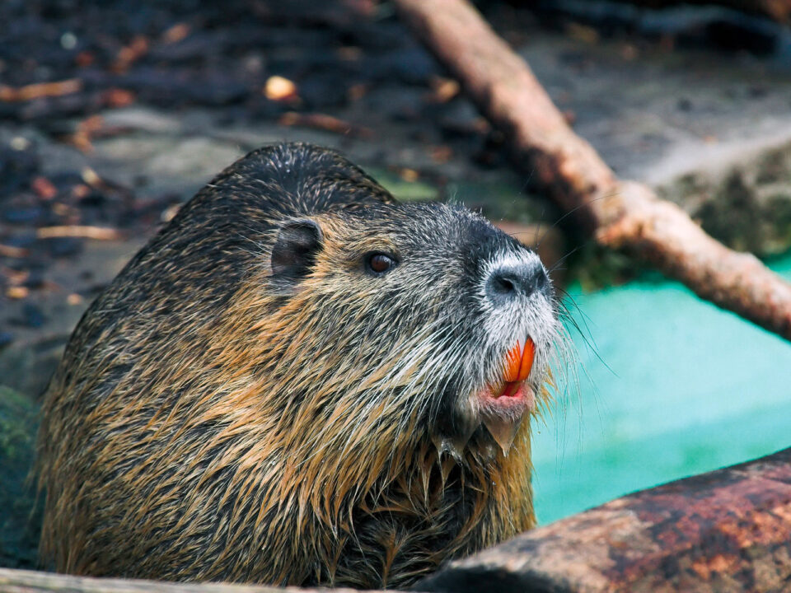
Example 2: CONTROL OF INVASIVE NUTRIA IN CITIES VIA BOWHUNTING
Problem: control of nutria in urban areas is challenging
Ethical and efficient removal of nutria with the help of bow hunters

Slide 9
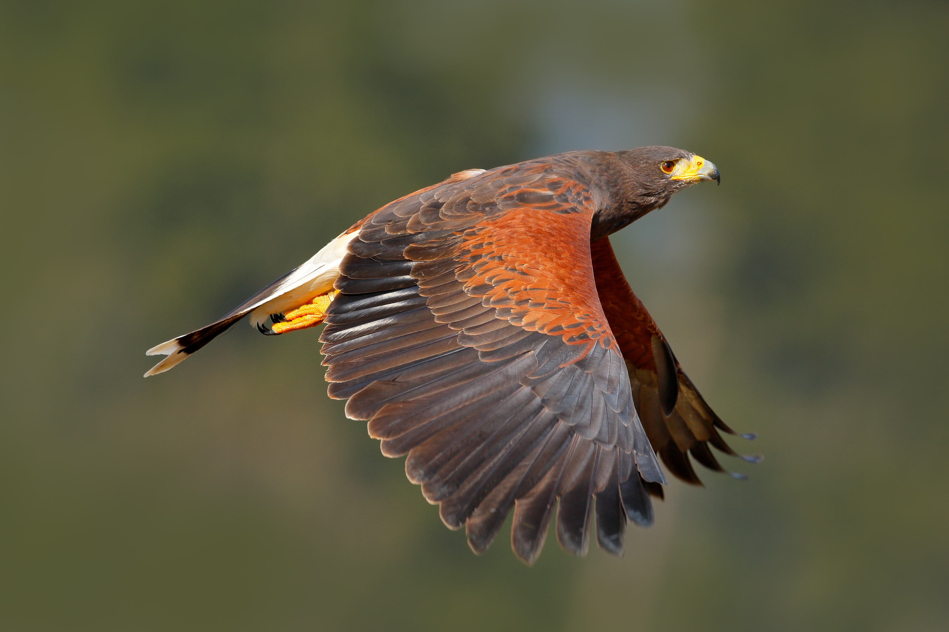
IAF AND REPORT ON PRINCIPLE 5

Slide 10
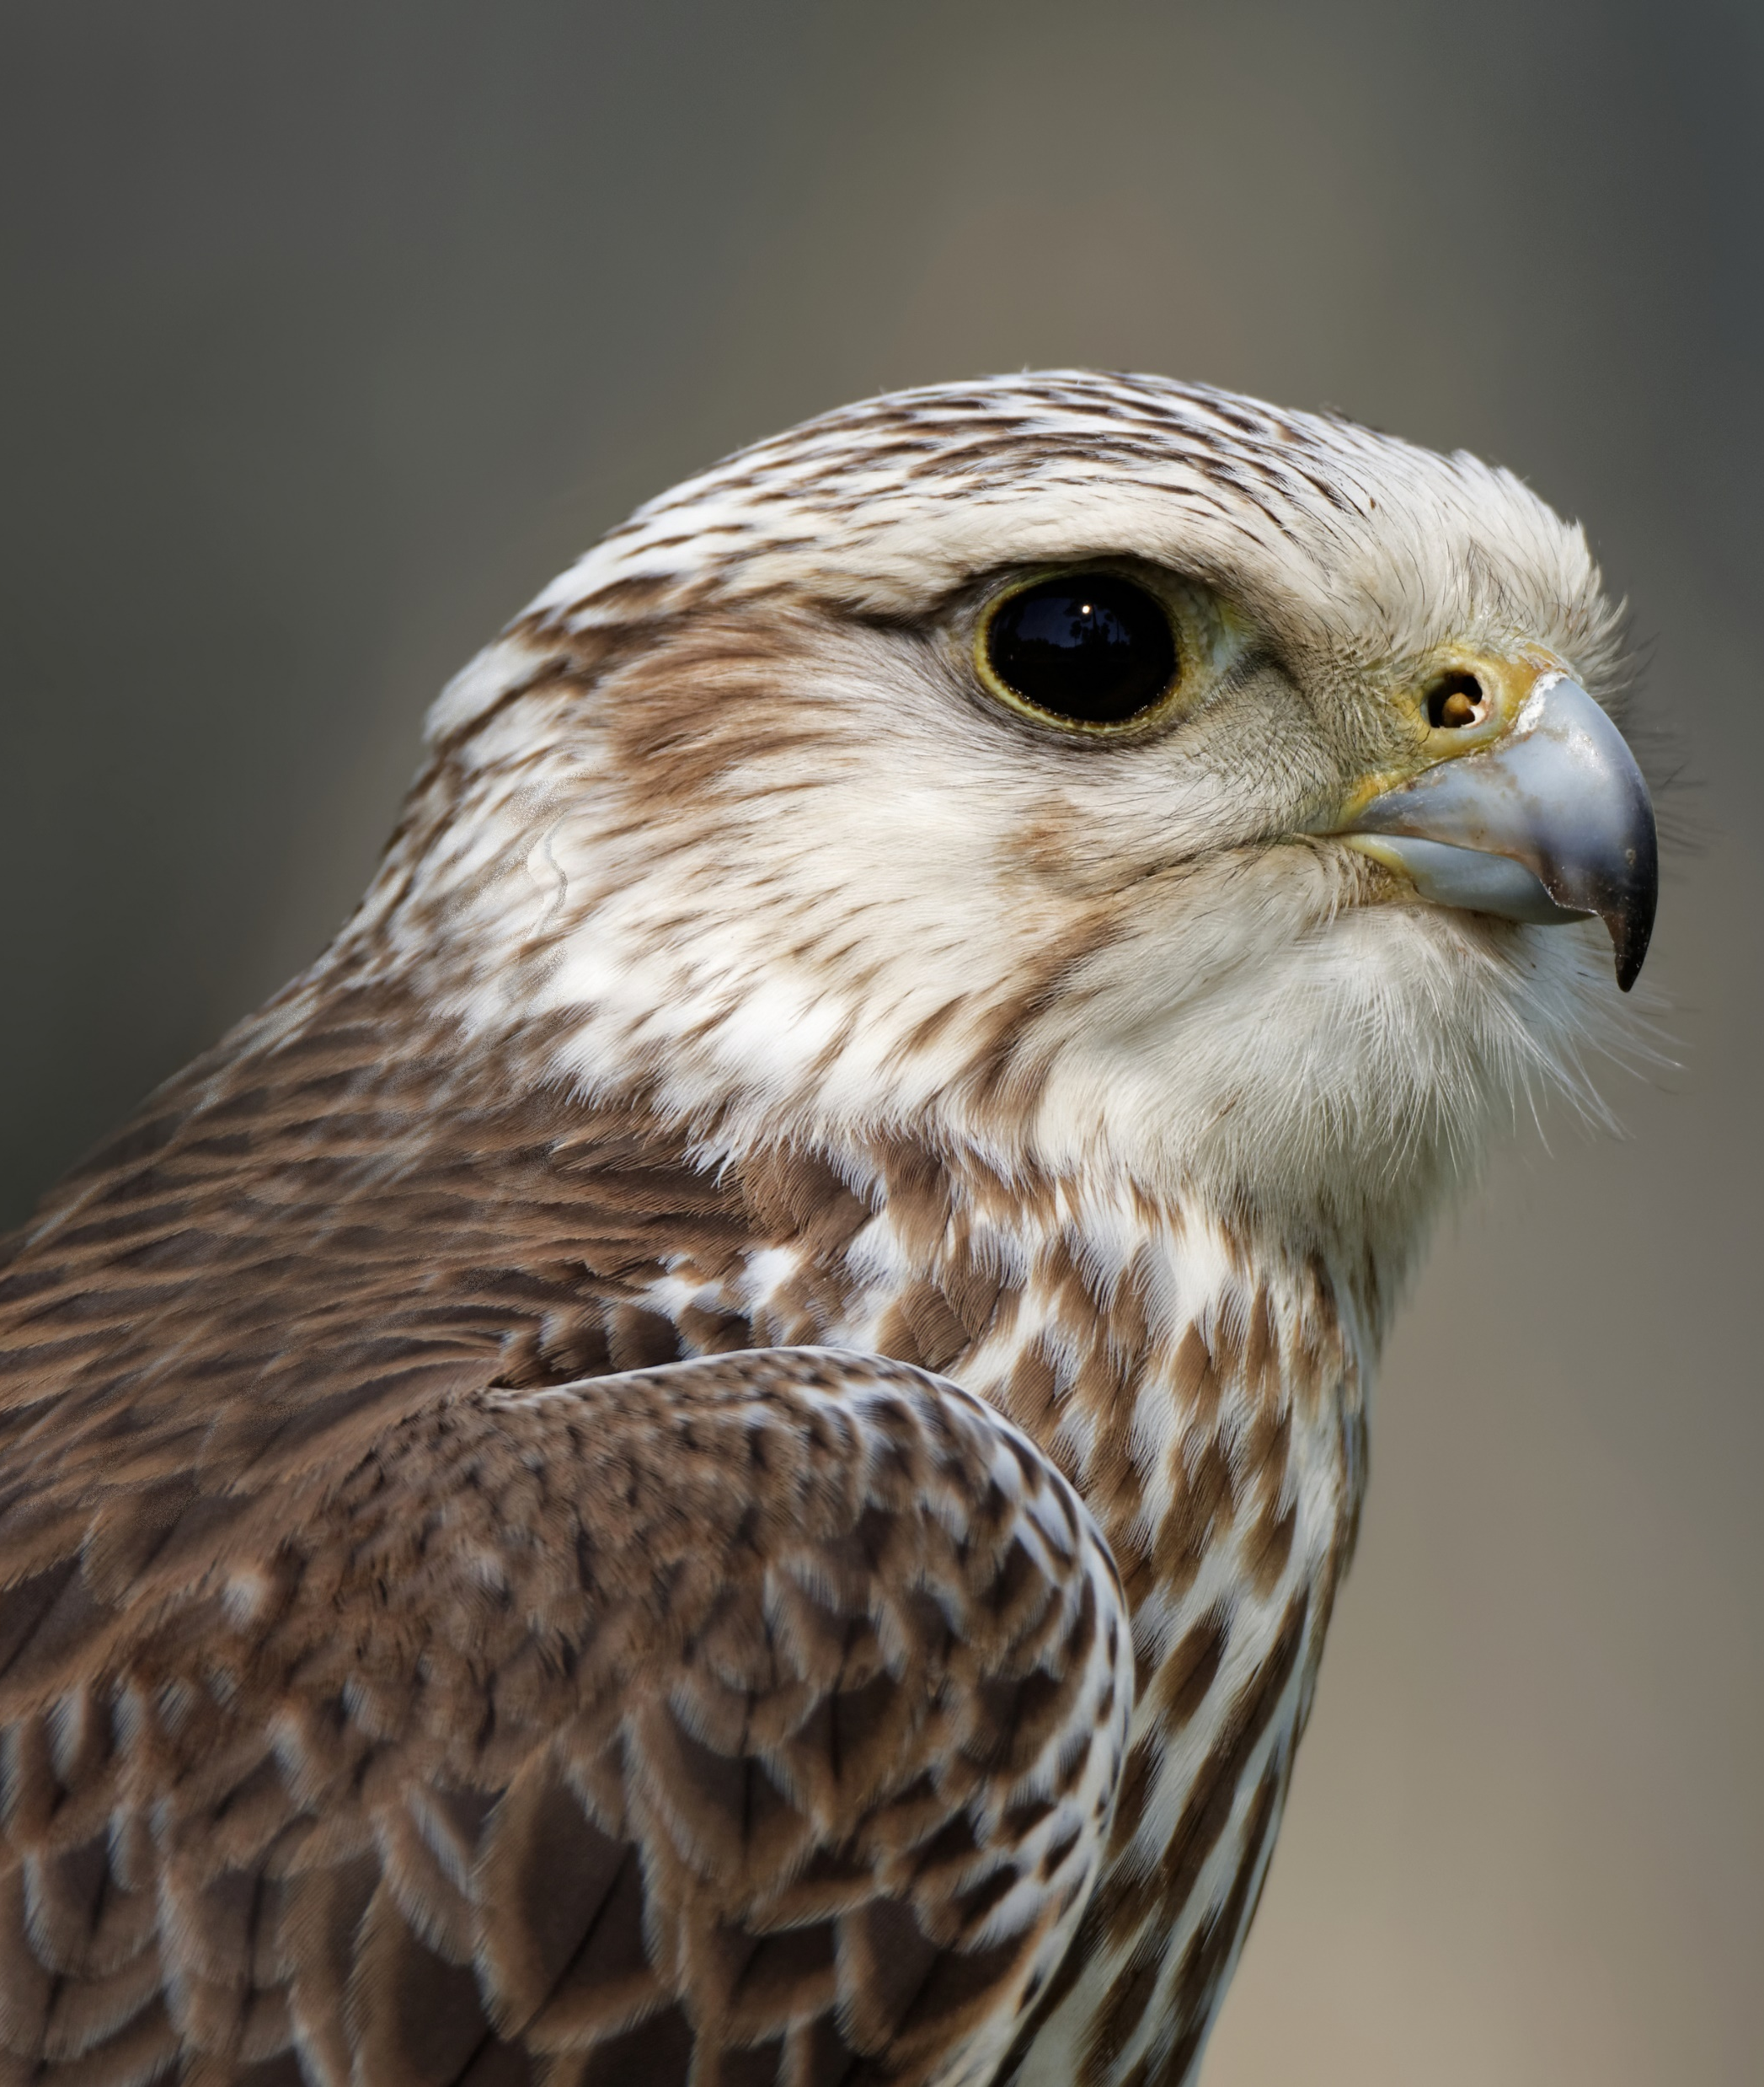
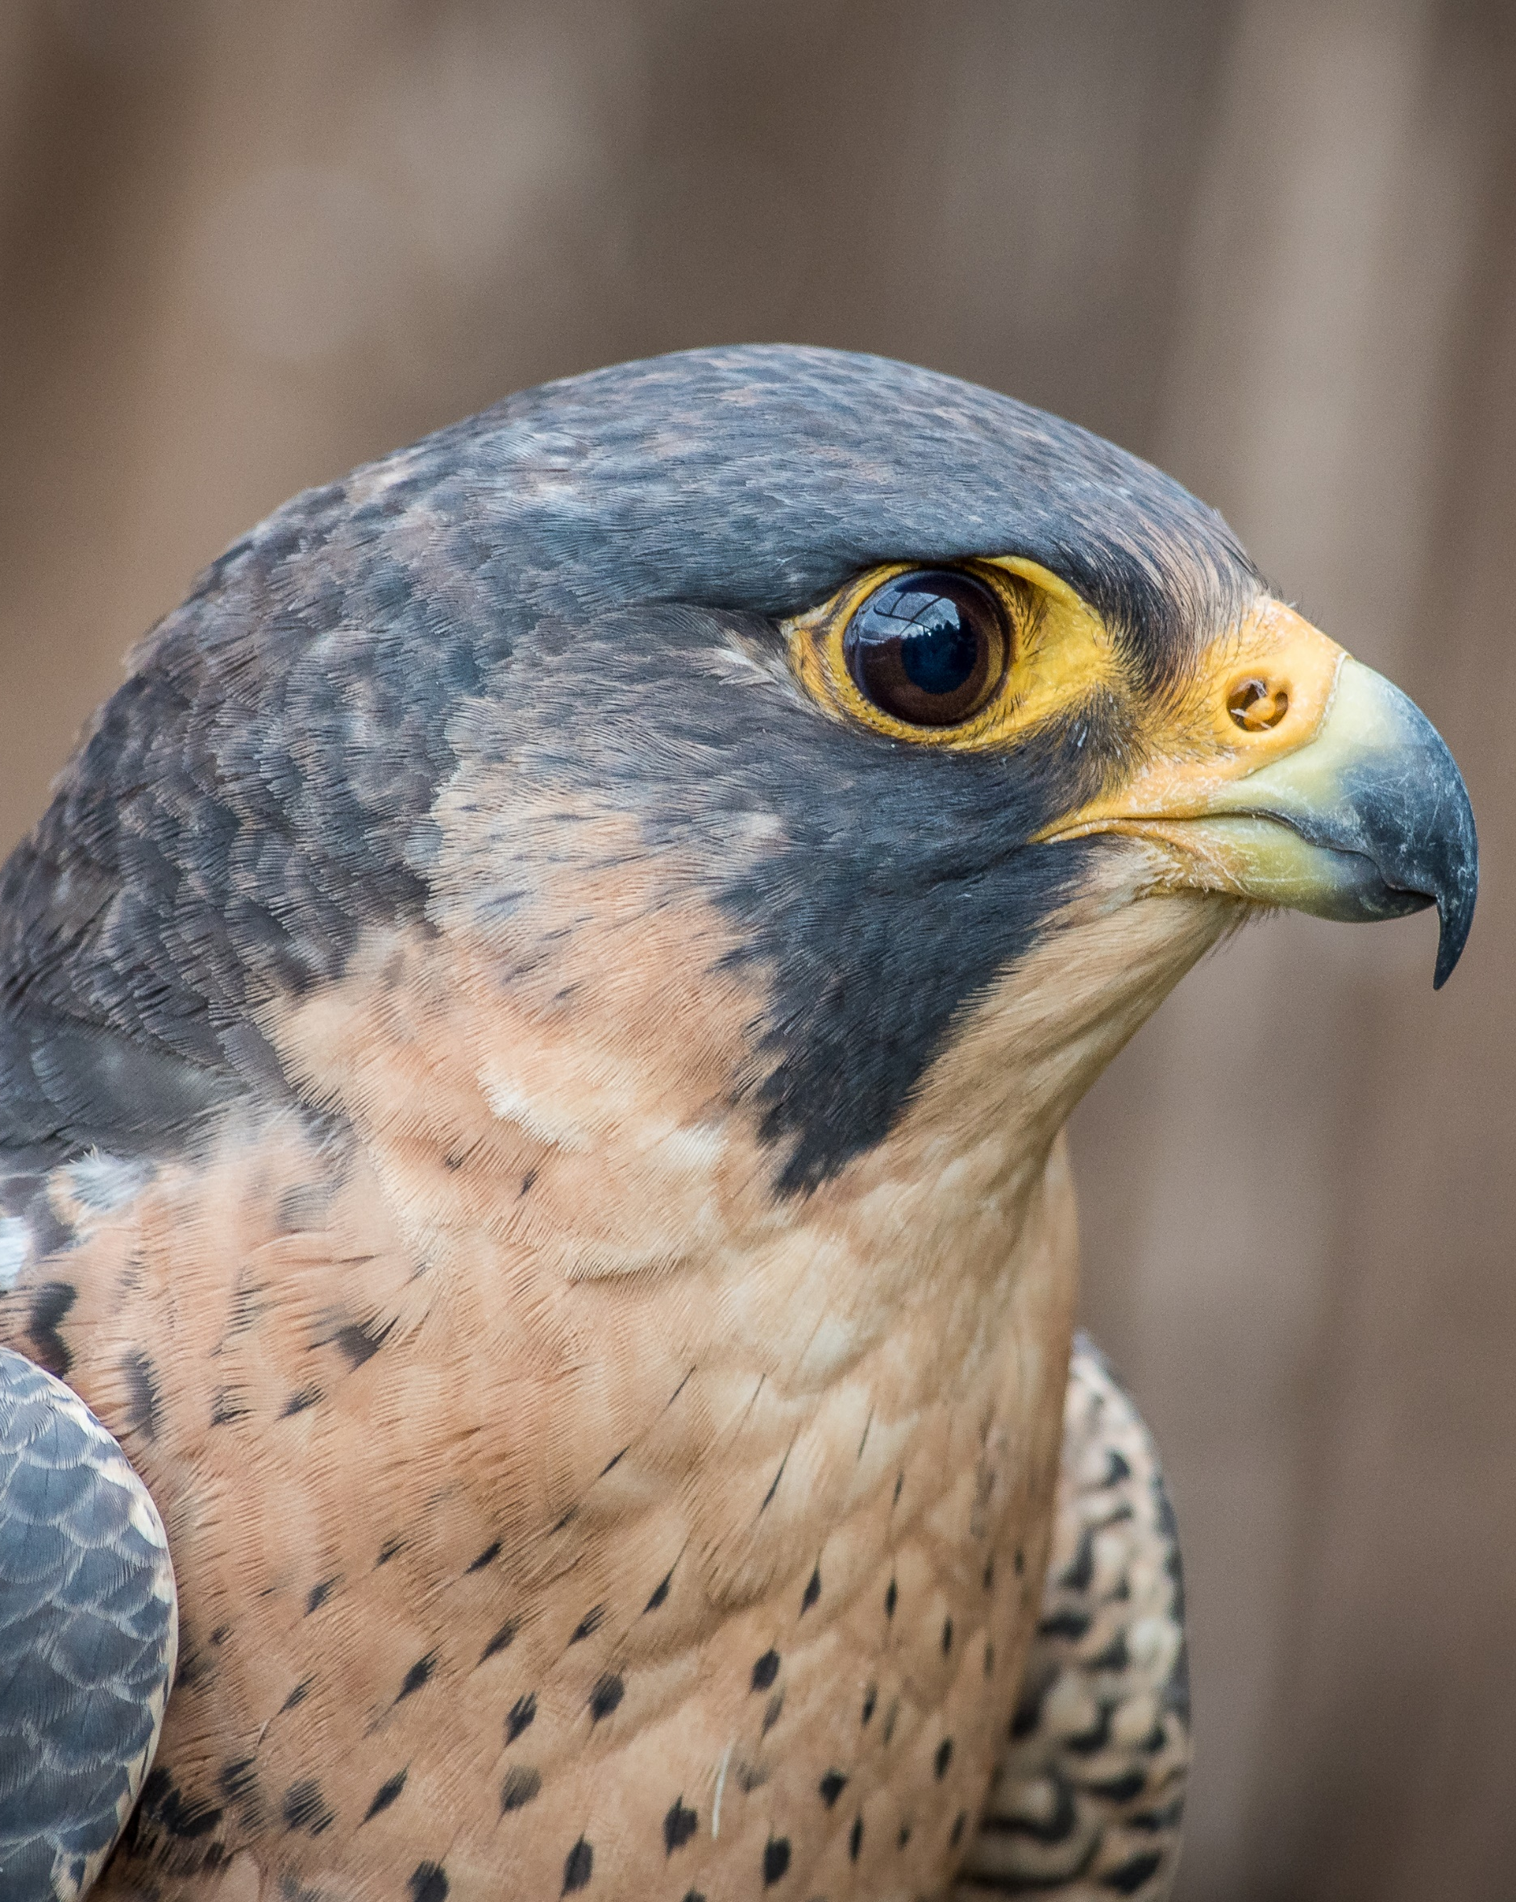
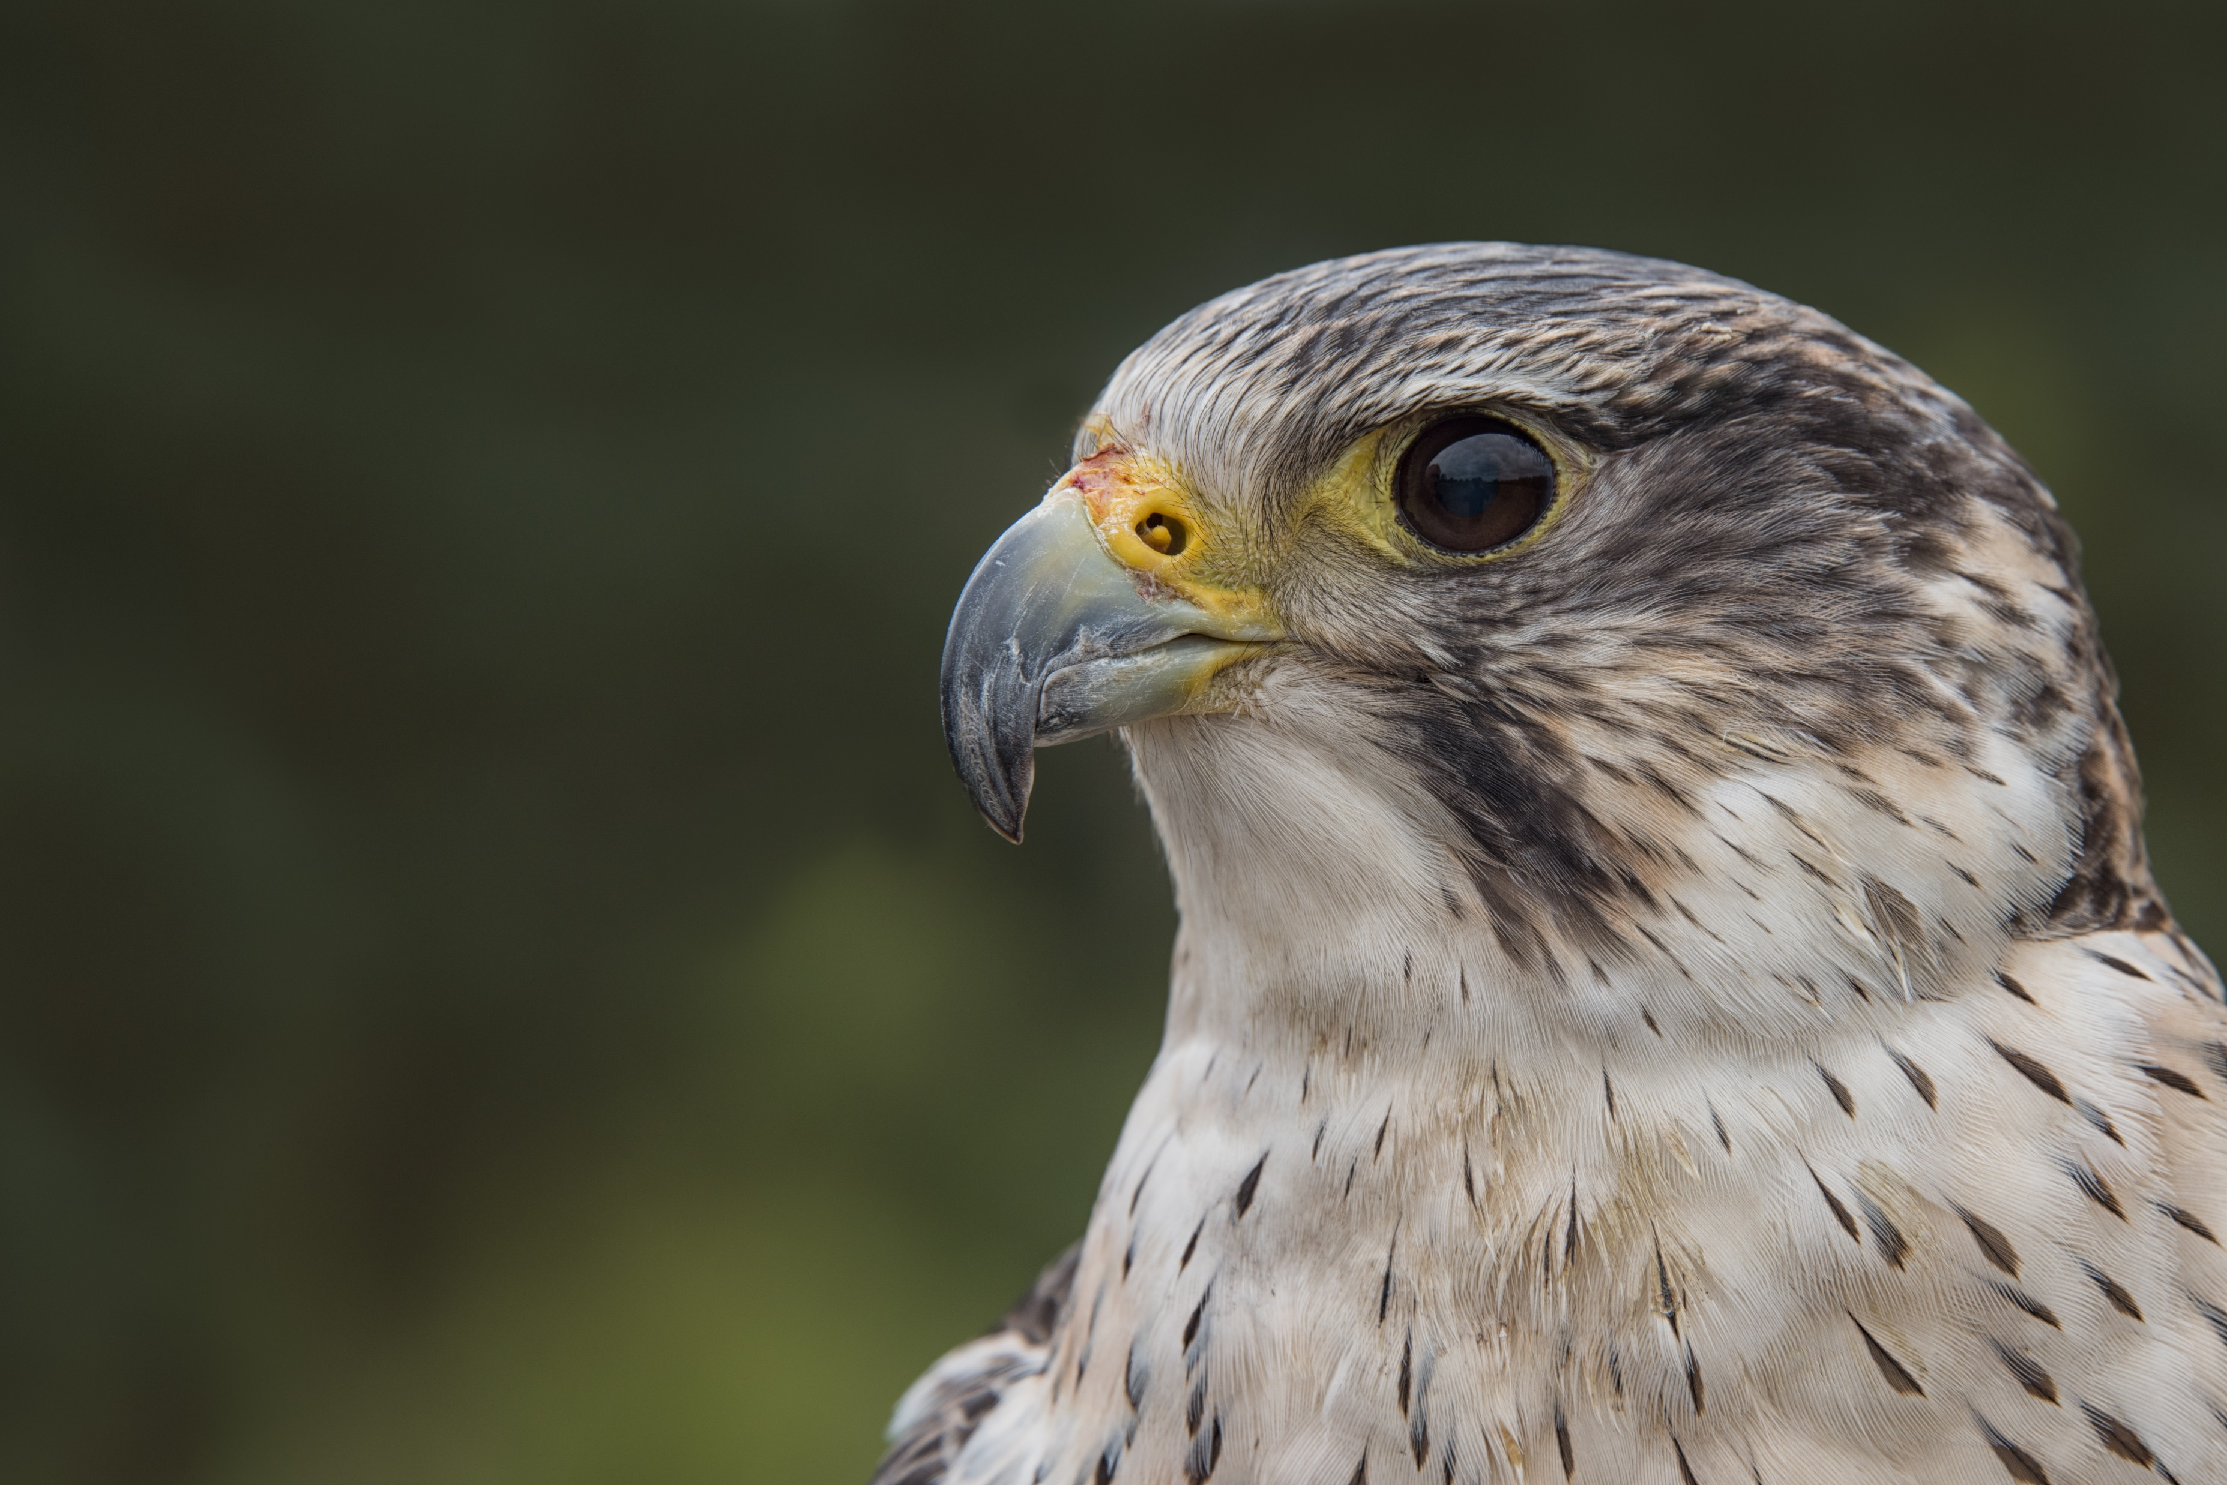
SAKER PEREGRINE X SAKER PEREGRINE

Slide 11
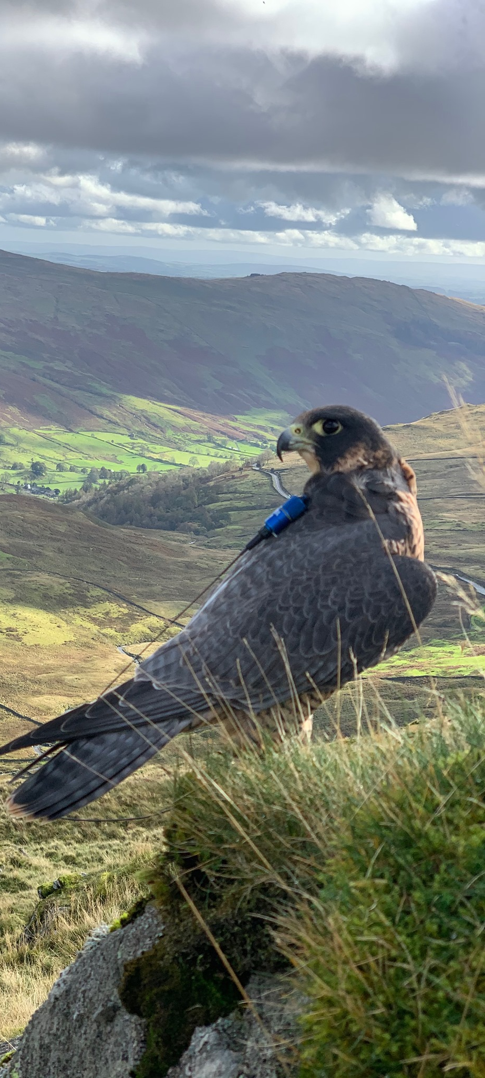
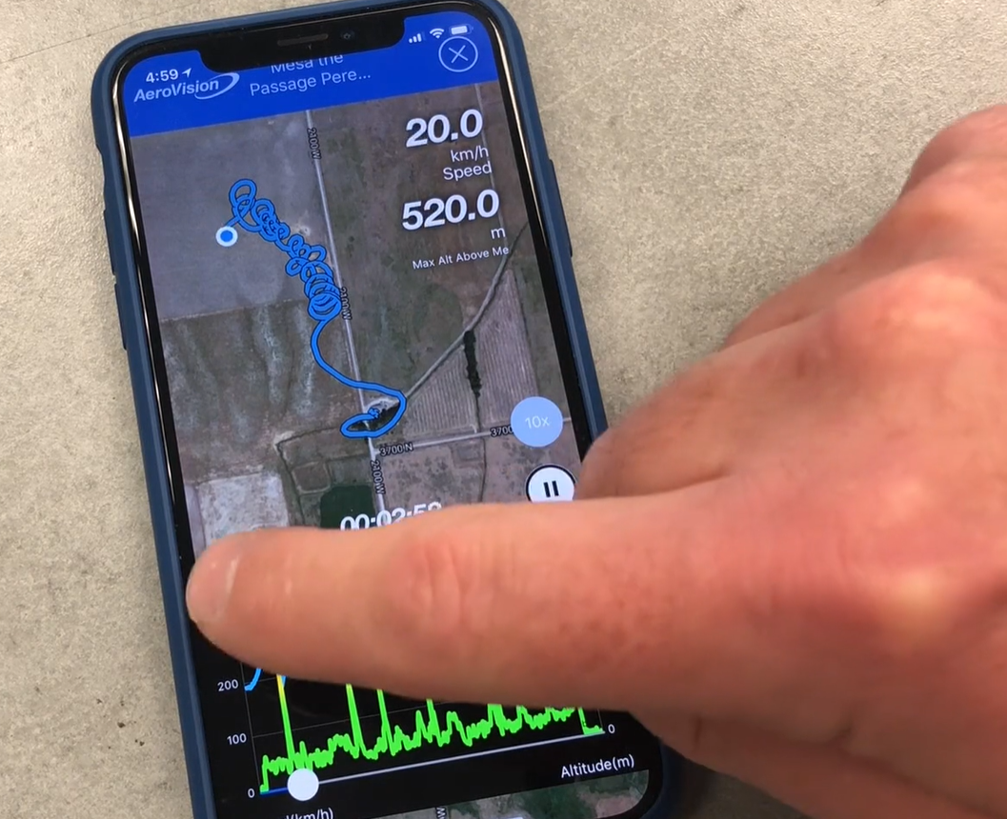
IAF’s Code is in widespread use and has been adopted by European clubs:
Hybrids/exotics never deliberately released
hybrids/exotics flown with telemetry/GPS
maximum efforts to recover any lost bird;
hybrids fostered by a parent that does not occur locally in the wild;

Slide 12
NEXT STEPS
Production of implementation report every 2 years
Continued cooperation with governments and other stakeholders
Collection of best practice examples
Regular updates of FACE members on IAS and the work of the Bern Convention

Slide 13
Sabrina Dietz Wildlife Policy Officer sabrina.dietz@face.eu
Thank you for your attention!
EUROPEAN CODE OF CONDUCT ON HUNTING AND IAS
2017 - REPORT ON THE IMPLEMENTATION OF THE CODE OF CONDUCT ON HUNTING AND INVASIVE ALIEN SPECIES

