Slide 1
Guideline for EX SITU conservation measures in sturgeons
World Sturgeon Conservation Society e.V.
W.S.C.S.
established 2003
Developed under the EC Service Contract 09.0201/2022/885601/SER/D.3
In support of the implementation of the “Recommendation No. 199(2018) of the Standing Committee on the Pan-European Action Plan for the conservation of the sturgeon”
Authors: Joern Gessner, James A. Crossman, Joel P. Van Eenennaam, Molly A.H. Webb, Thomas Friedrich, Marie-Laure Acolas, Ralf Reinartz, Leonardo Congiu, Patrick Chèvre, Elena Galich, Mikhail Chebanov

Slide 2
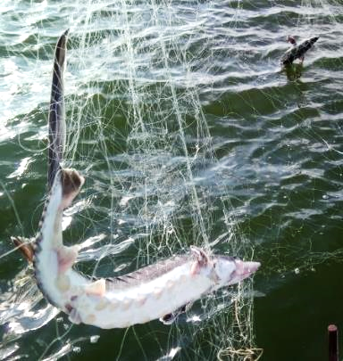
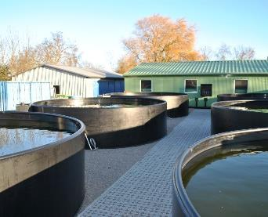
Contents
What is ex situ conservation?
What are its purposes?
Key targets and approaches
Guideline implementation
Perspectives

Slide 3
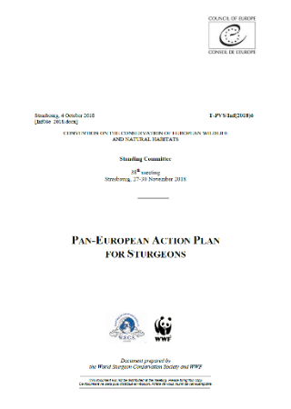
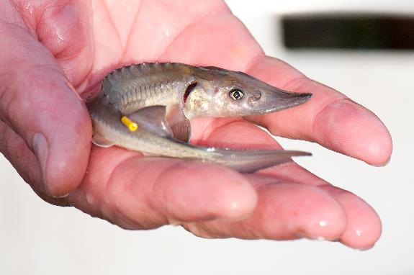
Ex situ conservation measures
The guideline for ex situ measures, contributing explicitly to reaching the PANEUAP Objective 2 Population structure is actively supported to reverse the decline
Comprise all measures to protect and promote
Genetic diversity between populations of different origin (reflects adaptations to different environmental conditions)
Genetic diversity within populations (represents their adaptive potential)
in threatened species and their populations under controlled conditions
Involve propagation and rearing
Can serve as a stop gap measure while other recovery actions are implemented

Slide 4
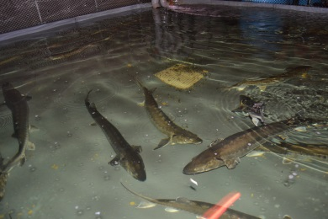
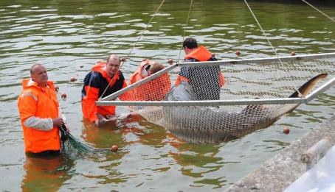
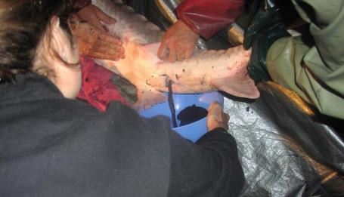
What are its purposes?
Protect and safeguard remaining genetic diversity in captive rearing
Bridge the time until in situ protection (incl. habitat restoration) becomes effective
Overcome the main obstacles for recovery of populations by circumventing recruitment bottlenecks (lack of spwners, deficits in incubation and high mortality)
Offers framework for regionally adapted implementation

Slide 5
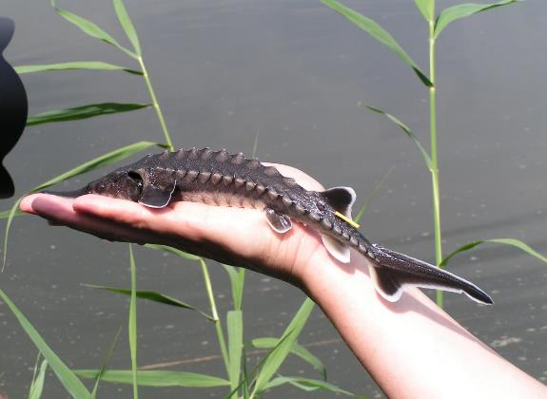
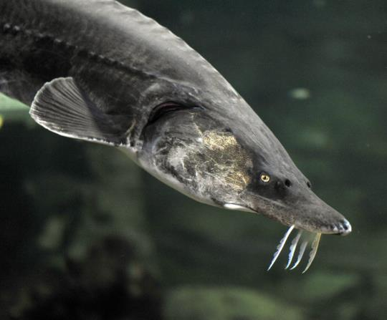
The Guideline…
addresses decision makers and practitioners
outlines best practice measures to implement ex situ measures at different levels
helps determining deficits in current programs
serves as a reference and training tool for implementing entities
provides the basis for harmonization of measures and approaches in range countries

Slide 6
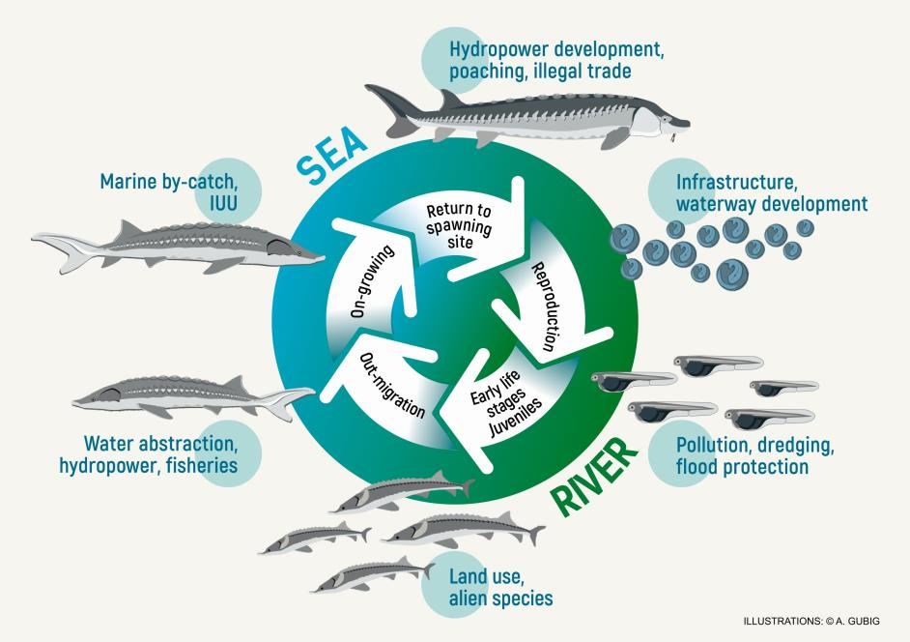
Key approaches
Based upon population monitoring results to identify the main obstacles in population recovery
Approach
Collecting wild offspring to rear early life stages for release, reducing natural mortality
Controlled reproduction of wild broodstock to increase year class strength through releases, no long-term rearing
Protect the remaining specimen of a threatened population through collection and long-term captive rearing with subsequent release of offspring to enhance population recovery
Monitoring the effectiveness of the measures taken and the shortcomings in recruitment

Slide 7
Guideline structure
Executive Summary
Introduction
Sturgeon biology and life history
Means of sturgeon conservation and the role of ex situ measures
Capture, Handling, Sampling and Fish Welfare
Ex situ facility concept and design
Genetic considerations in ex situ measures
Approaches for incorporating wild sturgeon populations into ex situ programs
Broodstock Management and Selection
Spawning and Gamete Processing
Rearing for release
Health Assessments and Treatments
Assessment of fitness for release
Tagging and Marking of fish prior to release
Transport and Release
Future outlook in the success of ex situ programs for recovery of sturgeons

Slide 8
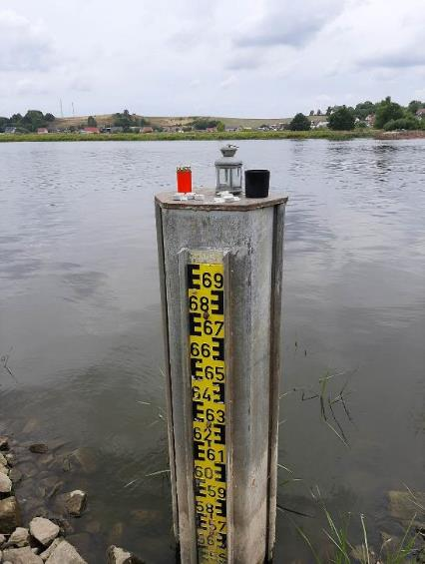
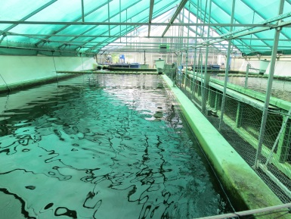
Challenges in current approaches
Very low population sizes in many species require immediate action of secure remaining diversity – and have started in many regions already
Ineffective protection and destruction of habitats require long term safeguarding of broodstock for measures to become effective
The time-frame for ex situ measures also depends on the effectiveness of other protection measures and threat reductions (bycatch, poaching, habitat destruction, pollution…)
Available public funding for conservation programs is limited in time and does not meet the long-term requirement for sturgeon ex situ programs (10+ years)
Involvement of private aquaculture facilities in ex situ measures requires clear framework (ownership, guideline implementation)
Harmonization of approaches and active information exchange on releases, genetic material used, etc. requires increased effort

Slide 9
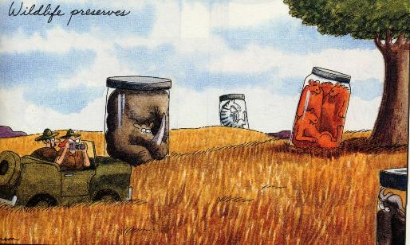
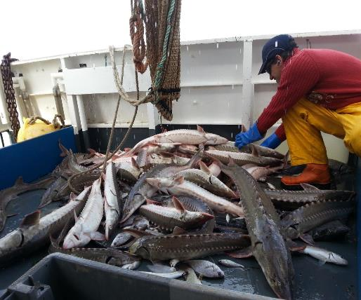
Perspective
Sound data base for decision making (monitoring programs to assess populations and habitats) is needed to determine onset and offset (success) of ex situ measures.
Integration of in situ and ex situ measures is essential to reach conservation targets and must be implemented in parallel
Depending upon the circumstances, the measures to be applied can vary, so can the costs
Active exchange, collaboration and harmonization of measures is essential for shared populations!
Regional collaboration helps to share costs and optimize resource utilization
Success requires committment!
©www.reitwein-mol.de

Slide 10
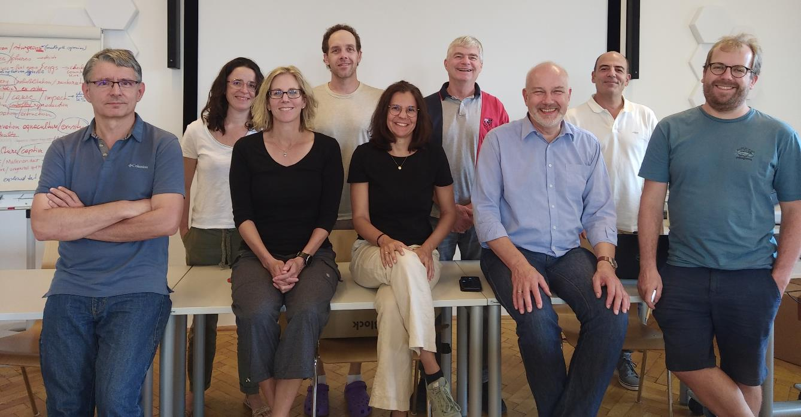
Thank you for your kind attention!

