Slide 1
Group of Experts on Protected Areas and Ecological Networks INFORMATION ON EMERALD SITE MANAGEMENT PLANS IN THE STANDARD DATA FORM Otars Opermanis & Marc Roekaerts

Slide 2
Group of Experts on Protected Areas and Ecological Networks
Background
Emerald Network monitoring framework
Emerald Network Barometer
Indicators for measuring progress
Reflect progress for each of three phases of Emerald Network development
Are based on readily available data
Can be further developed if new data are becoming available
Phase III: introduction of conservation measures

Slide 3
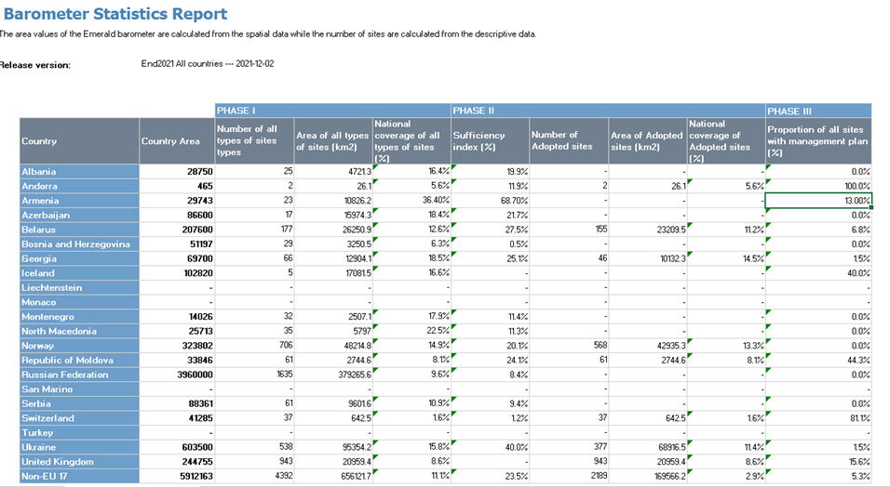
Group of Experts on Protected Areas and Ecological Networks
The name of Türkyie could not be changed in the Emerald Network Barometer at the time of the presentation

Slide 4
Group of Experts on Protected Areas and Ecological Networks
Current situation with Phase III indicator
Only one indicator: a proportion (%) of Emerald Network sites that are covered by site management plans
In the future it is foreseen to include an additional indicator(s) on implementation of conservation measures, management efficiency
The existing indicator relies on the information provided in the Standard Data Forms
Countries are required to indicate:
Is there a management plan (yes-no), or it is in preparation
Provide a web-link to this plan
[Optional] Provide an information on conservation measures (free text)

Slide 5
Group of Experts on Protected Areas and Ecological Networks
Problems with existing data
Not all management plans are recorded
Is this information systematically updated?
Other documents are often reported as “management plans”: are they relevant?
These uncertainties cast doubts about precision and quality of the existing Phase III indicator
Information on conservation measures very diverse and fragmentary

Slide 6
Group of Experts on Protected Areas and Ecological Networks
Request for review and update
Please review the information supplied in the Standard Data Form (Chapter 6: management plans)
At the country level, it is advised to plan it as a regular routine and consider it as a part of every SDF update
Provide information for all Emerald Network sites in your country, also if the response is «negative»
Critically assess the relevance of a plan, or other document that is mentioned in the SDF, for conservation of species and habitats. Does it include all crucial elements?
Please add information on conservation measures (even if not mandatory), but further guidance will probably follow in the light of possible update of the Standard Data Form and development of an additional Phase III indicator

Slide 7
Group of Experts on Protected Areas and Ecological Networks
Thank you for your attention!

