Slide 1

Group of Experts on Protected Areas and Ecological Network
Emerald Network Barometer
Marc Roekaerts / Otars Opermanis
Notes:
A few words on the Council of Europe and why the Convention was negotiated there.

Slide 2
Emerald Network Barometer
Background document on the Monitoring framework for the Implementation of the Emerald Network
https://rm.coe.int/pa02e-proposal-monitoring-framework-emerald/16809fb019

Slide 3
Emerald Network Barometer Indicators

Slide 4
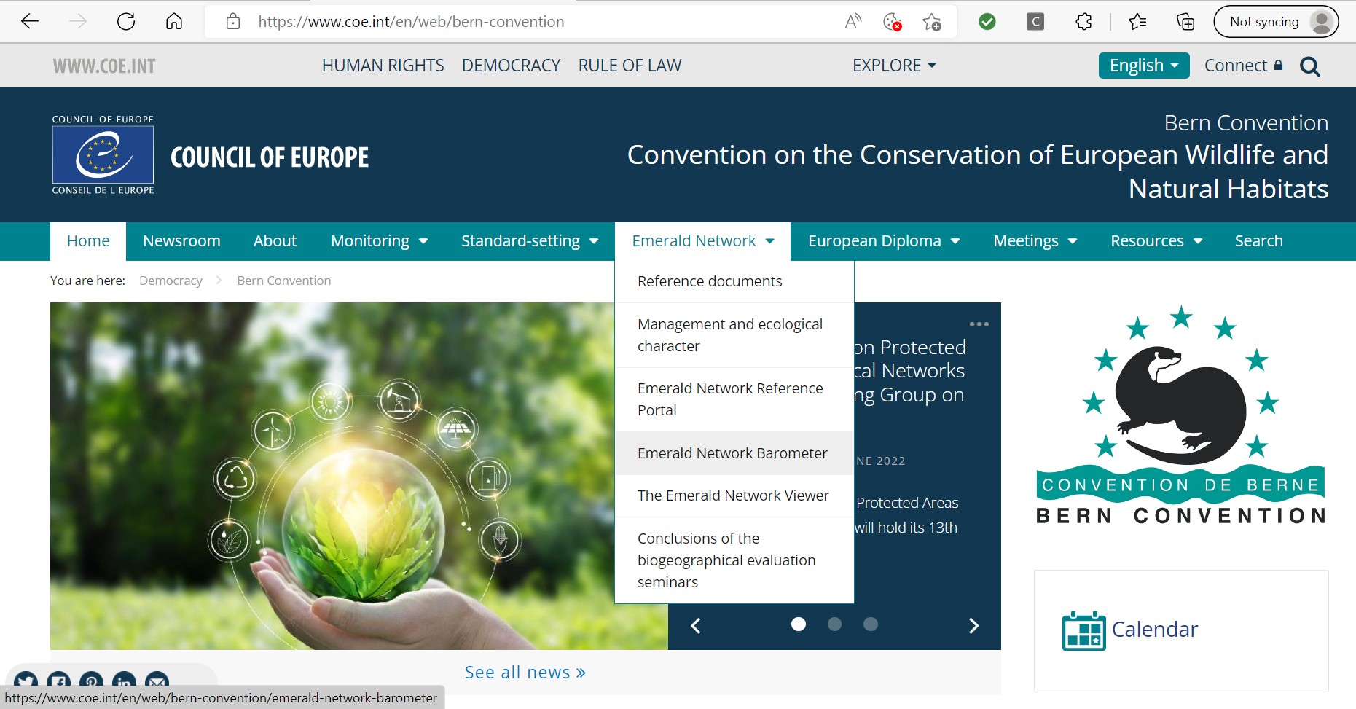
Accessible through Bern Convention Webpage

Slide 5
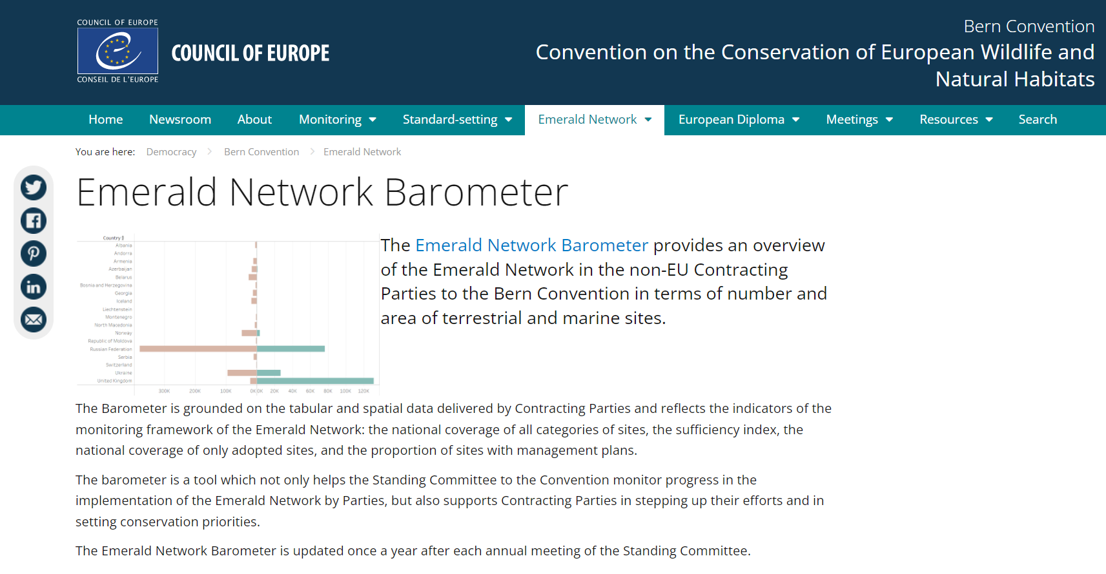
Introduction Page

Slide 6

Introduction Page

Slide 7
The next slides illustrate the 3 pages of the barometer
    The barometer statistics (general overview)
    The barometer statistics per country
    The barometer table
=> Online presentation using the Bern Convention Webpage
Convention on the conservation of European wildlife and natural habitats (Bern Convention) (coe.int)

Slide 8
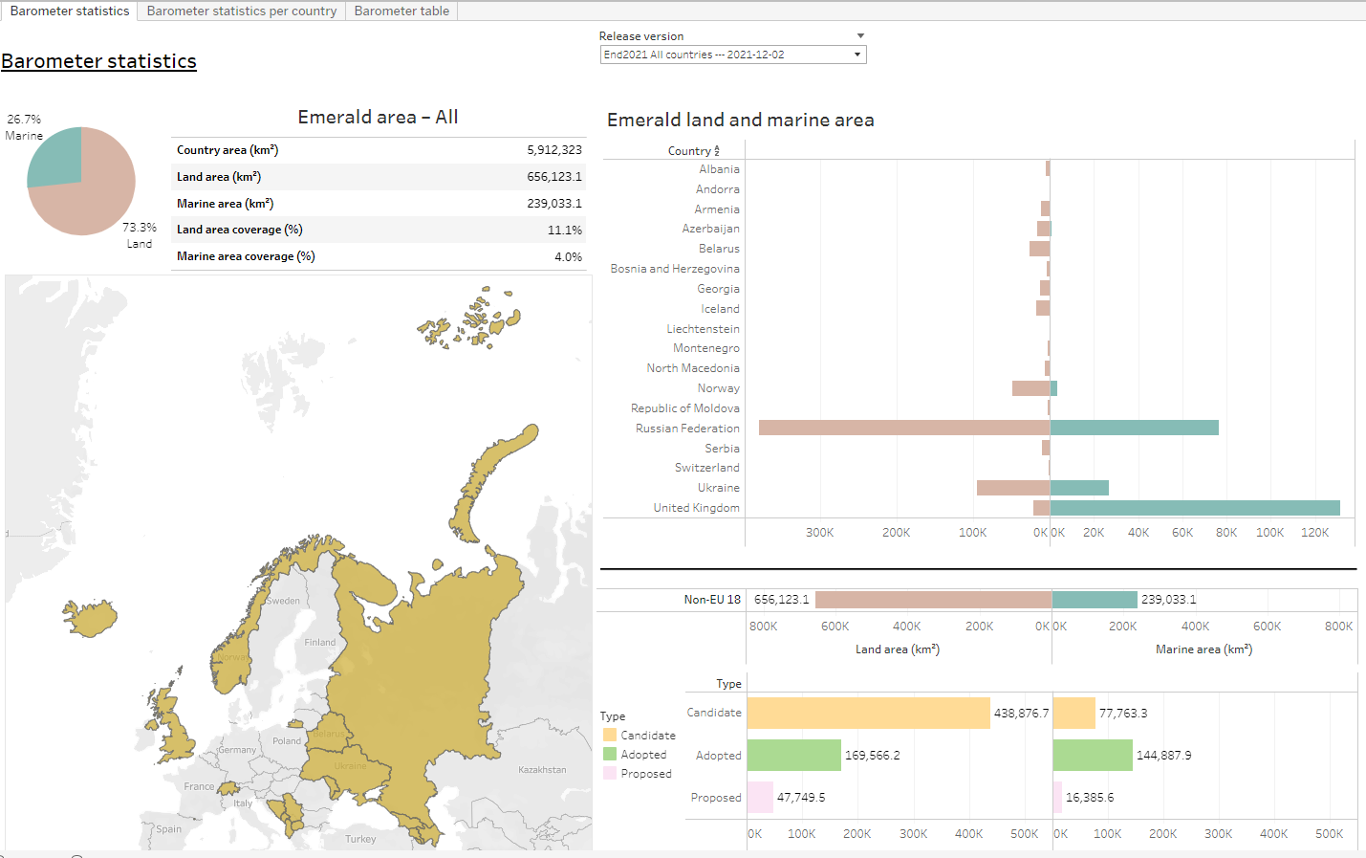
The name of Türkyie could not be changed in the Emerald Network Barometer at the time of the presentation

Slide 9
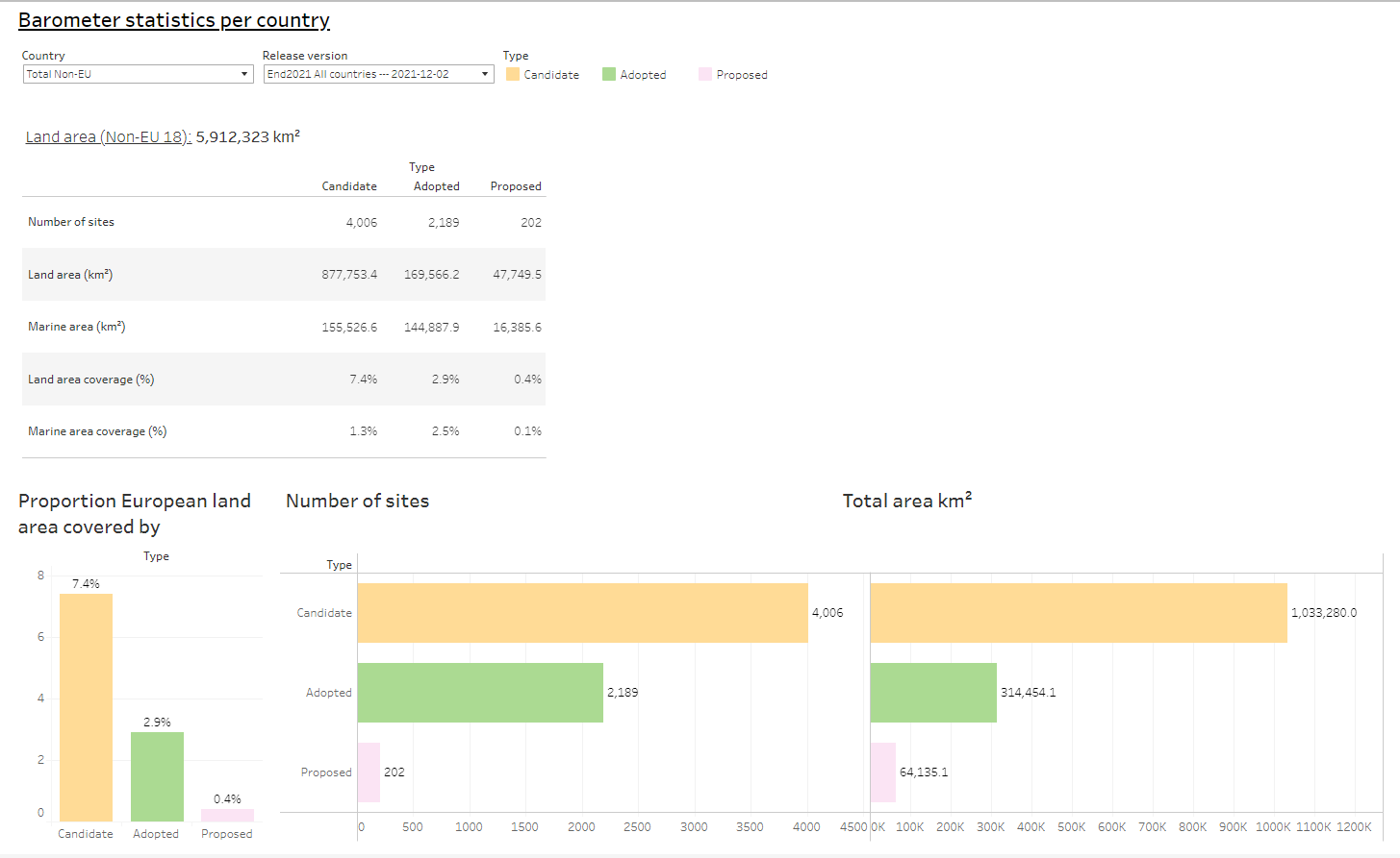

Slide 10
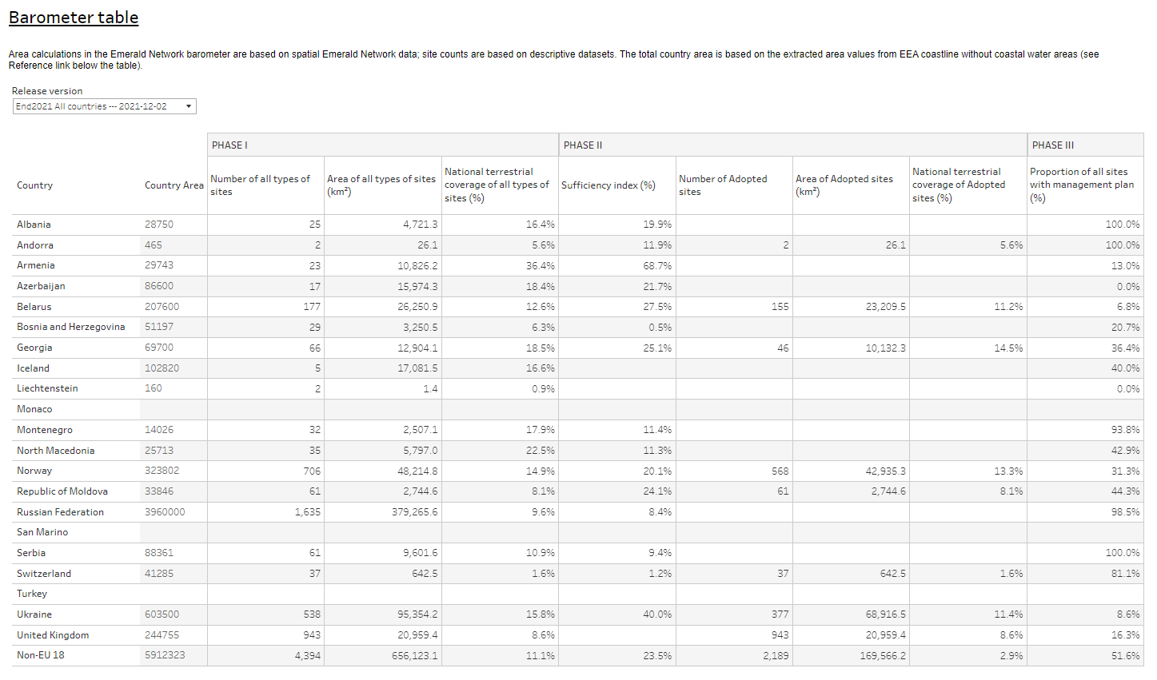
The name of Türkyie could not be changed in the Emerald Network Barometer at the time of the presentation

Slide 11
Questions and answers
Followed by a clarification of Phase III indicator on management plans by Otars Opermanis

Slide 12
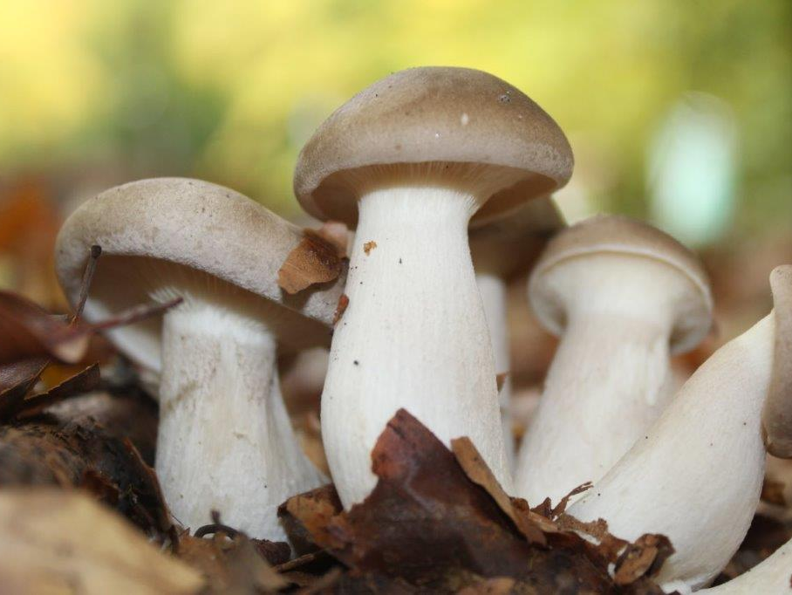
Thank you for your attention

