Slide 1
Group of Experts on Protected Areas and Ecological Network Description of the Emerald Network Dataflow Marc Roekaerts / Otars Opermanis
Notes:
A few words on the Council of Europe and why the Convention was negotiated there.

Slide 2
Emerald Network Consolidated Dataflow description
> 20 years of building up the dataflow since Resolution No. 5 (1998)
Starting with Pilot project and various larger projects
Rules and guidelines followed gradually for different aspects of the Emerald Network Dataflow
Today, we are looking at a more or less stable dataflow cycle .... About time to write a consolidated document https://rm.coe.int/pa06e-2022-emerald-network-consolidated-dataflow-guidelines/1680a6cd5d

Slide 3
Emerald Network Data Flow Cycle

Slide 4
1 The countries databases
1 The countries databases
The document follows the dataflow cycle in 5 sections
The countries databases
The Emerald Network software: the SDF manager
Upload of data via ReportNet (CDR)
The production and management of the European Emerald Network database
Products of the Emerald Network

Slide 5
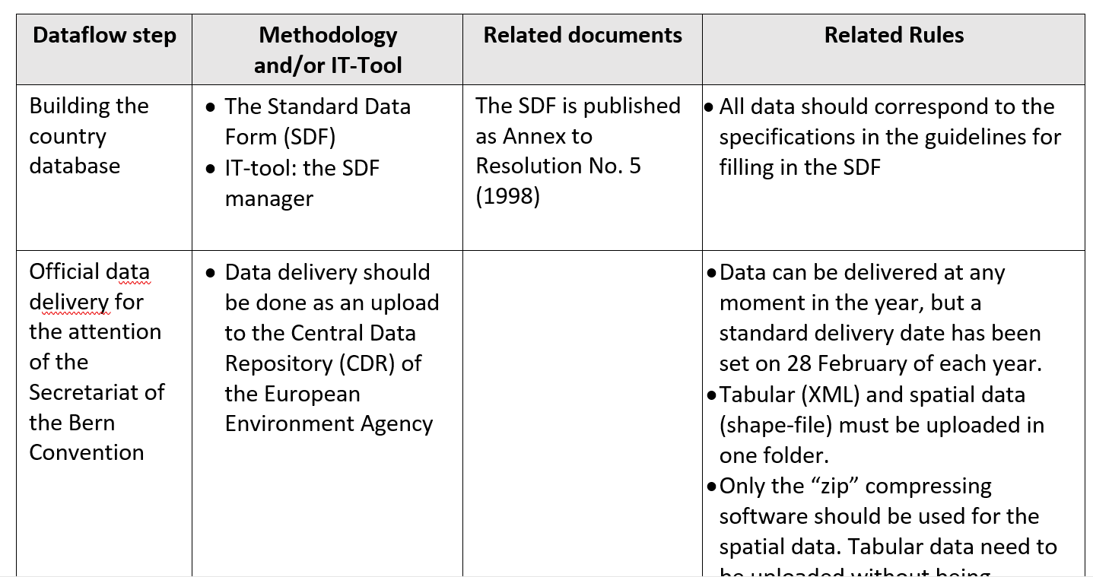
Summary Table (page 4 in the document)

Slide 6
The document makes reference to the more detailed documents and guidelines (such as: )
The Standard Data Form (SDF)
The guidelines for filling in the SDF
The document on the installation of the SDF-manager
Data structure schema’s
Guidelines for explaining negative changes
Etc ....
All available from the Emerald Network Reference Portal Emerald Network Reference Portal (coe.int)

Slide 7
Validation rules and qa/qc procedures in subsequent steps
During editing data in the SDF manager
When uploading the data to the CDR blockers and warnings
When merging the country data into the European dataset
When making the data public

Slide 8
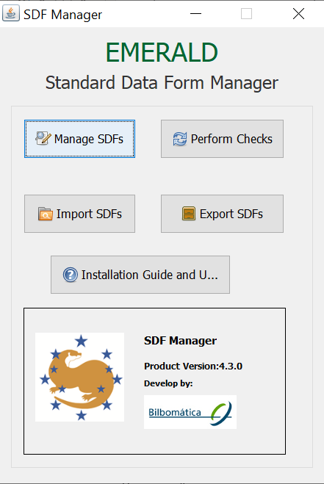
Data Validation in the SDF-manager data should correspond to the rules set in the guidelines for filling in the SDF

Slide 9
Quality assurance for the public version Clean-up process: Annex 1 in the document
Removal of obvious errors from the dataset to enhance readability and use by non-specialist users
Duplicated records
Empty strings or only empty spaces
Non UTF16 codes creating xml issues
species name field is created that removes 90% of the syntax errors in the species names (for search purposes) see examples in Annex 1

Slide 10
QA/QC rules during upload on the CDR paragraph 3.2 and Annex 5 in the document
New implementation since 2022
1st QA (FME envelope validation process) blockers
2nd QA (FME tabular data XML validation process) warnings

Slide 11
1st QA (FME envelope validation process) blockers
XML incorrect or several XML No XML file or not an XML file with an Emerald Network header correct or more XML files with Emerald Network header correct. Return blocker error and delivery is not accepted
Envelope not include a correct XML and Shape - An XML file with correct header (The XML can not be compressed in zip format). - A Shapefile, consisting of minimum *.shp, *.shx, *.dbf, *.prj files. (these files could be compressed in zip format).

Slide 12
2nd QA (FME tabular data XML validation process) warnings
Site code
Site type
Site name
Bioreg code
Species population unit
Species code
Species name
Species code and Species name

Slide 13
Implementation plan concerning blockers and warnings
2022 1stQA blockers, 2nd QA warnings
2023 first set of 2nd QA as blockers (to be defined)
2024 full set of 2nd QA as blockers
Or ???? To be discussed

Slide 14
Suggested further work on the document
Description of the consolidated database of the biogeographical sufficiency conclusions and Emrald Network Reference List => link with sufficiency index of the Emerald Network Barometer
Further elaboration on the uses of the European Emerald Network Database (section 5)
Incorporate comments received after the meeting, time period to be decided (1 month, 2 months or ???)
....

Slide 15
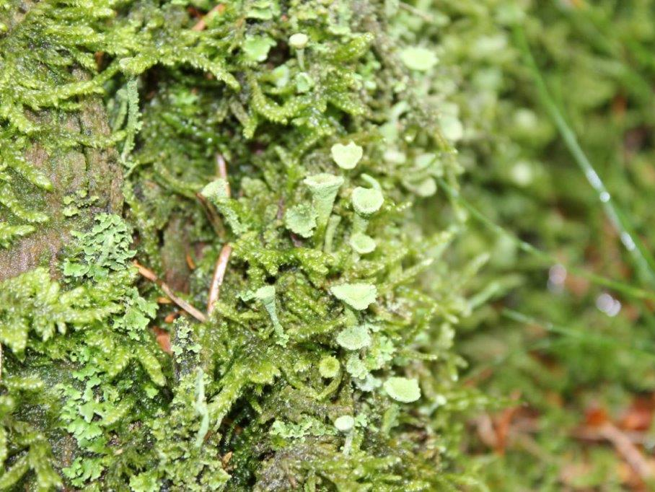
Thank you for your attention

