Slide 1

Threats to the Rhone streber (Zingel asper) in the Doubs
Report by the NGOs on the implementation of recommendation N°169/2013
Friedrich Wulf, Pro Natura
40th meeting of the Standing Committee of the Berne Convention
December 2nd, 2020

Slide 2
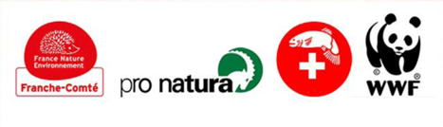

Content
Short recap and intro
Main developments since 2018
Situation overview of implementation of the different elements of recommendation N° 169/2013
Key issues: transboundary governance and cooperation, agri- and sylvicultural pollution
Text suggestions for the SC meeting report
Notes:
Gaps: see coming slides and slide9, but also; no monitoring of other fish species!

Slide 3
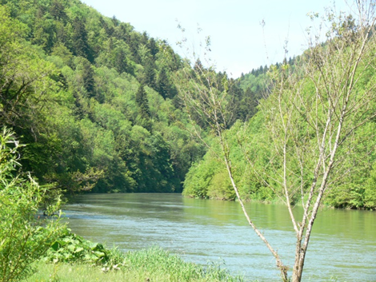
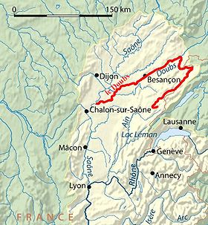
The river concerned: the Doubs
Notes:
Just a quick intro to explain the context

Slide 4
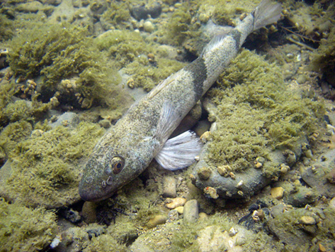
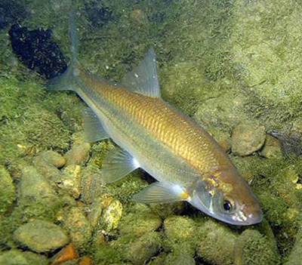
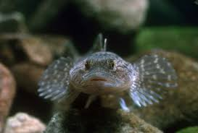
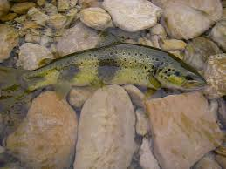
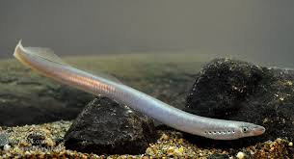
The fish species concerned
Rhone streber, Annex II
SW European Nase, Annex III
Lampetra planeri (Annex II HD)
Cottus gobio (Annex II HD)
Doubs trout
Notes:
Complaint is about Rhone streber, but more relevant species also present

Slide 5
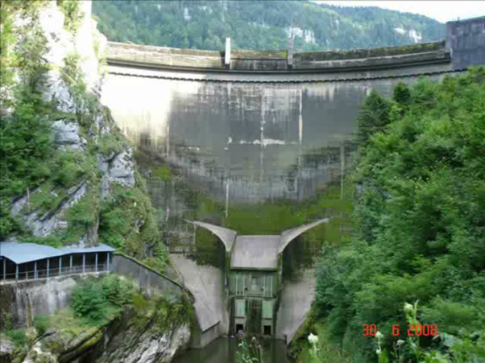
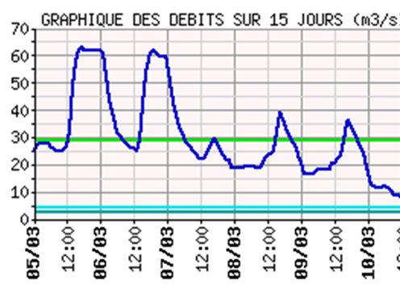
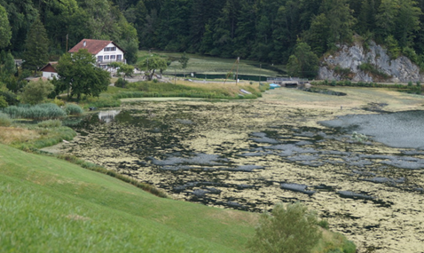
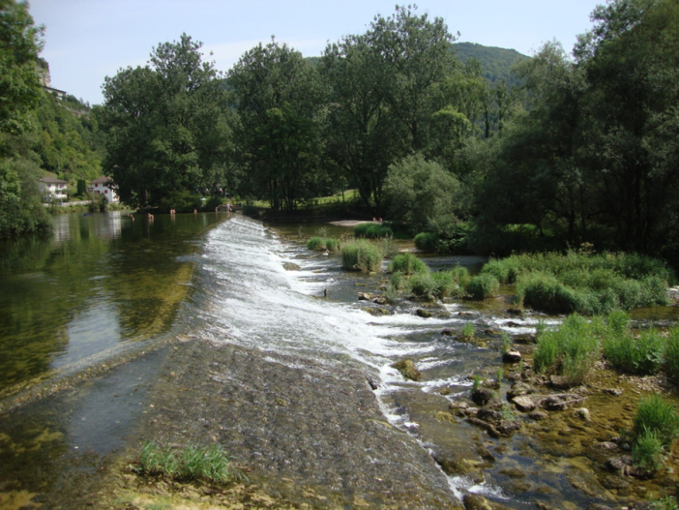
Many issues
Hydropower
surges
Pollution
Obstacles to
connectivity

Slide 6

Short history of case file
Bad situation of Apron and River
for many years
New HPP water regime had
worsened situation
Local and national protests
did not trigger necessary actions
→Pro Natura, FSP, WWF file complaint
(T-PVS/Files(2011)21)
June 2013: on the spot appraisal
December 2013: SC adopts recommendation N° 169
2015: National Action plan in favour of the Doubs
Notes:
Nothing happened despite protests at national level für a long time so we adressed the Berne Convention and filed a complaint which led to draft recommendation Nr. 169; this is about ist implementation

Slide 7
Status of activities on implementation
Swiss government / FOEN / Cantons active within existing resources – thank you!
Swiss Gov’t Report deals with every point of the recommendation ☺
Knowledge has been improved (e.g. genetic identity)
Action Plan (PND) is now being implemented.
    Follow-up group with stakeholders meets annually
    Catalogue of measures on almost all recommendations
    Still gaps, e..g concerning agriculture and pollution
BUT: Still little effects on the ground - except floods !!!
Notes:
Gaps: see coming slides and slide9, but also; no monitoring of other fish species!

Slide 8
Main progress since 2018
Fish bypass (ruisseau de contournement) in St Ursanne (Moulin Grillon) operational since 2019
Modernisation of big sewage treatment plants (Le Locle, La Chaux-de-Fonds) has begun, expected to be effective in 2023
Buffer zone along the Doubs river have been enlarged both in Neuchâtel and Jura cantons (Zone tampon)
Federal offices for the Environment and for agriculture discussed strategy for decreasing impacts of agricultural pollution, workshop with stakeholders held in september
Notes:
Gaps: see coming slides and slide9, but also; no monitoring of other fish species!

Slide 9
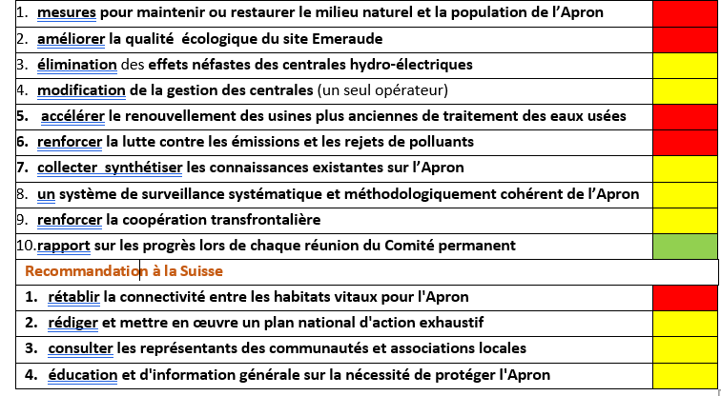

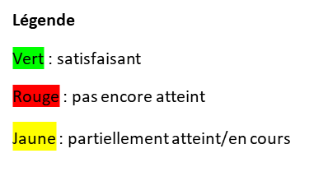
State of achievement of the different elements of Recommendation N°169
Recommendations à la France et la Suisse
ä
ä
ä
ä: progrès depuis 2019
Notes:
Important: distance to target, not about activities of administration. Arrows show progress, not shown in report due to formatting. Thanks to FOEN, FOE and cantonal offices for their work!

Slide 10
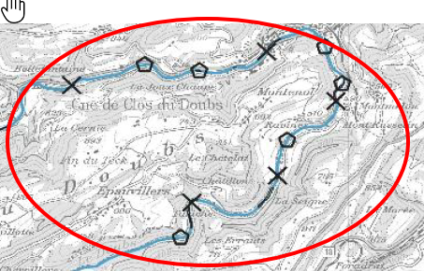
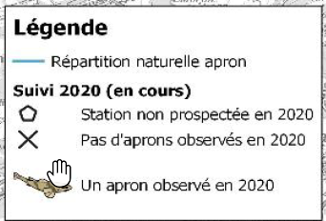
Situation overview
Achieving favourable State of the Rhône streber (N°1 of Recommendation): newest FOEN reports show no Rhône strebers found in 2020 - situation very alarming !
Still very far from achieving overall goal of recommendation.
Notes:
Alarming! Brink of extinction. Strcutural improvemenst to do with weirs… (flow around them, water dynamcis/colmatation will change)

Slide 11
Situation overview
  Hydropower plants (N°3 and 4) :
  regime has been changed in 2014,
  increased water levels downstream,
  no surges anymore except between 2 uppermost dams
  Pollution (N°5 and 6): modernisation of 2 main sewage treatment plants has started, first steps towards tackling impact of agri- and sylviculture, French impact?
  Connectivity (N°2 and CH1): no weirs removed so far, 1 bypass constructed
Notes:
…suffcient for stopping fish mortalities and effects
….Constructive measures: dotation turbine, better: run-of the river power station
…Support from France needed for this (License is isued by them)

Slide 12
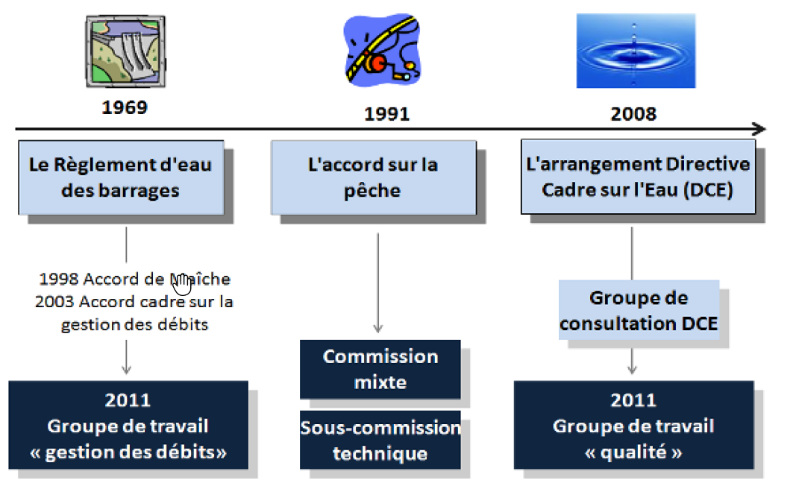
Key issue 1: lack of coordination F/CH
Collaboration between F and CH only via 3 Binational Groups.
Groups do
not coordinate
with each
other
Water quality
group has not
met since
2016
Responsibilities
in F not clear

Slide 13
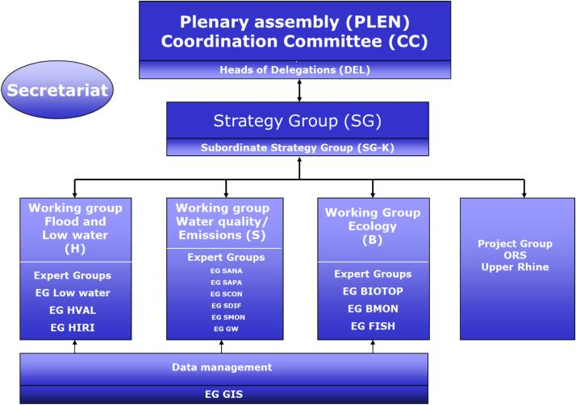

Key issue 1: lack of coordination F/CH
Suggestion of a binational conference compared to the Intl Comission for the Protection of the Rhine (ICPR)
Advantages:
clear and coordinated international structure, regular meetings, NGOs as Observers

Slide 14
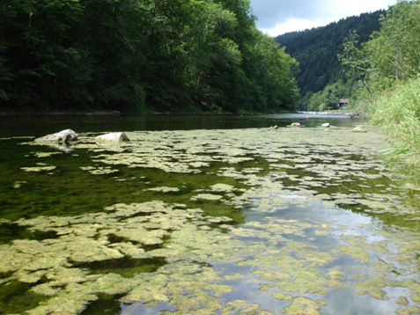
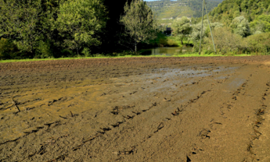
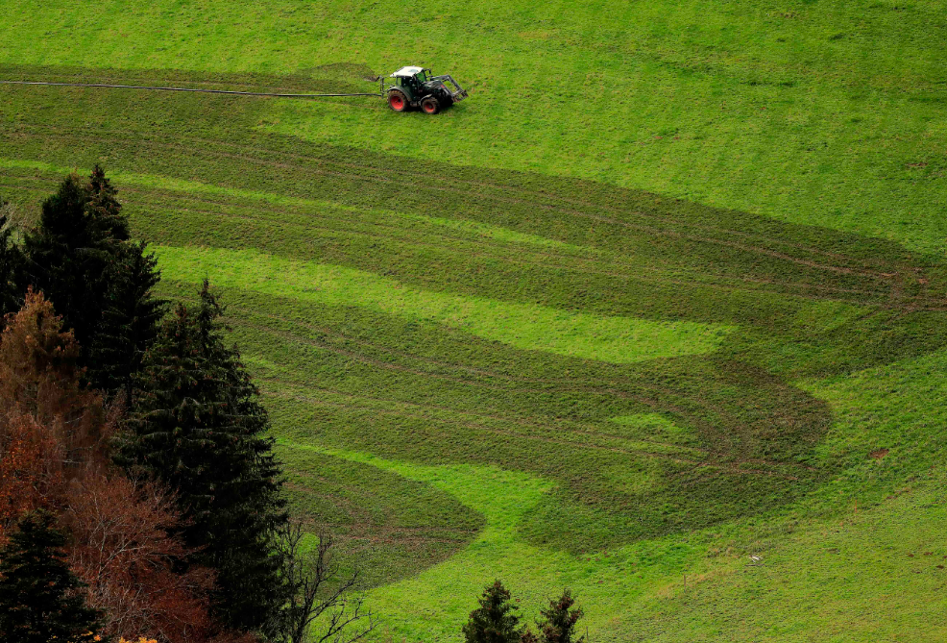
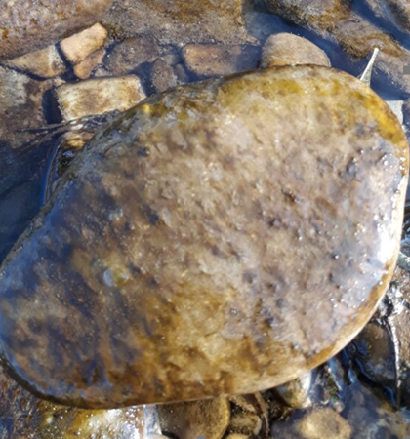
Key issue 2: impact of agri- und sylviculture
In recent years, several impacts linked to agricultural activities on water resources and biodiversity observed in both F and CH.
Consequences: algal development (river bottom increasingly black with algae), fish population not recovered. Rhone streber almost extinct!
Despite new monitoring (new stations, new observations) and in contrast to the studies carried out in France, measurements on the swiss part of the Doubs show that pollution is within “normal” ranges in the river !

Slide 15
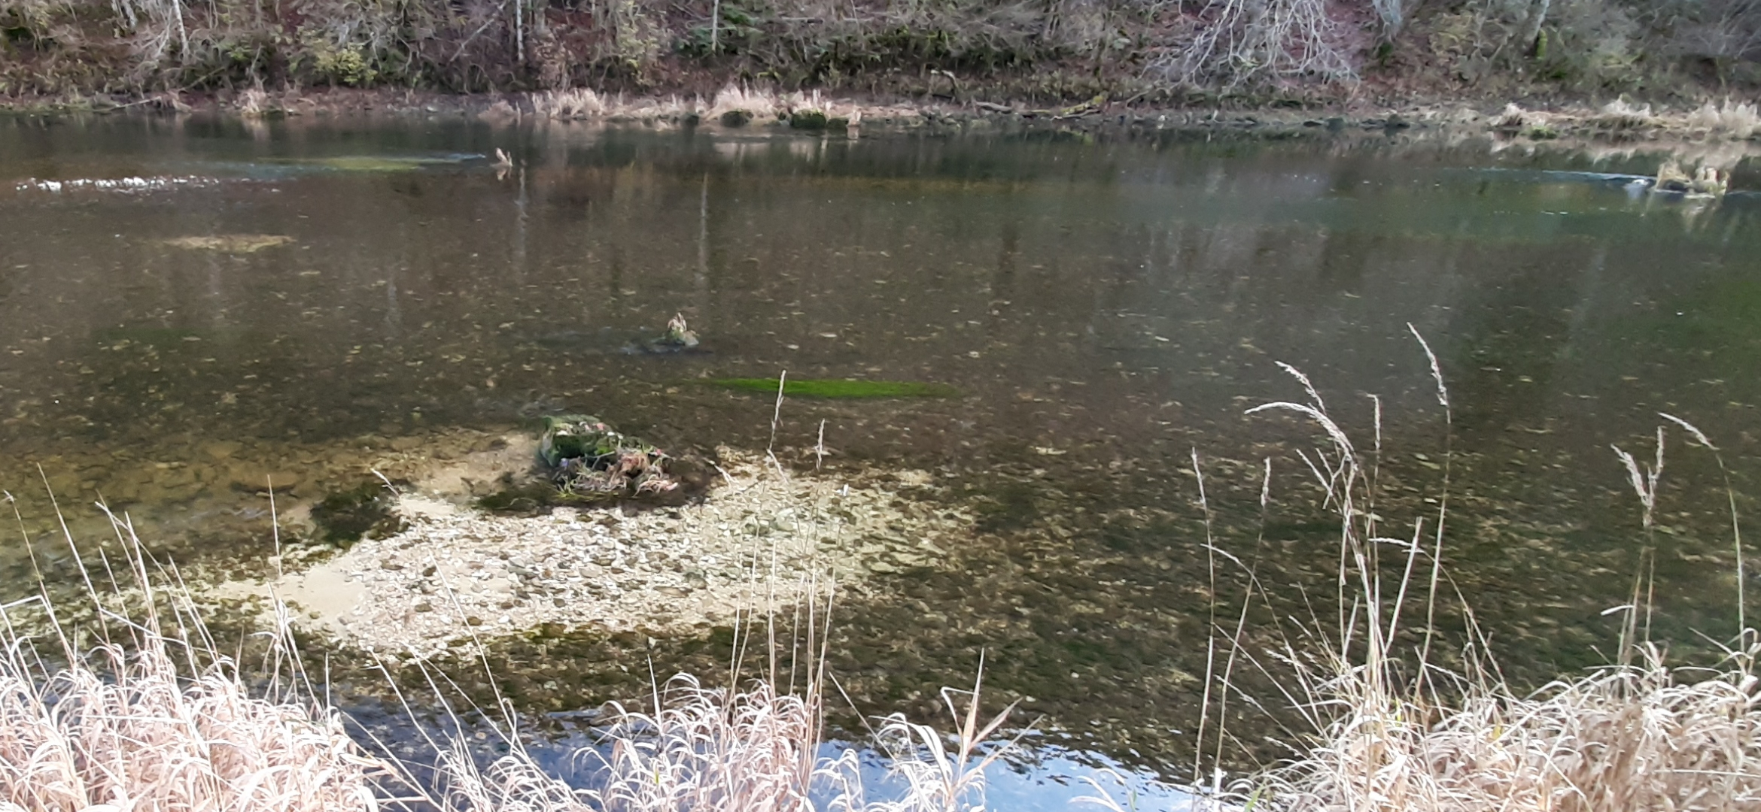
Key issue 2: impact of agri- und sylviculture
Doubs near Goumois, 23.11.2020 – river bottom black with algae

Slide 16

Key issue 2: impact of agri- und sylviculture
Summer situation

Slide 17
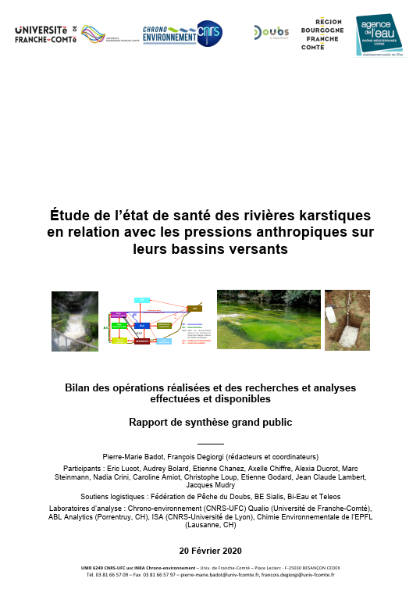
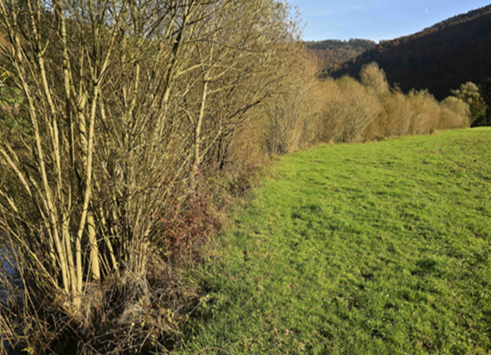
Key issue 2: impact of agri- und sylviculture
In F: Measurement show that Doubs and Loue clearly overloaded with nutrients and multiple chemicals (pesticides, veterinary medicines), major input from agriculture (French study on karstic rivers: Uni de Franche-Comté)
Also, too much Wood treatment pesticides
Agri workshop (swiss authorities) has decided on
3 new areas of work in the plan by mid-2021 :
- document agricultural efforts to protect water
- Improve river banks by afforestation, structuration,
enlargement
- Reward and give added value to engaged farmers
NGOs: Good start, but more measures
needed
Notes:
Why do algae grow here?

Slide 18
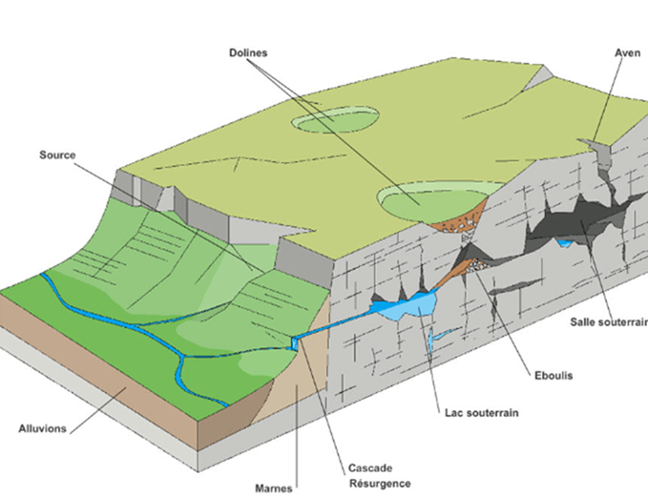
Key issue 2: impact of agri- und sylviculture
In CH: Several incentives taken at cantonal level but will they work? Are controls sufficient (e.g.
slurry in winter?
Is the karstic ecosystem taken
into account? Effect on fish?
Regarding nutrients, need to
measure close to inflow
Why not extend Uni Franche-
Comté study to Switzerland for
coherence of whole River Basin?
Need for further analysis and measures in F and CH

Slide 19
Suggested Conclusions for SC report
“The Standing committee took note of the reports and appreci-ated the progress that has been made by authorities and private enterprises. It noted the need for a more frequent and better coordination between French and Swiss authorities and between the different binational working groups. It also wel-comed the dedicated workshop on agriculture in Switzerland and highlighted the need to address agricultural pollution, especially on the French side. It encouraged the French and Swiss authorities to further pursue their implementation efforts and investigations in the different areas of work, such as water quality, hydraulic regime and connectivity in order to effectively minimise the pressures on the Doubs and to improve the
situation of the Rhone streber.”

