Slide 1

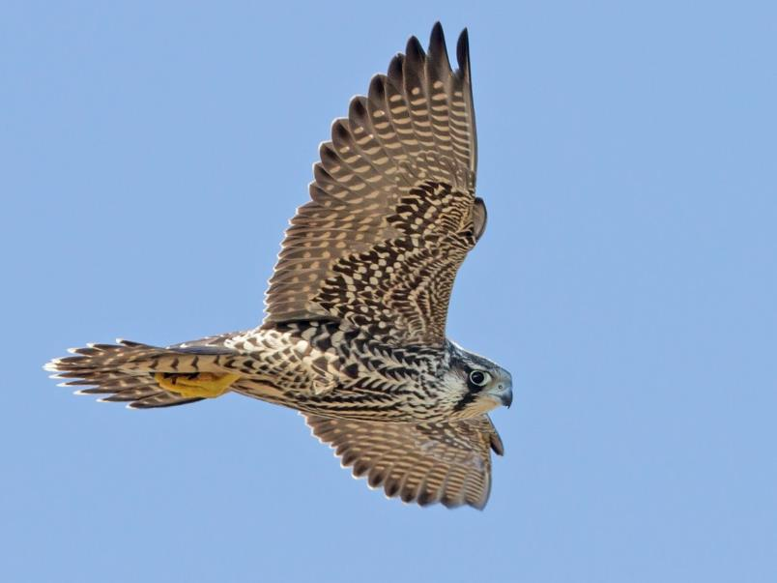
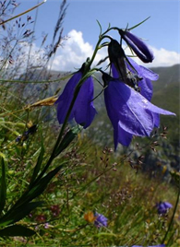
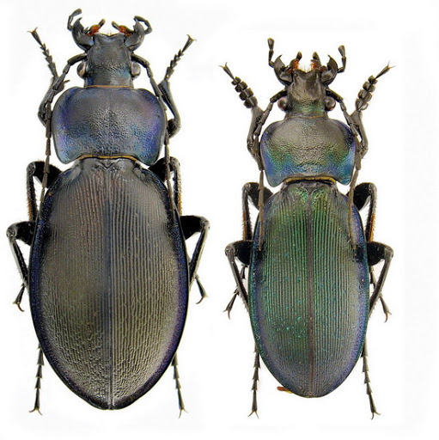
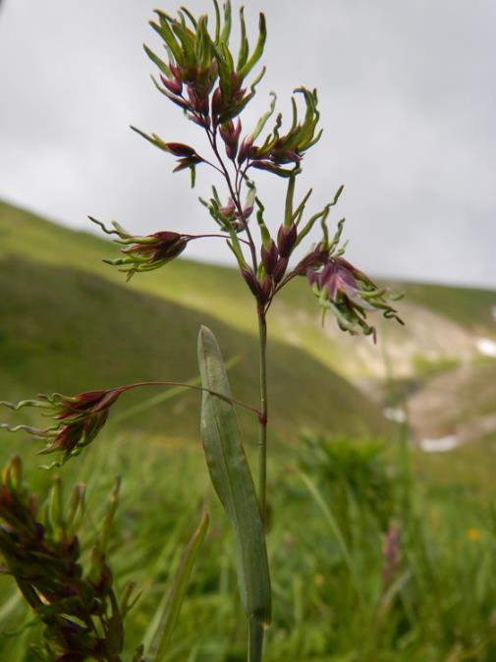
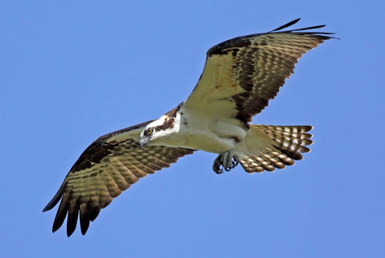
Presumed threat to Emerald site “Polonyna Borzhava” (UA0000263) from wind energy development
(and other complaints reg. WPP in Ukraine)
A103 Falco peregrinus
4070 Campanula serrata
4012 Carabus hampei
2316 Poa granitica
Pandion haliaetus (migration)
Notes:
Thank you, chair. Good (morning) afternoon to everyone. Before I move to my presentation,
I want to emphasize that we are not against wind energy as such.
But the problem in this case is that the wrong place was chosen for building a windfarm.
Therefore, the public demands search of an alternative place outside the Emerald network for this investment.
On the slide you see some of the species occurred on the area of Emerald network site “Polonyna Borzhava”.

Slide 2
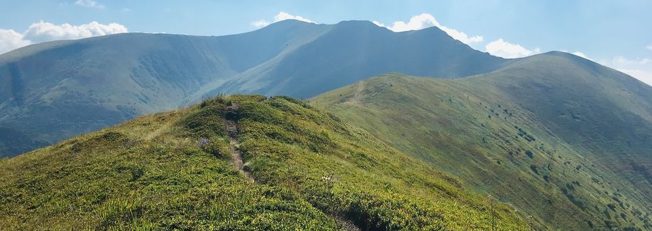
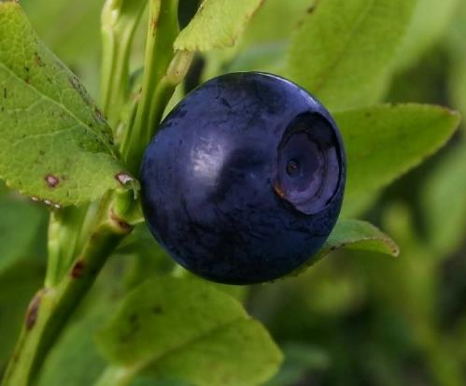
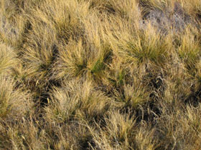
Emerald network site “Polonyna Borzhava”
F4.2 Dry heaths
(IN MOD for ALP-Car)
Photo: Ishtvan Tsap
almost completely covered with habitats from Resolution 4, mostly F4.2 Dry heaths and E1.71 Nardus stricta swards
12 habitats and 20 species are listed in SDF
NO MAPPING of habitats on the area of planned construction was carried out no studies on quantitative impact assessment
E1.71 Nardus
stricta swards
Notes:
Borzhava is a mountain range in the Carpathians, almost completely covered with habitats from Resolution 4. Most areas are covered with Dry heaths and Nardus stricta swards.
12 habitats and 20 species are listed in SDF. During the Environment Impact Assessment of the planned wind farm, NO MAPPING of habitats on the area of planned activity was carried out, so the impact on habitats from construction activity has not been assessed. There have been no studies on quantitative impact assessment.

Slide 3
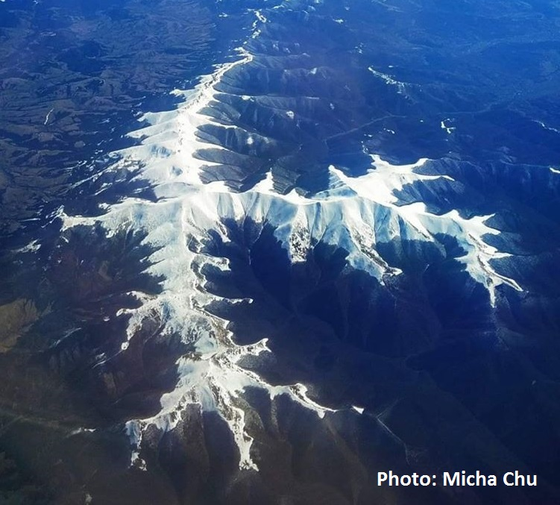
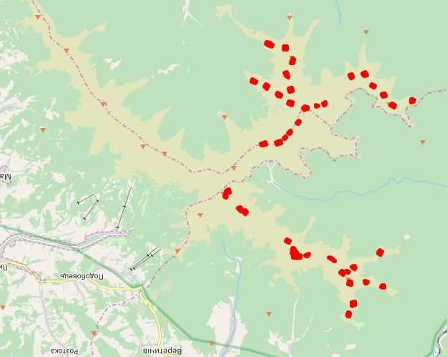
Emerald site “Polonina Borzhawa”: bird's-eye view and map showing planned 34 windmills 180 meters height (red dots)
Windmills = 30 ha
Roads and cables = 20 ha
TOTAL = 50 ha
NO EIA on 20 ha!
Notes:
On the map you can see Red dots, which shows planned thirty four 34 windmills of one hundred and eithy 180 meters height.
I was on Borzhava Emerald site three times and I can confirm that almost all of its territory is occupied by habitats, including areas designated for the construction of windmills, roads and cables.
When I first learned about this project, I thought only about the impact of windmills on the visual perception of mountains and on birds, but after studying the case in more detail, I realized that a very large-scale destruction of landscape and habitats will happen.
The TOTAL area of the planned activity is fifty 50 hectares. The area allocated for windmills, substations and distribution points is thirty 30 hectares. And the EIA was performed ONLY for those 30 hectars – separate land plots. On remaining 20 hectares, where the laying roads and cable lines is planned the ENVIRONMENTAL IMPACT ASSESSTMENT WAS NOT CARRIED OUT AT ALL.

Slide 4
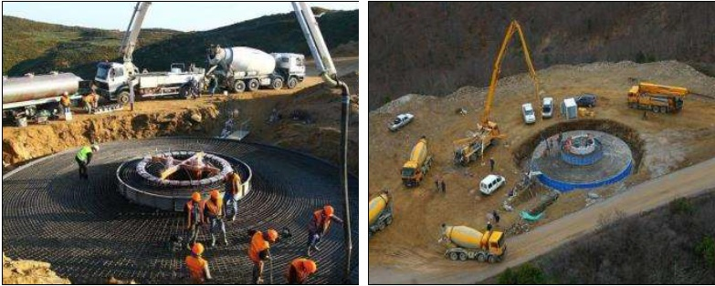
Such big windmills require building of massive foundations: illustrative photos from the EIA report
Dimensions of construction sites for each windmill is 50 x 60 m
Notes:
Such big windmills require building of massive foundations. Obviously such construction involves the excavation of significant amounts of soil and underlying rock. This soil later can be washed down the slope by rains.
Areas covered by habitats that will be destroyed both directly as a result of construction and indirectly - due to their backfilling, erosion, etc., have not been assessed in the report on EIA.

Slide 5
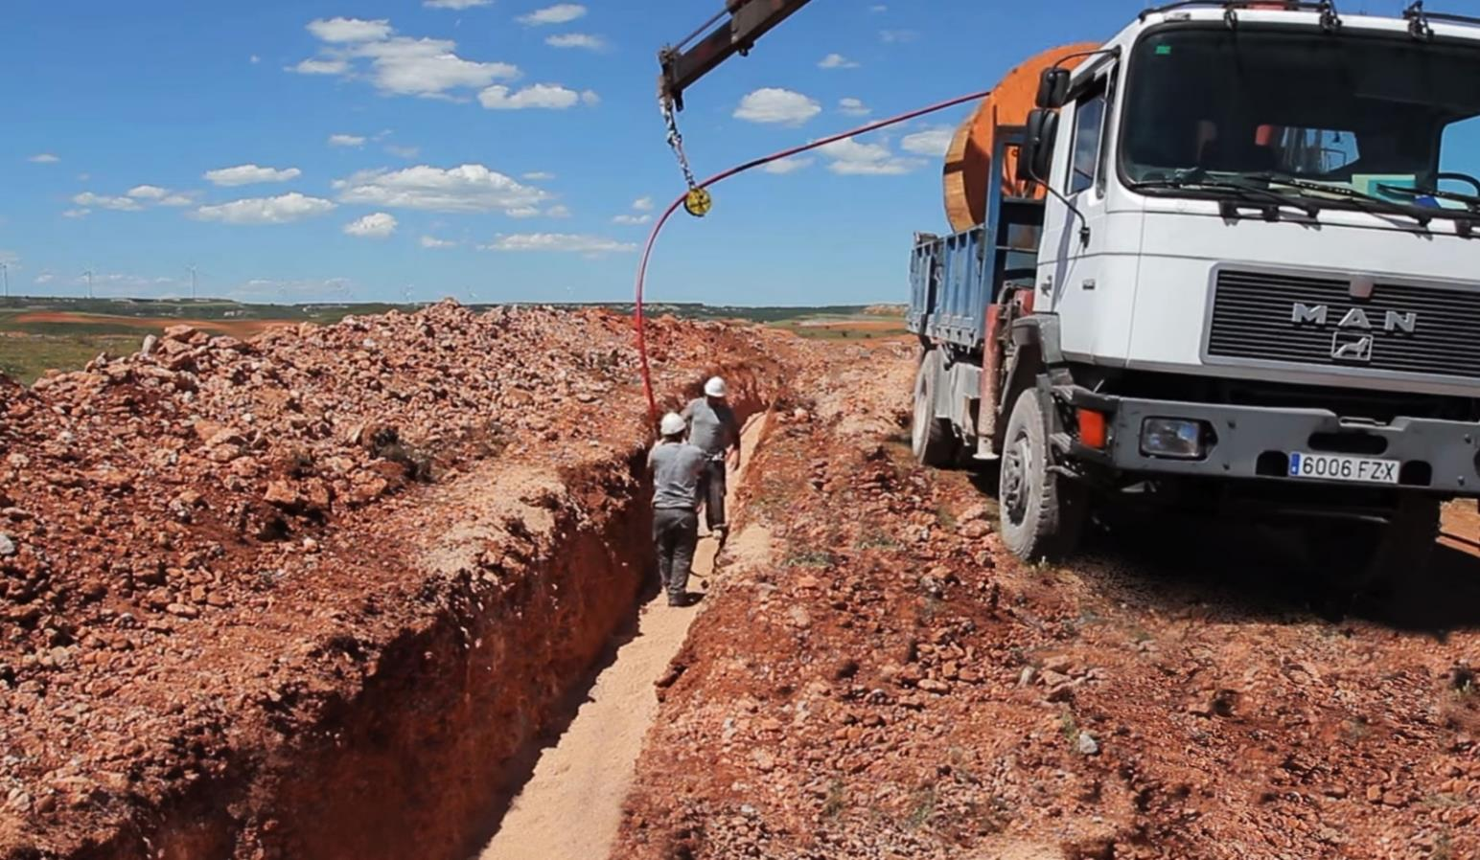
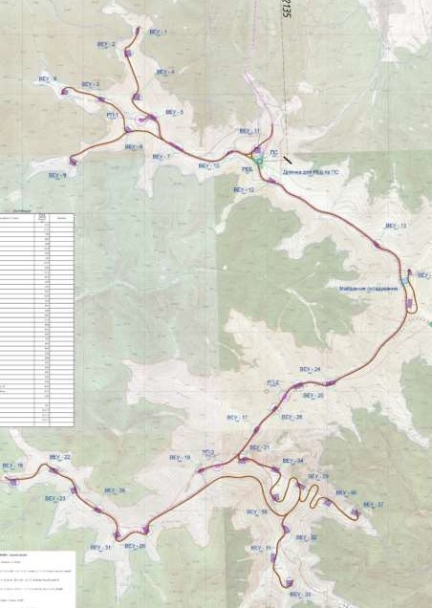
Laing of underground cable transmission lines by trench method (illustrative photo) and planned roads to connect all windmills
Trenches depth = 1,8 m
Trenches width = 2 m
Roads width = 4 m
Length = 20 km
Notes:
In the EIA report, the developer did not provide information on the exact location of trenches and roads, nor on the impact of these works on the habitats and species listed in SDF.
The total length of the roads and cable lines are estimated as about 20 km.

Slide 6
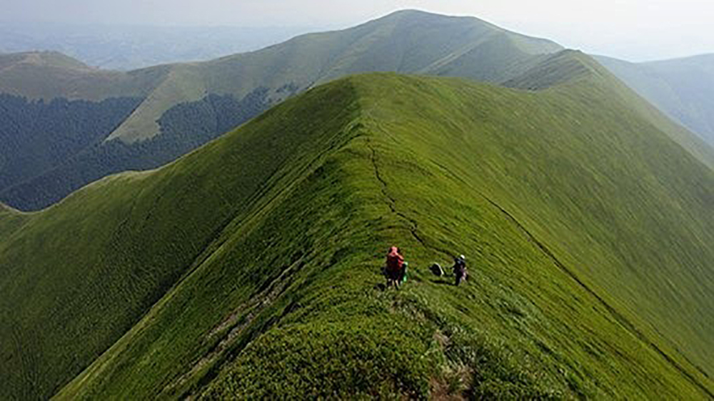
Steep slopes of Borzhava ridge
To make flat areas for construction of windmills, it is planned to cut up to 10 m of the mountain, which will lead to completely destroyed habitats in these areas.
Notes:
Because of steep slopes in some parts of Borzhava ridge, to make flat areas for construction of windmills, it is planned to cut up to 10 m of the mountain, which will lead to completely destroyed habitats in these areas.

Slide 7
An example of so-called “Appropriate assessment” performed as a part of the EIA report: one of the photos from EIA report – location where windmill №21 is planned to be built
No habitats here???
I see habitat “Dry heath”!!!
Notes:
On this photo from the EIA report the location of one of the planned construction sites is shown. The inscription under the picture says: «Protected species of flora/fauna and habitats of Bern convention are not detected». In the same time I clearly see habitat “Dry heath” on this picture.
As for the two species of plants listed in the SDF, the EIA report only states that one of them is found on the ridge tops. And it is along the ridge tops where the construction of wind farm infrastructure is planned – particularly roads and underground cable lines.

Slide 8
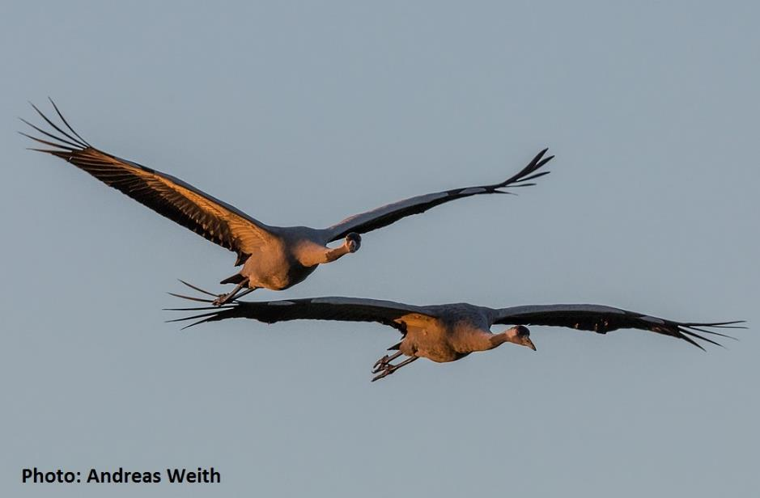
Migration of the common crane over Borzhava highlands
The data in the EIA report is not representative
The results in EIA report do not coincide with independent research
Common crane migration:
Report on EIA: 196 individuals
Independent ornithologists: more than 3000 individuals (autumn 2018, 55 days of observation)
Notes:
The study of impact on birds in the EIA report, has poor quality. The observations were made during very short period – only several days in each season. Thus, the data collected by ornithologists from Melitopol-town are insufficient for a qualitative assessment of the project's impact on birds. We believe that the data obtained in this way are not representative and can not serve as the basis for calculating of mortality collision of birds with windmills. This is confirmed by the data of independent ornithologists, who conducted their study in autumn, two thousand eighteen 2018. During 55 days, they observed a much larger number of birds.
In our opinion, the problem with the study of birds during EIA is, that the recommendations of the Berne Convention, in particular «Wind Farms and Birds» (two thousand thirteen 2013), were not applied. The Ministry has done nothing to communicate recommendations of Berne Convention regarding impact assessment of windfarms to regional departments, which issue conclusions on EIA.

Slide 9
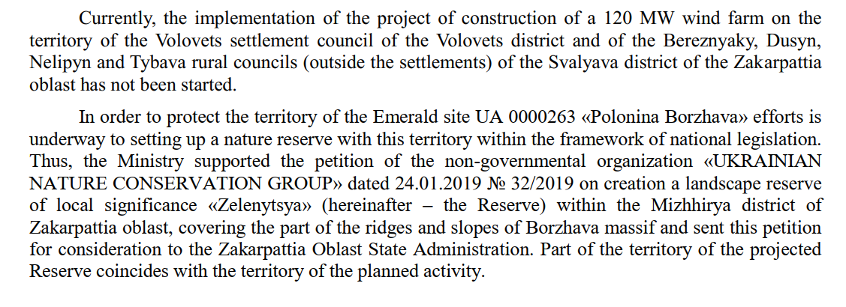
Quote from the last report of The Ministry of Ecology and Natural Resources of Ukraine
Notes:
In its latest rEport, the Ministry сайтс cites the report and conclusion on EIA. But they didn’t mention the comments from independent scientists. In that comments of scientists it is pointed out, and the information presented in the EIA report is incomplete and contradictory and partially false.
The only efforts to preserve Borzhava are described by the Ministry in two paragraphs presented on this slide. We can comment on this as follows: at present, the developer has received all the necessary permits. The only one thing that prevents the beginning of the construction is lawsuits initiated by the public.
The Ministry also mentions its support for creation of local protected area “Zelenytsia” and provides false information that the territory of this area partially covers the territory of the planned activity. Unfortunately, this protected area was not created and it is located outside the territory of the planned activity.

Slide 10
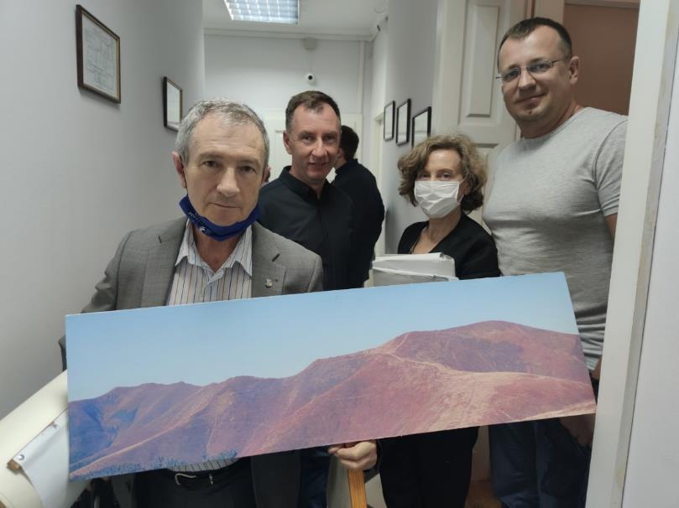

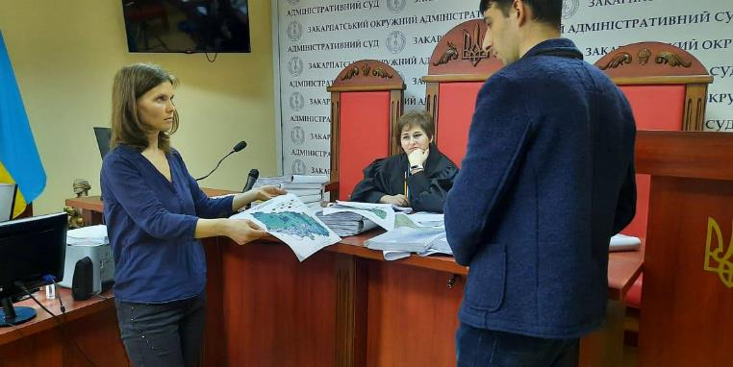
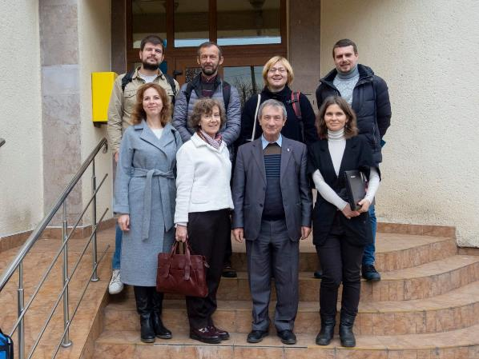
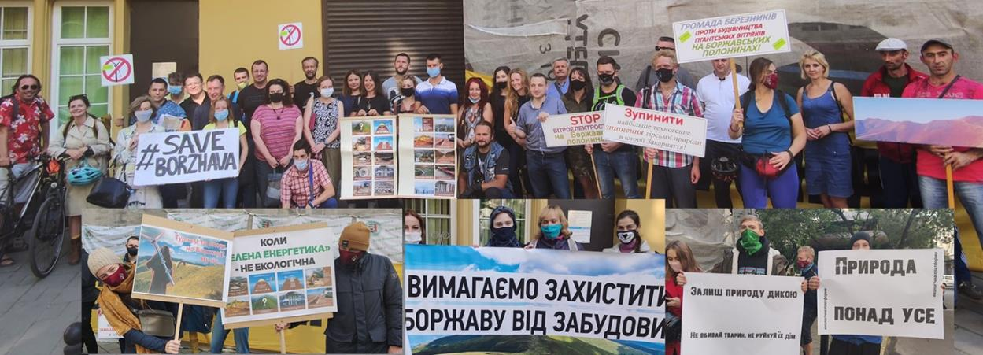
Protection of Borzhava in courts
Notes:
The Ministry of Ecology, initially neglected its responsibilities, and now its openly takes the developer's side and ignoring obvious facts of law violations during EIA process.
The public is defending Borzhava for 3 years without any support from governmental bodies, responsible for nature protection.
In March two thousand twenty 2020, the EIA Conclusion was cancelled in court. The court’s decision was based in particular on the fact that Borzhava is a valuable natural area.
But we lost in the Appellate court and now the EIA Conclusion is valid again. The Ministry of Ecology, did not provide support for us in court - in the first instance, they were on the developer's side, in the second instance they did not participate at all.
We are preparing cassation appeal to the Supreme Court & we continue to defend Borzhava.
The trial on cancelling the permit to build the first phase of the wind farm is ongoing.
Last week, the regional prosecutor's office filed a lawsuit in the interests of the state regarding the illegal change of purpose of land plots for wind farm. We hope that the Ministry will join this case and finally start the real protection of Borzhava.

Slide 11
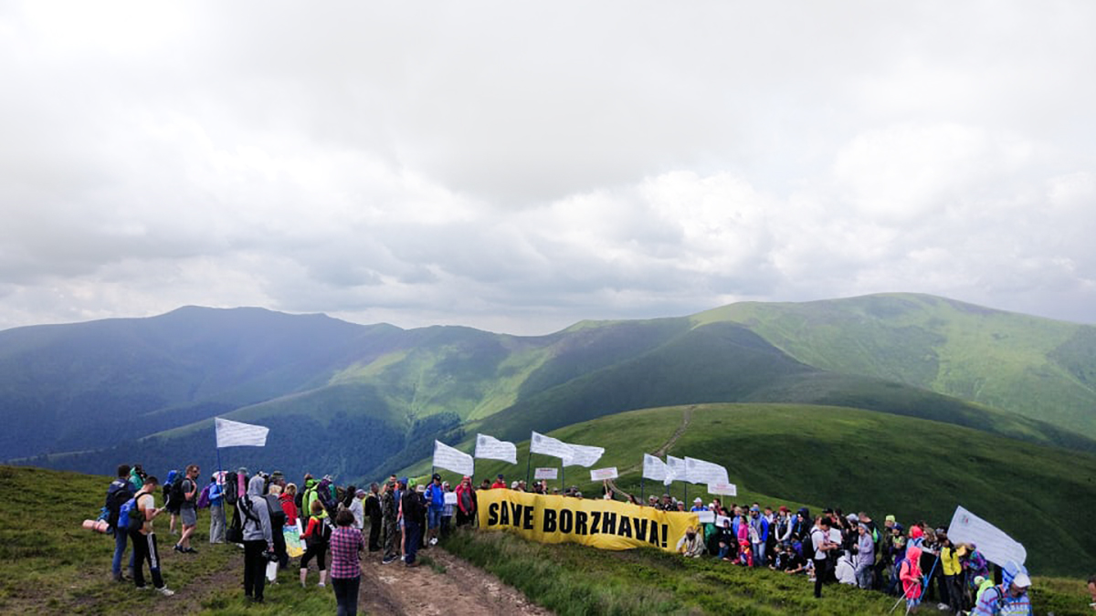
We are grateful to the Standing Committee for considering Borzhava's case and kindly ask for the following
to send the future official letters not to mr. KLID, but to the Minister directly
to continue the consideration of Borzhava issue and to change the case’s status
to “Open file”
to consider on-the-spot appraisal (maybe together with other cases from Ukraine)
to help us to look for funding of a project on mapping of habitats and species on this and other threatened Emerald network sites in Ukraine.
Notes:
The official responses of Convention to our complaints are valuable support for us in court cases together with the pressure which the society puts on the government. In the same time the Ministry of Ecology does not act efficiently to solve the problems of preservation of Emerald sites. This problem is partially concerned with the lack of coordination between the different departments within the Ministry, such as the department of econetwork, department of EIA and legal department. According to this we kindly ask you to send the future official letters not to the director of econetwork department, mr. KLID, but to the Minister directly. We believe that this will help to spread the information about the existing threats for the Emerald sites within all responsible officials and will promote more coordinated action to protect such areas.
We kindly ask the Standing Commity to continue the consideration of Borzhava issue and to change the case’s status to “Open file”. And also we ask you to consider on-the-spot appraisal (maybe together with other cases from Ukraine).
We’d also ask to help us to look for funding of a project on mapping of habitats and species on this and other threatened Emerald network sites in Ukraine.

Slide 12
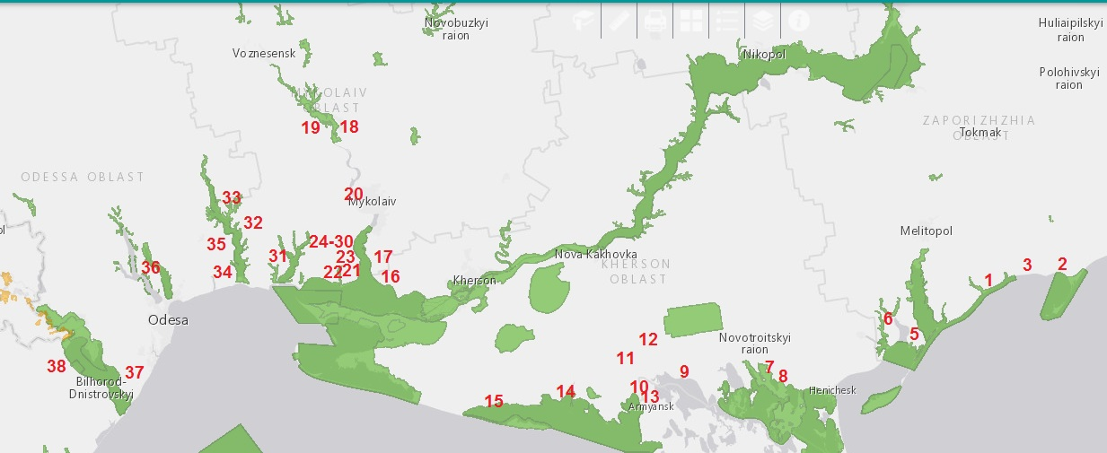
Recent years - a boom in wind energy projects, especially on the Black Sea coast
Green = Emerald sites, numbers - planned/under construction/already constructed windfarms
Notes:
Generally, I should note that In the recent years we observe a boom in the wind farms development in Ukraine, especially on the Black Sea coast where lots of Emerald and ramsar sites, IBA and migratory pathways for birds are located. This situation is very similar to the case «2004/2 - Bulgaria: Wind farms in Balchik and Kaliakra –Via Pontica», because many windfarms, which are planned/under construction/already constructed on the migrating route of birds located along the Black Sea coast in Ukraine. In Ukraine there is no control upon the process of wind energy development from the governmental bodies, responsible for nature protection. Possible negative impacts of wind power plants are not assessed properly, and there is also no adequate monitoring of how the already constructed power plants impact birds and bats.

Slide 13
Other complains of UNCG regarding planned wind power plants in Ukraine

Slide 14
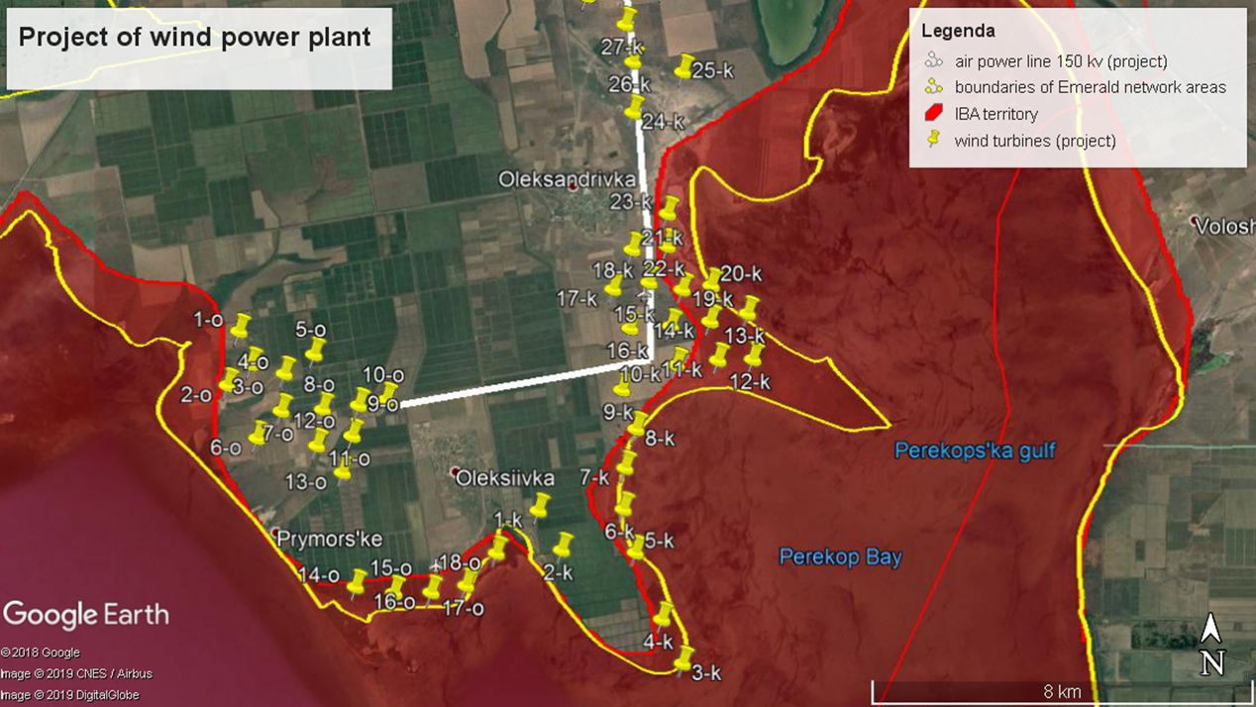
2019/2: Presumed threat to Emerald site Zatoky (UA0000214) from windfarm developments
Notes:
Planned Kalanchak windfarm is located on the border of Emerald site “Zatoky”, which covers bays of Black sea, in place where two migration routes of birds are crossed. This area is also a ramsar site and it is a key area for wintering of birds in Kherson region near Sivash lake.
Developer have a positive conclusion on EIA, but studies of the project's impact on birds were carried out in a very short time. Since time we had send our compliant on this case to the Bern convention, we have no new information about this project development.

Slide 15
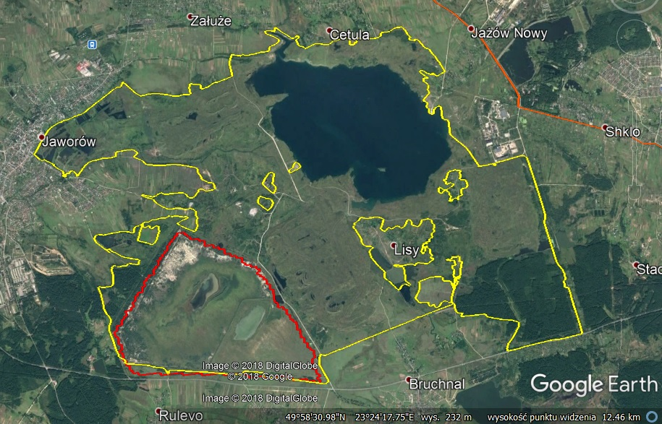
2019/3: Presumed threats to Emerald site “Cholhynskyi” (UA0000178) from windfarm developments
Yellow line = Emerald site
Red line =
IBA and local protected area for birds
White line = planned windfarm
WPP
Notes:
The area of Emerald site “Cholhynskyi” is covered by artificial wetlands, which have been gradually drying up in the last few years due to lack of rain and high temperatures.
According to ornithologists, this reduces the number of birds that stop here during migration.
Developer of windfarm get positive Conclusion on EIA.
We are thankful to the Ministry of ecology, which has moderated discussion of this case between the public and developer. As a result, at the expense of the developer there were conducted additional research on habitats distribution on the planned construction sites, but we insisted on new EIA prosidure.
A month ago new EIA was started for this windfarm, because developer want to decrease the quantity of windmills but to increase their power. Due to that we think that additional research on bats and birds needed. We also afraid that this project, if will be allowed, will entail the construction of additional wind farms, solar power plants and power lines in this and other Emerald sites.
Our position is that other place should be found for building of windfarm outside Emerald network area.

Slide 16
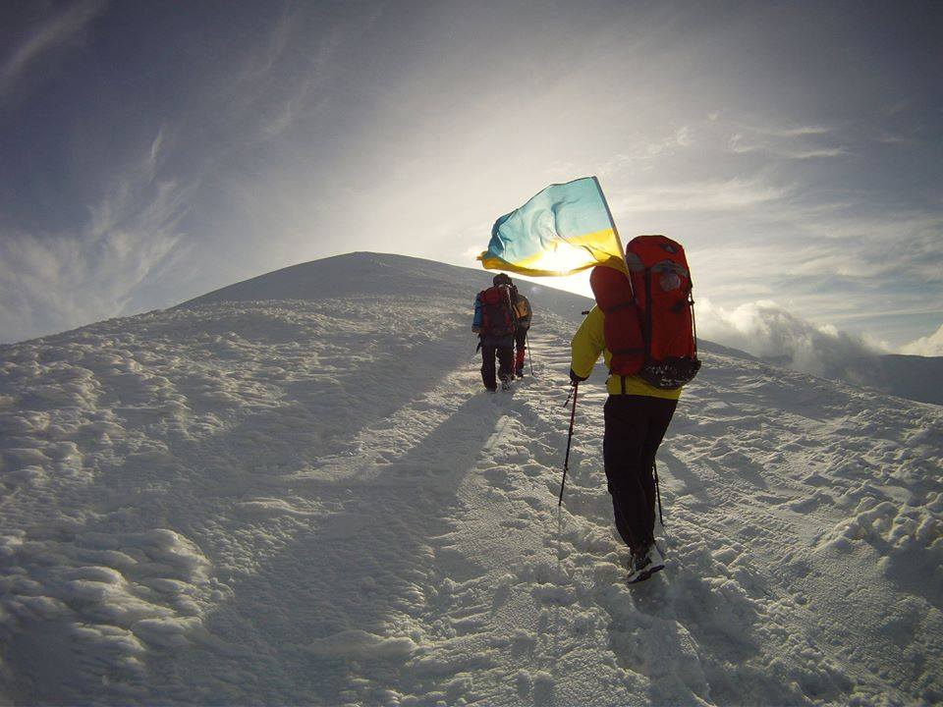


Thank you!
Thank you for attention!
Kateryna Borysenko, ecologist
Ukrainian Nature Conservation Group
kborysenko18@gmail.com
Photo: Denis Fortushnyi

