Slide 1
Energy development projects and the Emerald Network of Ukraine
Problem overview
Kateryna Borysenko, ecologist
Ukrainian Nature Conservation Group
kborysenko18@gmail.com

Slide 2
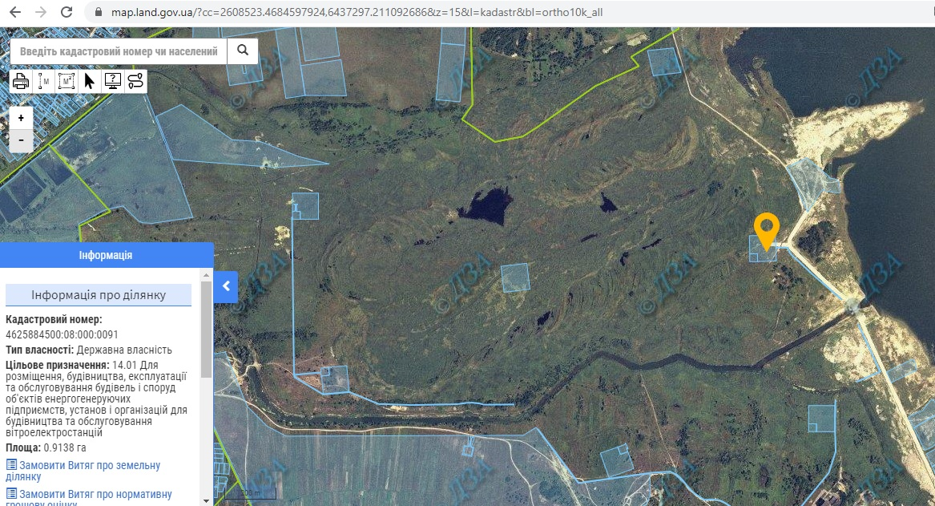
1. Location of energy development projects – priority to state-owned lands, not private agricultural lands.
Red squares = State-owned land plots where windmills are planned in Emerald Network site
Notes:
Speaking about the energy development in Ukraine – wind or solar power plants, power lines etc. – the top-priority locations for such projects are usually state-owned lands. Often within the forests, high-conservation value protected areas or Emerald Network sites. State-owned lands are prioritized over private lands because investors don't want to sign numerous land lease agreements as private lands are distributed among numerous owners. As a result, local communities appear to have a destroyed nature and no financial profit.

Slide 3
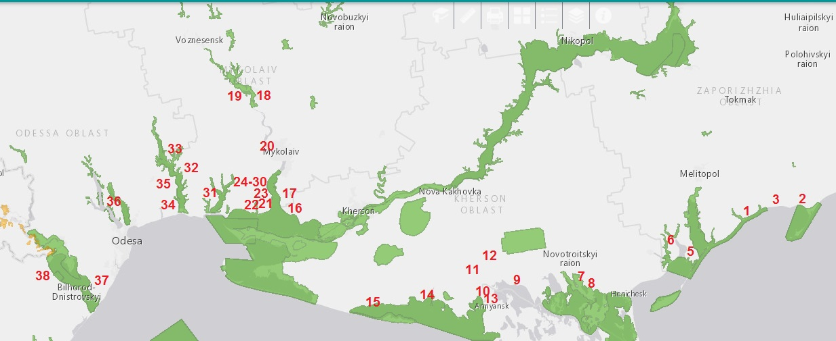
2. Recent years - a boom in wind energy projects, especially on the Black Sea coast
Notes:
In the recent years we observe a boom in the wind power plant development, especially on the Black Sea coast where lots of Emerald and ramsar sites, IBA and migratory pathways for birds are located. This is similar to the case «2004/2 - Bulgaria: Wind farms in Balchik and Kaliakra –Via Pontica», because many windfarms, which are planned/under construction/already constructed on the migrating route of birds located along the Black Sea coast in Ukraine. In Ukraine there is no control upon the process of wind energy development from the governmental bodies, responsible for nature protection. Possible negative impacts of wind power plants are not assessed properly, and there is also no adequate monitoring of how the already constructed power plants impact birds and bats.

Slide 4
3. Ornithologists on wind power plant service
Notes:
Ornithologists from Melitopol – a city in Ukraine – have prepared a few dozen environmental impact assessment reports on planned windfarms. All of them developed by the same people, all saying that the planned WPP will have low impact on birds and bats. At the same time, the field work to justify such position is definitely not enough – only a few fieldwork days for each WPP.
No one doubts that ornithologists from Melitopol are professionals, but we feel that they behave in a dishonest way, because wind power plants are the main source of their income. As a result, a conflict of interests appear. They provide justifications for any wind power plant because that is what they are paid for. If they provide any real data on how WPP impact birds – no one will pay them, because that will mean that not all WPP can be constructed in the places investors want. There is also lack of adequate data on how these planned and already acting WPP really impact birds and bats because other ornithologists do not have resources to conduct independent studies of such impacts.

Slide 5
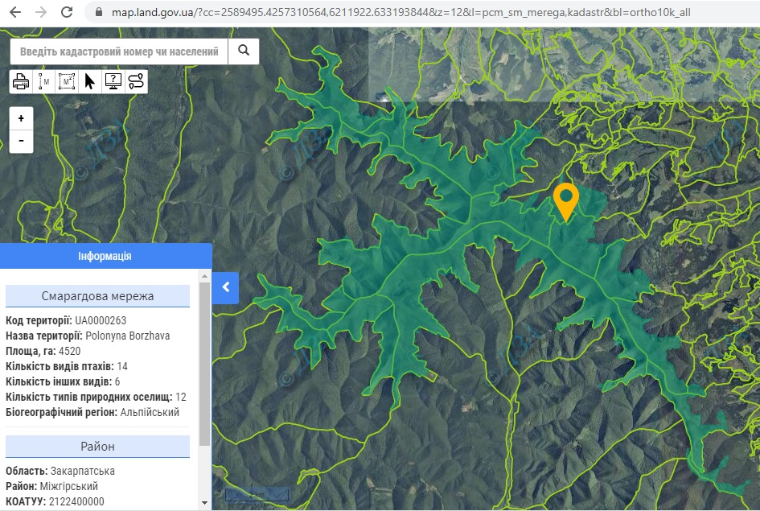
Good points – achievements ☺
The Emerald Network appeared on the official Public Cadastral Map of Ukraine
Notes:
The Emerald Network appeared on the official Public Cadastral Map – this is a big achievement. We believe that this was possible also because the Convention contacted with the Ministry of ecology having received our complaints.

Slide 6
What is good – achievements
2. Draft Law “On the Emerald Network of Ukraine” developed
3. Project developers start to recognize the Emerald Network as a thing to consider in the EIA (which was different in 2017 when EIA was introduced)

Slide 7
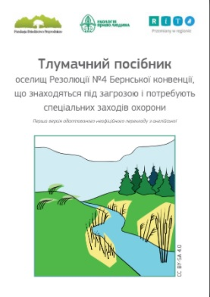
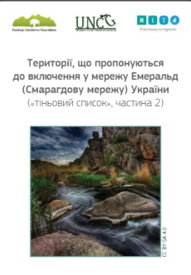
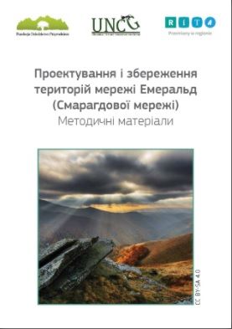
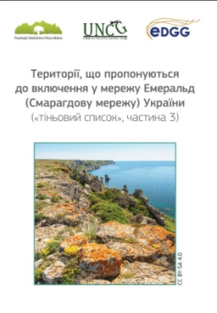
Our publications on the Emerald Network
Notes:
Ukrainian Nature Conservation Group together with other NGOs do a lot of ecoeducation connected with the Emerald Network and we are ready for collaborations in this field. For example, we can translate and distribute educational materials in collaboration with the Secretariat of the Convention.

Slide 8
Summary + request
The Minister of the Environment of Ukraine
Secretariat of the Bern Convention
Letters
Notes:
To sum up – the appeals to the Convention play a great role in protection of wild nature from unsustainable investments. The letters which the Convention develops after our complaints are a valuable support for us in court cases together with the pressure which the society puts on the government. We kindly ask you to message not some officials in the Ministry BUT the Minister of the Environment directly, whereas until recently, problems with the preservation of Emerald sites have not gained enough weight to make the Ministry act to solve these problems in a coordinated manner – because not only department of Econetwork of the Ministry should take actions, but also department on EIA and legal department.

