Slide 1
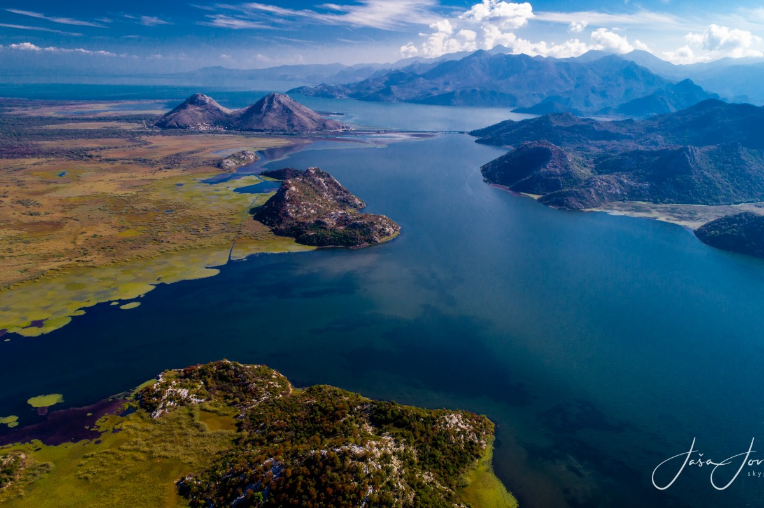
2016/4 - Montenegro: Development of a commercial project in Skadar Lake National Park and candidate Emerald site
Standing Committee 40th meeting Strasbourg, 30 November- 4 December 2020
CONVENTION ON THE CONSERVATION OF EUROPEAN WILDLIFE AND NATURAL HABITATS

Slide 3
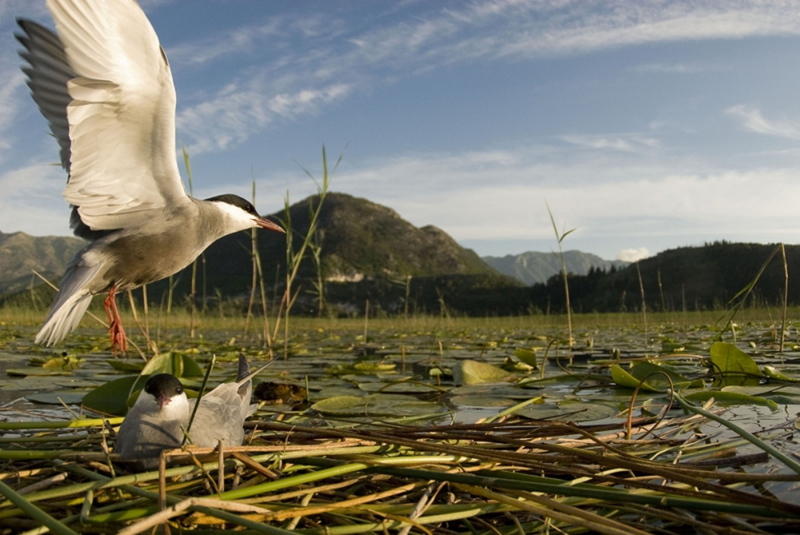

Slide 4
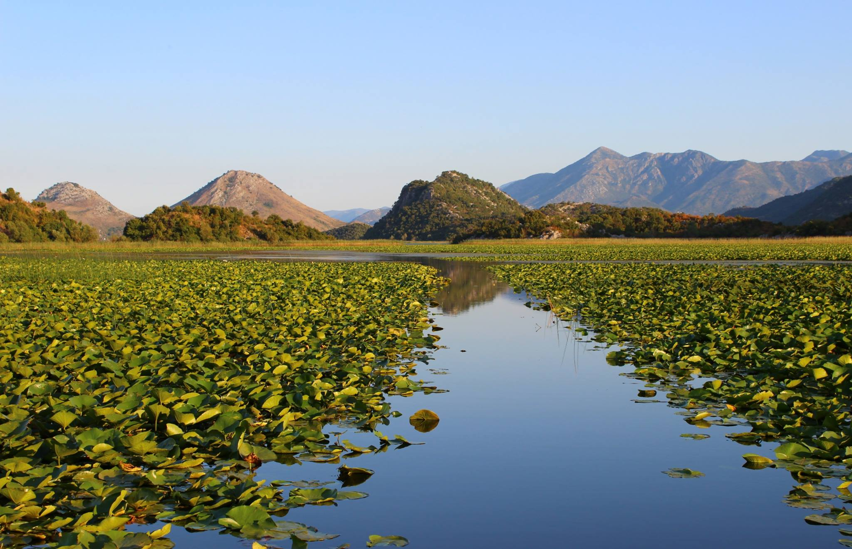

Slide 7
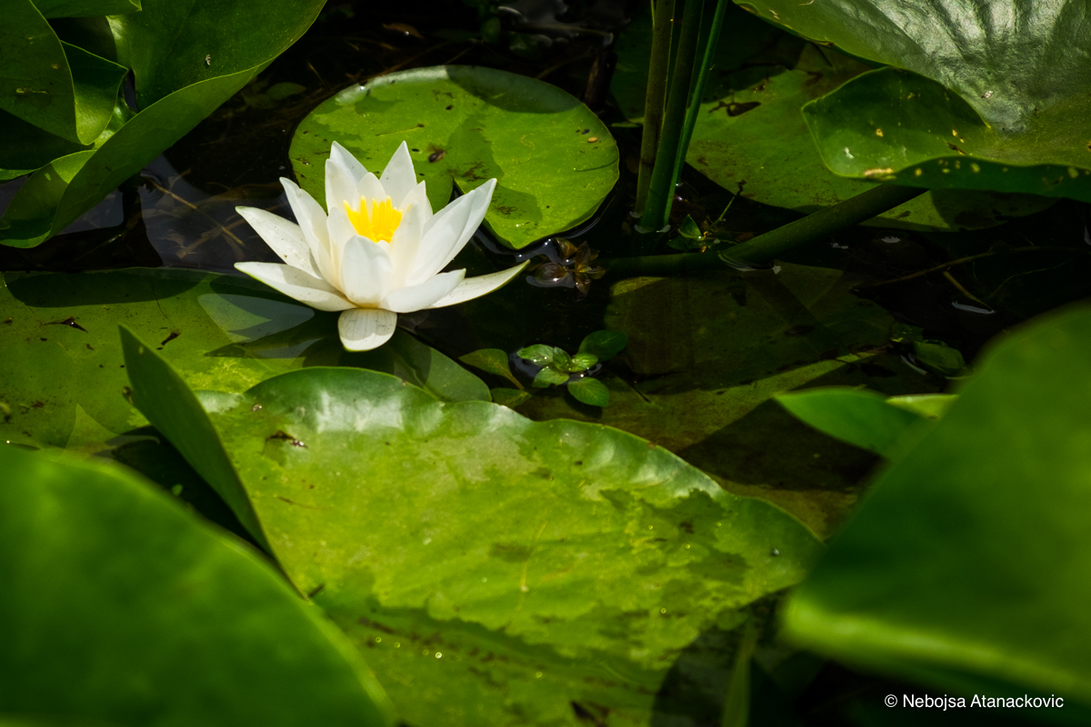

Slide 8
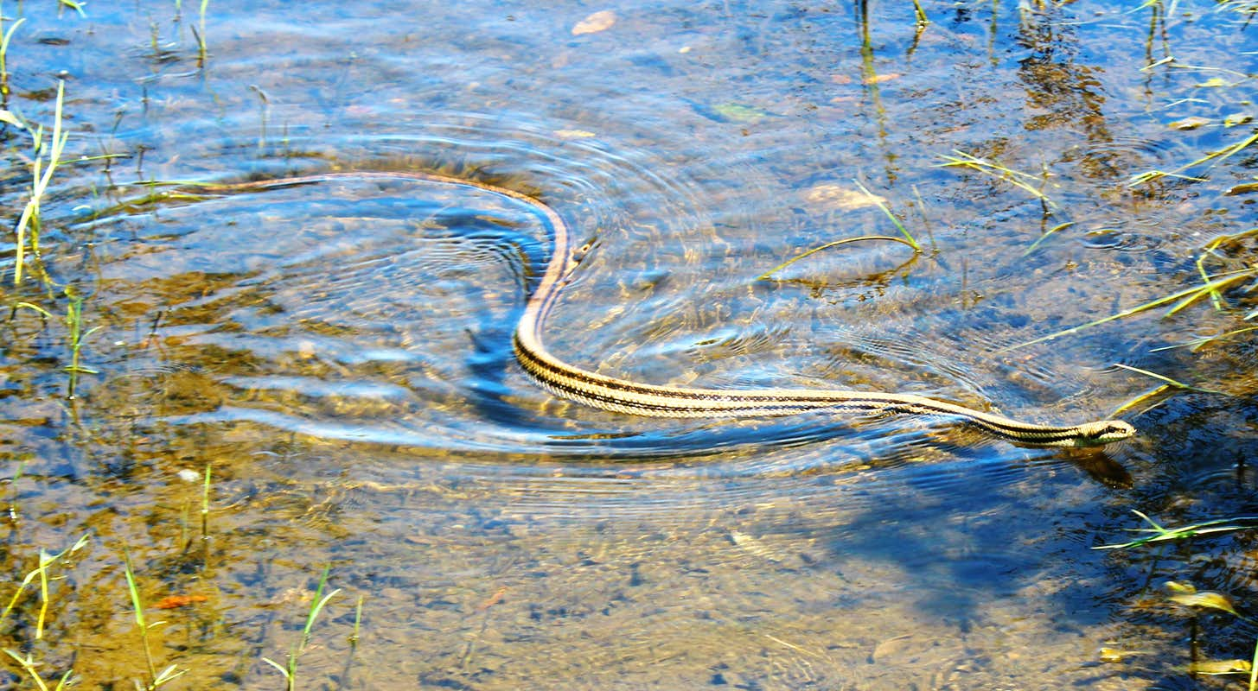

Slide 9
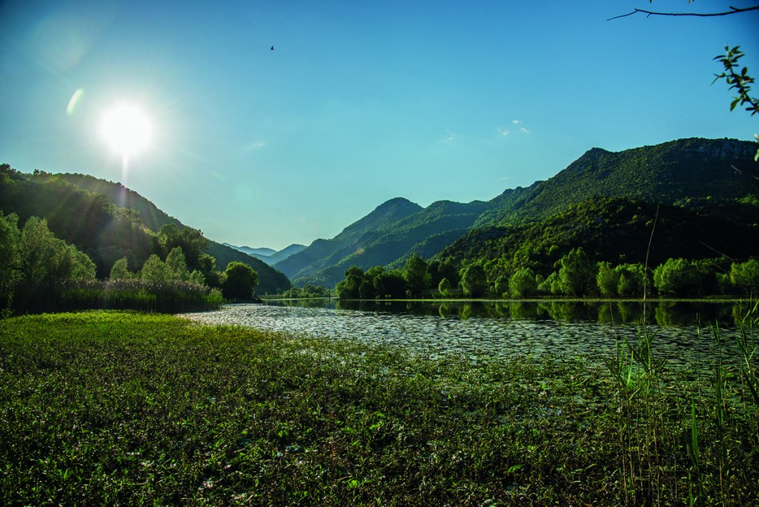

Slide 10
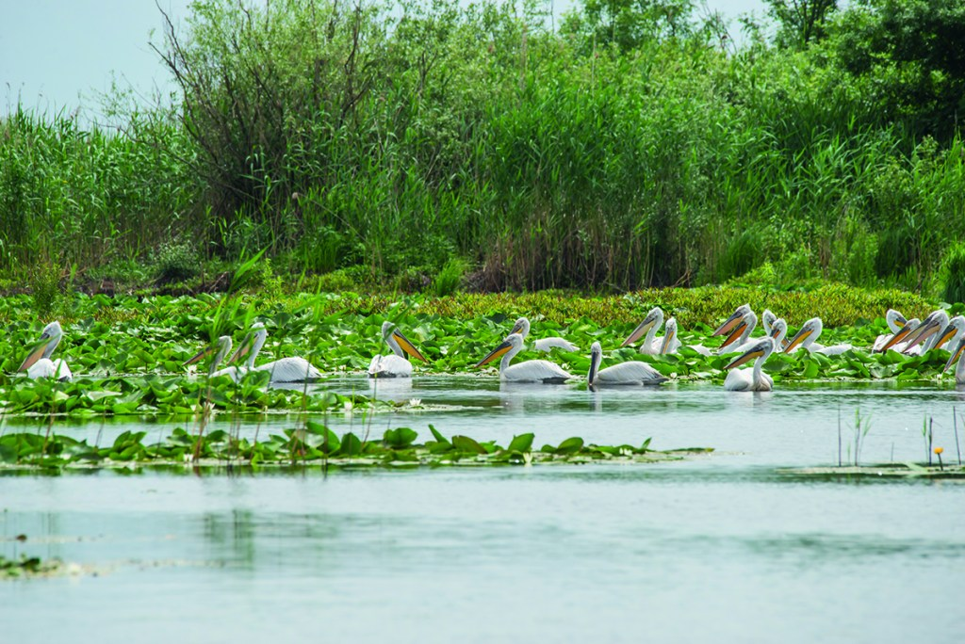

Slide 11
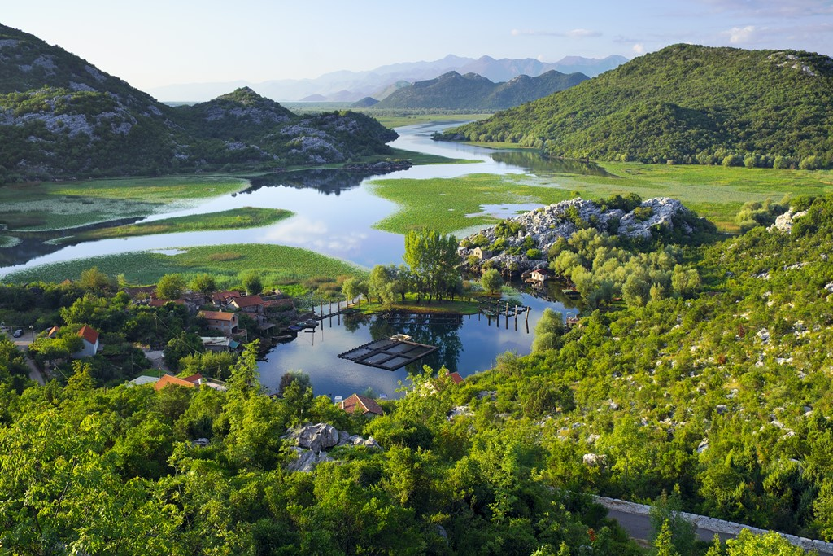

Slide 12
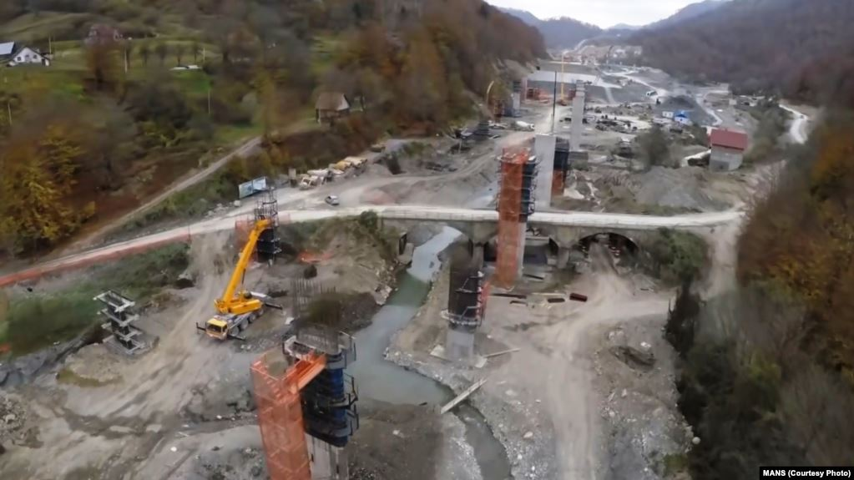
Tara River devastation, November 2018

Slide 13
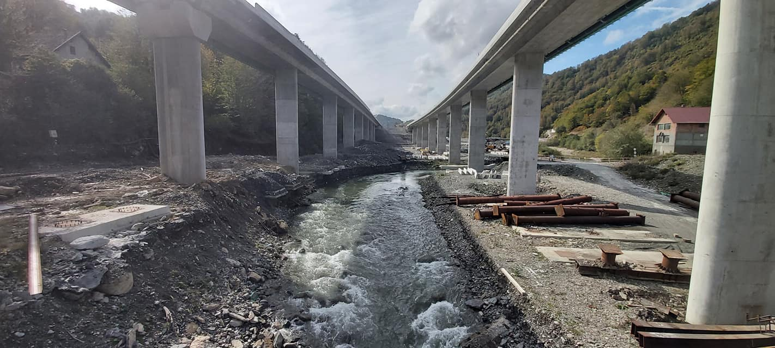
Tara River devastation, October 2020

Slide 14
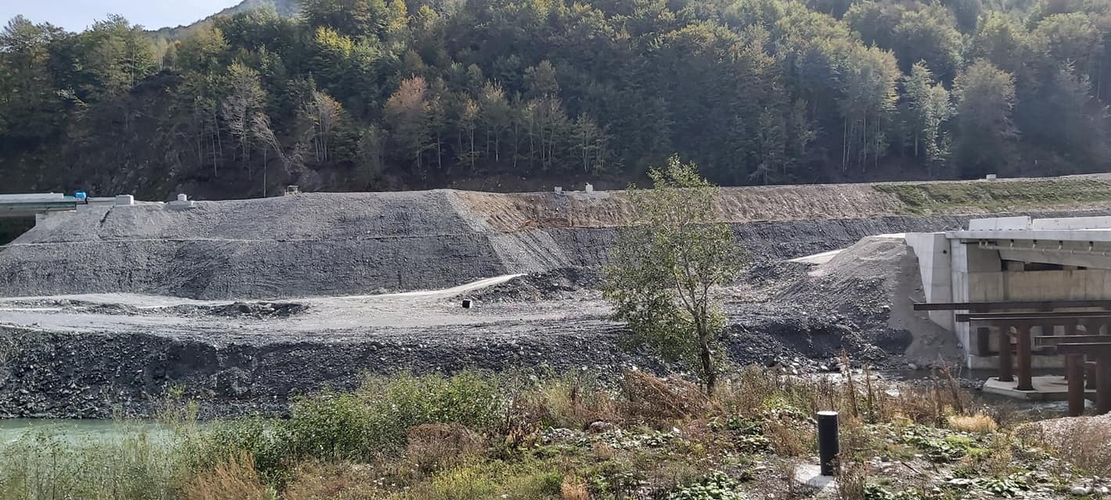
Tara River devastation, October 2020

Slide 15
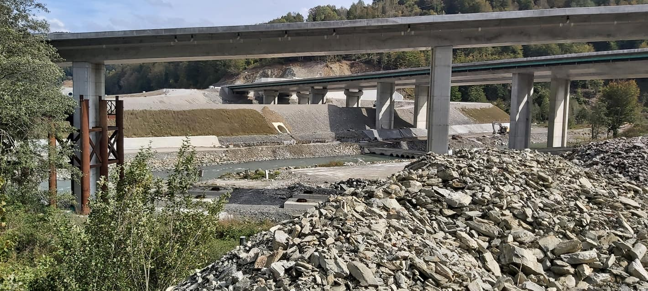
Tara River devastation, October 2020

Slide 16
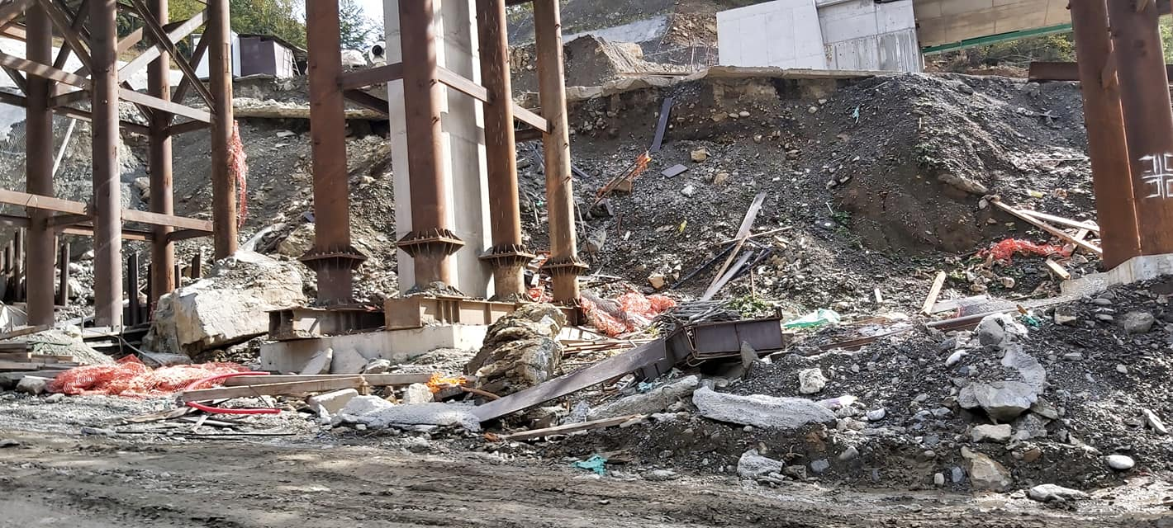
Tara River devastation, October 2020

Slide 17
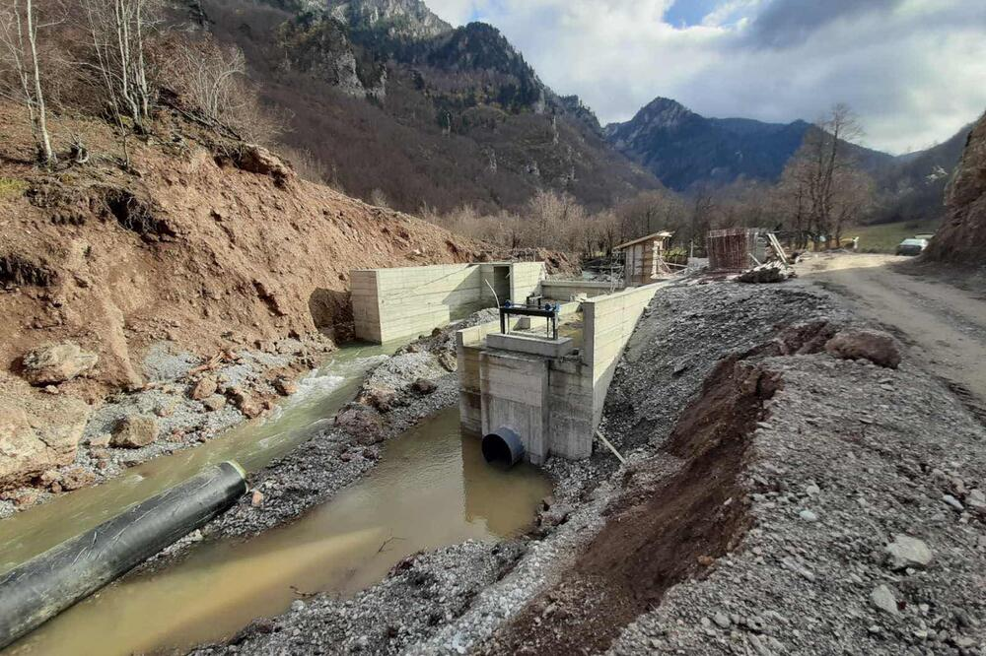
Kutska River devastation, October 2020

Slide 18
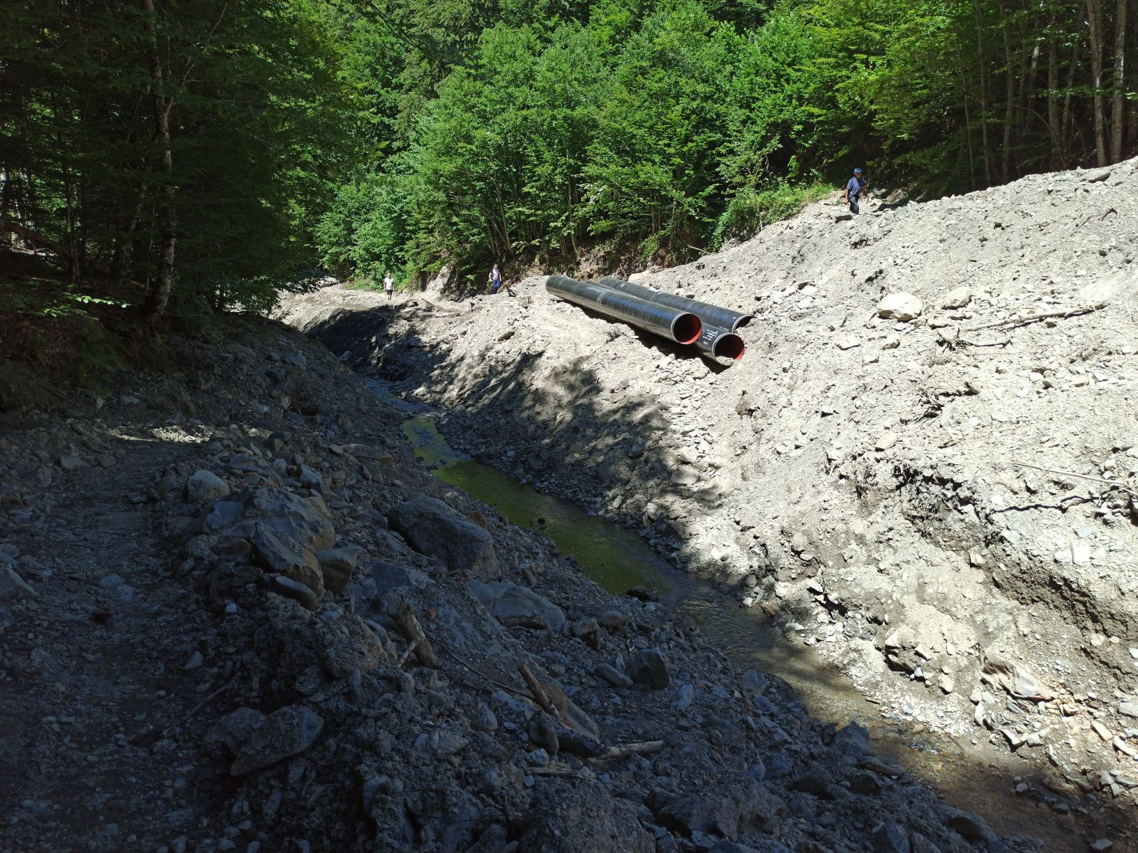
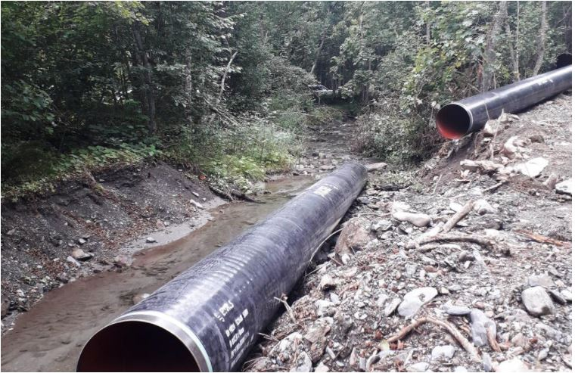
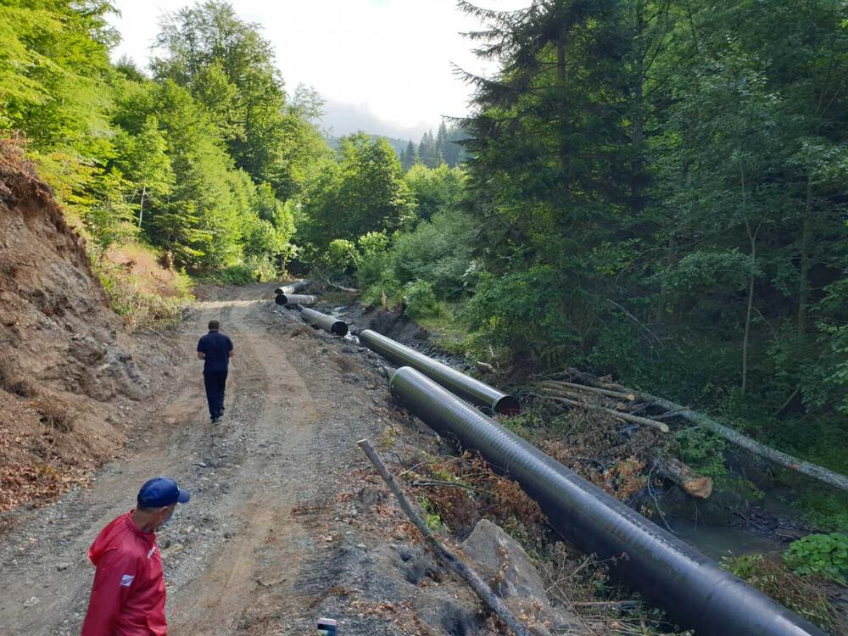
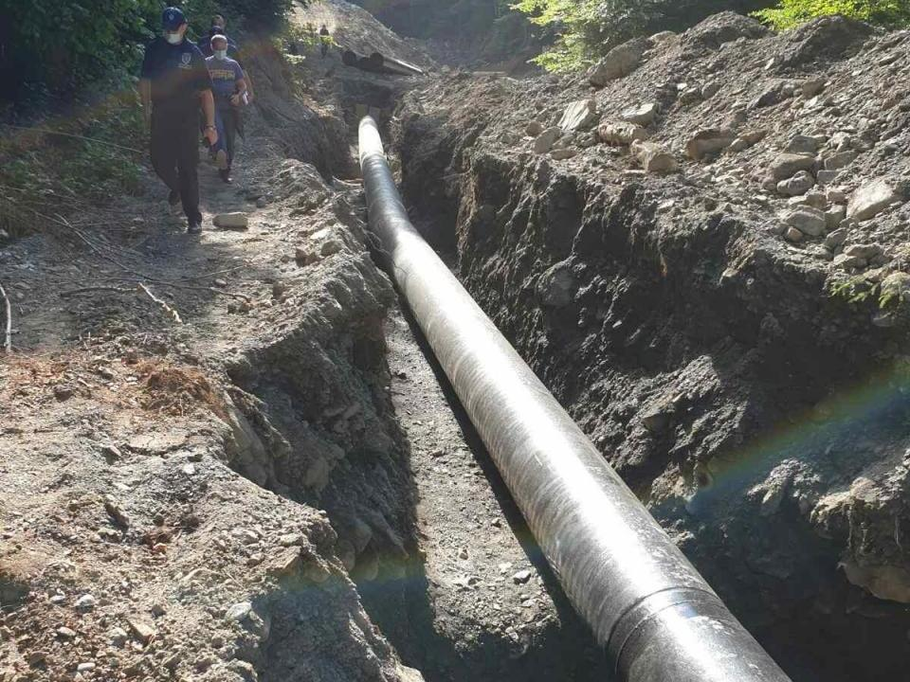
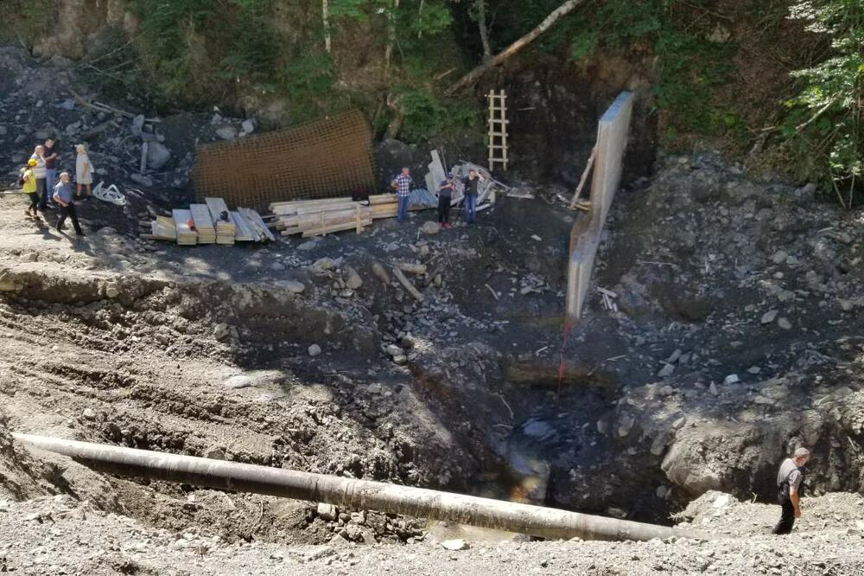
Cestogaz River devastation, October 2020

Slide 19
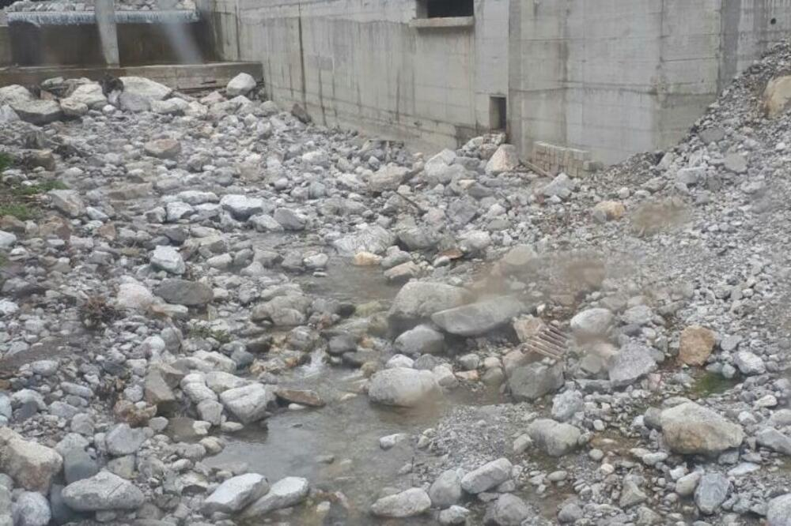
Mojanska River downstream, May 2020

Slide 20
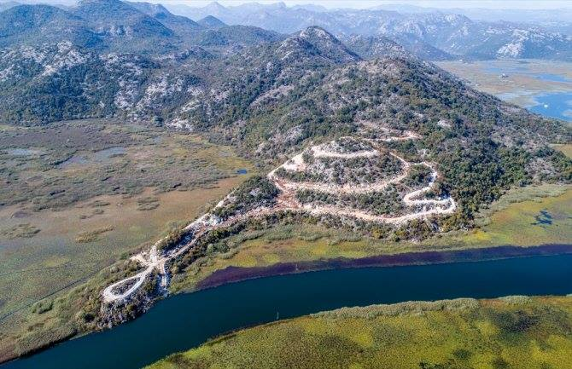
No meaningfull progress on implementation 201 Recomendations while worseing nature conservation status in 2020

Slide 21
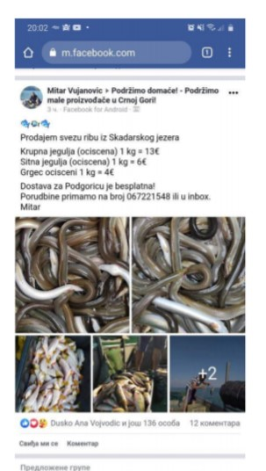
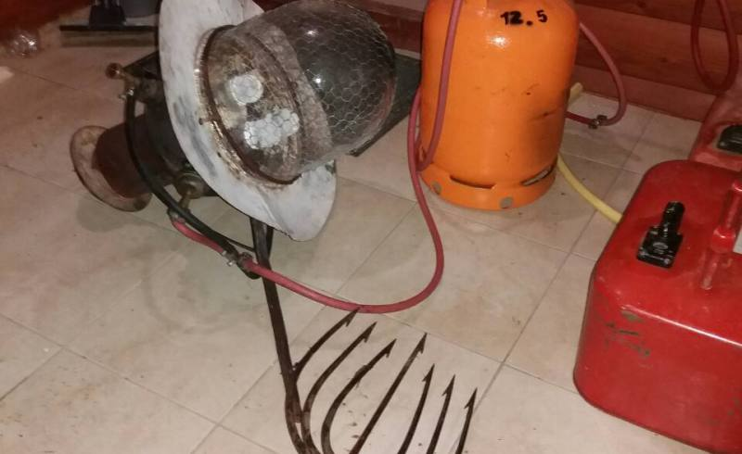
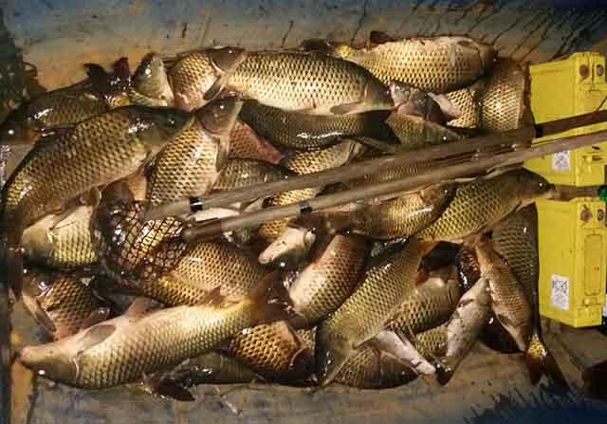
Illegal electro fishing of carp, bleak and eel, January – November 2020
NO MEANINGFUL PROGRESS
21

Slide 22
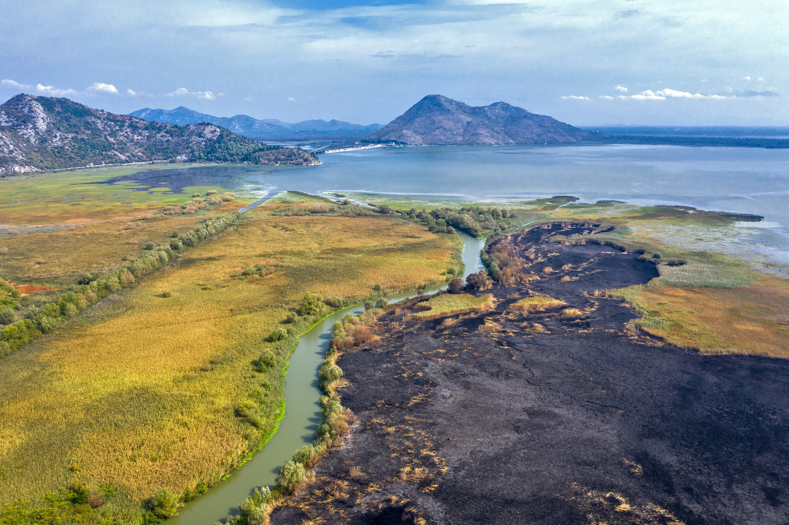
Disastrous fire at Skadar Lake, September 2020

Slide 23
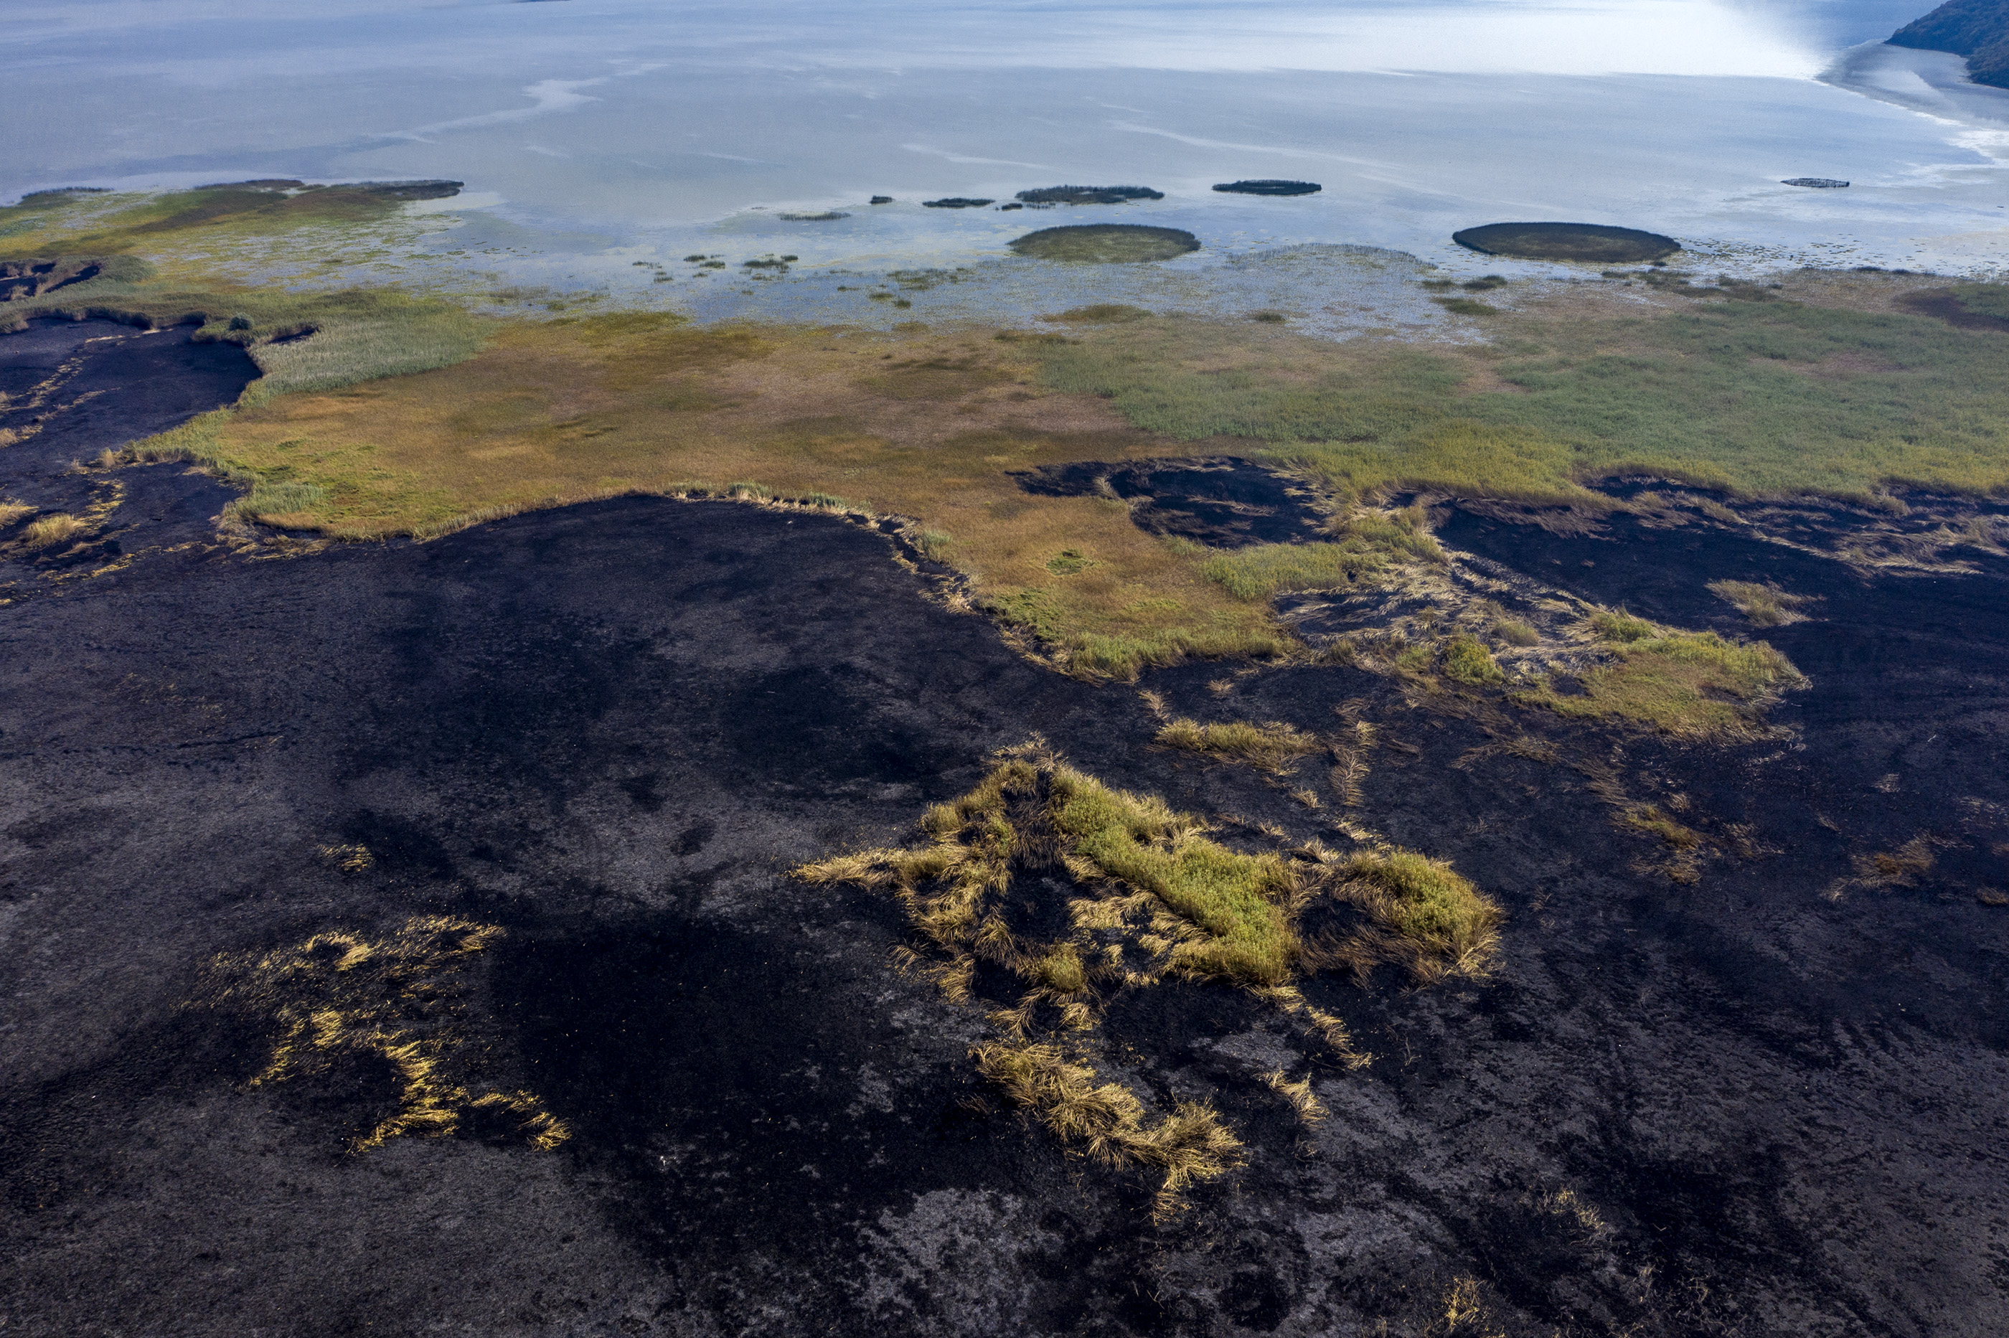
Disastrous fire at Skadar Lake, September 2020

Slide 24
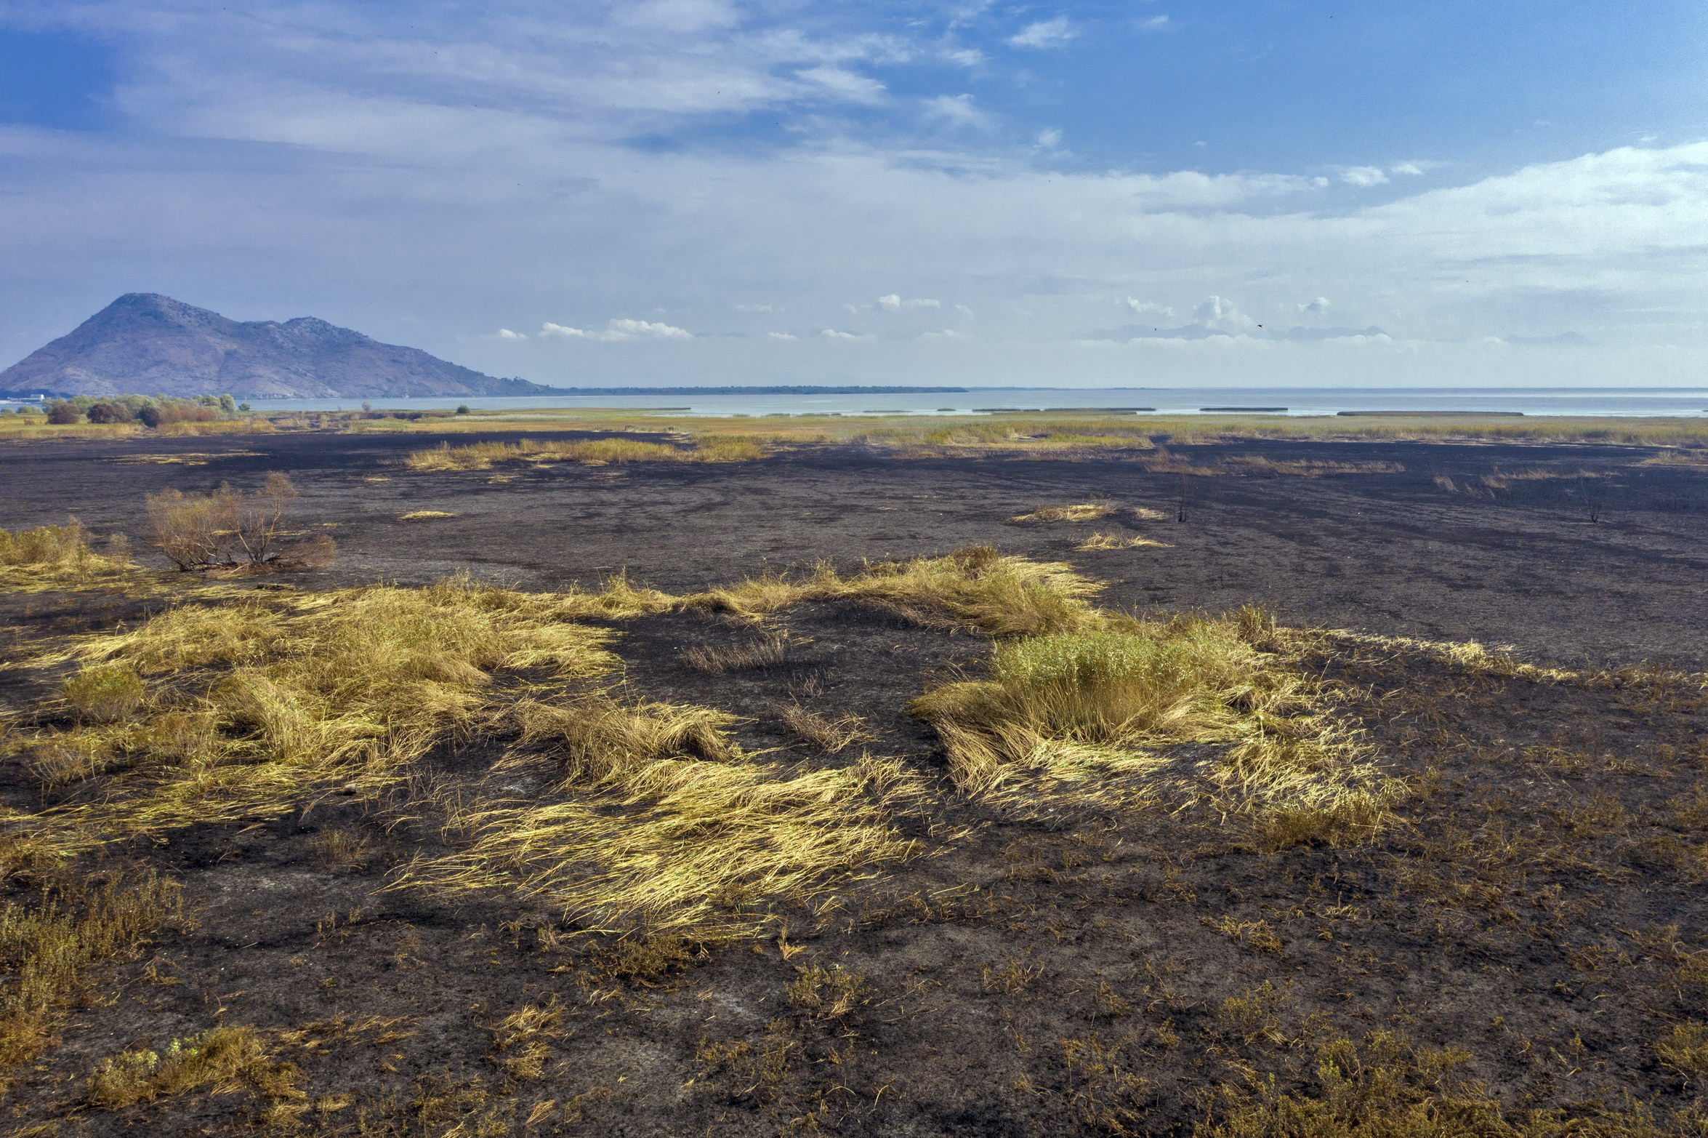
Disastrous fire at Skadar Lake, September 2020

Slide 25
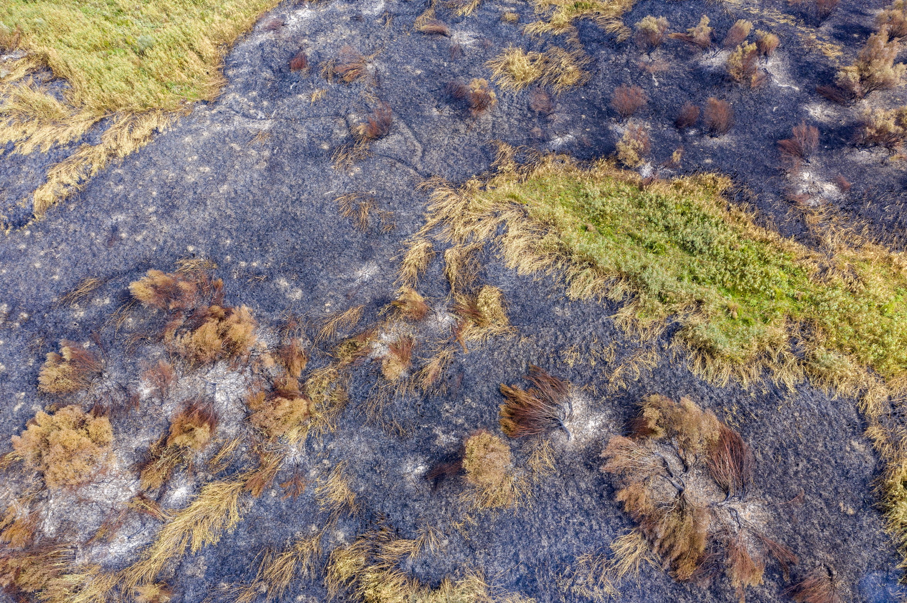
Disastrous fire at Skadar Lake, September 2020

Slide 26
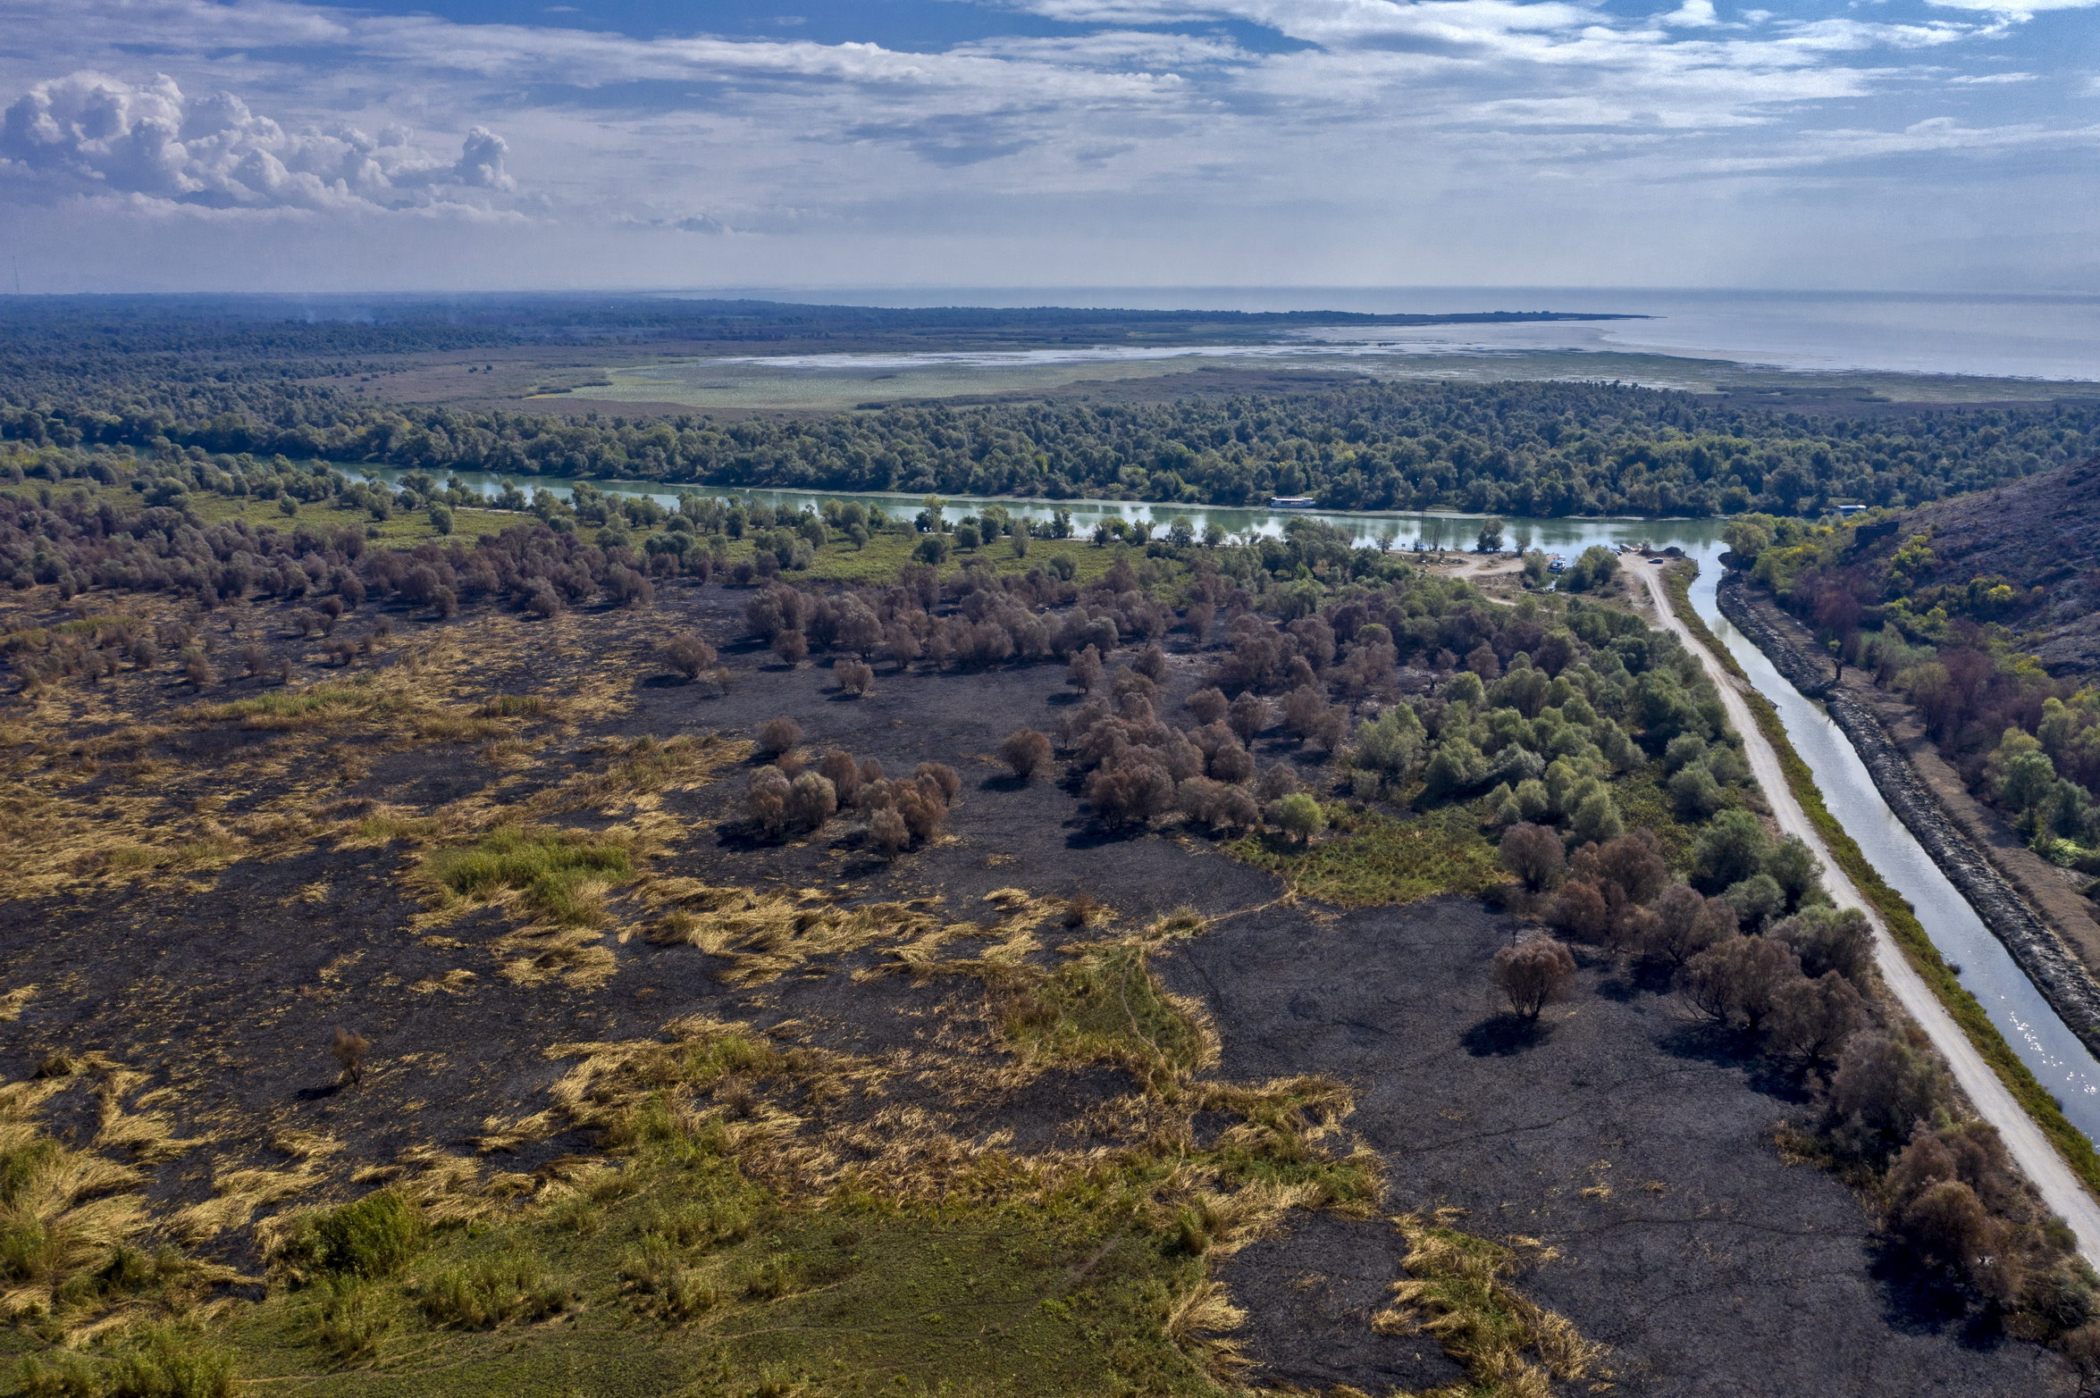
Disastrous fire at Skadar Lake, September 2020

Slide 27
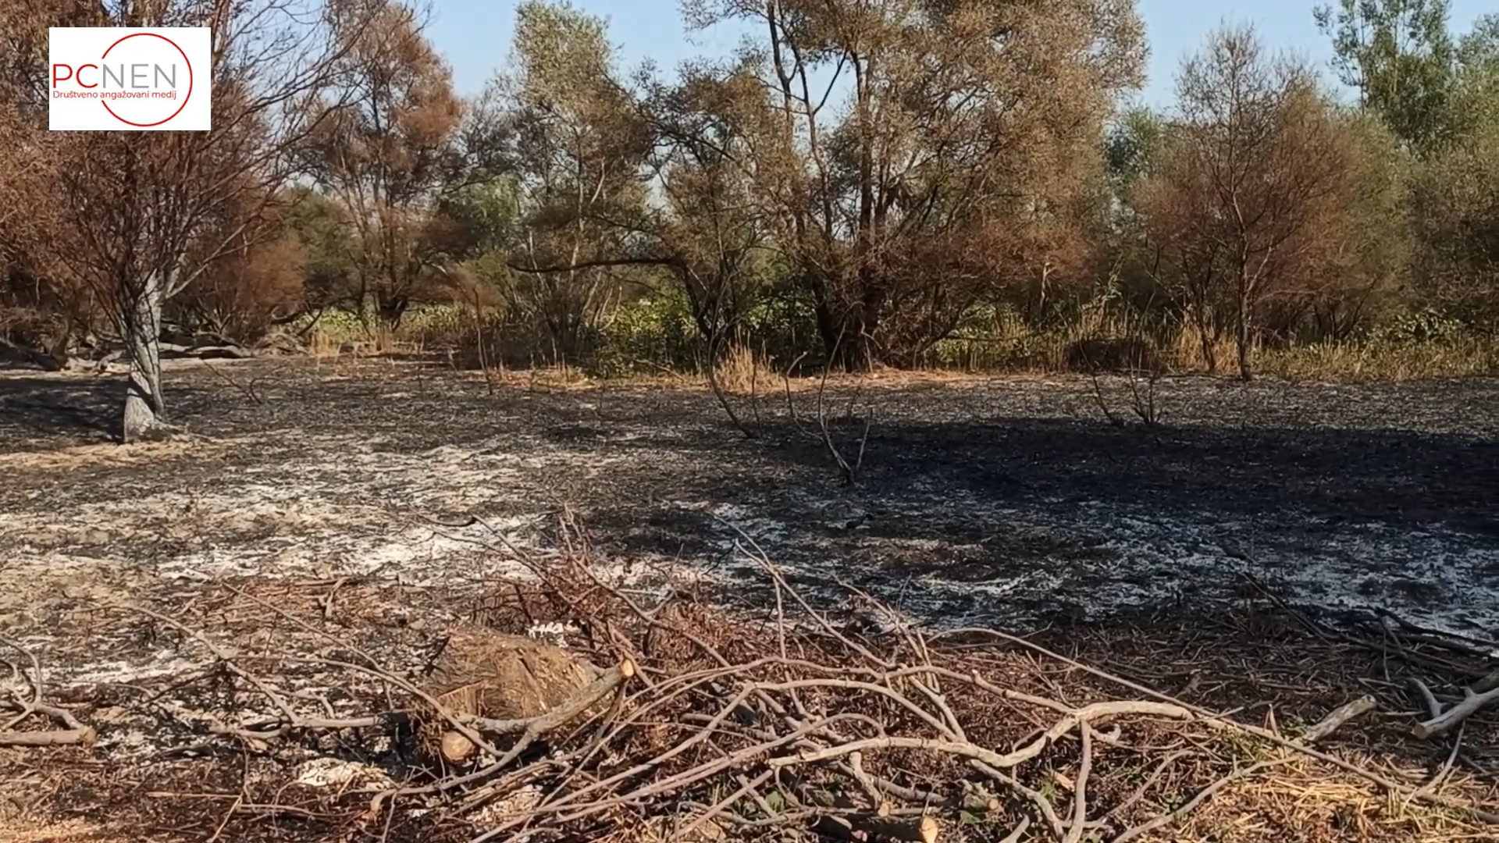
Disastrous fire at Skadar Lake, September 2020

Slide 28
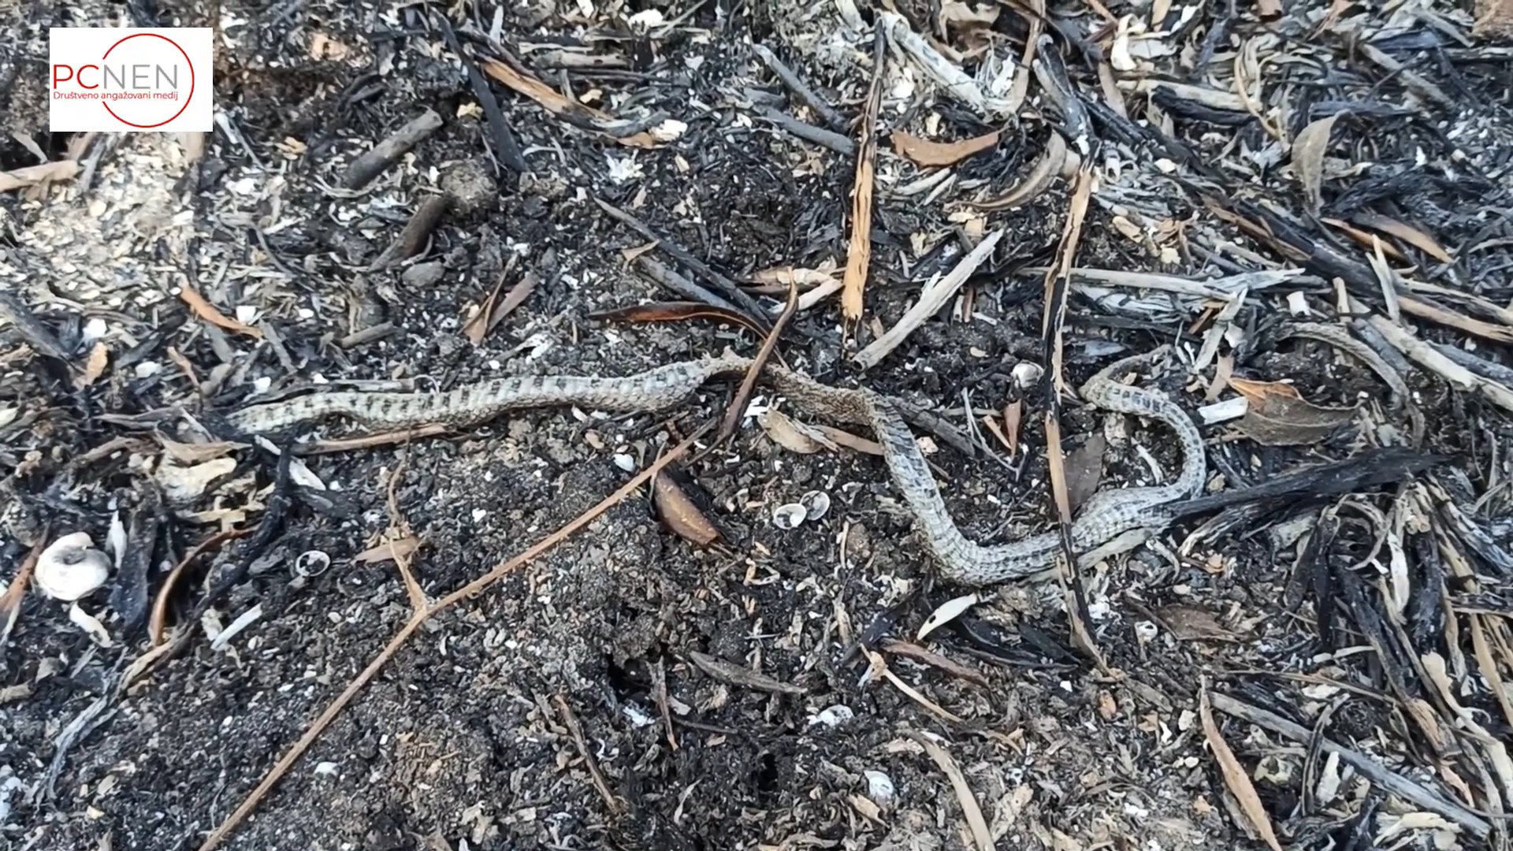
Disastrous fire at Skadar Lake, September 2020

Slide 29
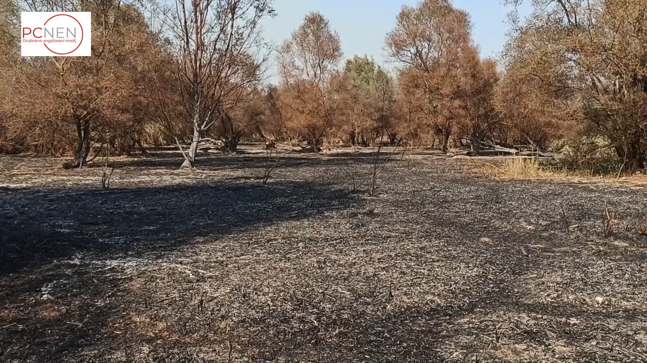
Disastrous fire at Skadar Lake, September 2020

Slide 30
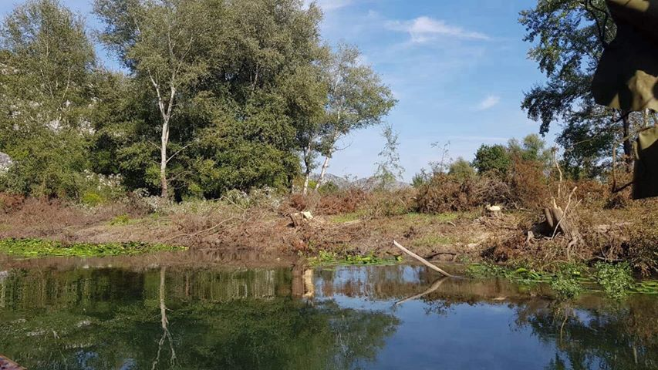
Illegal forest cut, September 2019

Slide 31
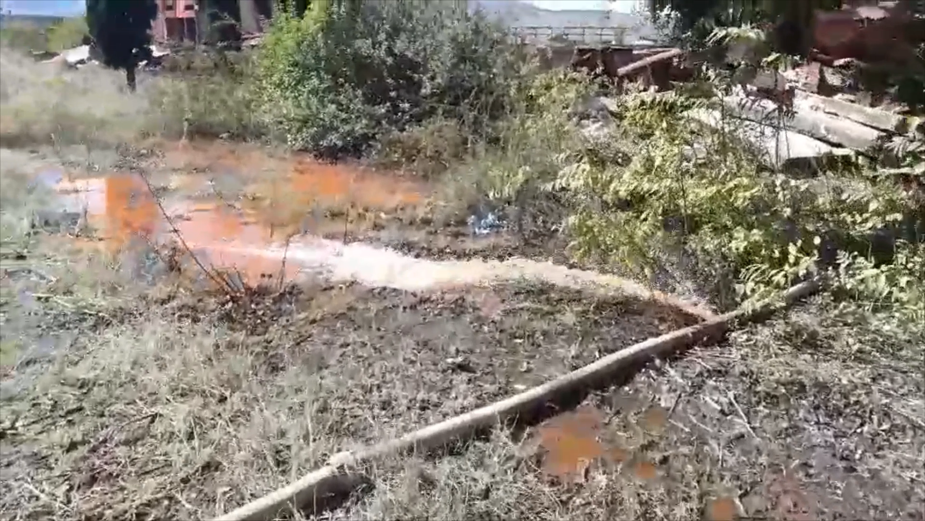
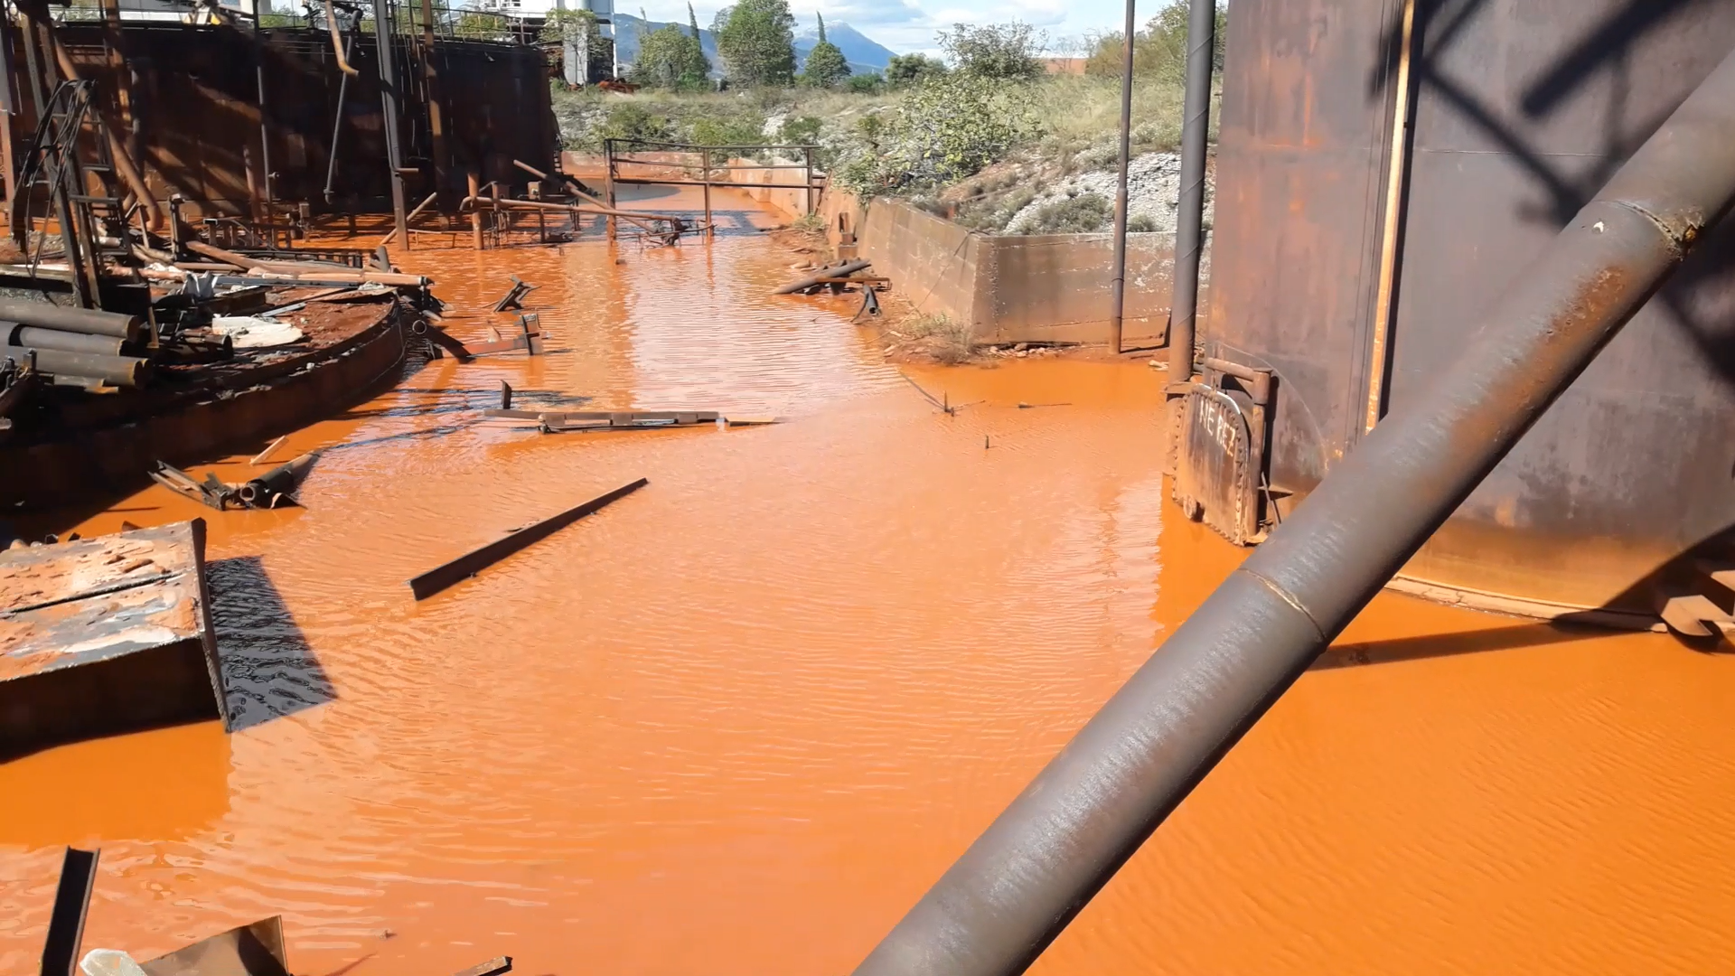
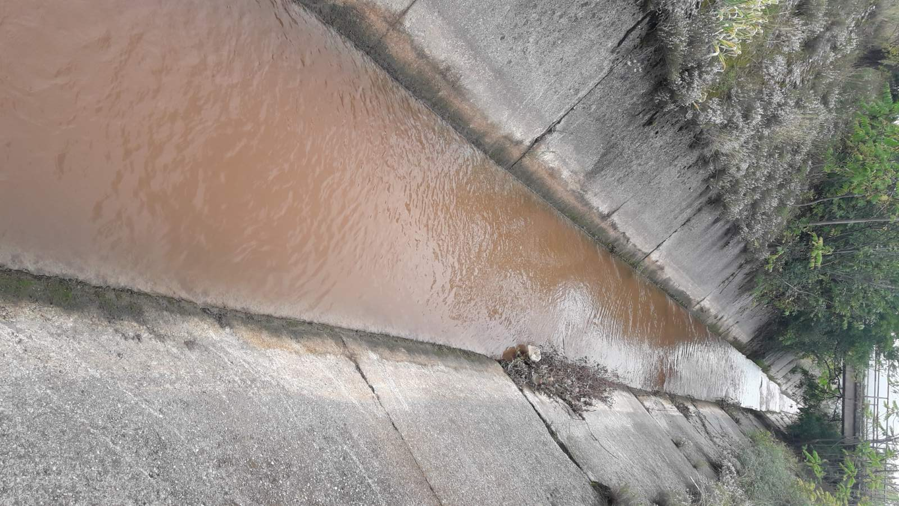
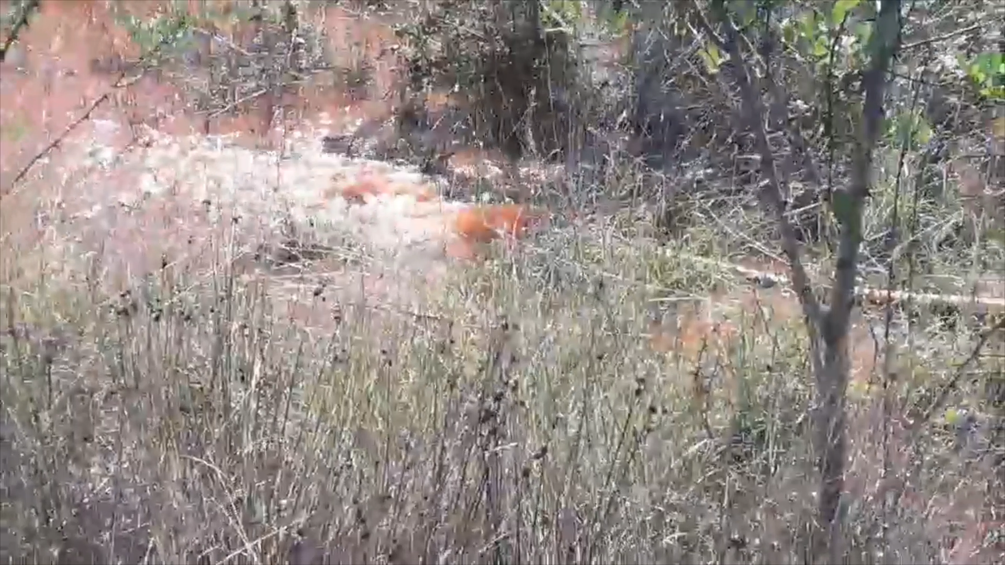
Industrial wastewater discharge, Alumini Plant, October 2020.

Slide 32
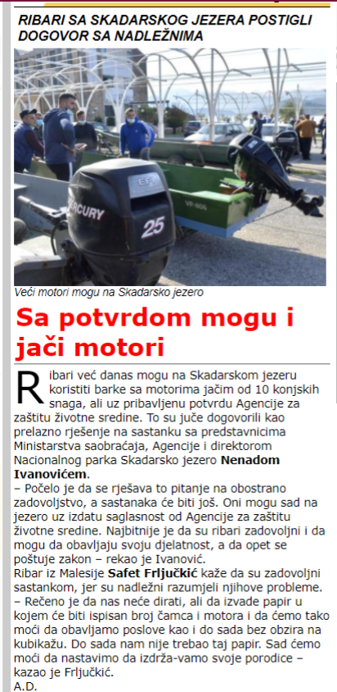
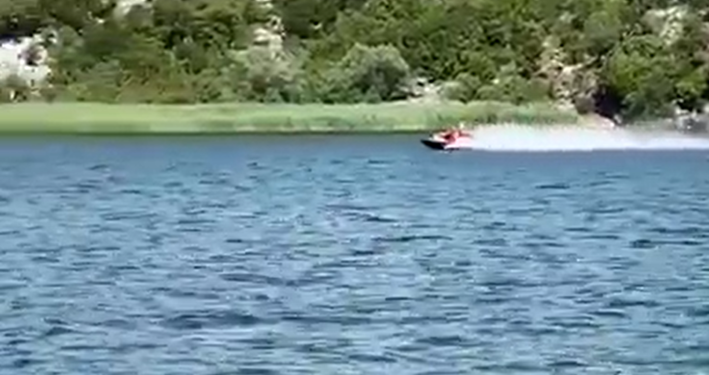
Vessels more than 10 horsepower permission granted, November 2020.

Slide 33
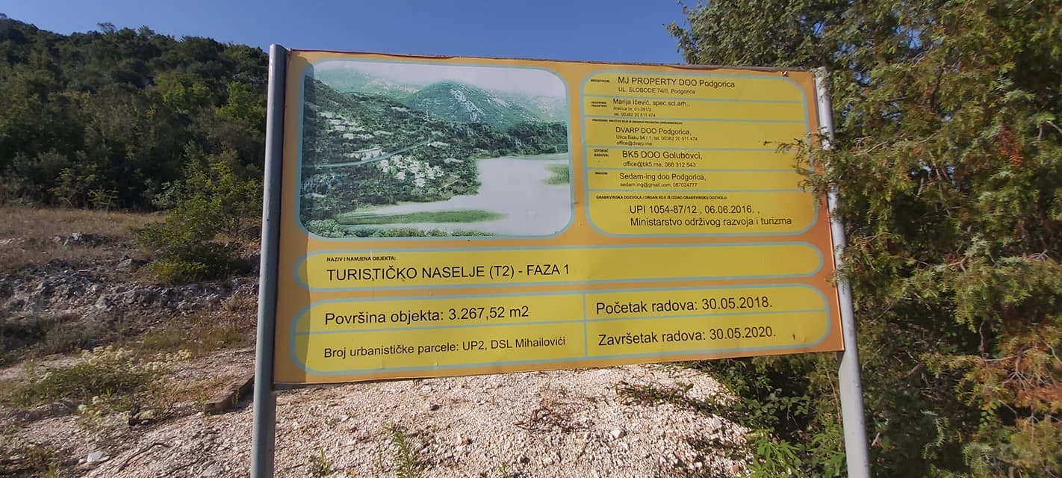
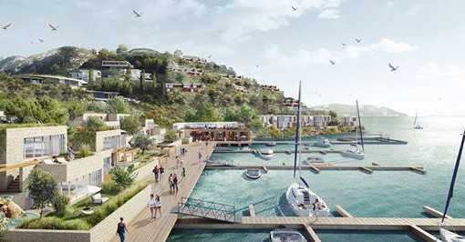
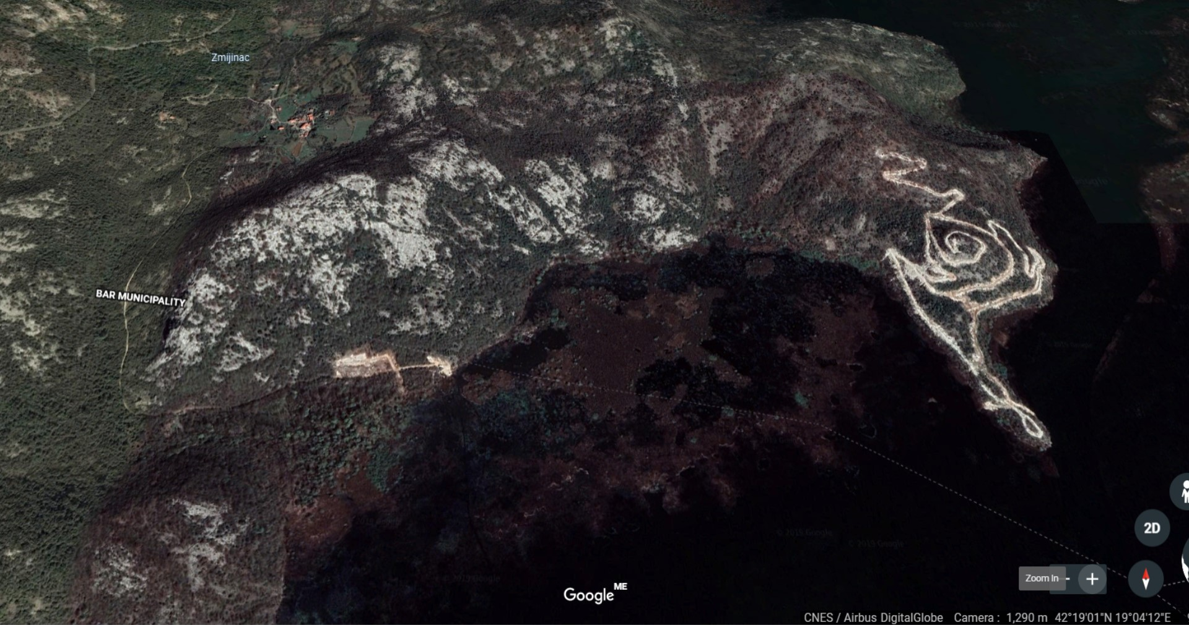
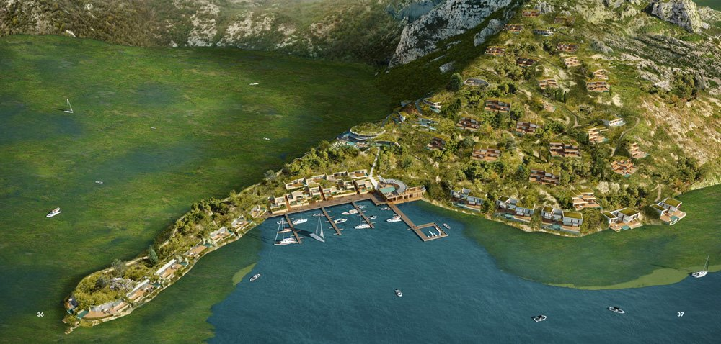

Slide 34
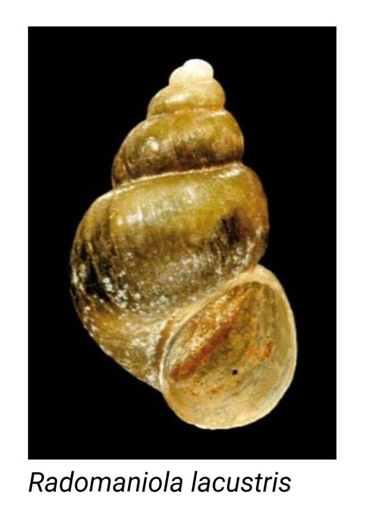
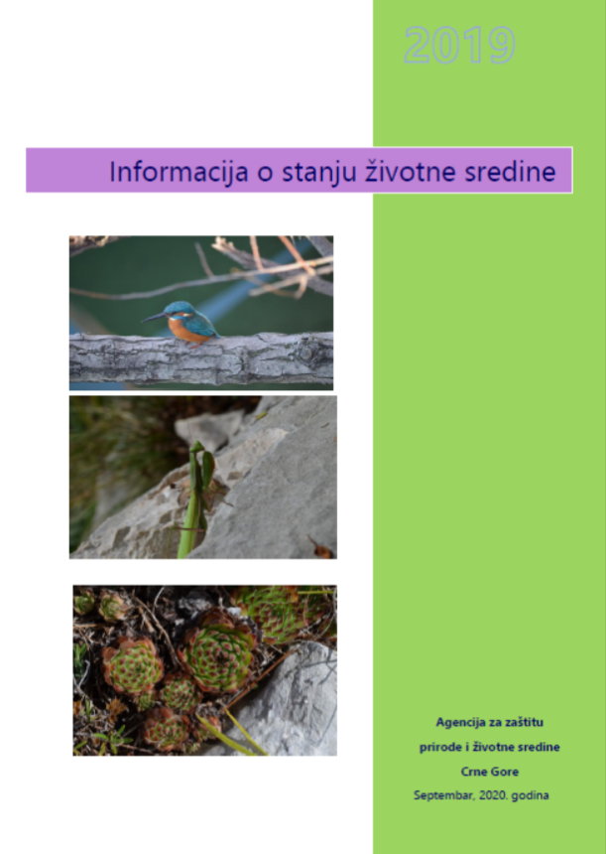

Slide 35
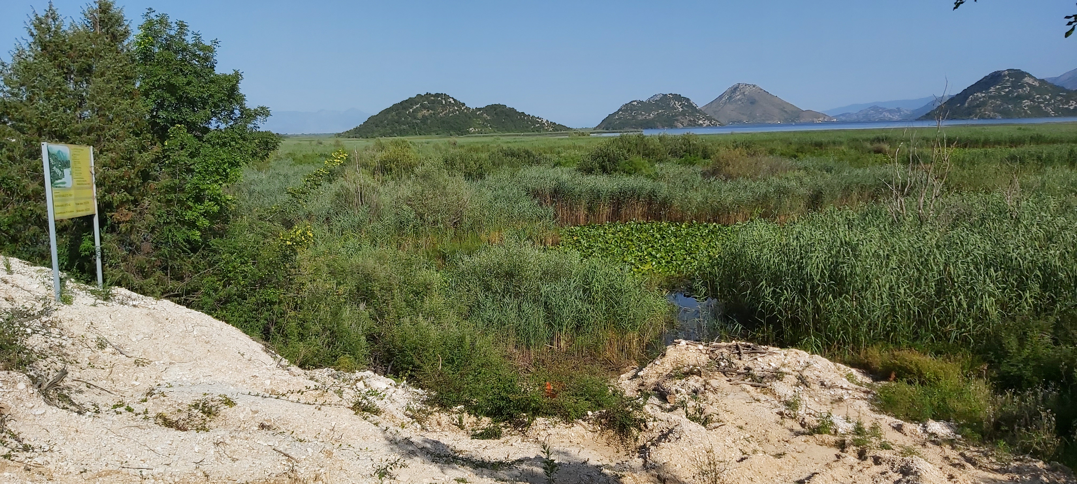
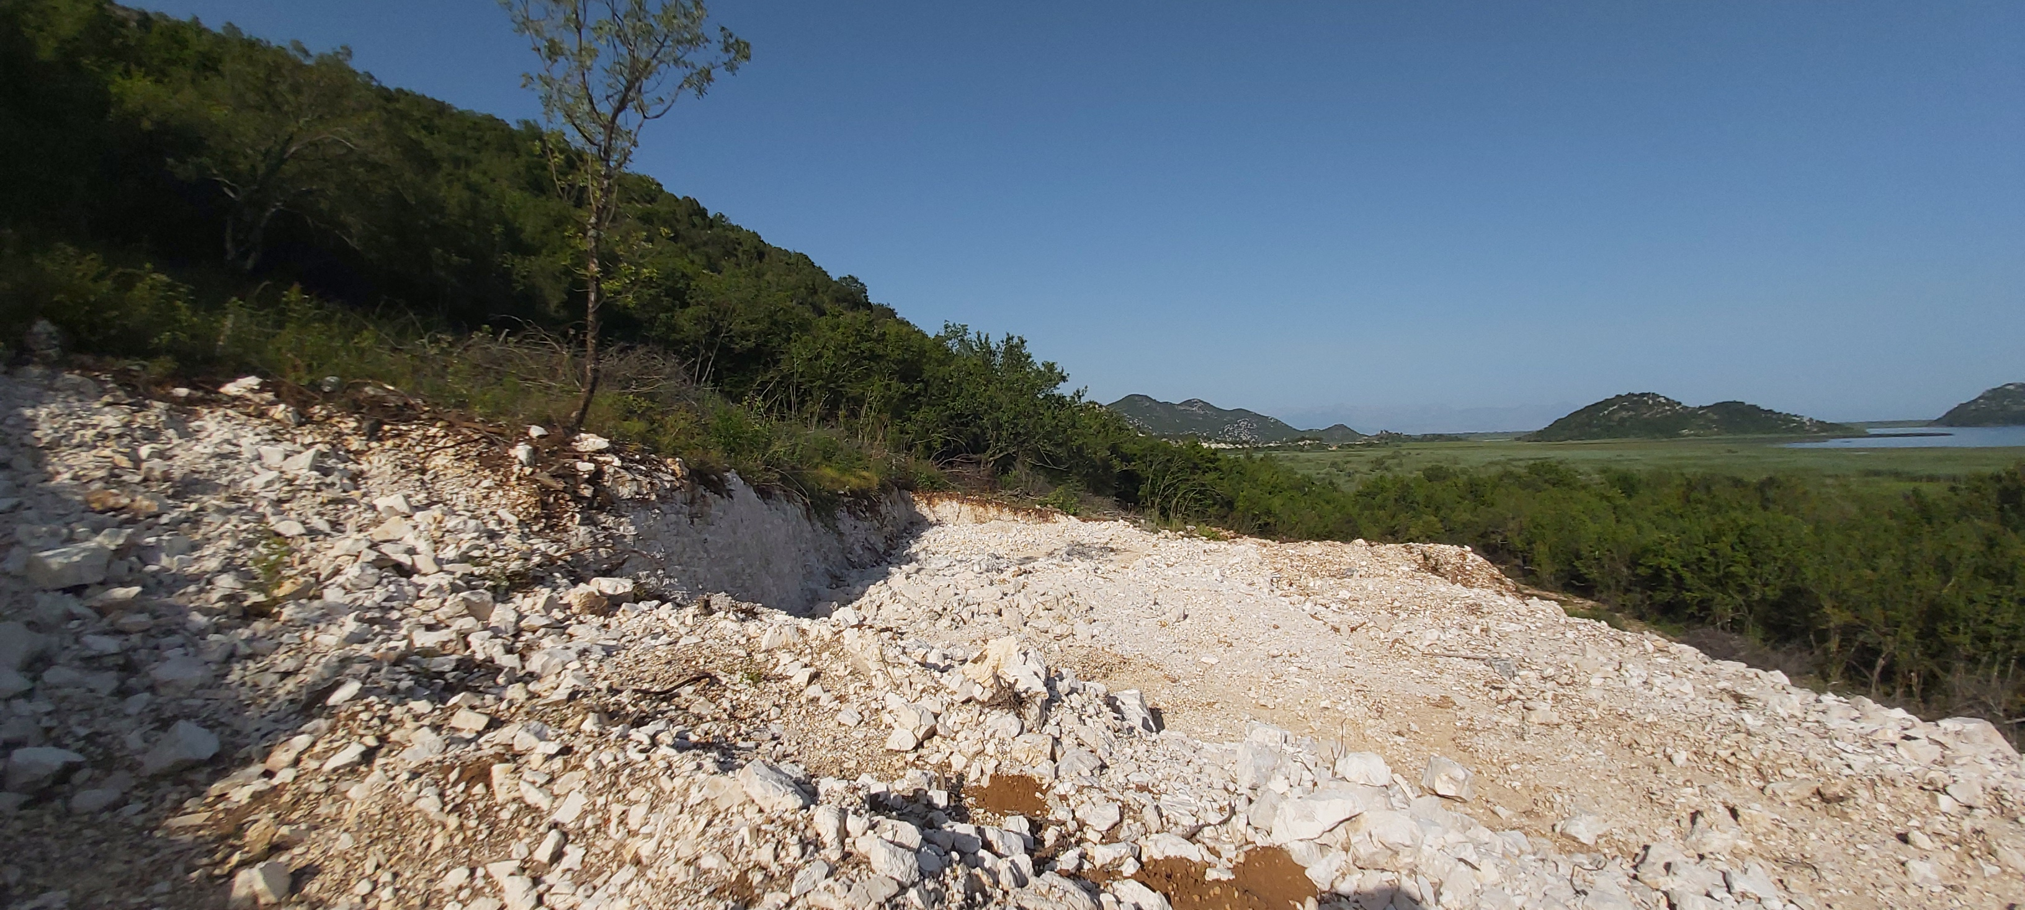
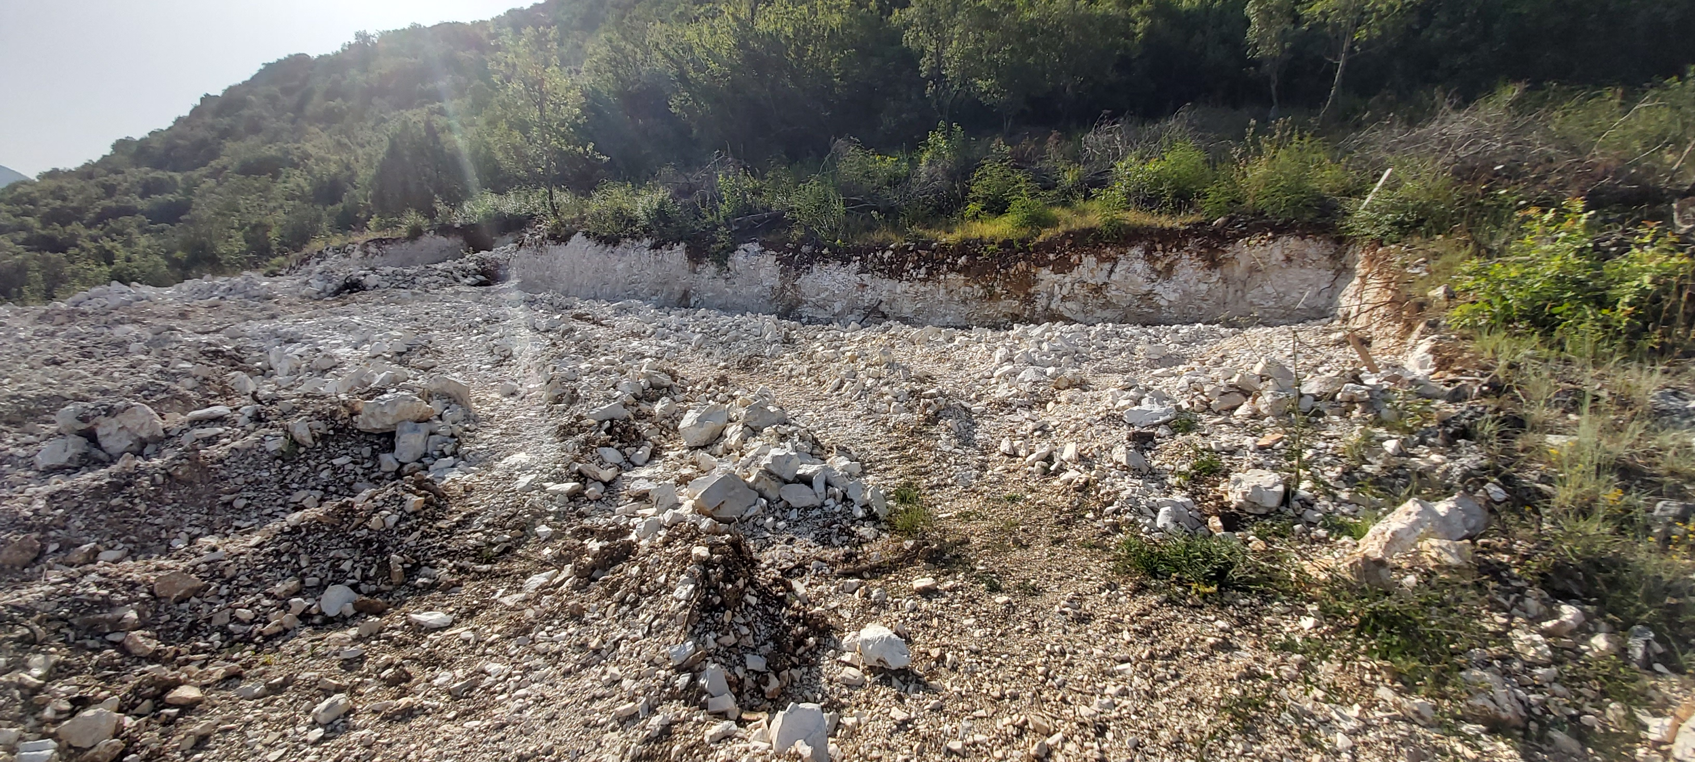
Porto Skadar Lake and White Village tourist settlement building site

Slide 36
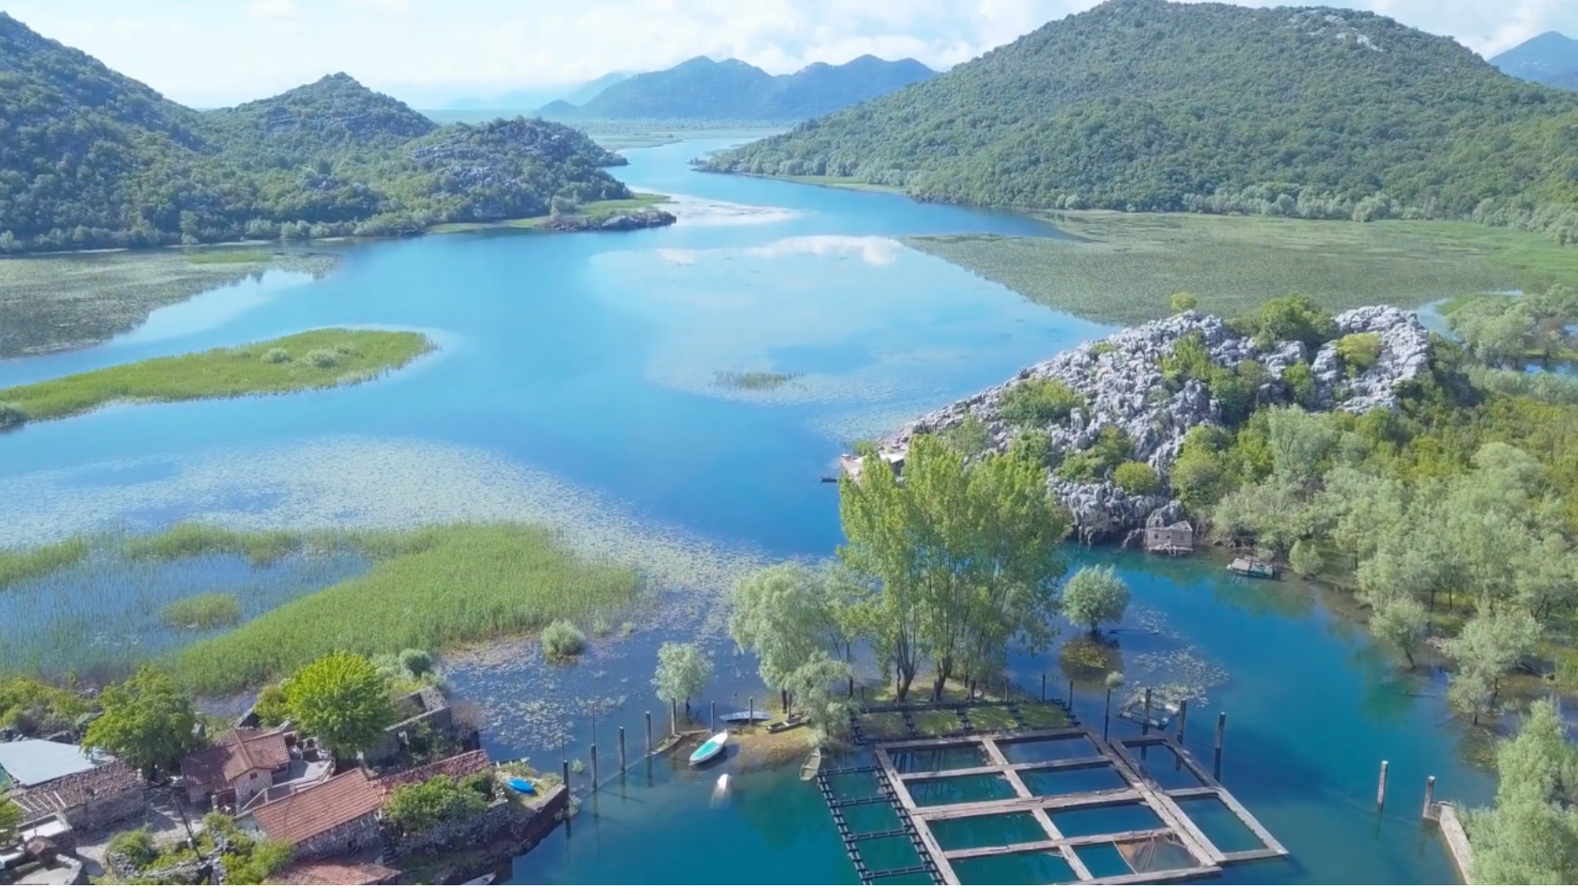

Slide 37
THANK YOU!
Natasa Kovacevic,
NGO Green Home
natasa.kovacevic@greenhome.co.me
Milan Knezevic,
The Informal Citizens Group from Virpazar
cracatau@hotmail.com

