Slide 1
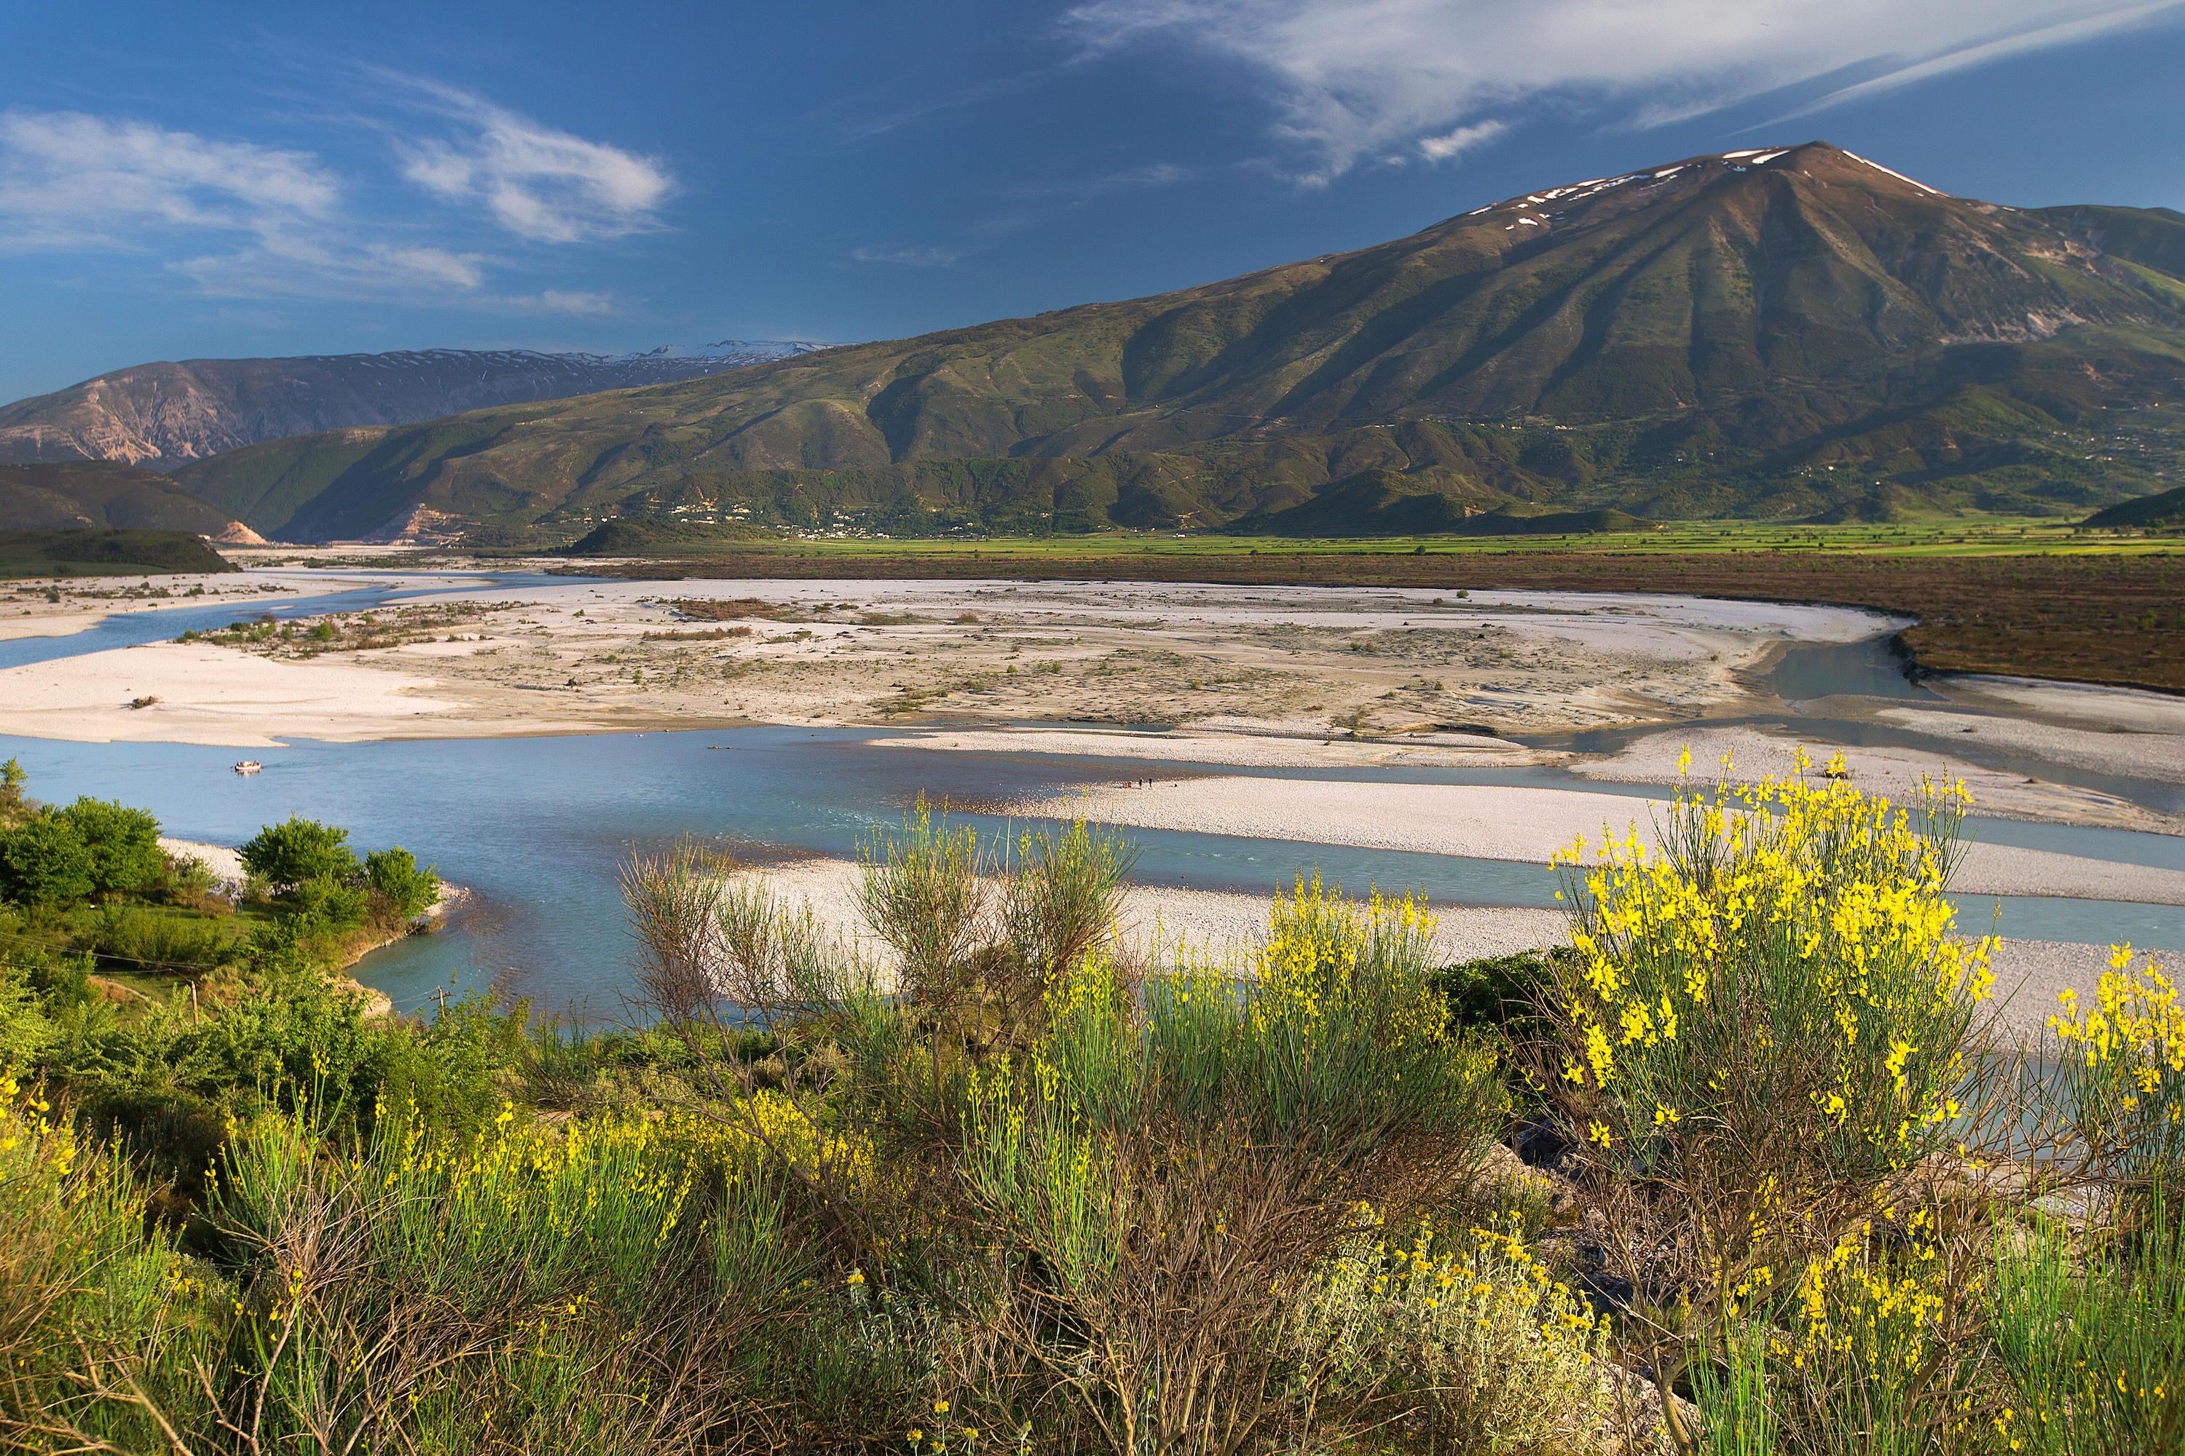
Upadate Report Vjosa River
Olsi Nika – EcoAlbania, 2020
o.nika@ecoalbania.org
40th Standing Committee Meeting
of the Bern Convention

Slide 2
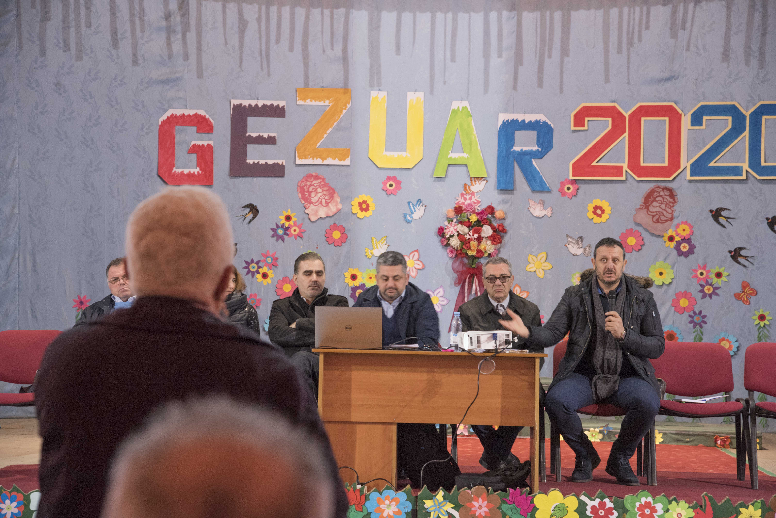
Public Hearing

Slide 3
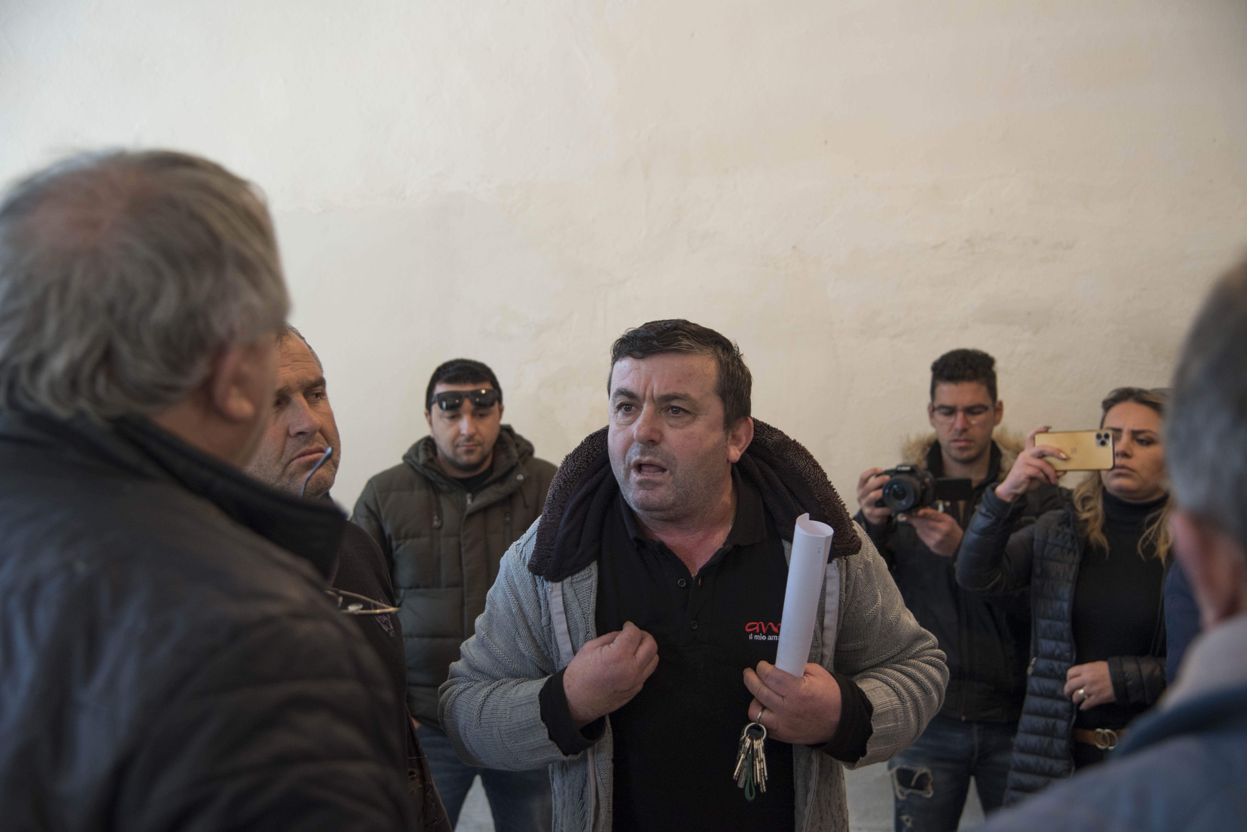
Not more than 30 people attended
The information technical and not relevant
No Full-EIA was made available
No further/additional consultation process
Notes:
January 22nd

Slide 4
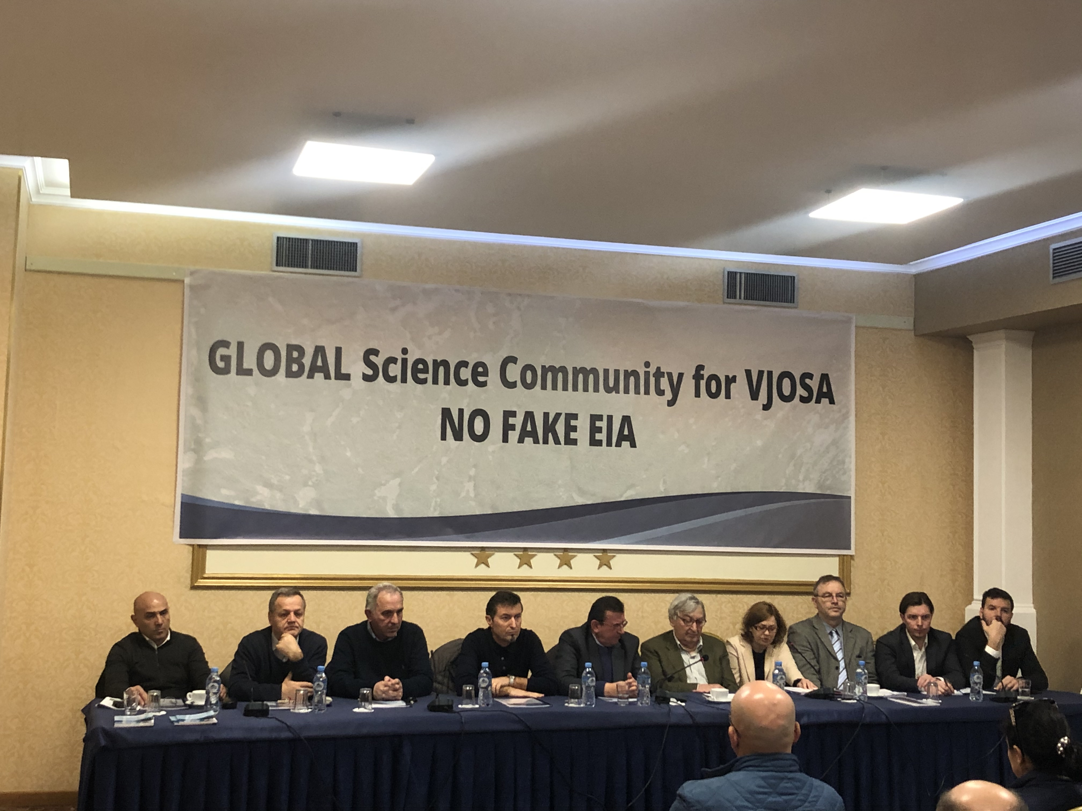
Reaction of the Scientific Community

Slide 5
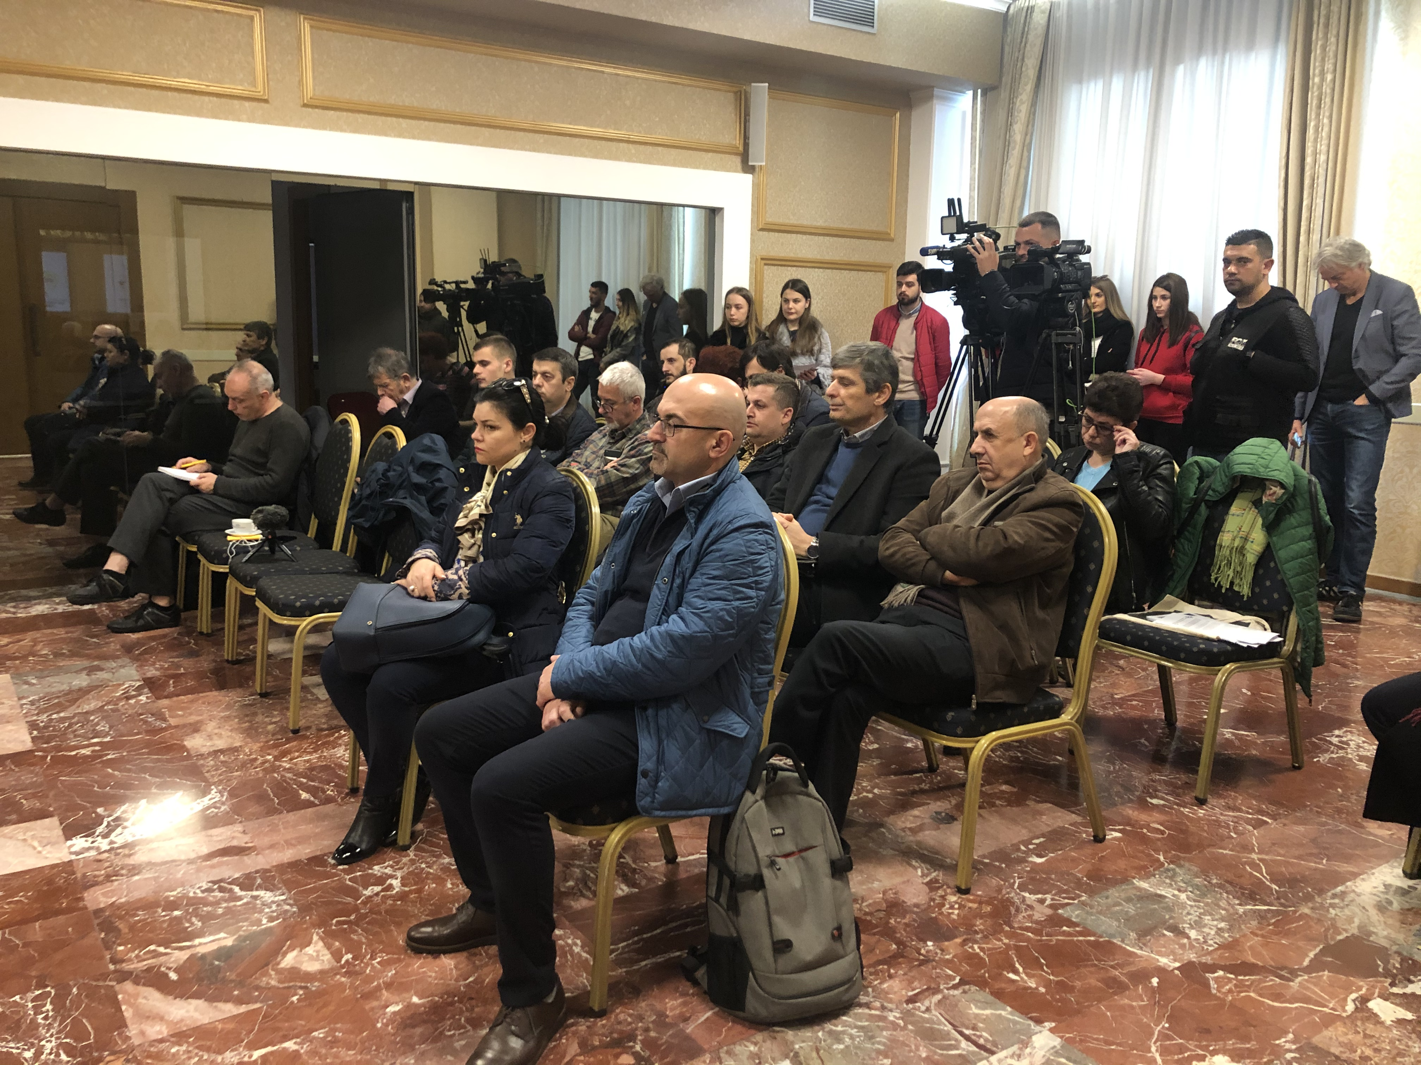
More than 20 people attended
The Letter of Concern was addrssed to AL Institutions
The EIA Summary was assessed to be fake
The Scientists committed to follow the process
Notes:
February 15th, 2020

Slide 6
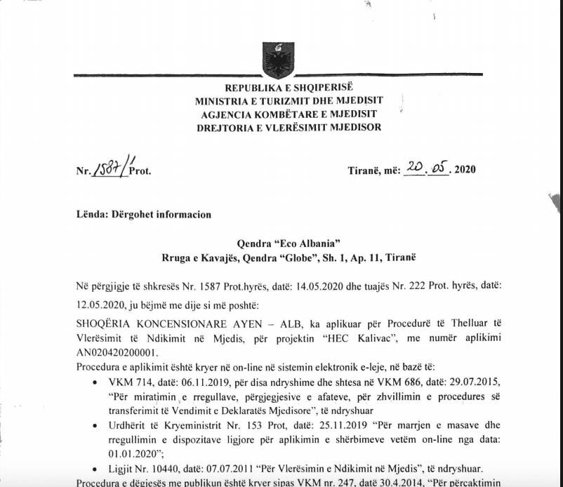
Notes:
Application – April 2nd, 2020

Slide 8
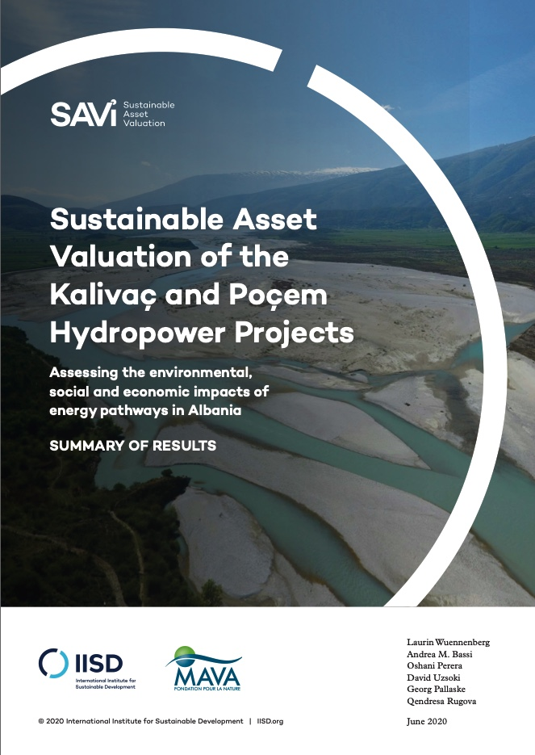
- EUR 233 million for Poçemi HPP
- EUR 321 million for Kalivaçi HPP

Slide 9
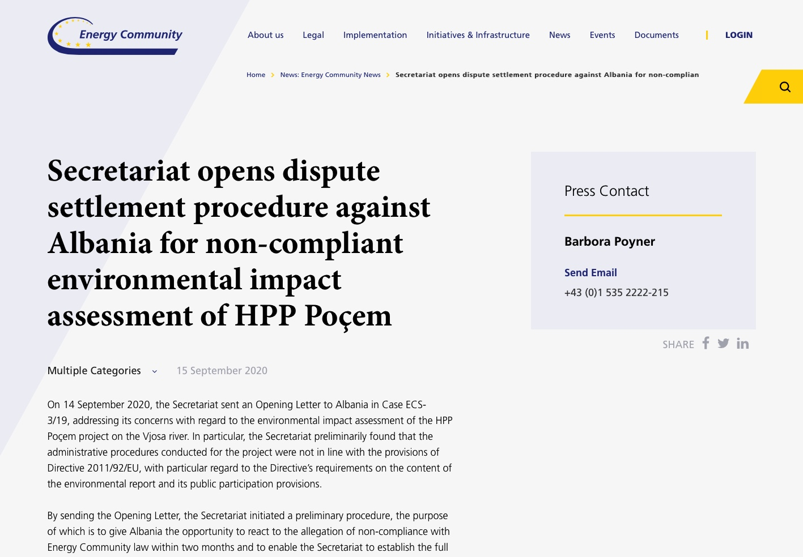

Slide 10
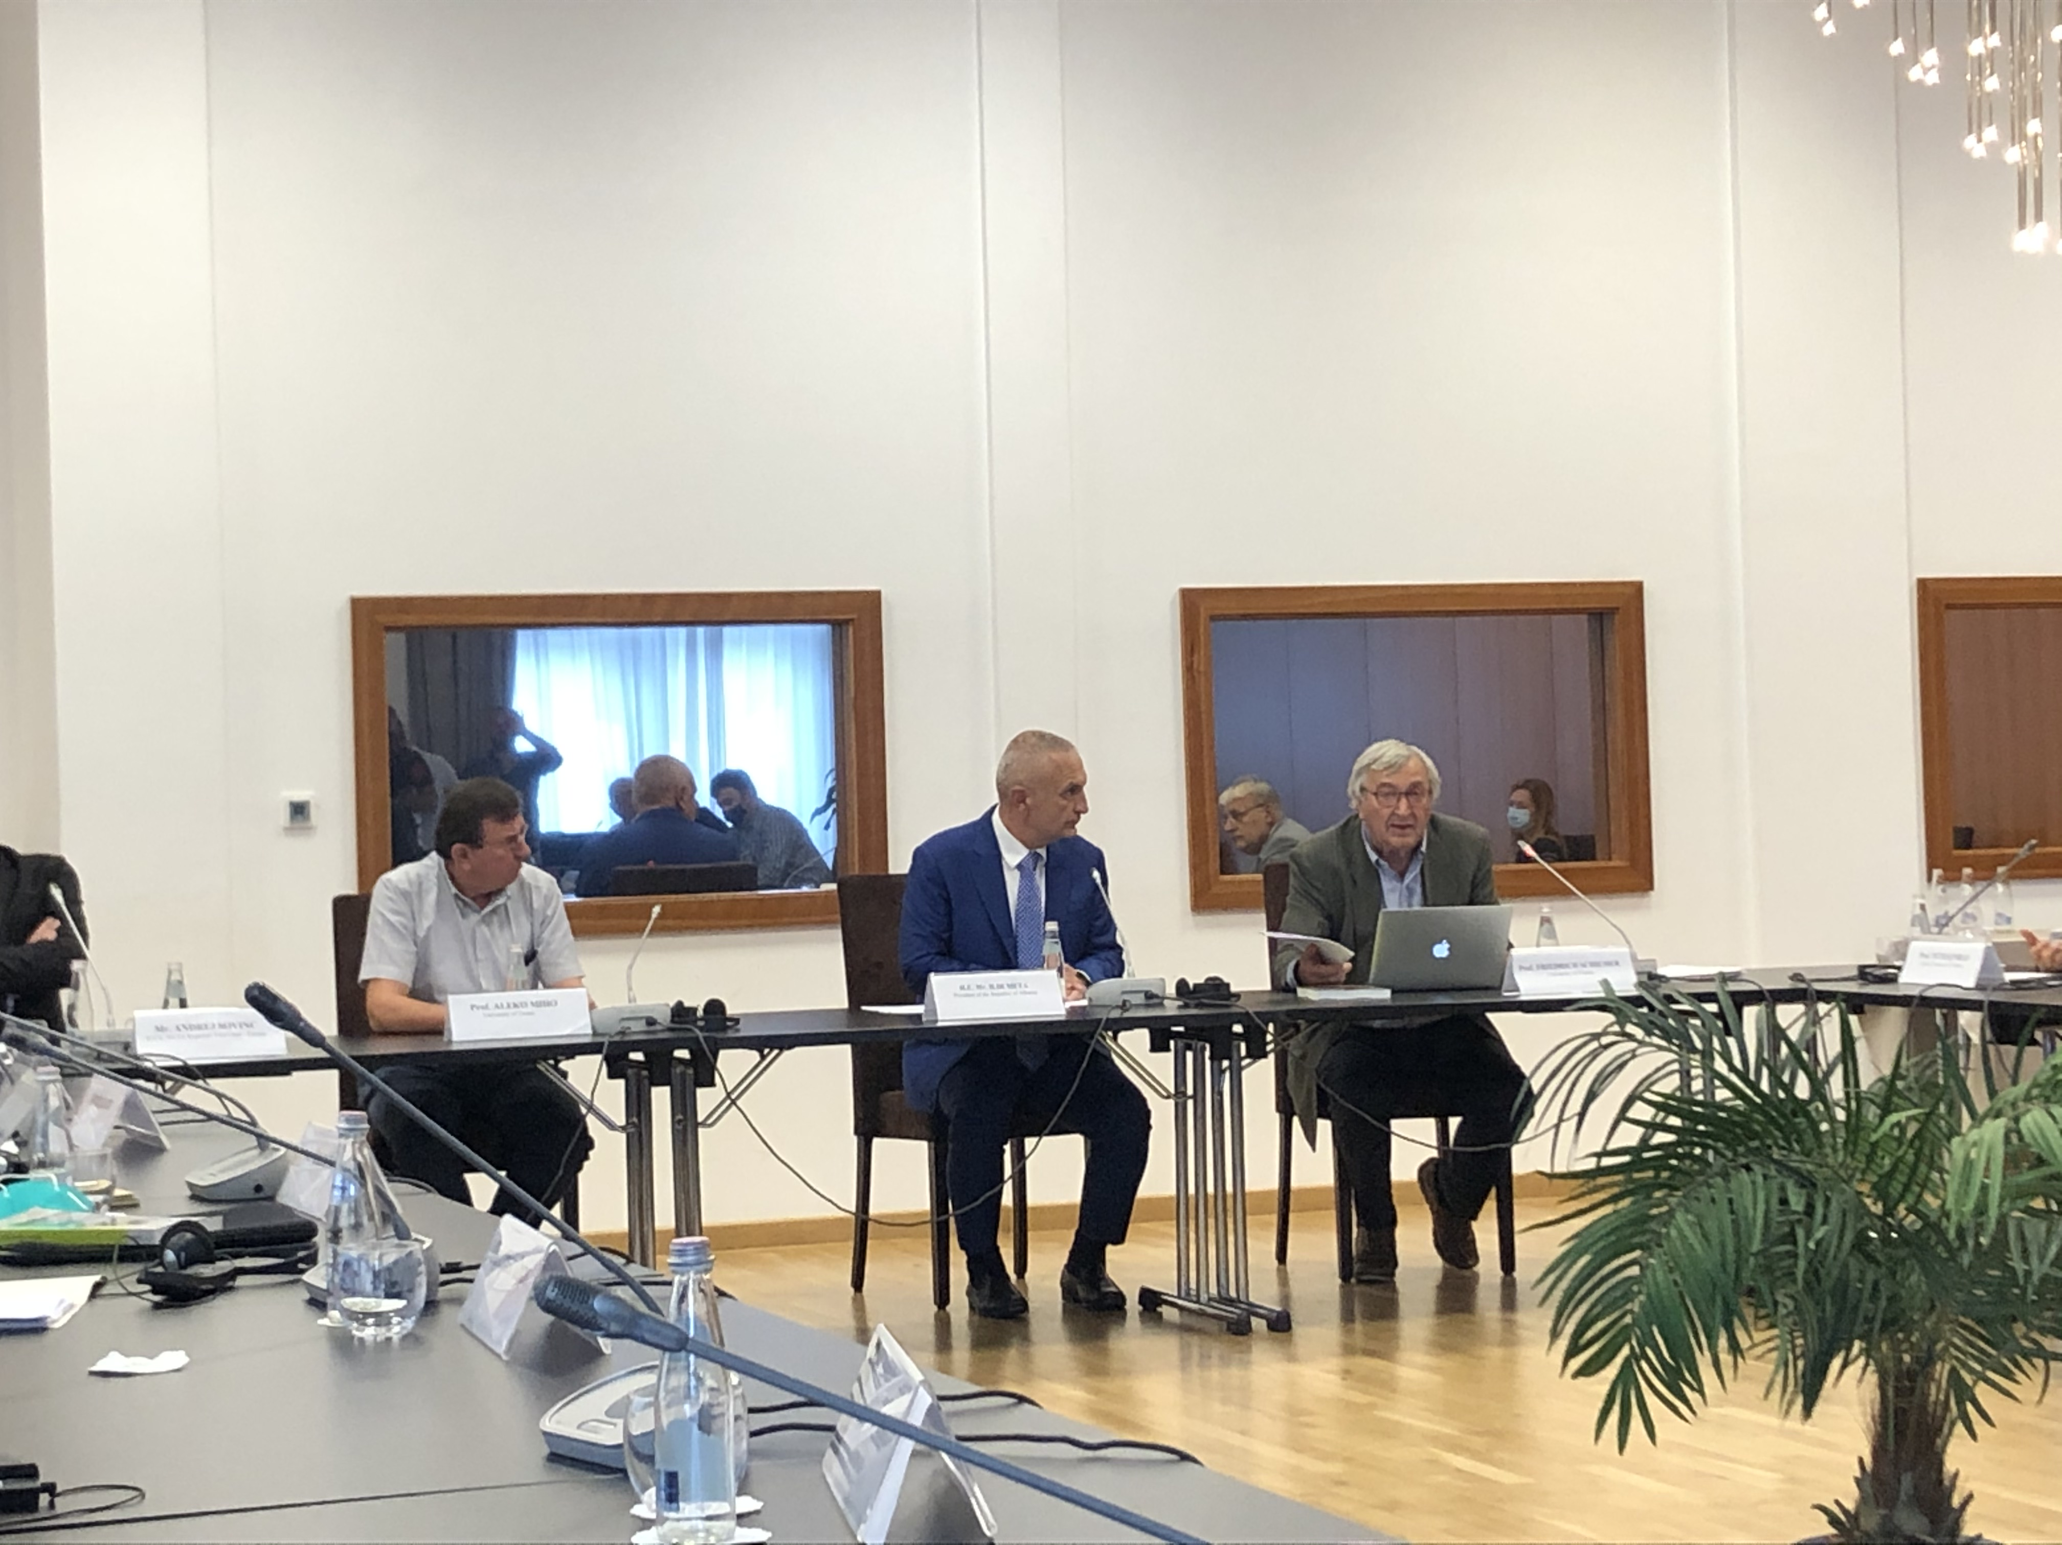
Stakeholders’ Roundtable for the Future of Vjosa
Criticism of the EIA and the Procedure
Presentation of the Studies
Presentation of the Vjosa WRNP Arguments
Notes:
Baseline Survey On Biodiversity, Potential Impacts And Legal Framework For Hydropower Development At River Vjosa, Albania
Socio-Economic Analysis for the Vjosa Rive Basin
Land-use and planning of the Vjosa River Basin
Ecosystem Services Assessment
Assessment of the Cultural Heritage of the Vjosa River Basin

Slide 11
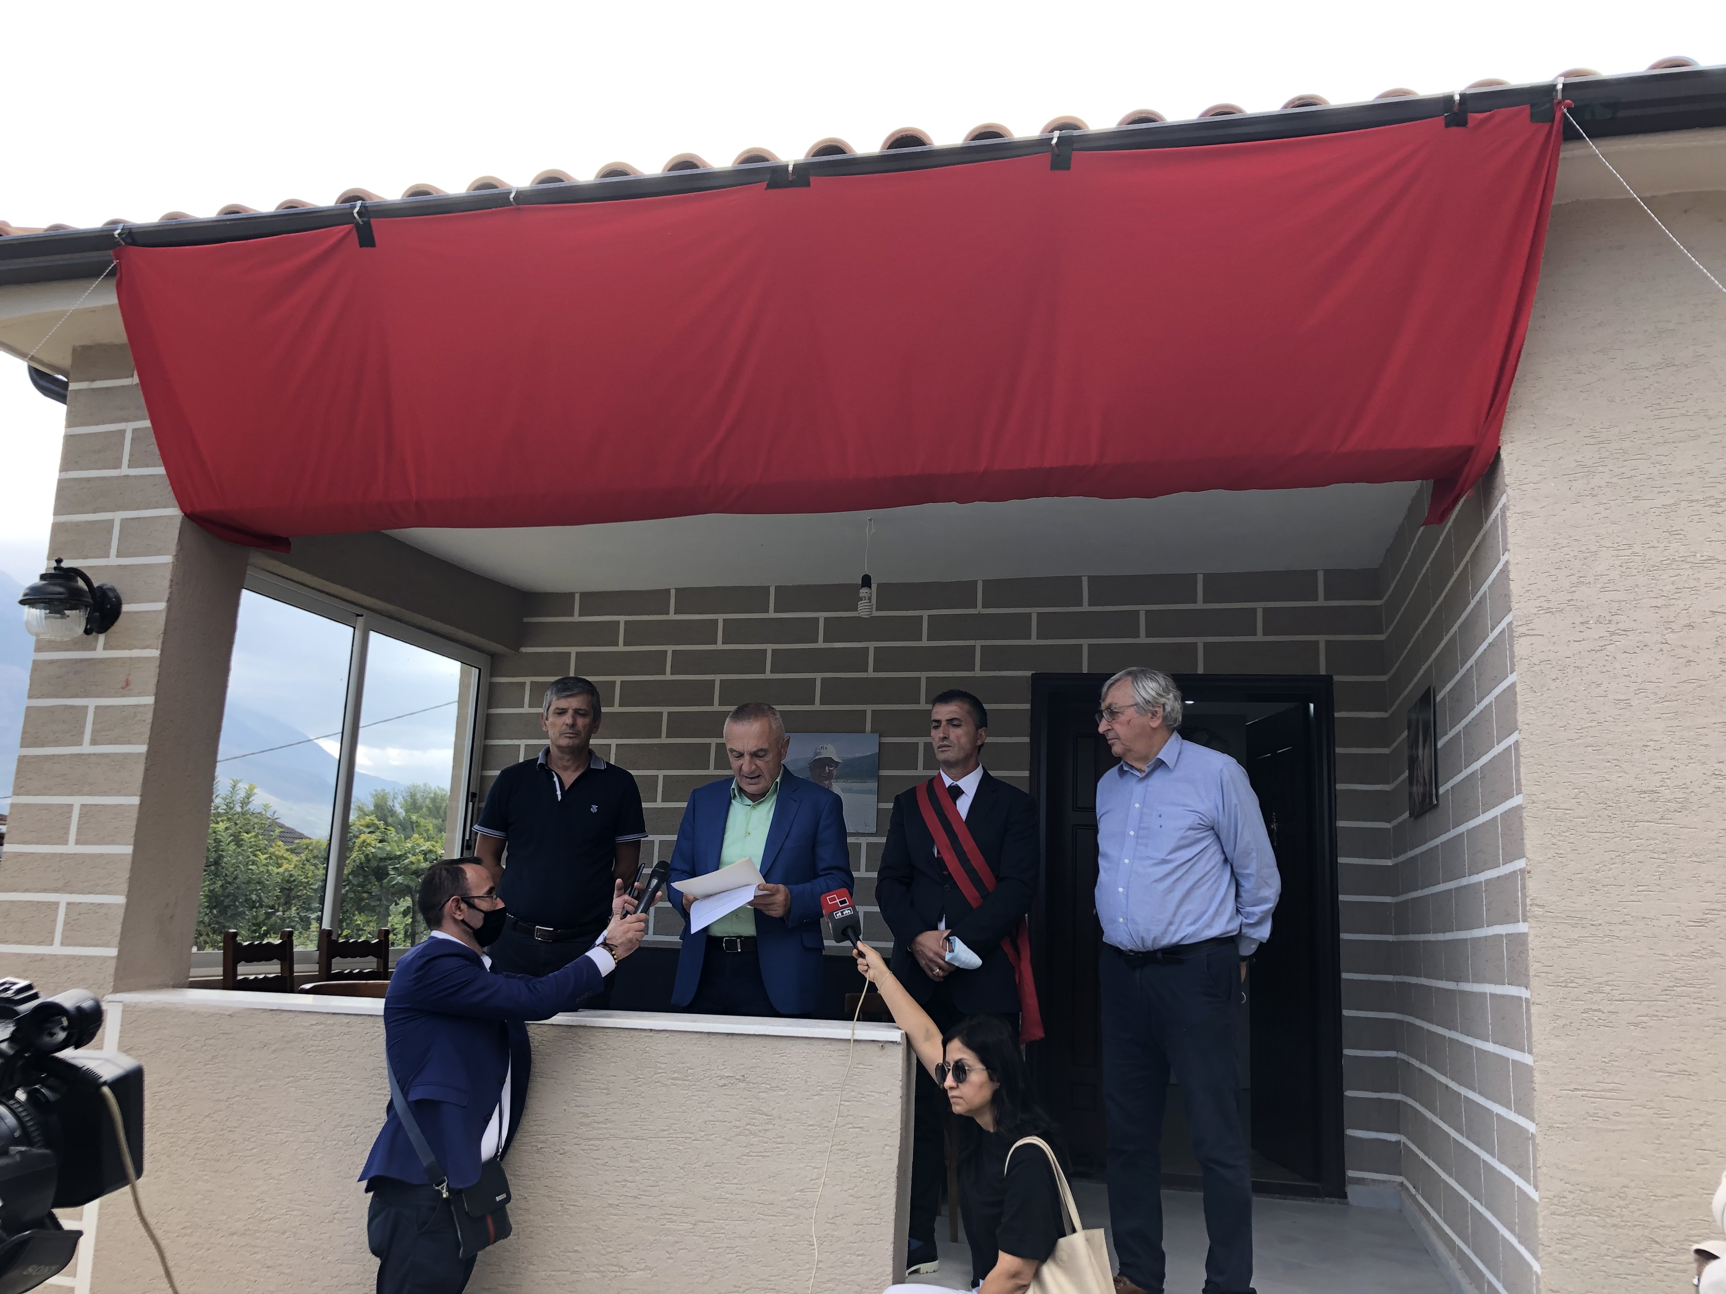
Innauguration of the Vjosa Research Center
Significant Importance for the European River science
Stronger Political Debate for the Vjosa
Temporary withdrawal from the Project

Slide 12
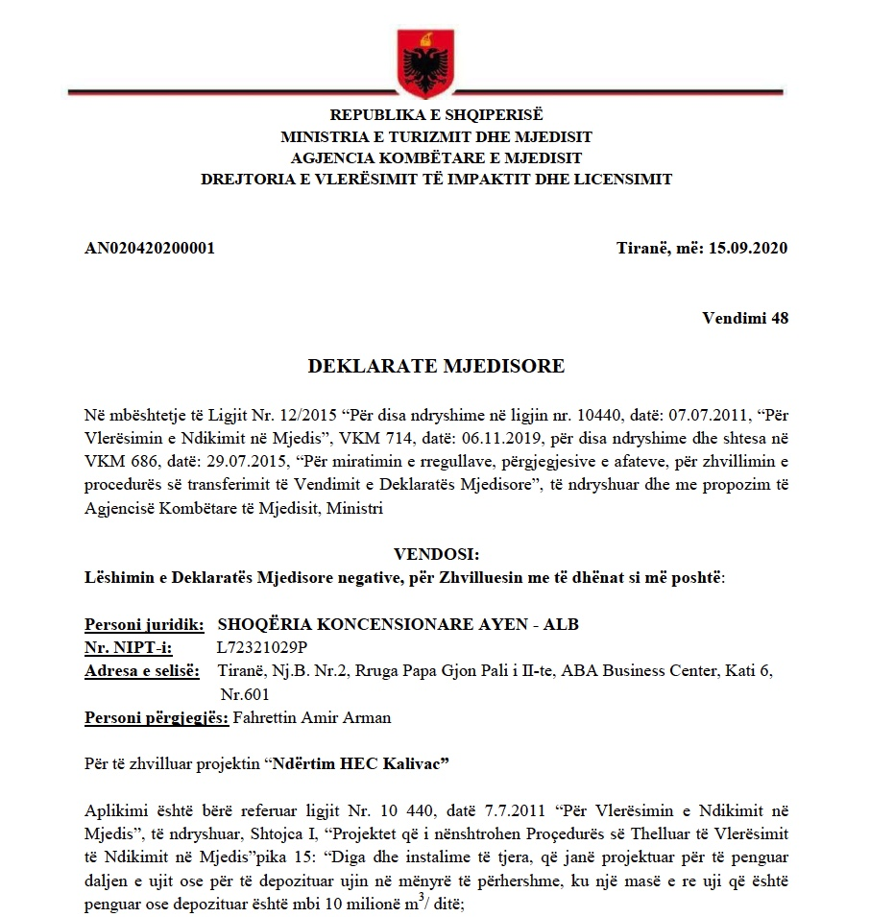

Slide 14
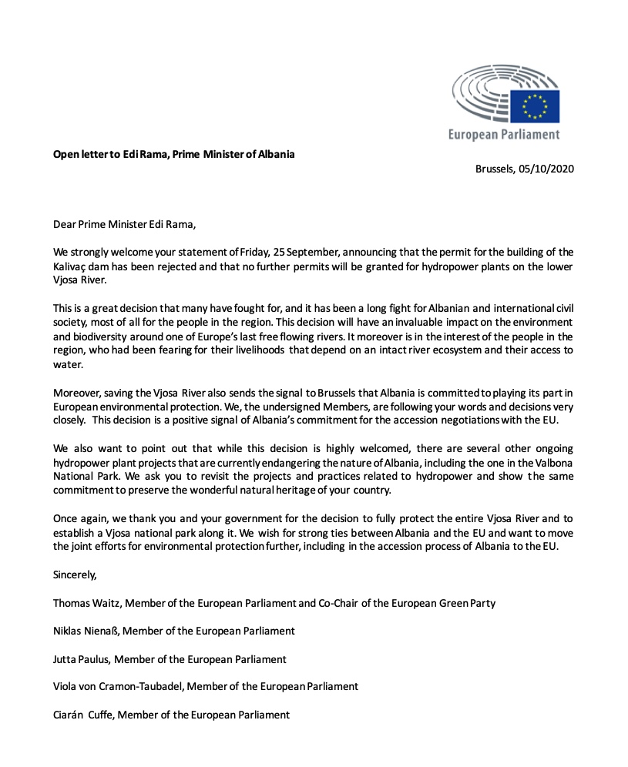

Slide 15
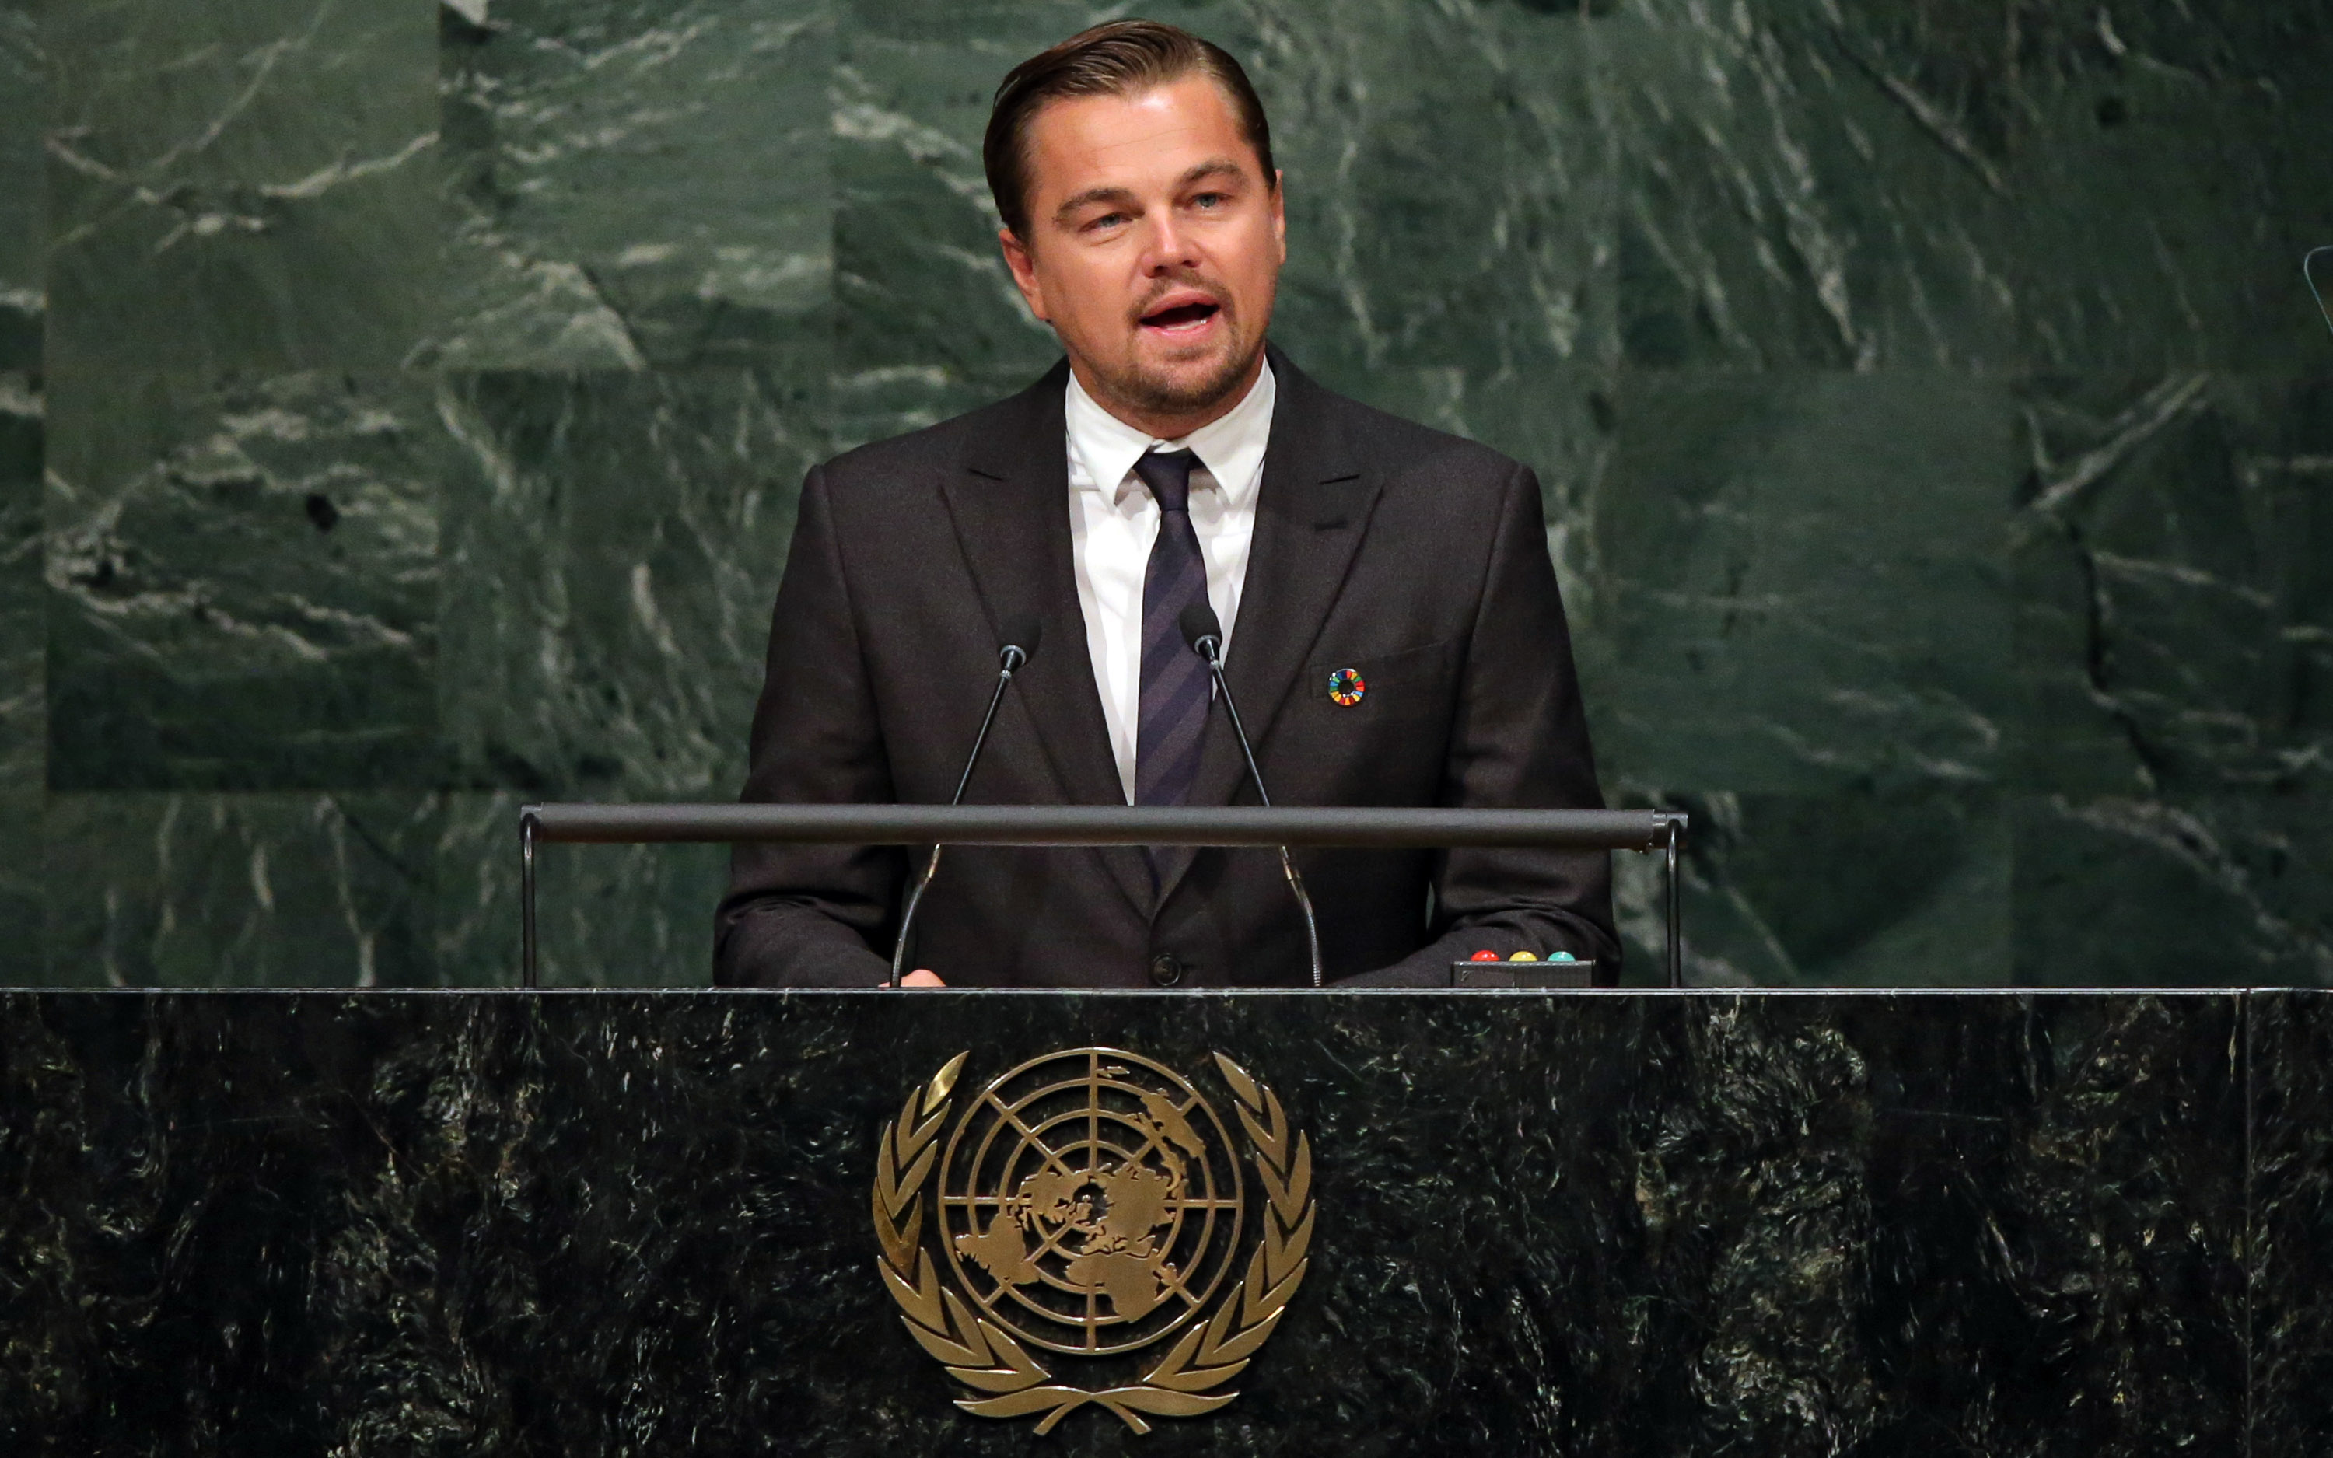
“ A very promising news coming from Albania. Vjosa, one of Europe’s last big wild rivers might be saved from hydropower development. “
“ The Vjosa Wild River National Park would become Europe’s largest river conservation site ”

Slide 16
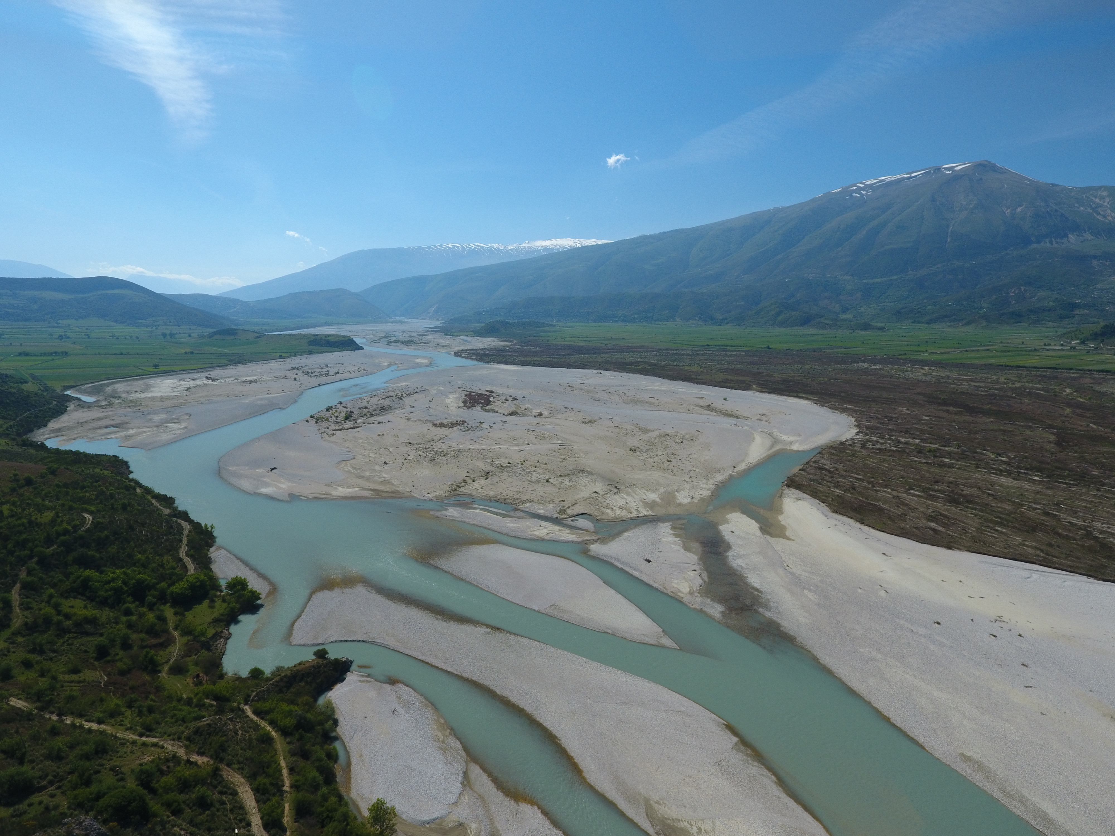
Keep the case-file Open
Ask the Albanian Government to Proclaim the Vjosa WRNP
Follow closely the Planning phase of the Vjosa WRNP

Slide 17
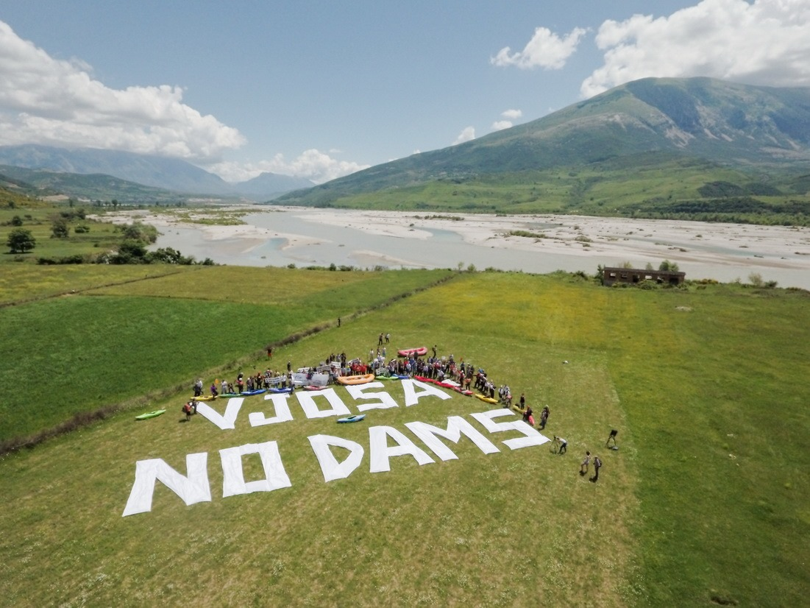
SAVE VJOSA

