Slide 1
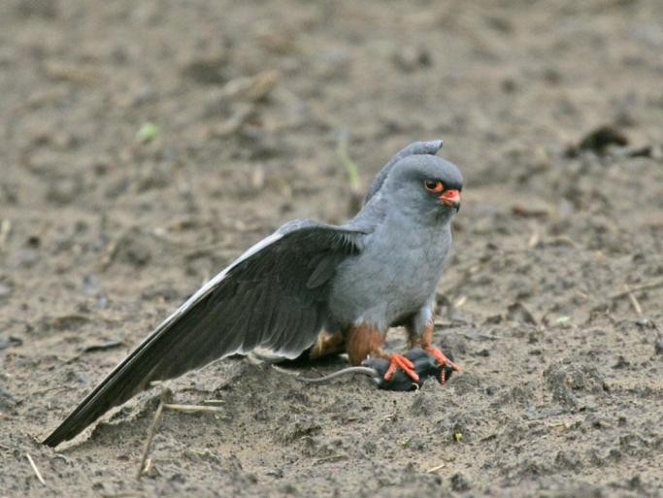
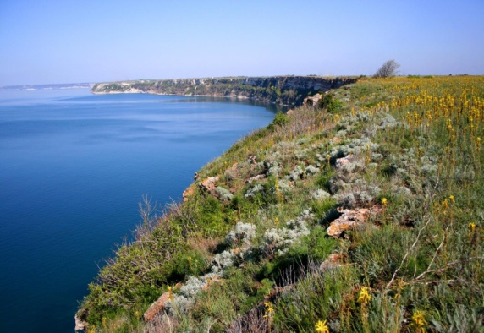
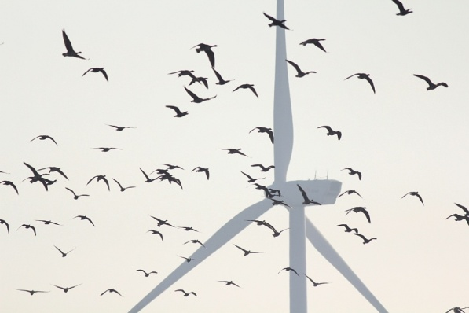
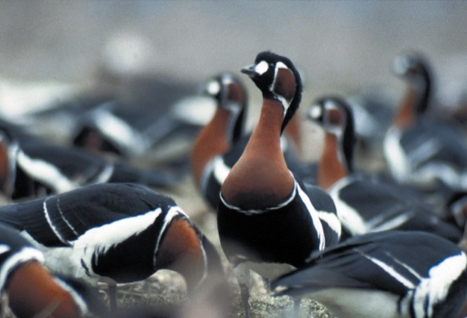
Windfarms in Balchik and Kaliakra – Via Pontica (Bulgaria)
Case file update 2020
Irina Mateeva
Bulgarian Society for the Protection of Birds

Slide 2
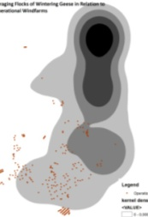
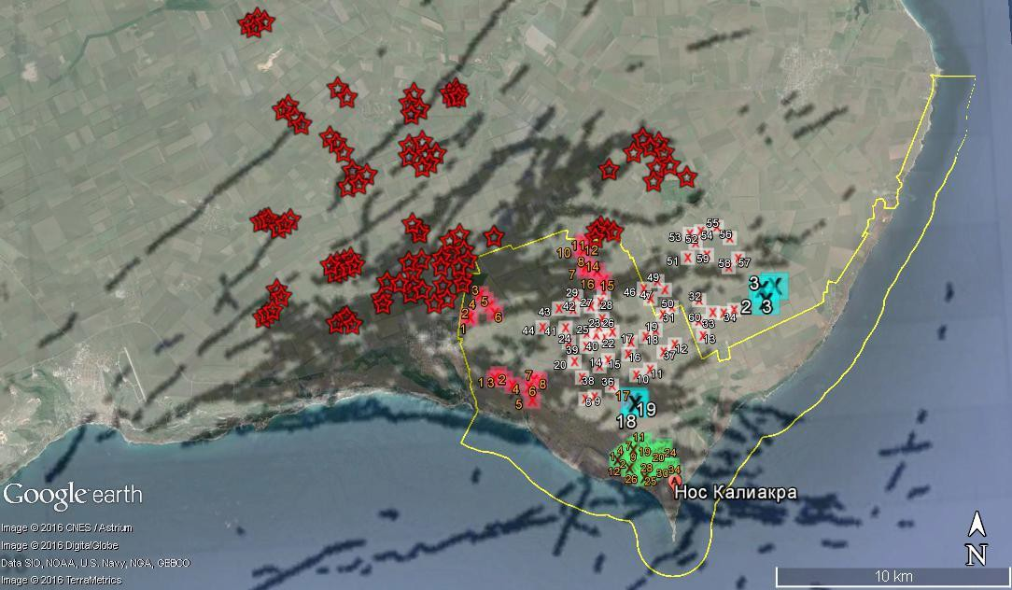
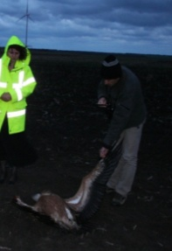
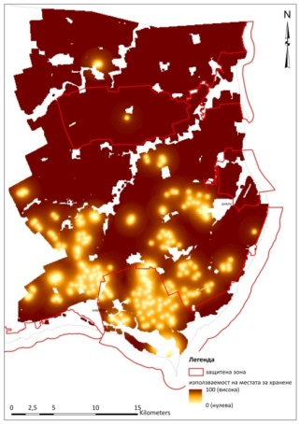
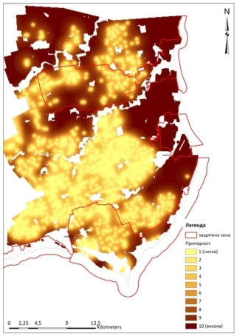
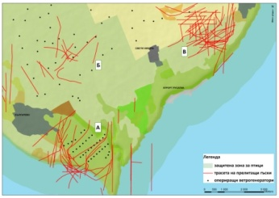
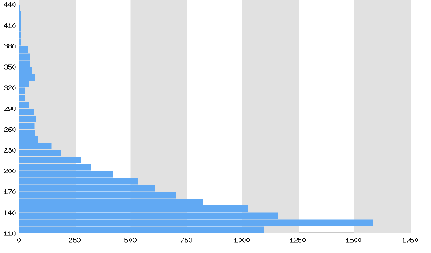
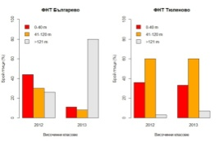
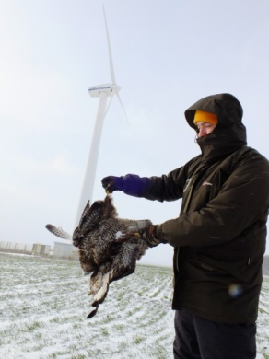
Evidence of significant impacts on birds
COLLISION
Proven at St Nikola WF and Kaliakra WF, but high risk also at EVN WF
DISPLACEMENT Proven at St Nikola WF for the Red-breatsed Goose
BARRIER
Proven at St Nikola WF Kaliakra WF, and EVN WF
AES Geoenergy Wind farm
Source BSPB
EVN Wind farm
Kaliakra Wind farm
Source BAS
Source BSPB
Presents: 6% loss of foraging habitats
Predicted: 30% (6+24) loss of foraging habitats
Source WWT, BSPB
Notes:
If any further study or assessment should be conducted for the wind farms (according to point 5 above) it has to be executed by independent experts (most suitably appointed by the Bern Convention), all the collected raw data by the investors and other institutions should be provided, as well as the possibility for field studies to be conducted with full access to the territories and without intervention by the investors and their monitoring team or staff. Also such assessment and study should not be longer than one year. Such assessment should continue after removal of wind farms in order to document the level of restoration.

Slide 3
Actions of Bulgarian Government to comply with recommendation 200 (2020)
Points 1 and 2
Assessment of the available data is done by expert hired by the Government
Methodology for further monitoring on site is elaborated
Findings
Vast amount of the unpublished raw data remain again out of the scope of the analysis
Lack of assessment of the methodologies of the studies so far and reliability of data gathered through them
CONCLUSIONS
there are serious impacts on birds and their habitats, but the scale and magnitude of the impacts will remain insufficiently studied, because of weaknesses of different field study methodologies, difference collection data effort and lack of analysis and assessment of all data
all the impacts on birds and deterioration of habitats due to windfarms development are result of insufficient and improper studies/monitoring; inadequate EIA and related decisions
Necessity of robust monitoring and publicity and transparency of both the data and analyses
Government fail => implement specific measures to remove the risks for birds and restore the value of the area for them

Slide 4
Actions of Bulgarian Government to comply with recommendation 200 (2020)
No report on other points
Point 4
! NO INTENTION OF REMOVAL/RELOCATE WIND FARMS !
Point 5
There is no procedure for development new RES action plan, and new intentions for WF development are in place
There is risk for not ensuring continuation of monitoring and put important sites at risk
Point 9
Tender calls for implementation of Action plan, but not implementor selected
BSPB implement conservation measures upon the plan under other projects
Suggestion to the Bern Convention
to continue to follow the case until all the recommendations are fully and sustainably implemented; values for the site for migratory birds is restored and migratory corridor via Kaliakra area is safe for migratory birds

Slide 5
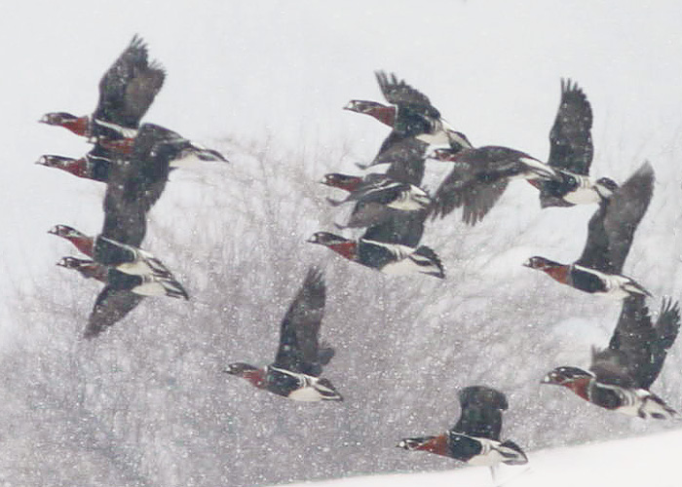
Thank you!

