Slide 1
CONVENTION ON THE CONSERVATION OF EUROPEAN WILDLIFE AND NATURAL HABITATS Standing Committe REPORTING UNDER RESOLUTION No. 8 (2012) PERIOD 2013-2018 Final Report Marc Roekaerts & Otars Opermanis
Notes:
A few words on the Council of Europe and why the Convention was negotiated there.

Slide 2
Agenda Item 5.8
Background
2012: the Standing Committee adopted Resolution No. 8, asking contracting parties to report every 6 years on the Conservation Status of species of Resolution No. 6 and Habitats of Resolution No. 4
The Council of Europe’s expert group on protected areas and ecological networks developed a format completely compatible with the Art.17 and Art.12 reporting (merged into one format)
The reporting cycle follows the same time-line as the EU
All non-EU contracting parties were requested to deliver by December 2019
Keep in mind: it’s the first time non-EU countries are performing such an exercise: (more about capacity building, the report is not an equivalent for the EU SN-report)
Final Report available at: https://rm.coe.int/reporting-under-resolution-no-8-2012-period-2013-2018-final-report/16809fad04

Slide 3
Agenda Item 5.8
In summary
8 countries delivered reporting data on the CDR
Reporting on predefined selection of 46 features, according to the agreed CheckList
Tabular and Spatial data in various combinations
Overall, 71% of the reports in the checklist are delivered
Analysis at Pan-European scale by merging EU data from Art. 17 and Art. 12 reporting

Slide 4
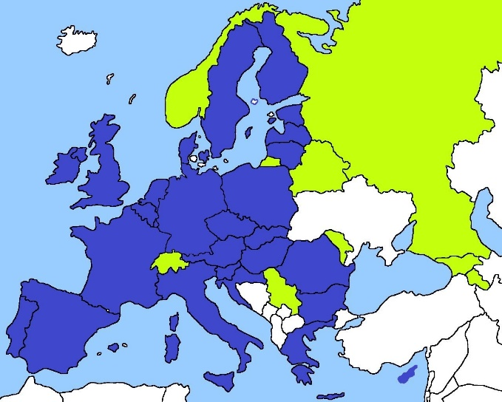
Agenda Item 5.8
Pan-European view on available data Dark blue: 28 EU Countries (Art. 17 and 12), Green: 8 Res. 8 Countries

Slide 5
Quantitative Assessment Number of reports delivered and percentage according to the agreed checklist (tabular data)
Agenda Item 5.8
 | Birds |  |  | Non-avian Species |  |  | Habitats |  |  | Total
Country | In checklist but not delivered | Delivered | % delivered | In checklist but not delivered | Delivered | % delivered | In checklist but not delivered | Delivered | % delivered | Delivered | % delivered
AM | 0 | 11 | 100 | 4 | 16 | 80 | 0 | 10 | 100 | 37 | 90,24
BY | 0 | 12 | 100 | 0 | 37 | 100 | 0 | 6 | 100 | 55 | 100,00
CH | 4 | 6 | 60 | 2 | 21 | 91 | 0 | 10 | 100 | 37 | 86,05
GE | 1 | 11 | 91 | 1 | 35 | 97 | 0 | 15 | 100 | 61 | 96,83
MD | 1 | 10 | 90 | 3 | 22 | 88 | 2 | 5 | 71 | 37 | 86,05
NO | 0 | 6 | 100 | 5 | 25 | 83 | 6 | 7 | 53 | 38 | 77,55
RS | 0 | 11 | 100 | 11 | 40 | 78 | 7 | 14 | 66 | 65 | 78,31
RU | 17 | 2 | 10 | 51 | 9 | 15 | 24 | 8 | 25 | 19 | 17,12
Total | 23 | 69 | 75 | 77 | 205 | 73 | 39 | 75 | 66 | 349 | 71

Slide 6
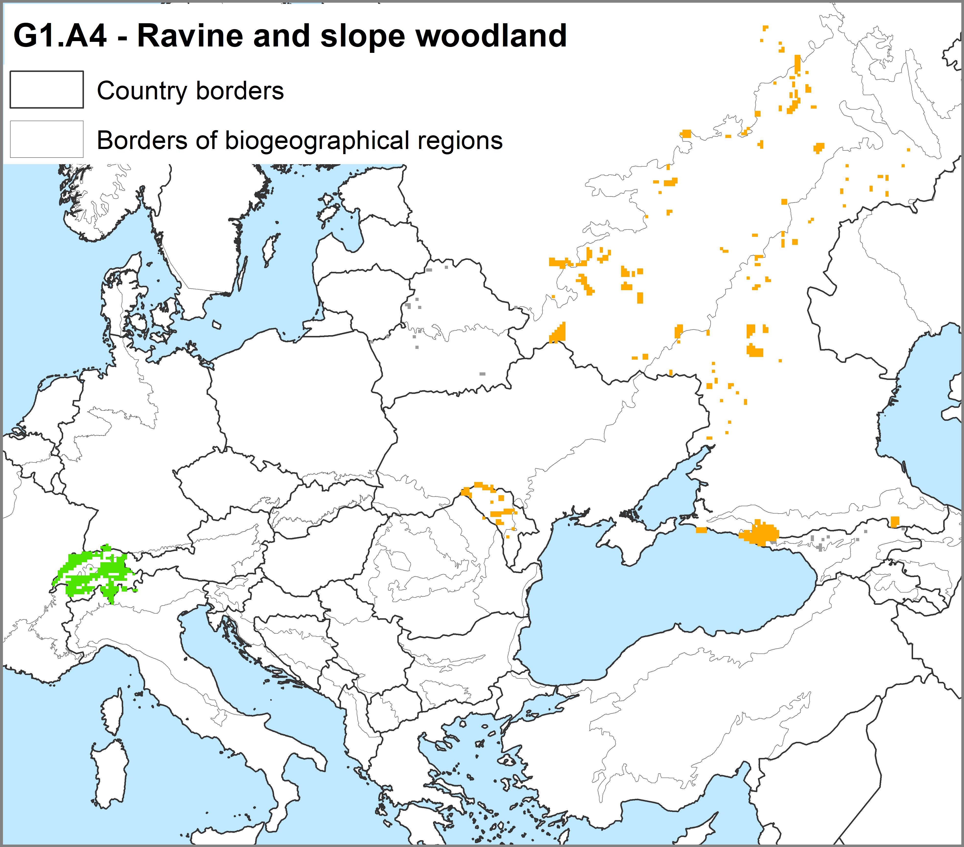
Agenda Item 5.8
Spatial distribution maps (10x10 km grids) Example map for Habitat G1.A4
Conservation Status as given by the country
green: favourable
orange: unfavourable-inadequate
grey: unknown
Species/habitat name | AM | GE | BY | MD | RU | CH | RS | NO
Ravine and slope woodland | missing | 14 | 16 | 55 | 472 | 260 | missing | missing

Slide 7
Agenda Item 5.8
Availability of spatial distribution maps (10x10 km grids) according to the agreed CheckList
Plants (number of 10x10 km grid cells)
Species/habitat name | AM | GE | BY | MD | RU | UA (*) | CH | RS
Drepanocladus vernicosus | missing | 11 | 6 (as 6216 Hamatocaulis vernicosus) | NP | NP | NP | 60 (as 6216 Hamatocaulis vernicosus) | NP
Marsilea quadrifolia | missing | 2 | NP | 9 | 25 | 5 | 1 | 12
Cypripedium calceolus | missing | missing | 38 | 13 | 165 | missing | 154 | 1
Saxifraga hirculus | missing | missing | 6 | missing | missing | missing | 1 | NP
Angelica palustris | missing | missing | 9 | missing | NP | NP | NP | missing
Paeonia tenuifolia | missing | 73 | NP | missing | missing | missing | NP | 8
Ligularia sibirica | missing | 144 | NP | missing | missing | missing | NP | NP
Agrimonia pilosa | missing | 176 | 70 | missing | missing | missing | NP | NP
Fritillaria montana | missing | missing | NP | missing | missing | missing | NP | 34
(*) for UA only draft data delivered
See appendix 4 of the report for full overview

Slide 8
Agenda Item 5.8
Qualitative Assessment - Background
Due to limited resources .... limited QA/QC procedures:
No quality assessment for data deliveries on the CDR
No second delivery foreseen, data are taken as delivered
but 3 preparatory workshops assisted countries and this was clearly visible in the data delivered

Slide 9
Qualitative Self-Assessment Categories according to the Reporting Format “Method used:”
Agenda Item 5.8
Extra category: not reported, missing assessment in the database

Slide 10
Qualitative Self-Assessment for Habitats Proportions of categories of quality assessments
Agenda Item 5.8
A. Range trend
dark green: complete survey or a statistically robust estimate
light green: based mainly on extrapolation from a limited amount of data
light orange: based mainly on expert opinion with very limited data
dark orange: insufficient or no data available
grey: quality not reported
B. Coverage

Slide 11
Qualitative Self-Assessment for Habitats Proportions of categories of quality assessments
Agenda Item 5.8
C. Coverage trend
dark green: complete survey or a statistically robust estimate
light green: based mainly on extrapolation from a limited amount of data
light orange: based mainly on expert opinion with very limited data
dark orange: insufficient or no data available
grey: quality not reported
D. Habitat condition

Slide 12
Agenda Item 5.8
Species resources in non-EU Contracting Parties (green),
compared to EU countries (blue)

Slide 13
Agenda Item 5.8
Habitats resources in non-EU Contracting Parties (green),
compared to EU countries (blue)

Slide 14
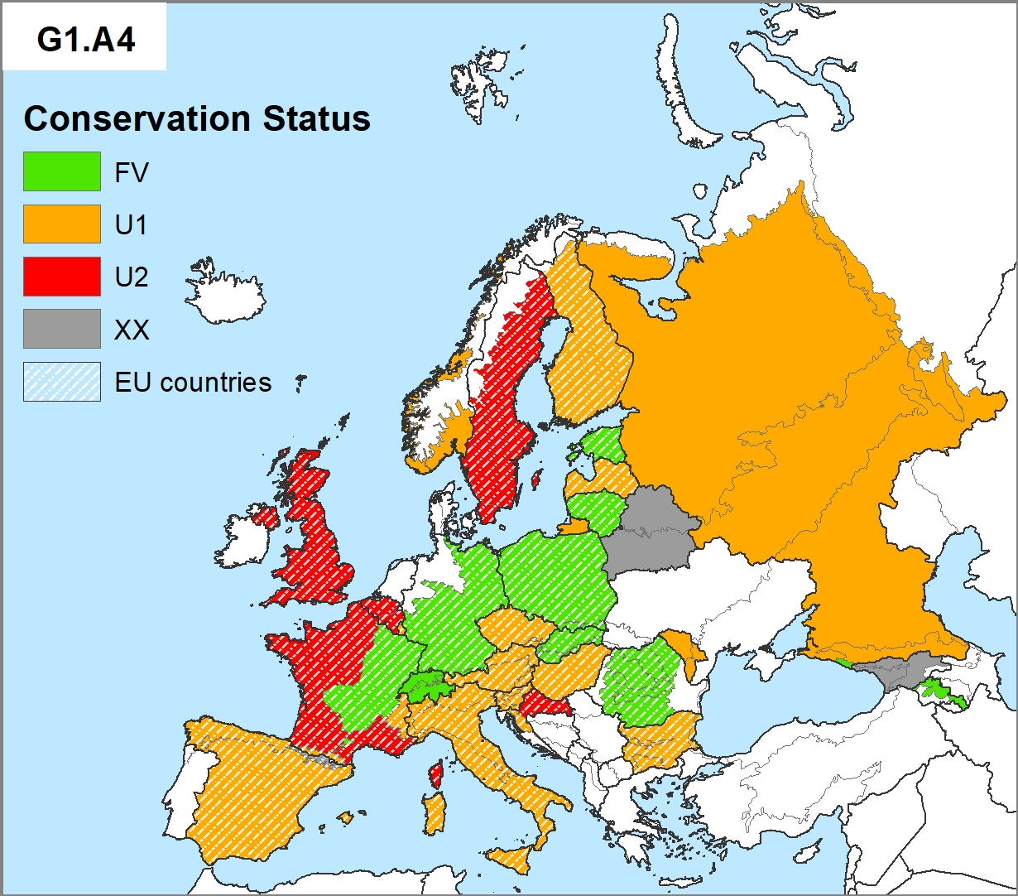
Agenda Item 5.8
Conservation Status as given by the countries
Ravine and slope woodland

Slide 15
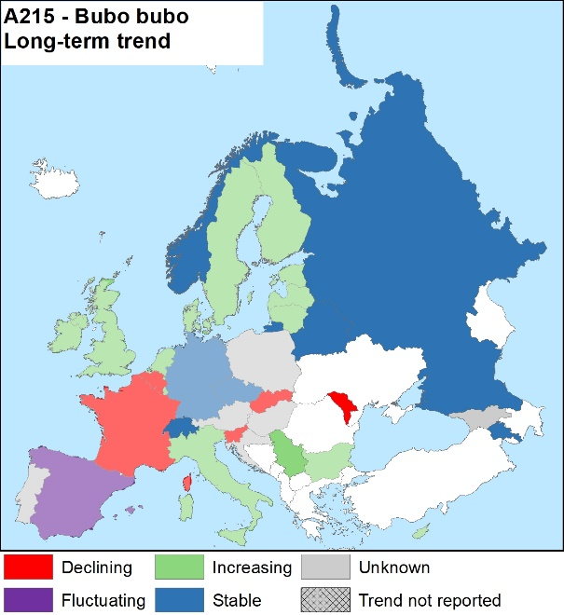
Agenda Item 5.8
For Birds: Long-term trend data as given by the countries

Slide 16
Agenda Item 5.8
Recommendations
Need to decide on public availability of the data:
Minimally as raw data
Ideally as a querriable IT-Tool as available for Art. 17 and Art. 12
Further evaluation and preparation of the next reporting round
Develop the CheckList for all features and all possible countries
Enhance compatibility with Art. 17 and 12 reporting by including other species (like Annex IV and V species of the HD) and related data fields (like huntable species)
More attention to the “typical species” for assessing conservation status for habitats
Produce a short questionnaire to countries to better understand the process at country level
Preparation of the next reporting round (2019-2024) according to needs and future decisions

Slide 17
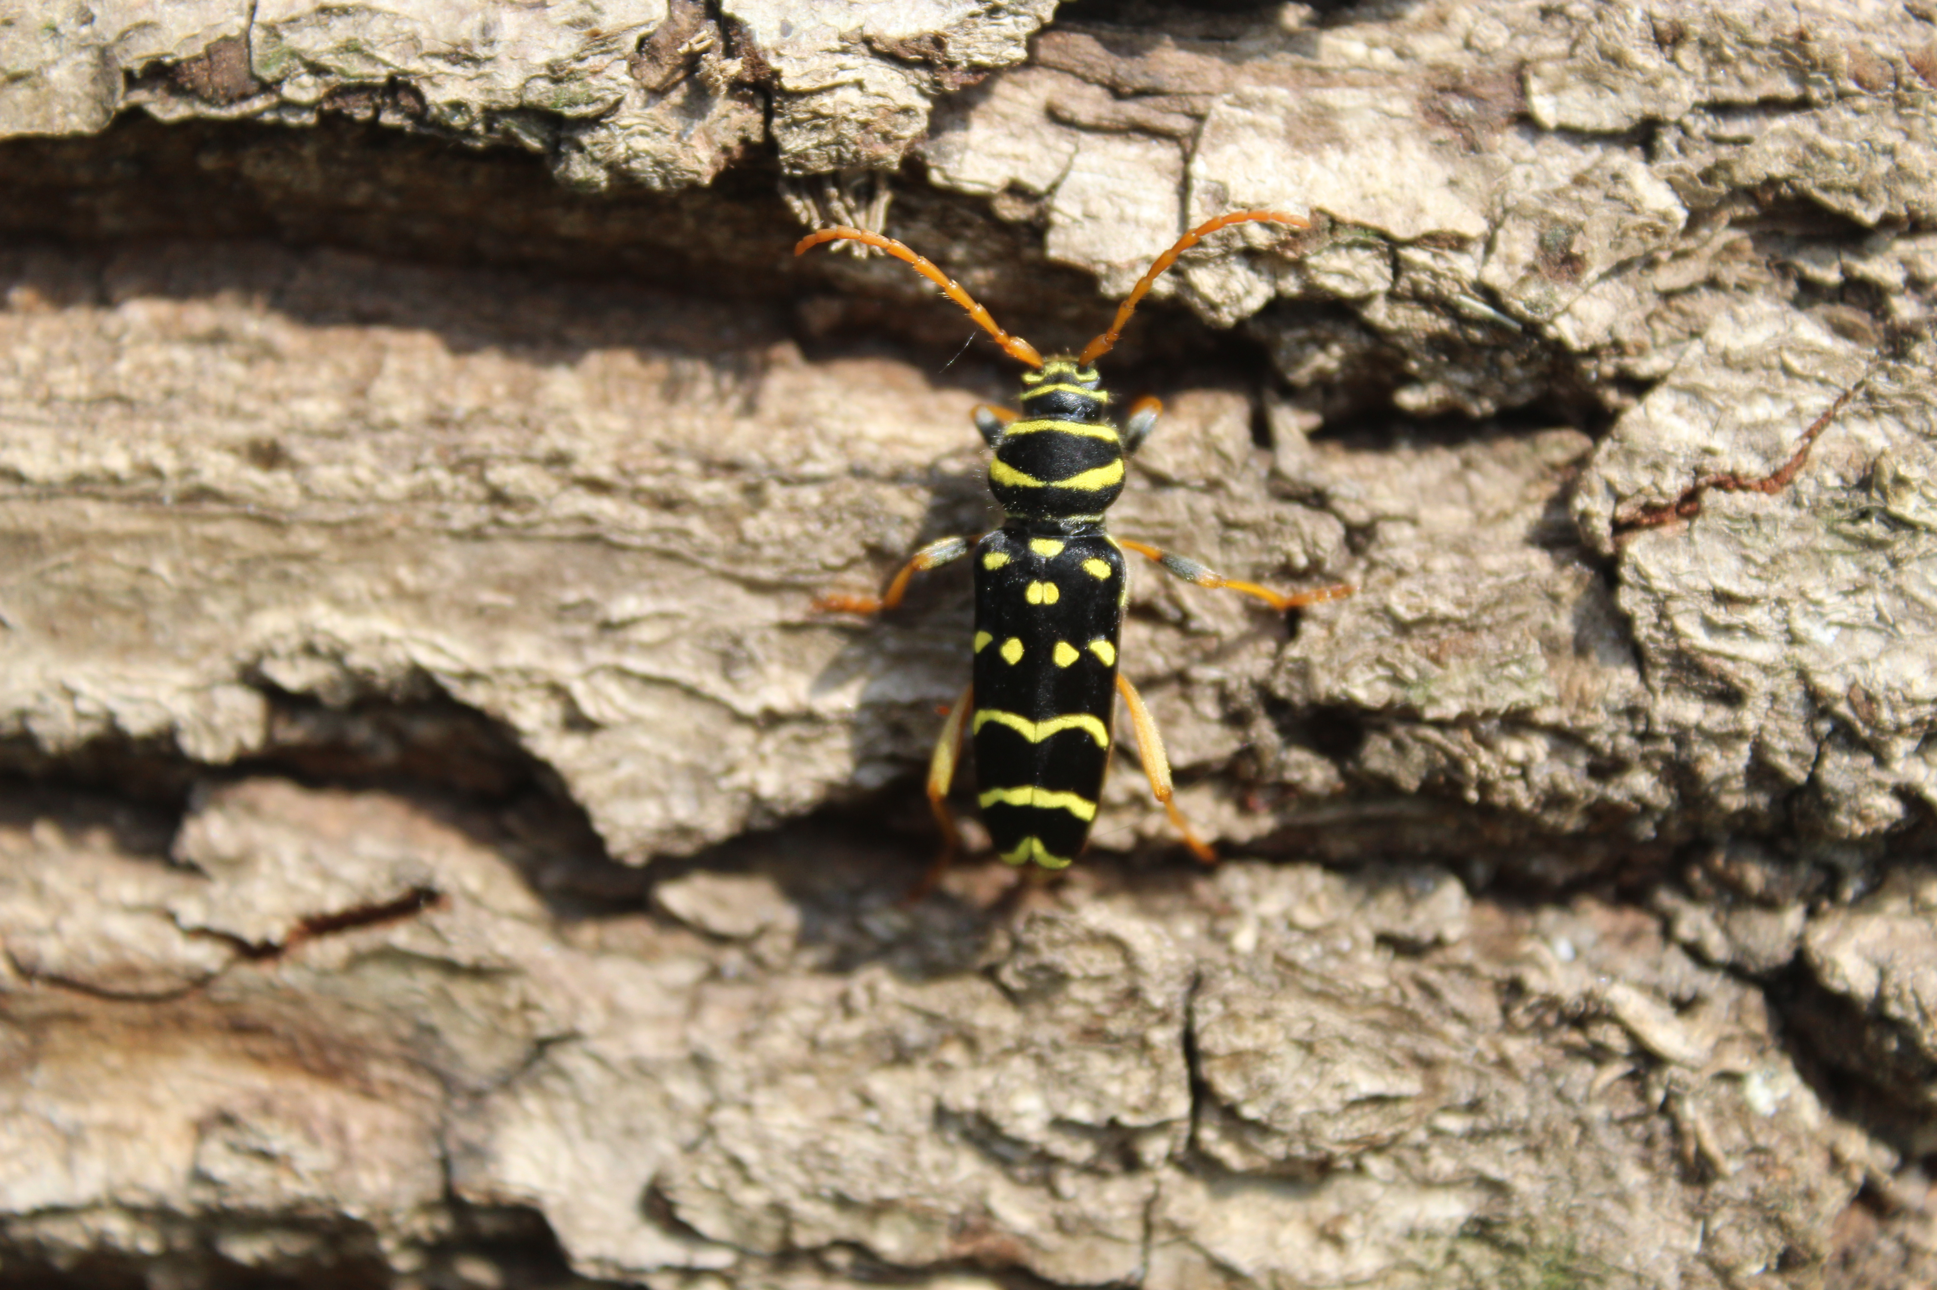
Thank you for your attention
Agenda Item 5.8
Plagionotus arcuatus

