Slide 1
European Diploma for Protected Areas in 2020
Jan Plesník
Nature Conservation Agency of the Czech Republic
Prague
40th Meeting of the Standing Committee to the Convention on the Conservation of European Wildlife and Natural Habitats, Strasbourg,
30 November - 4 December 2020

Slide 2
European Diploma
European Diploma – a prestigious award since 1965
Only 75 sites in 29 European countries have been awarded yet
https://www.coe.int/en/web/bern-convention/european-diploma-for-protected-areas

Slide 3
European Diploma
Report of the annual meeting of the Group of Specialists on the European Diploma for Protected Areas
18- 19 March 2020 virtual meeting
T-PVS/DE (2020) 18

Slide 4
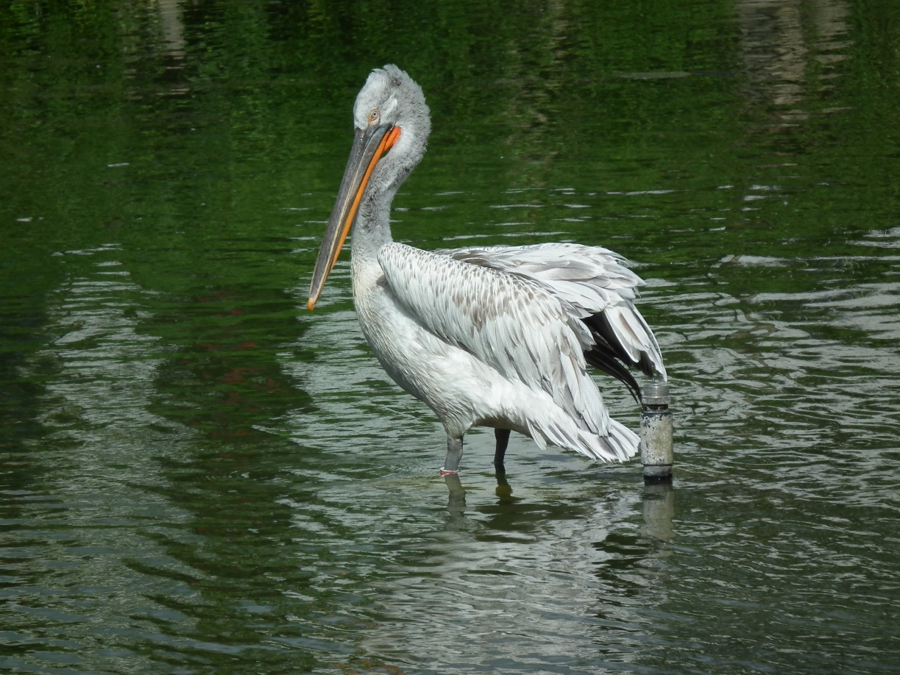
European Diploma
Renewal of the Diploma to 13 areas and the new one, the latter being the Regional Park Gallipoli Cognato, Italy
Document
T-PVS/DE (2020)12

Slide 5
European Diploma
In 2020, 13 on-the-spot appraisal visits to areas whose ED is due in 2021 planned
COVID-19 restrictions applied→ visits had to be delayed
9 sites for 2021
Notes:
Retezat National park, Romania

Slide 6
European Diploma
The ED will not be renewed to the French National Park Ecrins upon its request of its administration
The GSED had expressed its concern regarding the deteriorating situation in the Scandola Nature Reserve (France) and decided not to renew its Diploma

Slide 7
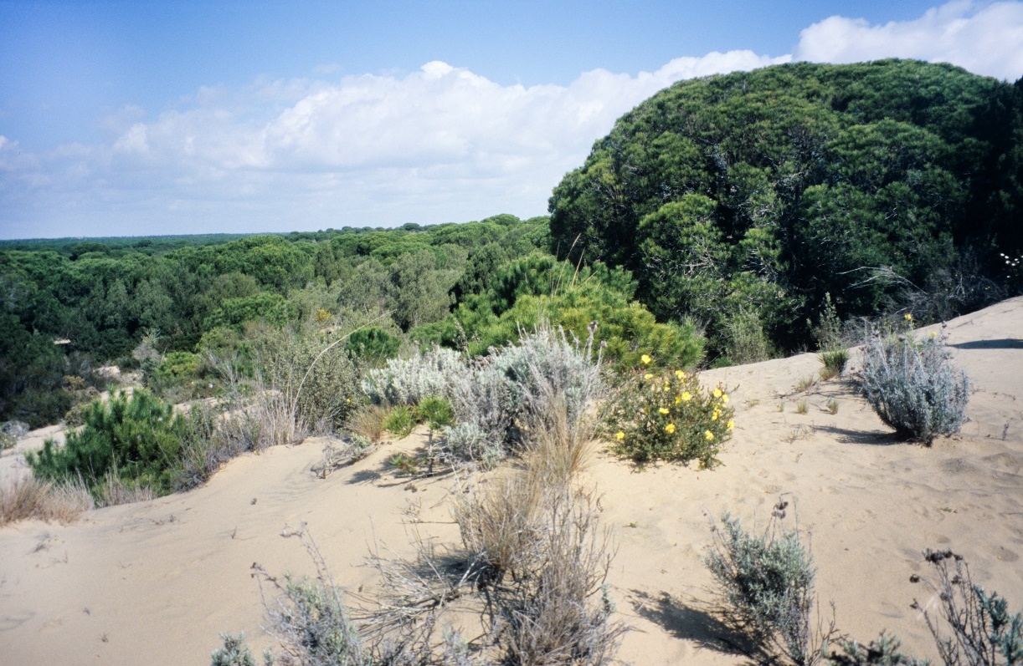
European Diploma
The GSED had expressed its concern regarding the deteriorating situation in the Doñana National Park (Spain) and decided to postpone the renewal of its Diploma

Slide 8
European Diploma
The ongoing updates of the dashboard and the database of the European Diploma and the mapping of the multiple designations/certifications held by Diploma awarded areas

Slide 9
European Diploma
Discussion on a vision for the European Diploma for the next decade
Visionary statement
Three priorities

Slide 10
European Diploma
Appreciation to:
Members of the Group
Secretariat
Independent experts
ED holder management authorities

Slide 11
European Diploma
Thank you very much for your attention
Děkuji za pozornost

