Slide 1

Convention on the Conservation of European Wildlife and Natural Habitats
Standing Committee
EVALUATION OF THE 2011-2020 EMERALD NETWORK WORKPLAN
Otars Opermanis & Marc Roekaerts

Slide 2
Background
Achievements of the Emerald Network workplan 2011-2020 needs to be assessed as this is the last year of the plan period
Emerald Network workplan earlier referred to as the «Calendar» for the implementation of the Emerald Network of Areas of Special Conservation Interest
This work is closely related to:
  Development of Emerald Network Monitoring Framework
  Proposal of a post-2020 Emerald Network workplan

Slide 3
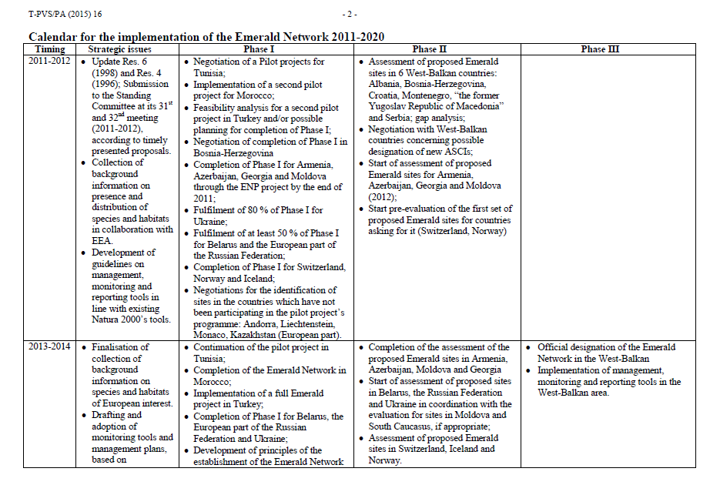
Contents of the workplan

Slide 4
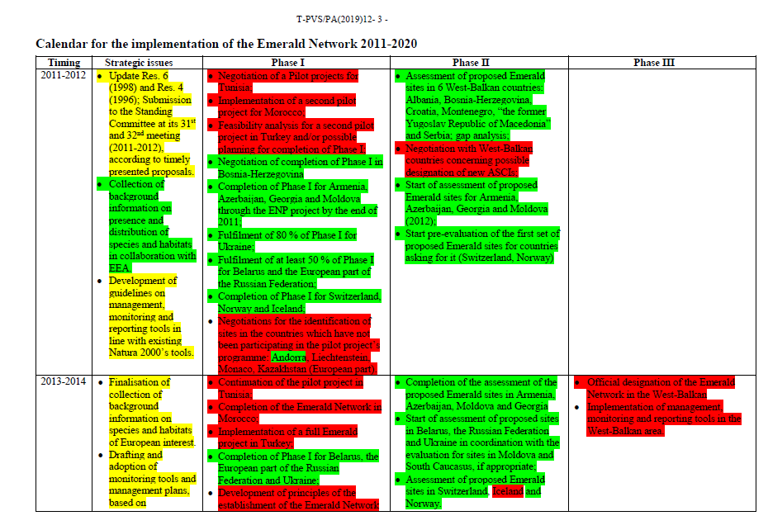
Yearly progress assessments

Slide 5
+ two «targets» for 2020
The Emerald Network of Areas of Special Conservation Interest is fully operational to guarantee the long-term survival of all species and habitats of European Interest, including appropriate management, monitoring and reporting tools, compatible with NATURA2000
Procedures for continuous updating of the data and evaluation of the long-term survival of the species and habitats have been put in place

Slide 6
Method of evaluation
Assessing progress report 2019
Updated progress by October 2020 (addtional table presented in the report)
Used information supplied by the Secretariat and observations by consultants
Used Emerald Network site database, Emerald Network conclusions database, Natura 2000 site database, Natura 2000 conclusions database [databases included most recent and historic versions]
Calculated statistics about implementation of activities
Trying to identify reasons of failure to implement certain activities (clustering of countries)

Slide 7
Basic statistics (facts)
None of targets 2020 are met (although there are significant IT advancements as regards to data submission and viewing)
Of 41 activities listed in the 2011-2020 workplan, 35% were considered completed, 20% as ongoing and 45% as outstanding
Nine countries have not started even the Phase I of Emerald Network constitution
Six other countries have no significant progress in the past 6-7 years

Slide 8
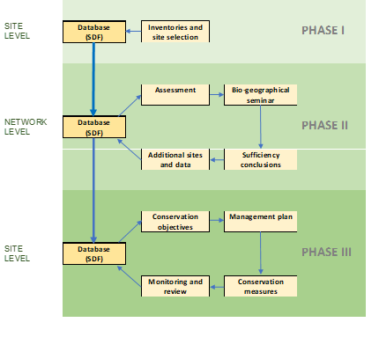
Problems in evaluation and solution
2011-2020 workplan lacked any measurable targets
It was possible only to assess if activity was «done», «in progress» or «not done»
Cyclic character of Phases: it is difficult to assert that the Phase has been completed, but it is easy to say that the Phase has been started
We used proposed outcome-related indicators of the proposed Emerald Monitoring Framework to better see where non-EU countries are in the process

Slide 10
A need for reference value?
The overall 2020 target has been over-ambitious?
What could have been realistically done during 2011-2020?
Proposal to use historical data about progress of developing Natura 2000 network
Natura 2000 values of 2006 mark 10 year period after the launching of bio-geographical process in 1996
This corresponds to 2020 situation for Emerald Network, i.e. 10 years after starting bio-geographical process in 2011

Slide 11
Comparison
NON-EU: Average national cover of all types of Emerald sites in 2020 is 14.8%
EU: Average national cover of SPAs and SCIs in 2006 were 8.9% and 12.1% accordingly
NON-EU: Average sufficiency index for Emerald countries in 2020 is 21.7%
EU: Average sufficiency index for SCI part of Natura 2000 network in 2006 was 82.6%

Slide 12
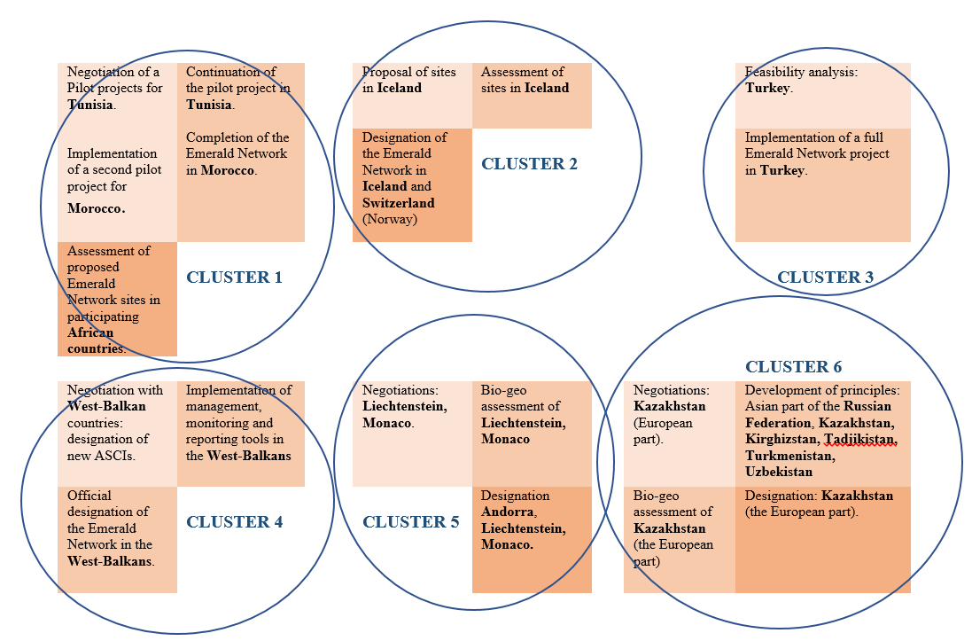
Reasons of failure to reach objectives
It is important to understand the obstacles which prevented countries from reaching better progress
Clustering of countries and outstanding activities did not help to identify reasons
Possibly reasons are country-specific
A special survey is proposed to inform better the Secretariat about the reasons of inactivity and invite countries to submit ideas for future work

Slide 13
Closing remarks
Numeric data from the proposed Emerald barometer already shows good progress in some countries
Most «strategic» issues/activities which were classified as «ongoing» are actually recurring activities. Thus they could have been evaluated with apositive sign (green)
The outcome of this evaluation has been used for the subsequent task: proposal for post-2020 workplan

