Slide 1
CONVENTION ON THE CONSERVATION OF EUROPEAN WILDLIFE AND NATURAL HABITATS 40th Standing Committee Emerald Network IT-Tools Update Marc Roekaerts
Notes:
A few words on the Council of Europe and why the Convention was negotiated there.

Slide 2
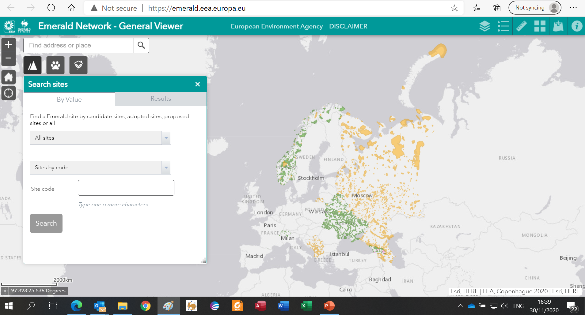
Agenda Item 5.7.1c
New version of the Emerald Viewer Online
https://emerald.eea.europa.eu

Slide 3
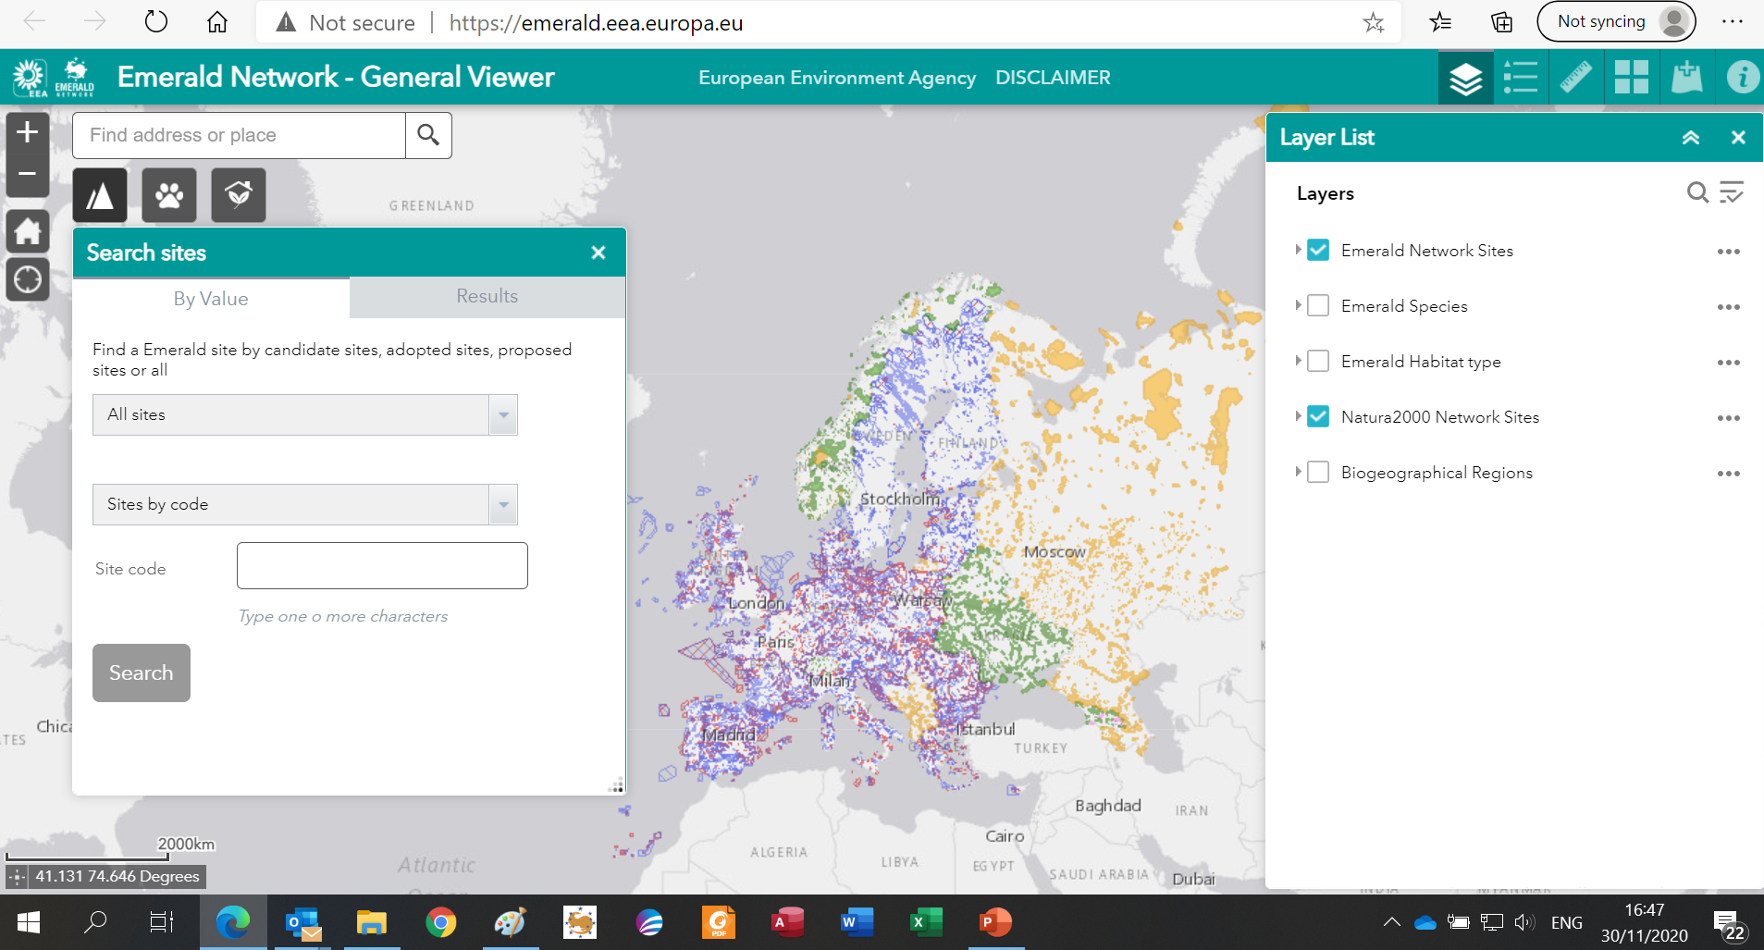
Agenda Item 5.7.1c
Combined view with Natura2000 is possible

Slide 4
Agenda Item 5.7.1c
Introduction
IT-Tools are needed to streamline and enforce data quality
Thanks to recent investments further developments are possible (the Bern Convention secretariat, the European Environment Agency and a voluntary contribution of Norway)
3 levels considered:
CDR data delivery: QA/QC
International Emerald Network data management: WebApp
Making the data public: the Emerald Network Viewer

Slide 5
Data flow cycle
Country Data
Standard Data Form
SDF (Tabular)
Site boundaries
Official Delivery on
Central Data Repository
CDR managed by EEA
European Dataset
Management
IT-Tool
SDF manager
IT-Tool
CDR
IT-Tool
Emerald Web App
Used for
Evaluation Seminars
Public version
Emerald Viewer

Slide 6
Data flow cycle
Country Data
Standard Data Form
SDF (Tabular)
Site boundaries
Official Delivery on
Central Data Repository
CDR managed by EEA
European Dataset
Management
IT-Tool
SDF manager
IT-Tool
CDR
IT-Tool
Emerald Web App
Used for
Evaluation Seminars
Public version
Emerald Viewer

Slide 7
Agenda Item 5.7.1c
Data Delivery on the CDR
Until today, CDR is just a “mailbox” for “organised” data deliveries
From next year on: better use of the background tools behind the CDR
The delivery folder needs to be officially “released” by the country and the delivery needs to be “ended” before data can be harvested by CoE
Automated QA/QC rules will be implemented and a QA/QC report will be automatically available to the country
Deliveries with wrong formats or incomplete spatial layers will be automatically blocked by the system and a warning will be send to the country indicating a new delivery is needed
No content related blockers will yet be implemented, but warnings for wrong content for important fields will be listed
When a delivery is accepted, the system will generate a short report, available in the same folder. This report will need to be send to the secretariat, proving a correct delivery

Slide 8
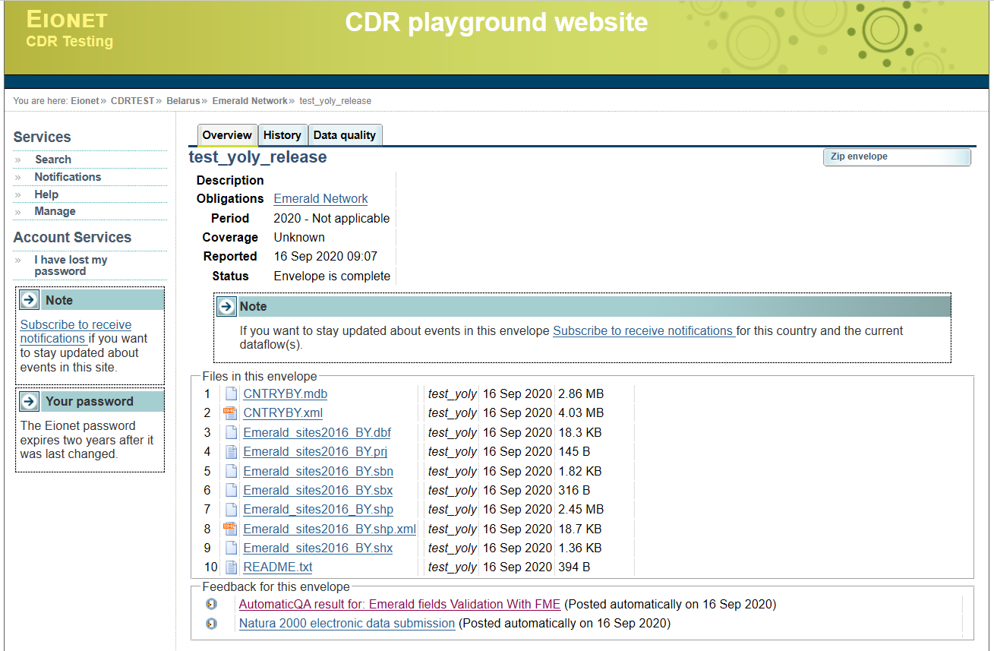
Agenda Item 5.7.1c

Slide 9
Agenda Item 5.7.1c
Emerald Network IntraNet (WebApp)
For international data management by the secretariat and international consultants
Includes:
(Semi-)automated harvesting of country data from the CDR
Creation of change report for tabular as well as spatial data
Creation of the Lists of Adopted (ASCI-List) and Candidate site lists
From next year on, those lists will include reference to the accepted changes to the site boundaries and site tabular data
More elaborated QA/QC reports for tabular and spatial data
Historical release management (comparing two data sets from different years)
Will produce minimally yearly a new release of the Emerald Network database to be used in the Emerald Viewer and be put available for the wider public (does not include sensitive species)

Slide 10
Agenda Item 5.7.1c
Emerald Network Public Viewer
https://emerald.eea.europa.eu/
Fully aligned with all options available for the NATURA2000 Viewer
Includes:
All types of Emerald Network sites: Adopted, Candidate and Proposed
Query options for sites, species and habitats
Use of different types of base maps
Minimally yearly updated according to the new releases of the Emerald Network database created by the Emerald Network WebApp (does not include sensitive species)
Need to find the proper way to make the barometer data visible

Slide 11
Summary Note
Thanks to the additional budget from the Bern Convention and the EEA, all the above is now under development and will be available by the end of this year
The Emerald Network dataflow will be much more automated and QA/QC procedures will enhance the description and data quality
Historical data release management will allow for better data transparency about the historical knowledge of the data flow
Finally, more people, experts and non-experts, will be able to benefit from the Emerald Network data
Thank you !!

