Slide 1


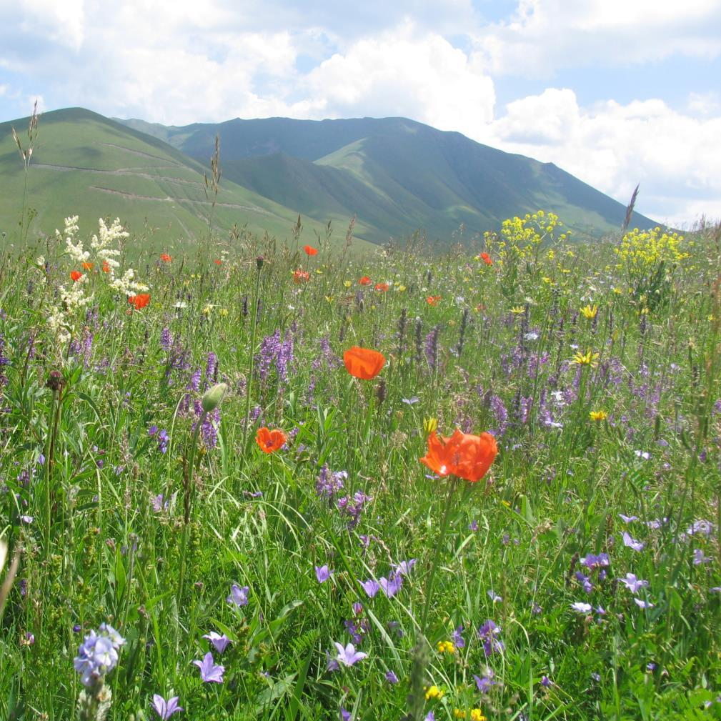


40th Standing Committee of the Bern Convention
December 1, 2020
European progress towards the Global Strategy for Plant Conservation
2011-2020
The Review in a nutshell

Slide 2
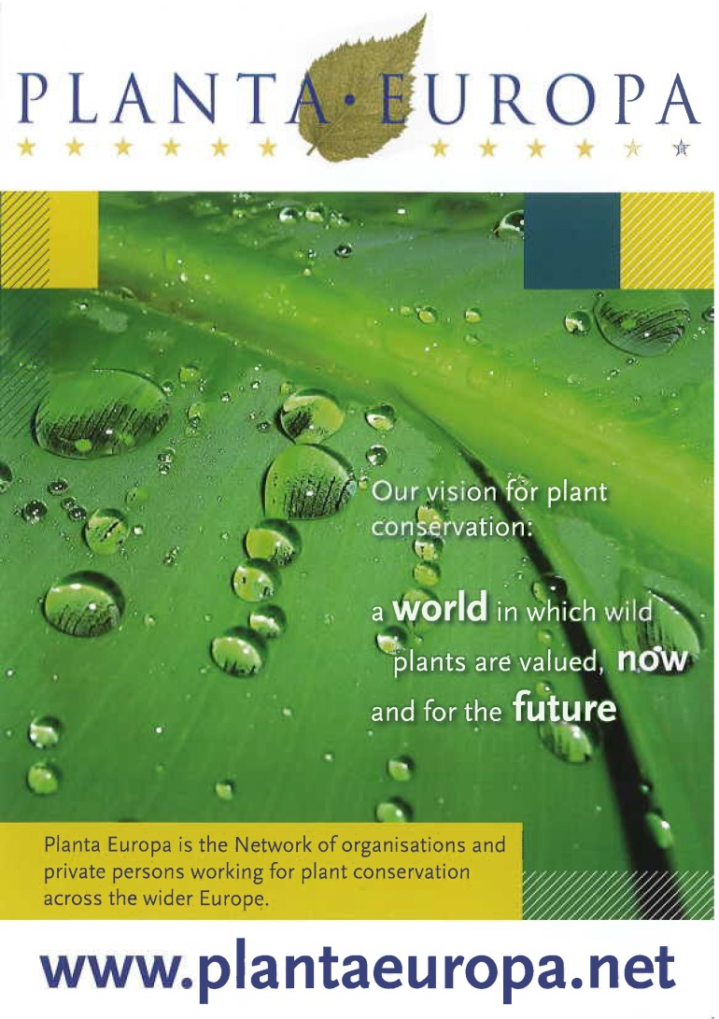
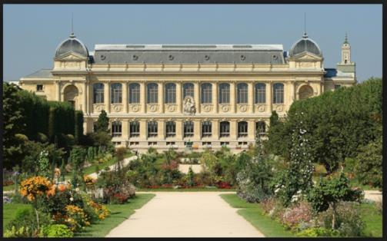

Network founded in the 1990’s
A world in which plants are valued, now and for the future
Foundation (Wales regulations)
Secretariat hosted by PLANTLIFE, The Hague (JWS) and Uppsala (SLU).
More than 70 members
As from 2019: Association (French regulations)
Secretariat hosted by the National Museum of Natural History, Paris.

Slide 3
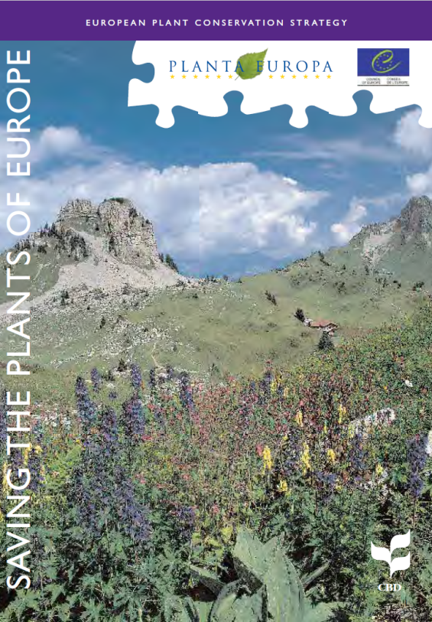
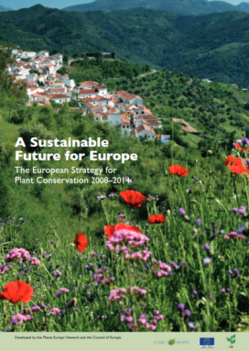
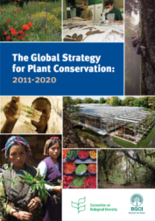



CBD-Global Strategy for Plant Conservation (GSPC): the main global Agenda for plants (implemented by BGCI and GPPC).
European Plant Conservation Strategy (EPCS): a strong background for the emergence of the Global Strategy for Plant Conservation.
European Strategy: the regional response to the GSPC (CBD Secretariat), and the “most developed response to the GSPC so far” (GPPC).
PLANTA EUROPA: Implementation of the EPCS since 2001.

Slide 4
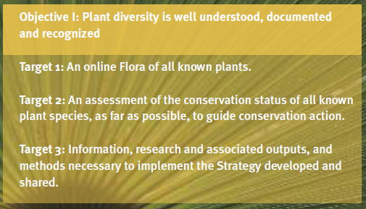
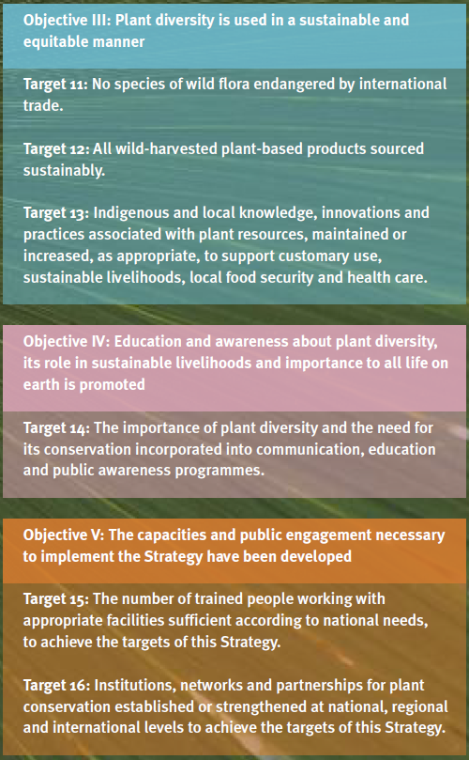
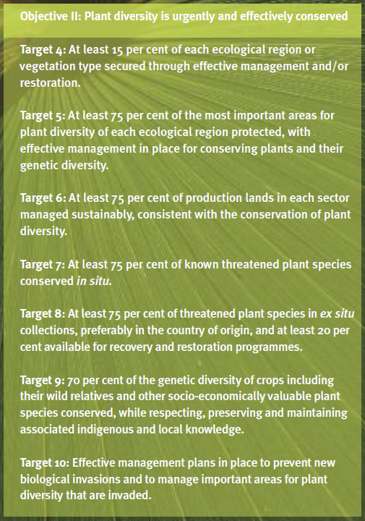
European Plant Conservation Strategy: 16 Targets fully aligned with the GSPC Targets.
GSPC: Scope of the 2020 review to assess the European progress.

Slide 5

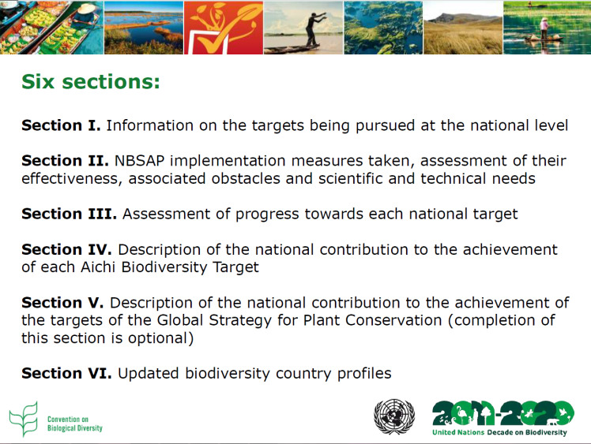
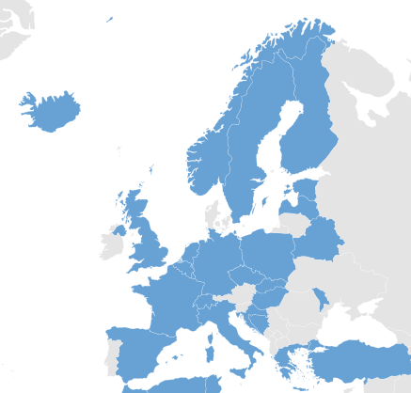
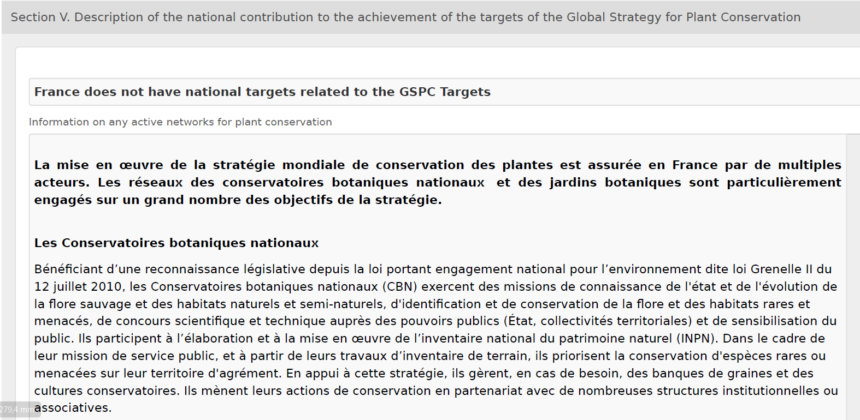
Data providers: CBD 6th National Reports, Section V « Achievement of the targets of the GSPC ».
Main gaps:
  Section V optional
  6th NR not translated
  6th NR not available
- Additional data : CBD-GSPC National Focal Point

Slide 6
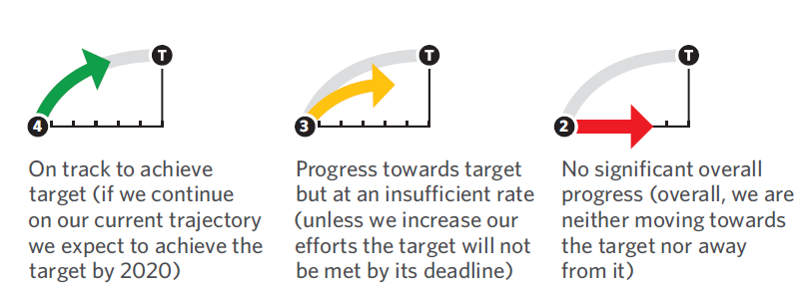
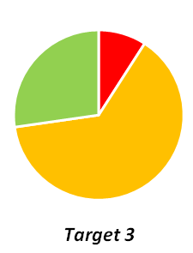
16 assessed Targets:
Background
European progress
National implementation:
  Red-Amber-Green assessment of the 6th NR
  Pie-chart at the European scope
  List of outstanding contributions (not comprehensive)
  Case studies
Issues to consider
Executive summary : key issues/messages

Slide 7
Enhancing capacities / Networking
Knowing
Conserving
Using sustainably
Raising awareness
Raising awareness
Enhancing capacities / Networking
Using sustainably
Knowing
Conserving

Slide 8
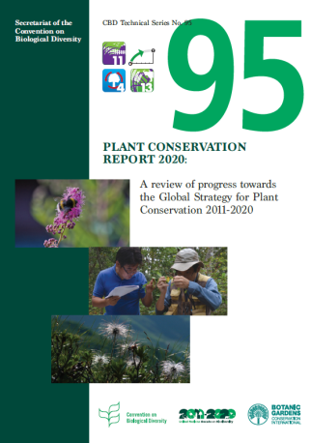

Progress towards GSPC Objectives I-V + World
Enhancing capacities / Networking
Knowing
Conserving
Using sustainably
Raising awareness
Europe
World
Europe
World
Europe
World
Europe
World
Europe
World

Slide 9
Progress towards GSPC targets 1-16 + World
Enhancing capacities / Networking
Raising awareness
Using sustainably
Knowing
Conserving
Europe
World
IAS
In situ conservation
International trade
Conservation status assessment
Management of production lands

Slide 10
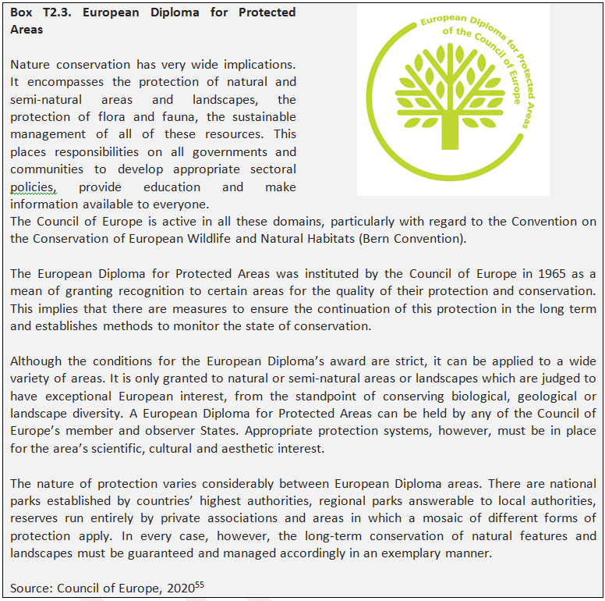
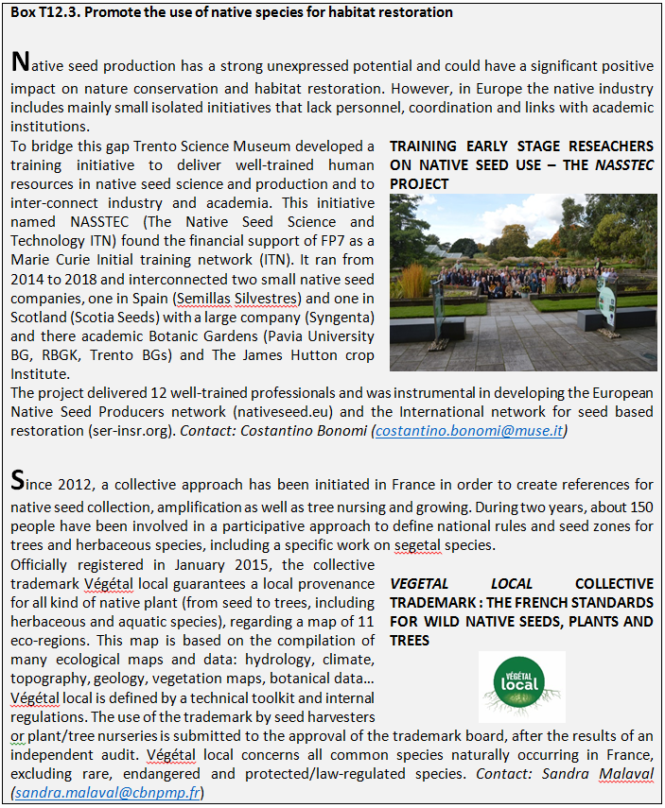
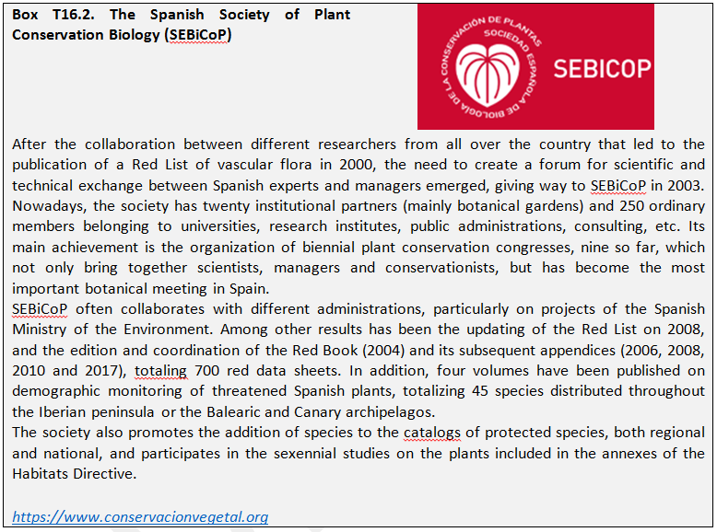
~40 outstanding and inspiring case-studies
bardin@mnhn.fr

Slide 11

SAVE THE DATE!
13-17 September 2021
National Museum of Natural History, Paris, FRANCE
9thplantaeuropa@sciencesconf.org
“Armed with these progress assessments, the PLANTA EUROPA network emphasizes that international, regional and national agendas are core contributions to plant and habitat conservation and urges governments - as well as international and national bodies - to strengthen their human and financial support and to move towards the development of more integrative policies for plant and habitat preservation”.
Ph. BARDIN, PLANTA EUROPA Chair in Pain, D.J., Bardin, Ph., Hutchinson, N., Pénzesné Kónya, E. & Krause, M. 2020. A review of European progress towards the Global Strategy for Plant Conservation 2011-2020. PLANTA EUROPA and Plantlife International, 160p. Council of Europe.

