Slide 1

7th meeting of the Ad hoc Working Group on Reporting
Summary of the webinar on FRV, habitat condition and future prospects

Slide 2
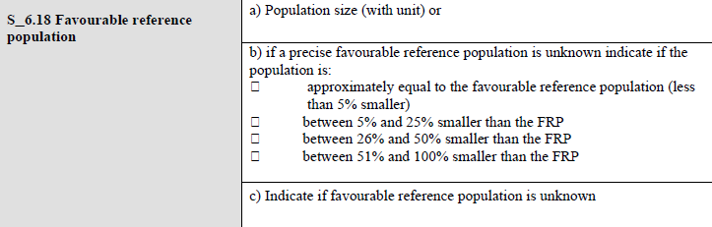
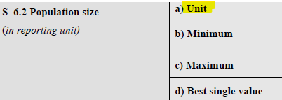
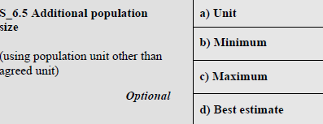

Favourable Reference Values
FRV are used to calculate the Overall Conservation Status (matrix)
FRR for a habitat or species will determine the final range conservation status
FRP for a species will determine the final population conservation status
FRA for a habitat will determine the final conservation status of the habitat’s area

Slide 3
Favourable Reference Values
Rules applying to ensure that conditions stablished in the Conservation Status Matrix are respected (trends not considered for simplification purposes):
 | FV | U1 | U2 | Unknown
Range SP | CV≥FRR |  | CV ≈10% below FRR | No data on Range and/on FRR unknown
Pop SP | CV≥FRP |  | CV ≈ 25% below FRP | No data on Pop and/on FRP unknown
Range HT | CV≥FRR |  | CV ≈10% below FRR | No data on Range and/on FRR unknown
Area HT | CV≥FRA |  | CV ≈10% below FRA | No data on Area and/on FRA unknown

Slide 4
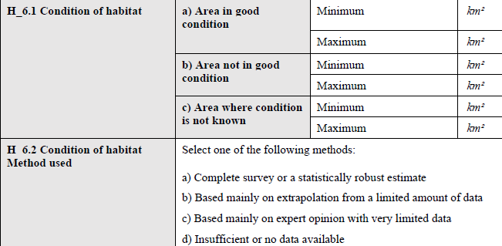
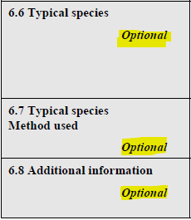
Habitat Condition
You cannot use H_6_2: insufficient when area in good and not good condition is provided
Inversely, when area condition is unknown-> Method used: insufficient

Slide 5
Habitat Condition
Rules applying to ensure that conditions stablished in the Conservation Status Matrix are respected (trends not considered for simplification purposes):
 | FV | U1 | U2 | Unknown
Structure & functions | In good condition |  | > 25% area in non-good condition | No data on habitat condition
Incoherent information. The sum of the mean of [H_6_1_a_condition_good_min] and [H_6_1_a_condition_good_max] and the mean of [H_6_1_b_condition_notgood_max] and [H_6_1_b_condition_notgood_min] and the mean of [H_6_1_c_condition_unknown_max] and [H_6_1_c_condition_unknown_min] should be approximately the same as the mean of [H_5_2_a_surface_area_min] and [H_5_2_b_surface_area_max] or [H_5_2_c_surface_area_best_single_value].
Information missing. If [H_6_6_a_typical_species_change] is 'Yes' and attachment should be provided in any row in [H_6_6_b_typical_species_list] field and a comment in [H_6_8_additional_information_structuresandfunctions]

Slide 6
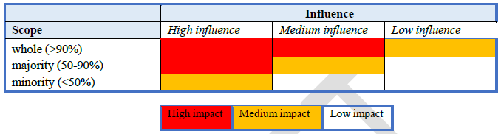
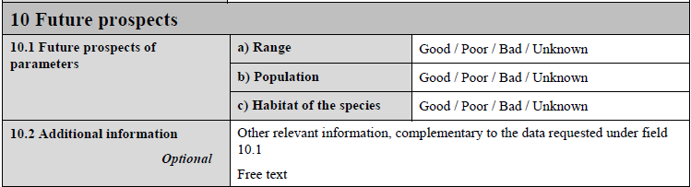
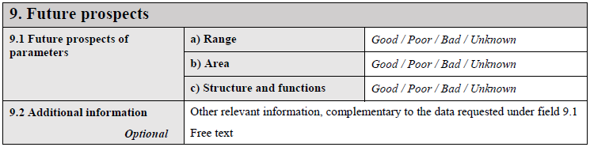
Future prospects
FUTURE PROSPECTS
Threats
Future trends
Conservation Status
Conservation measures

Slide 7
Future prospects
Future Prospects | Assessment criteria
FV | Main pressures & threats are not significant, long-term variability assured. All parameters (range, area, structure & functions) have good prospects or the prospect of one parameter is unknown while the others are good.
U1 | Prospects of one or more parameters (range, area, structure & functions) are poor (but none has bad prospects). Just one unknown prospect.
U2 | Sever influence of pressures & threats. Long-term viability at risk. Prospects of one or more parameters (range, area, structure & functions) are bad.
XX | No information or insufficient reliable information. Prospects of two or more parameters (range, area, structure & functions) are unknown.

Slide 8
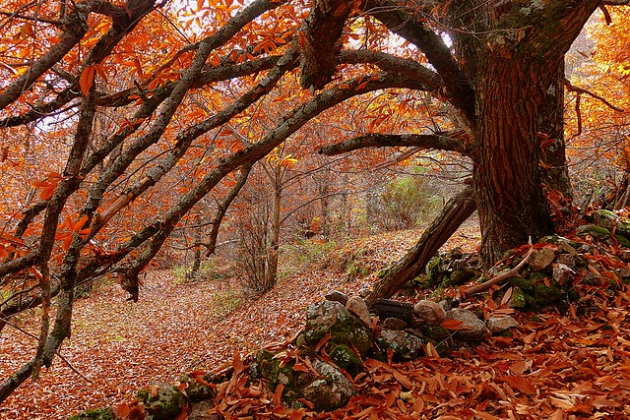
Thank you for the attention

