Slide 1
Checking criminal records in sport
Experiences from Norway / International challenges
Webinar organised by the EPAS Consultative Committee
Thursday June 3rd 2021
Håvard B. Øvregård
Senior adviser, The Norwegian Olympic and Paralympic
Committee and Confederation of Sports

Slide 2
Why?

Slide 3
Vision:
Joy of Sport
– for All

Slide 4
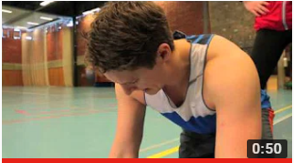
Timeline
2000: Research shows 28 % of female elite athletes have experienced sexual harassment in sport (Fasting & Sundgot-Borgen)
2000: Guidelines against sexual harassment
2009: Required police-checks (certificate) for those with responsibility for children or people with intellectual disabilities
2010: New revised guidelines against sexual harassment and abuse in sport
2011: A dedicated staff member
2013: Five films for use in education and preventive work
2017: Guide for dealing with cases regarding sexual harassment and abuse
2018: Start to talk – Campaign launch in Norway
2021: Report: “Ethical and safe sport”

Slide 5
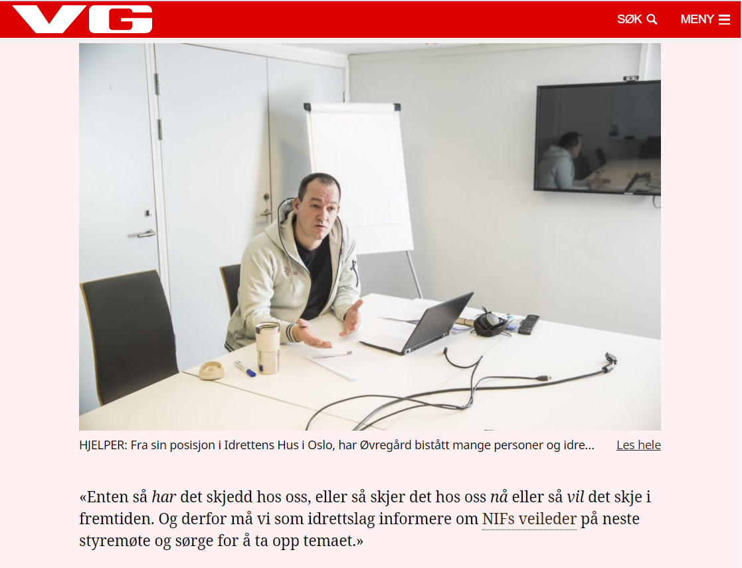
“Every sports club must be aware,
either;
it has happened in our club,
or it happens now,
or it will happen in the future”

Slide 6
«Politiattest»
Politiattest = Police-attestation
Legal basis – State
Legal basis – Sport
Procedures
Challenges

Slide 7
Law on treatment of information in the police and the prosecution authorities (police-registration-law)
§ 37. Purposes that entitles use of police attestation
4) [if] exclusion can prevent persons to commit abuse to or have negative influence on minors, or contributes to increase the confidence in minors being taken care of by qualified persons
§ 39: Police attestation for persons who shall have care for or tasks related to minors (child-care-attestation)
Regulates:
Someone with a position that implies a confidence- or responsbility-relation to minors or persons with intellectual disabilities.
Regularity, including the potential to develop a relation of trust over time
Notes:
Lov om behandling av opplysninger i politiet og påtalemyndigheten (politiregisterloven)
§ 37.Formål som berettiger bruk av politiattest
4) utelukkelse kan forhindre at personer begår overgrep mot eller har skadelig innflytelse på mindreårige, eller bidrar til å øke tilliten til at mindreårige tas hånd om av skikkede personer,
§ 39 Politiattest for personer som skal ha omsorg for eller oppgaver knyttet til mindreårige (barneomsorgsattest)

Slide 8
Law on treatment of information in the police and the prosecution authorities (police-registration-law)
§ 39: (child-care-attestation): Shall include information if the person is charged for or sentenced for violations of the following paragraphs in the Penal Code;
§231, §232: Narcotics-related crimes
§257, §258: Trafficking-related crimes
§ 274, § 275: Major bodily harm / Murder
§ 282, § 283: Maltreatment in close relations (family, etc.)
§§ 291 – 314: Sexual crimes (17 paragraphs)
§ 327, § 328: Robbery
(some of the violations will be deleted after a set time)

Slide 9
Legal basis - Sport
NIF demands that everyone (over 15) with a position that implies a confidence- or responsbility-relation to minors or persons with intellectual disabilities shows a “clean” police attestation.
Board-decision 2008, in function from 1/1 2009
NIFs law: Every sport club that organises activities for minors or persons with intellectual disabilities shall have a board member responsible for police-attestations (criminal record check)

Slide 10
Procedure
The person must him-/herself send an application to the police for the attestation
Can be done electronic, and is free of charge
Attached to the application there must be a confirmation from the Sport club that the person has relevant responsibilities that demands a police attestation
When the police has processed the application, the attestation is sent to the person applying.
This person must show the police attestation to (responsible person) in the Sport club
The responsible in the Sport club keeps record of who has been requested to show police attestation, that the attestation is presented, and at which date.
The attestation is NOT kept by the Sport club
If the attestation is not «clean», the person can not have the relevant responsibilities.
There is no possibility to do exceptions from this rule.

Slide 11
Renewal
Renewal originally every 3rd year
Since 2017: Not possible to renew
Current dialogue with Police and Government

Slide 12
Challenges
Those convicted are a minority…
Activities outside NIF / organised sport
Crimes committed abroad
Renewals
Systems for registration

Slide 13
Challenges
Those convicted are a minority…
Activities outside NIF / organised sport
Crimes committed abroad
Renewals
Systems for registration

Slide 14
International perspective
Coaches from another country
How to obtain a criminal record check from another country?
Information about other countries legislation
Possibility to warn clubs/federations abroad
What about those not charged/convicted?

Slide 15
You can not be neutral

Slide 16
Joy of Sport
for ALL

Slide 17
Håvard B. Øvregård
Senior adviser
m: +47 91 77 31 57 havard.ovregard@idrettsforbundet.no
www.idrettsforbundet.no/english
The Norwegian Olympic and Paralympic Committee and Confederation of Sports

