Slide 1
Council of Europe Human Rights and Technologies in Biomedicine Committee on Bioethics Seminar Early Intervention on Intersex Children, Promoting the Rights of the Child
Can medicalising be made compatible with humanising child and family?
Lih-Mei Liao PhD FBPsS
Consultant Clinical Psychologist
Independent Practice
(formerly University College London Hospitals, UK)

Slide 2
Declarations (and caveats)
No known conflict of interests, but many biases:
Trustee of Interconnected UK - https://interconnecteduk.org
Founding committee member of Psychosocial Studies in Intersex International - https://psiinternational.wixsite.com
I refer to babies with an intersex variation, not intersex babies
I dialogue with medicine and also use the term differences in sex development (DSD)
Please do not screenshot slides that reference published works – they are clearly referenced to enable you to go to source – thank you.
Notes:
RG is a real SIPSMART patient entering the trial

Slide 3
Magritte E. Working together in placing the long term interests of the child at the heart of the DSD evaluation. J Pediatr Urol 2012; 8(6):571-5.
“I believe that there are two key factors in helping [children] to come to terms with their condition. One is that their parents accept and are comfortable with the physical effects of their condition and the other is that the emphasis of their condition is not placed on these obvious physical effects.”

Slide 4
CONTENT

Slide 5
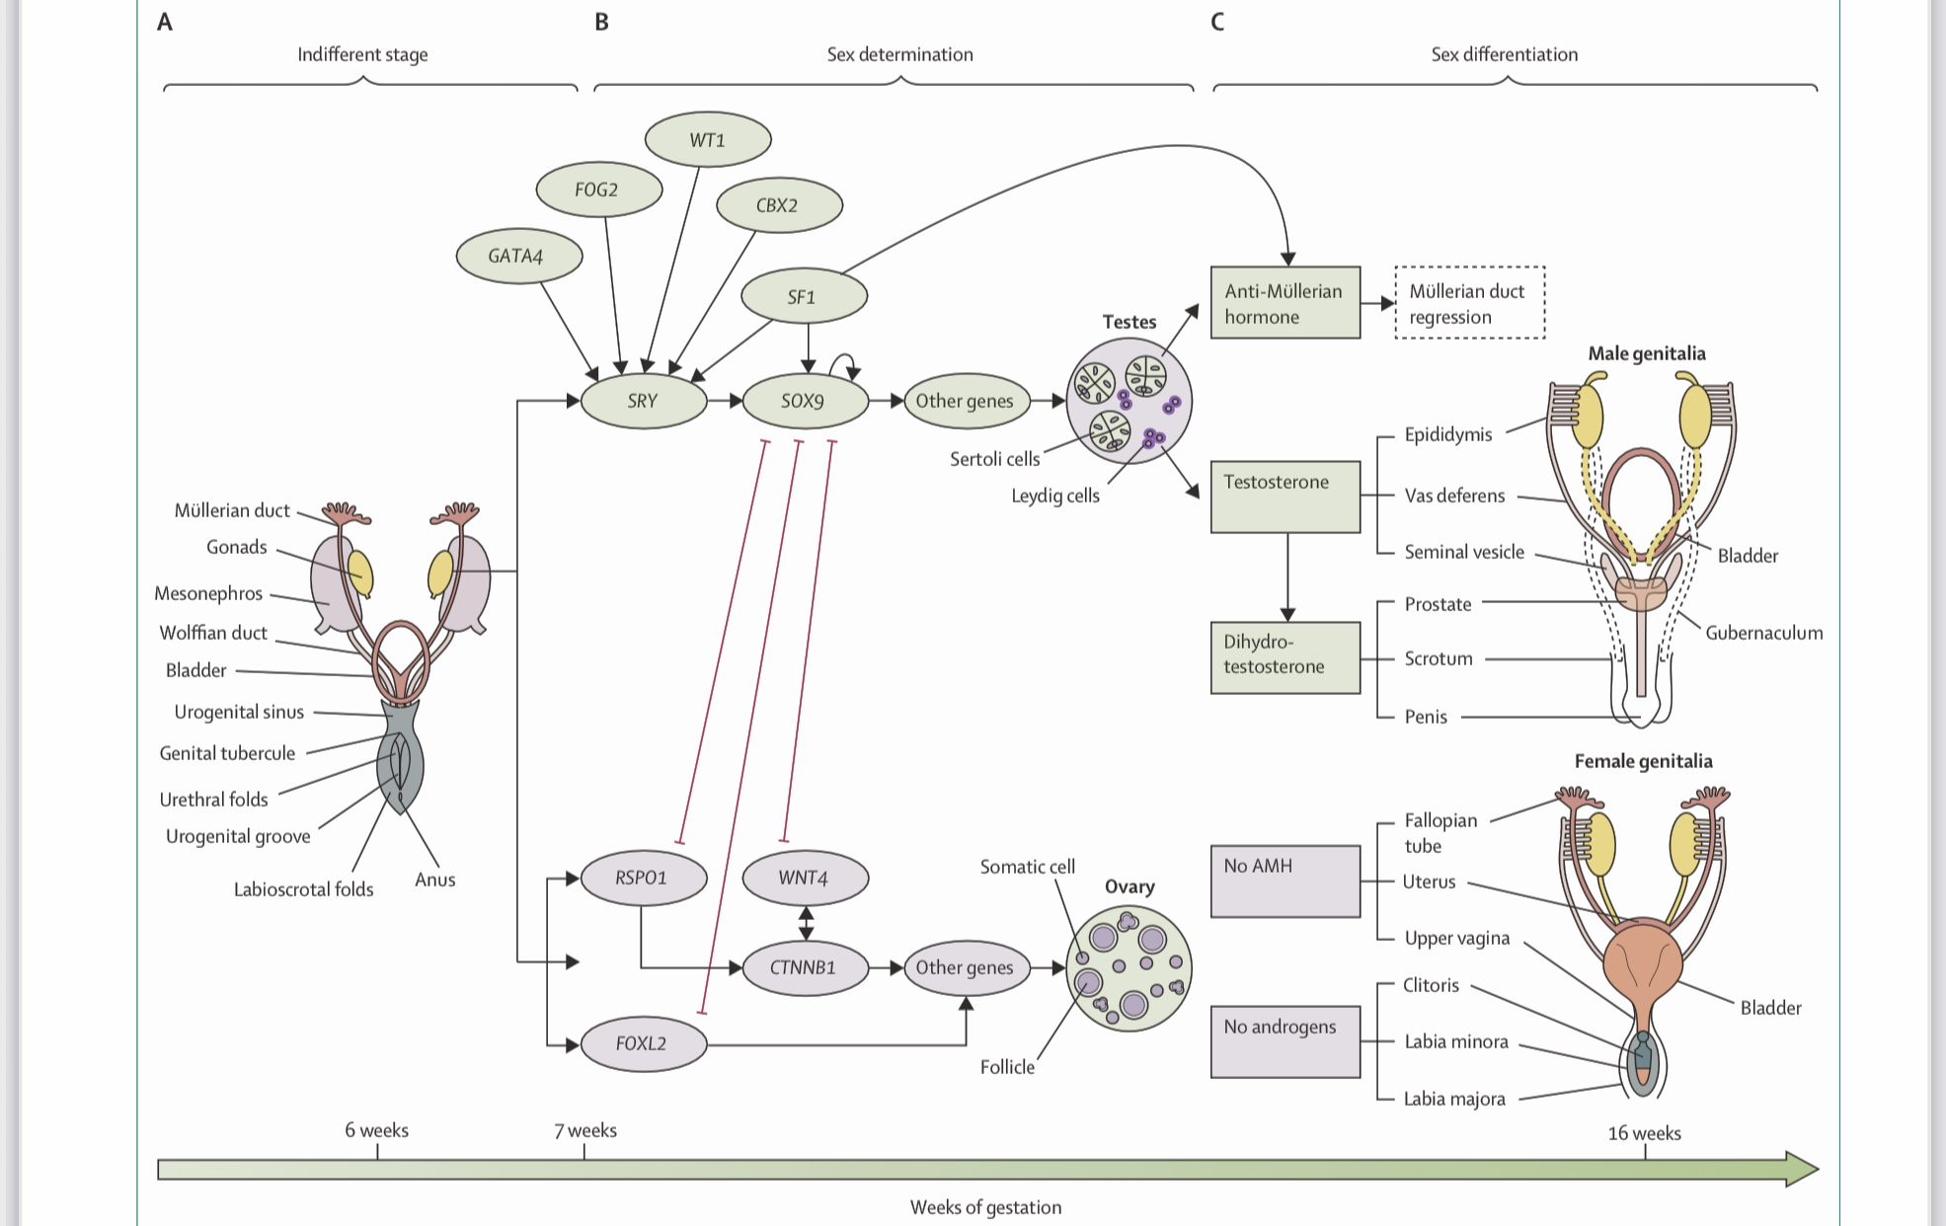
León NY, Reyes AP, Harley, VR. A clinical algorithm to diagnose differences of sex development. Lancet Diabetes Endocr 2019; 7(7):560-14.

Slide 6
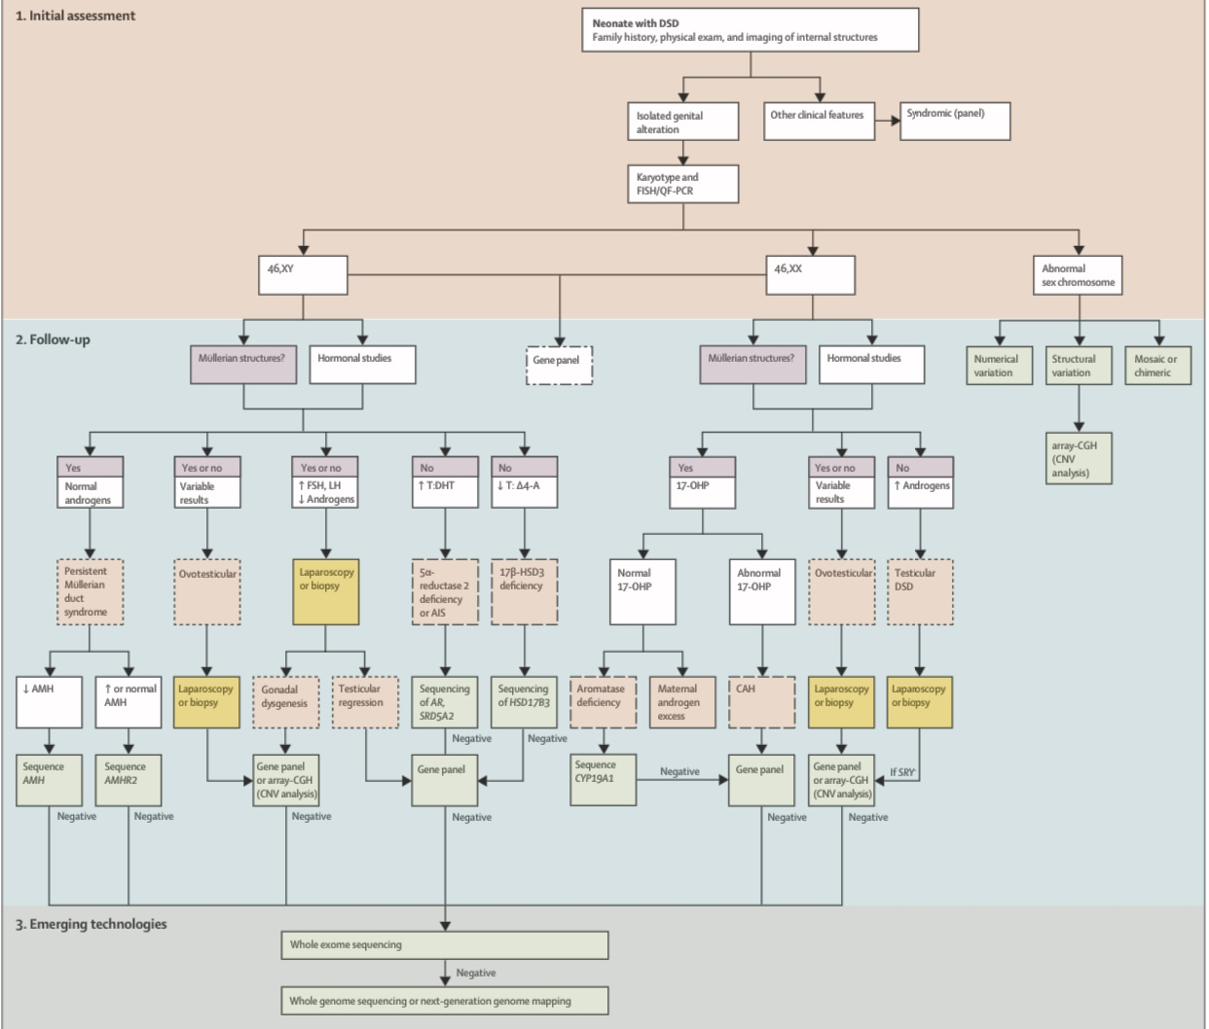
León et al. 2019

Slide 7
SENS programme:
katravels.wixsite.com
Psychosocial research with DSD experts
Clinicians are passionate, knowledgeable, skilled, trying their hardest…
Exclusively medical frame of understanding
Struggle with uncertainties
Immersion in task work rather than team work → lack of integration and fragmented patient experience
Struggle to separate what is medically necessary and unnecessary
Do not know how to integrate psychological contributions from professional and peer providers

Slide 8
Also, lack of awareness of systemic influence of the biomedical process
37.5% of the parents in a recent study spontaneously mentioned being initially unconcerned about the genital appearance of their newborn but all subsequently gave proxy consent for clitoral surgery:
“…because back then I didn’t think, I didn’t think it was a problem”
“she was my first born so I didn’t notice a difference”
Perceptions shifted towards pathologisation of the child’s body.
Alderson et al., 2022 forthcoming

Slide 9
Psychosocial research with parents
“The first six months of her life it was like you were, it’s like looking after somebody else’s child cos you can’t form a bond a proper bond with a baby that people are just fiddling with constantly…” Sanders et al., 2008, p. 3191
“There were so many residents and different people coming in… it felt like [the baby] was a show-horse and that was frustrating... you’re trying to breastfeed for the first time.”
“I felt like [the doctor] was just exploiting [the baby] for his own... you know – he wanted to see the surgery.” Crissman et al., 2011, p. 7
“If [daughter with a variation] was my first baby, she’d be the last.” Alderson et al., 2022, forthcoming

Slide 10
Shaping towards the surgical path
“Reflecting on early decision-making, parents recalled strong wishes to surgically ‘normalize’ their child’s sexual anatomy... Many parents viewed surgery as obvious and necessary, and did not experience it as something that involved a decision-making process.” Crissman et al., 2011, p. 4

Slide 11
Responsibility for the continuation of childhood surgery increasingly shifted onto parents, with providers experiencing their counsel as neutral, free of framing effects
Liao LM, Hegarty P, Creighton S, Lundberg T, Roen K. Clitoral surgery on minors: an interview study with clinical experts of differences in sex development. BMJ Open 2019; 9(6):e025821
Roen K, Hegarty P. Shaping parents, shaping penises: How medical teams frame parents’ decisions in response to hypospadias. Br J Health Psychol 2018; 23(4):967-981.
“And then I’ve seen, um, little girls with a clitoris that’s very mildly enlarged and it causes the family great concern and you counsel them strongly not to have surgery and they still, “No we want it.” So that’s a more difficult one.”
“I am the one who says ‘we don’t have to do’ this if you have a very mild hypospadias [. . .] the parents’ expectation is that really they want something to be done…”

Slide 12
What parents say they need right away…
“And I needed someone to empower me, to tell me that even if I didn’t understand much of this yet ‒ my/our parenting would play a really important part in my child’s wellbeing, and that they would help me and give me strategies to be the best possible mum.”
Magritte, 2012, p. 573

Slide 13
To promote the rights of the child, we need to understand the systemic factors in medical services, such as the pathologising and objectifying effects of technocentrism in DSD services.

Slide 14
Master class series on non-technical aspects of care for all care providers, on:

Slide 15
Thank you for inviting me to speak
Thank you for listening
lihmei01@gmail.com

