Slide 1
An ethical process regarding early interventions and supporting measures in Variations of Sex Characterics (VSC)
Jürg Streuli, MD, PhD, MAS
University of Zürich
Institute of Biomedical Ethics
University Children‘s Hospital
Zürich, Switzerland

Slide 2
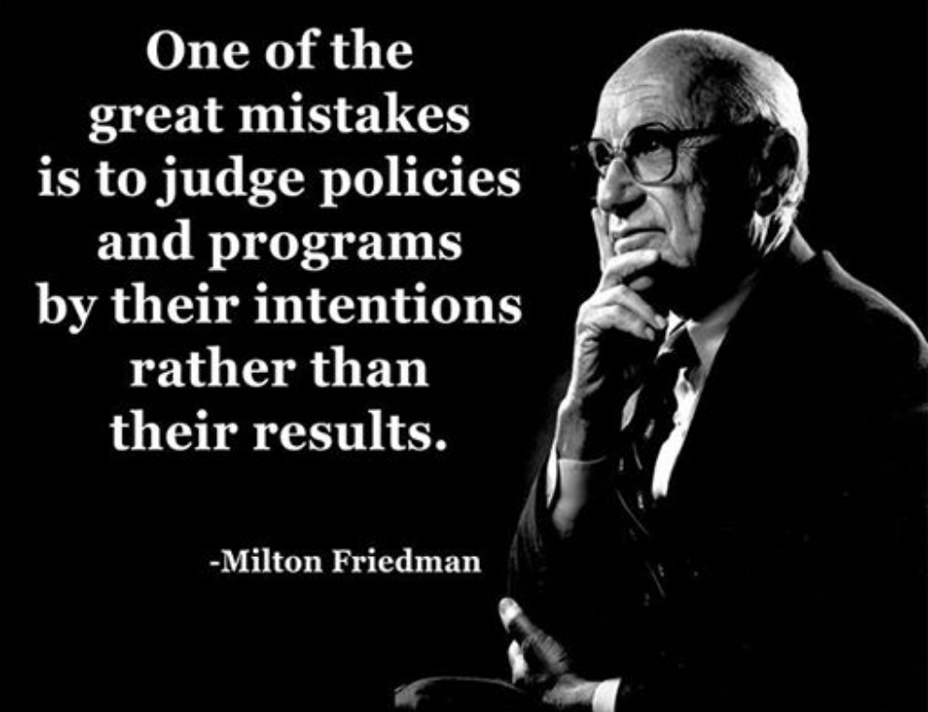
Introductory thoughts (1)
«The road to hell is paved with good intentions...» origin unkown

Slide 3
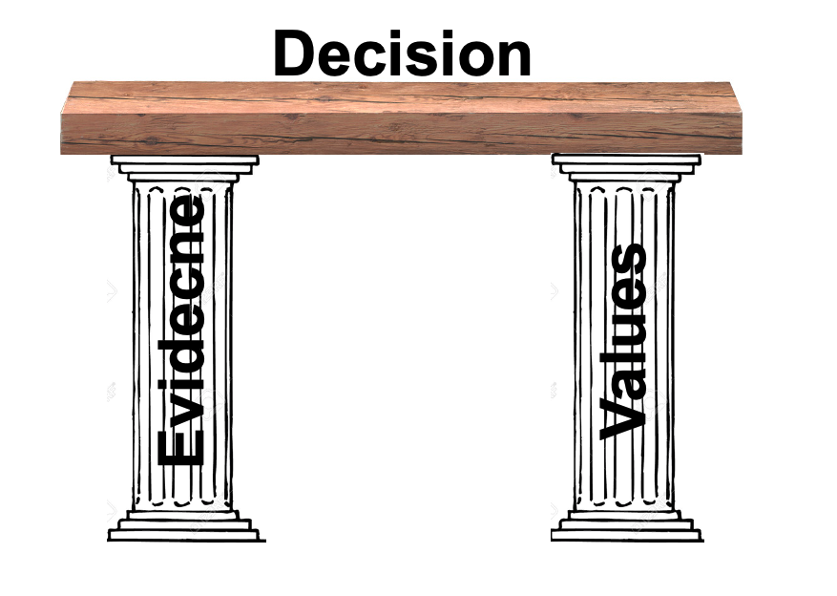
Introductory thoughts (2)
„... No decision is, in itself, a decision.“
William James

Slide 4
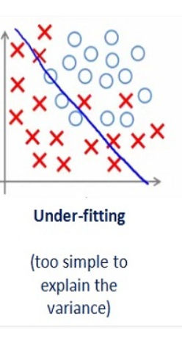
Introductory thoughts (3)
“Make everything as simple as possible, but not simpler.”
Albert Einstein
medium.com

Slide 5
How we decide(d) in a medicalized setting? And what are the results?

Slide 6
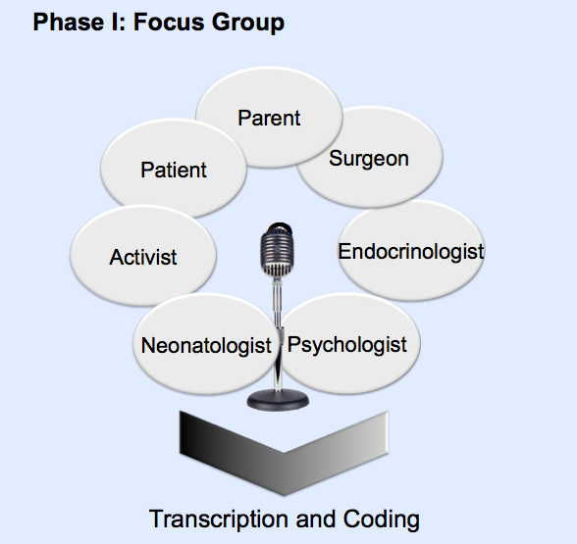
Shaping parents by sharing information?
Streuli JC, Vayena E, Cavicchia-Balmer Y, Huber J. (2013) Shaping Parents: Impact of Contrasting Professional
Counseling Journal of Sexual Medicine

Slide 7
Results: highly significant influence (p<0.001)
Streuli JC, Vayena E, Cavicchia-Balmer Y, Huber J. (2013) Shaping Parents: Impact of Contrasting Professional
Counseling Journal of Sexual Medicine

Slide 8
Self-assessment of influencing factors
“Why did you choose surgery?” | “Why did you not choose surgery?”
My own values /opinion | Choices / Selfdetermination of the child
Better future perspective of the child | My own values /opinion
Jürg C. Streuli, „Shaping Parents - Intersex and (De-)Medicalized Decision-Making“, in process (2012).
Streuli JC, Vayena E, Cavicchia-Balmer Y, Huber J. (2013) Shaping Parents: Impact of Contrasting Professional
Counseling Journal of Sexual Medicine

Slide 9
What do «patients» want?
One more view on genital surgery:
No favor for or against genital surgery in childhood:
But roughly 65% preferred deferrable surgical interventions in early childhood
Notes:
66% of individuals with CAH, 50% of individuals with XY DSD (after surgery) think that infancy or childhood are the appropriate age for genital surgery
23% CAH and 33% XY-DSD respectively preferred adolescence or adulthood, or any time if the patient decides herself/himself.

Slide 10
Why do “patients” want what they want?
Social desirability bias or social acceptability bias. Based on desire to be better accepted, especially in cases of sensitive questions or questions on personal or controversial topics.
Habituation bias occurs when give repeatedly give answers in response to similarly-worded questions.
Confirmation bias occurs if we interpret the data to (unconsciously) support our own expectation or hypothesis, not thinking outside of the box.

Slide 11
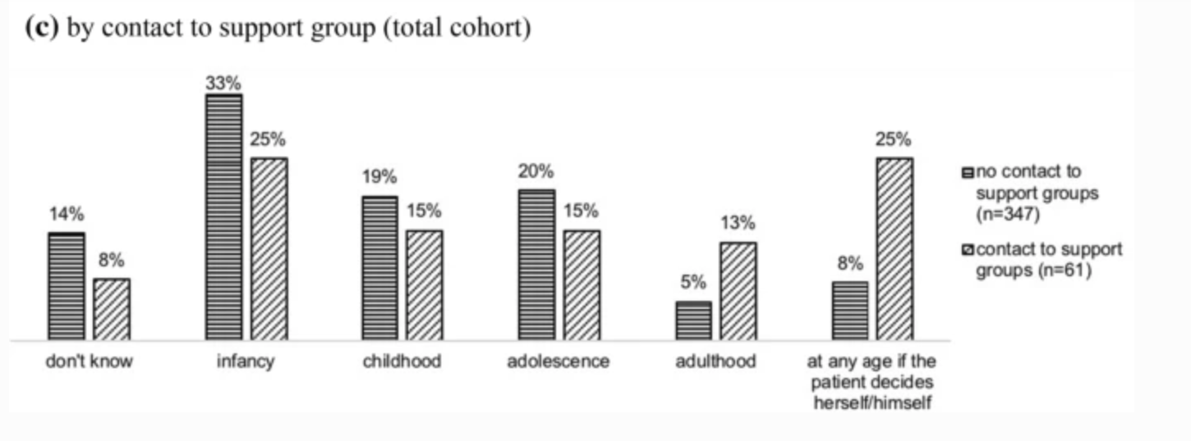
Why do people with VSC want, what they want? (2)
Preferences change in contact with support groups!
Bennecke, Elena, et al. Archives of Sexual Behavior , 2021, https://doi.org/10.1080/00224499.2019.1703130

Slide 12
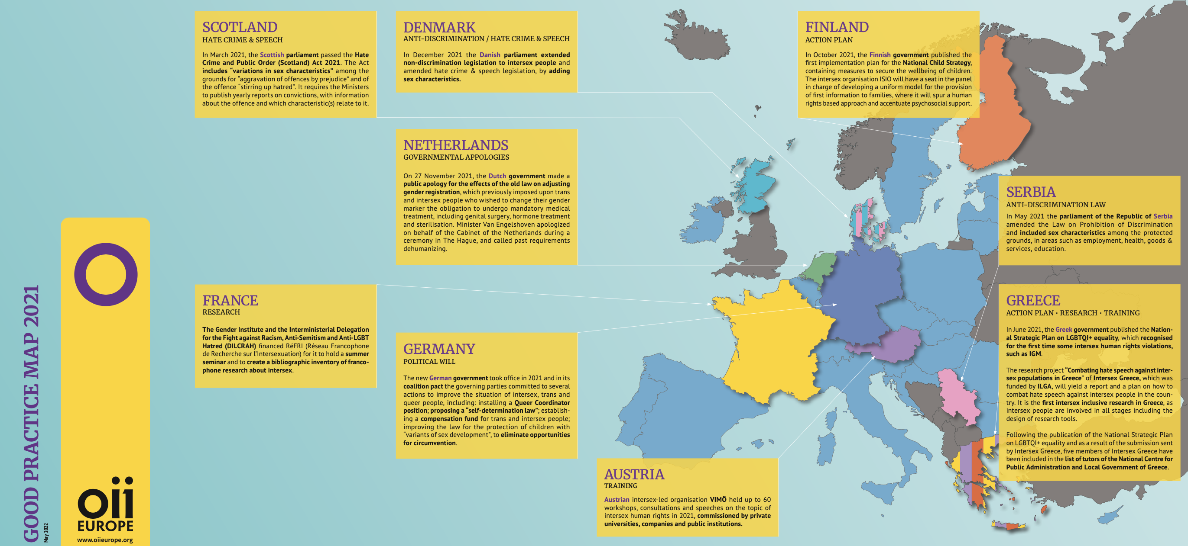
Thinking out side of the (medical) box
https://oiieurope.org/ ; https://www.intersexnew.co.uk/

Slide 13
Why have we lost each other? And how can we meet again for a common strategy?
Higher Ethical Theories
Duties Relationship Outcome
Virtue ethics
Care Ethics
Deontololgy
Utilitarisms
Human rights
Evidence-based Medicine
Middle-Range Ethical Principles
But even agreeing on principles is not enough.
Streuli@ethik.uzh.ch

Slide 14
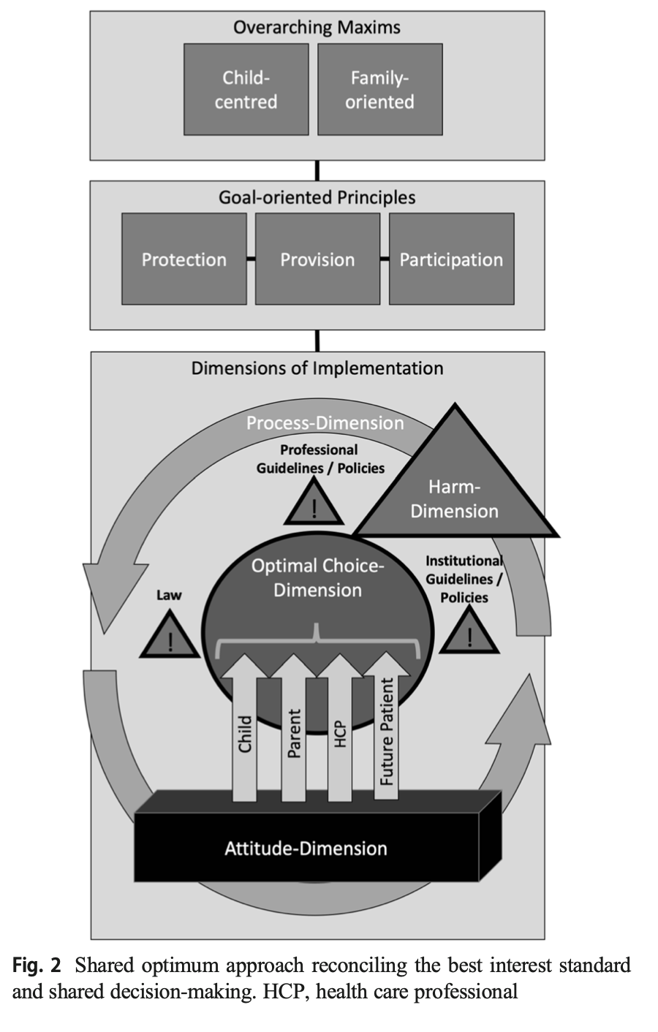
„Shared Optimum“
A Children‘s Rights based combination of Shared Decision-Making and Best interests
Streuli et al Shared Optimum, EJP, 2021

Slide 15
Best Interests and Shared Decision-Making = Child-centered and Family-oriented (Shared Optimum Process)
Threshold Value of Harm
Laws and Regulations on what
a team or parents can’t decide
Shared Optimum
Parents
Values and ideals
HCPs
Values and ideals
Shared Decision-Making
with parents and the child
Child
Values and ideals
Future Being
Values and ideals
Streuli, Jürg C. "The Concept of Best Interests in Clinical Practice." The Nature of Children's Well-Being. Springer Netherlands, 2015. 179-190. AND Streuli et al 2020, Shared Optimum, European Journal of Pediatrics

Slide 16
Conclusions
Clarifying the Threshold Value and Limit of Harm
Less talking about „medical necessity“, more about the limits of medical indication
Support clear, realistic laws
Enable a child-centered and family-oriented Shared Optimum
Learning and implementing Shared Decision-Making
Standard use of checklists
Standard use of adequate language (congratulation to the child, find positive words for genitals)
Demedicalize information for non-medical problems
Use of adequate information material (support parents to explain them to the child, grandparents, society)
Develop transprofessional teams (including support groups) not only multi- or interdisciplinar teams
Create continuers, adequate support of families and children
No treatment offer without the necessary ressources of transprofessional support
Clarify what professionalism is (Streuli et al. 2012)

Slide 17
Thank you very much!
Jürg Streuli, MD, PhD, MAS
University of Zürich
Institute of Biomedical Ethics
University Children‘s Hospital
Zürich, Switzerland

