Slide 1
Decisionmaking Processes and Supporting Measures:
State Obligations for Early Medical Intersex Interventions
A Children’s Rights Perspective from Sweden
An Overview of Legal Frameworks
Notes:
In this presentation, I will focus on Sweden’s recent changes of health care practices with three examples of positive child-centered developments but which also still need improvement.

Slide 2
Recommendation 1: Ensuring the Right to Information to Reduce Discrimination in Health Care CoE: PACE Res 2191: §§ 7.1.6, 7.2 and 7.6 CRC: Articles 17 & 24(1)&(3)
Notes:
My first recommendation centers on the Right to Information, which is in the Convention on the Rights of the Child and not well known. In this case, information is important to address bias, even unintentional, against children who are not perceived as sufficiently “normal”, whatever that means.

Slide 3
Recommendation 1: Ensuring the Right to Information
Common Questions
Is our child a boy or a girl?
What if you assign our child the wrong sex?
Is my child going to be gay?
What do we tell our friends?
Is surgery safe?
Will our child’s genitals be able to look and function normally?
Notes:
In 2005 when the Chicago Consensus began to support practice changes, the first major clinical guidelines on consent revealed that many parents’ main anxieties were not primarily medical and affected their preferences.

Slide 4
Recommendation 1: Ensuring the Right to Information
National Board of Health and Welfare (2022):
Facts on DSD and Conditions That Affect
Gender Development
Intended for adults & children (10 years and older) in connection with health care.
Predominantly focuses on biology and treatment.
Supportive of diversity – at the end (“Atypical does not mean “abnormal”, “what terms do we use”, “how does it affect sex and gender”)

Slide 5
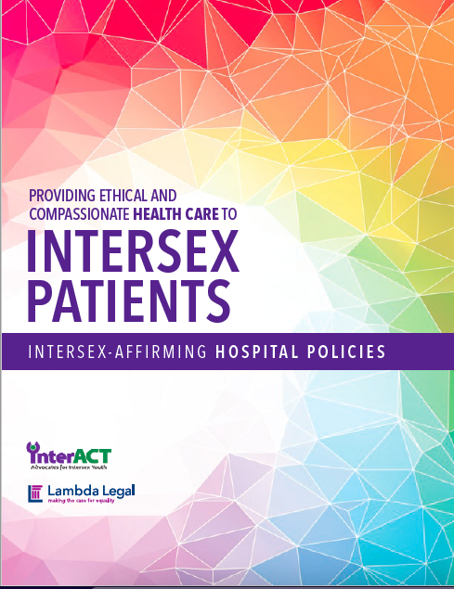
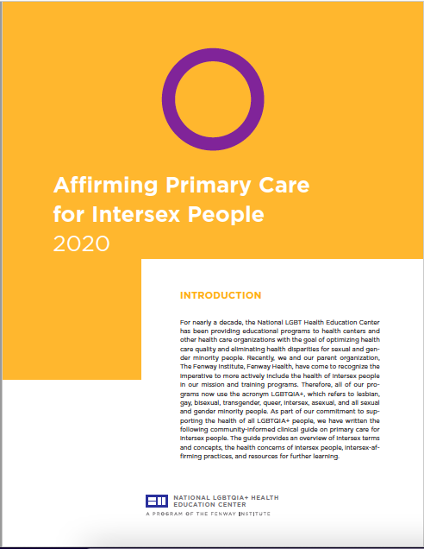
Recommendation 1: Ensuring the Right to Information – InterACT (US)
What we wish they knew ....
Doctors
Parents
Teachers
Friends
Notes:
As you can see, in the US, a much wider array of materials have been made to help to inform hospitals, doctors, and different adult groups. There have been translations into Russian, Greek and so on. Other countries may wish to seek collaboration with InterACT and other organizations to produce more documentation.

Slide 6
Recommendation 2: Guaranteeing Children Fully Informed Consent CoE: PACE Res 2191: §§ 7.1.1 & 7.1.2, 7,5.1 & 7.5.2 ECHR Art. 3 & 8 ICCPR: Art. 7 CRC: Article 12 & 24, General Comments nos. 12, 20

Slide 7
Recommendation 2: Guaranteeing Children Fully Informed Consent
Non-Binding Practice Changes in Sweden
Recommends delaying most procedures until the child can participate in the decision-making process and consent (with key exceptions)
Sets forth considerations for the consent process in acccordance with reference to law based on age.
Beginning production of information materials.
Notes:
In 2020, National Board of Health and Welfare announced changes in how health care for children with intersex conditions will be carried out.

Slide 8
Recommendation 2: Guaranteeing Children Fully Informed Consent
For parents and children aged 10 and older
For parents to tell their children
For parents on sex registration

Slide 9
Recommendation 2: Guaranteeing Children Fully Informed Consent
The Patient Act (2014:821)
The child patient has rights to be informed and heard and consent (with maturity/understanding)
The child has rights to parental support and participation.
The child shall have safe and effective care.
But in practice....
Serious breaches of consent for all patients.
No effective right to written information before consent.
No rights to judicial remedies for failure to disclose foreseeable risks and other relevant information.
Notes:
This is a test, however, for many informed consent frameworks, as we have seen in the Nordic Countries. It is critical that legal systems are monitoried, and not just to criticize health care personnel, who are often not well-trained in the process, but to ensure effective legal protection for informed consent.

Slide 10
Recommendation 2: Guaranteeing Children Fully Informed Consent
ECtHR: (1) Requires that all foreseeable risks must be disclosed to validate consent, (2) parents have a right to consent on behalf of their children in the children’s best interests, which is not equivalent to the child’s own rights, and (3) any violation of informed consent in public hospitals triggers a right to judical access under Article 8.
CRC: According to the CRC Committee, the CRC as a whole establishes:
Children’s rights to refuse or consent below any age limit should be respected, relative to their understanding of the intervention in question.
Even young children can “demonstrate understanding, choices and preferences” through “play, body language, [and] facial expression.”
Children generally have a right to confidential counselling in all health care decisions without either an age limit or the consent of their parents.

Slide 11
Recommendation 3: Assessing the Highest Attainable Standard of Health and Patient Safety CRC: Article 24 Convention on Human Rights in Biomedicine, Article 3 & 4 ECHR, Article 3 and 8

Slide 12
Recommendation 3: Assessing the Highest Attainable Standard of Health and Patient Safety
Swedish Law
Health care shall be provided in accordance with “science and carefully tested experience”, carried out with diligence and exepertise (Patient Safety Act, 6:1) to ensure the good quality and safety of care (Patient Safey Act, ch.1, Patient Act 1)
Convention on Biomedicine (Explanatory Report)
Professional standards must be “fitting ... in the light of scientific progress’ ... with ‘a continuous quality assessment’ … ’in relation to scientific knowledge and clinical experience … eliminates methods which do not reflect the state of the art.’”
CRC
To reach the highest attainable standard of health, care must be scientifically and medically appropriate, based on the best available evidence, with medicines that are child-specific. Traditional harmful practices must be eliminated.

Slide 13
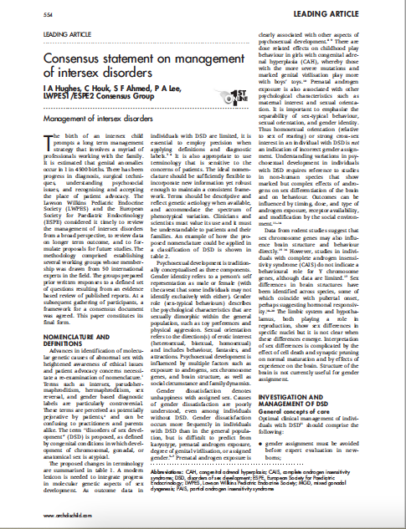
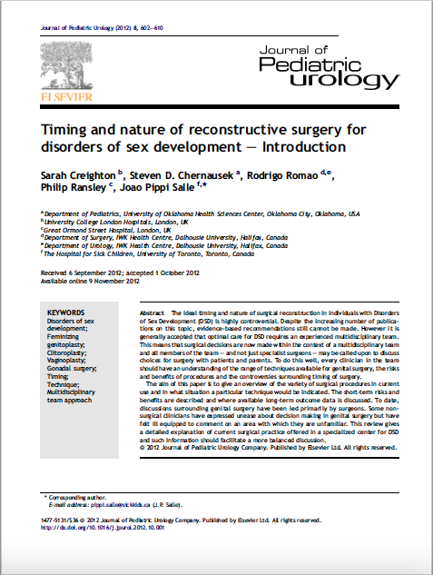
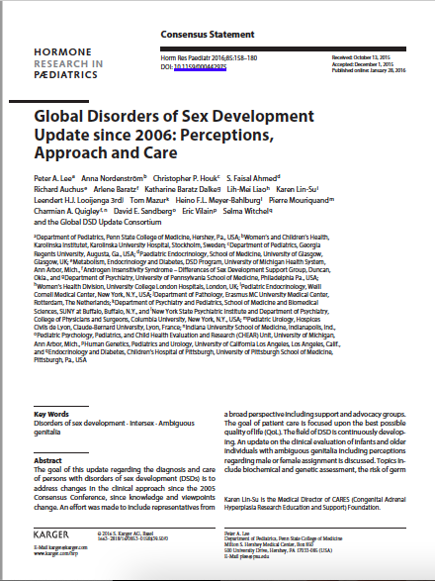
Recommendation 3: Assessing the Highest Attainable Standard of Health and Patient Safety
Ex. 1: Continuing Clitoral Surgery on Chlldren with CAH
The Challenge of Measuring Loss of Sexual Sensitivity from Infancy
Chicago Consensus
Annecy Working Party
Global DSD Consortium
Garland & Diamond (2018)
Notes:
Swedish health care leaves open the possibility of clitoral reduction surgery in infants and young children,which is the prominent exception to delaying care for the child’s consent. I urge everyone to go back and read the clinical position statements abovem which explain damage can be done to genital sensitvity. As my colleague, Mitlon Diamond and I have explained, the idea that genital sensitiviity can be preserved is very hard to prove. Only an individual who has reached puberty, had sexual pleasure or experience, and then had surgery can know what has been lost after the genitals have surgically altered. All of the studies that talk about preservation have no way to measure loss when very young children have never had the experience necessary to know how they would otherwise feel and what they have lost.

Slide 14
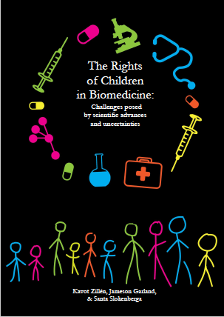
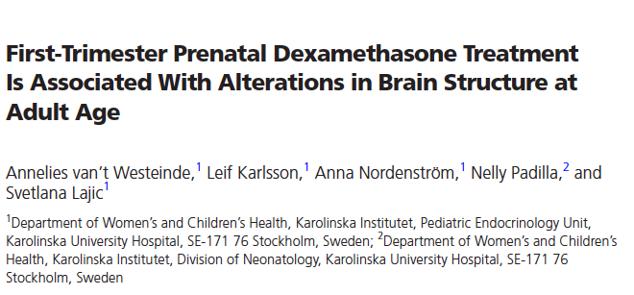
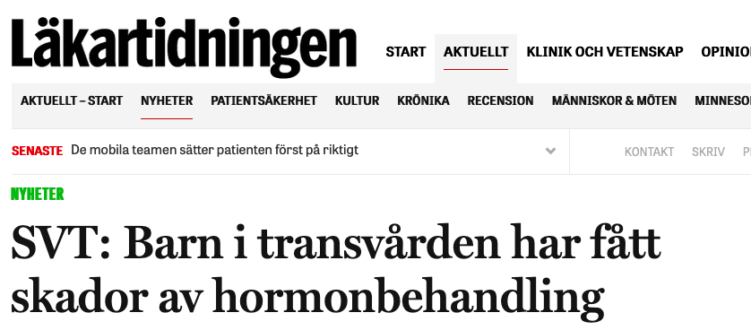
Recommendation 3: Assessing the Highest Attainable Standard of Health and Patient Safety
Ex. 2: Uncertainty of Hormone Therapy – Young Children with “Micropenis”?
Notes:
The second example involves ongoing experiments to enlarge childfen’s penises through hormone therapy. But as my colleagues have warned when we filed our report with the Committee on Bioethics in 2017, hormones effect many patient groups at different ages. In Sweden, we know there are risks for transgender adults (bone loss, physical discomfort), dexamethasone experiments on embryous, and now questions about hormone dosage and timing on transgender youth, not to mention boys of all sexualities to boost their muscle mass, women after surgery on reproductive system surgery and so on... These measures must be proven to be child-specific. There not only needs to be transparency in these cases, but they do not meet human rights standards for care, should be in studies with carefully controlled and monitored.

Slide 15
1. Document multiple forms of information given to patients (and their parents) for transparency & substance
Recommendations
2. Ensure that consent is free and fully informed based on the best scientific evidence
3. Determine the state of the evidence that supports interventions on children at all ages

