Slide 1

Decision making process regarding early interventions on intersex people
(Serbian perspective)
Vladimir Kojovic, MD, PhD University of Belgrade, Serbia

Slide 2
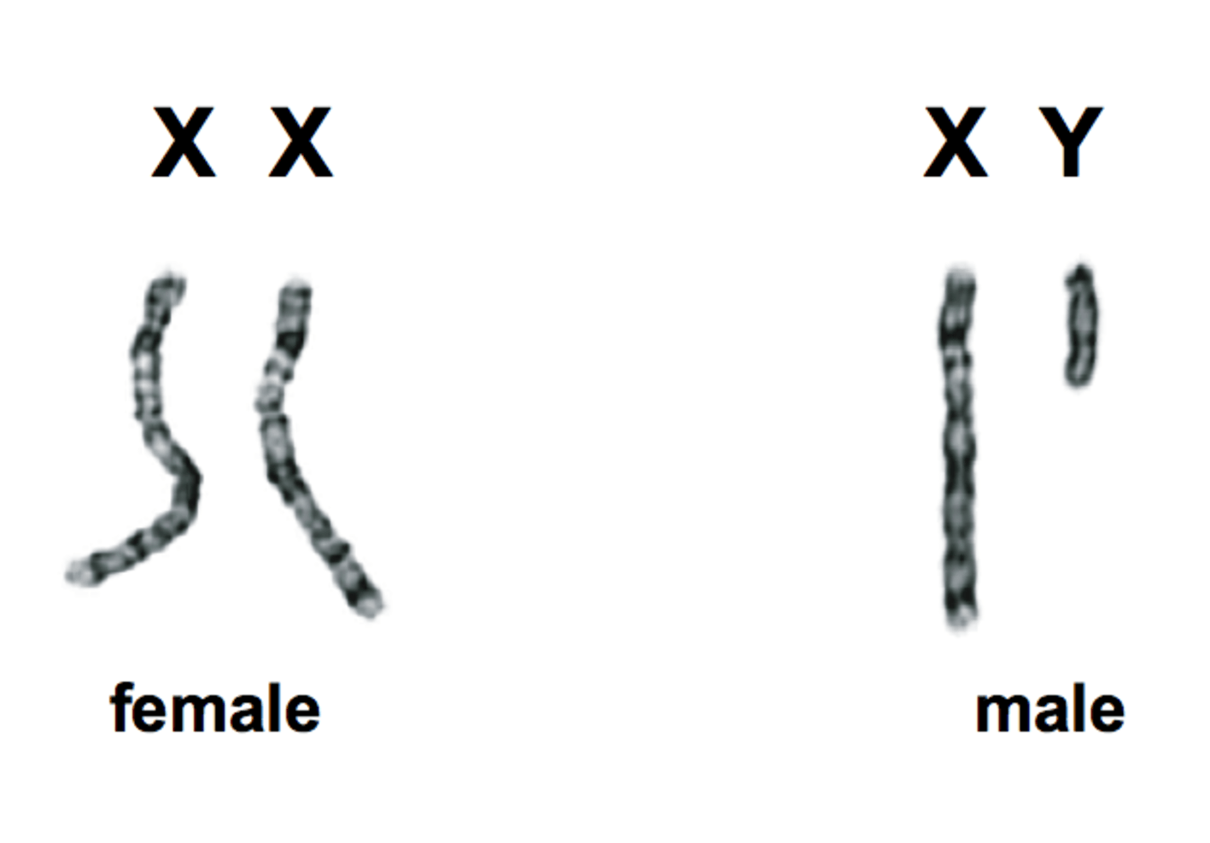
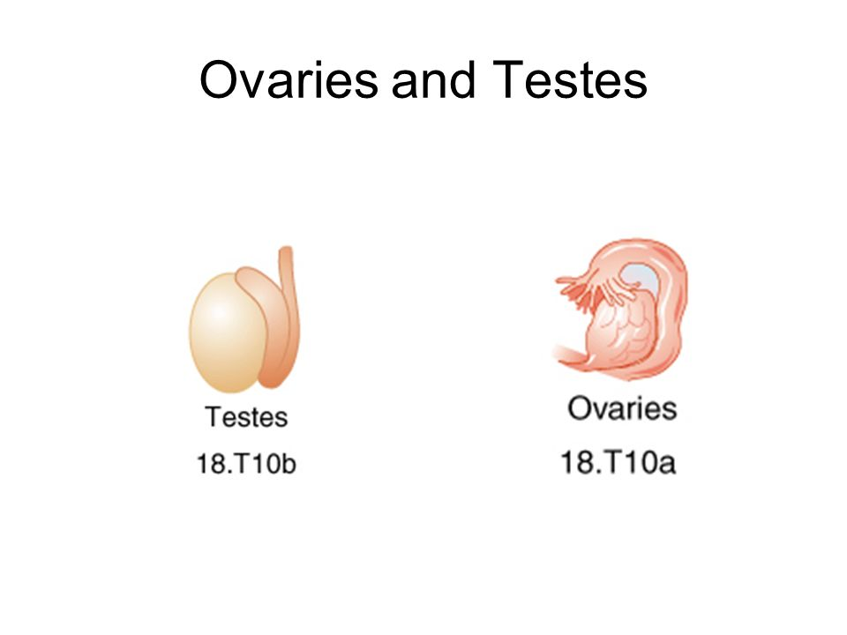
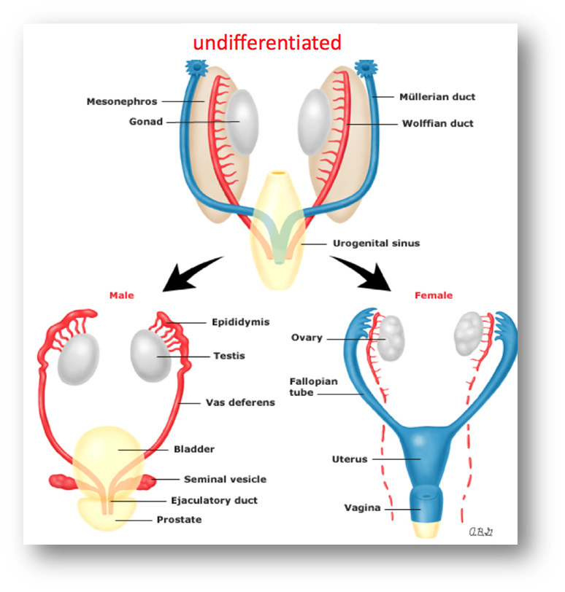
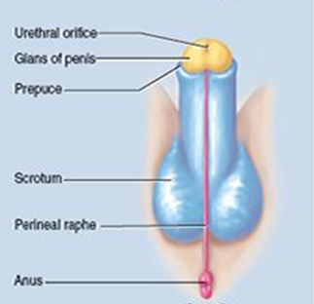
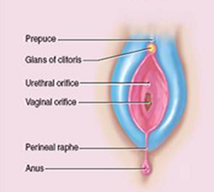
1. chromosomal gender
2. gonadal gender
3. phenotypic gender
4. GENDER IDENTITY

Slide 3
Differences
Disorder of sexual development (DSD) –
development of chromosomal, gonadal or anatomical sex is atypical (variations)

Slide 4
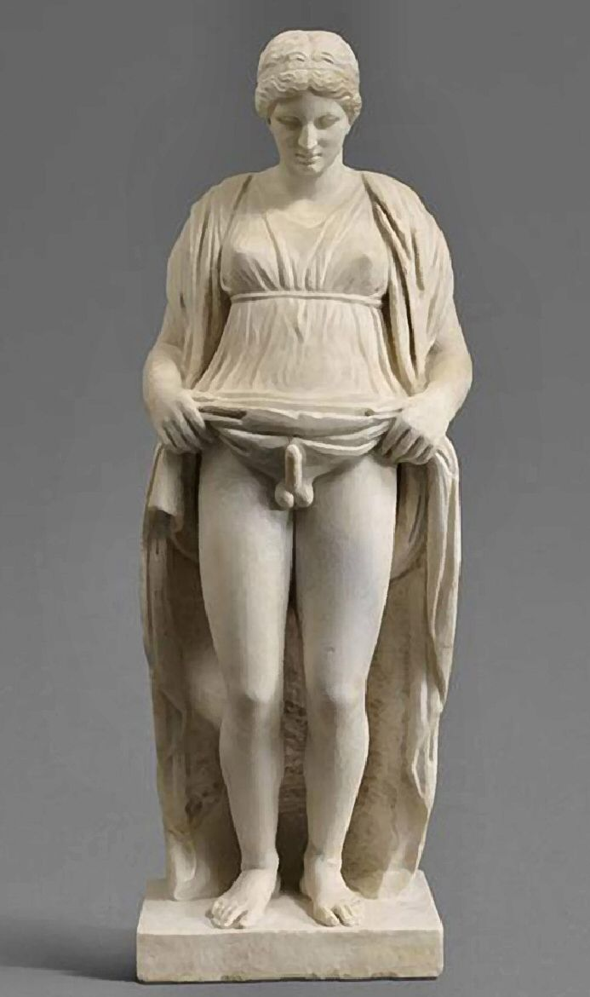
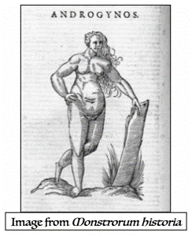
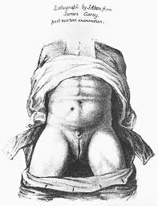
Hermaphroditism
Intersex
Disorder of sexual development (DSD)
Differences of sexual development (DSD)
DSD history

Slide 5
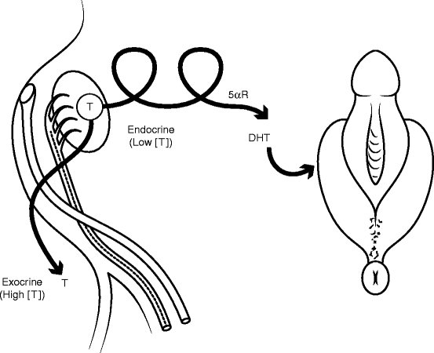
DSD individuals can be presented as newborn with ambiguous genitals.
CLINICAL PRESENTATION

Slide 6
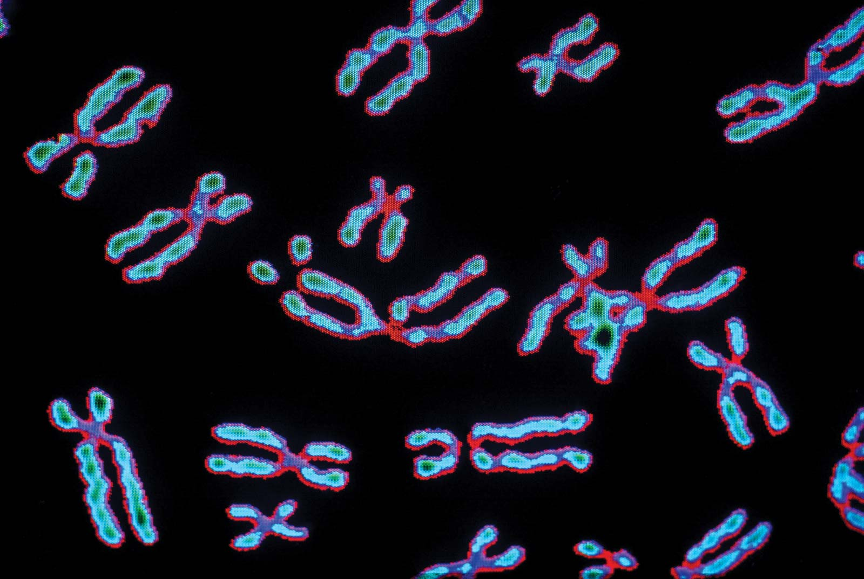
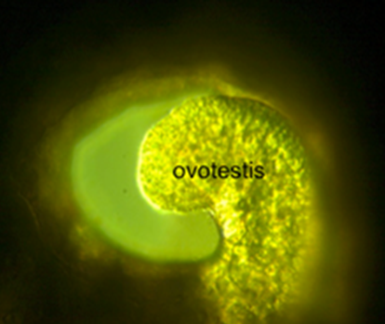
DIAGNOSTIC TESTS
karyotype (chromosomes)
genetic evaluation
hormone tests
gonadal biopsy (gonadal dysgenesis)
skin biopsy (receptor deficiency)

Slide 7
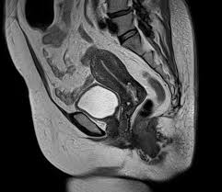
IMAGING
ultrasound exam
MRI exam
cystoscopy
vaginoscopy
genitography
laparoscopy

Slide 8

TREATMENT
Physhological/psychiatic support
Hormonal treatment
Reconstructive surgery

Slide 9

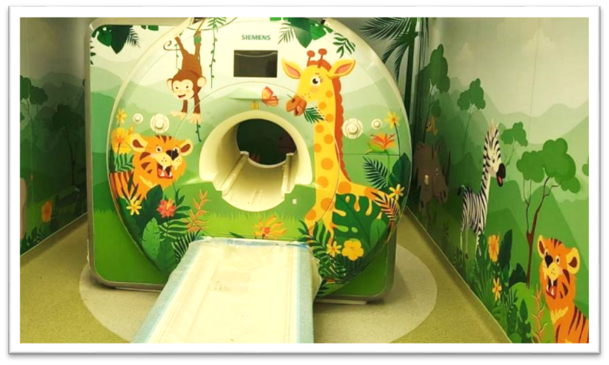
WHERE
Medical center of excellence for pediatric population
Contemporary medical equipment:
- labs (hormones, electrolytes, chromosomes, genetics etc.)
- imaging (MRI, US)
- operating theatres (endoscopy, laparoscopy etc.)
- pathology unit
Academic units, if possible
Institute for Mother and Child Health Care of Serbia, Belgrade
University Children Hospital, Belgrade

Slide 10
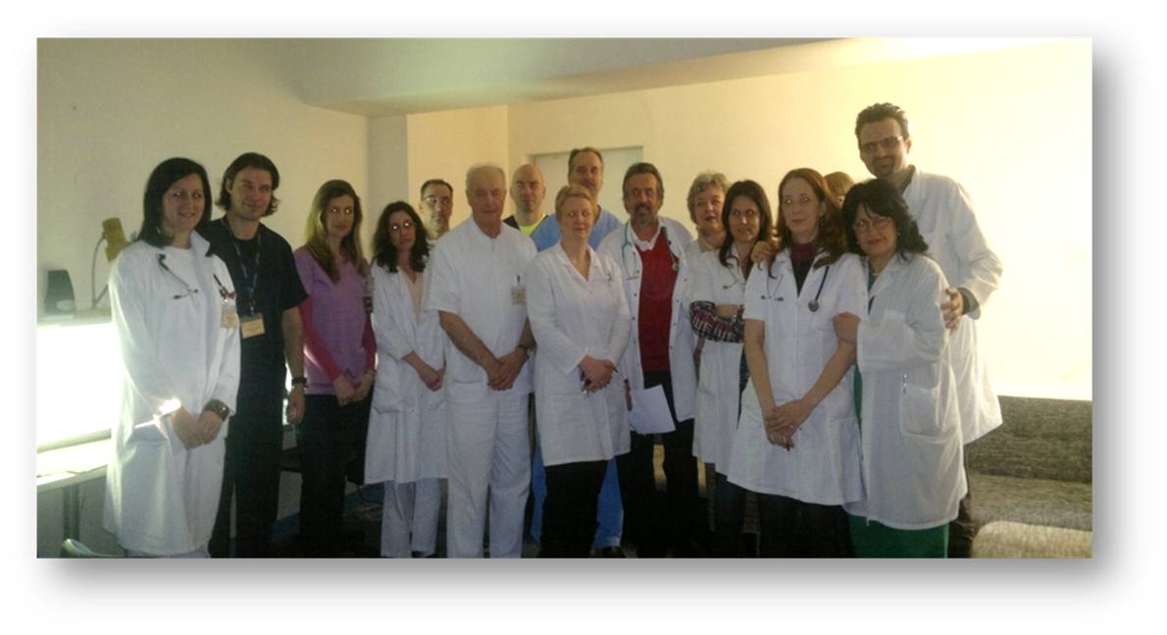
WHO
DSD TEAM Serbia
Neonatologist
Endocrinologist
Genetics
Urologist
Gynecologist
Radiologist
Psychiatrist
Pathologist

Slide 11

WHY
Endocrinological issues
Homeostatic issues
Malignancy issues
Sexual issues
Fertility issues
Psychological issues
Early (non-necessary) surgery issues!

Slide 12

WHY
No issues at all

Slide 13
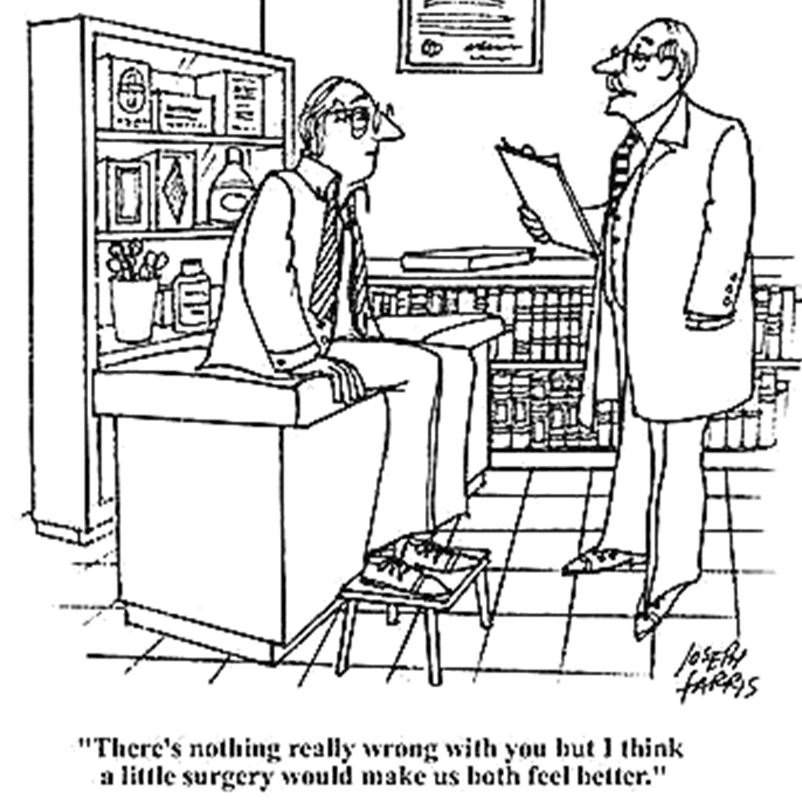
No issues at all

Slide 14

HOW IT WAS
DSD newborn
DSD team
Diagnostic procedures
Treatments (hormones, surgery…)
Everything in 30 days….!
”Newborn should not leave the hospital without having a gender assigned and the entire treatment should be completed!”

Slide 15
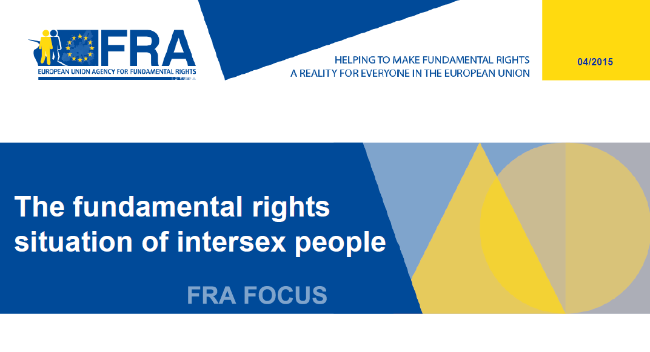

Slide 16
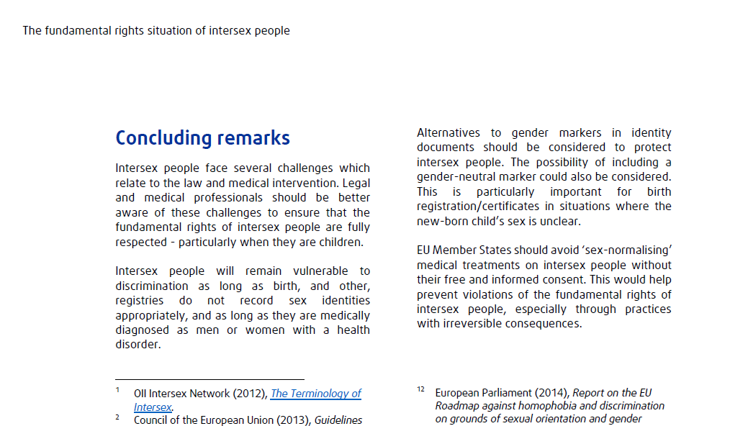

Slide 17
PROGRESS
Permanent education
Attend international meetings and conferences
Introducing the new team members
Collaborate with NGOs, legal professionals and institutions

Slide 18
PROGRESS
Avoid all non-necessary early surgery
DSD individuals should participate in decision for corrective surgery

Slide 19
Decision making process regarding surgery
The UN Committee on the Rights of the Child, has denounced:
“medically unnecessary surgical and other procedures on intersex children, without their informed consent, which often entail irreversible consequences and can cause severe physical and psychological suffering”
as a harmful practice and a clear violation of the human rights of the child.

Slide 20
DECISION
COMMUNICATION
ROLE OF THE MULTIDISCIPLINARY TEAM
SUPPORTING GROUPS
TIME

Slide 21
Genital reconstructive surgery
Is it necessary? why?
When should it be done?
What are the benefits and risks?

Slide 22
DSD SURGERY
GOALS
minimal scaring
appearance that fits gender identity
fertility
voiding
sexual
malignancy
FUNCTIONAL
AESTHETIC

Slide 23
DECISION MAKING
When should the decisions be made?
Who makes the decision?
What support is available?
What information are used to make the decision?

Slide 24

PARENTS
DSD is extremely stressful for the parents (it is considered as a second stressful event, after stillbirth / neonatal death)
Explain the condition / counseling
Discuss the protocols
Introduce to the rights of the child
Connect with supporting groups

Slide 25


Gayten-lgbt
Xy speCTrum

Slide 26
In our country the deadline for registering the birth of a child (including the gender of a baby) is 30 days after delivery

Slide 27
The child has the right to health care and timely given information about his/her health condition
From the age of 15, everyone has the right to receive timely information from the competent healthcare professional in order to make a decision on whether to agree to the proposed medical measure, as well as access to all their medical documentation.

Slide 28
From the age of 15, he/she has the right to submit a request for a change of personal name
Gender surgery is allowed at the age of 18

Slide 29
Changes IN THE PAST YEARS (SERBIA)
Year 2009. recognize “health issues and conditions” as a basis for discrimination (article 22 of the Law on Prohibition of Discrimination, Republic of Serbia, “Sl. glasnik RS”, no. 22/2009)

Slide 30
Changes IN THE PAST YEARS (SERBIA)
From 2021 we have two legal acts that recognize “gender characteristics” (besides gender identity, sexual orientation etc.) as a basis for discrimination (article 52 of the Law on Prohibition of Discrimination, “Sl. glasnik RS”, 52/2021and article 4 of the Law on Gender Equality, “Sl. glasnik RS ”, no. 4/2021)
These legal acts enables full legal protection of intersex individuals in the legal system of our country) and we became the second country in the region to do so

Slide 31

OUR GOALS
Multidisciplinary approach is necessary
Try to enroll guidelines to health care workers
Individualized approach to all DSD individuals
Make transparent all procedures and statistics, with the respect of the privacy
Avoid early non-necessary surgery (human right violation!)
DSD individuals should participate in the decision for the treatment

Slide 32
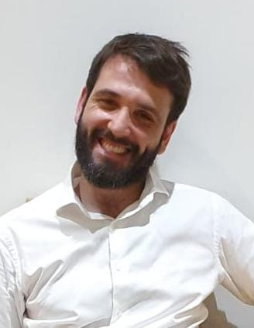
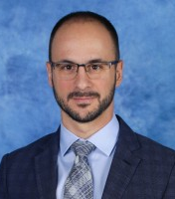
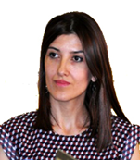
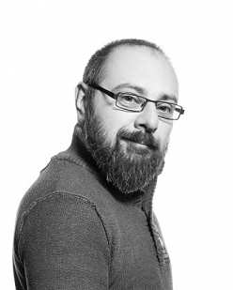
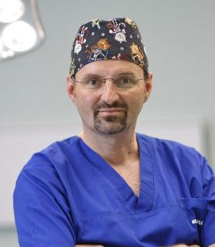

Regards from Belgrade
Danilo Pesic, MD, PhD
Psychiatrist and
Psychotherapist
Rade Vukovic, MD, PhD
Pediatric endocrinologist,
DSD Working Group Secretary (ESPE)
Jelena Simic, PhD
Professor of Law,
Union University,
Belgrade
Kristijan Randjelovic
NGO „XY Spectrum“
Vladimir Kojovic, MD, PhD
Pediatric surgeon
and urologist

