Slide 1
African Forum on Cybercrime, Addis Ababa, 16 – 18 October 2018
Cybercrime legislation and policies in Africa:
Issues for discussion
Alexander Seger
Council of Europe
alexander.seger@coe.int
www.coe.int/cybercrime

Slide 2
Cybercrime legislation and policies in Africa:
Issues for discussion
Legislation on cybercrime AND electronic evidence: what is needed?
Making attacks against and by means of computers a criminal offence ►What substantive criminal law?
Empowering law enforcement authorities to secure electronic evidence in relation to any crime ►What procedural law powers? What safeguards?
Enabling international cooperation ►What is needed in terms of harmonisation/ compatibility of domestic legislation with international standards?
Domestic legislation on cybercrime and e-evidence: What international benchmarks?
Budapest Convention on Cybercrime ►what relevance, what benefits for Africa?
What legislation on cybercrime and e-evidence in Africa:
What is the current situation?
How to move ahead with domestic reforms of legislation?

Slide 3
Cooperation on Cybercrime: The approach of the Council of Europe
1 Common standards: Budapest Convention on Cybercrime and relates standards
“Protecting you and your rights in cyberspace”
2 Follow up and assessments:
Cybercrime Convention Committee (T-CY)
3 Capacity building:
C-PROC 
Technical cooperation programmes
3

Slide 4
Legislation on cybercrime AND electronic evidence
What is needed?
Criminalising conduct
Illegal access
Illegal interception
Data interference
System interference
Misuse of devices
Fraud and forgery
Child pornography
IPR-offences
+
Procedural tools
Expedited preservation
Search and seizure
Production orders
Interception of computer data
Limited by safeguards
+
International cooperation
Extradition
MLA
Spontaneous information
Expedited preservation
MLA for accessing computer data
MLA for interception
24/7 points of contact
Harmonisation

Slide 5
Legislation on cybercrime AND electronic evidence
What international benchmarks?
►Scope of the Budapest Convention on Cybercrime
Criminalising conduct
Illegal access
Illegal interception
Data interference
System interference
Misuse of devices
Fraud and forgery
Child pornography
IPR-offences
+
Procedural tools
Expedited preservation
Search and seizure
Production orders
Interception of computer data
Limited by safeguards
+
International cooperation
Extradition
MLA
Spontaneous information
Expedited preservation
MLA for accessing computer data
MLA for interception
24/7 points of contact
Harmonisation

Slide 6
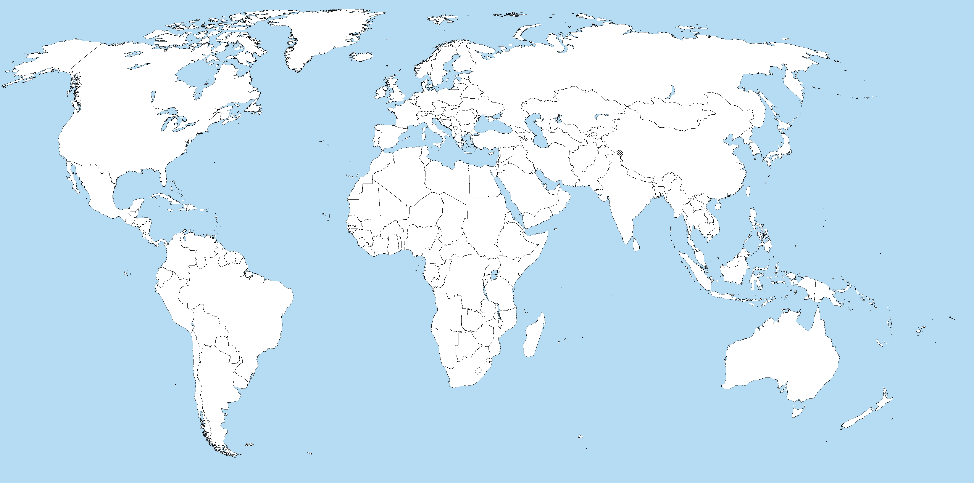
Reach of the Budapest Convention
Parties:
Cabo Verde
Mauritius
Morocco
Senegal
Signatory / invited to accede:
Ghana
Nigeria
South Africa
Tunisia
140+
Indicative map only
Ratified/acceded: 61
Other States with laws/draft laws largely in line with Budapest Convention = 20+
Signed: 4
Further States drawing on Budapest Convention for legislation = 50+
Invited to accede: 6
= 71

Slide 7
Legislation on cybercrime AND electronic evidence:
Progress 2013 – 2018 re substantive criminal law
By January 2013 | States | Largely in place |  | Partially in place |  | Not in place or no information
All Africa | 54 | 6 | 11% | 18 | 33% | 30 | 56%
All Americas | 35 | 10 | 29% | 12 | 34% | 13 | 37%
All Asia | 42 | 13 | 31% | 17 | 40% | 12 | 29%
All Europe | 48 | 38 | 79% | 8 | 17% | 2 | 4%
All Oceania | 14 | 3 | 21% | 6 | 43% | 5 | 36%
All | 193 | 70 | 36% | 61 | 32% | 62 | 32%
By January 2018 | States | Largely in place |  | Partially in place |  | Not in place or no information
All Africa | 54 | 14 | 26% | 21 | 39% | 19 | 35%
All Americas | 35 | 14 | 40% | 15 | 43% | 6 | 17%
All Asia | 42 | 17 | 40% | 18 | 43% | 7 | 17%
All Europe | 48 | 44 | 92% | 4 | 8% | 0 | 0%
All Oceania | 14 | 5 | 36% | 6 | 43% | 3 | 21%
All | 193 | 94 | 49% | 64 | 33% | 35 | 18%
www.coe.int/cybercrime

Slide 8
Legislation on cybercrime AND electronic evidence:
Progress 2013 – 2018 re procedural powers
Specific procedural powers |  |  | In January 2013 |  |  | In January 2018
 | States |  | Largely in place |  |  | Largely in place
All Africa |  | 54 | 5 | 9% |  | 10 | 19%
All Americas |  | 35 | 5 | 14% |  | 9 | 26%
All Asia |  | 42 | 8 | 19% |  | 13 | 31%
All Europe |  | 48 | 31 | 65% |  | 39 | 81%
All Oceania |  | 14 | 1 | 7% |  | 3 | 21%
All |  | 193 | 50 | 26% |  | 74 | 38%
www.coe.int/cybercrime

Slide 9
Cybercrime legislation and policies in Africa:
Issues for discussion in Workshop 4
Legislation on cybercrime AND electronic evidence: what is needed?
Making attacks against and by means of computers a criminal offence ►What substantive criminal law?
Empowering law enforcement authorities to secure electronic evidence in relation to any crime ►What procedural law powers? What safeguards?
Enabling international cooperation ►What is needed in terms of harmonisation/ compatibility of domestic legislation with international standards?
Domestic legislation on cybercrime and e-evidence: What international benchmarks?
Budapest Convention on Cybercrime ►what relevance, what benefits for Africa?
Legislation on cybercrime and e-evidence in Africa: what is the state of play?
What is the current situation?
How to move ahead with domestic reforms of legislation?

Slide 10
www.coe.int/cybercrime

