Slide 1
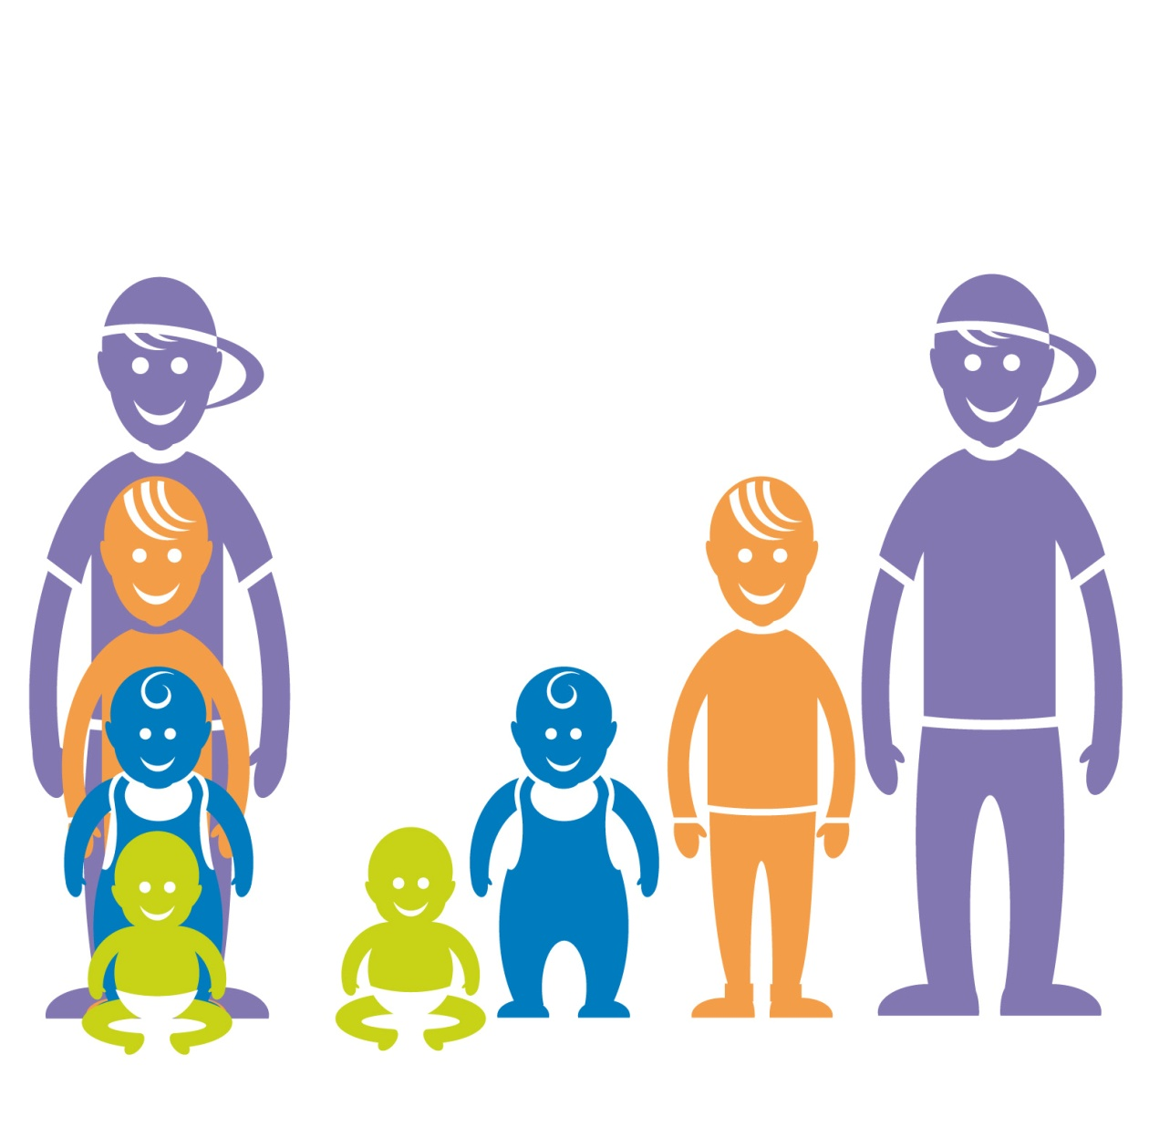
PROMOTING CHILDREN’S RIGHTS Education and Training around Sex & Gender Professor Gary Butler MD FRCPCH University College London Hospital UCL Great Ormond Street Institute of Child Health European Society for Paediatric Endocrinology European Paediatric Association Scientific Committee

Slide 2
Where do we start? Who can define Sex and Gender?
Sex: biological status of male or female (usually)
Gender: role preference

Slide 3
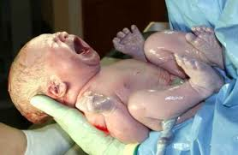
How do we tell what our sex is?

Slide 4
Background

Slide 5
Binary biology
Sex chromosomes are X and Y……
……….. is that it??

Slide 6
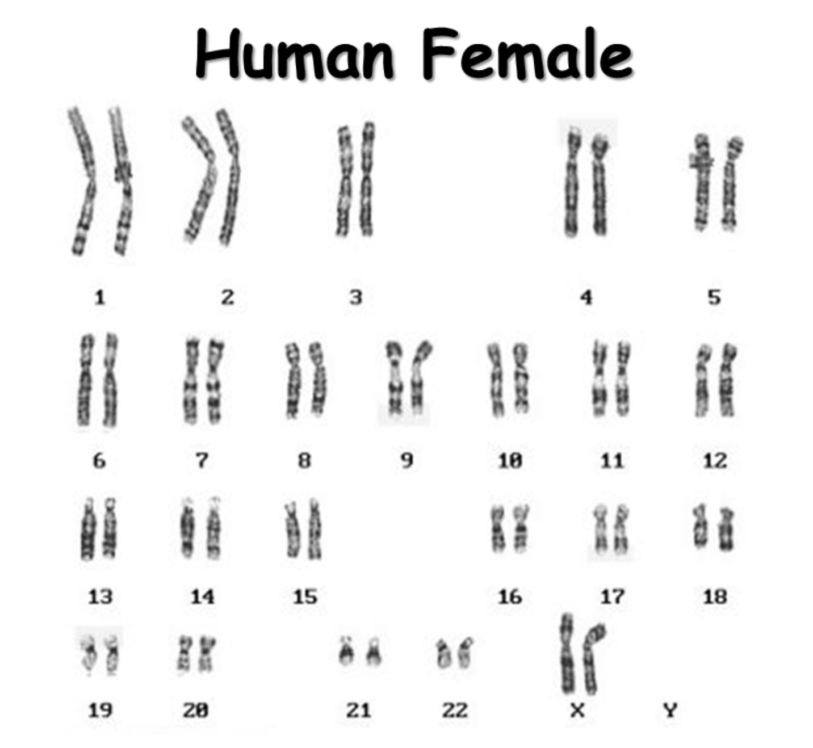
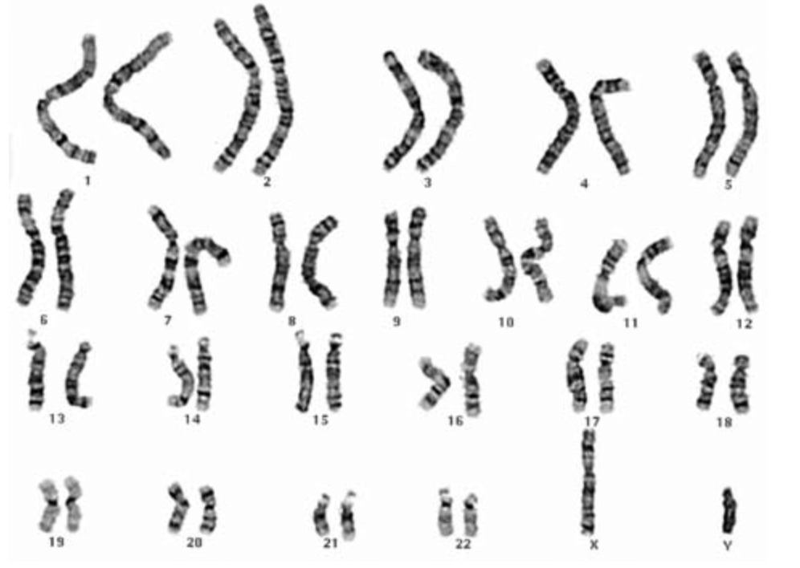
Normal chromosomes (karyotype)
Human Male

Slide 7
Binary biology
Sex chromosomes are X and Y
Principal sex hormones are oestradiol and testosterone
How do they influence sex development and gender?
Prenatal exposure: genital sex and gender??
Minipuberty: unknown
Puberty: gender??

Slide 8
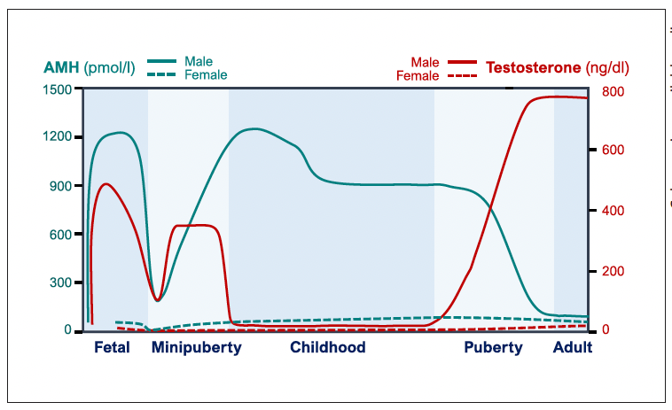

Slide 9
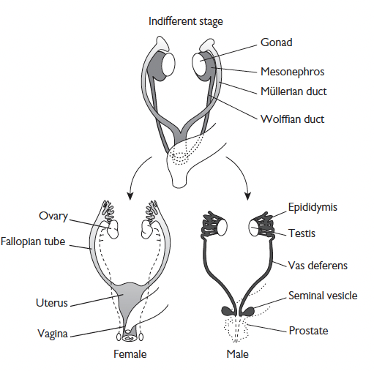
Sex differentiation
6-12 weeks into pregnancy!
SRY and other genes on Y chromosome
Gonad becomes a testis
Testosterone develops male internal genitalia
Inhibition of Mullerian tract (AMH)
Dihydrotestosterone develops external genitalia
IS FEMALE DEFAULT SEX?
Specific ovarian development genes

Slide 10
When does it go wrong? (Disorders/differences of sex differentiation)
Genetic female XX: virilised
Testosterone (T) from adrenal/gonad
Genetic male XY: undervirilised
No T/blocked T action
Prader stages of sex differentiation

Slide 11
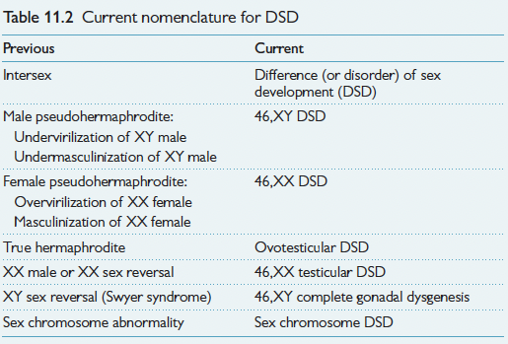

Slide 12
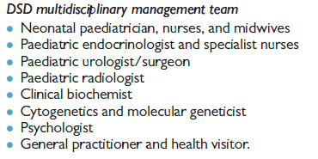
Providing support and answers for a very upset family
Gough B., Weyman N., Alderson J., Butler G., & Stoner M.
"They did not have a word":
The parental quest to locate a 'true sex' for their intersex children.
Psychology & Health 2008:23(4);493-507.

Slide 13
Education about DSD (…and sex and gender)
Who needs to know –specifically and generally
Specifically – those at the sharp end
Midwives
Paediatric nurses
Neonatal and other doctors – especially trainees
Generally
All health care students and practitioners
The general public….

Slide 14
What things do we need to know about?
Do we have to decide sex/gender in infancy?
Who should decide the sex of rearing and any interventions anyway?
Doctors?
Parents?
Child/adolescent when older?
Treatments: testosterone to attempt completion of masculinisation
Surgery to correct ‘deformed’ genitalia: is there a need to do this in infancy or childhood?
Longer term complications
NB gender identification may not equate with presumed biological sex
Gender dysphoria

Slide 15
Gender Dysphoria (DSM-V) Gender Incongruence (WHO) formerly Gender Identity Disorder
Gender of identification different from birth sex
Sometimes present from birth
Can develop in childhood, adolescence or as adult
Formal diagnostic process DSM-V and ICD-11 (WHO)
Persistent cross gender identification
Extreme dislike of body/genitalia/function- the dysphoria
Living in opposite role

Slide 16
Some definitions on gender

Slide 17
Names for different genders: what do they all mean?
Sex
Gender
Transvestite
Transgender……Transsexual
Trans male/masculine……..Trans female/feminine
Gender queer
Non-binary
Gender variant
Transgender and gender diverse young people

Slide 18
Chromosome and endocrine variations in trans young people
Butler G et al, Arch Dis Child 2018 July;103:631–636
Autosomal chromosome variations
Sex chromosome variations
NO DIFFERENCE FOUND
Hormonal balance
NO DIFFERENCE FOUND
Gender Incongruence IS NOT THE SAME
as Differences of Sex Development (DSD)

Slide 19
Who should provide the support for trans YP? Multi-disciplinary Team Clinical psychologists Social workers Child and adolescent psychotherapists Family therapists Child and adolescent psychiatrists Senior Trainees Research psychologists Clinical Nurse Specialists Paediatricians and endocrinologists
The Gender Identity Development Service (England and Wales National Health Service)

Slide 20
Sexual orientation or preference
How does this overlap with DSD?
How does this overlap with gender variance?
Can we explain why sexual orientation may vary?
Nature or Nurture theory?

Slide 21
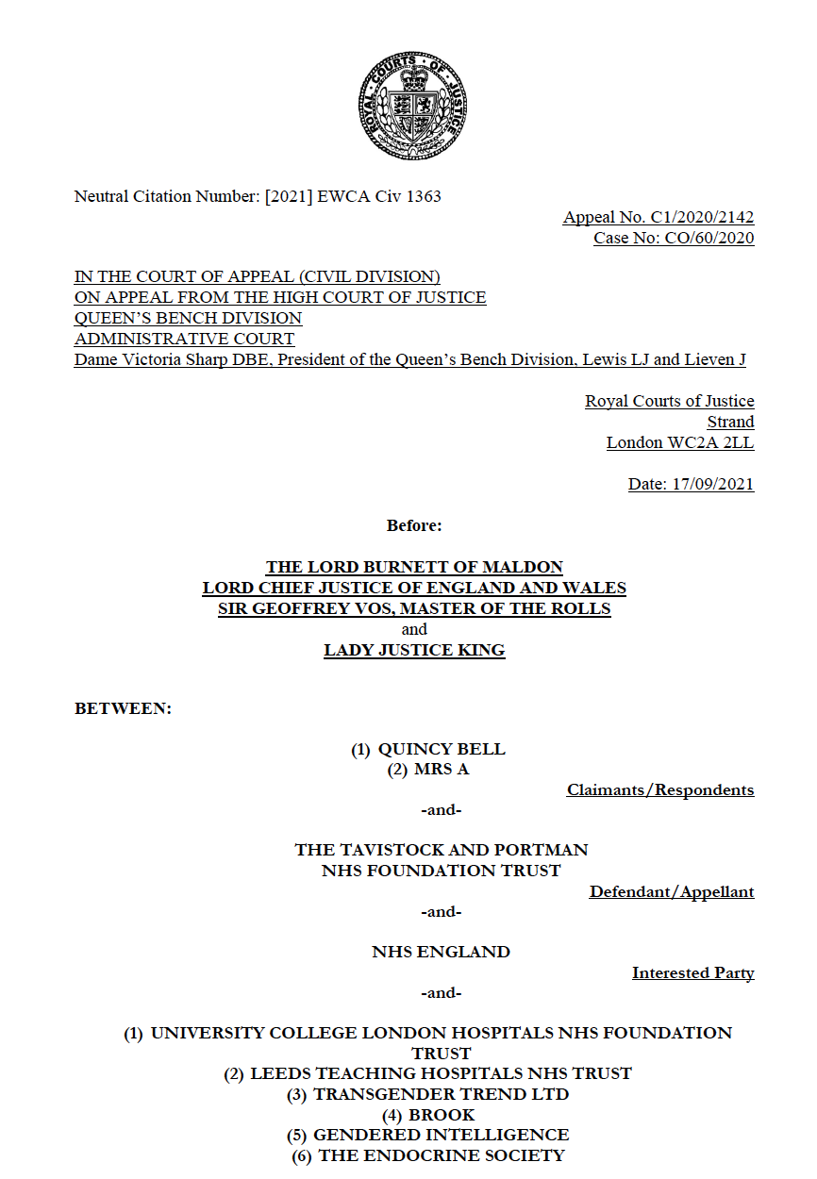
Challenge to Children’s Rights in England
English High Court judgement: December 2020 (Bell v Tavistock) -No child under 16yr has competence to consent -16-17yr have capacity but cannot have treatment without application to the Court English Family Court: June 2021 (AB v CD) Parents can consent on behalf of their children English High Court of Appeal: September 2021 Multi agency appeal against Bell v Tavistock Original judgement overturned

Slide 22
When and how do we educate?
Knowledge about DSD
Knowledge about gender variance
Knowledge about children’s and young people’s rights
Assessing competence and capacity around decision making

Slide 23
Support organisations
DSD life: www.dsd-life.eu
DSD families: https://dsdfamilies.org/
WPATH: www.wpath.org
Gender incongruence: https://gids.nhs.uk

Slide 24
Where are we with the understanding about human sex and gender development? Massive hole in knowledge of biological and social development Need to educate all societies to accept and support these natural variations of human kind A very big humbling experience being involved

Slide 25
Thank you Any questions?

