Slide 1




The rights of intersex persons in Malta
Gabi Calleja
Head SOGIGESC Unit
Notes:
Thank you for the opportunity to share our Country’s experience so far. As you are aware Malta was one of the first States to introduce a ban on normalising interventions on intersex persons and we are glad to observe that others have followed. The opportunity to learn from each other is important if we wish for such legislation to have the desired impact.

Slide 2
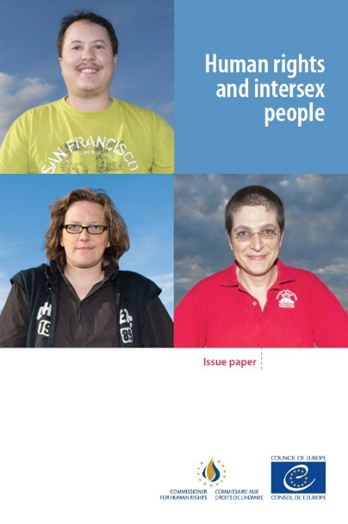

Introduction
International Forum for the rights of intersex persons (2011 - )
Trans and Intersex People (European Commission, 2012)
Human Rights and Intersex People (Council of Europe, 2015)
Notes:
It would be good perhaps to provide a little bit of context. The first International Forum for the rights of intersex persons met for the first time in 2011 facilitated by ILGA-World and ILGA-Europe. I was at the time a member of the ILGA-Europe Executive Board and it was around this time that I was exposed to any form of capacity building on intersex issues.
The Third International Intersex Forum, supported by ILGA and ILGA-Europe, was held between the 29 November and 1 December 2013 and took place in Malta. The event brought together 34 activists representing 30 intersex organisations from all continents. It was facilitated by Silvan Agius on behalf of ILGA-Europe and Ruth Baldacchino on behalf of ILGA-World, and it so happened that both of these experts, happened to be Maltese. Then Minister for Social Dialogue, Consumer Affairs and Civil Liberties, Helena Dalli had the opportunity to meet the intersex activists at the Forum and to listen to their stories. That International Intersex Forum gave rise to what has come to be known as The Malta Declaration which comprised a number of principles and demands aiming to end discrimination against intersex people and to ensure the right of bodily integrity, physical autonomy and self-determination.
Two studies were also published, one by the European Commission in 2012 on Trans and Intersex People and the other by the Council of Europe in 2015, which focused specifically on the Human Rights of Intersex People. Silvan Agius was the author of both these papers.

Slide 3

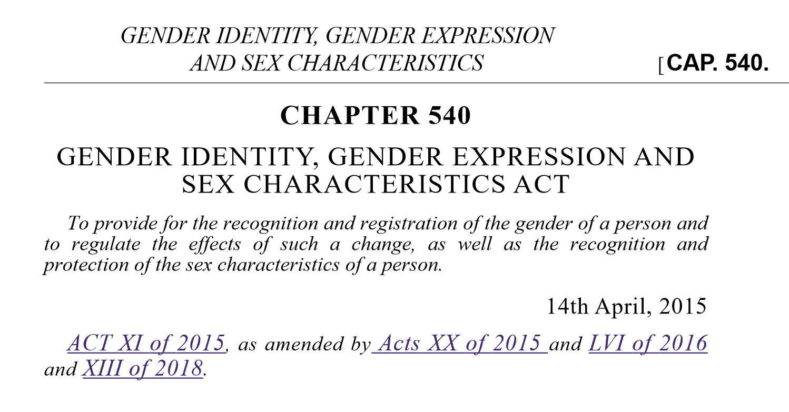
Chapter 540 of the laws of Malta
Notes:
In April 2014 Malta enacted the Civil Unions Act and shortly after, work began on the drafting of the Gender Identity, Gender Expression and Sex Characteristics Act. By that time both Silvan Agius and Ruth Baldacchino were employed within the Ministry for Social Dialogue, Consumer Affairs and Civil Liberties and could contribute their technical expertise as well as their ability to tap into the fledgeling network of intersex activists. Maltese LGBTIQ Civil Society was also involved in the consultation process through the LGBTIQ Consultative Council comprised of representatives of LGBTIQ NGO’s working at the National Level.
The need for a new process to regulate Legal Gender Recognition was recognised as an opportunity to also introduce provisions protecting the rights of intersex persons in line with the Malta Declaration. Consultations were held with the lead clinicians who were supportive of the measures being proposed and who affirmed that it was already practice for any non-medically necessary interventions on intersex children to be delayed until the children were older. The actual drafting of the legal text underwent a number of revisions before being finalised. Also because there was very little to base it on, given that this was the first time such a ban was being put forward.
One of the useful documents referred to was that by the Swiss National Advisory Commission on Biomedical Ethics entitled On the Management of differences of sex development: Ethical issues relating to “intersexuality” published in 2012.

Slide 4
Definition
Sex characteristics refers to the chromosomal, gonadal and anatomical features of a person, which include primary characteristics such as reproductive organs and genitalia and/or in chromosomal structures and hormones; and secondary characteristics such as muscle mass, hair distribution, breasts and/or stature
Notes:
In order to ensure that Maltese legislation was inclusive, the legal texts do not refer to LGBTIQ identities but focus on the protected characteristics of sexual orientation, gender identity, gender expression and sex characteristics.
The GIGESC Act of 2015 included a number of definitions and was the first to refer to the ground of sex characteristics. This was defined as the chromosomal, gonadal and anatomical features of a person, which include primary characteristics such as reproductive organs and genitalia and/or in chromosomal structures and hormones; and secondary characteristics such as muscle mass, hair distribution, breasts and/or stature.

Slide 5
Rights
Right to Gender Identity
Right to bodily integrity and physical autonomy
Inclusion of «sex characteristics» in:
  Anti-discrimination provisions (Chapter 456)
  Hate speech and hate crime (Criminal Code)
  Procedural Standards for granting & withdrawing international protection regulations (S.L. 420.07)
Possibility of a non-declaration of gender at birth (for all)
Notes:
The GIGESC Act established a number of important rights. Primary of which, the Rights to Gender Identity based on self determination, and the Right to Bodily Integrity and Physical Autonomy. The Act also extended existing provisions in relation to anti-discrimination, hate speech and hate crime and asylum that till then made reference to sexual orientation and gender identity to also include the grounds of gender expression and sex characteristics. This ensured that equality provisions encompassed all LGBTIQ identities.
The GIGESC Act also addressed the issue of birth registrations and in particular the difficulty some parents of intersex children encountered in registering the birth of their child within the 15 day period stipulated by law, given that for some intersex variations it was not always possible to determine sex within this timeframe. The possibility of a non-declaration of gender at birth for all parents was therefore adopted. As things stand today, gender on birth certificates must be determined by the time a person reaches 18 years of age.

Slide 6
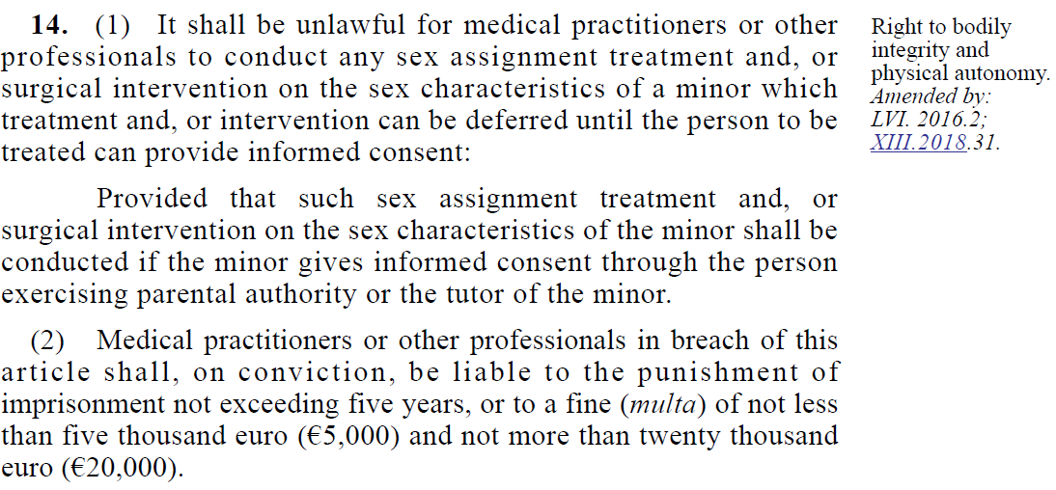
Right to bodily integrity & physical autonomy (1)
Notes:
The Right to Bodily Integrity and Physical Autonomy was covered under Article 14 which established the ban on normalising interventions on intersex children. This was to some extent based on the Swiss document referenced previously with respect to limits of choice which stated, and I quote:
As part of the state’s duty of care, it is obliged to protect children whose parents request interventions which clearly violate the child’s welfare or participatory rights. The following basic principle should therefore apply to the management of DSD: on ethical and legal grounds, all (non-trivial) sex assignment treatment decisions which have irreversible consequences but can be deferred should not be taken until the person to be treated can decide for him/herself. This includes genital surgery and the removal of gonads, unless there is an urgent medical indication for these interventions (e.g. increased risk of cancer). Exceptions to the general rule would be cases where a medical intervention is urgently required to prevent severe damage
to the patient’s body or health.
The legislation also established the penalty that would apply on breach of this article.

Slide 7
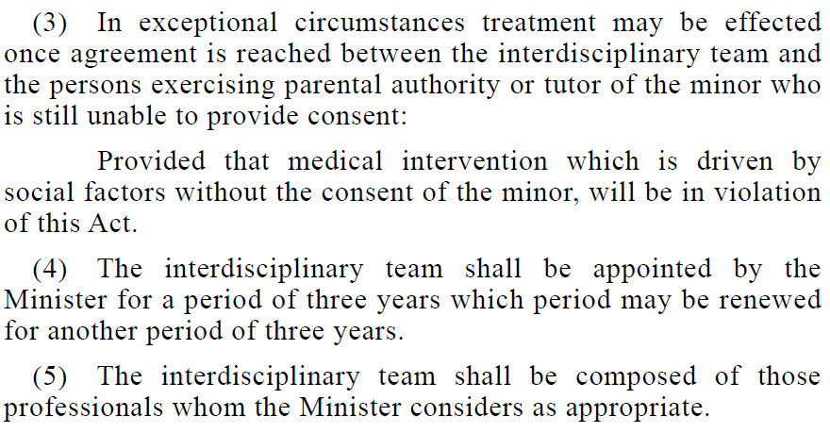
Right to bodily integrity & physical autonomy(2)
Notes:
The Act also sought to establish a working group that would be made up of Medical, psychosocial and human rights experts who task it was to review the intersex treatment protocols following which an interdisciplinary team would be set up to assist the clinicians and the persons exercising parental authority of the child in the decision making process.
There was some delay in the appointment of the Intersex Protocol Review working group but we hope to finalise this process by the end of this year. This has also delayed the setting up of the Interdisciplinary Team the law envisaged.

Slide 8
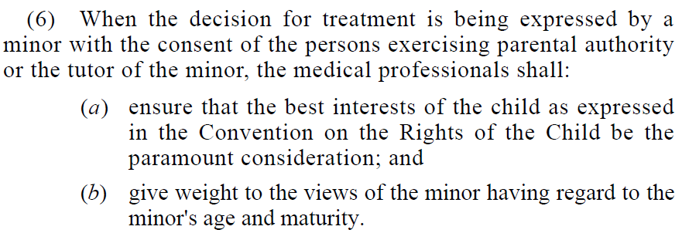
Right to bodily integrity & physical autonomy(3)
Notes:
The legislation also reiterated the best interest of the child principle needed to be applied where decisions on treatment were being discussed. The current process to date involves an assessment on the minor’s ability to provide informed consent, that is their ability to understand the purpose, appropriateness and effects of a given course of action. This assessment is to date conducted by a psychologist specialising in the therapeutic care of children. This process also ensures that the child’s voice is heard.

Slide 9
Implementation and Mainstreaming
Protocol Review Working Group
Interdisciplinary Team
Policy Provisions in: Education; Detention; Policing; Public Service
Possibility of an ‘X’ marker on identity documents (ID Card & Passport)
Capacity Building: TRANSFORM Project
Funding OII Europe
Notes:
In support of the legislation, a number of policies and guidelines have also been adopted, specifically in education and detention settings. Maltese Government Guidelines on the Recognition of Sex, Sexuality and Gender for the public administration were also adopted in 2021 and are gradually being disseminated.
In 2017 the possibility of opting for an X Marker on Identity Cards and passports was also made available to all. This does not require any amendments to the birth certificate.
Through the REC Funded TRANSFORM Project, training was also offered to over 650 persons working in health settings. Under an initiative spearheaded by the Dutch government, Malta also provided a grant to OII-Europe to support its efforts in advocating for the Rights of Intersex Persons in Europe.

Slide 10
SOGIGESC UNIT
Human Rights Directorate
A3 Towers, Triq l-Arkata, Paola
Telephone: 22263225
Email: lgbtiq@gov.mt
Website: www.lgbtiq.gov.mt
Notes:
I thank you for your time and look forward to answering any questions that you might have.

