Slide 1
Early intervention on intersex children - promoting the rights of the child
Session III Part 1: Legislation and Training: Germany
31 May 2022
Prof. Dr. Katharina Lugani

Slide 2
Overview
I. The legal situation of intersex persons in Germany in general
II. Interventions on intersex children before 2021
III. The history of § 1631e BGB, § 167a FamFG
IV. Limitations imposed by § 1631e BGB on early intervention on intersex children
V. Appreciation of the new legislation
Annex: § 1631e BGB, § 167a FamFG

Slide 3
I. The legal situation of intersex persons in Germany in general
Rising awareness of the rights of intersex persons, e.g. Opinion of Ethics Council 2012
Federal Constitutional Court, 10 october 2017 – 1 BvR 2019/16: Third gender
Gender entry in the civil registry may be male, female, blank or diverse 2018
Easy way to change first name 2018
(Marriage is open to persons of any sex 2017)
→ Restrictions on medical interventions on intersex persons 2021

Slide 4
II. What was the situation for interventions on intersex children like before 2021?
Any medical treatment requires consent, § 630d BGB
Minor capable of consenting (no fixed age; generally not below 14 years)
Minor not capable of consenting
Consent of the patient requires capacity to consent.

Slide 5
II. What was the situation for interventions on intersex children like before 2021?
Minor not capable of consenting
Consent of the person(s) having parental care required, §§ 630d I 2, 1626, 1629 BGB
Parental care has to be exercised in the best interest of the child
Large grey area
(Prohibition of sterilisation, § 1631b BGB)
No automatic invalidity of parental decisions not serving the best interests of the child, but rather court procedure limiting parental care, § 1666 BGB
Claim for damages in case of decision not serving the best interests of the child requires gross negligence, §§ 280 I, 1626, 1664 BGB

Slide 6
III. The history of § 1631e BGB, § 167a FamFG
Promise in Coalition Agreement Mar 2018
Draft of the Ministry of Justice Jan 2020
Draft of the Government Nov 2020
Consultation of experts
Jan 2021
Act of 12 May 2021
EiF 22 May 21

Slide 7
III. The development of § 1631e BGB, § 167a FamFG
§ 1631e BGB – rule in the law of parental care limiting the powers of the parents to consent to medical interventions on intersex children
Act of 12 May 2021
EiF 22 May 21
§ 167a FamFG – accompanying procedural rule with supplementary rules on the approval procedure in the family court

Slide 8
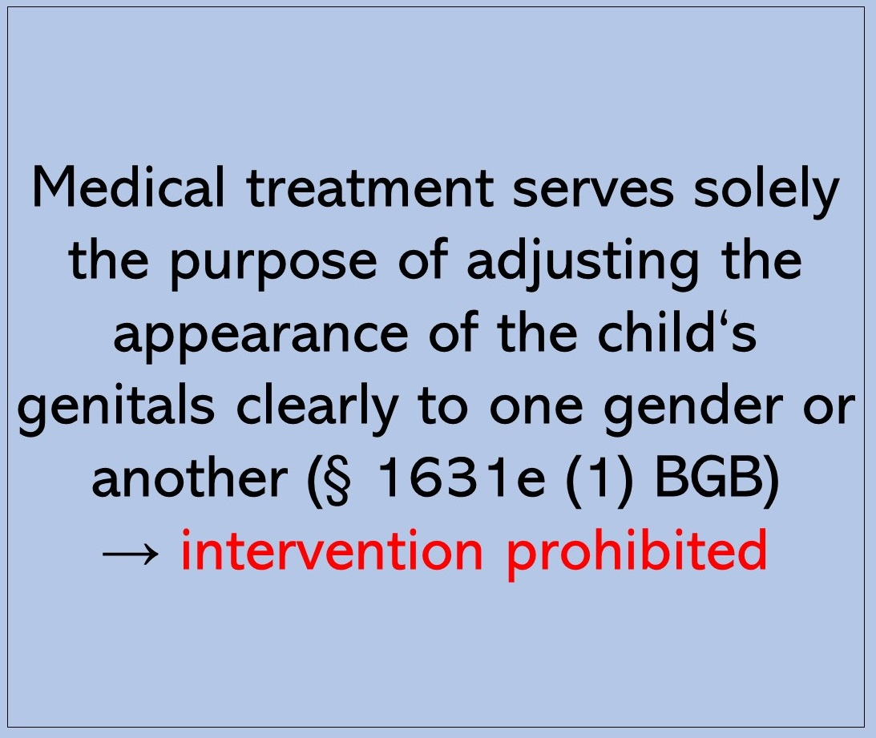
IV. Limitations imposed by § 1631e BGB on early intervention on intersex children

Slide 10
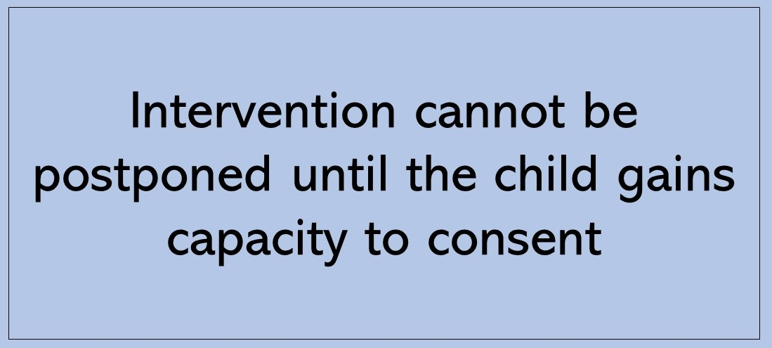
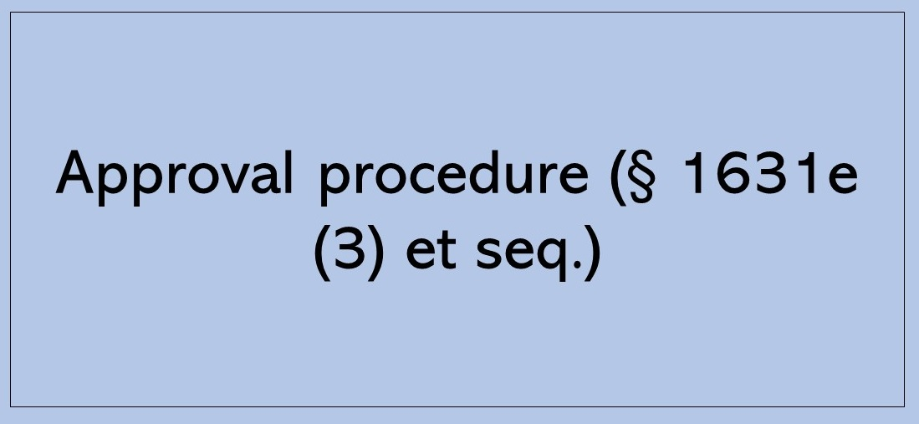

Slide 11
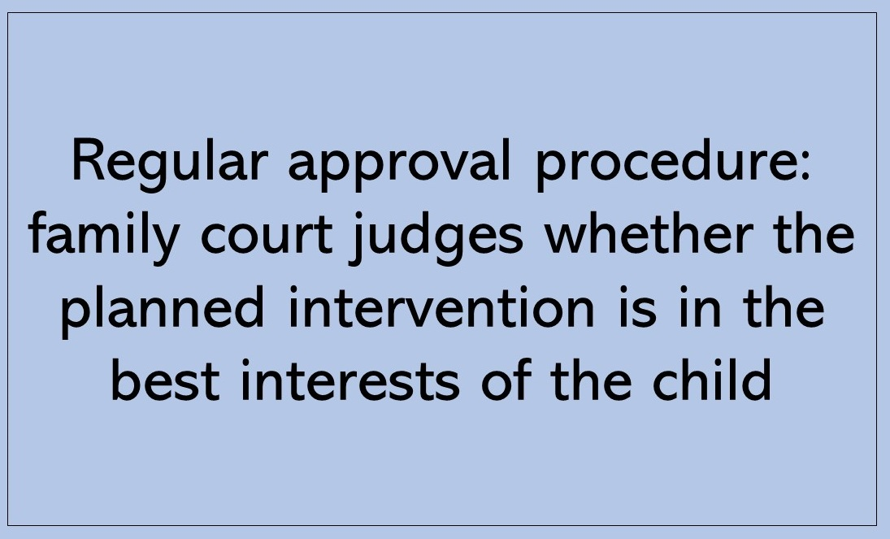
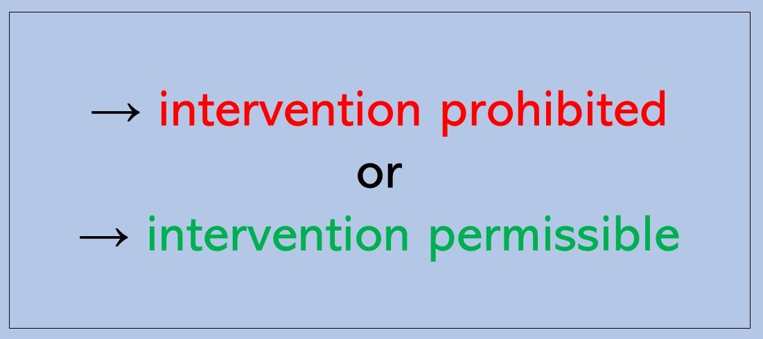

Slide 12
IV. Limitations imposed by § 1631e BGB on early intervention on intersex children

Slide 13
V. Appreciation of the new legislation
Generally positive feedback that legislation has been passed
Criticism concerning § 1631e BGB, § 167a FamFG
High complexity
Large number of very vague terms
No special regime for hormonal treatment
Interdisciplinary commission not sufficiently regulated
Shortened procedure dangerous and unnecessary
Costs of interdisciplinary commission not covered by social security

Slide 14
V. Appreciation of the new legislation
Generally positive feedback that legislation has been passed
Criticism concerning § 1631e BGB, § 167a FamFG
Criticism concerning other possible content of the 2021 Act
No compensation fund
No right to consultation
No central registry

Slide 15
V. Appreciation of the new legislation
Generally positive feedback that legislation has been passed
Criticism concerning § 1631e BGB, § 167a FamFG
Criticism concerning other possible content of the 2021 Act
→ Fear that the new Act does not effectively prevent early intervention on intersex children

Slide 16
Annex: § 1631e BGB, § 167a FamFG
§ 1631e BGB. Treatment of children with variants of sex development
(1) Personal care does not include the right to consent to treatment of a child who is incapable of giving consent and has a variant of sex development, or to carry out such treatment oneself, which, without any further reason for the treatment being added, is carried out solely with the intention of bringing the child's physical appearance into line with that of the male or female sex.
(2) ¹In surgical interventions on the internal or external sexual characteristics of the child who is incapable of giving consent and has a variant of sexual development, which could result in an approximation of the physical appearance of the child to that of the male or female sex and for which the authority to give consent is not already lacking in accordance with subsection 1, the parents may only give their consent if the intervention cannot be postponed until the child has made a self-determined decision. ²Section 1909 shall not apply.
(3) ¹Consent pursuant to subsection (2) sentence 1 shall require the approval of the family court unless the surgical intervention is necessary to avert a danger to the child's life or health and cannot be postponed until approval has been granted. ²Permission shall be granted on application by the parents if the planned intervention is in the best interests of the child. ³If the parents submit to the family court an opinion of an interdisciplinary commission in accordance with subsection (4) in favour of the intervention, it shall be presumed that the planned intervention is in the best interests of the child.
(4) 1An interdisciplinary commission shall include at least the following persons:
1. the person treating the child in accordance with § 630a,
2. at least one other medical person,
3. one person with a professional qualification in psychology, child and adolescent psychotherapy or child and adolescent psychiatry, and
4. one person who has received training, further training or continuing education in ethics.
2The medical commission members must have different specialisations in paediatrics. 3One of them must be a specialist in paediatrics and adolescent medicine with a focus on paediatric endocrinology and diabetology. 4A commission member in accordance with sentence 1 number 2 may not be employed in the health care facility in which the surgical intervention is to be performed. 5All commission members must have experience in dealing with children with variants of sex development. 6If requested by the parents, the commission shall involve a counsellor with a variant of sex development.
(5) 1The opinion of the interdisciplinary commission in favour of the surgical intervention in accordance with sub-section 2 sentence 1 shall contain in particular the following information:
1. the designation of the members of the commission and information on their qualifications,
2. the age of the child and whether and which variant of sexual development it exhibits,
3. the name of the planned intervention and what the indication for it is,
4. why the Commission is in favour of the intervention, taking into account the best interests of the child, and whether, in its view, it is in the best interests of the child, in particular what risks are associated with this intervention, with other treatment or with not having an intervention until the child has made a self-determined decision,
5. whether and by which commission members a discussion was held with the parents and the child and whether and by which commission members the parents and the child were informed and advised on how to deal with this variant of gender development,
6. whether counselling of the parents and the child by a counsellor with a variant of gender development has taken place,
7. the extent to which the child is capable of forming and expressing an opinion and whether the planned intervention is in accordance with his or her wishes, and
8. whether the counsellor with a variant of sex development involved in accordance with paragraph 4 sentence 6 supports the favourable opinion.
2The opinion must be signed by all members of the interdisciplinary commission.
(6) The person providing treatment pursuant to Section 630a shall, if treatment has been carried out on the internal or external sexual characteristics, keep the patient's file until the day on which the person treated reaches the age of 48.
§ 167b FamFG . Approval procedure pursuant to section 1631e of the Civil Code; authorisation to issue ordinances
(1) 1In proceedings pursuant to section 1631e subsection (3) of the Civil Code, the court shall grant approval by written procedure, provided that the parents submit a statement in favour of the intervention and no reasons are apparent that would prevent approval. 2If the court decides by written procedure, it shall dispense with the hearing of the youth welfare office, the personal hearing of the parents and the appointment of a guardian ad litem. 3Section 162 shall not apply.
(2) 1If the parents do not submit to the court a statement in favour of the intervention or if reasons are apparent which stand in the way of authorisation in accordance with subsection (1), the court shall discuss the matter with the parties involved at a hearing. 2The court shall point out the possibilities of counselling by the counselling centres and counselling services of the child and youth welfare organisations. 3It may order the parents to seek counselling on how to deal with variants of gender development and to submit a confirmation thereof to the court. 4This order may not be challenged independently and may not be enforced by means of coercion.
(3) 1The Land governments shall be empowered to assign jurisdiction for proceedings under subsections (1) and (2) by statutory order to the family court in whose district the Higher Regional Court has its seat or to another family court. 2This authorisation may be transferred by the respective Land government to the Land judicial administration. 3Multiple Länder may agree on the jurisdiction of a court for proceedings under this provision beyond the boundaries of the Länder.

Slide 17
Annex: § 1631e BGB, § 167a FamFG
§ 1631e BGB. Treatment of children with variants of sex development
(1) Personal care does not include the right to consent to treatment of a child who is incapable of giving consent and has a variant of sex development, or to carry out such treatment oneself, which, without any further reason for the treatment being added, is carried out solely with the intention of bringing the child's physical appearance into line with that of the male or female sex.
(2) ¹In surgical interventions on the internal or external sexual characteristics of the child who is incapable of giving consent and has a variant of sexual development, which could result in an approximation of the physical appearance of the child to that of the male or female sex and for which the authority to give consent is not already lacking in accordance with subsection 1, the parents may only give their consent if the intervention cannot be postponed until the child has made a self-determined decision. ²Section 1909 shall not apply.
(3) ¹Consent pursuant to subsection (2) sentence 1 shall require the approval of the family court unless the surgical intervention is necessary to avert a danger to the child's life or health and cannot be postponed until approval has been granted. ²Permission shall be granted on application by the parents if the planned intervention is in the best interests of the child. ³If the parents submit to the family court an opinion of an interdisciplinary commission in accordance with subsection (4) in favour of the intervention, it shall be presumed that the planned intervention is in the best interests of the child.
(4) 1An interdisciplinary commission shall include at least the following persons:
1. the person treating the child in accordance with § 630a,
2. at least one other medical person,
3. one person with a professional qualification in psychology, child and adolescent psychotherapy or child and adolescent psychiatry, and
4. one person who has received training, further training or continuing education in ethics.
2The medical commission members must have different specialisations in paediatrics. 3One of them must be a specialist in paediatrics and adolescent medicine with a focus on paediatric endocrinology and diabetology. 4A commission member in accordance with sentence 1 number 2 may not be employed in the health care facility in which the surgical intervention is to be performed. 5All commission members must have experience in dealing with children with variants of sex development. 6If requested by the parents, the commission shall involve a counsellor with a variant of sex development.
(5) 1The opinion of the interdisciplinary commission in favour of the surgical intervention in accordance with sub-section 2 sentence 1 shall contain in particular the following information:
1. the designation of the members of the commission and information on their qualifications,
2. the age of the child and whether and which variant of sexual development it exhibits,
3. the name of the planned intervention and what the indication for it is,
4. why the Commission is in favour of the intervention, taking into account the best interests of the child, and whether, in its view, it is in the best interests of the child, in particular what risks are associated with this intervention, with other treatment or with not having an intervention until the child has made a self-determined decision,
5. whether and by which commission members a discussion was held with the parents and the child and whether and by which commission members the parents and the child were informed and advised on how to deal with this variant of gender development,
6. whether counselling of the parents and the child by a counsellor with a variant of gender development has taken place,
7. the extent to which the child is capable of forming and expressing an opinion and whether the planned intervention is in accordance with his or her wishes, and
8. whether the counsellor with a variant of sex development involved in accordance with paragraph 4 sentence 6 supports the favourable opinion.
2The opinion must be signed by all members of the interdisciplinary commission.
(6) The person providing treatment pursuant to Section 630a shall, if treatment has been carried out on the internal or external sexual characteristics, keep the patient's file until the day on which the person treated reaches the age of 48.
§ 167b FamFG . Approval procedure pursuant to section 1631e of the Civil Code; authorisation to issue ordinances
(1) 1In proceedings pursuant to section 1631e subsection (3) of the Civil Code, the court shall grant approval by written procedure, provided that the parents submit a statement in favour of the intervention and no reasons are apparent that would prevent approval. 2If the court decides by written procedure, it shall dispense with the hearing of the youth welfare office, the personal hearing of the parents and the appointment of a guardian ad litem. 3Section 162 shall not apply.
(2) 1If the parents do not submit to the court a statement in favour of the intervention or if reasons are apparent which stand in the way of authorisation in accordance with subsection (1), the court shall discuss the matter with the parties involved at a hearing. 2The court shall point out the possibilities of counselling by the counselling centres and counselling services of the child and youth welfare organisations. 3It may order the parents to seek counselling on how to deal with variants of gender development and to submit a confirmation thereof to the court. 4This order may not be challenged independently and may not be enforced by means of coercion.
(3) 1The Land governments shall be empowered to assign jurisdiction for proceedings under subsections (1) and (2) by statutory order to the family court in whose district the Higher Regional Court has its seat or to another family court. 2This authorisation may be transferred by the respective Land government to the Land judicial administration. 3Multiple Länder may agree on the jurisdiction of a court for proceedings under this provision beyond the boundaries of the Länder.

Slide 18
Annex: § 1631e BGB, § 167a FamFG
§ 1631e BGB. Treatment of children with variants of sex development
(1) Personal care does not include the right to consent to treatment of a child who is incapable of giving consent and has a variant of sex development, or to carry out such treatment oneself, which, without any further reason for the treatment being added, is carried out solely with the intention of bringing the child's physical appearance into line with that of the male or female sex.
(2) ¹In surgical interventions on the internal or external sexual characteristics of the child who is incapable of giving consent and has a variant of sexual development, which could result in an approximation of the physical appearance of the child to that of the male or female sex and for which the authority to give consent is not already lacking in accordance with subsection 1, the parents may only give their consent if the intervention cannot be postponed until the child has made a self-determined decision. ²Section 1909 shall not apply.
(3) ¹Consent pursuant to subsection (2) sentence 1 shall require the approval of the family court unless the surgical intervention is necessary to avert a danger to the child's life or health and cannot be postponed until approval has been granted. ²Permission shall be granted on application by the parents if the planned intervention is in the best interests of the child. ³If the parents submit to the family court an opinion of an interdisciplinary commission in accordance with subsection (4) in favour of the intervention, it shall be presumed that the planned intervention is in the best interests of the child.
(4) 1An interdisciplinary commission shall include at least the following persons:
1. the person treating the child in accordance with § 630a,
2. at least one other medical person,
3. one person with a professional qualification in psychology, child and adolescent psychotherapy or child and adolescent psychiatry, and
4. one person who has received training, further training or continuing education in ethics.
2The medical commission members must have different specialisations in paediatrics. 3One of them must be a specialist in paediatrics and adolescent medicine with a focus on paediatric endocrinology and diabetology. 4A commission member in accordance with sentence 1 number 2 may not be employed in the health care facility in which the surgical intervention is to be performed. 5All commission members must have experience in dealing with children with variants of sex development. 6If requested by the parents, the commission shall involve a counsellor with a variant of sex development.
(5) 1The opinion of the interdisciplinary commission in favour of the surgical intervention in accordance with sub-section 2 sentence 1 shall contain in particular the following information:
1. the designation of the members of the commission and information on their qualifications,
2. the age of the child and whether and which variant of sexual development it exhibits,
3. the name of the planned intervention and what the indication for it is,
4. why the Commission is in favour of the intervention, taking into account the best interests of the child, and whether, in its view, it is in the best interests of the child, in particular what risks are associated with this intervention, with other treatment or with not having an intervention until the child has made a self-determined decision,
5. whether and by which commission members a discussion was held with the parents and the child and whether and by which commission members the parents and the child were informed and advised on how to deal with this variant of gender development,
6. whether counselling of the parents and the child by a counsellor with a variant of gender development has taken place,
7. the extent to which the child is capable of forming and expressing an opinion and whether the planned intervention is in accordance with his or her wishes, and
8. whether the counsellor with a variant of sex development involved in accordance with paragraph 4 sentence 6 supports the favourable opinion.
2The opinion must be signed by all members of the interdisciplinary commission.
(6) The person providing treatment pursuant to Section 630a shall, if treatment has been carried out on the internal or external sexual characteristics, keep the patient's file until the day on which the person treated reaches the age of 48.
§ 167b FamFG . Approval procedure pursuant to section 1631e of the Civil Code; authorisation to issue ordinances
(1) 1In proceedings pursuant to section 1631e subsection (3) of the Civil Code, the court shall grant approval by written procedure, provided that the parents submit a statement in favour of the intervention and no reasons are apparent that would prevent approval. 2If the court decides by written procedure, it shall dispense with the hearing of the youth welfare office, the personal hearing of the parents and the appointment of a guardian ad litem. 3Section 162 shall not apply.
(2) 1If the parents do not submit to the court a statement in favour of the intervention or if reasons are apparent which stand in the way of authorisation in accordance with subsection (1), the court shall discuss the matter with the parties involved at a hearing. 2The court shall point out the possibilities of counselling by the counselling centres and counselling services of the child and youth welfare organisations. 3It may order the parents to seek counselling on how to deal with variants of gender development and to submit a confirmation thereof to the court. 4This order may not be challenged independently and may not be enforced by means of coercion.
(3) 1The Land governments shall be empowered to assign jurisdiction for proceedings under subsections (1) and (2) by statutory order to the family court in whose district the Higher Regional Court has its seat or to another family court. 2This authorisation may be transferred by the respective Land government to the Land judicial administration. 3Multiple Länder may agree on the jurisdiction of a court for proceedings under this provision beyond the boundaries of the Länder.

Slide 19
Annex: § 1631e BGB, § 167a FamFG
§ 1631e BGB. Treatment of children with variants of sex development
(1) Personal care does not include the right to consent to treatment of a child who is incapable of giving consent and has a variant of sex development, or to carry out such treatment oneself, which, without any further reason for the treatment being added, is carried out solely with the intention of bringing the child's physical appearance into line with that of the male or female sex.
(2) ¹In surgical interventions on the internal or external sexual characteristics of the child who is incapable of giving consent and has a variant of sexual development, which could result in an approximation of the physical appearance of the child to that of the male or female sex and for which the authority to give consent is not already lacking in accordance with subsection 1, the parents may only give their consent if the intervention cannot be postponed until the child has made a self-determined decision. ²Section 1909 shall not apply.
(3) ¹Consent pursuant to subsection (2) sentence 1 shall require the approval of the family court unless the surgical intervention is necessary to avert a danger to the child's life or health and cannot be postponed until approval has been granted. ²Permission shall be granted on application by the parents if the planned intervention is in the best interests of the child. ³If the parents submit to the family court an opinion of an interdisciplinary commission in accordance with subsection (4) in favour of the intervention, it shall be presumed that the planned intervention is in the best interests of the child.
(4) 1An interdisciplinary commission shall include at least the following persons:
1. the person treating the child in accordance with § 630a,
2. at least one other medical person,
3. one person with a professional qualification in psychology, child and adolescent psychotherapy or child and adolescent psychiatry, and
4. one person who has received training, further training or continuing education in ethics.
2The medical commission members must have different specialisations in paediatrics. 3One of them must be a specialist in paediatrics and adolescent medicine with a focus on paediatric endocrinology and diabetology. 4A commission member in accordance with sentence 1 number 2 may not be employed in the health care facility in which the surgical intervention is to be performed. 5All commission members must have experience in dealing with children with variants of sex development. 6If requested by the parents, the commission shall involve a counsellor with a variant of sex development.
(5) 1The opinion of the interdisciplinary commission in favour of the surgical intervention in accordance with sub-section 2 sentence 1 shall contain in particular the following information:
1. the designation of the members of the commission and information on their qualifications,
2. the age of the child and whether and which variant of sexual development it exhibits,
3. the name of the planned intervention and what the indication for it is,
4. why the Commission is in favour of the intervention, taking into account the best interests of the child, and whether, in its view, it is in the best interests of the child, in particular what risks are associated with this intervention, with other treatment or with not having an intervention until the child has made a self-determined decision,
5. whether and by which commission members a discussion was held with the parents and the child and whether and by which commission members the parents and the child were informed and advised on how to deal with this variant of gender development,
6. whether counselling of the parents and the child by a counsellor with a variant of gender development has taken place,
7. the extent to which the child is capable of forming and expressing an opinion and whether the planned intervention is in accordance with his or her wishes, and
8. whether the counsellor with a variant of sex development involved in accordance with paragraph 4 sentence 6 supports the favourable opinion.
2The opinion must be signed by all members of the interdisciplinary commission.
(6) The person providing treatment pursuant to Section 630a shall, if treatment has been carried out on the internal or external sexual characteristics, keep the patient's file until the day on which the person treated reaches the age of 48.
§ 167b FamFG . Approval procedure pursuant to section 1631e of the Civil Code; authorisation to issue ordinances
(1) 1In proceedings pursuant to section 1631e subsection (3) of the Civil Code, the court shall grant approval by written procedure, provided that the parents submit a statement in favour of the intervention and no reasons are apparent that would prevent approval. 2If the court decides by written procedure, it shall dispense with the hearing of the youth welfare office, the personal hearing of the parents and the appointment of a guardian ad litem. 3Section 162 shall not apply.
(2) 1If the parents do not submit to the court a statement in favour of the intervention or if reasons are apparent which stand in the way of authorisation in accordance with subsection (1), the court shall discuss the matter with the parties involved at a hearing. 2The court shall point out the possibilities of counselling by the counselling centres and counselling services of the child and youth welfare organisations. 3It may order the parents to seek counselling on how to deal with variants of gender development and to submit a confirmation thereof to the court. 4This order may not be challenged independently and may not be enforced by means of coercion.
(3) 1The Land governments shall be empowered to assign jurisdiction for proceedings under subsections (1) and (2) by statutory order to the family court in whose district the Higher Regional Court has its seat or to another family court. 2This authorisation may be transferred by the respective Land government to the Land judicial administration. 3Multiple Länder may agree on the jurisdiction of a court for proceedings under this provision beyond the boundaries of the Länder.

Slide 20
Thank you for your attention
Prof. Dr. Katharina Lugani
Chair for German, European and International Private and Procedural Law
Institute for Medical Law
Law Faculty of Heinrich-Heine-University Düsseldorf
Universitätsstraße 1
D-40225 Düsseldorf GERMANY
Tel.: +49 211 81-11429
Mobile: +49 179 546 82 35
E-Mail: lugani@hhu.de
URL: https://www.jura.hhu.de/dozenten/lugani
Instagram: LS_lugani_hhu

