Slide 1
European Programme for Human Rights Education for Legal Professionals CoE HELP Eva Pastrana, June 2022
12/07/2022
1

Slide 2
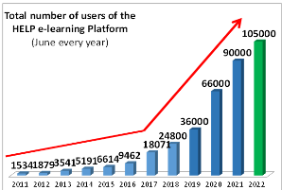
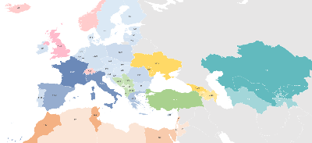
OVERVIEW
HELP Network/users
HELP courses
Methodology
Impact
Overview

Slide 3
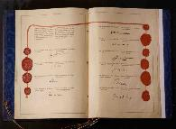
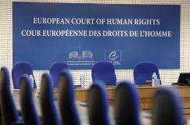
STANDARDS
COUNCIL OF EUROPE
Cooperation programmes
ASSISTANCE
Mechanisms of
Notes:
Le triangle vertueux du Conseil de l’Europe

Slide 4
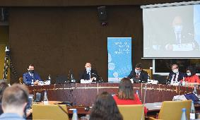
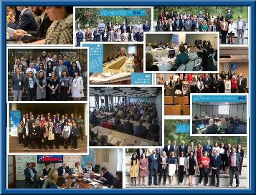
HELP Network
Nat’l Training Institutions/Bars
Partners: EU,
HELP’s goal: effective implementation of European Human Rights standards (CoE + EU) , mainly by training on
European Convention on Human Rights, (Revised) ESC, CoE Conventions
EU Charter of Fdtal. Rights, EU Law
HELP METHODOLOGY
HELP e-COURSES & e-PLATFORM
Notes:
↗ Users: 46,000 March→ 66,000 June
↗ highly demanded: VaW, Data Protection, Bioethics, Labour
HELP is:
- the only pan-European Network of national training institutions for judges, prosecutors and lawyers in the 47 Member States;
- an e-learning platform on human rights;
a human rights training methodology for legal professionals.
HELP Network
The HELP Network, the only pan-European peer-to-peer Human Rights Training Network, is composed of representatives from National Training Institutions for Judges and Prosecutors (NTIs) and Bar Associations (BAs) of the 47 member states of the Council of Europe.
The HELP Network is entrusted with the implementation of paragraph 9.vi of the 2012 Brighton Declaration and shall, in this respect:
promote the development and promotion of initial and continuous training of legal professionals on standards of the ECHR, as interpreted by the case law of the European Court of Human Rights (ECtHR);
share best practices and provide advice on curricula, training materials and training methodologies for legal professionals, identifying priority themes for future training activities.
E-learning platform
A wide range of training resources on the ECHR, developed and collected under the HELP Programme, is available on-line, translated into the national languages of the beneficiary countries. It is becoming a real challenge for legal professionals to follow the case law of the Strasbourg Court, which evolves quickly and expansively. The HELP Programme is also a platform where they will be able to keep abreast of Strasbourg case law developments through easy available updates.
There are two main types of HELP training resources:
Distance-learning courses are available for selected groups of legal professionals participating in pilot courses moderated by certified national tutors. The list of available courses (including a description) is available in the catalogue of courses.
Self-learning resources are available to any user who has an account on the platform.
They include training manuals on both ECHR Methodology and Key Concepts, as well as Handbooks, standard curricula, course outlines, presentations, case studies, and e-learning courses on the different Articles and themes of the ECHR.
Training methodology
The HELP methodology takes into account the heavy time pressure imposed on legal professionals in their daily work. Its added value is that curricula are drafted on a tailor-made basis, meeting participants’ specific training needs and learning pace, allowing flexibility.The HELP methodology and resources are systematically used in all CoE capacity building activities on the ECHR, organised in the Member States, including within the framework of EU/CoE Joint Programmes.
HELP organises training of trainers sessions, with the aim to increase ownership by national training institutions.

Slide 5
Notes:
2017 slide

Slide 6
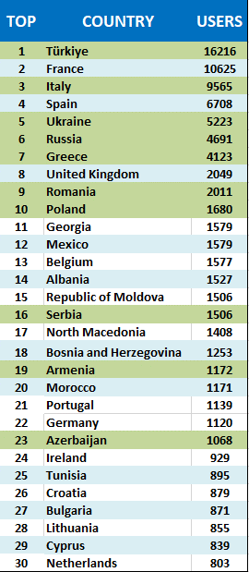
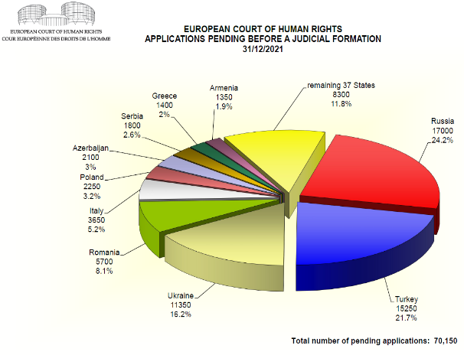
HELP Platform
HELP in EU: +48,000
HELP in WB and TK: +23,000
Eastern Partnership: +11,000
HELP in South Mediterranean: +2,300
HELP in Central Asia: +390
Notes:
PENDING ALLOCATED CASES
Approximately 70150 62000 applications were pending before a judicial formation at 31 Dec 2021 2020. Nearly a quarter of these applications had been lodged against the Russian Federation.
The number of applications allocated to a judicial formation in 2021 exceeded the number disposed of judicially during the year.

Slide 7
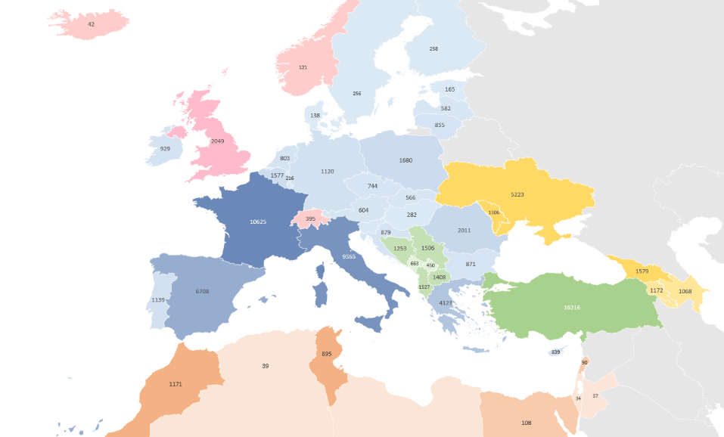
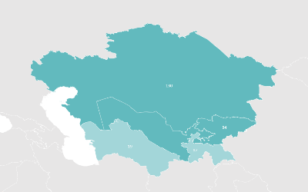
Geographical distribution of HELP platform users
- figures until June 15, 2022 -

Slide 8
HELP PROJECTS
HELP in the EU
Radicalisation Prevention, Judicial Response to Terrorism and International Cooperation in Criminal Matters (until May 2022)
HELP in Russia (until March 2022)
HELP in Cyprus –EaP (Armenia, Azerbaijan, Georgia, Republic of Moldova)
HELP COMPONENTS in mainly EU-funded programmes:
HELP in the Western Balkans & Turkey
South Mediterranean
Support to Indep. Instances- Tunisia
HELP in Central Asia
Notes:
European Court of Human Rights
Published on 17 Oct 2016
Aimed at a wide audience, the film on the European Court of Human Rights explains how the Court works, describes the challenges faced by it and shows the scope of its activity through examples from the case-law.

Slide 9
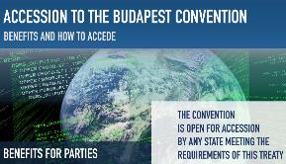
New HELP Courses – links to Int’l/CoE Conventions but also EU law and case-law of ECHR & CJEU
Notes:
THB for the purpose of labour exploitation:
The main legal document of the CoE is the 2005 Convention on Action against Trafficking in Human Beings (the Anti-trafficking Convention). The Convention is monitored by GRETA (Group of Experts on Action against THB)
Definition of THB for the purpose of labour exploitation and related legal concepts.
Key actors: Organisations that play a role in detecting offences and in identifying victims
Identification of victims
Victiims’ rights and assistance
Investigations, prosecutions and trials
Corporate liability for THB
Access to remedies and compensation for victims
Module 0: Introduction
Welcome message, navigation instructions, course authors and course target group
Module 1: Understanding Violence Against Women and Domestic Violence
Key concepts and definitions
Violence against women and its different forms
What is domestic violence
Impact on victims
Consequences for society: costs of VAW and DV.
Module 2: Effective law enforcement responses in addressing violence against women and domestic violence
Principles of law enforcement response
Confronting stereotypes and professional bias
First contact with victims
At the scene of the incident/crime
At the police station
Investigation, evidence and reporting to prosecutor
Module 3: Assessing Risk of Violence Against Women and Domestic Violence

Slide 10
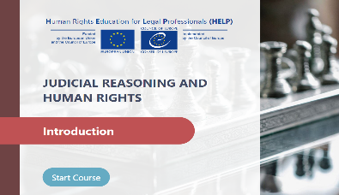
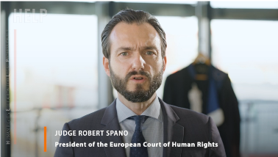
Introduction
Judicial reasoning and fair trial
Judicial reasoning in criminal proceedings:
Pre-trial stage
Trial, Appeal and Enforcement
Judicial reasoning in non-criminal proceedings:
General concepts
Thematic issues I:
Family, privacy, FoE
medical, property, work-, education-related issues
Click on the picture or here to watch a (4-min ) HELP course introductory video
Notes:
Skills & attitudes: Refer to relevant legal framework in your daily work as legal professional

Slide 11
NEW!
- Primarily for legal practitioners including representatives of Armed Forces and relevant law enforcement bodies, police o or military police and/or military investigations and other stakeholders.
HELP course update
Notes:
Course TARGET AUDIENCE:
Primarily for legal practitioners including representatives of Armed Forces and relevant law enforcement bodies, police o or military police and/or military investigations and other stakeholders working n this or related fields.
The course may be particularly useful for students of military universities, civil servants, media, policy makers and other professionals dealing with the topic of human rights in the Armed Forces.
Course learning objectives:
Explain what does wearing a uniform mean with regards to enjoyment of human rights.
Understand the meaning of the relevant legal framework for protection of human rights in armed forces;
Identify and understand the international and CoE standards which protect a series of rights and liberties applicable to members of armed forces
List the main social and economic rights as applied to the military context and life
Understand remedies, judicial and non-judicial, against violations of human rights of members of armed forces and mechanisms to improve the existing standards.
Analyse the ECHR standards for right to life, torture, other forms of ill-treatment, and prohibition of forced labour, as well as the methodology and techniques to be followed to fulfill the procedural requirements of an effective investigation and/or examination.
Learn about the concepts of equality and non-discrimination and their legal implications

Slide 12
HELP courses – Rule of Law
Notes:
EU Rule of Law Mechanism and first monitoring cycle
The EU wants to strengthen the Rule of Law on its soil, particularly since it felt that for the last 5 years, it has come under attack, more visible in member states like Hungary or Poland but also elsewhere.
Following the July 2019 Communication on ‘Strengthening the rule of law through increased awareness, an annual monitoring cycle and more effective enforcement’, (around promotion, prevention and enforcement), the EU triggered it’s Rule of Law Mechanism.
The process started in January 2020 with the setting up of the RoL Network (EU contact points) that agreed on the methodology to be used to monitor countries (based on the existing tools such as the EU Justice Scoreboard) and concluded in September 2020, when the EU adopted its fist annual Rule of Law report covering all member states. It identifies positive and negative developments covering four areas: the justice system, anti-corruption framework, media pluralism, and institutional checks and balances. This report will be followed by subsequent annual monitoring cycles and reports.
Council of Europe added value and expertise
The CoE has been -to date- the reference on Rule of Law in Europe
The first annual Rule of Law Report acknowledges the CoE’s standard setting role, expertise and best practices in the area of RoL as well as the case-law of the ECHR:
When describing what is the RoL and enumerating the RoL principles, it states “These principles have been recognised by the European Court of Justice and the European Court of Human Rights. In addition, the Council of Europe has developed standards and issued opinions and recommendations which provide well-established guidance to promote and uphold the rule of law.”
Underlines the wish to strengthen cooperation with the CoE, mentioned alongside UN and the OSCE.
Regarding Commission’s support to MS in addressing RoL challenges, it states that “Reforms would also benefit from expertise from recognised international bodies, in particular the Council of Europe, as well as from exchanges with practitioners from other Member States.”
The report refers to opinions and recommendations from the Council of Europe, which provide useful guidance and to the specific CoE inputs at country level both in its general part and its 27 country chapters, and also referring to the CoE/VC opinions adopted during the pandemic and related emergency measures taken by MS.
“The case-law of the European Court of Human Rights also provides for key standards to be respected to safeguard judicial independence.” Other references to the ECHR mainly refer to the independence of judiciary or the prosecution services.

Slide 13
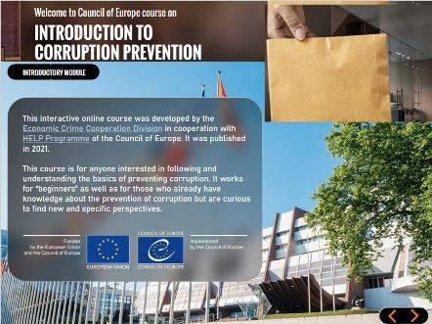
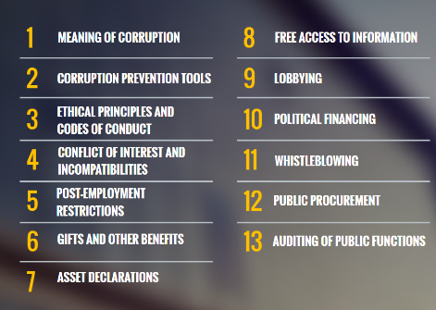
Overview

Slide 16
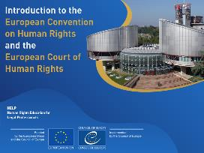
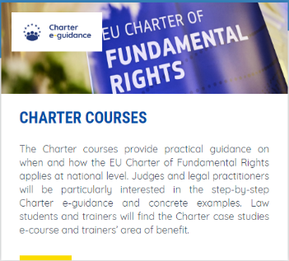
COURSES under preparation:
Quality of Justice: the work of CEPEJ
Interplay between the ECHR and the EU Charter of Fundamental Rights (w. FRA, EU)

Slide 17
COURSES updates
Prohibition of Ill-treatment
Child-friendly Justice
Trafficking in Human Beings

Slide 18
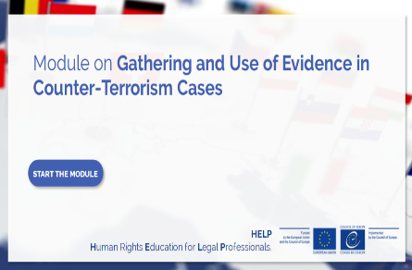
HELP courses with ended project
Notes:
ECHR + ESC + CoE legislation + EU law for EU
+ EU Charter and EU law for EU countries

Slide 19
Migration/Asylum/IDP
w. UNHCR & OSRSG
6 hour online learning
REFUGEE AND MIGRANT CHILDREN (10 hour online learning)
NEW MODULES:
LGBTI PERSONS IN THE ASYLUM PROCEDURE
TRANSITION TO ADULTHOOD AND FAMILY-BASED CARE
7 hour online learning

Slide 20
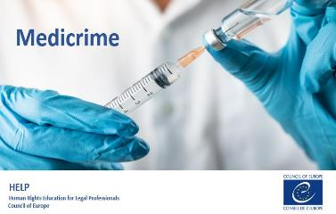
HELP courses w/out (or ended) project
Notes:
Courses for which there is demand but unfortunately there is no financial specific support through current project

Slide 21
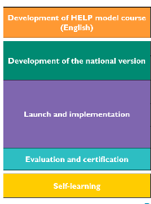
HELP Programme: direct implementation and transversal element
Accelerating factors
RESULTS (TO DATE)
> 40 HELP model courses
500 HELP courses translated/contextualised to national legislation and practice
> 800 HELP certified tutors in Europe, South Mediterranean and Central Asia
> 105,000 users of the CoE HELP platform (15,000 new since last year)
>31,000 participants in HELP tutored courses ≈100,000 self-enrolments in the HELP platform, with > 17,000 completing in full their courses (some 142,000 e-learning hours)
€
HELP Methodology

Slide 22
Catalogue of HELP Courses
Admissibility criteria in applications submitted to the ECtHR
Alternative measures to detention
Alternatives to Immigration Detention
Anti-discrimination
Asylum and Human Rights
Key human rights principles in biomedicine
Business and human rights
Child-friendly Justice
Combatting Trafficking in Human Beings
Counterfeiting of Medical Products
CPT Standards
Data Protection and Privacy Rights
Ethics for judges, prosecutors and lawyers
Family Law and human rights
Fight against Racism, Xenophobia, Homophobia and Transphobia
Freedom of Expression
Gathering/use of evidence in counter-terrorism
Hate crime and Hate speech
Human Rights in Sports
Introduction to the ECHR and ECtHR
Introduction to the European Social Charter
Int’l Cooperation in Criminal Matters
Internal Displacement
Judicial Reasoning and Human Rights
Labour Rights
Managing foreign prisoners (europris)
Pre-trial Investigation in light of the ECHR
Procedural safeguards in criminal proceedings and victims’ rights
Prohibition of Ill-treatment
Property Rights
Protection and Safety of Journalists
Radicalisation Prevention - Gathering and use of evidence in counter-terrorism cases
Refugee and Migrant Children
Reasoning of (Criminal) Judgments
Rights of Persons with Disabilities
Right to Liberty and Security (Art 5 ECHR)
Right to Respect for Private and Family Life (Art 8 ECHR)
Right to the Integrity of the Person (Bioethics)
The environment and human rights
Transitional Justice
Violence Against Women and Domestic Violence
Women’s Access to Justice

Slide 23
Users of the CoE HELP Platform enrolled in courses as SELF-LEARNERS…

Slide 24
Overview

Slide 25
17,000 SELF-LEARNERS of the of the CoE HELP Platform certified

Slide 26
Overview

Slide 27
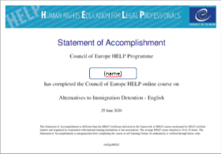
Methodology: Good practices/success stories
Integration of HELP courses in training curricula: Armenia, Belgium (BA), Croatia (NJI), Finland (NJI), France (BA), Greece (NJI), Ireland (BA), Italy (CNF), Romania (BA), Spain (EJ, PO,BA), W.Balkans…
Launches completely organised by partners: Bulgaria, Croatia, Finland, Italy, Lithuania, Portugal, Romania, Spain…
HELP Statements of Accomplishment recognised as training

Slide 28
Impact à moyen terme des cours élaborés dans le cadre du programme HELP dans l'Union européenne 1,5 an après la conclusion du projet
Added value of HELP courses:
Number of users in the HELP online platform
Tested high quality
Efficiency
Proved sustainability
Medium –term impact courses developed under HELP in the EU 1,5 and 5 year after project conclusion

Slide 29
Purpose: Support lawyers assisting those fleeing the war in Ukraine
By HELP tutors and legal experts
Coordinated w. CCBE Migration Committee
Imp. EU Directive on Temporary Protection
Click here and look for your country/language :
Belgium Bulgaria
Cyprus Czechia
France Germany
Greece Hungary
Ireland Italy
Moldova Poland
Romania Slovakia
Spain Ukraine
Under preparation: Latvia, Lithuania
Slovenia
Notes:
managed by HELP tutors and legal experts to support lawyers assisting refugees from Ukraine in the five neighbouring countries (Moldova ,Romania, Slovakia, Hungary and Poland). These HELP e-Desks are being gradually fed with resources and information as they become available in each country, particularly after the activation of the EU Directive on Temporary Protection - and the initiative is co-ordinated together with the Migration Committee of the Council of Bars and Law Societies in Europe (CCBE).
The Asylum/Migration HELP e-Desks facilitate access of legal professionals to information and training on the effective handling of cases at national level regarding refugees and displaced persons, with an immediate focus on refugees from Ukraine. The National HELP e-Desks includes:
• useful links and practical tips assisting legal professionals working with refugees and displaced persons.
• legal resources, including the relevant national legal framework and context: the e-Desks are being updated with developments at the national and European level, especially related to procedures and practices regarding the EU Temporary Protection Directive, as well as asylum and resettlement procedures.
• online self-paced training based on HELP courses related to the context (Asylum and Human Rights; Refugee and Migrant Children; Internal Displacement; Combating Trafficking in Human Beings), on the basis of which legal professionals can undertake fast and high-quality training, benefitting from electronically-generated “Statements of Accomplishment” upon successful completion.
Some eDesks have a forum for exchange, moderated by national experts.

Slide 30
How HELP reinforces its work in Ukraine ...
Asylum/migration HELP eDesks
More HELP courses translated in Ukrainian
Working w. justice training institutions for + contextualisations of HELP courses
Specific modules of HELP courses during conflict (e.g. Prohibition of Ill-treatment)
Organise an online HELP Training of Trainers in Summer/Autumn 2022
Dissemination of HELP course for Universities, MPs and their staff
Network:
>5200 HELP users
≈50 HELP trainers
www.coe.int/HELP
Tutored or self-learning courses
http://help.elearning.ext.coe.int/
National School of Judges of Ukraine
UNBA’s High School for Advocates
Notes:
Continuing updating the Asylum/migration HELP eDesks.
Expanding the catalogue of HELP courses translated in Ukrainian
Working with national (training) justice institutions for + Ukrainian contextualisations of HELP courses
Preparing specific modules of HELP courses adapted to the conflict situation (e.g. Prohibition of Ill-treatment and Torture)
Dedicating a specific session to the situation in Ukraine during the next HELP Annual Conference that will be mainstreamed online:
Organise an online HELP Training of Trainers in Summer 2022
Make HELP presentations for Universities.
National School of Judges of Ukraine
Prosecutor's Training Center of Ukraine
UNBA’s High School for Advocates

Slide 31
HELP in Universities/Academia – HOW?
CM Rec(2019)5 on the ECHR system in university education and professional training
No formalities!
Self-learning: HELP courses to complement university programmes
Exceptionally: Dedicated pages for Unis/law schools if YOU are HELP certified tutor
Watch this video: https://vimeo.com/657882955

Slide 32
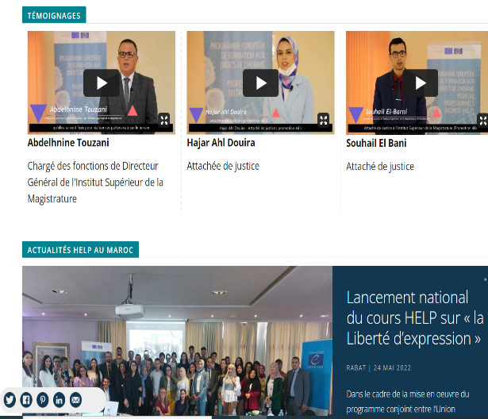
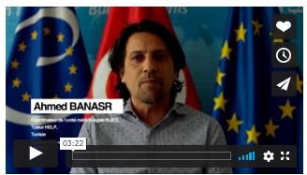
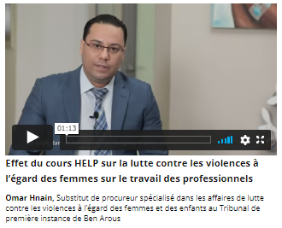
Page HELP Tunisie:
Page HELP Maroc:

Slide 33
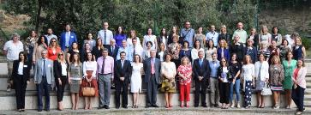
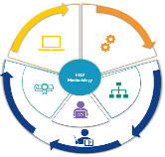
For WHOM:
HELP Network
Justice professionals
> 31,000 tutored participants
+ 105,000 users online
WHAT:
42 courses on
Human Rights
+500 national versions
HOW:
HELP methodology
(virtual) face-to-face & online
cross-border
cross-professional

Slide 34
Join us in Facebook, Twitter:
CoEHELP
HELP
Good training for good judgments
Thank you very much for your attention!
Head of Justice and HR Training Division: Eva.PASTRANA@coe.int
Deputy HELP HoU–EaP: Ana.MEDARSKA-LAZOVA@coe.int
HELP assistants: Helene.Gangloff@coe.int; Stephanie.DENTON@coe.int
HELP e-learning officer: Daniela.BALESTRA@coe.int
HELP in the EU: Ana-Maria.TELBIS@coe.int
HELP in Western Balkans: Jasminka.PERUNICIC-ALLEN@coe.int
HELP in Turkey: Fethullah.SOYUBELLI@coe.int
HELP in Ukraine / migration: Olga.KOSTENKO@coe.int
HELP in Morocco: Malika.SMAALI@coe.int
HELP in Tunisia: Imene.KHALIFA@coe.int
HELP in Central Asia: Krystyna.KHOKHLOVA@coe.int

