Slide 1
HELP in the EU – Achievements Ana-Maria Telbis, EU-CoE HELP in the EU III project coordinator

Slide 2
Achievements under EU-funded projects HELP in the EU HELP RP TERR ICCM
HELP in EU MS

Slide 3
HELP in EU MS
78000+ participants from enrolled in self-learning courses in EU languages
48000+ HELP users from EU
12000+ users completed HELP self-learning courses in EU anguages
271 translations of HELP courses in EU languages available on the e-learning platform
100000+ learning hours

Slide 4
HELP in EU MS
7500+ participants from EU enrolled in TUTORED COURSES
250+ HELP tutored courses launched in EU
5500+ participants from EU successfully completed tutored courses
SUCCESS RATE
78%
90000+ learning hours

Slide 5
Overview
Since completing the course, I used the knowledge and skills gained, in my daily work
36 %
I regularly return to the course page to retrieve information and resources
93% (64/29)
The completion of the course contributed positively to my professional development
The course contributed to developing my skills on the topic
I would enroll in other HELP online courses if they were included in the training curricula of my national training institution/centre
36 %
Since the completion of the course I also enrolled in other HELP self-learning courses available on the platform
71%
(40/31)
My knowledge on the topic increased following the completion of the course
The particiption in the course helped me extend my network of peers interested in the topic
58%
(34/24)
91% (67/24)
61% (22/39)
45% (28/17)
91% (50/41)
95%
(68/27)
*(strongly agree/agree)

Slide 6
Total number users from EU MS of the HELP e-learning platform
(June every year)
HELP in the EU III
HELP in the EU II
HELP RAD ICCM
HELP in 28
HELP in the EU
HELP Rad Prev.
Notes:
HELP is:
the only pan-European Network of national training institutions for judges, prosecutors and lawyers in the 47 Member States;
online courses on human rights;
a human rights training methodology for legal professionals.

Slide 7
10625
9565
6708
4123
1577
1680
2011
1120
1139

Slide 8
929
871
879
855
839
803
744
604
582
566
454
256
282
258
216
165
164
138

Slide 9
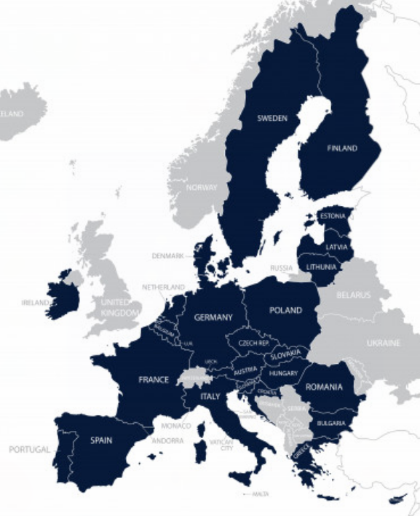
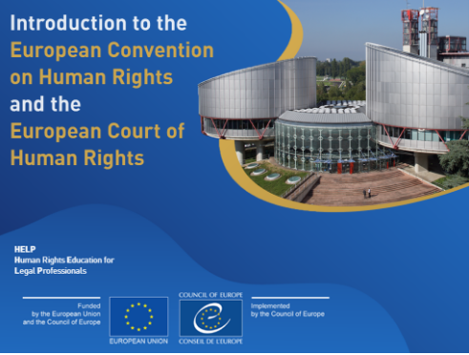
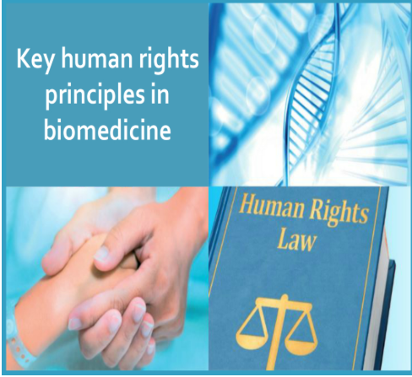
General HELP Course launches

Slide 10
EU-CoE HELP in the EU II Sep 19 – Feb 22
To enhance EU justice professionals’ capacities to effectively and coherently apply European fundamental rights standards at the national level through training, mainly referring to the EU Charter on Fundamental Rights (the Charter), the European Convention on Human Rights (ECHR), the (revised) European Social Charter (ESC) and other relevant EU and Council of Europe (CoE) Law.
To strengthen the HELP Network in the EU, as well as the capacity of the Network members to effectively implement the HELP methodology and courses and contribute to increasing mutual trust between EU practitioners.
NEW course on Ethics for Judges, Prosecutors, Lawyers
HELP courses updated
Translations
Course launches (national, intl, cross-border)
NEW HELP Methodology Guidebook
ToTs (for new tutors; refresh ToT)
Notes:
To enhance EU justice professionals’ capacities to effectively and coherently apply European fundamental rights standards at the national level through training, mainly referring to the EU Charter on Fundamental Rights (the Charter), the European Convention on Human Rights (ECHR), the (revised) European Social Charter (ESC) and other relevant EU and Council of Europe (CoE) Law.
To strengthen the HELP Network in the EU, as well as the capacity of the Network members to effectively implement the HELP methodology and courses and contribute to increasing mutual trust between EU practitioners.

Slide 11
EU-CoE HELP in the EU II
ACHIEVEMENTS
New/updated HELP courses:
Ethics for Judges, Prosecutors and Lawyers
Asylum and HR
Fight against Racism, Xenophobia, Homophobia, Transphobia
Labour Rights as Human Rights
International Cooperation in Criminal Matters
20 new translations in EU languages
15 new national adaptations for EU MS
14 course launches (22 groups ->650 participants)
Training of Trainers (ToT) (50 tutors/20 new)
700 new EU users of HELP courses
New/updated HELP courses:
Ethics for Judges, Prosecutors and Lawyers
Asylum and HR
Fight against Racism, Xenophobia, Homophobia, Transphobia
Labour Rights as Human Rights
International Cooperation in Criminal Matters
+ Rights of Persons with Disabilities
60 new translations in EU languages
15 new national adaptations for EU MS
55 course launches (->1600 enrolled participants)
Training of Trainers (ToT) (74 tutors/51 new)
26000 new EU users of HELP courses

Slide 12
EU-CoE HELP EU II – Course launches

Slide 13
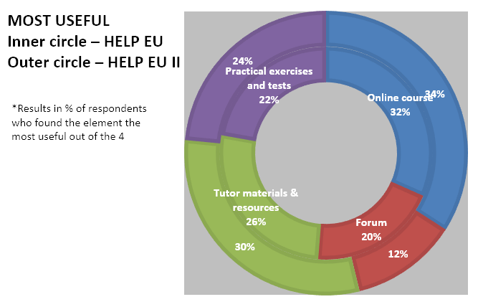
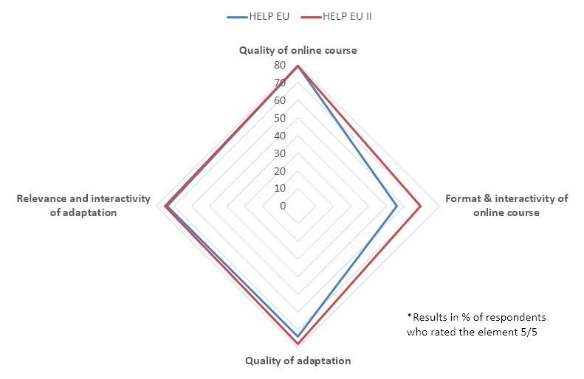
Overview

Slide 14
At the personal level, the impact of the Project was best described by one of the interviewees. She was initially enrolled as a participant in one of the HELP courses and subsequently got involved as a national tutor while also taking new courses in her area of expertise both in the self-learning mode and in the tutored courses. She thus continued her professional education in a trusted, stimulating and effective way, while developing her tutor experience at the same time.
…
The trust and respect for the HELP in the EU II courses is also explained by one of the interviewees who mentioned that the participants frame their certificates in their offices, also as a way of affirming their professional accomplishments and stating their commitment to human rights and fundamental freedoms.
The HELP in the EU initial programme and HELP in the EU II project perfectly embodies the partnership between the European Union and the Council of Europe, which builds on the shared values of human rights, democracy and the rule of law.
The synergistic approach embedding international, EU and CoE (ECHR) standards in the course curricula is conducive to coherent application of European standards across the Member States and supports the harmonisation efforts for countries in the Western Balkans or the Eastern Partnership.

Slide 15
EU-CoE HELP EU III
Mar 22-Aug 24
New module ECHR-EU Charter
Update of 2 courses:
- Child-friendly Justice and Children’s Rights
- Combating Trafficking in Human Beings
Launch of HELP courses

Slide 16
EU-CoE HELP project ‘Radicalisation Prevention, Judicial Response to Terrorism & International Cooperation in Criminal Matters’ (RP-TERR-ICCM)
Jan. 2020-May2022
In partnership with
Objective:
To improve justice cooperation in criminal matters and to contribute to the effective and coherent application of related European instruments through increasing capacities and mutual trust of justice practitioners.
Course launches (national & international versions)
Cross-border Seminars
High level Conference
©bbc

Slide 17
Overview
EU-CoE RP-TERR-ICCM
Course launches

Slide 18
Good practices/success stories
Integration of HELP courses in regular training curricula
Launches completely organised by partners
HELP Statements of Accomplishment recognised as training

Slide 19
Good practices/success stories
In addition, my legal "sense" in the protection of human rights has been significantly sharpened, so that when studying cases, which seemingly do not at first sight concern human rights, I am now able to identify subtle aspects of the case. related to the protection of human rights, with the result that the decisions I issue have a greater "legal depth".
It is a very pleasant form of deepening knowledge, a lot of useful material, very interesting rulings. The course material is presented in an easy and pleasant way to be repeated at any time, although very extensive.
My experience with this online training was so scholastic. I could cover the knowledge that should have taken me a minimum of 1 year training. Thank you so much.
Since I have made this course, my colleagues at the office check with me if they have a doubt on this field.

Slide 20
Thank you!

Slide 22
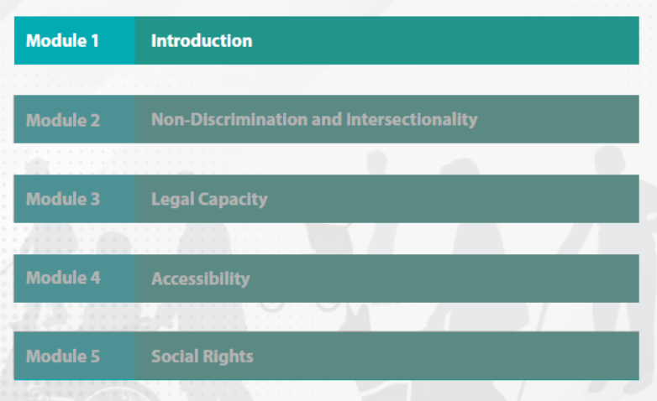

Slide 23
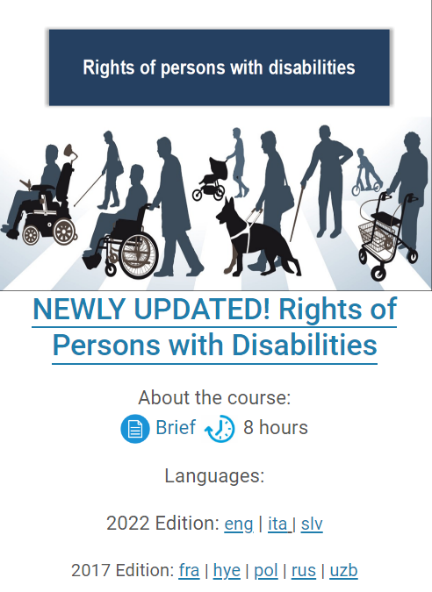
8 hours – 5 modules
8 languages
Launches: Poland, Italy, Slovenia, Uzbekinstan
Self learning: 865 users, 135 Statements of Accomplishment

