Slide 1
Human Rights Education for Legal Professionals
HELP for Ukraine Eva Pastrana, Strasbourg, June 2022

Slide 2
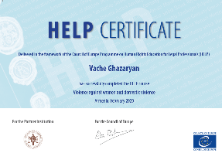
OVERVIEW
What is HELP?
HELP courses
Format HELP courses:
Self-learning
National versions for Ukraine
Overview
Eva Pastrana

Slide 3
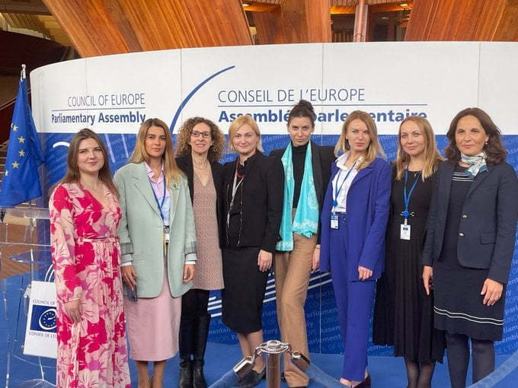
May 2022
Notes:
The Council of Europe Programme European Programme for Human Rights Education for Legal Professionals (HELP) offers free HELP #onlinecourses in Ukrainian:
- Internal Displacement #IDP
- Introduction to the European Convention on Human Rights #ECHR
- Admissibility criteria of cases filed to the European Court Of Human Rights (ECHR)
- Prohibition ⛔️ of Ill-treatment
- Right to #liberty and #security (Article 5 ECHR)
- Access to #Justice for Women
- #Bioethics
- #Child-friendly Justice
- #Labour rights
- Pre-trial investigation
- Transitional Justice
- Hate speech
- Violence against Women and Domestic Violence
Other important HELP courses that exist in English will be soon in Ukrainian: Asylum and Human Rights (developed with UNHCR, the UN Refugee Agency) Refugee and Migrant Children; Combating Trafficking in Human Beings.
Most of these courses have been developed and implemented with EU funding. They cover International and European standards (CoE and EU legal framework and case-law) and, those in Ukrainian, national laws and practice.
All courses available at the Council of Europe HELP e-learning platform at https://help.elearning.ext.coe.int/
We discussed this in exchanges with members of Ukrainian delegation to the Parliamentary Assembly of the Council of Europe

Slide 4
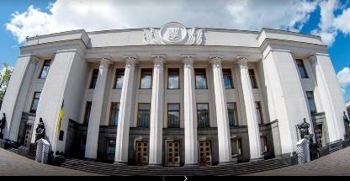
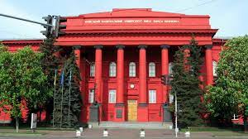
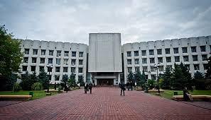
Why use HELP courses?
For MPs, Parliament staff, Universities:
High quality content on Human Rights and Council of Europe standards
HELP courses support the effective implementation of those standards and CoE Conventions priority for Ukraine
Easy and quick access to standards on various HR issues, key documents & case-law of the ECHR and CJEU
Free, easy navigation to go directly to the info 24/7 – No need to take the full course, just browse the course modules & access what you need.
If you have more time (6-12 hrs) and you want a Council of Europe digital and individual certificate, then complete the course.
TARAS SHEVCHENKO NATIONAL UNIVERSITY OF KYIV
Institute of Int’l Relations
Kyiv Taras Shevchenko
Notes:
The Council of Europe Programme European Programme for Human Rights Education for Legal Professionals (HELP) offers free HELP #onlinecourses in Ukrainian:
- Internal Displacement #IDP
- Introduction to the European Convention on Human Rights #ECHR
- Admissibility criteria of cases filed to the European Court Of Human Rights (ECHR)
- Prohibition ⛔️ of Ill-treatment
- Right to #liberty and #security (Article 5 ECHR)
- Access to #Justice for Women
- #Bioethics
- #Child-friendly Justice
- #Labour rights
- Pre-trial investigation
- Transitional Justice
- Hate speech
- Violence against Women and Domestic Violence
Other important HELP courses that exist in English will be soon in Ukrainian: Asylum and Human Rights (developed with UNHCR, the UN Refugee Agency) Refugee and Migrant Children; Combating Trafficking in Human Beings.
Most of these courses have been developed and implemented with EU funding. They cover International and European standards (CoE and EU legal framework and case-law) and, those in Ukrainian, national laws and practice.
All courses available at the Council of Europe HELP e-learning platform at https://help.elearning.ext.coe.int/
We discussed this in exchanges with members of Ukrainian delegation to the Parliamentary Assembly of the Council of Europe

Slide 5
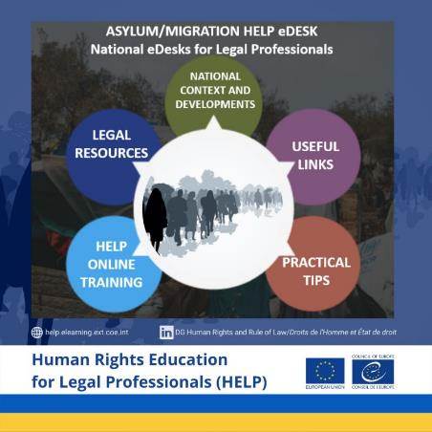
To assist lawyers and all legal professionals dealing with the huge increase of war people on the move and/or refugees, mostly women, girls and boys, the Council of Europe took immediate steps, thanks to the flexibility of its Human Rights Education for Legal Professionals (HELP) Programme.
As of 1 March 2022, virtual Asylum/Migration HELP e-Desks managed by HELP tutors and legal experts support lawyers in four EU neighbouring countrie: Romania, Slovakia, Hungary and Poland (with EU support) as well as for Moldova.
These HELP e-Desks are being gradually fed with resources and information as it becomes available in each country, particularly after the reactivation of the EU Directive on Temporary Protection.
The initiative is coordinated with the Migration Committee of the Council of Bars and Law Societies in Europe (CCBE).
National HELP eDesks have also been set up for Bulgaria, Cyprus, France, Germany, Greece and Spain and several others are in preparation (for Belgium, Czechia, Latvia, Lithuania and Slovenia).
In parallel, a similar Asylum/Migration National HELP e-Desk is being developed for Ukraine for those still in the country who need legal information on asylum/migration/displacement issues.

Slide 6
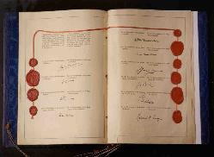
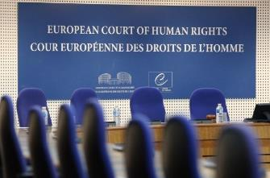
STANDARDS
MONITORING (ECtHR, Execution, CPT, GRECO, GREVIO…)
COOPERATION
Notes:
Le triangle vertueux du Conseil de l’Europe

Slide 7
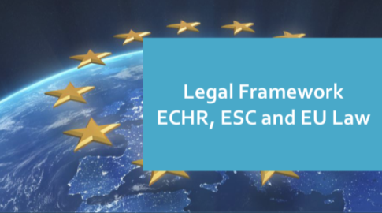
HELP’s main goal
HELP legal professionals* apply Int’l/European human rights standards (CoE + EU) in their daily work, by training
* and other current/future professionals
European Convention on Human Rights, (Revised) ESC, Council of Europe Conventions and EU Law
Notes:
ECHR + ESC + CoE legislation + EU law for EU
+ EU Charter and EU law for EU countries

Slide 8
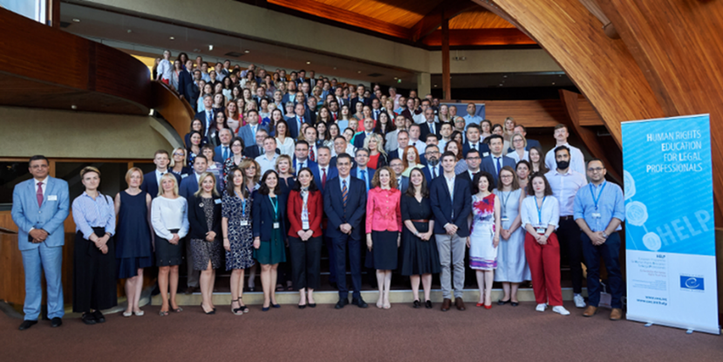
HELP key 3 components
1) HELP Network: Nat’l Training institutions/Bar Councils/EJTN-CCBE
2) Free online courses
3) Human rights training methodology
Notes:
HELP is:
- the only pan-European Network of national training institutions for judges, prosecutors and lawyers in the 47 Member States;
- an e-learning platform on human rights;
a human rights training methodology for legal professionals.
HELP Network
The HELP Network, the only pan-European peer-to-peer Human Rights Training Network, is composed of representatives from National Training Institutions for Judges and Prosecutors (NTIs) and Bar Associations (BAs) of the 47 member states of the Council of Europe.
The HELP Network is entrusted with the implementation of paragraph 9.vi of the 2012 Brighton Declaration and shall, in this respect:
promote the development and promotion of initial and continuous training of legal professionals on standards of the ECHR, as interpreted by the case law of the European Court of Human Rights (ECtHR);
share best practices and provide advice on curricula, training materials and training methodologies for legal professionals, identifying priority themes for future training activities.
E-learning platform
A wide range of training resources on the ECHR, developed and collected under the HELP Programme, is available on-line, translated into the national languages of the beneficiary countries. It is becoming a real challenge for legal professionals to follow the case law of the Strasbourg Court, which evolves quickly and expansively. The HELP Programme is also a platform where they will be able to keep abreast of Strasbourg case law developments through easy available updates.
There are two main types of HELP training resources:
Distance-learning courses are available for selected groups of legal professionals participating in pilot courses moderated by certified national tutors. The list of available courses (including a description) is available in the catalogue of courses.
Self-learning resources are available to any user who has an account on the platform.
They include training manuals on both ECHR Methodology and Key Concepts, as well as Handbooks, standard curricula, course outlines, presentations, case studies, and e-learning courses on the different Articles and themes of the ECHR.
Training methodology
The HELP methodology takes into account the heavy time pressure imposed on legal professionals in their daily work. Its added value is that curricula are drafted on a tailor-made basis, meeting participants’ specific training needs and learning pace, allowing flexibility.The HELP methodology and resources are systematically used in all CoE capacity building activities on the ECHR, organised in the Member States, including within the framework of EU/CoE Joint Programmes.
HELP organises training of trainers sessions, with the aim to increase ownership by national training institutions.

Slide 9
HELP key 3 components
1) HELP Network: Nat’l Training institutions/Bar Councils-EJTN/CCBE
2) Free online courses
3) Human rights training methodology
Click here to open your account or create a new one
Log in
Notes:
HELP is:
- the only pan-European Network of national training institutions for judges, prosecutors and lawyers in the 47 Member States;
- an e-learning platform on human rights;
a human rights training methodology for legal professionals.
HELP Network
The HELP Network, the only pan-European peer-to-peer Human Rights Training Network, is composed of representatives from National Training Institutions for Judges and Prosecutors (NTIs) and Bar Associations (BAs) of the 47 member states of the Council of Europe.
The HELP Network is entrusted with the implementation of paragraph 9.vi of the 2012 Brighton Declaration and shall, in this respect:
promote the development and promotion of initial and continuous training of legal professionals on standards of the ECHR, as interpreted by the case law of the European Court of Human Rights (ECtHR);
share best practices and provide advice on curricula, training materials and training methodologies for legal professionals, identifying priority themes for future training activities.
E-learning platform
A wide range of training resources on the ECHR, developed and collected under the HELP Programme, is available on-line, translated into the national languages of the beneficiary countries. It is becoming a real challenge for legal professionals to follow the case law of the Strasbourg Court, which evolves quickly and expansively. The HELP Programme is also a platform where they will be able to keep abreast of Strasbourg case law developments through easy available updates.
There are two main types of HELP training resources:
Distance-learning courses are available for selected groups of legal professionals participating in pilot courses moderated by certified national tutors. The list of available courses (including a description) is available in the catalogue of courses.
Self-learning resources are available to any user who has an account on the platform.
They include training manuals on both ECHR Methodology and Key Concepts, as well as Handbooks, standard curricula, course outlines, presentations, case studies, and e-learning courses on the different Articles and themes of the ECHR.
Training methodology
The HELP methodology takes into account the heavy time pressure imposed on legal professionals in their daily work. Its added value is that curricula are drafted on a tailor-made basis, meeting participants’ specific training needs and learning pace, allowing flexibility.The HELP methodology and resources are systematically used in all CoE capacity building activities on the ECHR, organised in the Member States, including within the framework of EU/CoE Joint Programmes.
HELP organises training of trainers sessions, with the aim to increase ownership by national training institutions.

Slide 10
Ukraine: +5200!
Notes:
Separately, by end March 2022, alongside yourself, there were over 4600 Ukrainians registered in the HELP e-learning platform. We have a number of HELP online courses translated into Ukrainian and adapted to the Ukrainian legal framework and context. Upon completion, you can generate a digital and individualised ‘statement of accomplishment’. Though our courses are developed by and for legal professionals, they may be useful for future legal professionals, thus, university students, particularly from law faculties.

Slide 11
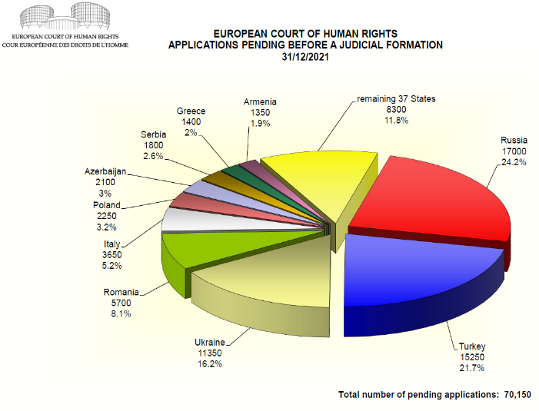
HELP Platform users
HELP in EU: +45,000
HELP in WB and TK: +15,000
Eastern Partnership: +10,000
Notes:
PENDING ALLOCATED CASES
Approximately 70150 62000 applications were pending before a judicial formation at 31 Dec 2021 2020. Nearly a quarter of these applications had been lodged against the Russian Federation.
The number of applications allocated to a judicial formation in 2021 exceeded the number disposed of judicially during the year.

Slide 12
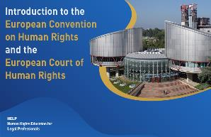
Council of Europe HELP courses
Notes:
2018 slide

Slide 13
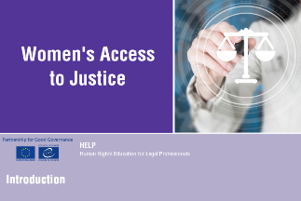
HELP Courses
- PROCEDURAL SAFEGUARDS IN CRIMINAL PROCEEDINGS
- VICTIMS’ RIGHTS
NEW! Violence Against Women for Law Enforcement

Slide 14
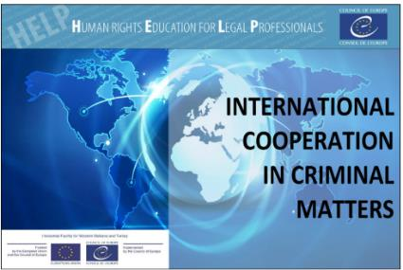
Notes:
With the support of the HF action “Strengthening the effective legal remedies to human rights violations in Serbia” and the regional action “HELP in the Western Balkans”, the Judicial Academy of Serbia has included in its compulsory training programme (for the initial training) the HELP online course “Introduction to the European Convention on Human Rights and the European Court of Human Rights”.
50 trainees of the tenth generation started and successfully completed the online course which will be followed in the upcoming months by three additional courses (on anti-discrimination, child-friendly justice and violence against women/domestic violence). These courses are intended to be systematically incorporated in the initial training programme of the Judicial Academy of the Republic of Serbia.
Training Centres of the Federation of Bosnia and Herzegovina and Republika Srpska as the course was successfully implemented for interns and young practitioners.
- The course has also been included in the initial training programme (as a compulsory course) of the Macedonian Academy for judges and public prosecutors. 60 candidates judges and prosecutors are currently attending the online course.

Slide 15
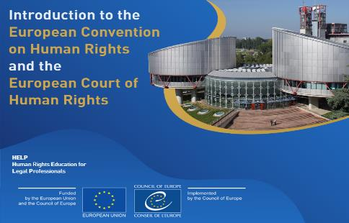
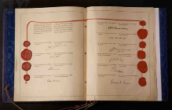
HELP 5-hr online course Jointly w. Execution Department & ECtHR Registry lawyers
+18,000
users!
Notes:
It is recommended that you follow one module after the other, but you can navigate freely among and inside them. In particular, the Module on Execution of the Judgments of the European Court of Human Rights can be taken autonomously.
You are expected to spend approximately 1 hour for Modules 1 and 2, and 2 hours for Module 3. In case you would like to study some topics more in-depth, you will have the opportunity to do so, for example, by exploring the linked documents and resources.

Slide 16
SCOPE:
law-enforcement,
criminal justice,
related areas
(use of force, deprivation of liberty…)
Relevant ECtHR case law (+ CPT standards)

Slide 17
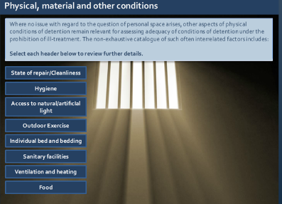
Target audience:
Judges –Prosecutors -Lawyers
Law enforcement
NHRIs – CSO - Students
Content: Six substantive modules
Definitions and International Legal Framework
Conditions of detention [Living (personal) space / Physical, material and other conditions]. Medical treatment of detainees
Use of force and means of restraint
Safeguards against ill-treatment
Effective investigations
Interrelation with other rights
Summary (who does what)
Case study scenario

Slide 18
HELP Course
Judges –Prosecutors -Lawyers
Law enforcement
NHRIs – CSO – Legal staff- Students

Slide 19
HELP Course
Introduction
Law enforcement
Prisons and other penal institutions
Immigration detention
Psychiatric establishments
Social care

Slide 20
HELP Course
Introduction and legal framework
Definitions and legal concepts
Identification of victims of human trafficking
Assistance for victims of human trafficking
The non-punishment provision
Investigation, prosecution and victims’ rights
Sentencing
Compensation for victims of trafficking
Return and repatriation

Slide 21
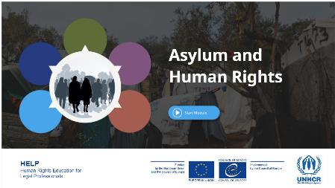
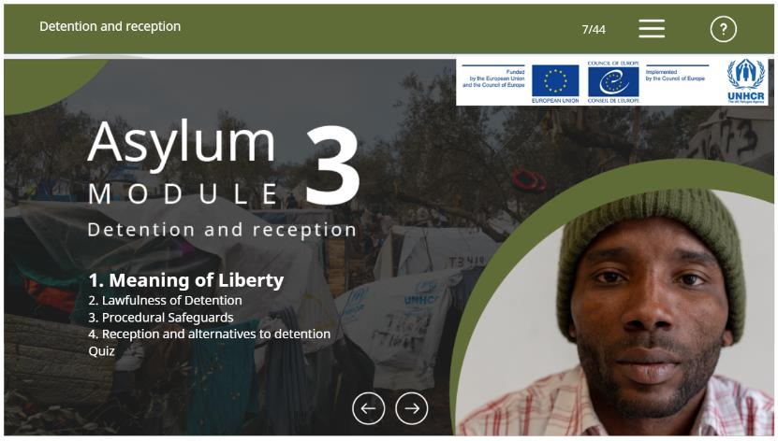
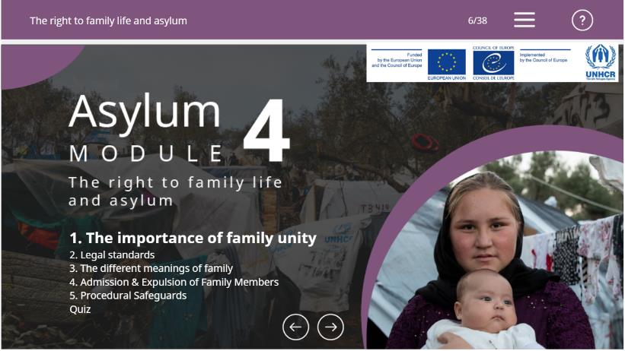
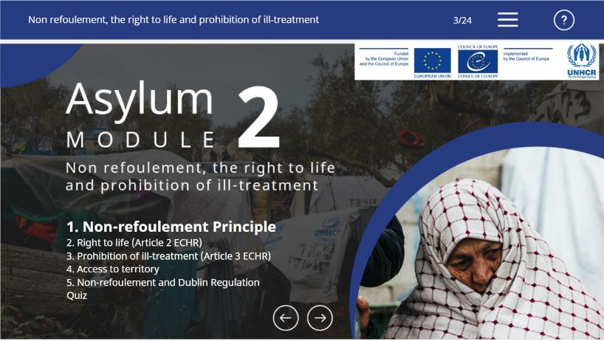
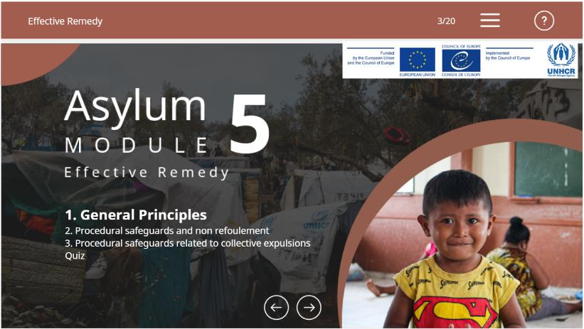
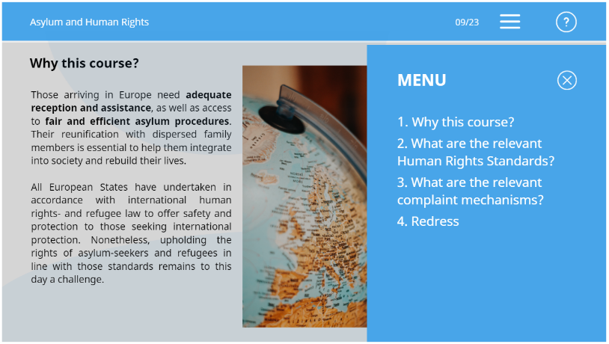

Slide 22
Refugee and Migrant Children
Introduction to legal framework (RMC rights)
Child-friendly procedures (the best interests of the child assessment; identification of children; access to information; reception conditions; appointment of a guardian; legal representation; access to asylum and migration procedures; (forced) return of children)
Alternatives to detention (legal framework; alternatives to child immigration detention; safeguards and standards)
Family reunification (importance; int’l and European standards; application of the principles to RMC)
Social rights and integration (adequate standards of living; education; safe work; health; integration and durable solution)
Guardianship (legal framework; timing and appointment of a guardian; monitoring and complaints; volunteer and professional guardians; guardians and legal representatives; principles for guardians)
Age assessment (legal framework; the benefit of the doubt; non-invasive and holistic age assessment procedures; legal remedies)
Developed in 2018
Contents:
Legal Framework
Child-friendly Procedures
Alternatives to Detention
Family Reunification
Social Rights
Guardianship
Age Assessment
eng | ara | aze | bul | ell | fra | hrv | ita | spa | tur

Slide 23
HELP/UNHCR: Alternatives to Immigration Detention
Contents:
Legal and Practical Basics
Legal Framework
What Possible Types of Alternatives?
How to make Alternatives effective
Developed in 2020
| eng |

Slide 24
1. Introduction to computers, networks and cybercrime
Course Format
2. Introduction to the Budapest Convention on Cybercrime
3. Substantive provisions
4. Electronic evidence & the BC procedural provisions
5. International cooperation provisions
6. Cybercrime in practice and Human Rights
7. The Second Additional Protocol to the Budapest Convention

Slide 25
Course Format
1. Introduction
2. Extradition and surrender
3. Mutual legal assistance
4. Transfer of sentenced persons
5. Transfer of Proceedings, International Validity of Criminal Judgments, and Supervision of Offenders
6. Seizure and Confiscation of Proceeds of Crime
Notes:
Jointly developed bet. HELP and the Council of Europe’s Committee of Experts on the Operation of European Conventions on Co-operation in Criminal Matters (PC-OC), with assistance of the European Judicial Training Network (EJTN)
Funded under the EU/CoE “Horizontal Facility for Western Balkans and Turkey”

Slide 26
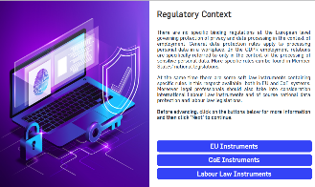
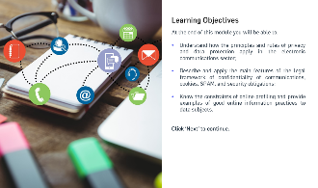
Data Protection and Privacy Rights
Basic knowledge:
Legal framework
Role of European institutions (CoE/ECtHR – EU/CJEU)
Concepts, principles and rules
Thematic Areas:
health
media
e-communications & marketing
new technologies
work place surveillance
Enforcement:
Remedies and enforcement
Trans-border data flows

Slide 27
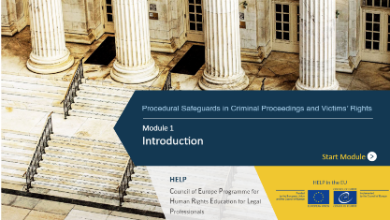
Procedural Safeguards in Criminal Proceedings and Victims’ Rights
CONTENT:
ECHR/EU CFR
CoE instruments/EU Roadmap Directives
ECtHR/CJEU case-law
Fundamental procedural rights of accused and suspected persons in criminal proceedings
Rights of victims of crime
Notes:
Skills & attitudes: Refer to relevant legal framework in your daily work as legal professional

Slide 28
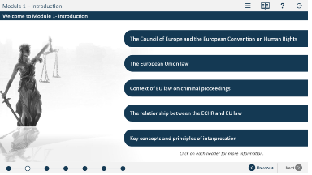
Procedural Safeguards in Criminal Proceedings and Victims’ Rights
6 Modules:
Introduction.
General Aspects of a Fair Trial.
Specific Rights/Procedural Safeguards I – The Presumption of Innocence.
Specific Rights/Procedural Safeguards II.
Specific Rights/Procedural Safeguards III.
Victims’ Rights.

Slide 29
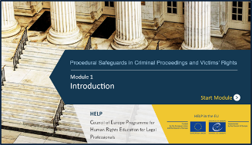
Procedural Safeguards in Criminal Proceedings and Victims’ Rights
CONTENT - Modules:
1. Introduction, legal framework and key concepts
2. General Aspects of a Fair Trial.
3. Specific Rights/Procedural Safeguards I – The Presumption of Innocence.
4. Specific Rights/Proc.Safeguards II - Right to Information; Right to Remain Silent and Not to Incriminate Oneself; Right of Access to a Lawyer; Right to Legal Aid; Right to Interpretation and Translation.
5. S.Rights/Proc. Safeguards III - Right to Examine Witnesses; Right to be present at Trial; Right to Appeal; Right to an Effective Remedy.
6. Victims’ Rights.
Notes:
Skills & attitudes: Refer to relevant legal framework in your daily work as legal professional

Slide 30
HELP course on Ethics for judges, prosecutors and lawyers
Modules
Introduction (for all legal professionals)
Sources on ethical conduct (Treaty, UN, CoE UE, professional bodies…)
Ethics for judges
Ethics for prosecutors
Main principles of the ethics of lawyers
Notes:
Introduction (for all legal professionals)
Why does professional ethics matter
Common values and principles
Key concepts
Distinction between ethical principles and disciplinary rules
Skills & attitudes: Refer to relevant legal framework in your daily work as legal professional

Slide 31
HELP online course
Click on the picture for
quick access to online course

Slide 33
HELP course on Violence against women (VAW) and domestic violence (DV)
Understanding VAW and DV
Int’l and European Legal Framework
Overcoming barriers to Justice / A2J
Criminal Justice Response I – Investigation and pre-trial
Criminal Justice Response II – Trial and sentencing
Civil Justice Response
Alternative Dispute Resolution
Notes:
Many forms: physical violence, sexual abuse, stalking, female genital mutilation or forced marriages.
The course consists of the following seven substantive modules:
❖ Understanding violence against women and domestic violence
❖ International and European Legal Framework
❖ Overcoming barriers / access to Justice
❖ Criminal Justice Response I – Investigation and pre-trial
❖ Criminal Justice Response II – Trial and sentencing
❖ Civil Justice Response
❖ Alternative Dispute Resolution

Slide 34
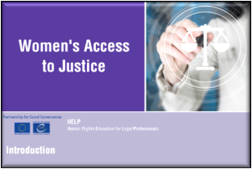
HELP course on Access to Justice for Women Developed with the CoE Gender Equality Division
Modules (2/3 hr learning per substantive module
Understanding women’s access to justice
International and European legal framework
Discrimination on the grounds of sex and gender
Avoiding gender stereotyping
Practical guidance to improve women’s access to justice
Gender sensitive approach to the practice of law
Notes:
Skills & attitudes: Refer to relevant legal framework in your daily work as legal professional

Slide 35
HELP course on Transitional Justice
Modules
Introduction
Basics of Transitional Justice
Investigation and prosecution
Legality
Fair Trial guarantees
Witnesses and victims
Victims’ rights
Notes:
Skills & attitudes: Refer to relevant legal framework in your daily work as legal professional

Slide 36
Course outline
Introduction
Child-friendly Justice
Non-judicial proceedings
General elements
Interaction with children in judicial system: main challenges
Interdisciplinarity
Deprivation of liberty
Violence against children
Migration and asylum
Notes:
The course is composed of 9 modules (details for each module in following slides):
- Introduction: human rights, children’s rights and child-friendly justice; principles and concepts.
- Child-friendly justice: before, during and after judicial procedures; special situation to be kept in mind.
- Non-judicial proceedings: definitions and reasons why to encourage non-judicial proceedings; forms and stages of the procedures; guarantees and conditions; legal advice, support and legal representation.
- General elements: privacy; safeguards and protection measures; organisation of the setting; right to legal representation; guardianship/legal representation.
- Interaction with children in the judicial system – main challenges: age of understanding; gender; status; vulnerabilities; participation.
- Interdisciplinarity: introduction and drivers (main reasons for interdisciplinarity); teamwork and collaboration; identity and inter-professionality.
- Deprivation of liberty: definition and principles; condition of detention; reintegration; monitoring and complain mechanisms.
- Violence against children: introduction and legal framework; definition and typology of violence against children; dealing with victims of violence within the judicial system.
- Migration and asylum: specific rights of migrant children; unaccompanied children; family reunification; detention and monitoring; administrative proceedings.

Slide 37
HELP course on Labour Rights
Modules:
Labour rights as human rights
Right to work and employment relationship
Working time
Fair remuneration and protection of wages
Termination of employment
Equality and non-discrimination
Collective labour rights
Freedom of association – Right to negotiate
Occupational safety and health
Notes:
Skills & attitudes: Refer to relevant legal framework in your daily work as legal professional

Slide 38
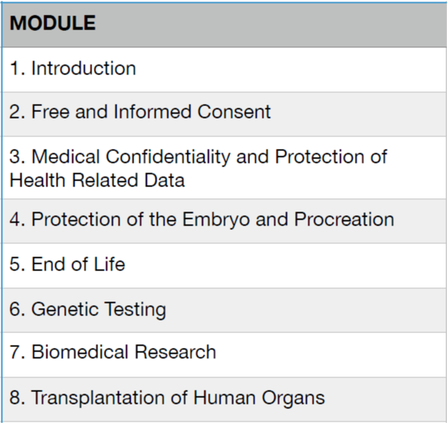
Notes:
Skills & attitudes: Refer to relevant legal framework in your daily work as legal professional

Slide 39
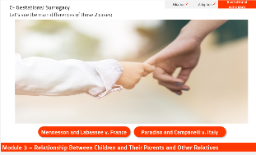
HELP course on Family Law and Human Rights
6 Modules:
Introduction
Rights Related to Couples
Relationship between Children and their Parents and Other Relatives
International Child Abduction
Children’s Rights: Key Challenges
sexual abuse; children in digital era)
Private life & family life

Slide 40
Catalogue of HELP Courses
Admissibility criteria in applications submitted to the ECtHR
Alternative measures to detention
Alternatives to Immigration Detention
Anti-discrimination
Asylum and Human Rights
Key human rights principles in biomedicine
Business and human rights
Child-friendly Justice
Combatting Trafficking in Human Beings (soon)
Counterfeiting of Medical Products
CPT Standards
Data Protection and Privacy Rights
Ethics for judges, prosecutors and lawyers
Family Law and human rights
Fight against Racism, Xenophobia, Homophobia and Transphobia
Freedom of Expression
Gathering/use of evidence in counter-terrorism
Hate crime and Hate speech
Human Rights in Sports
Introduction to the ECHR and ECtHR
Introduction to the European Social Charter
Int’l Cooperation in Criminal Matters
Критерії прийнятності скарг в ЄСПЛ
Альтернативні заходи затримання під вартою
Анти дискримінація
Право притулку і ЄКПЛ
Ключові принципи прав людини в біомедицині
Бізнес і права людини
Правосуддя дружнє до дітей
Боротьба з торгівлею людьми і сучасними формами рабства
Фармацевтична злочинність та Конвенція Медікрайм
10. Комітет проти тортур (CPT)
11. Персональні дані і приватне життя
12. Управління іноземними ув’язненими
13. Сімейне право
14. Боротьба з расизмом, ксенофобією, гомофобією та трансфобією
15. Свобода вираження поглядів
16. Злочини на ґрунті ненависті та мова ворожди
17. Права людини в спорті
18. Вступ до Конвенції ЄКПЛ
19. Міжнародне співробітництво у кримінальних справах
20. Права осіб з обмеженими можливостями
21. Трудові права
22. Досудове розслідування і ЄКПЛ
Notes:
Separately, by end March 2022, alongside yourself, there were over 4600 Ukrainians registered in the HELP e-learning platform. We have a number of HELP online courses translated into Ukrainian and adapted to the Ukrainian legal framework and context. Upon completion, you can generate a digital and individualised ‘statement of accomplishment’. Though our courses are developed by and for legal professionals, they may be useful for future legal professionals, thus, university students, particularly from law faculties.
This is the case of the following HELP courses; all available at help.elearning.ext.coe.int:
• Internal Displacement
• Admissibility criteria of cases filed to the European Court of Human Rights
• Introduction to the ECHR and ECtHR
• Prohibition of Ill-treatment
• Right to liberty and security (Article 5)
• Access to Justice for Women
• Bioethics
• Child-friendly Justice
• Labour rights
• Pre-trial investigation
• Hate speech
• Violence against Women and Domestic Violence
We are also working tirelessly to translate other important HELP courses into Ukrainian. We are prioritising the following HELP courses which now exist in English but that soon will be also available in Ukrainian: Asylum and Human Rights; Refugee and Migrant Children; Combating Trafficking in Human Beings. In the current context, the courses on Transitional Justice and Property Rights may need to be translated as soon as we find the needed resources.

Slide 41
Catalogue of HELP Courses
Internal Displacement
Judicial Reasoning and Human Rights
Labour Rights
Managing foreign prisoners (europris)
Pre-trial Investigation in light of the ECHR
Procedural safeguards in criminal proceedings and victims’ rights
Prohibition of Ill-treatment
Property Rights
Protection and Safety of Journalists
Radicalisation Prevention - Gathering and use of evidence in counter-terrorism cases
Refugee and Migrant Children
Reasoning of (Criminal) Judgments
Rights of Persons with Disabilities
Right to Liberty and Security (Art 5 ECHR)
Right to Respect for Private and Family Life (Art 8 ECHR)
Right to the Integrity of the Person (Bioethics)
The environment and human rights
Transitional Justice
Violence Against Women and Domestic Violence
Women’s Access to Justice
Заборона неналежного поводження
Процедури гарантії в кримінальному процесі та права жертви
Право власності та ЄКПЛ
Запобігання радикалізації – використання доказів у випадках боротьби з тероризмом
Діти біженці і мігранти
Обґрунтованість кримінальних вироків
Внутрішнє переміщення
Право на свободу та безпеку (5 стаття)
Право на повагу приватного та сімейного життя (8 стаття)
Біоетика
Правосуддя в перехідний період і права людини
Насильство щодо жінок і домашнє насильство
Насильство щодо жінок і домашнє насильство для правоохоронних органів
Доступ до правосуддя для жінок
Альтернативи імміграційному затриманню
Захист та безпека журналістів
Навколишня середа та права людини
Судова етика
Кіберзлочинність та електронні докази
Вступ до запобігання корупції
Notes:
Separately, by end March 2022, alongside yourself, there were over 4600 Ukrainians registered in the HELP e-learning platform. We have a number of HELP online courses translated into Ukrainian and adapted to the Ukrainian legal framework and context. Upon completion, you can generate a digital and individualised ‘statement of accomplishment’. Though our courses are developed by and for legal professionals, they may be useful for future legal professionals, thus, university students, particularly from law faculties.
This is the case of the following HELP courses; all available at help.elearning.ext.coe.int:
• Internal Displacement
• Admissibility criteria of cases filed to the European Court of Human Rights
• Introduction to the ECHR and ECtHR
• Prohibition of Ill-treatment
• Right to liberty and security (Article 5)
• Access to Justice for Women
• Bioethics
• Child-friendly Justice
• Labour rights
• Pre-trial investigation
• Hate speech
• Violence against Women and Domestic Violence
We are also working tirelessly to translate other important HELP courses into Ukrainian. We are prioritising the following HELP courses which now exist in English but that soon will be also available in Ukrainian: Asylum and Human Rights; Refugee and Migrant Children; Combating Trafficking in Human Beings. In the current context, the courses on Transitional Justice and Property Rights may need to be translated as soon as we find the needed resources.

Slide 42
Каталг курсов HELP
Критерії прийнятності скарг в ЄСПЛ
Альтернативні заходи затримання під вартою
Анти дискримінація
Право притулку і ЄКПЛ
Ключові принципи прав людини в біомедицині
Бізнес і права людини
Правосуддя дружнє до дітей
Боротьба з торгівлею людьми і сучасними формами рабства
Фармацевтична злочинність та Конвенція Медікрайм
10. Комітет проти тортур (CPT)
11. Персональні дані і приватне життя
12. Управління іноземними ув’язненими
13. Сімейне право
14. Боротьба з расизмом, ксенофобією, гомофобією та трансфобією
15. Свобода вираження поглядів
16. Злочини на ґрунті ненависті та мова ворожди
17. Права людини в спорті
18. Вступ до Конвенції ЄКПЛ
19. Міжнародне співробітництво у кримінальних справах Оновлена версія
20. Права осіб з обмеженими можливостями
Трудові права
Досудове розслідування і ЄКПЛ
Заборона неналежного поводження
Процедури гарантії в кримінальному процесі та права жертви
Право власності та ЄКПЛ
Запобігання радикалізації – використання доказів у випадках боротьби з тероризмом
Діти біженці і мігранти
Обґрунтованість кримінальних вироків
Внутрішнє переміщення
Право на свободу та безпеку (5 стаття)
Право на повагу приватного та сімейного життя (8 стаття)
Біоетика
Правосуддя в перехідний період і права людини
Насильство щодо жінок і домашнє насильство
Насильство щодо жінок і домашнє насильство для правоохоронних органів
Доступ до правосуддя для жінок
Альтернативи імміграційному затриманню
Захист та безпека журналістів
Навколишня середа та права людини
Судова етика
Кіберзлочинність та електронні докази
Вступ до запобігання корупції

Slide 43
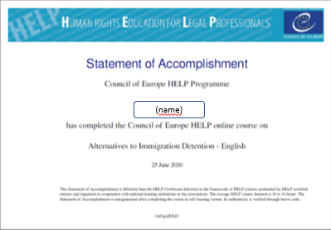
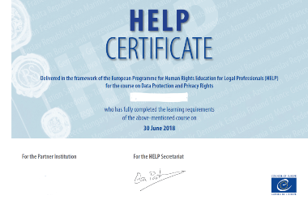
Online course duration is 6-12 hrs More if reviewing links
Self-learning Tutored course
Notes:
Access to free, high-quality materials at HELP e-learning platform
Permanent access to the course
Learning when and as much as users want/have the time
Statement of accomplishment
Available only to LIMITED GROUPs of participants
Advantages: facilitated by certified TUTORs and + interaction
CERTIFICATE (CoE + NTI/BA or other national institution)
+ NATIONAL ADAPTATION! (w information on nat’l laws + case law)

Slide 44
Online course duration is 6-12 hrs More if reviewing links
Self-learning Tutored course
Курси для самостійного проходження
6-12 годин – проходження
Курси для проходження з національним т’ютором/викладачем
Лише для обмежених груп учасників

Slide 45
HELP Online courses: 1) Self-learning
Free
Available to anyone with an account at HELP e-platform
Learning when and as much as users want/have the time
Statement of accomplishment

Slide 46
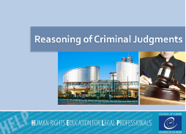
2) Tutored – NATIONAL ADAPTATION
Int’l & European standards + information on nat’l laws + case law
Available only to LIMITED GROUPs of participants
Organised by National Justice Training Institutions or Bar associations
Advantages: facilitated by certified TUTORs and + interaction
CERTIFICATE (CoE + NTI/BA or other national institution)

Slide 47
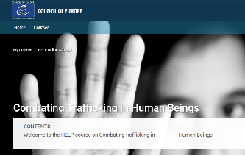
Що в собі містить HELP курс?
5 – 9 модулів
Введення в курс (цілі курсу та задачі)
Міжнародна практика
Судова практика і прецеденти
Особливості національного законодавства (якщо є національна версія)
Глосарій (дуже часто)
Перевірка знань/тести/завдання після кожного модуля
Матеріали для самостійного навчання (у вигляді посилань, статей і бібліографії)
Інтерактив
Вступне тестування (зворотній зв’язок)*
Notes:
Курсы с тренером
Запускаем вместе с партнерами – ВУЗами или адвокатскими палатами
Время ограничено (обычно 3-4 месяца), 3 очных встречи
Тренер общается, дает задания

Slide 48
Pool of trainers
www.coe.int/HELP
Tutored courses
http://help.elearning.ext.coe.int/
Network
Self-learning courses
http://help.elearning.ext.coe.int/
HELP in Ukraine

Slide 49
HELP в Україні
Наші партнери: Національна Школа Суддів; Національна Академія Прокурорів України (НАПУ), Національна Асоціація Адвокатів України, Офіс Уповноваженого з прав людини
Курс «Введення в Конвенцію» - в 2018 році для 240 прокурорів України
Робота з університетами - Університет Тараса Шевченка та Харківська Академія Внутрішніх Справ
2019 рік – Запуск курсу Внутрішнє переміщення для 13 груп представників юридичних професій
2020 рік - запуск курсу з біоетики та курсу Міжнародне співробітництво у кримінальних справах
Pool of trainers
https://www.coe.int/en/web/help/help-tutors

Slide 50
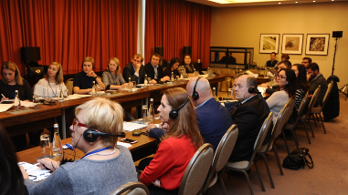
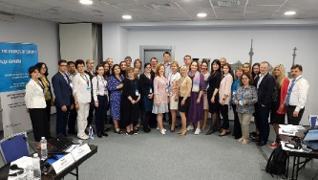
Training of Trainers sessions
Kyiv, November 2018:
Labour Rights and Prohibition of Ill-treatment
* Under CoE Project “Enhancing the implementation of European Human Rights standards in Ukraine”
Kyiv, May 2019:
Internal Displacement
* Under CoE Project "Internal Displacement in Ukraine: Building Solutions"

Slide 51
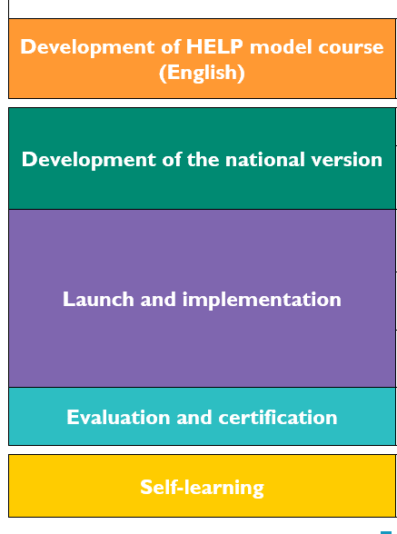
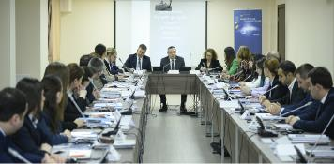
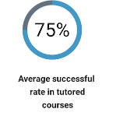
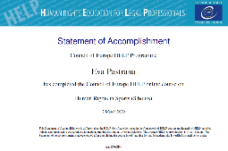
HELP training methodology
Notes:
HELP is:
the only pan-European Network of national training institutions for judges, prosecutors and lawyers in the 47 Member States;
online courses on human rights;
a human rights training methodology for legal professionals.

Slide 52
HELP in Universities/Academia – HOW?
No formalities!
Self-learning: HELP courses to complement university programmes
Exceptionally: Dedicated pages for Unis/law schools if YOU are HELP certified tutor

Slide 53
HELP PROJECTS:
HELP in the EU
Radicalisation Prevention, Judicial Response to Terrorism and International Cooperation in Criminal Matters
HELP in Russia – funded by HRTF – VC
HELP in Cyprus –EaP (Armenia, Azerbaijan, Georgia, Republic of Moldova)– funded by UK
HELP COMPONENTS in mainly EU-funded projects:
HELP in the Western Balkans & Turkey
South Mediterranean
Support to Independent Instances- Tunisia
HELP in Central Asia
Other CoE cooperation projects (e.g. Business & HR, migration)
Notes:
European Court of Human Rights
Published on 17 Oct 2016
Aimed at a wide audience, the film on the European Court of Human Rights explains how the Court works, describes the challenges faced by it and shows the scope of its activity through examples from the case-law.

Slide 54
NEXT!! HELP us promote HELP courses….
Encourage/kindly push your (Parliament) staff to follow/use HELP courses linked to their work or priorities (good to easy check Int’l/European HR standards). Staff from HR and legal committee should take relevant courses in line with national priorities.
Promote HELP courses among legal/justice/education professionals of your constituencies. E.g. make sure lawyers from your constituencies know about HELP courses.
Encourage legal professionals to reach out to their institutions (School of judges, Prosecutor’s Office or Ukrainian Bar) to
offer Ukrainian contextualisations of HELP courses (that are necessarily done at nat’l level)
Organise HELP training of trainers together with CoE staff
For university professors, use HELP courses as complement to your own programmes. You can request students to complete the HELP course(s) and forward you the ‘statement of accomplishment’ as proof of their work. HELP courses complement –never replace- your own programme.

Slide 55
How HELP reinforces its work in Ukraine during the war….
Continuing updating the Asylum/migration HELP eDesks.
Expanding the catalogue of HELP courses translated in Ukrainian
Working with national (training) justice institutions for + Ukrainian contextualisations of HELP courses
Preparing specific modules of HELP courses adapted to the conflict situation (e.g. Prohibition of Ill-treatment and Torture)
Dedicating a specific session to the situation in Ukraine during the next HELP Annual Conference that will be mainstreamed online:
Organise an online HELP Training of Trainers in Summer 2022
Make HELP presentations for Universities.
Training of legal professionals at times of war: why and how? Tetyana FULEY, HELP Focal Point, National School of Judges of Ukraine Olesia OTRADNOVA, Director, Prosecutor’s Training Centre of Ukraine TBC Savva KUZMENKO, Director of the Ukrainian National Bar Association’s High School for Advocates

Slide 56
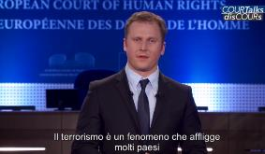
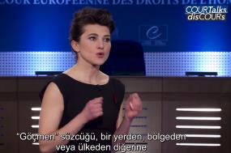
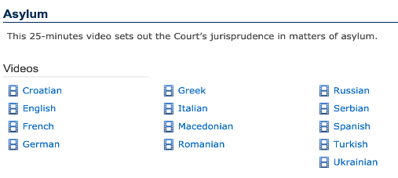
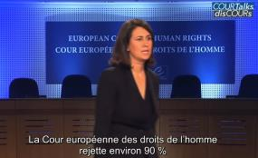
ECtHR-HELP videos with Court’s jurisprudence https://www.echr.coe.int/Pages/home.aspx?p=caselaw/analysis/courtalks&c=
Terrorism: 6,250
Asylum: +7,500
Admissibility + 40,000
criteria:

Slide 57
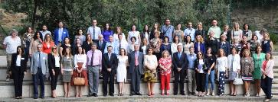
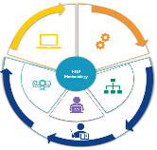
For WHOM:
HELP Network
Justice professionals
+/- 30,000 tutored courses
+ 90,000 users online
WHAT:
42 courses on
Human Rights
+500 national versions
HOW:
HELP methodology
(virtual) face-to-face & online
cross-border
cross-professional

Slide 58
Join us in Facebook, Twitter:
CoEHELP
HELP
Good training for good judgments
Дякую за увагу!
HELP Head of Division: Eva.PASTRANA@coe.int
Deputy HoD–EaP/Universities: Ana.MEDARSKA-LAZOVA@coe.int
HELP in Ukraine: Olga.KOSTENKO@coe.int
HELP in Central Asia: Krystyna.Khokhlova@coe.int
HELP in the EU: Ana-Maria.TELBIS@coe.int
HELP in Western Balkans: Jasminka.PERUNICIC-ALLEN@coe.int
HELP in Turkey: Fethullah.Soyubelli@coe.int
HELP in Morocco: Malika.SMAALI@coe.int
HELP in Tunisia: Imene.KHALIFA@coe.int
HELP main assistant: Adela.DOLTU@coe.int /Helene.GANGLOFF@coe.int

