Slide 1

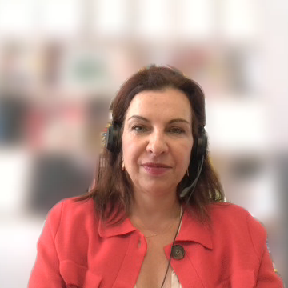
C
The Status of Artists and Professionals in the Cultural and Creative Sectors
Conference “Social Conditions, Rights, and Well-Being of Creators, Artists, and Cultural Sector Professionals
Kreatywna Europa MEDIA, Warsaw, 11 June 2026
  Sophie Valais
  Deputy Head of the Legal Information Department

Slide 2

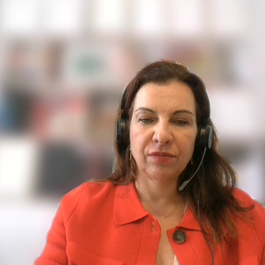
DEFINITION OF ARTIST AND CCS PROFESSIONALS
What is an artist?
UNESCO’ 1980 Recommendation on the Status of the Artist
“Artist”
  “[…] any person who creates or gives creative expression to, or re-creates works of art, who considers his artistic creation to be an essential part of his life, who contributes in this way to the development of art and culture and who is or asks to be recognised as an artist, whether or not he is bound by any relations of employment or association.”

Slide 3
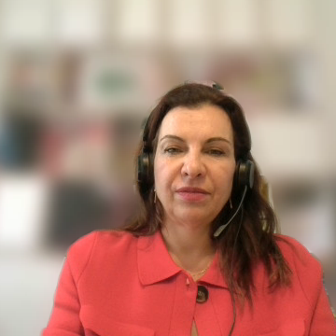
DEFINITION OF ARTIST AND CCS PROFESSIONAL – EU approach
Three broad categories of CCS professionals
CCS workers in cultural and creative occupations
  « artists » (actors, dancers, musicians...)
CCS workers in non-cultural and creative occupations
  E.g. accountant for a production company, technicians, staff…
Workers in cultural and creative occupations outside the CCS
Different levels of autonomy, work organisation, flexible working patterns, income vulnerability…

Slide 4
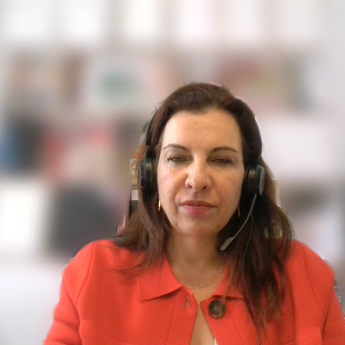
DEFINITION OF ARTIST AND CCS PROFESSIONAL – A fragmented landscape across Europe
Broad approach
Narrow approach
AT, DE, FI: persons directly involved in artistic creation or performance
HR, CY, BG, IE..: “professional” artist, i.e. freelance or self-employed
Multiple sub-categories
PT, FR: distinctions between authorship / artistic / technical artistic / cultural mediation activities / technicians / performing artists / intermittents…
HU: “Artist of the Nation” / LT: regularly updated list of 70 specialised professions eligible for state-funded social support
Stand-alone approach
SK, SI, PT: national register
BE: art worker (artistic, artistic-technical and support activities)
GR, CZ : essential contributions to artistic creation (lighting technicians, sound engineers, costume designers…)

Slide 5
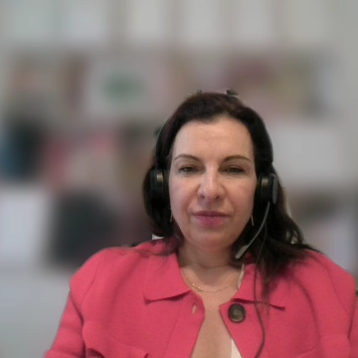
WHY IS THIS IMPORTANT?
Lack of comparative data for policy makers
No harmonised framework at EU level
Labour & social framework unsuited to CCS workers
Barriers to cross-border mobility

Slide 6
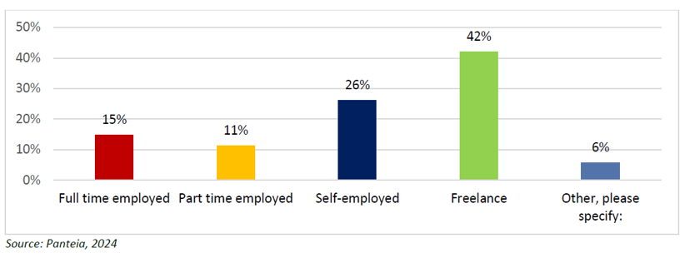
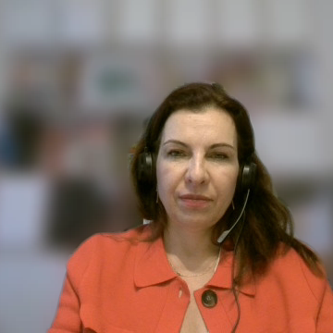
EMPLOYMENT TRENDS IN THE CCS IN EUROPE – Contract Types
Freelance and self-employment

Slide 7
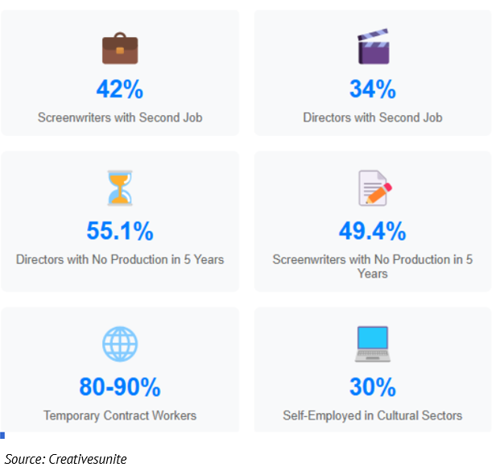
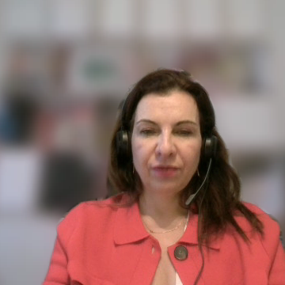
TRENDS IN EMPLOYMENT IN THE CCS – Precarity and multiple job-holding
Precarity and multiple jobs

Slide 8
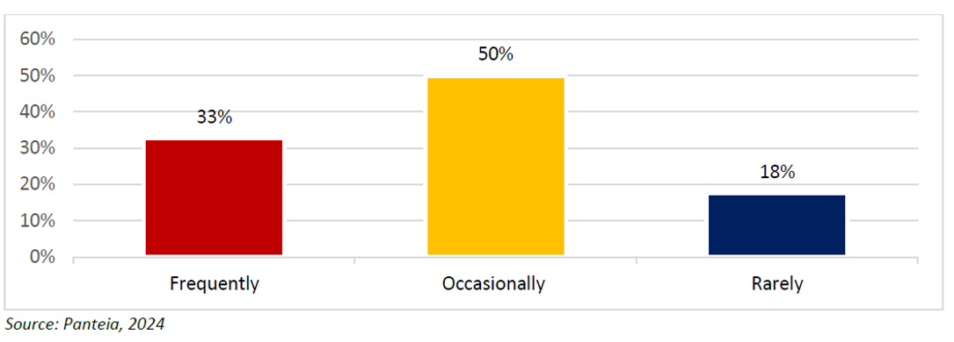
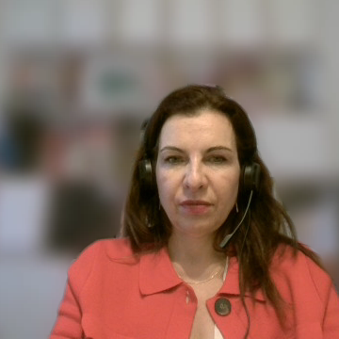
TRENDS IN EMPLOYMENT IN THE CCS - Mobility
High mobilty

Slide 9
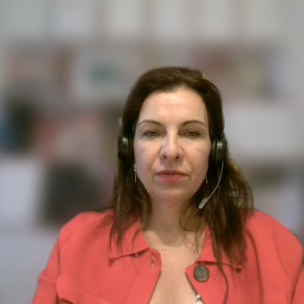
KEY CHALLENGES FOR ARTISTS AND CCS PROFESSIONALS
Project-based and self-employment
No formal recognition / fragmented rules: self-employed, own-account worker, workers hired under author’s contracts..
Unequal access and coverage of social protection
Increased risks of work injuries, early pension..
Tax-related issues
Frequent change of employment status within one single fiscal year / Multiple job holding
Cross border mobility issues
Risks of double taxation, especially for performers (OECD Convention, Art. 17)
Portability of social rights
Un(der)paid activities (e.g. rehearsals, technical tasks)
Multiple jobs / New atypical flexible employment models: job-employee-sharing, ICT-based mobile work, portfolio work, hybrid/collaborative models…
Bogus (false) self-employment, i.e. misclassification of dependent employee
Lack of or partial coverage in law or in practice for unemployment, sickness, maternity, old age..
Income fluctuations / no tax deducion allowance for professional expenses / treatment of royalties compensation
Incompatibility of traditional contributory social insurance schemes with realities of CCS work

Slide 10
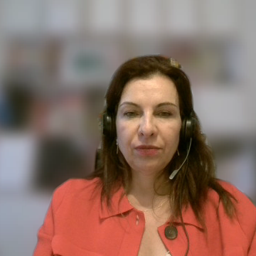
EU LEGAL FRAMEWORK – EU competences
EU competences in culture and social policy
Art. 167 TFEU - Cultural policy is primarily under the competence of the Member States.
  The EU has a supporting and coordinating role towards broader objectives
Art. 9 TFEU - Social policy is under shared competence EU / Member States
  The EU ensures alignment with higher goals (high level of employment, adequate social protection, social exclusion, access to education, training, healthcare…)
  2017: European Pillar of Social Rights: framework on equal opportunities, fair working conditions, social inclusion
  Principle 5: Preventing precarious employment by restricting the misuse of atypical contracts
  Principle 12: Ensuring self-employed individuals have access to adequate social protection when their situation is comparable to that of workers

Slide 11
EU LEGAL FRAMEWORK – EU acquis
EU social and labour legal framework
Large set of EU legislative and non-binding instruments on labour law
  Working conditions, minimum wages, temporary and part-time work, working in platforms..
Large set of EU legislative and non-binding instruments on social protection
  Coordination of social security systems, posting of workers, equal treatment, work-life balance..
  Covering all workers, including CCS professionals
  But, in practice, not adapted to atypical contractual situations
2018 Council Recommendation on access to social protection for workers and self-employed
  Called on Member States to extend coverage to all forms of employment
  2023 implementation report: mixed and uneven picture across the EU

Slide 12





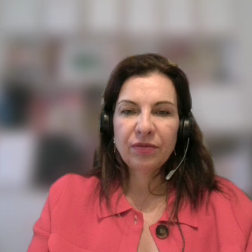
EXAMPLES OF NATIONAL APPROACHES
Special legal and employment status
  Special rules addressing undeclared work
    GR - law defining rehearsals work for actors and technician's tasks as dependent employment
  Formal employment status for self-employed in the CCS
    DE - “quasi-employed” status by law (KSK) for access to pension and health insurance
    SI - extended definition of self-employed to include CCS workers
    CY - new artist’s register to facilitate access to new support measures
    ES – “artistic employment contract”, acknowledging the intermittent and project-based nature of artistic activities

Slide 13



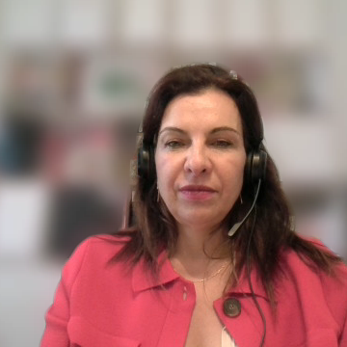
NATIONAL APPROACHES – Social protection
Special access to social protection schemes
  Special regime for self-employed in the CCS
    FR - “Intermittent” workers in the entertainment sector: special fixed term contract CDDU and access to unemployment benefit based on number of hours or performances
    DE - Quasi-employed artists (KSK) have access to social insurance with only partial contribution from income, the rest being covered by users and the state
    HU - Simplified taxation and social contribution regime with flat 15% tax on income exceeding the minimum wage serving as basis for social security contributions
    SI - Self-employed CCS workers mandatorily recognised by law as covered under general pension and health schemes
    ES - Special unemployment allowance for intermittent artistic employment + reduction of social security contributions for self-employed artists with low incomes + broader access for technical and auxiliary roles

Slide 14




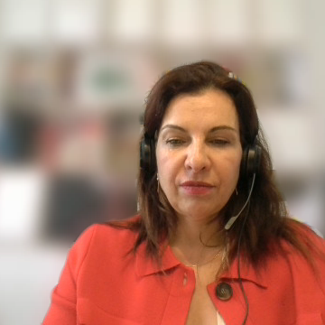

NATIONAL APPROACHES - Taxation
Special taxation schemes
  Special tax regime and exemptions in the CCS
HU, IE - Favorable tax regime and exemptions for CCS workers
FR, FI - Income averaging mechanism to accommodate irregular income : possibility to spread exceptional incomes over several years, umbrella employment contract (“portage salarial”)
DE, ES - Specific deductions and allowances tailored to self-employed artists (deduction of professional expenses from taxable income for self-employed in the CCS, VAT exemptions and special rates, including for young artists)
DK, IE, NL – Exemption of non-resident performers from taxation
UK - Minimum income thresholds to avoid imposing tax on lower-earning artists

Slide 15
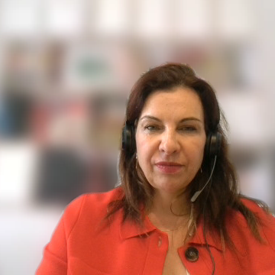
EU UPDATE – Policy shift
From recommendations towards a structured agenda
Policy shift: From recommendations → structured EU agenda (Culture Compass)
Working conditions: Focus on precarity, fair pay, social protection
Planned EU Artists Charter (coordination, non-binding)
Strategic role: Culture linked to democracy & EU values
Key issues: Employment, mobility barriers, AI impact, skills gaps
Funding: Proposed AgoraEU programme (post-2027)

Slide 16
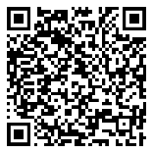



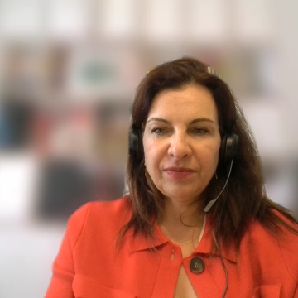
NEW EUROPEAN AUDIOVISUAL OBSERVATORY IRIS REPORT
New report out!
Thank you!
sophie.valais@coe.int

