Slide 1



Council of Europe Project “HELP (Human Rights Education for Legal Professionals) for Ukraine including during wartime” Phase II
Project main goal: at enhancing the capacities of current/future legal professionals in Ukraine (judges, prosecutors, lawyers and law students) to apply the European human rights standards efficiently including during and post war time
Implemented within the Council of Europe Action Plan for Ukraine “Resilience, Recovery and Reconstruction” for 2023-2026

Slide 2










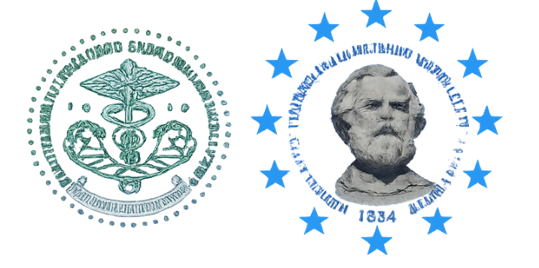


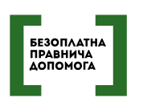
Partner Ecosystem: A Unified Framework Across the Ukrainian Legal Landscape
Judiciary & Prosecution
Government & Civil Service
Legal Profession
Academic sector
7 University Partnerships |
National School of Judges | Prosecutor's Training Center
High School of Public Governance | National Agency on Civil Service
Ukrainian National Bar Association | High School of Advocacy | Coordination Center for Legal Aid Provision
2

Slide 3




Key Results (2025–2026)
28,000+
6,405
23
250+
Certified HELP Tutors
Registered Users
Certificates of completion for Self-Learning courses
Tutored Course Launches
HELP Platform reach for legal professionals across Ukraine
National pool of certified HELP tutors
Tutored courses with 600+ successful participants in 2025-26
issued in 2025

Slide 4
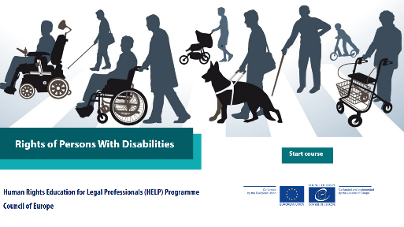
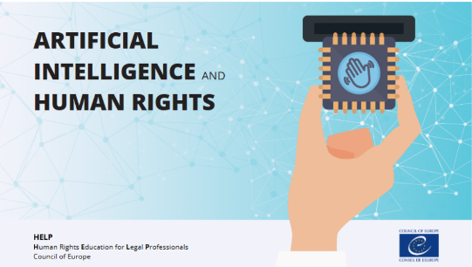


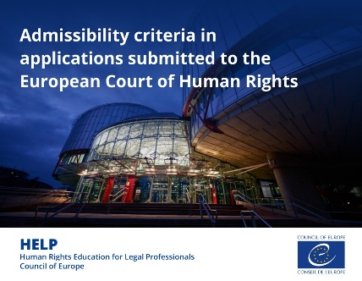
HELP Tutored Courses Reflect Ukraine's Strategic Priorities
Course Title
Participants
Launches
Strategic Value
Rights of Persons with Disabilities
97
3 launches
Inclusive social justice & post-war accessibility
AI & Human Rights
60
3 launches
Digital rights & public administration modernization
Deportation of Children during AC
57
2 launches
International humanitarian law & displacement
Pre-Trial Investigation and the ECHR
48
2 launches
Strengthening human rights compliance in criminal proceedings
Admissibility Criteria
64
2 launches
Reducing inadmissible ECHR applications

Slide 5



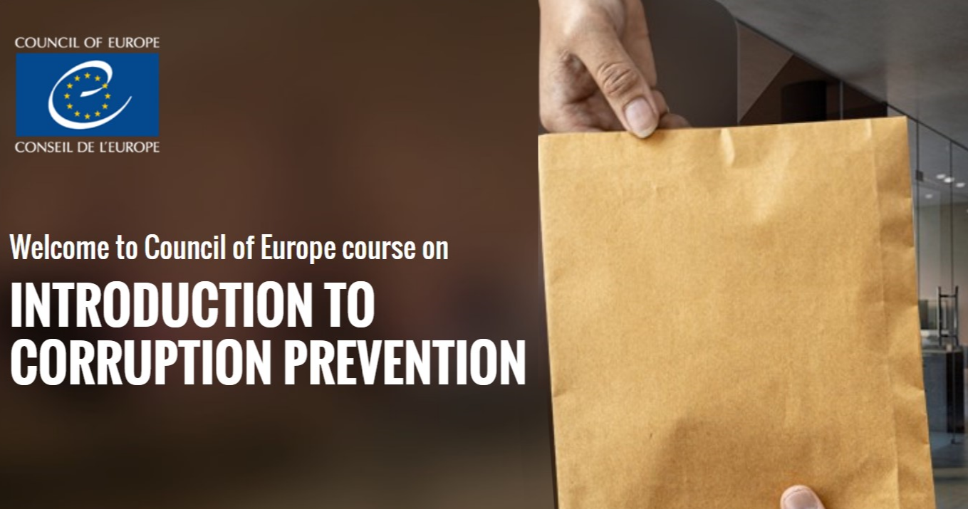

HELP Tutored Courses Reflect Ukraine's Strategic Priorities
Course Title
Participants
Launches
Strategic Value
Combating Trafficking in Human Beings
41
1 launch
Strengthening anti-trafficking responses
Interplay between the ECHR and the EU Charter of Fundamental Rights (course in progress)
45
1 launch
Supporting EU accession process
Right to Liberty and Security
38
1 launch
Safeguarding personal liberty rights
Introduction to Corruption Prevention
37
1 launch
Strengthening public sector integrity
Mental Health & Human Rights
45
1 launch
Protecting mental health rights

Slide 6
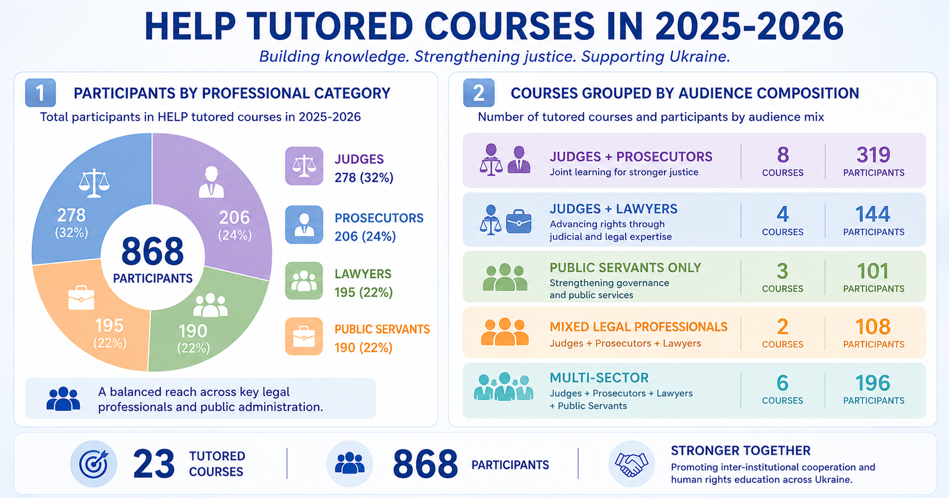

Slide 7
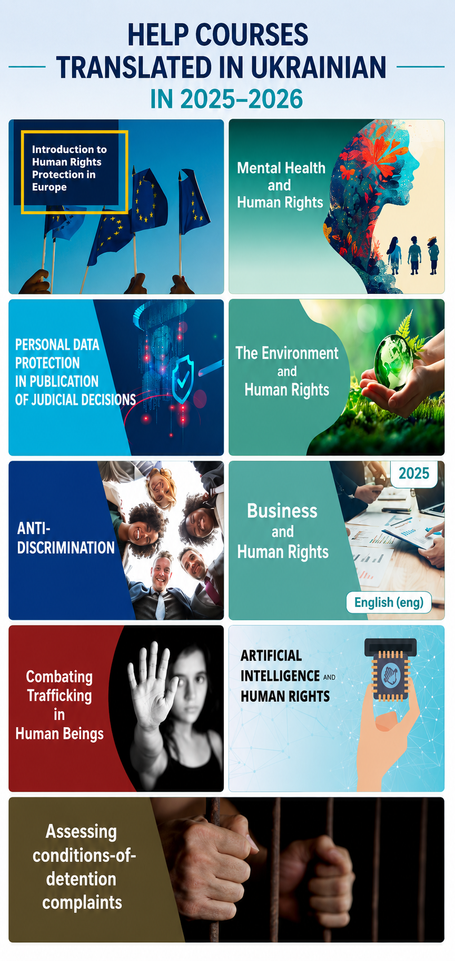
Legal Adaptation: Making 47 HELP Courses Accessible in Ukrainian
Standard HELP Courses
Ukrainian HELP Portfolio
Strategic Value
1
2
3
47 HELP courses translated and adapted to the Ukrainian legal context
Limited by language and generic context
Language accessibility removes primary barrier for 28,000+ professionals; Localization facilitates learning and improves practical relevance.

Slide 8
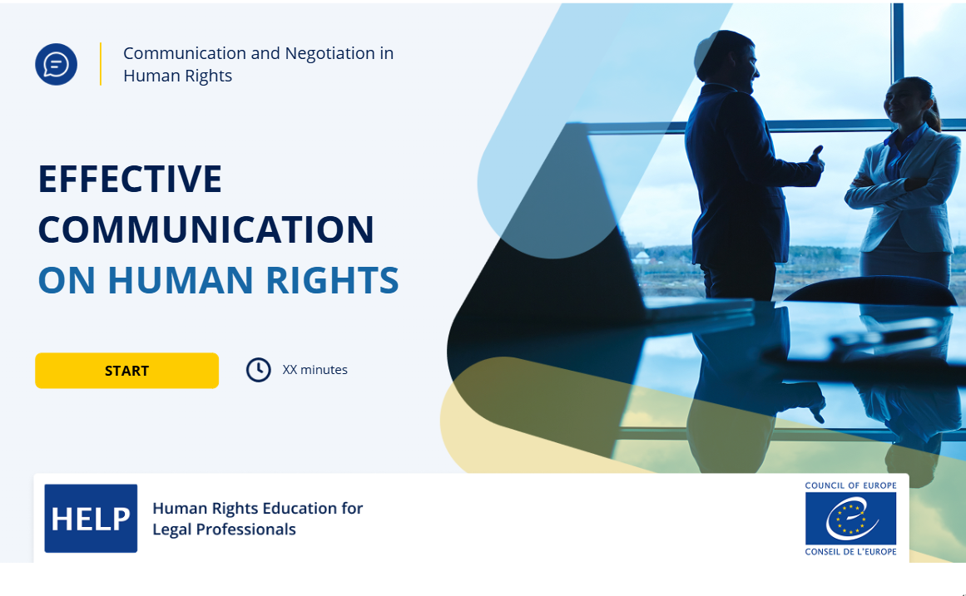

Developing and Updating HELP Courses
Communication and Negotiation on Human Rights
(new course, in progress)
Pre-Trial Investigation and the ECHR
(course update)

Slide 9
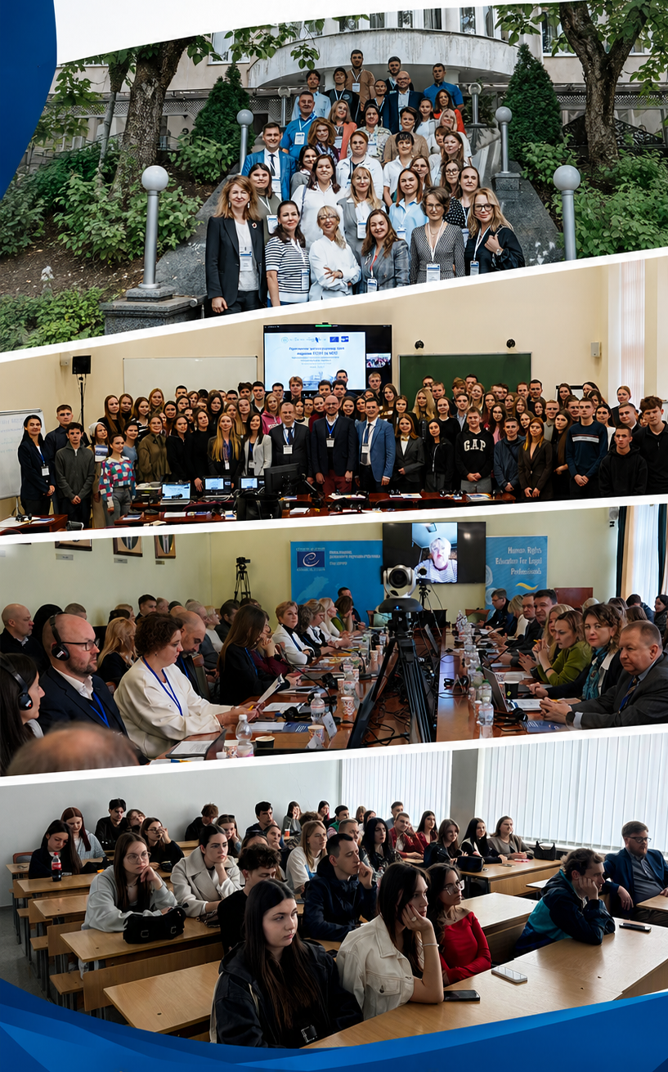

Investing in the Next Generation: University Partnerships and Integration of courses
Memoranda of Cooperation
Training University Lecturers
HELP in Universities conference
7 memoranda with leading Ukrainian universities. HELP becomes a permanent component of legal education
International conference held in Lviv for advancing HELP in university education, 90+ participants
Series of trainings for a pool of university lecturers. Focus on ECHR case-law, HELP courses and interactive teaching methods

Slide 10
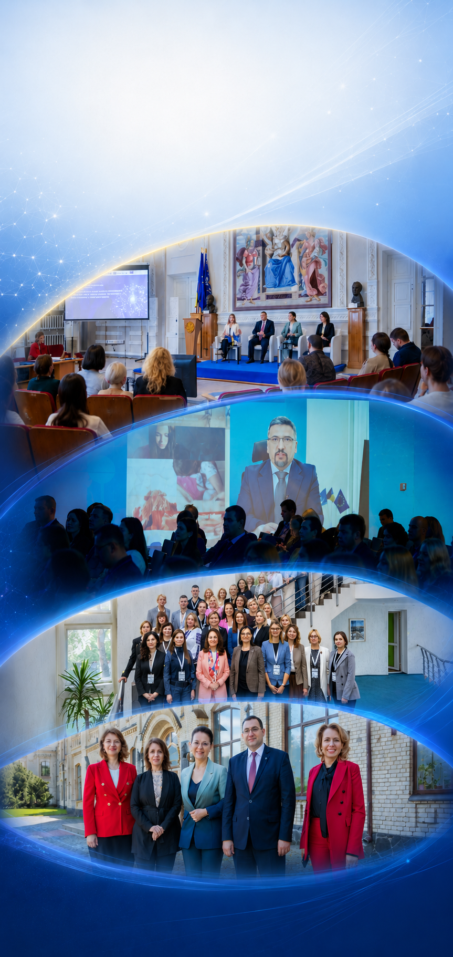
Thematic Events Driving Professional Engagement and Institutional Change
Promoting Inclusion
AI in Public Administration
Capacity Building for Public Servants
Educational marathon based on course Rights of Persons with disabilities. Direct engagement with frontline service delivery. Removes access barriers
International conferences based on HELP course on AI and HR to discuss the role of AI in Ukraine's justice sector. Bridges theory and policy
Summer schools on coaching excellence for public servants with specialized focus on HELP course on Rights of Persons with Disabilities. Fosters inclusive civil service
Notes:
These events translate digital content into peer-to-peer networking. Institutional change driven by dialogue. Strengthening institutional cooperation and knowledge exchange

Slide 11
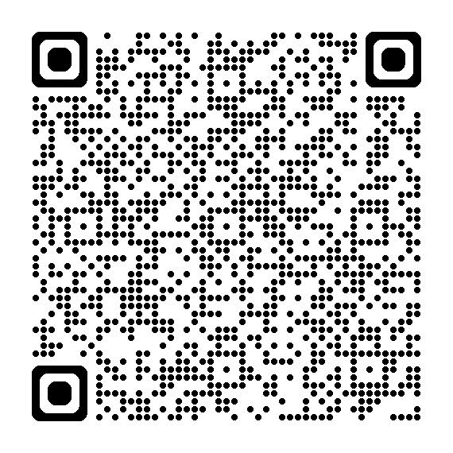
Stay Updated on HELP for Ukraine Progress
Project Team
Krystyna Khokhlova | Project Manager| Krystyna.Khokhlova@coe.int
Galyna Smirnova | Senior Project Officer | Galyna.Smirnova@coe.int
Mariana Matseikiv | Project Assistant | Mariana.Matseikiv@coe.int
Project page

