Slide 1

Soft skills for legal professionals
Eva Massa Arranz

Slide 2

Why soft skills?
Increased demand of soft skills.
EU Commission European Judicial Training Strategy:
Transferable skills.
“European judicial training should go beyond legal education and support the development of professional skills”.
“…all justice practitioners need training on non-legal knowledge and skills”.
“Leaders and managers in the justice sector must also develop change management skills to effectively adapt to technological advancements…”

Slide 3

CHANGE MANAGEMENT
Guide institutions and people through reforms, helping them adapt to new policies, practices, and organisational structures.
Justice sector maintain public trust, safeguard human rights, and uphold the rule of law.
Change often meets resistance.
Understanding what barriers prevent people from adopting new ways of working.

Slide 4


Slide 5




EU-CoE Project "Attorney General and State Advocate in Malta - Implementation of action plan on offices re-organisation".

Slide 6

Objective
Behaviourally informed approach to change management.
Specificities of the justice sector - respect judicial independence and professional ethics.
To have legal professionals involved in the development and use of new technologies, as these tools can directly affect people’s rights.

Slide 7
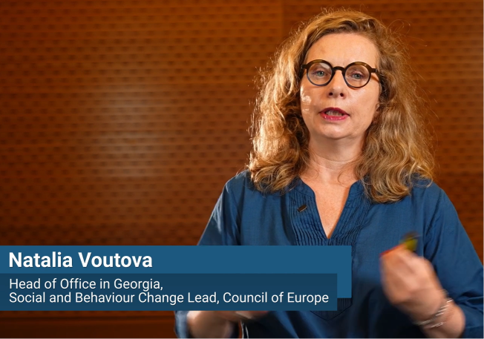




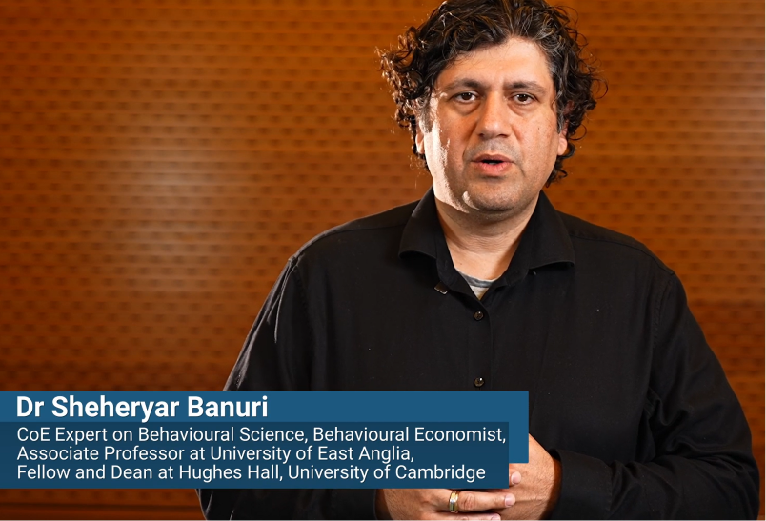
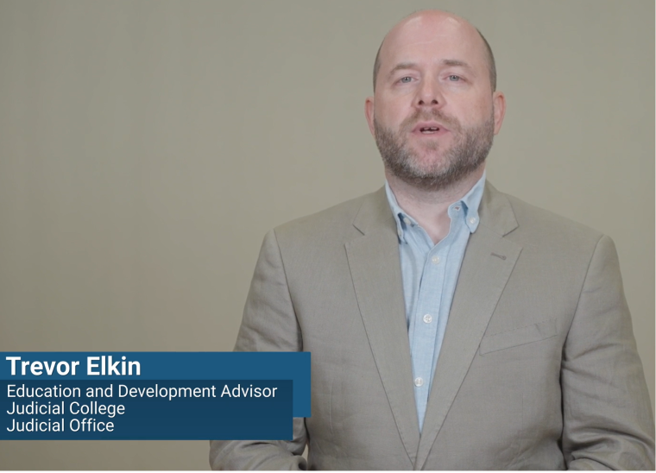
Format
15 short videos by experts.

Slide 8
General overview of behavioural models
Safeguarding human rights and the RoL during institutional transformation
Practical instruments for driving change
1
2
3
Delivering Successful Change Management Programmes.
Change Management Models.
Basics of Behavioural Science.
Barriers to Change.
Biases and De-biasing Techniques.
Specific Incentives and Incentive Management
Independence of the Courts in a Digital Age.
Safeguarding Human Rights and the Rule of Law in Justice Sector Transformation.
Leadership Role in Driving Change.
Champions of Change.
Awareness During Change.
Strategic Communication for Justice Sector Change
Training During Change.
Reinforcement of Change

Slide 9


COMMUNICATION & NEGOTIATION IN HUMAN RIGHTS
“HELP for Ukraine including during wartime, Phase I”.
Objective
Equip lawyers with knowledge and practical skills.

Slide 10



Article 8 ECHR:
protects private and family life, the home, and communications.
Any interference by public authorities must be lawful, pursue a legitimate aim, and be necessary and proportionate.
Article 8 requires public authorities to respect people’s private and family life in everyday decisions. Interference is allowed only when justified, limited, and lawful.
Article 8 is about your right to live your private and family life without unnecessary interference from the state. It covers your home, your relationships, and your personal information.

Slide 11


Slide 12
Effective communication
1
Introduction
2
What is effective communication?
3
Adapting communication to different audiences
4
Addressing resistence & misconceptions
5
Best practices in effective human rights communication

Slide 13
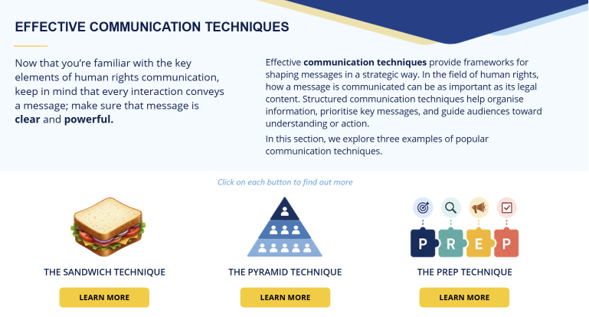

Slide 14







Slide 15
Negotiation
1
Introduction
2
Factors to be considered in negotiation
3
Negotiation styles
4
Negotiation stages
5
Inernational negotiation

Slide 16
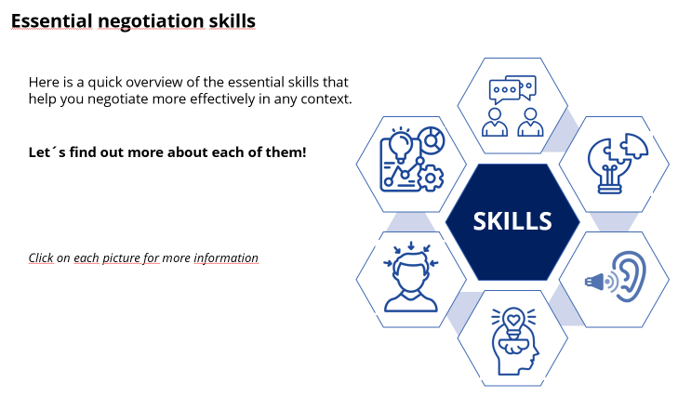
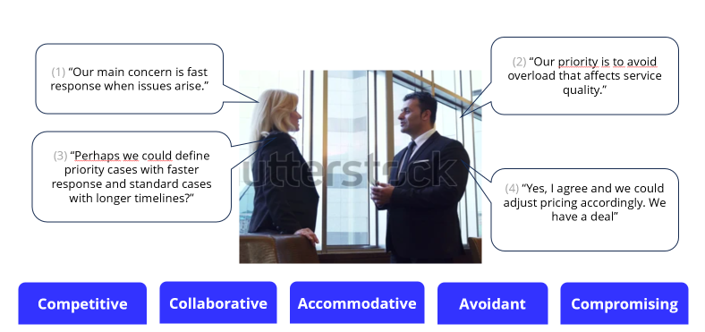

Slide 17






Develop leadership & shared vision
Negotiation strategies & confidence
Effective communication & audience awareness
Benefits of developing soft skills
Collaboration & conflict resolution
Improving capability & adaptability
Negotiation strategies & confidence

