Slide 1
NEW HELP COURSE ON
Technology-Facilitated Violence against Women and Girls
New HELP modules to supplement the existing courses on Violence Against Women available as of March 2026

Slide 2



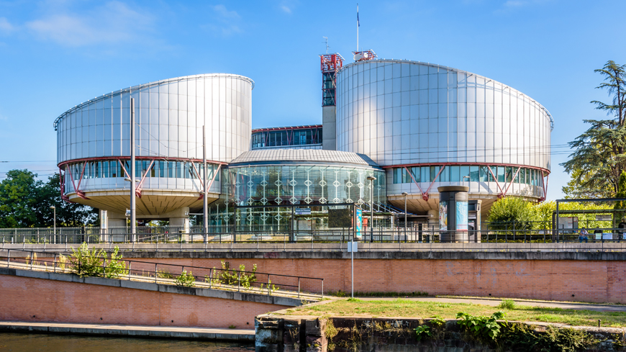
Background and link with the Council of Europe strategic triangle
The modules provide support to understand the GREVIO General Recommendation No. 1, the Recommendation on Accountability for Technology-Facilitated Violence Against Women and Girls, CM/Rec(2026)2, relevant ECtHR case-law, as well as GREVIO’s monitoring findings.

Slide 3
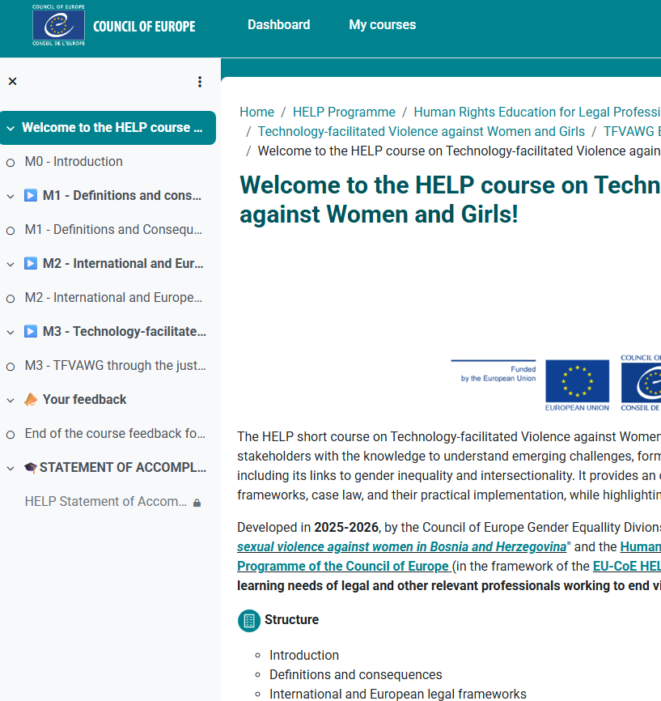
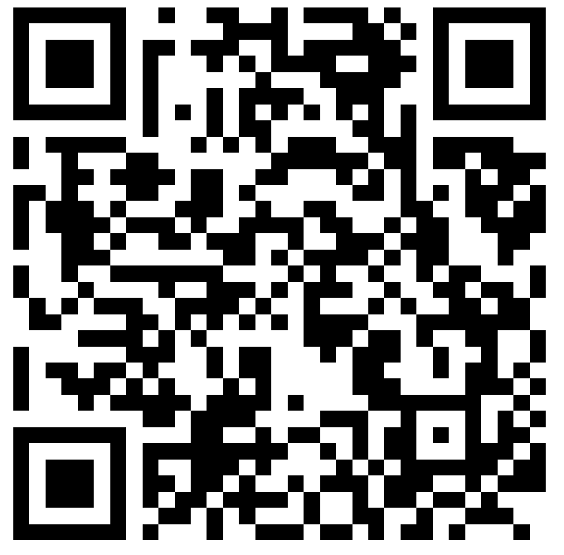
Course Info
Process of the development: Working group composed of international consultants and CoE experts during 2025
Available online as of March 2025
Duration 3h:30 minutes
Languages: English and French
Objective: The course aims to support legal professionals by explaining the nature, legal context of TFVAW and it impacts.
The Course has three modules:
Definitions and consequence
International and European Legal Frameworks
Technology-facilitated violence against women and girls through the justice chain
View the Course

Slide 4
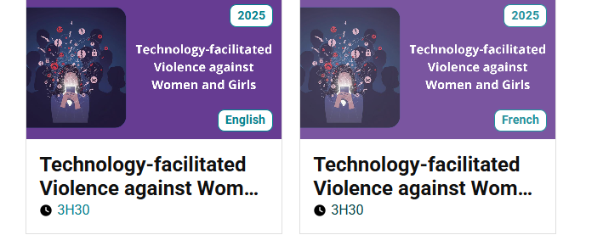
Results so far and plans for future
English version – 295 registrations, 45 completions to date.
French version launched in Brussels this year for 40 judges and prosecutors from 17 EU countries.
French version – 61 registrations, 13 completions to date.
Translation and legal adaptation in national context planned for 2027 in Moldova, Azerbaïdjan, Armenia, Bosnia and Hercegovina and other countries per request.

Slide 5
28 languages
14,465 enrolled
4468 certified
11 languages
3670 enrolled
1636 certified
Wider support on Violence against women
The course joins the 4 previously existing HELP courses on VAW
Violence against Women and Domestic Violence
VAW/DV for law enforcement officials
Women’s access to justice
Gender equality and gender mainstreaming
17 languages
11,772 enrolled
2302 certified
8 languages
2744 enrolled
1093 certified

Slide 6
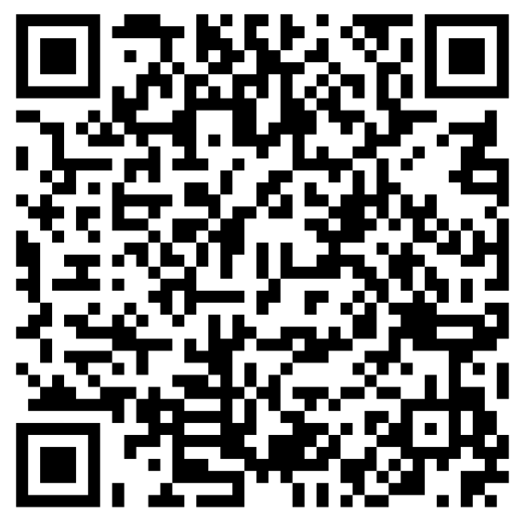
Gender Equality
Co-operation Projects
The course was developed within the framework of the Co-operation project Combating digital and sexual violence against women in Bosnia and Herzegovina II
Read more about the Council of Europe’s technical co-operation on gender equality by following the QR code

