Slide 1
Digital training for a digital justice
THE 2026 HELP NETWORK CONFERENCE
STRASBOURG, 2 JULY 2026
Alice Hamilton, Project Manager, Justice, Digital and Migration Unit, EU Agency for Fundamental Rights (FRA) alice.hamilton@fra.europa.eu

Slide 2
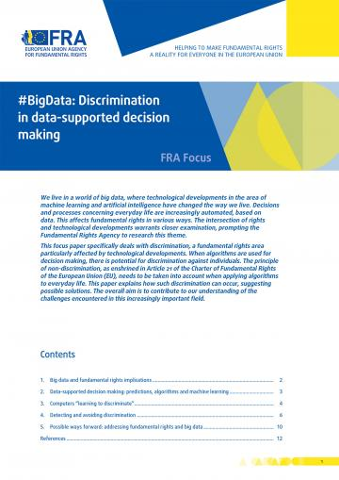
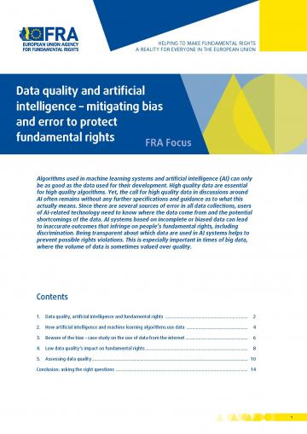
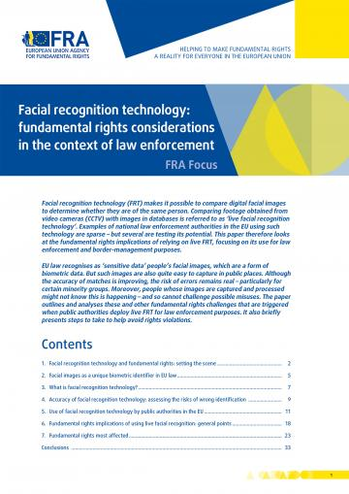


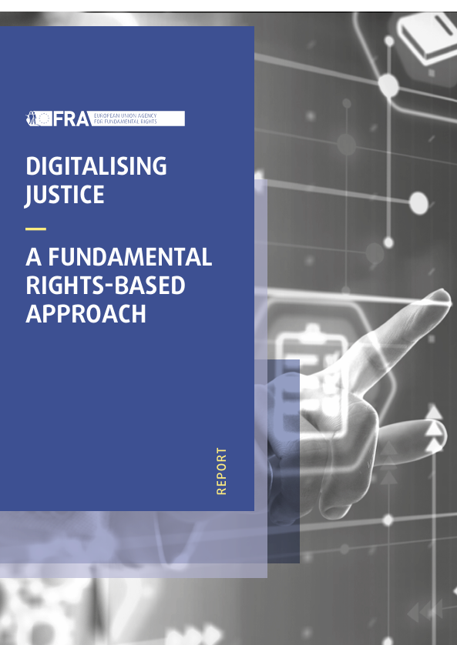

FRA work on AI and digitalisation of justice
  FRA supports digital justice training through qualitative
  research on how digital tools affect professionals and rights-holders
  in practice
  Selected publications
  Getting the future right – Artificial intelligence and fundamental rights (2020)
  Bias in algorithms – Artificial intelligence and discrimination (2022)
  Digitalising Justice: A fundamental rights-based approach (2025) and country reports (for Austria, Estonia, France, Italy, Latvia, Poland and Portugal)
  Assessing high-risk artificial intelligence: Fundamental rights risks (2025)
  Coming up:
  Remote biometric identification for law enforcement purposes: fundamental rights considerations (2026)
  Use of AI in asylum and immigration procedures – fundamental rights implications (2027)

Slide 3
FRA report: ‘Digitalising Justice: a fundamental rights-based approach’ (Nov 2025)
“Digitalisation can make the [justice] system more efficient and speed up decisions. That would benefit everyone who turns to [it] to protect fundamental rights. But the risk is that poor digitalisation can instead make it harder to protect those rights.”
(Judge)
31 digital tools across 7 MSs; criminal, civil and administrative justice
Examines rights impacts (benefits and risks) and recommends ways to make digital justice accessible & fair.
​208 in-depth interviews (e.g. justice practitioners, technical experts, civil society representatives)
4 clusters of digital tools
E-case management/document systems​
Tools to access information/services (e.g. online reporting)​
Videoconferencing platforms in court proceedings​
AI-driven tools (e.g. anonymisation and transcription tools)​

Slide 4
FRA report: Assessing high-risk AI: Fundamental rights risks (Dec 2025)
Aim:
  Provide empirical analysis and guidance about fundamental rights impacts and risk assessment practices by providers and deployers of high-risk AI systems
  Feeding into guidance under the AI Act
Methodology: ​
  Desk research and fieldwork (interviews and focus groups)
  Use case areas: asylum, law enforcement, education, employment, public benefits​

Slide 5
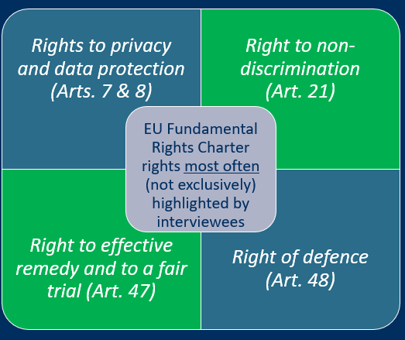
4 key safeguards for digital justice that protects fundamental rights
Embed fundamental rights from design to deployment
Assess fundamental rights risks across digital tools
Ensure inclusive digital justice and maintain non-digital pathways
Include fundamental rights focus in training
Practitioners' views on training
“In 20 years' time we will work differently. People should be trained not only to be able to use the tools, but to be aware of the risks of using them in the wrong way.”
(Judge)

Slide 6

EU Fundamental Rights Charter tools/training
Charter handbook (based on CJEU case law), available in all EU languages and Ukrainian: https://fra.europa.eu/en/publication/2018/applying-charter-fundamental-rights-european-union-law-and-policymaking-national
EU Charter eQuarterly (CJEU case law, training opportunities and academic articles, relevant documents/activities from EU institutions, FRA. Next edition July 2026. Write to charter@fra.europa.eu
4th Annual Online EU CharterXchange 23-24 November 2026 (FRA in cooperation with European Commission): Forum to promote the application of the Charter at national level, aimed at legal professionals. Summary and recording from 2025 event: 3rd Annual EU CharterXchange | European Union Agency for Fundamental Rights
New Commission training course: From Theory to Practice: Applying the Charter of Fundamental Rights of the EU: academy.europa.eu/courses/from-theory-to-practice-applying-the-charter-of-fundamental-rights-of-the-eu
Other FRA Charter material and resources: https://fra.europa.eu/en/eu-charter/fra-charter-resources
New project to promote FRA’s tools and Charter material at national level – if interested get in touch!

Slide 7
Thank you!
FRA – EUROPEAN UNION AGENCY FOR FUNDAMENTAL RIGHTS
Schwarzenbergplatz 11 – 1040 Vienna – Austria
T +43 158030-0 – F +43 158030-699

