Slide 1


Human Rights Education
for Legal Professionals
HELP Annual Conference, 2026
HELP in the EU
Oana Gîrlescu

Slide 2

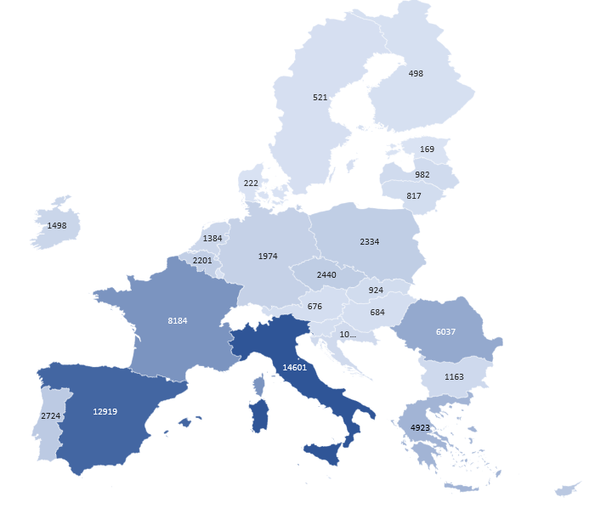

HELP in EU member states
HELP in the EU IV (EU funded)
Other highlights (July 2025 – June 2026)
73,000 HELP
users from EU

Slide 3
HELP
Top countries by no. of users
Ukraine | 28060
Turkey | 24285
Italy | 14601
Spain | 12919
France | 8184
Romania | 6037
Portugal | 5765
Greece | 4923
Georgia | 4185
Russian Federation | 3681

Slide 4


HELP in the EU IV
November 2024 - March 2027
Follows the path of HELP in the 28, HELP in the EU II and HELP in the EU III
Funded by the European Union (Directorate-General for Justice and Consumers)
In consortium with the Spanish Bar Association
The commitment of most National Training Institutions (NTIs) and Bar Associations (BAs) from EU MS, as well as the European Judicial Training Network (EJTN) and the European Council of Bars and Law Societies (CCBE).
Overall objective
  is to promote the digitalisation of national justice systems and to contribute to the effective and coherent application of European standards and EU law in selected areas of fundamental rights, as enshrined in both the CoE and EU systems and frameworks. The promotion of digitalisation will be done through training aimed at building the ‘digital capacity’ of justice/legal professionals on substantive law, digital procedures and digital tools. The project aims to enhance EU MS (and other eligible countries) justice professionals’ capacities (knowledge and skills) in priority topics identified under the call, through the implementation of HELP courses and networking seminars for justice professionals, in a format aimed at preparing them to embrace digitalisation and the use of new technologies in the learning process.

Slide 5
HELP in the EU IV - Achievements
Developing 5 new modules on human rights in the digital environment (4/5)
  Access to justice in the digital environment
  Business and human rights in the digital environment
  Children’s rights in the digital environment
  Investigating crimes using digital tools
  Technology-facilitated Violence against Women and Girls

Slide 6



HELP module on Access to Justice in the Digital Environment
Brief 2,5 hours
Availabile in English
Soon: French, Greek and Romanian
Published in November 2025
788 enrolled users (194 obtained certificate)

Slide 7
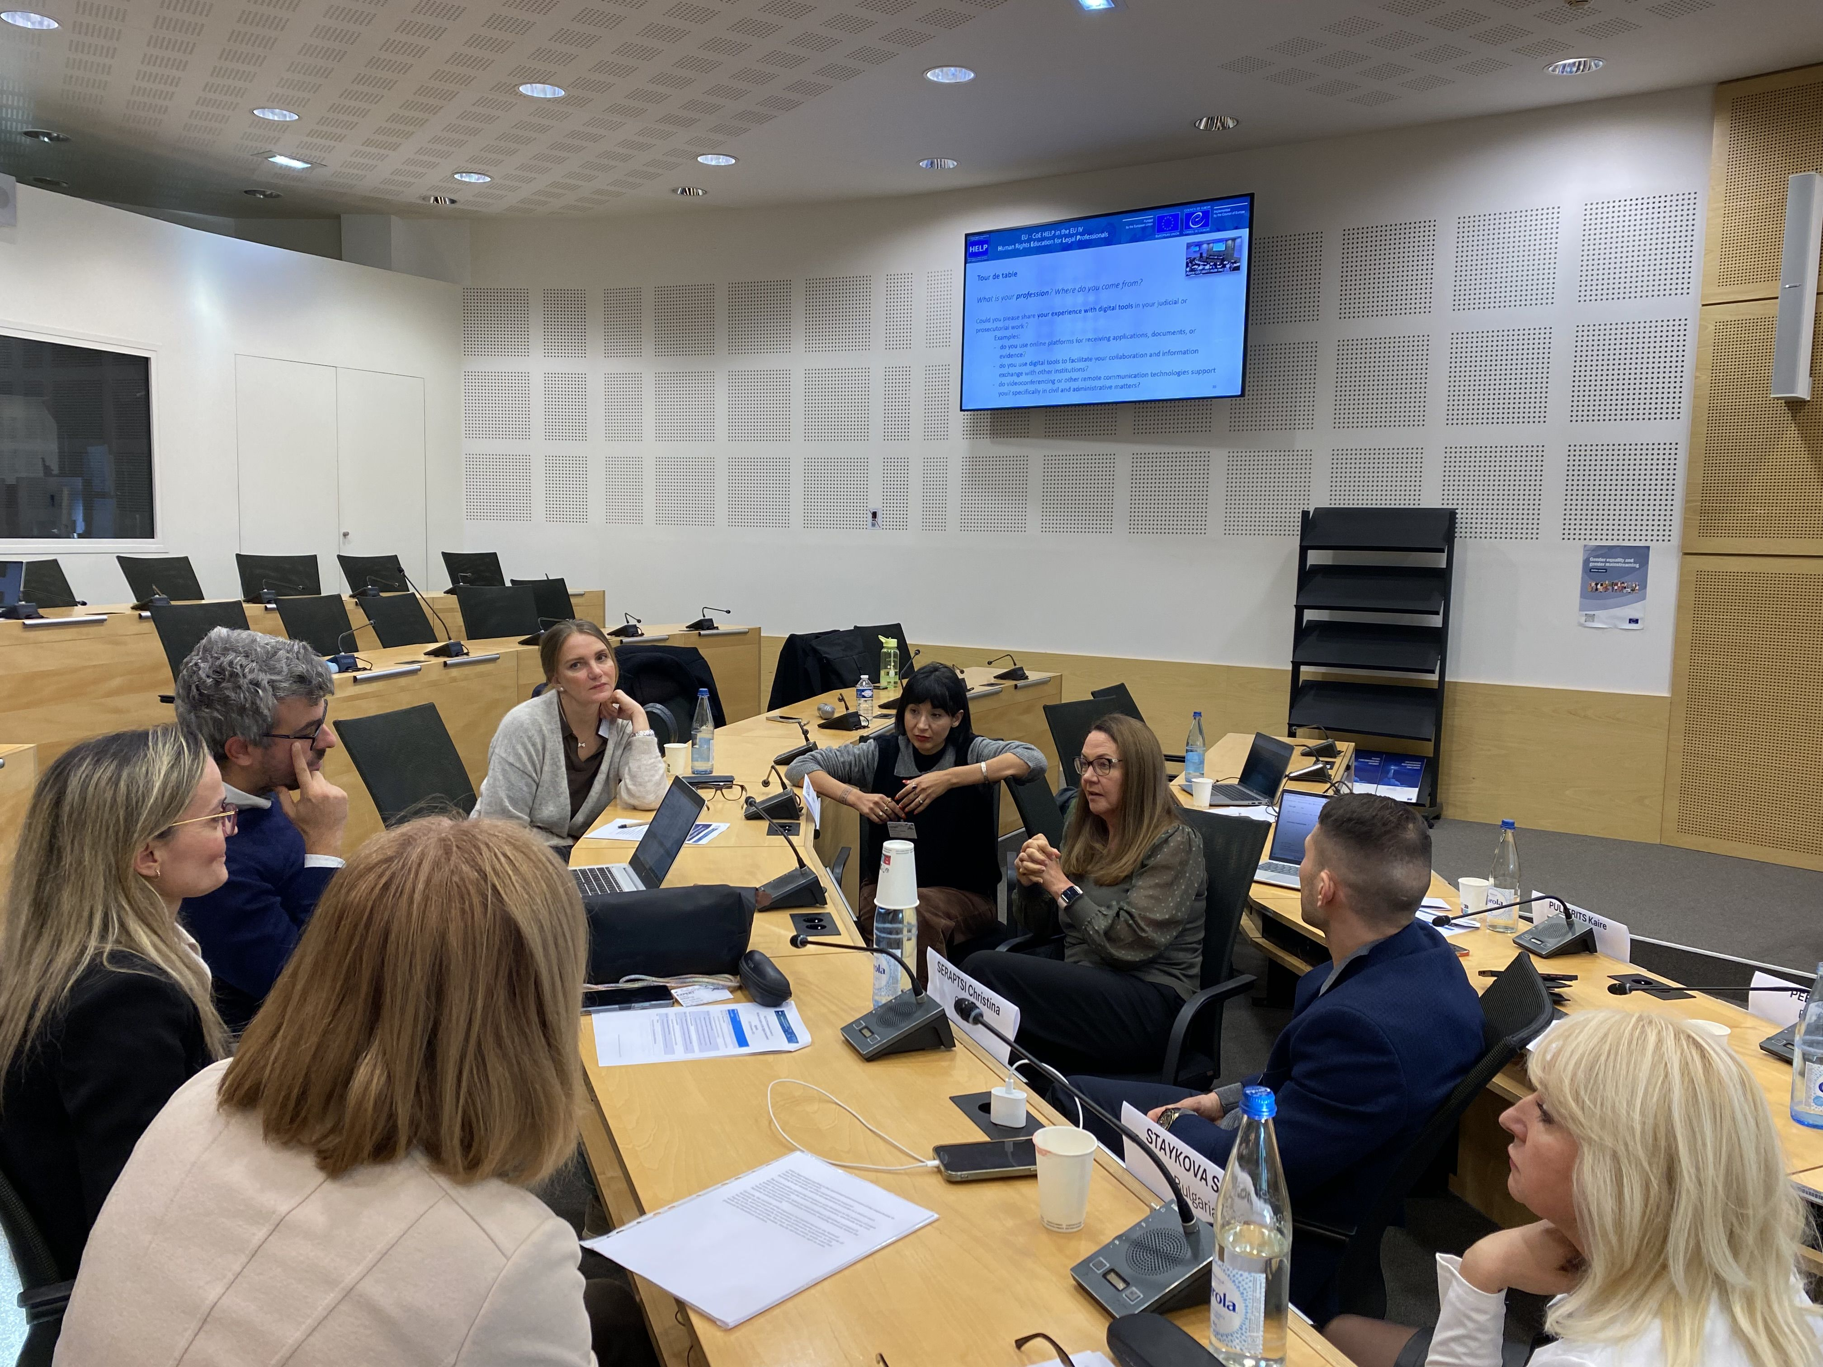
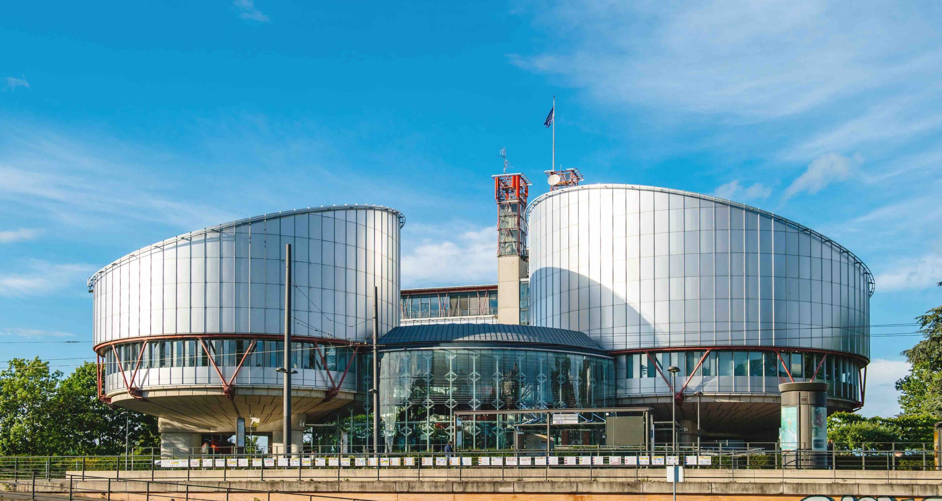

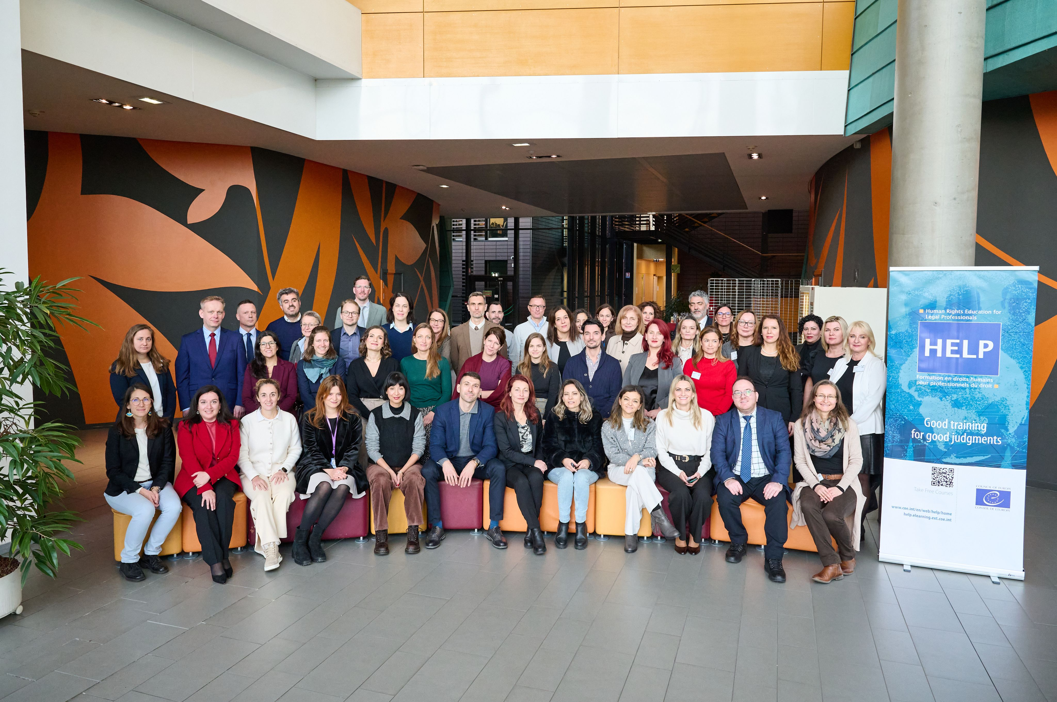
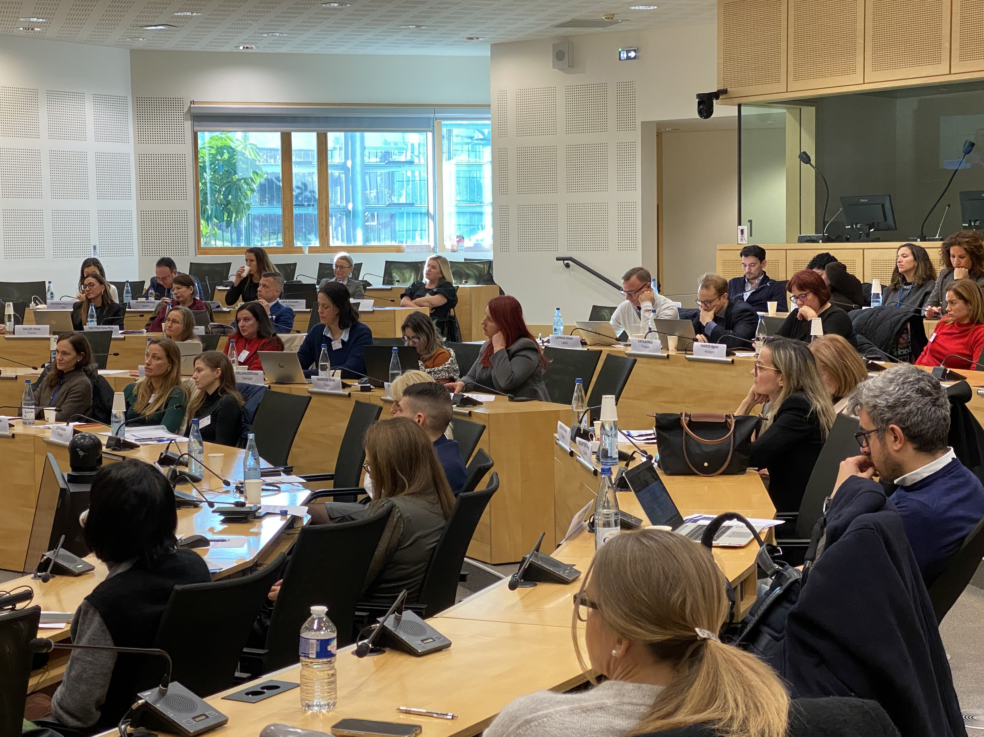
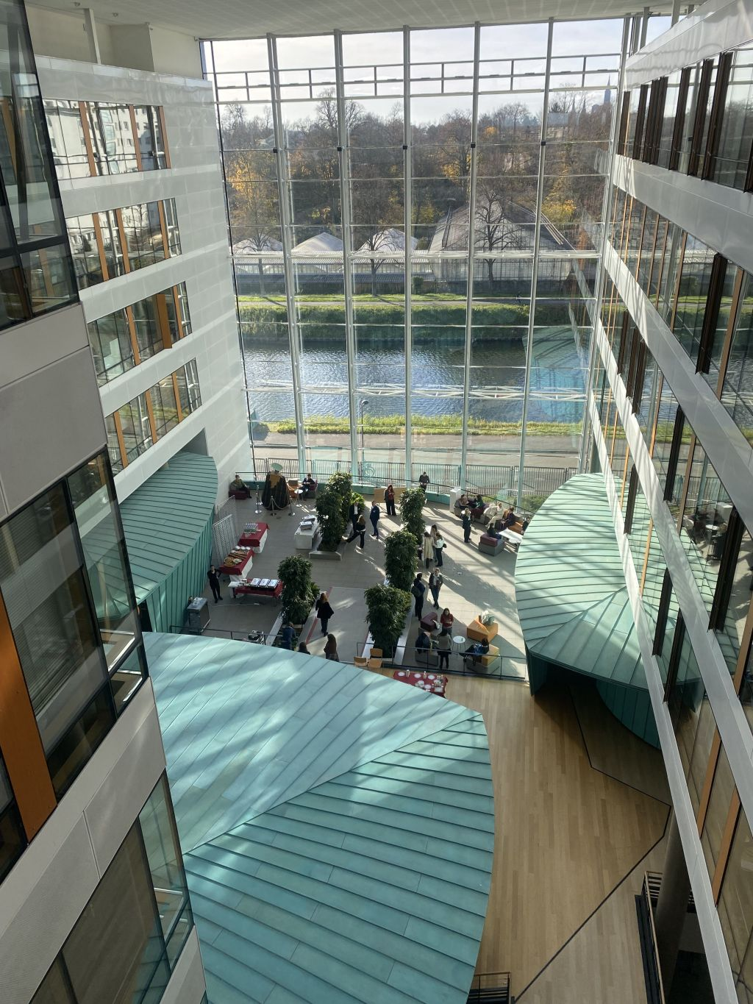

Launch of the HELP module on Access to Justice in the Digital Environment
Strasbourg (France)
18-19 November 2025

Slide 8

HELP module on Business and Human Rights in the Digital Environment
Availabile in English
Published in June 2026
To be launched at the end of the year

Slide 9

HELP module on Children’s Rights in the Digital Environment
Brief 1h 15
Availabile in English and Portuguese
Soon: French, Greek and Romanian
Published in October 2025
1300 enrolled users

Slide 10
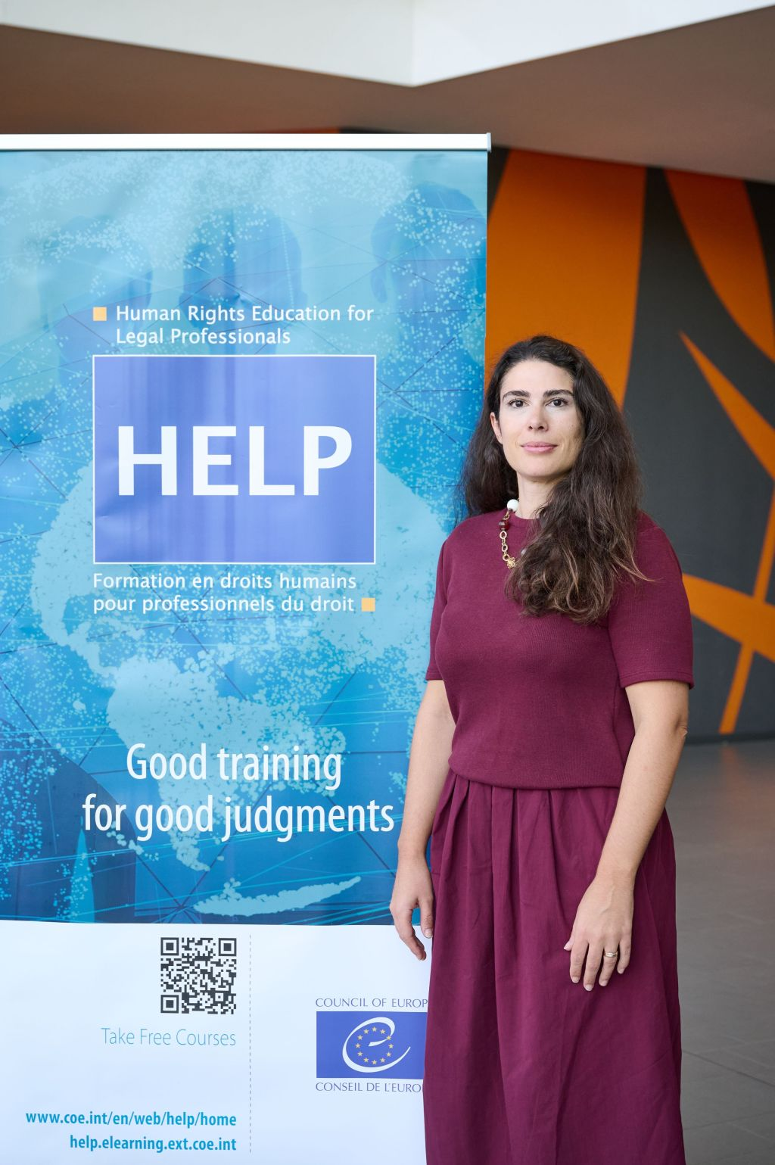
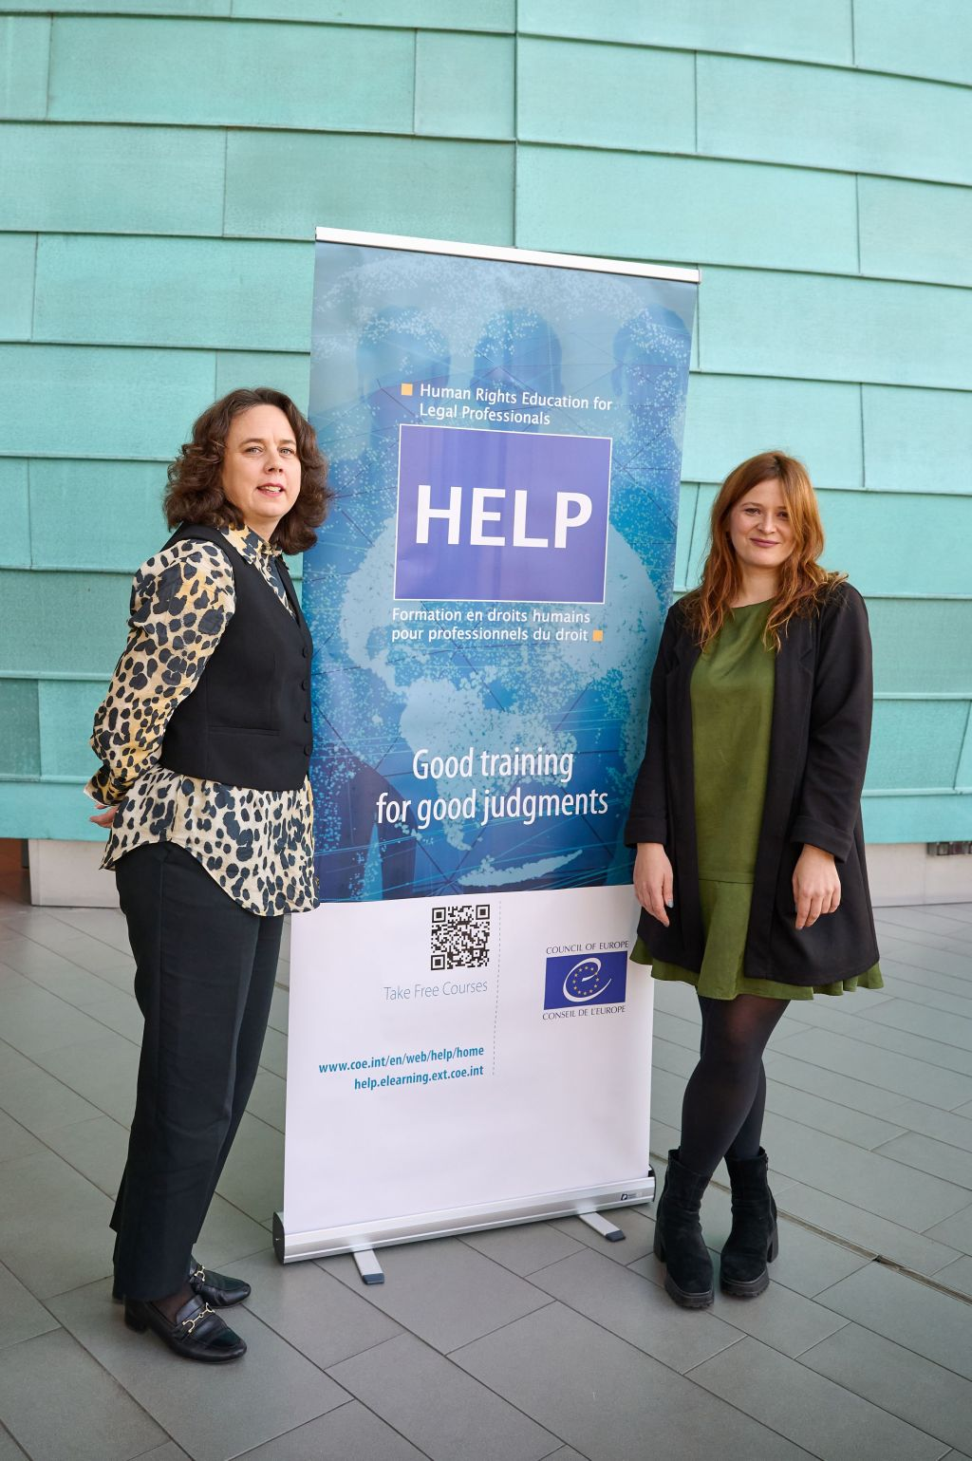
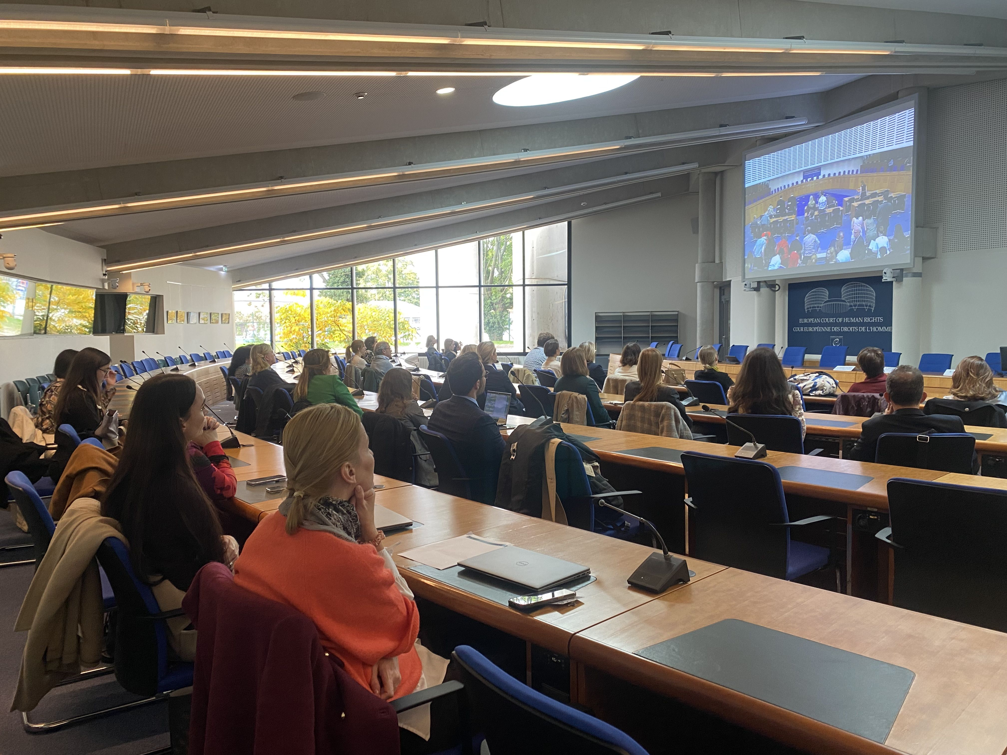
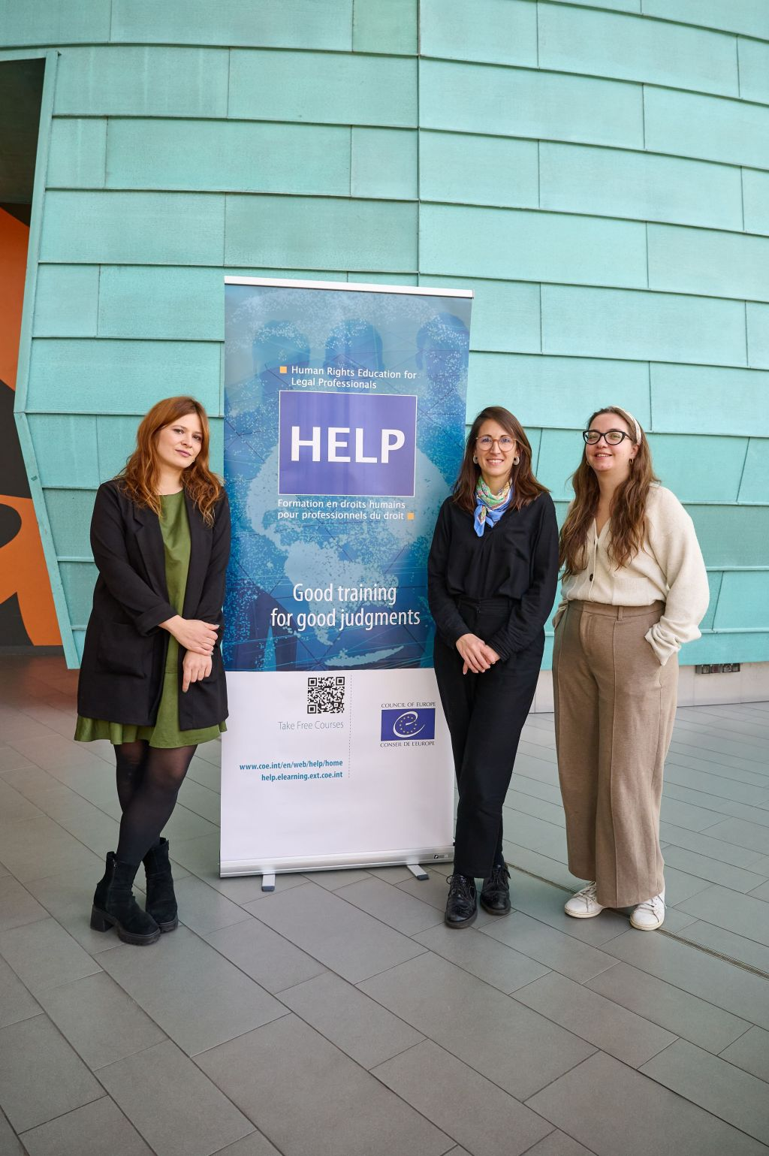
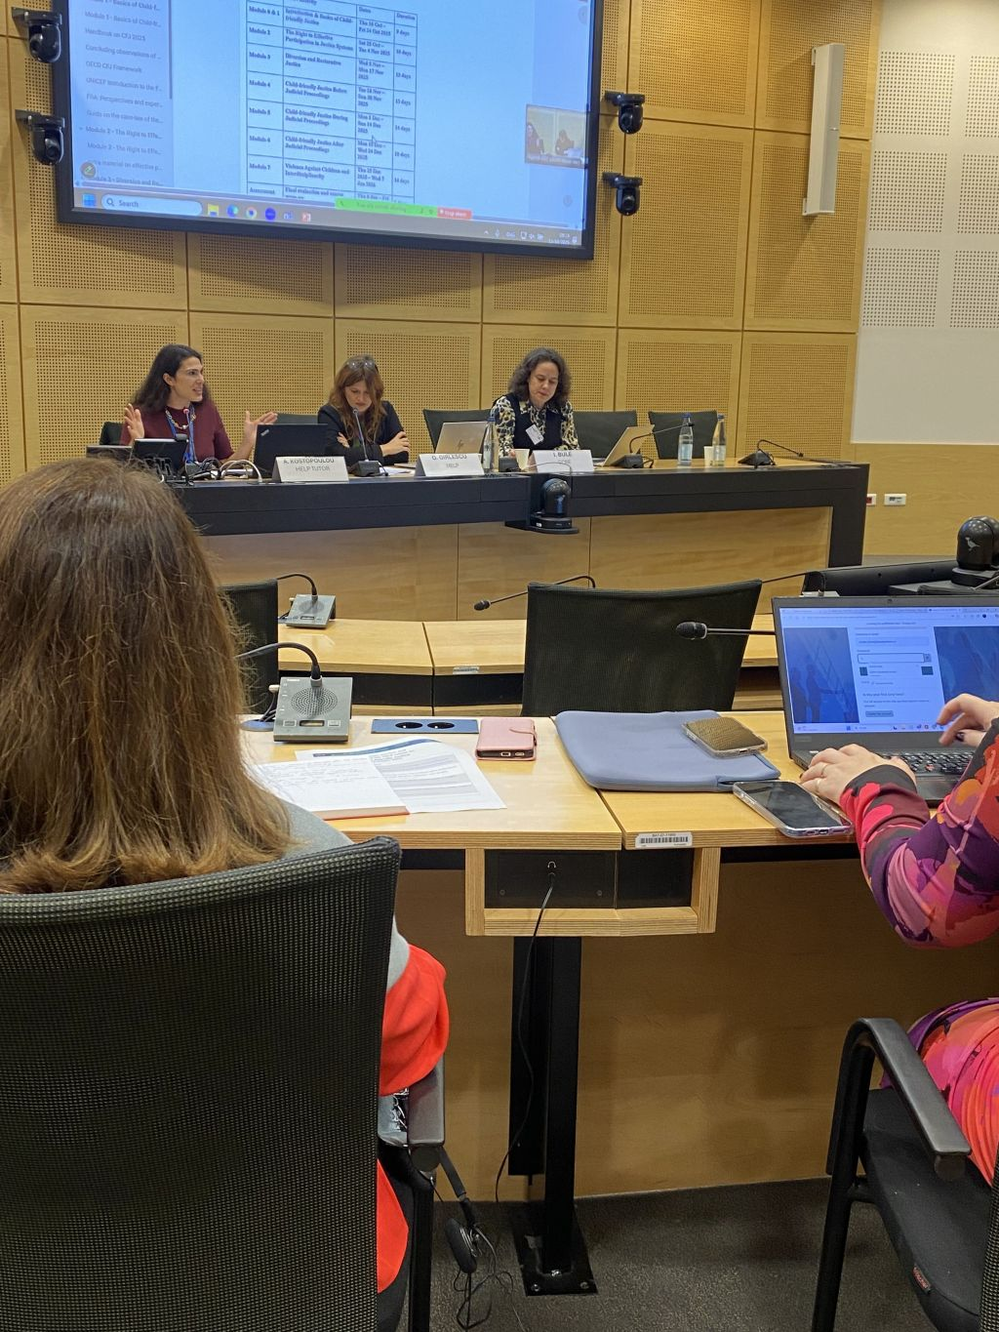
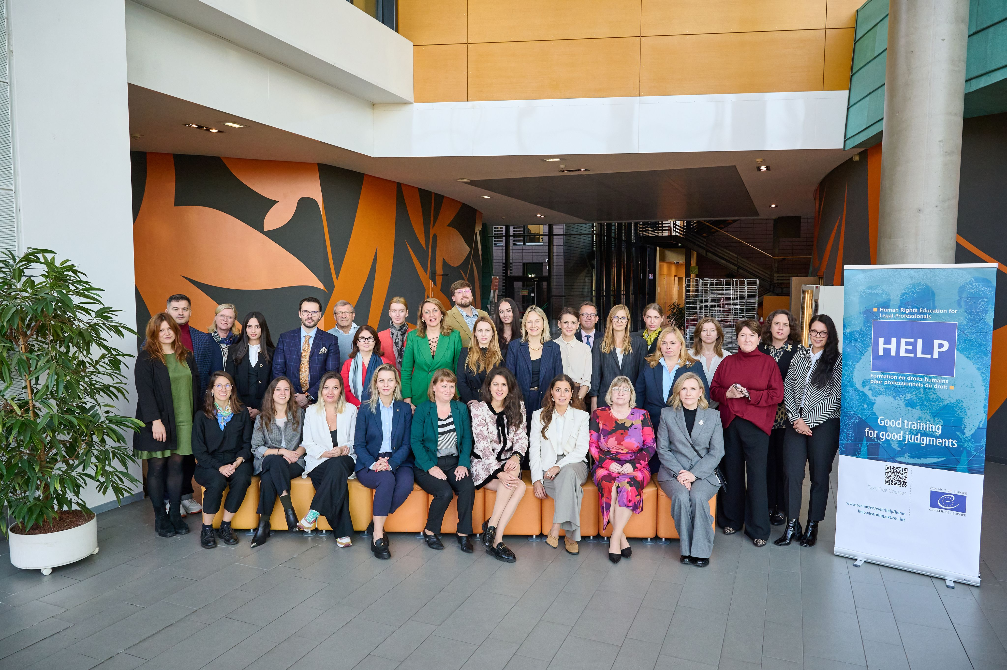

Launch of the HELP course on Child-friendly Justice (including the new module on Children’s Rights in the Digital Environment)
Strasbourg (France)
15 October
2025

Slide 11

HELP short course on Technology-facilitated Violence against
Women and Girls
Brief 3h 30
Availabile in English and French
Published in April 2026
519 enrolled users (427 English version, 92 French version)

Slide 12
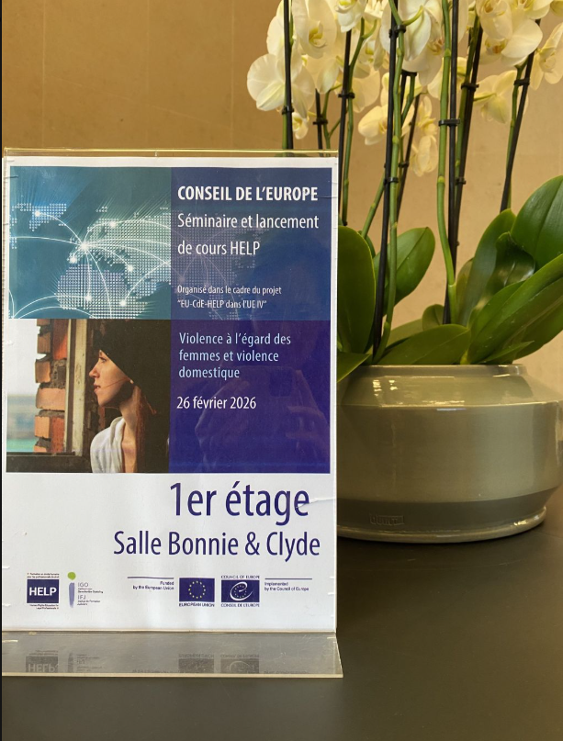
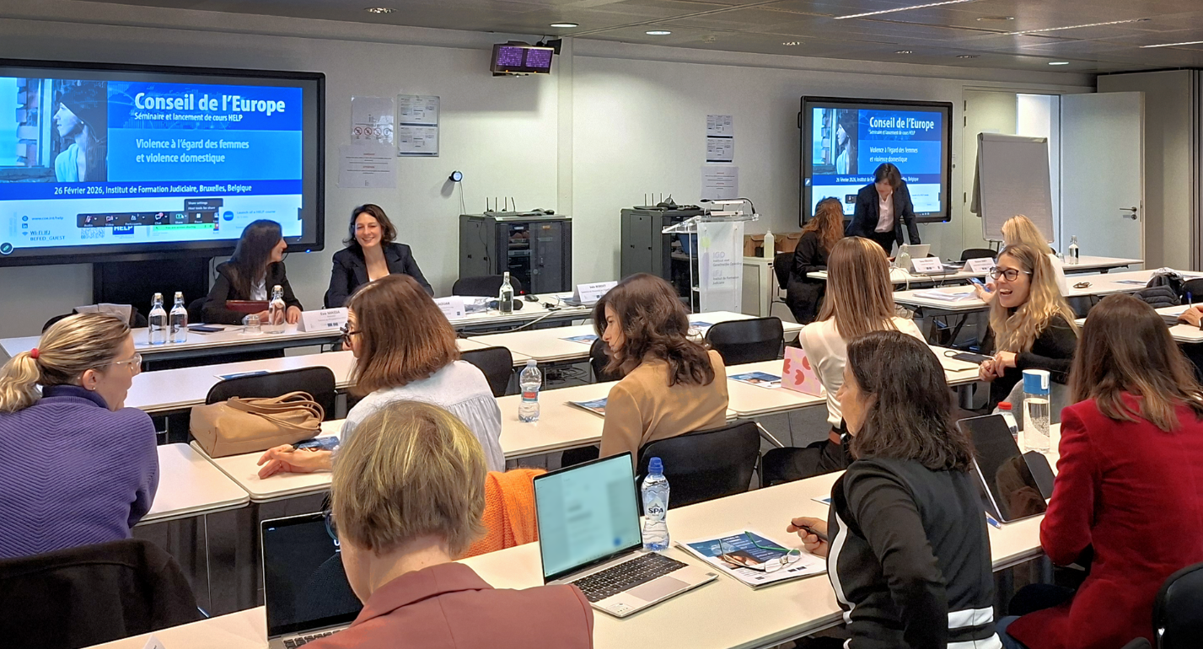
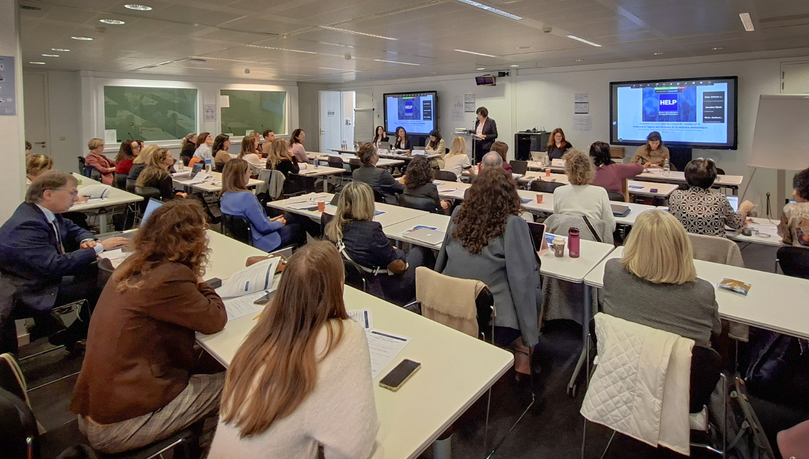
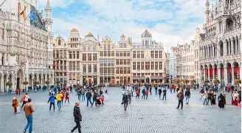

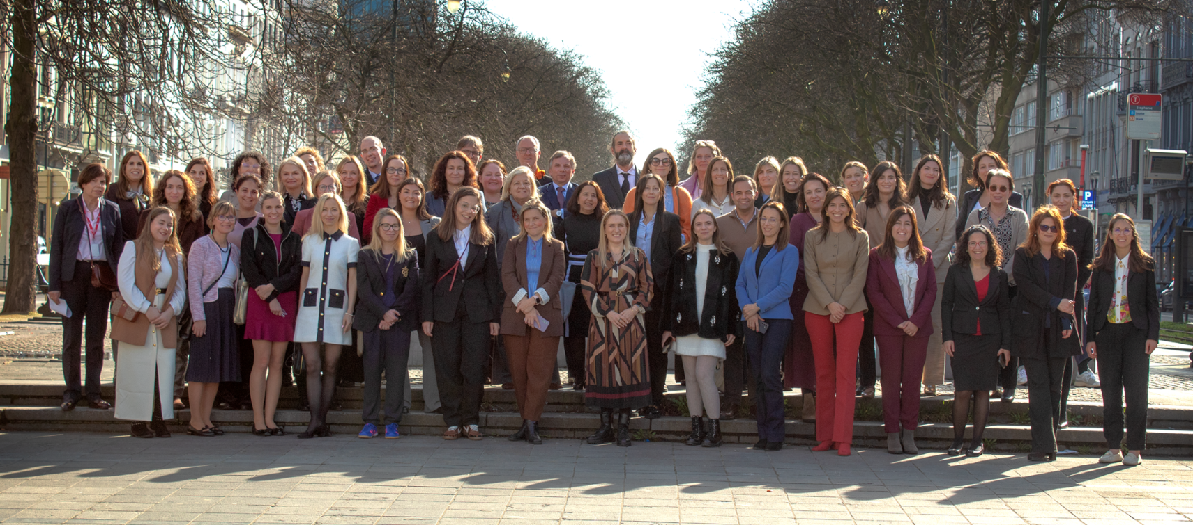
Launch of the HELP course on Violence against Women and Domestic Violence (including the HELP short course on Technology-facilitated Violence against
Women and Girls)
Brussels (Belgium)
26 February 2026

Slide 13

HELP in the EU IV - Achievements
Updating two HELP courses
  Data Protection and Privacy Rights

Slide 14

HELP in the EU IV - Achievements
Updating two HELP courses
  Hate Crime

Slide 15
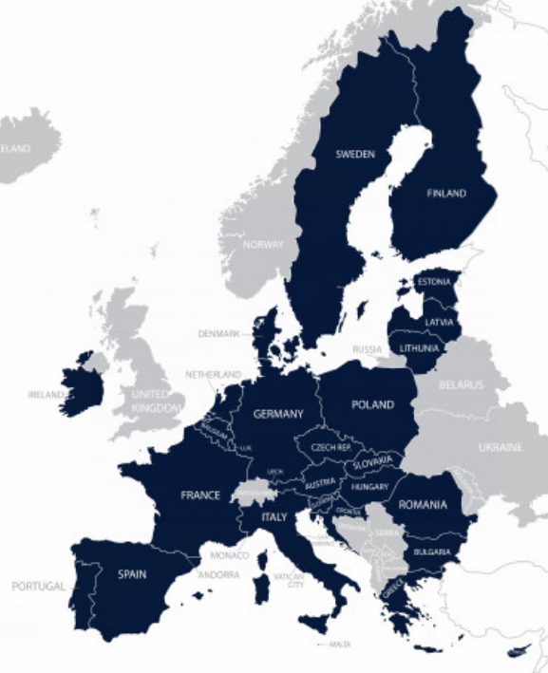

HELP in the EU IV -Achievements
- Adaptation of HELP online courses and launch in tutored format for at least 900 legal professionals
Course launched | Other information (TOTAL: 747)
Access to Justice in the Digital Environment (face to face/hybrid) | 47 judges and prosecutors (with EJTN)
Artificial Intelligence and Human Rights (face to face/hybrid/online) | 232 judges, prosecutors and lawyers
Child-friendly Justice (and Children's Rights in the Digital Environment) (face to face) | 28 lawyers (with CCBE) and 66 judges and prosecutors
International Cooperation in Criminal Matters (hybrid) | 39 judges and prosecutors
Judges Upholding the Rule of Law (hybrid) | 52 judges and prosecutors (with EJTN)
Personal Data Protection in the Publication of Judicial Decisions (hybrid) | 39 judges and prosecutors from Romania and Spain
Quality of Justice- the Work of the CEPEJ (hybrid) | 56 judges and prosecutors
Violence against Women and Domestic Violence (face to face/hybrid/online) | 188 judges and prosecutors

Slide 16
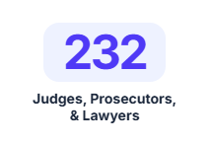



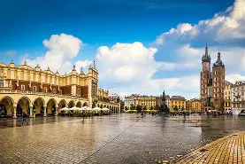

Launch of the HELP course on Artificial Intelligence and Human Rights

Slide 17
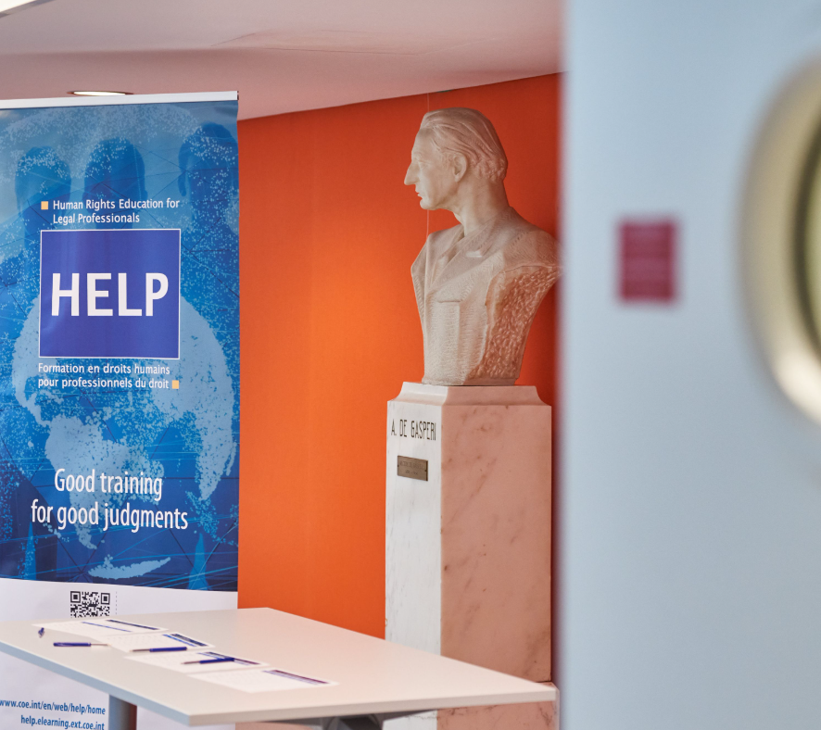
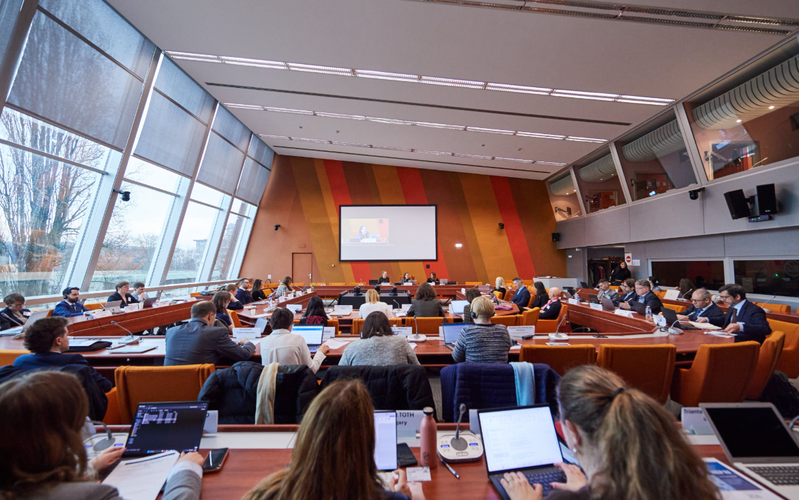
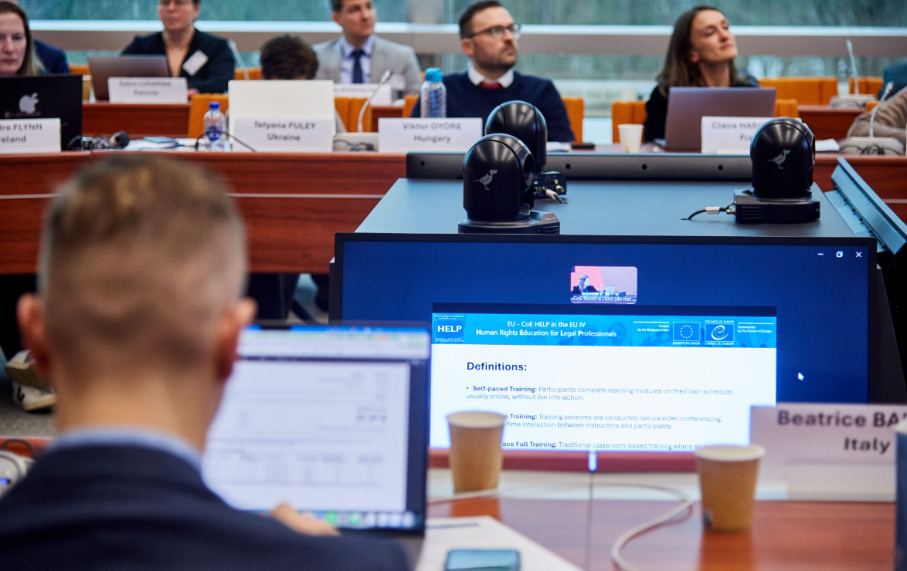
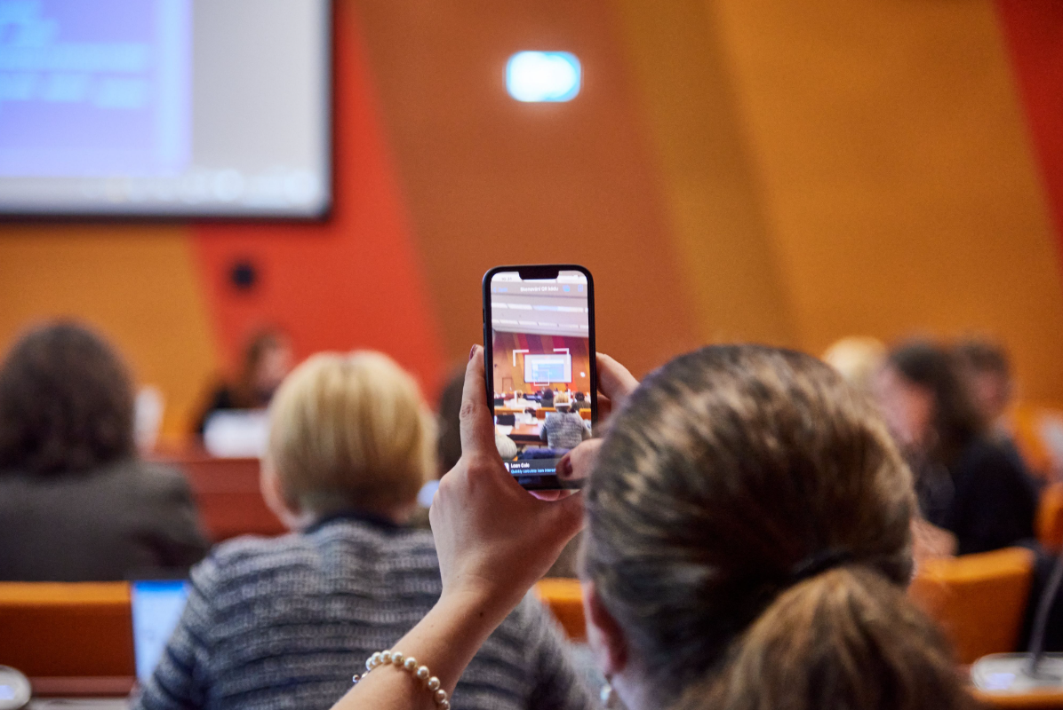
HELP in the EU IV - Achievements
HELP EU Contact Points Seminar – Collaborative Human Rights Training in the Digital Age: Priorities, Innovation and Best Practices
(19-20 February 2026)

Slide 18

HELP in the EU IV
What next?
  Training of trainers sessions – September/October 2026
  Tutorials on effective digital training techniques
  Launches
    Artificial Intelligence and Human Rights (with Business and Human Rights in the Digital Environment) (December 2026)
    Combating Hate Crime and Combating Hate Speech (February 2027)

Slide 19
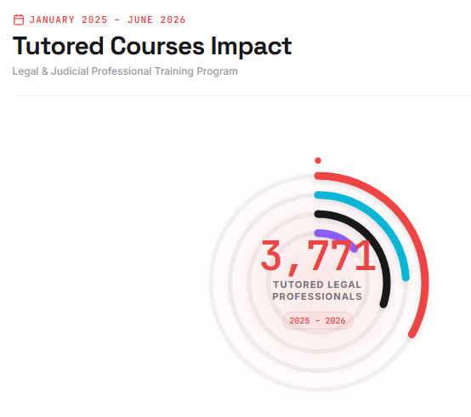
Other highlights (July 2025 – June 2026)

Slide 20

Other highlights (July 2025 – June 2026)
Partners adding HELP courses
to their own e-learning platform

Slide 21

Other highlights (July 2025 – June 2026)
Launches organised independently
  Czechia
  Anti-Discrimination
  Latvia
  Violence against Women and Domestic Violence
  Lithuania
  Ethics for Judges and Prosecutors

Slide 22

Other highlights (July 2025 – June 2026)
Launches organised independently
  Italy
    Judicial Reasoning and Human Rights and
    Violence against Women and Domestic Violence

Slide 23

Other highlights (July 2025 – June 2026)
Launches organised independently
  Centre for Judicial Studies (Portugal)
    Asylum and Human Rights
    Data Protection and Privacy Rights
    Interplay between the ECHR, the ESC and the EU Charter of Fundamental Rights
    Labour Rights and Human Rights
    Combating Hate Crime and Combating Hate Speech

Slide 24

Other highlights (July 2025 – June 2026)
Launches organised independently
  Spanish Judicial School
    International Cooperation in Criminal Matters
    Cybercrime and Electronic Evidence
    Right to Liberty and Security
    Access to Justice for Women
    Bioethics
    LGBTI Persons in Asylum Procedures

Slide 25

Other highlights (July 2025 – June 2026)
Launches organised by other entities of the Council of Europe
Children’s Rights Division
Protection of children against sexual exploitation and sexual abuse (Croatia and Spain)

Slide 26
HELP EU TEAM
Oana GIRLESCU (EU-CoE HELP in the EU IV Project Coordinator) oana.girlescu@coe.int
Eirini Pappa (EU-CoE HELP in the EU IV Project Assistant) eirini.pappa@coe.int
Thank you!

