Slide 1


Human Rights Education
for Legal Professionals
HELP Annual Conference, 2026
HELP course on Data Protection and Privacy Rights
Oana Gîrlescu

Slide 2


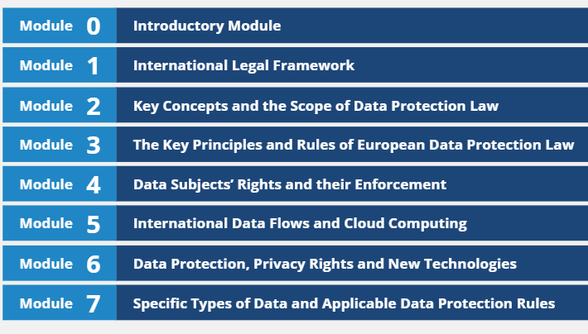

HELP course on Data Protection and Privacy Rights

Slide 3



HELP course on Data Protection and Privacy Rights

Slide 4





HELP course on Data Protection and Privacy Rights

Slide 5


HELP course on Data Protection and Privacy Rights

Slide 6








HELP course on Data Protection and Privacy Rights

Slide 7



HELP course on Data Protection and Privacy Rights

Slide 8

HELP course on Data Protection and Privacy Rights
The right to object
The right to access one’s data
The right to rectification, erasure and blocking of data
The right to data portability

Slide 9
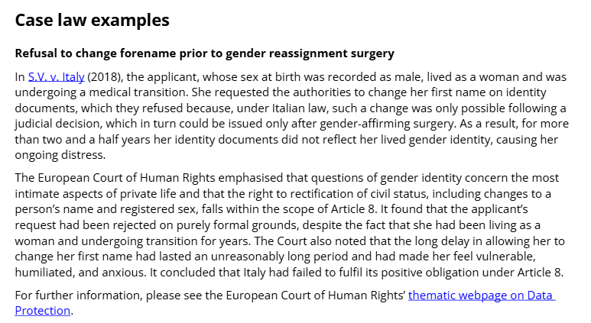
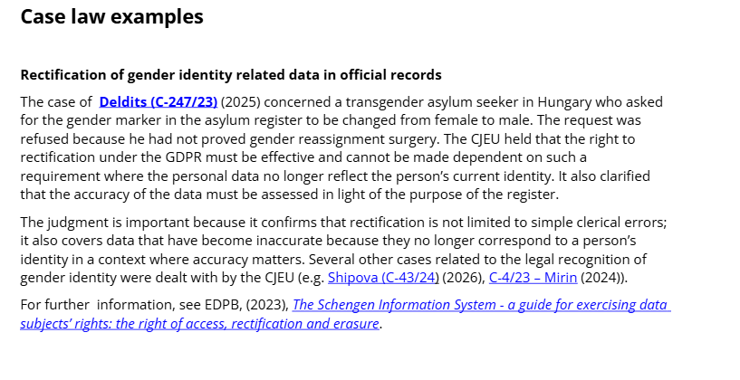
HELP course on Data Protection and Privacy Rights

Slide 10

HELP course on Data Protection and Privacy Rights

Slide 11

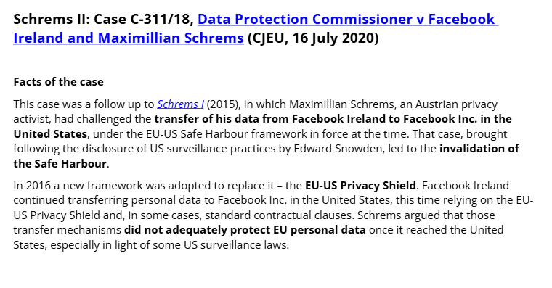
HELP course on Data Protection and Privacy Rights

Slide 12

HELP course on Data Protection and Privacy Rights

Slide 13


HELP course on Data Protection and Privacy Rights
Video surveillance
Internet of Things
Blockchain
Profiling
AI

Slide 14
HELP course on Data Protection and Privacy Rights
E-communication
Health
Media and Freedom of Expression
The Workplace

Slide 15
HELP EU TEAM
Oana GIRLESCU (EU-CoE HELP in the EU IV Project Coordinator) oana.girlescu@coe.int
Eirini Pappa (EU-CoE HELP in the EU IV Project Assistant) eirini.pappa@coe.int
Thank you!

