Slide 1


Human Rights Education
for Legal Professionals
HELP Annual Conference, 2026
HELP module on Access to Justice
in the Digital Environment
Oana Gîrlescu

Slide 2

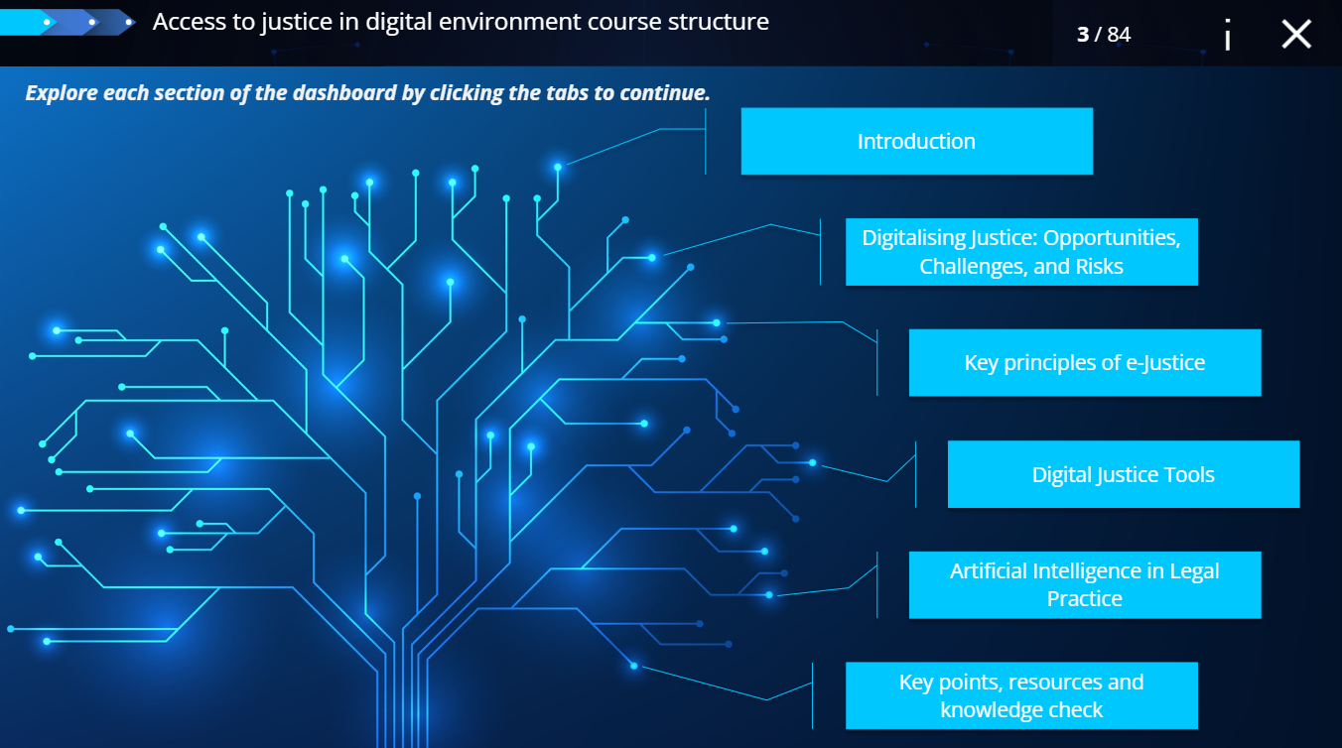




HELP module on Access to Justice in the Digital Environment
Brief 2,5 hours

Slide 3
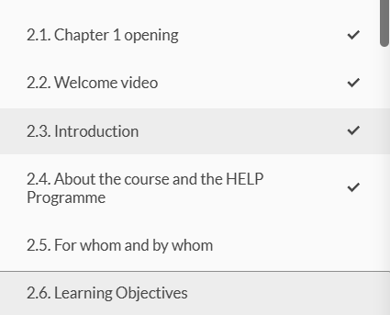
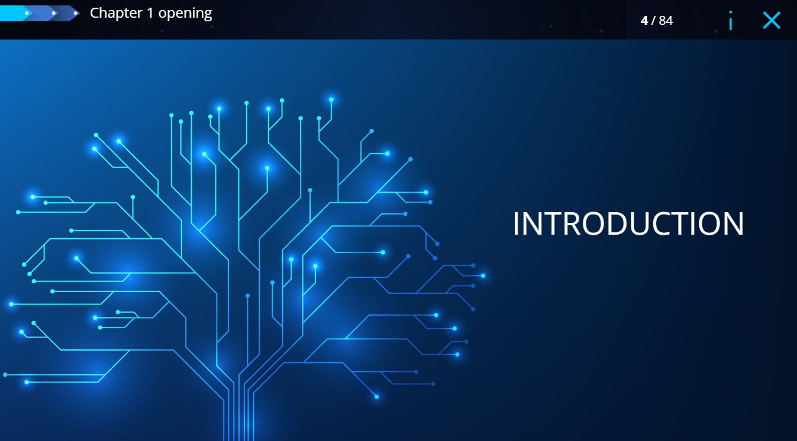
HELP module on Access to Justice in the Digital Environment

Slide 4
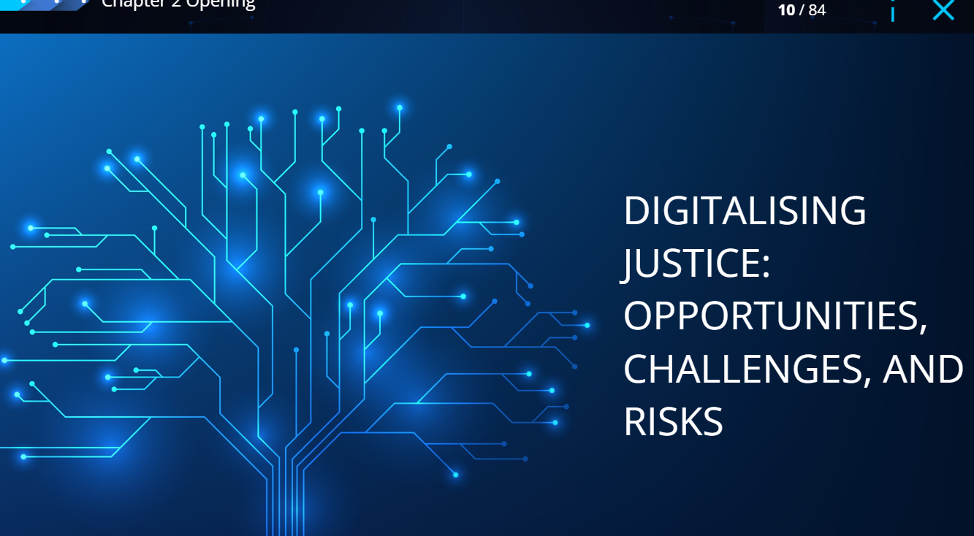
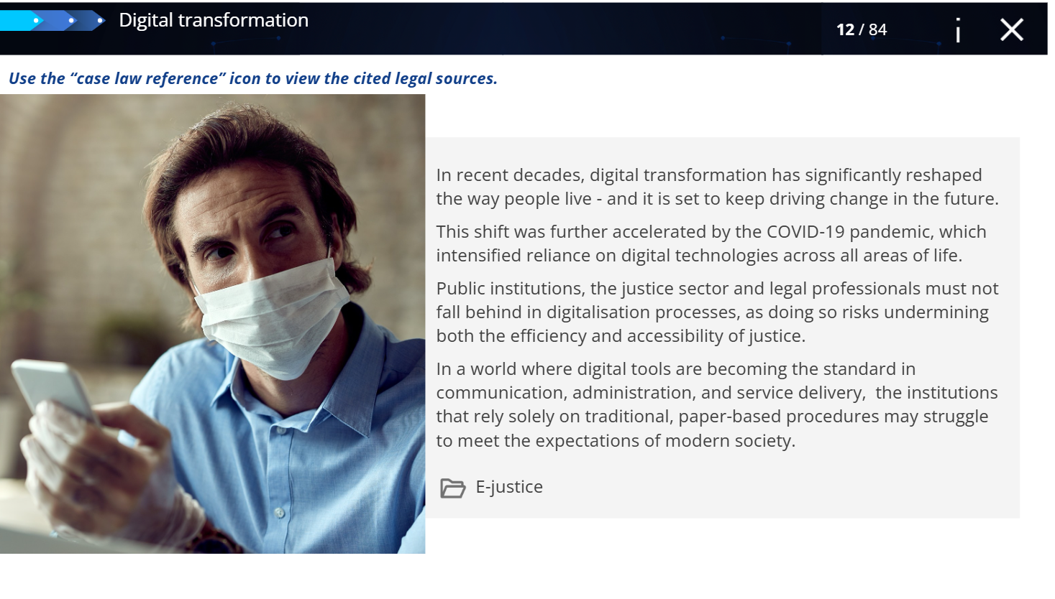
HELP module on Access to Justice in the Digital Environment

Slide 5
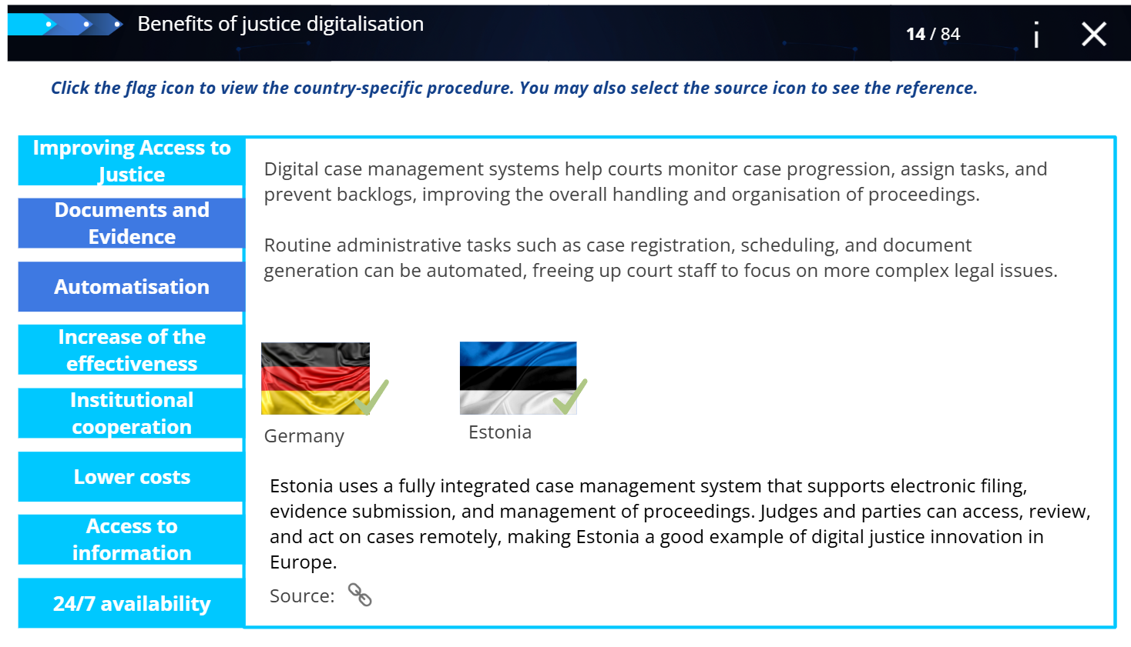
HELP module on Access to Justice in the Digital Environment

Slide 6
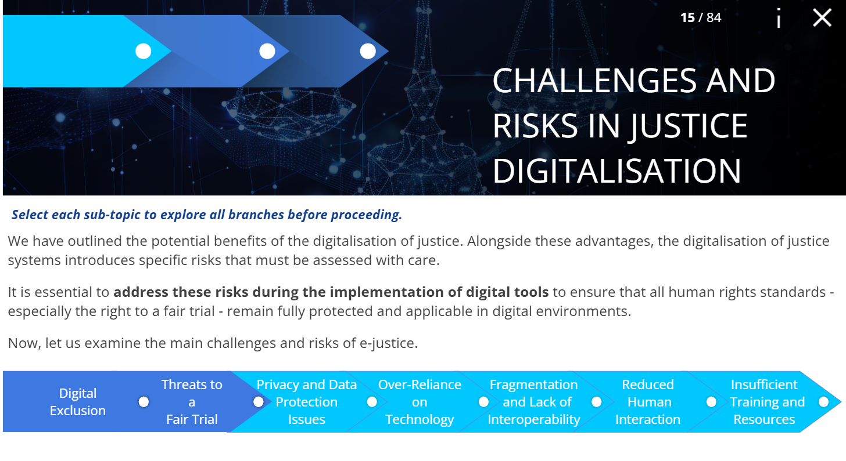
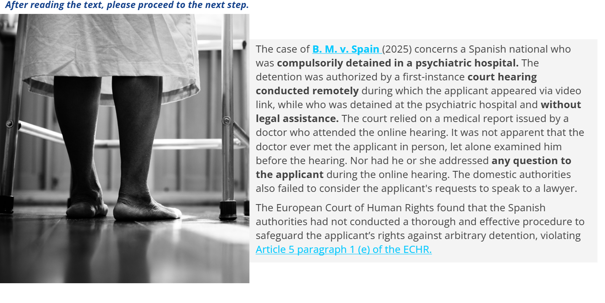
HELP module on Access to Justice in the Digital Environment

Slide 7
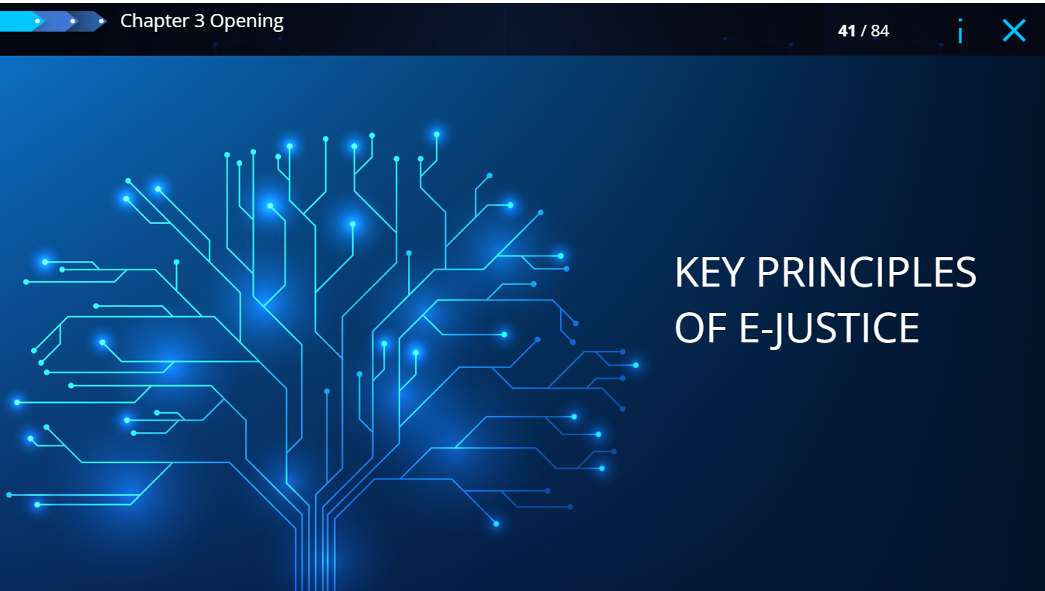
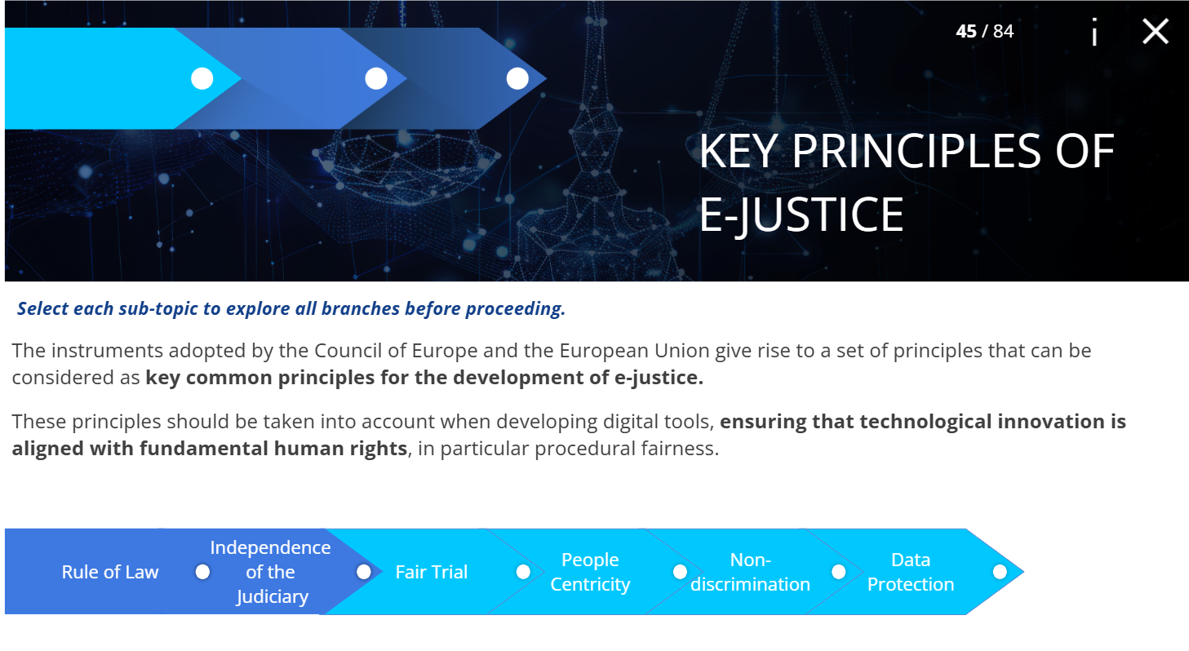
HELP module on Access to Justice in the Digital Environment

Slide 8
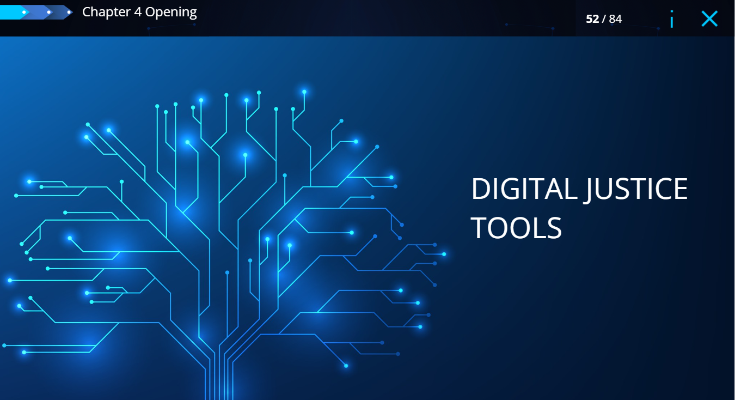
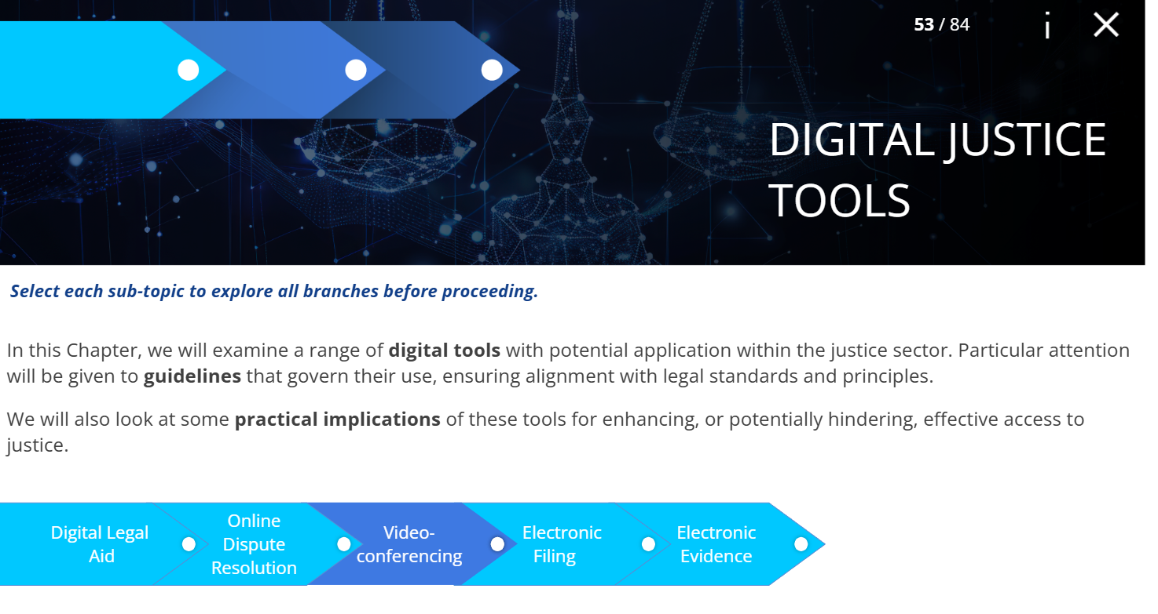
HELP module on Access to Justice in the Digital Environment

Slide 9
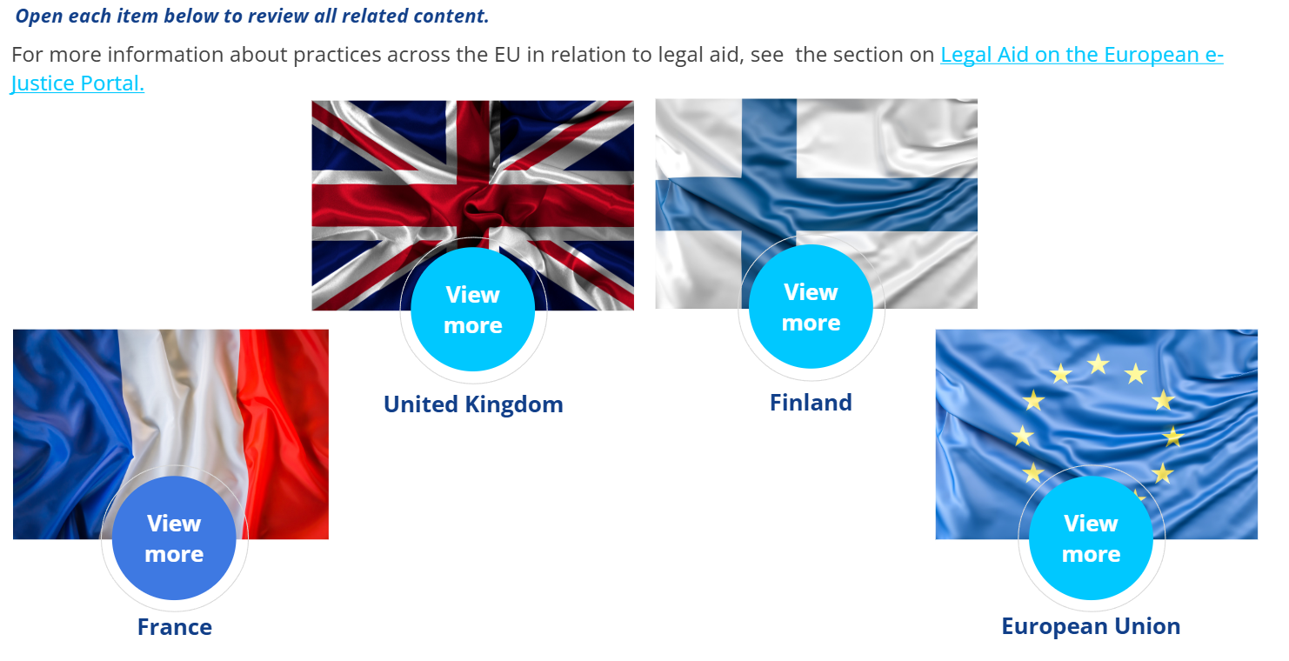
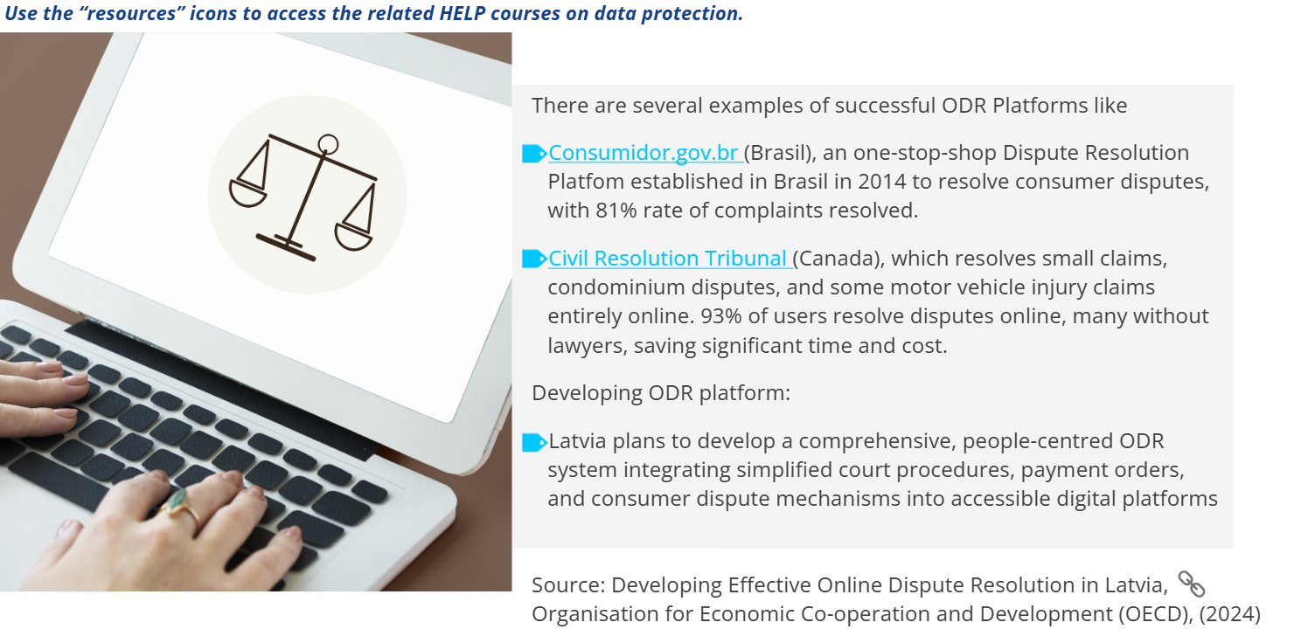
HELP module on Access to Justice in the Digital Environment

Slide 10
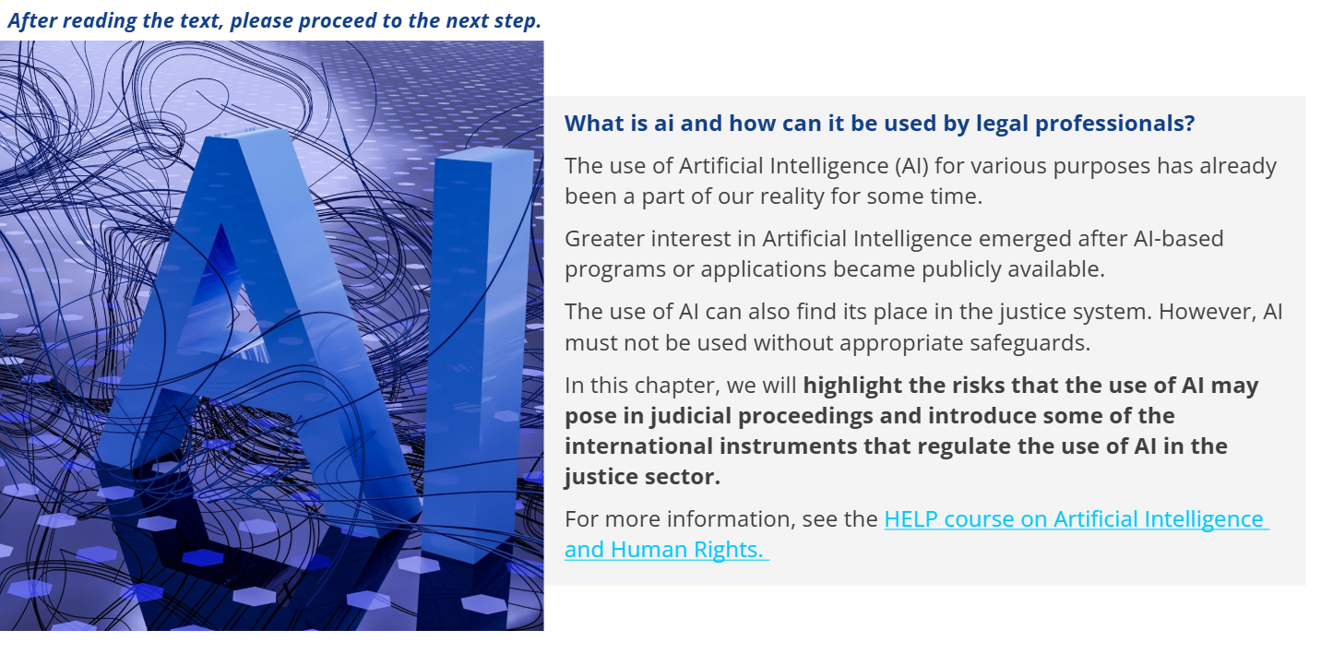
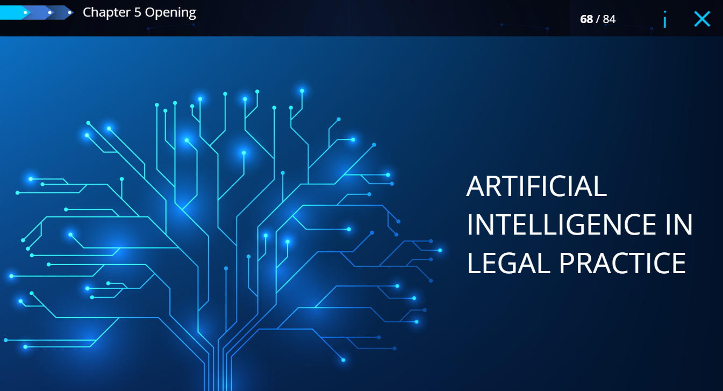
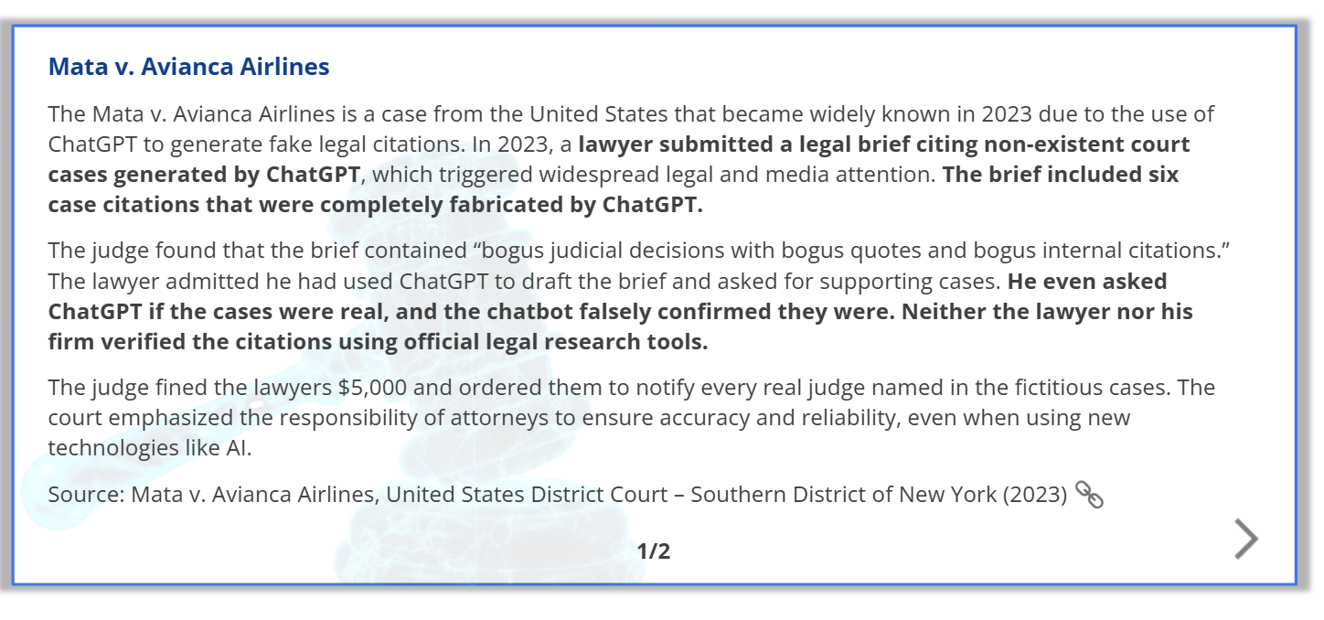
HELP module on Access to Justice in the Digital Environment

Slide 11
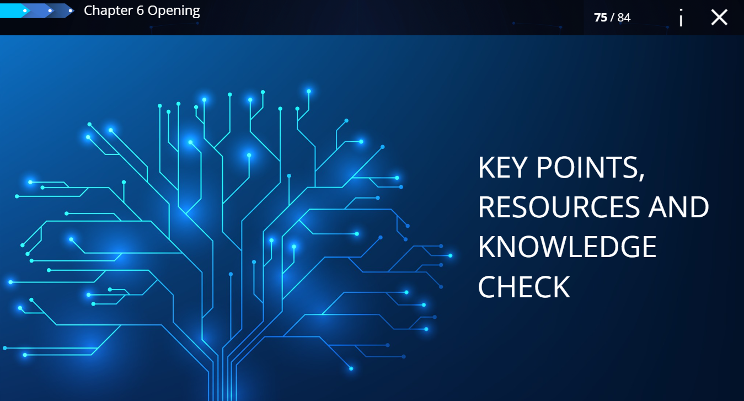
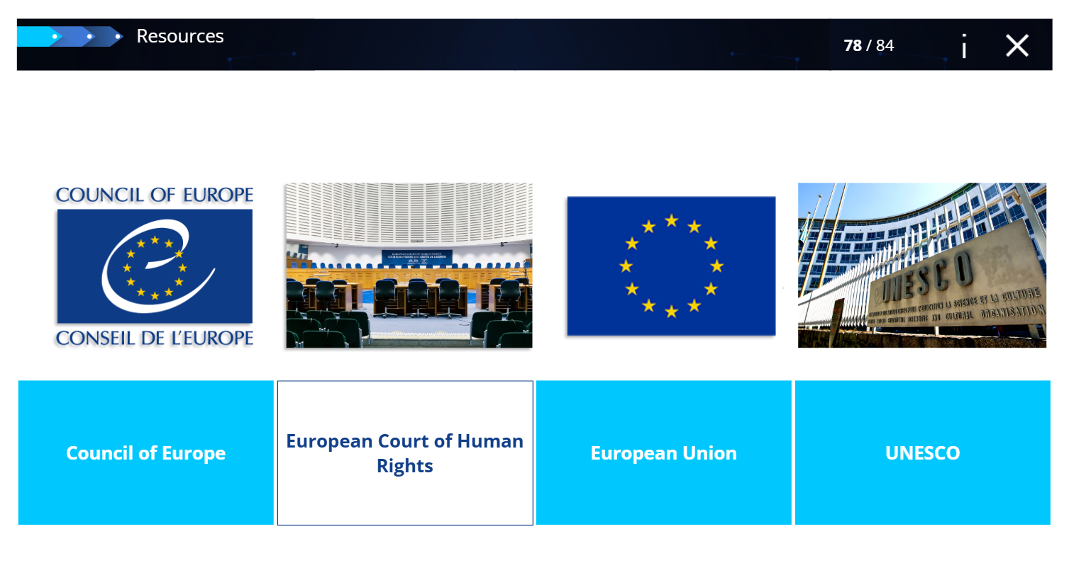
HELP module on Access to Justice in the Digital Environment

Slide 12
Human Rights Education
for Legal Professionals
HELP Annual Conference, 2026
HELP module on Children’s Rights
in the Digital Environment
Oana Gîrlescu

Slide 13

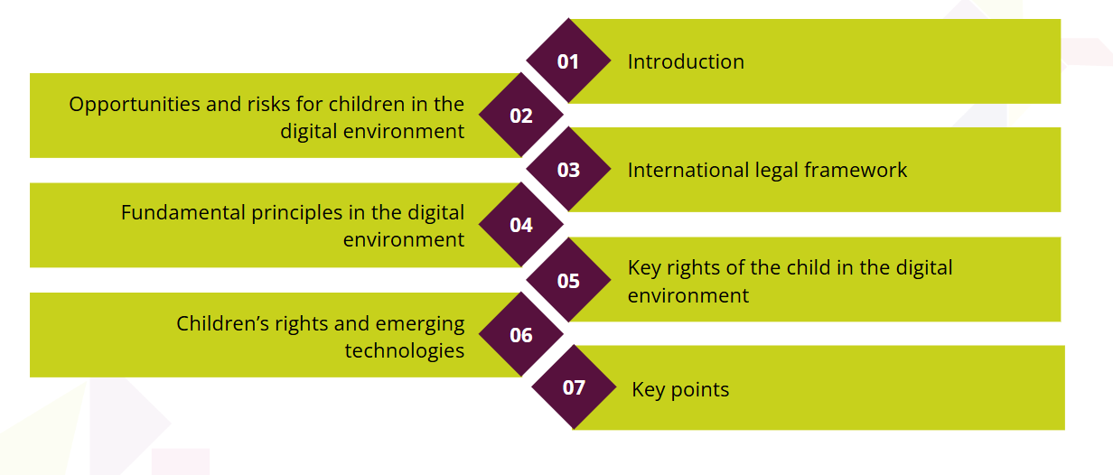
HELP module on Children’s Rights in the Digital Environment
Brief 1h 15

Slide 14
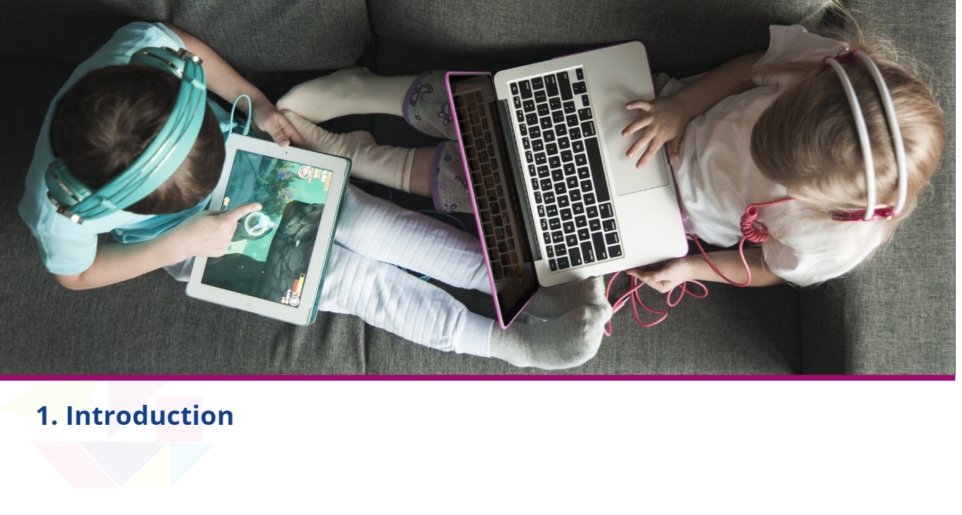
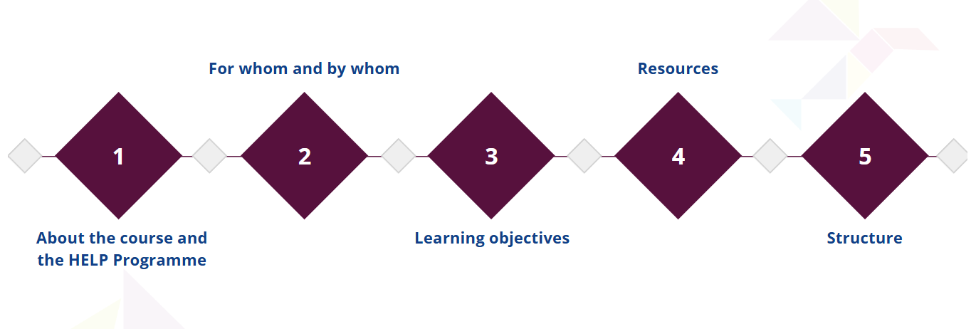
HELP module on Children’s Rights in the Digital Environment

Slide 15
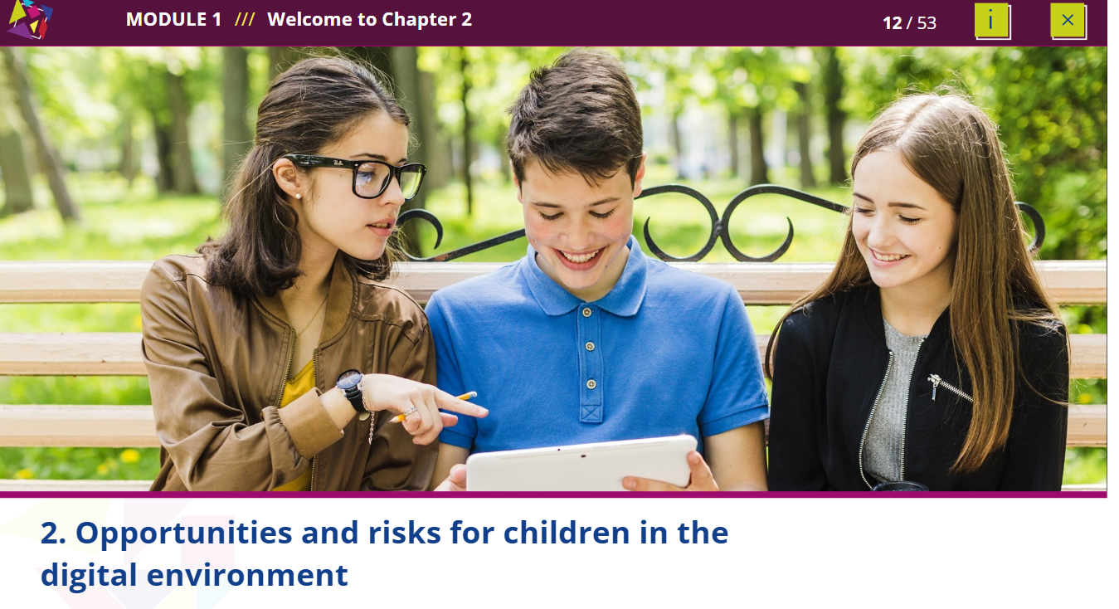


HELP module on Children’s Rights in the Digital Environment

Slide 16
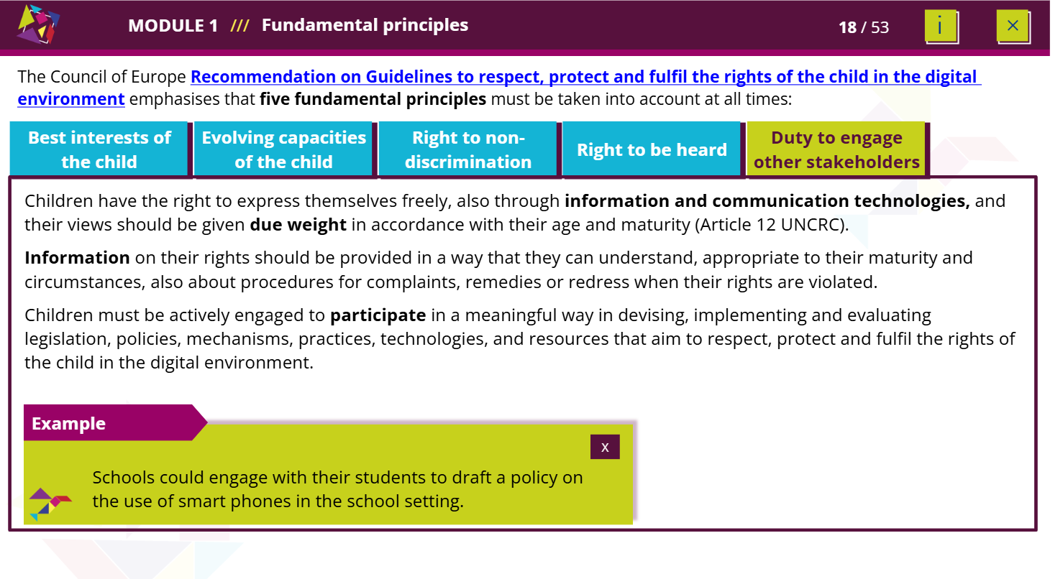
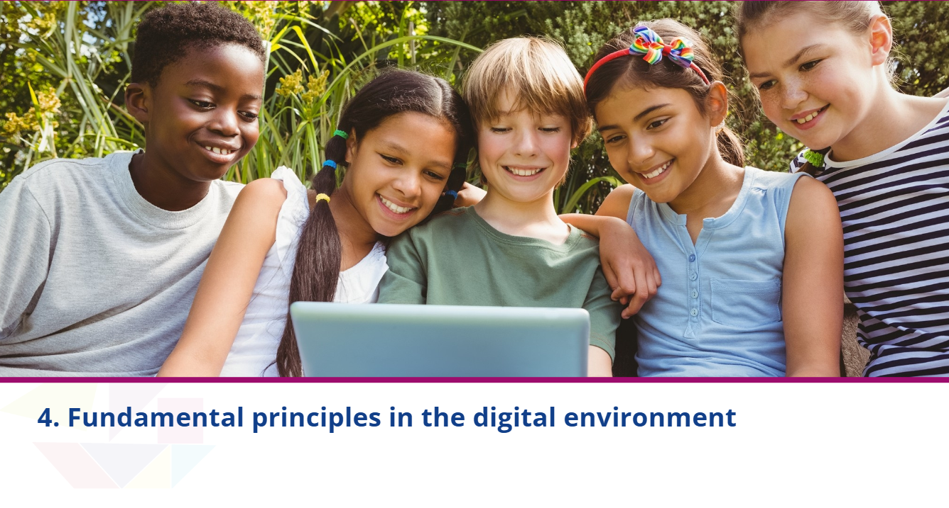
HELP module on Children’s Rights in the Digital Environment

Slide 17
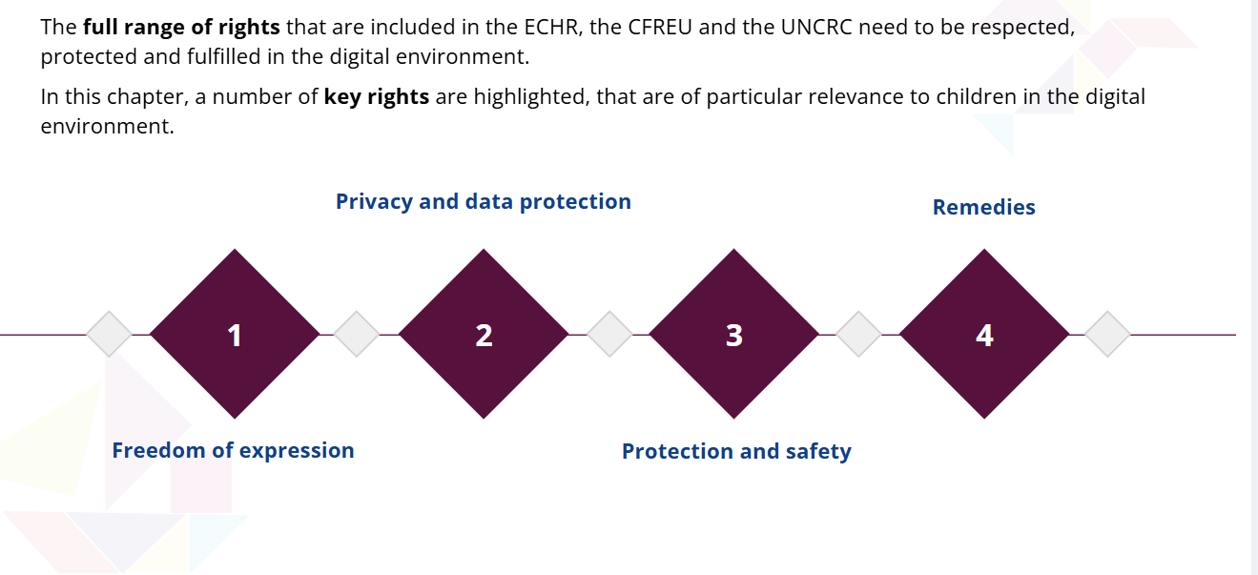
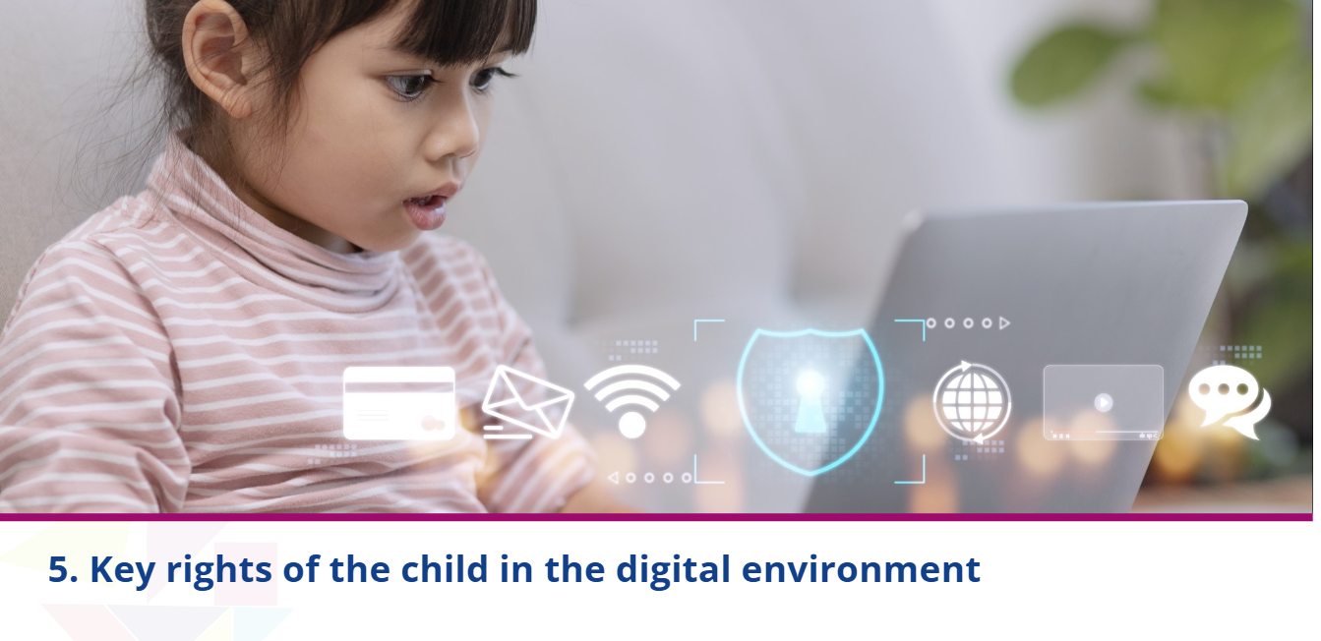
HELP module on Children’s Rights in the Digital Environment

Slide 18
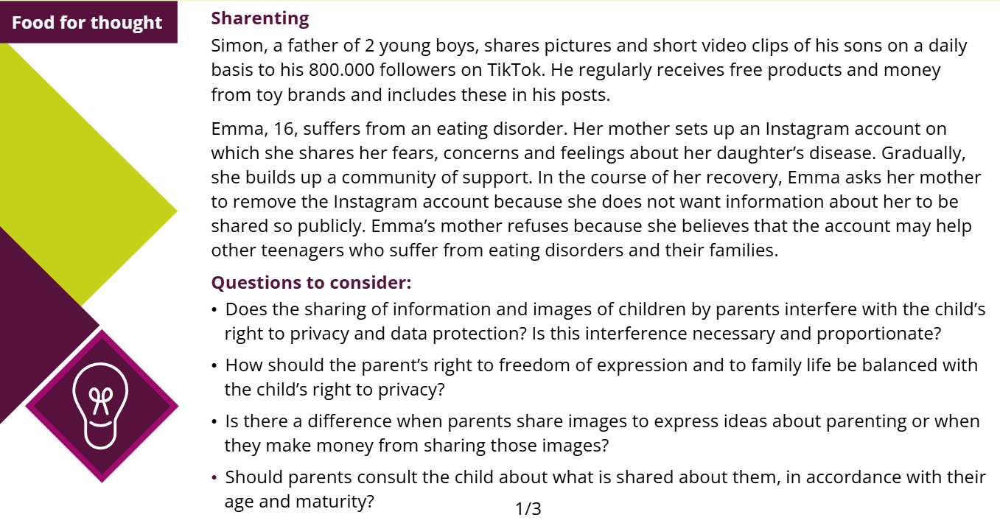
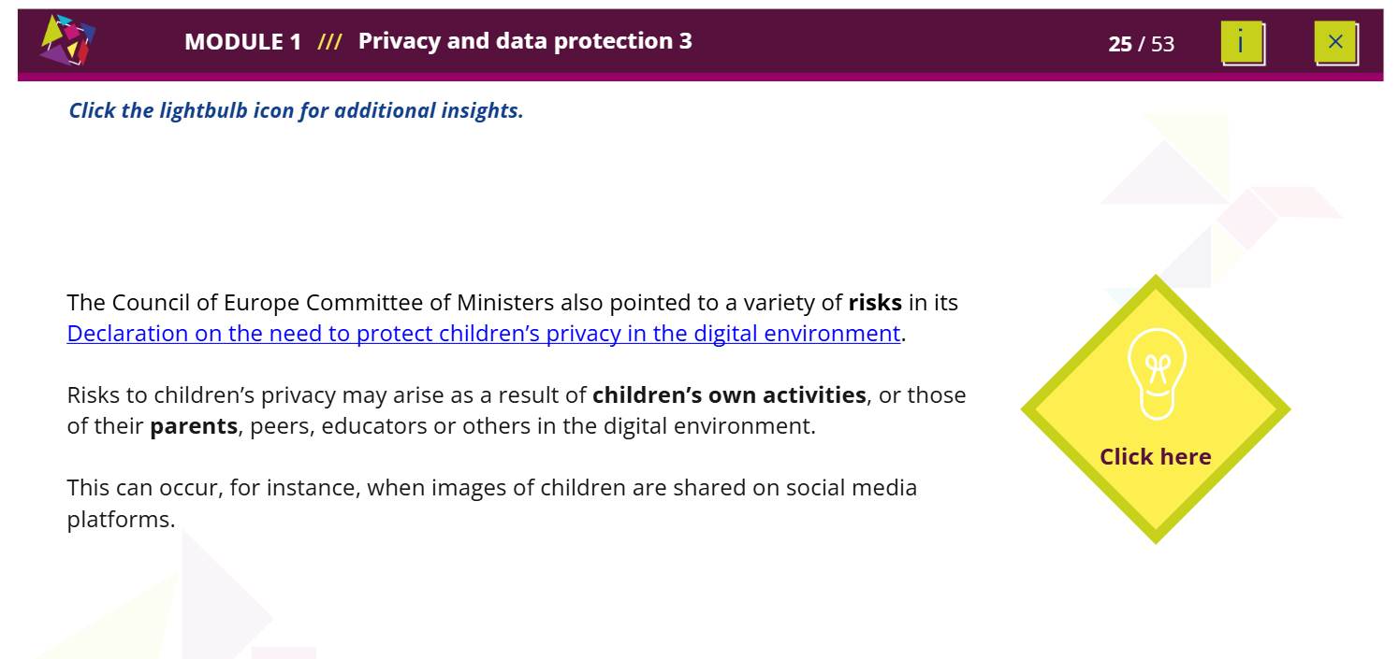
HELP module on Children’s Rights in the Digital Environment

Slide 19
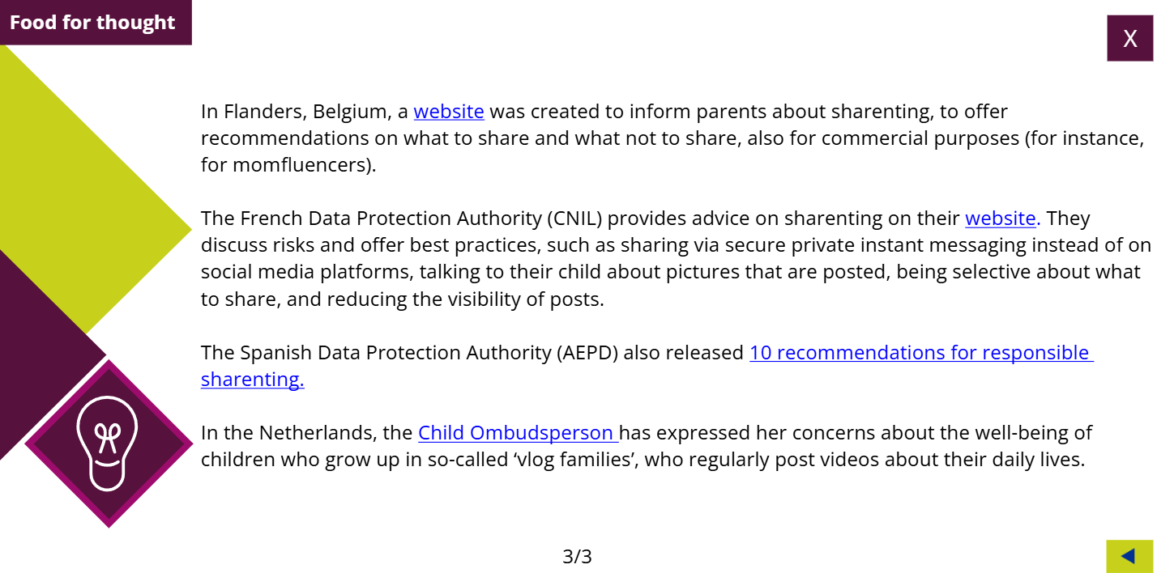
HELP module on Children’s Rights in the Digital Environment

Slide 20
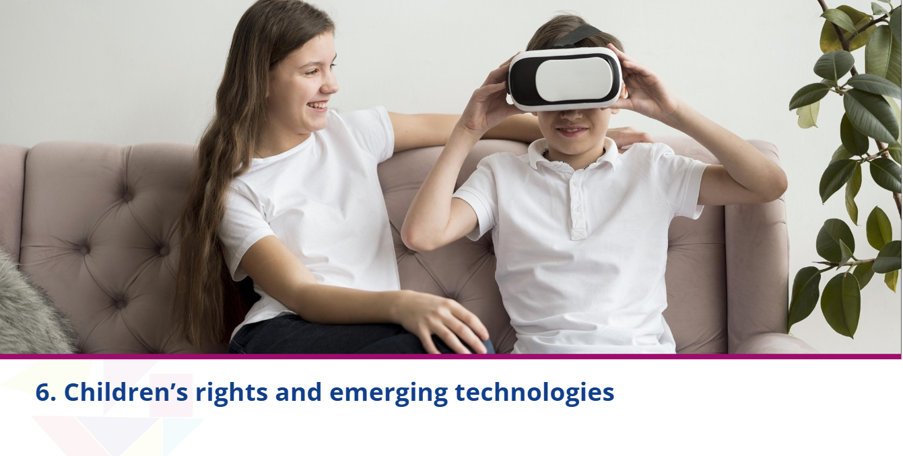
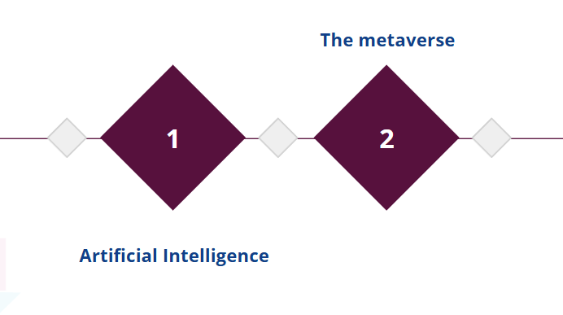
HELP module on Children’s Rights in the Digital Environment

Slide 21
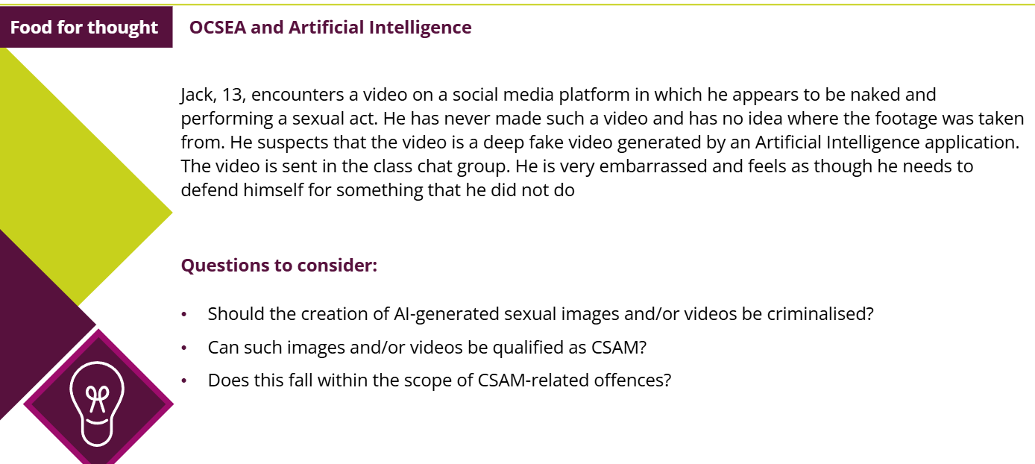
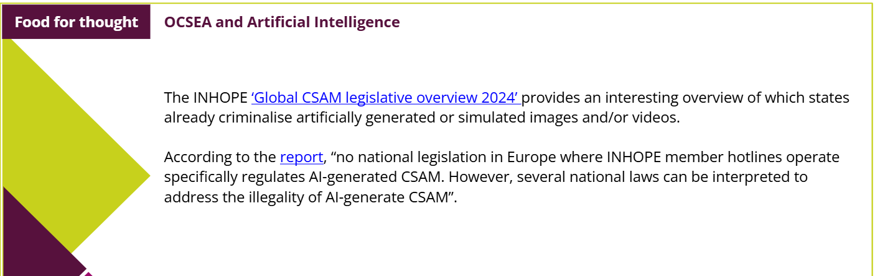
HELP module on Children’s Rights in the Digital Environment

Slide 22
HELP EU TEAM
Oana GIRLESCU (EU-CoE HELP in the EU IV Project Coordinator) oana.girlescu@coe.int
Eirini Pappa (EU-CoE HELP in the EU IV Project Assistant) eirini.pappa@coe.int
Thank you!

