Slide 1

Integrating HELP courses into university curricula – the Spanish experience
Eva Massa Arranz

Slide 2

Why?
University students are the future legal professionals.
Lacuna in traditional studies.
Interest in current topics: cybercrime; AI; freedom of expression; hate speech…
Learning + certification.

Slide 3



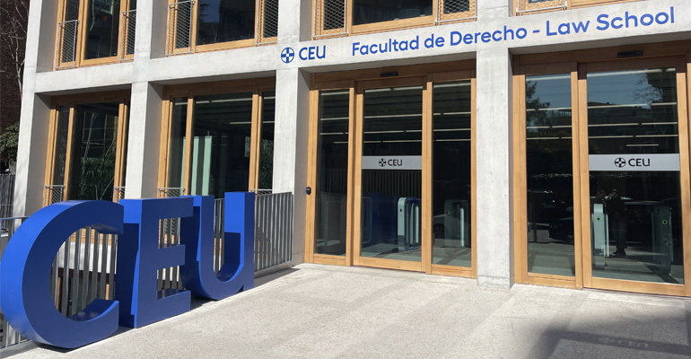
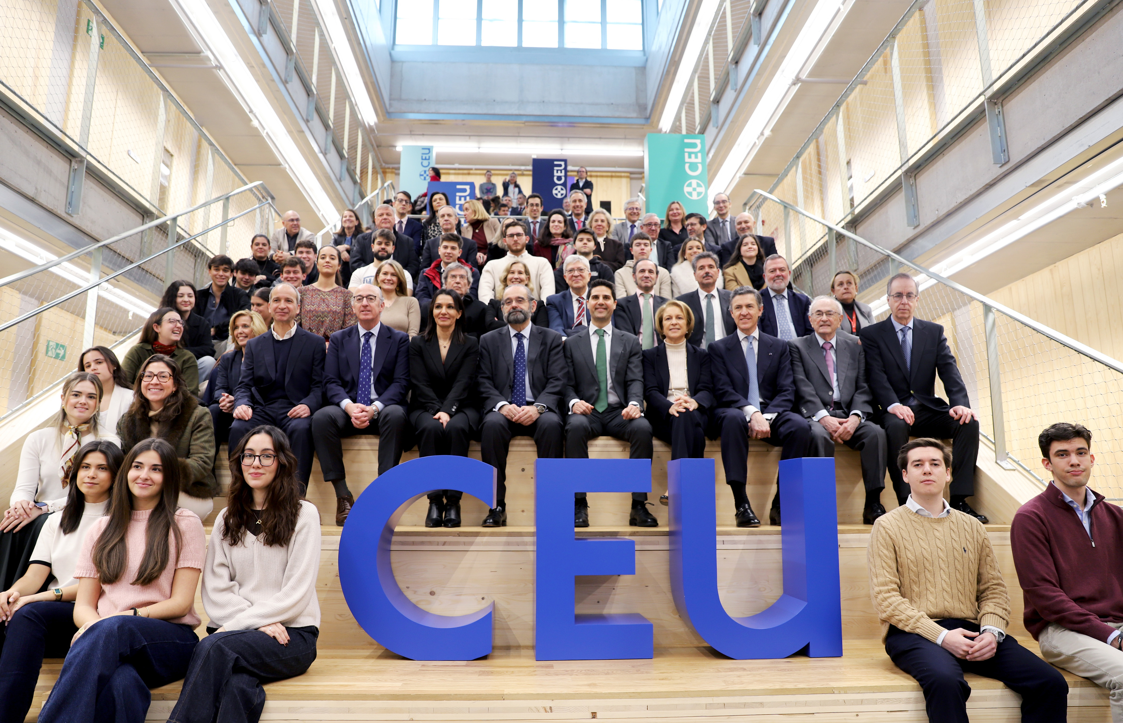
How?
1

Slide 4


How?
Degree in Law, International relations & EU. 2025/2026.
Cybercrime (EN)
5ft year students
Security & Defence.
Eva Massa Arranz
Cybercrime (ES)
2nd year students
Public International Law
Antonio Alonso
Freedom of Expression (ES)
5ft year students
Europe beyond the EU. Neighbourhood
Luis Rodrigo de Castro

Slide 5
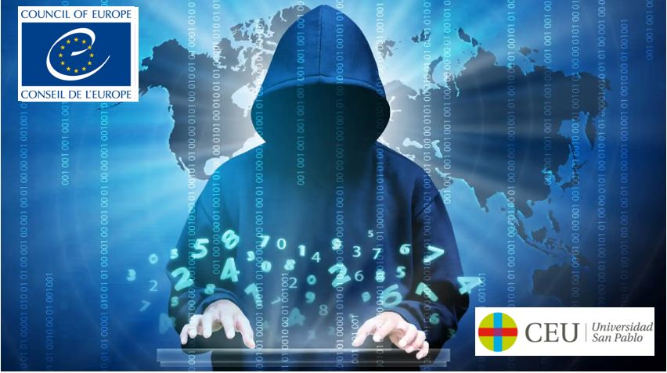
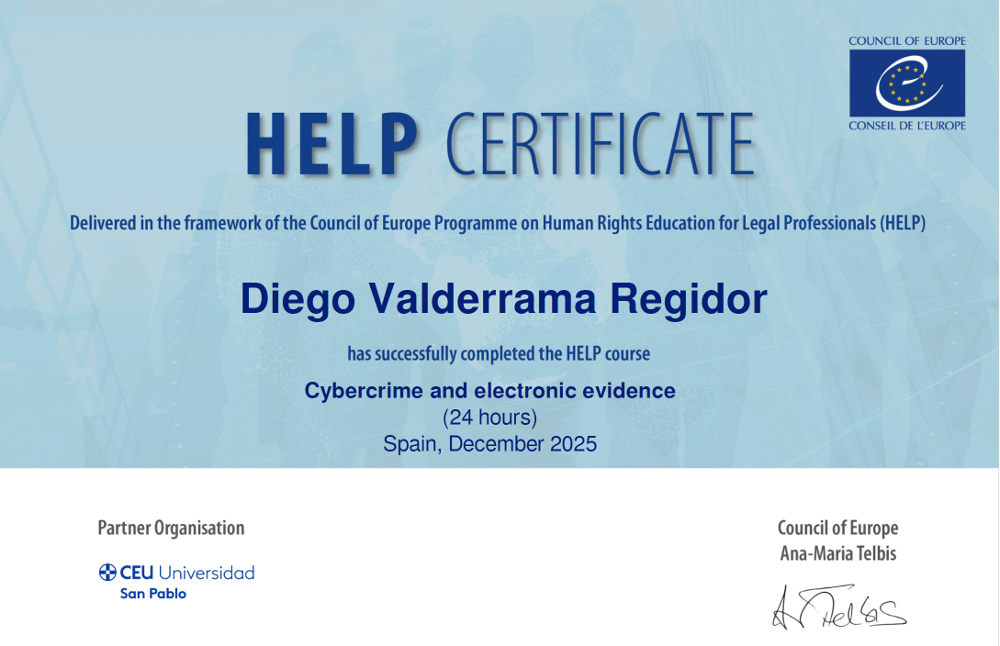
How?
Self-learning version.
Integrated in the official curriculum.
Complementary to modules´ topics. (20%).
Guided/monitored by tutor.
Final assessment.
Certificate of accomplishment signed by CoE & CEU.
Course open for research.

Slide 6
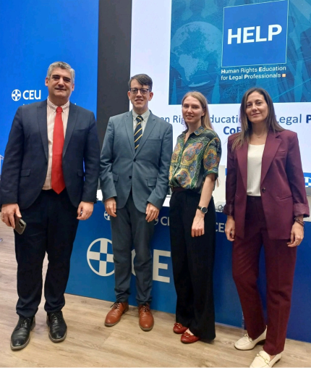
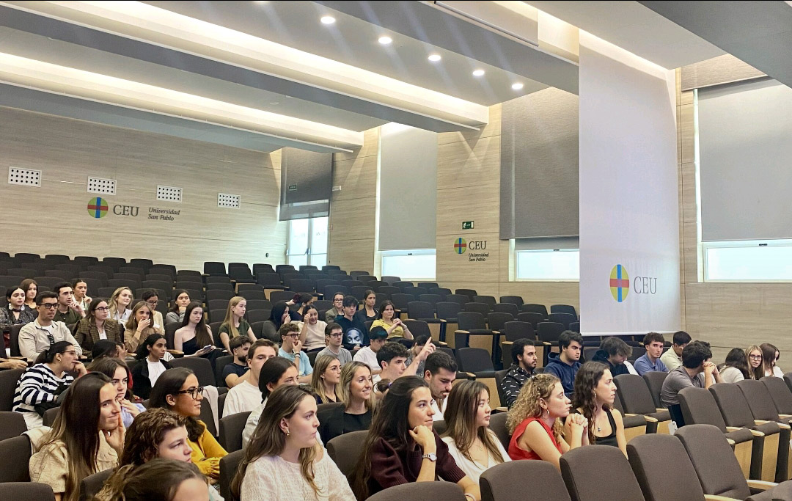
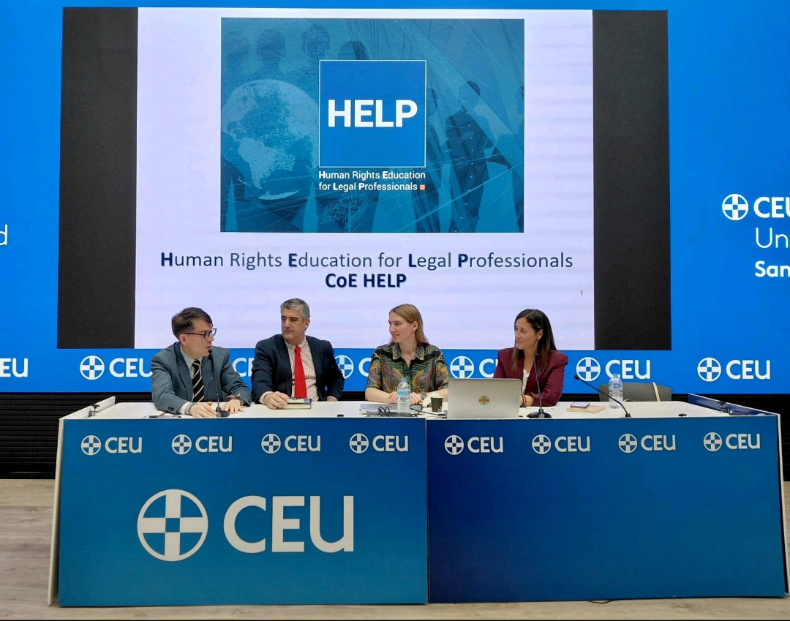
The launch (Madrid, 30/09/2025)

Slide 7

Challenges
Agreement between CoE & university.
Level of knowledge.
Tutor´s skills & commitment.
Adaptation.
Forum.
Assessment.

Slide 8
Results
103 students
Familiarised with CoE
86,91% Success rate
Helped research final thesis
Learned about the topic
Self-learning & time management

Slide 9
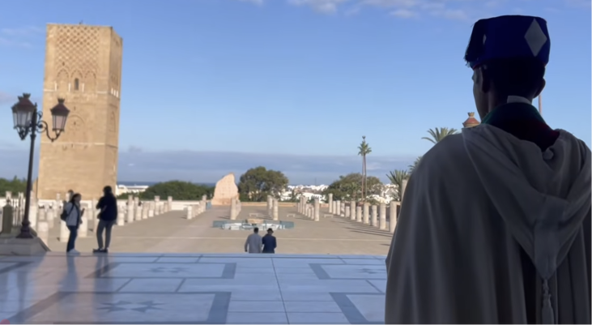
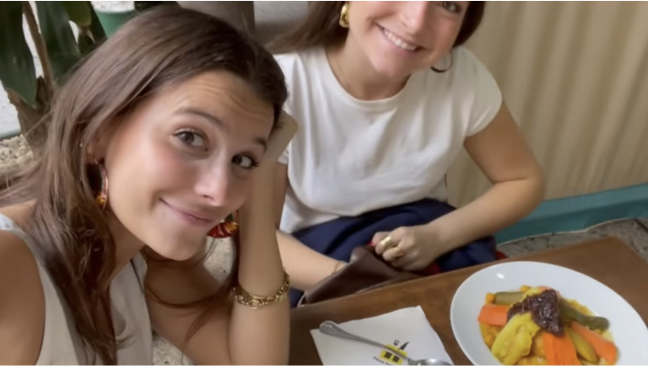
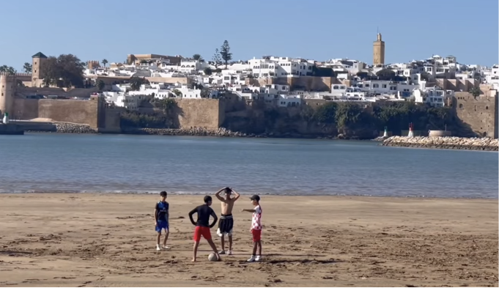
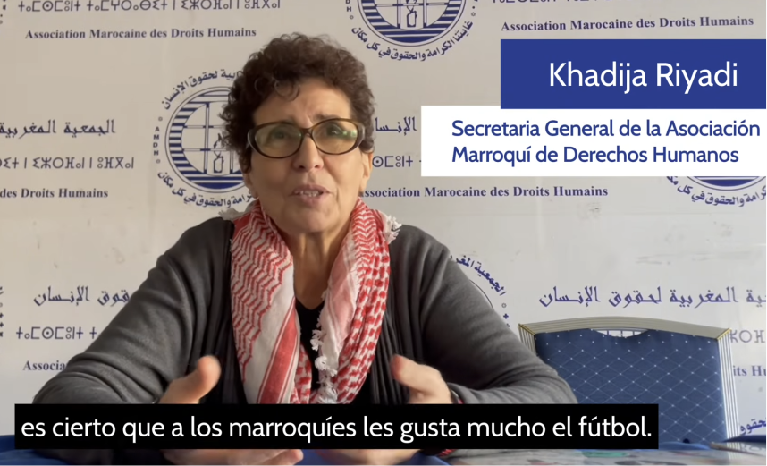
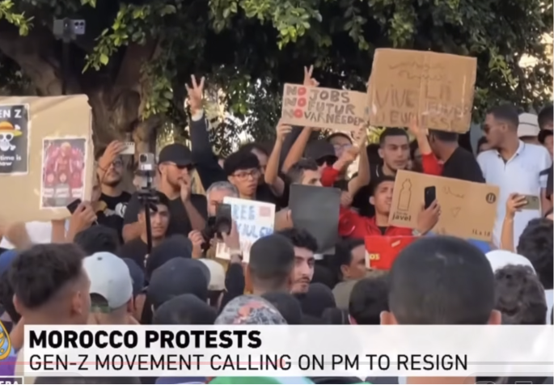
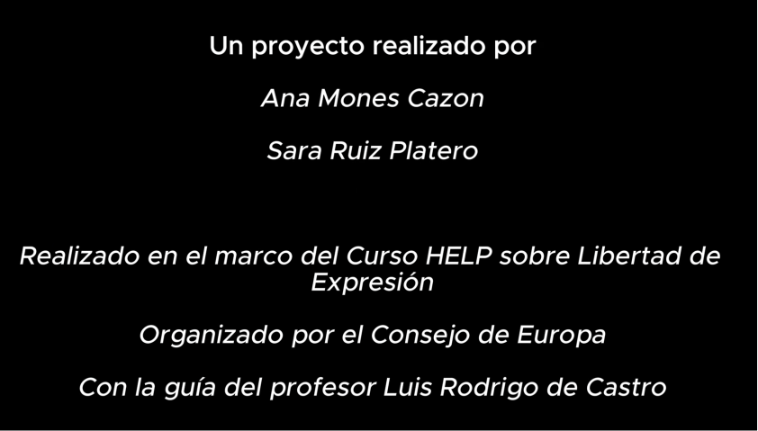
UN PAÍS A LA ALTURA DE SU GENTE | Reportaje sobre las protestas de la Generación Z en Marruecos
(A COUNTRY THAT LIVES UP TO ITS PEOPLE | Report on the Generation Z protests in Morocco)

Slide 10
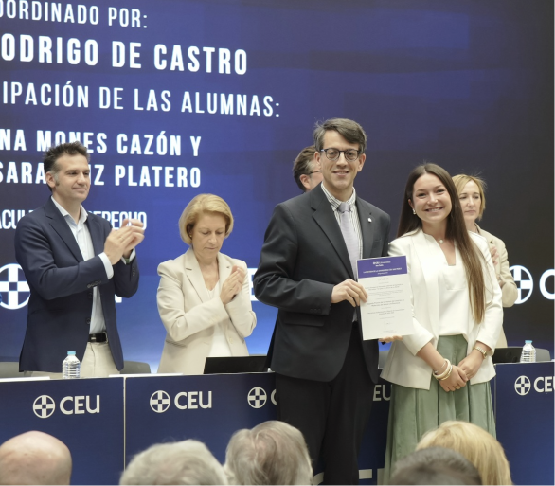
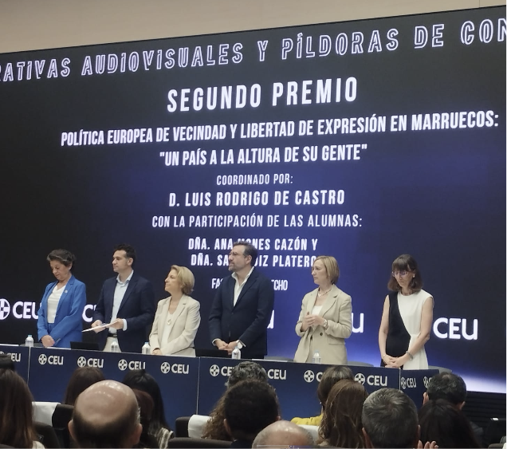

Slide 11

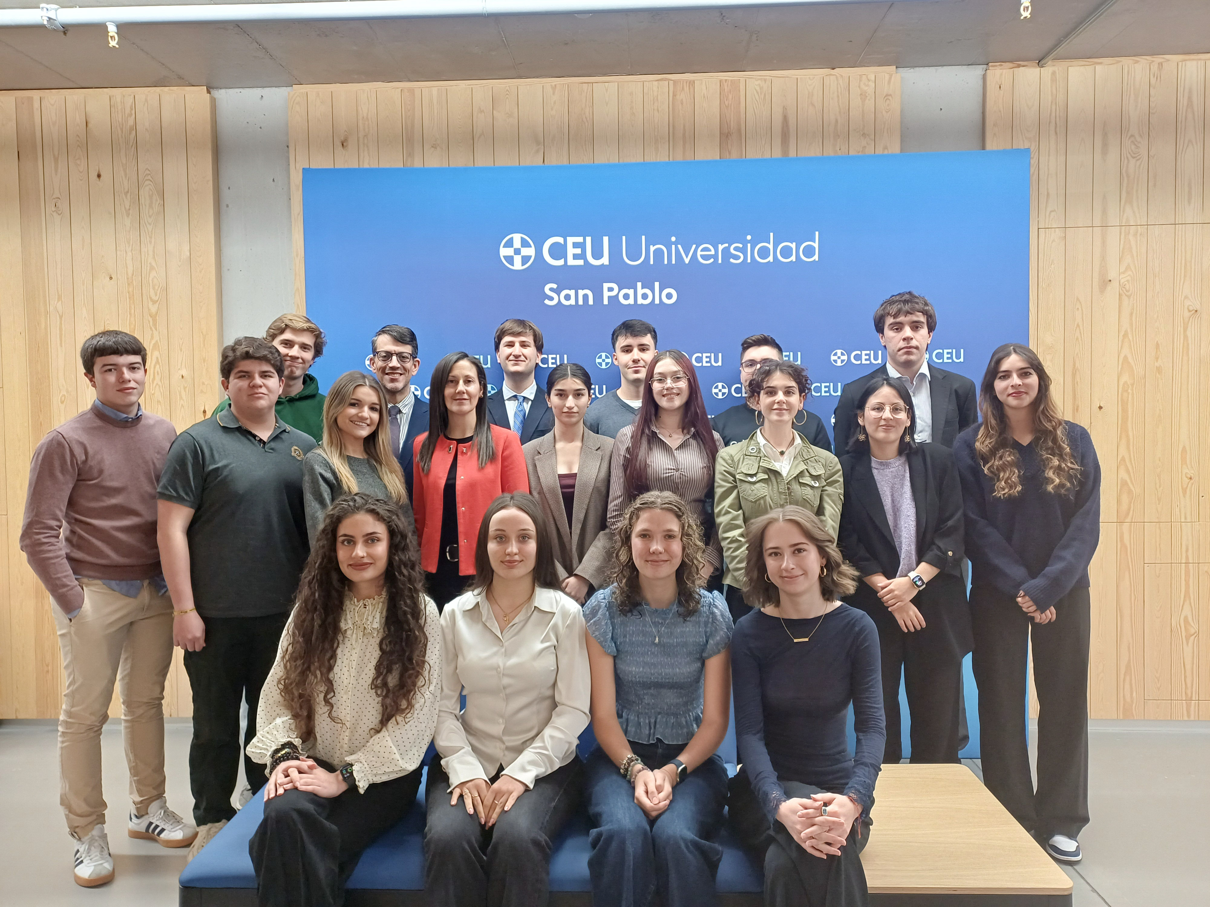
Next steps
AULA Council of Europe
Cooperation IRE-UKR-SPA
New HELP Courses 2026/2027

Slide 12
"That the powerful play goes on, and you may contribute a verse. What will your verse be?“
(Dead Poets Society)
Thank you!

