Slide 1
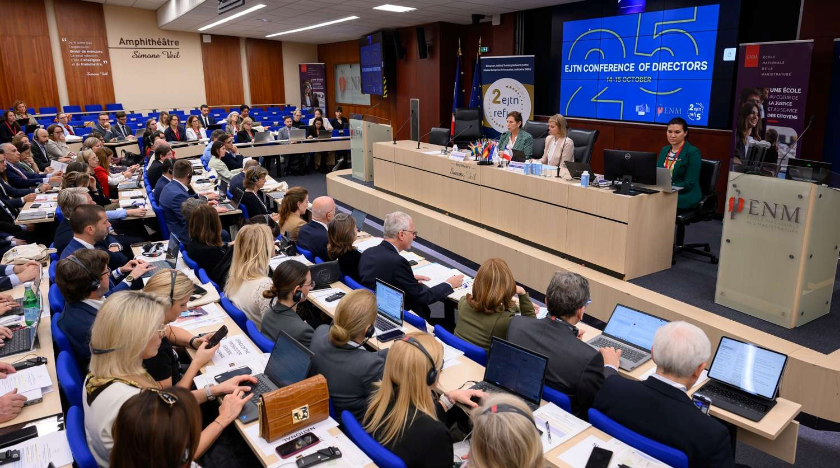


EUROPEAN JUDICIAL TRAINING NETWORK
Contributing to a strong Europe of Justice
HELP CONFERENCE, 2-3 JULY 2026, Strasbourg

Slide 2
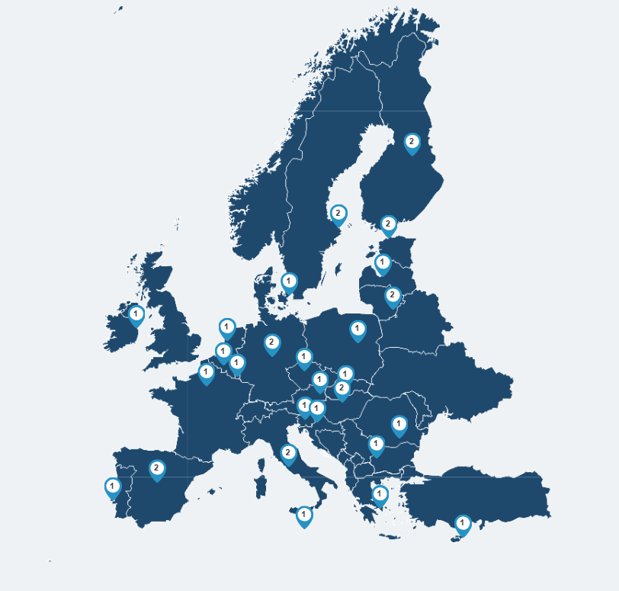
Who we are
Coordinator of judicial training
Supporter of European judicial culture
Driving force for training innovation
Bridge between national judiciaries
Promoter of the Rule of Law
Notes:
Coordinator of judicial training
EJTN is the leading authority in promoting and coordinating high-quality judicial training to European justice practitioners
Supporter of European judicial culture
EJTN encourages cooperation and knowledge sharing to build a shared European judicial culture across EU Member States
Driving force for training innovation
EJTN develops and tests innovative training formats and methodologies to respond to evolving needs in justice systems
Bridge between national judiciaries
EJTN connects national judicial training institutions to foster dialogue, convergence and long-term cooperation
Promoter of the Rule of Law
EJTN contributes to the protection of the Rule of Law by fostering a shared understanding of European legal standards and judicial values

Slide 3
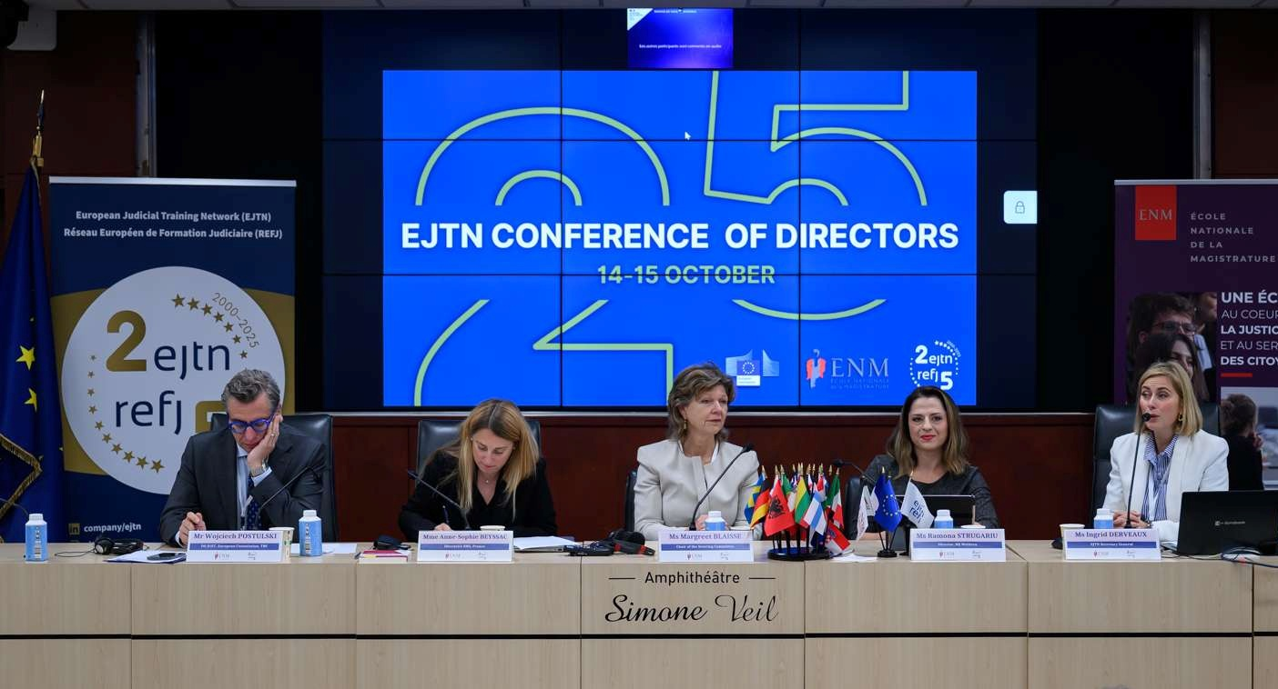
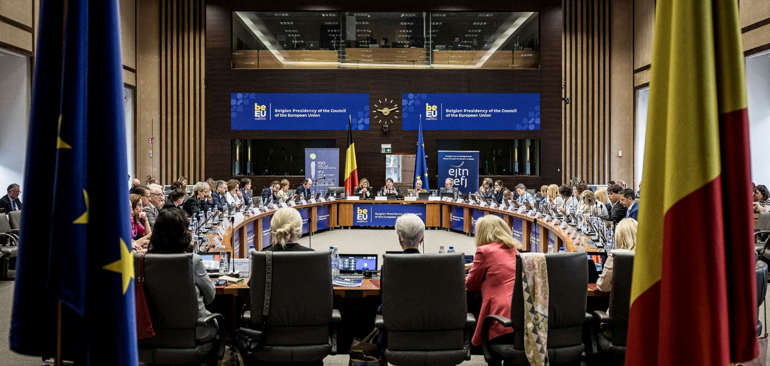

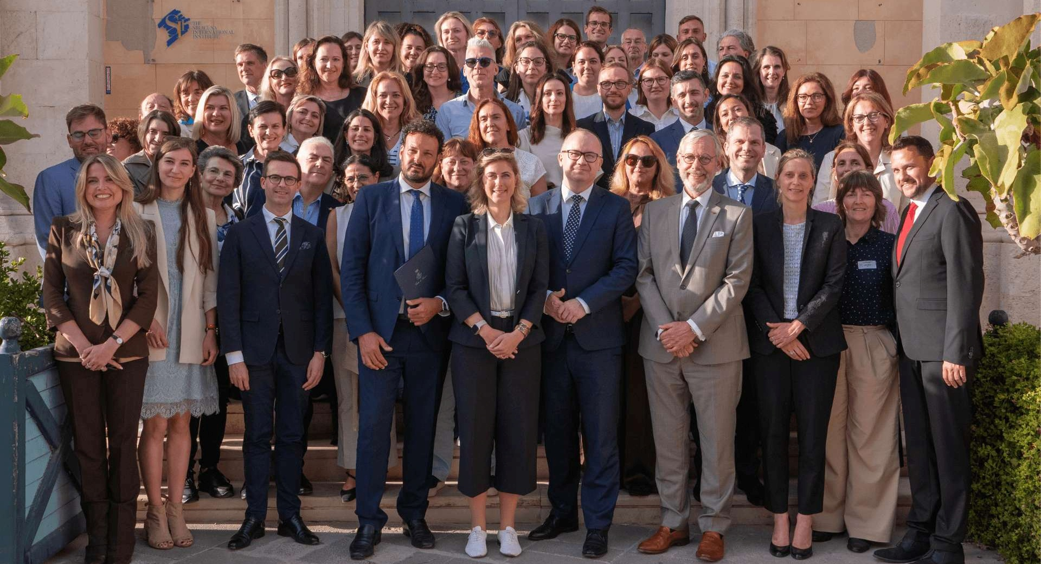
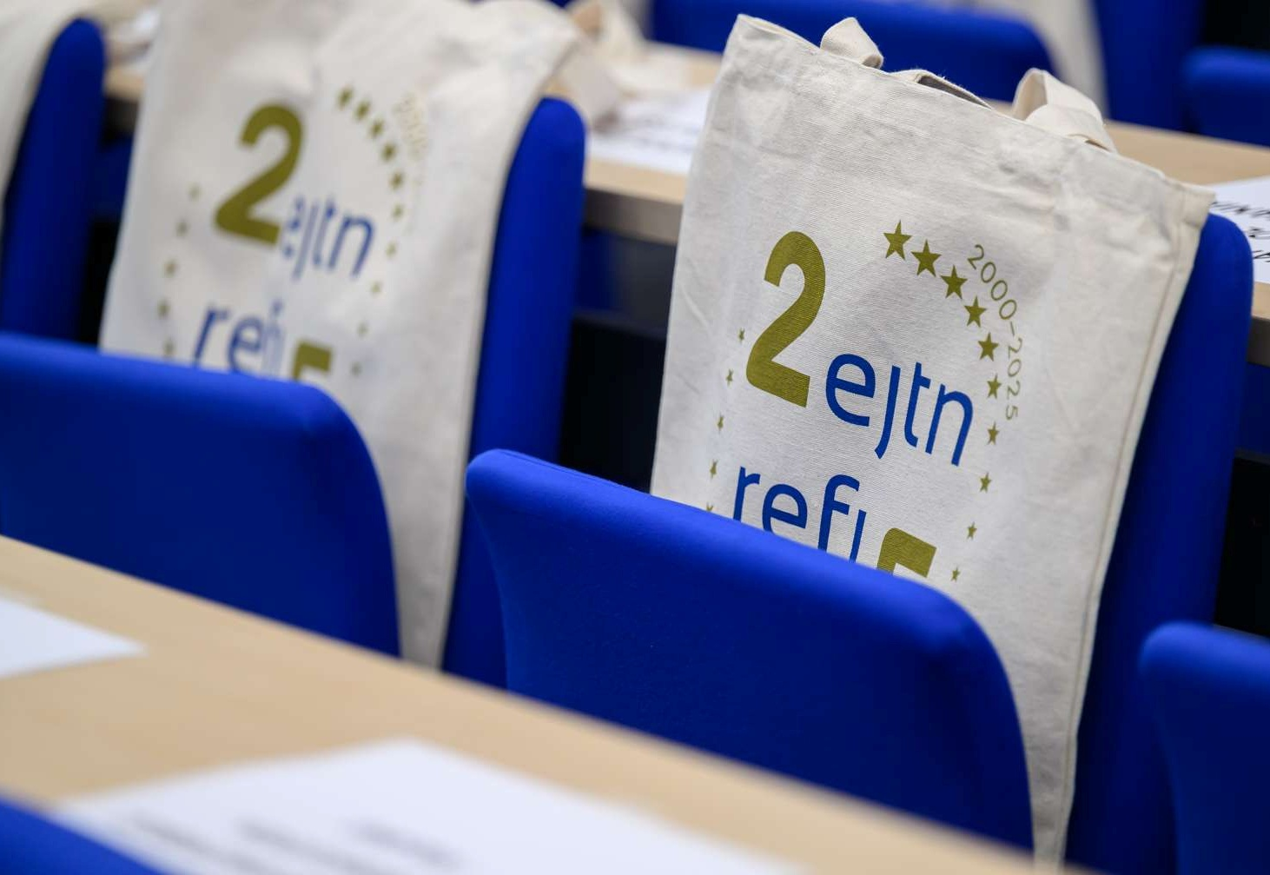
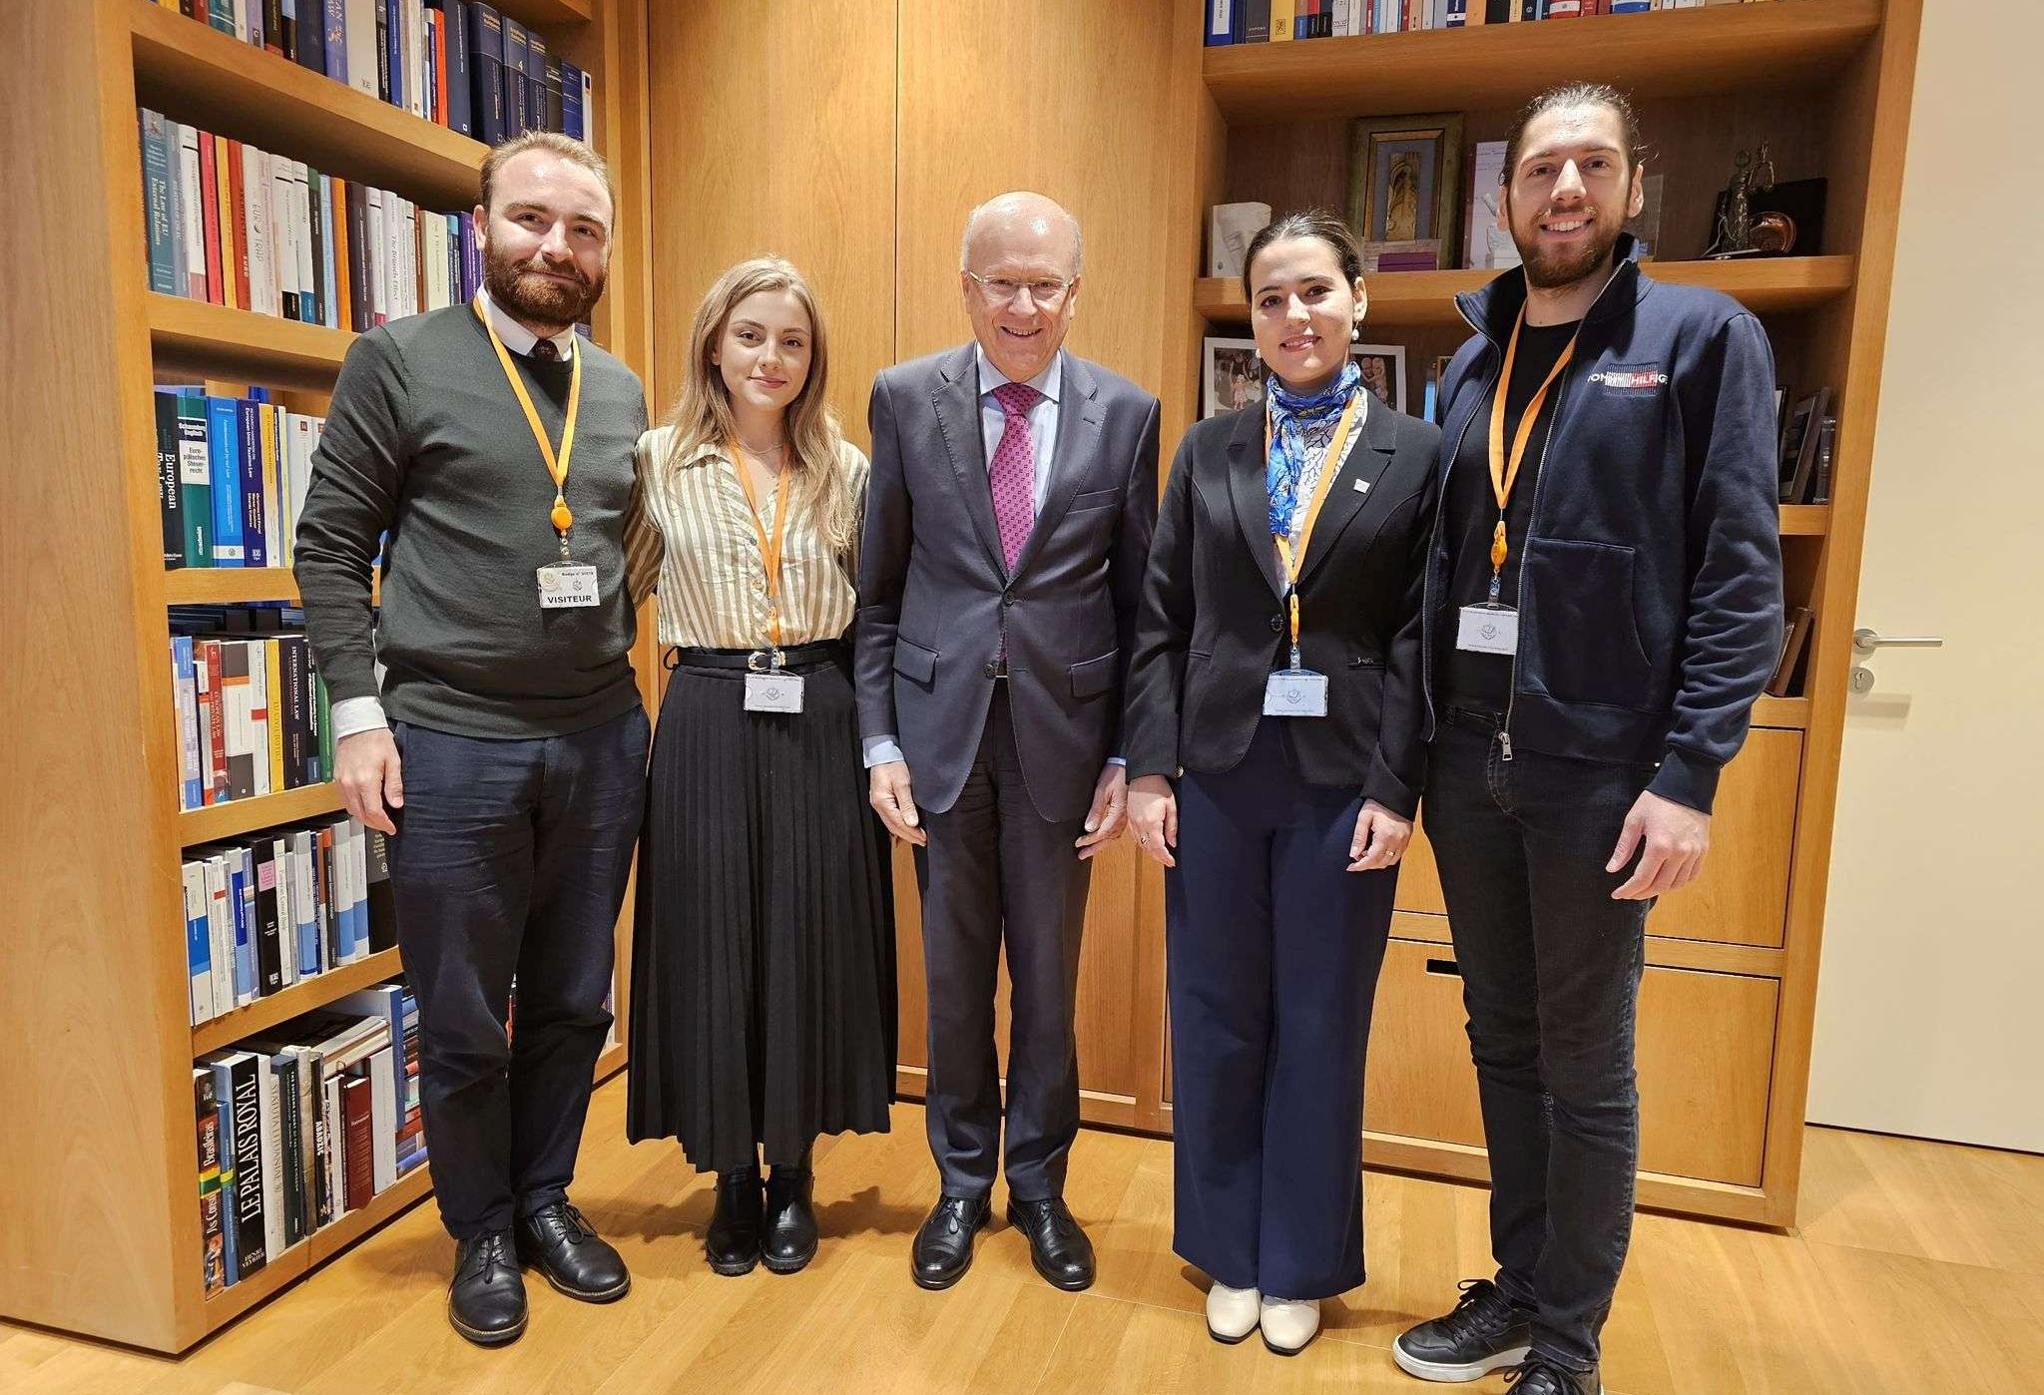
In 2025
We trained
13,915 justice practitioners, including
5586 judges
We organised
947 training activities
We facilitated
38,452 training days

Slide 4
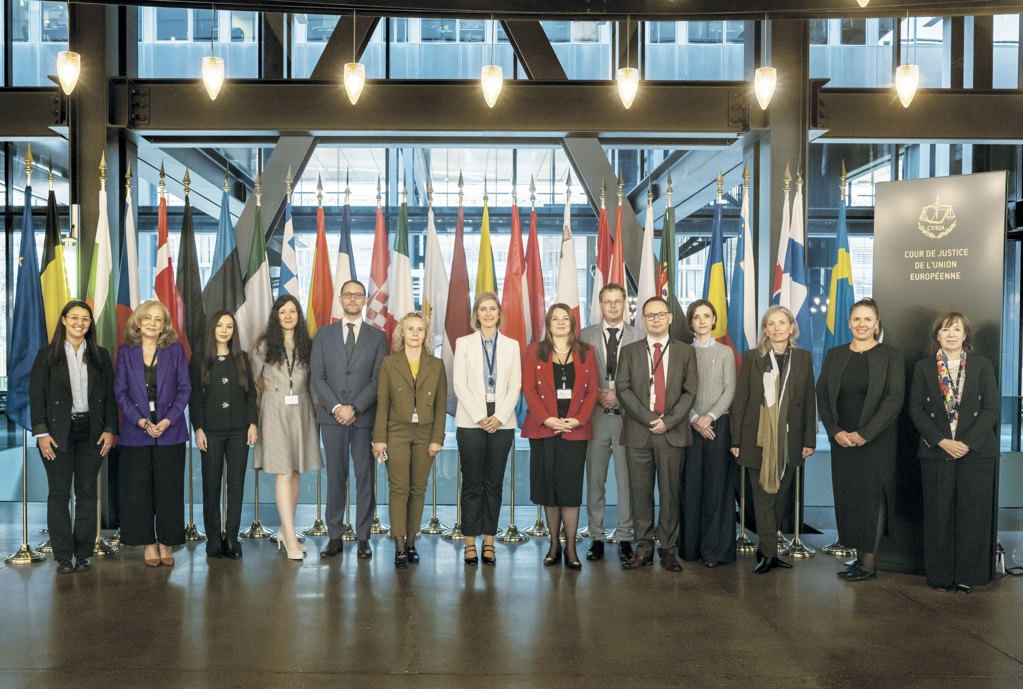

Partnerships
Around 30 partnerships with different European institutions, networks and organisations
Tailored cooperation and bilateral agreements support high-quality European judicial training
Strategic collaboration creates tangible impact through learning materials and participation in relevant events, such as the EJTN Training Needs Assessment
Key partners include the European Commission, the CJEU, the EPPO, Eurojust, Council of Europe, the HELP Network, CEPOL, FRA, JNEU, EUAA, GEMME, ENCJ, EAJ...

Slide 5
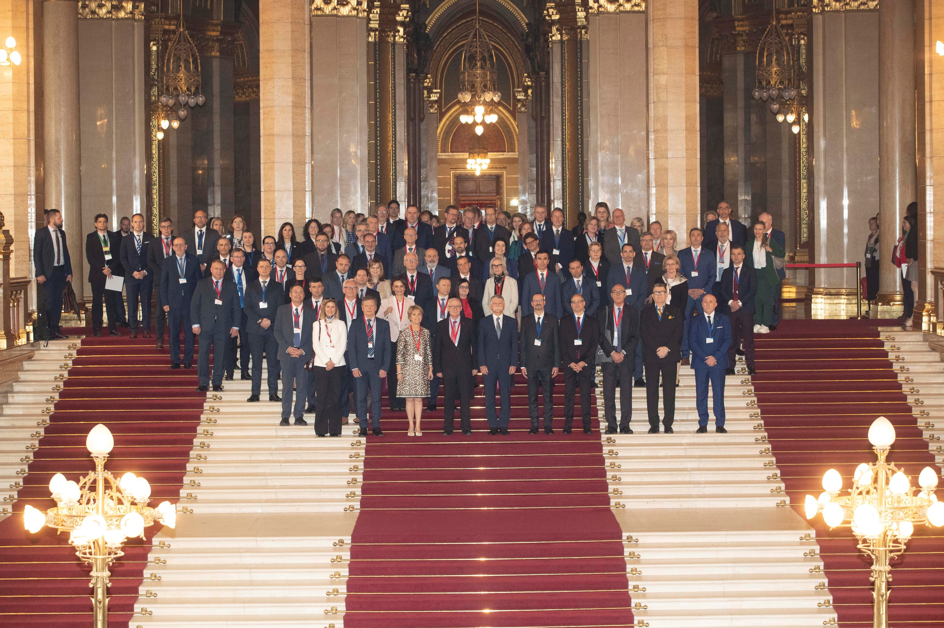
EJTN & Council of Europe HELP Programme – a strategic partnership
Long-standing cooperation: EJTN and HELP have maintained a long-term partnership focused on judicial training and human rights education.
Main pillars of cooperation: The partnership includes joint seminars, e-learning, AIAKOS Programme, EJTN Digital Ambassadors Programme; Judges@Europe Forum
Audience and strategic value: Targeted at judicial institutions and partners, the partnership supports the rule of law and digitalisation of justice.
Shared commitment to Rule of Law: Strengthen the rule of law, foster a common European judicial culture, and support justice professionals in a rapidly evolving legal landscape, including digitalisation and AI challenges.

Slide 6
Mutual governance engagement: HELP and EJTN maintain strong governance ties through regular participation in assemblies, committees, and network conferences.
Flagship e-Learning course: The 'Judges Upholding the Rule of Law' e-learning course covers accountability, ethics,and digitalisation in justice.
HELP e-learning for initial training : EJTN's AIAKOS participants access a dedicated e-learning course on AI impact in the judiciary through HELP cooperation.
HELP e-learning for EJTN digital ambassadors: certification of 132 digital ambassadors in 2025.

Slide 7
Digital Justice: Equipping the judiciary for the digital era​
1. Digital training & tools:
innovating HOW we train
● Innovative formats
  Blended learning combining face-to-face, webinars, e-learning, podcasts, learning videos and gamified content on EJTN's Moodle.
● NEW consumer protection game (April 2026)
  Serious game by the Civil Law SWG illustrating how EU consumer law applies to online shopping, travel, refunds and cross-border disputes — "Consumer law has never been this fun".
● E-learning with HELP
  Joint courses such as 'Judges Upholding the Rule of Law' and an AI course, accessible via EJTN's Moodle and the CoE HELP platform.
● Digital tools for cooperation
  Use of e-CODEX, JITs Collaboration Platform, videoconferencing and digital case-files integrated into training scenarios.
2. Training on digitalisation:
innovating WHAT we train
● Working Group on Digitalisation (since 2023)
  Three Task Forces: Artificial Intelligence, Best Practices on Digitalisation, and the BCDC programme.
● Digital Ambassadors Programme (BCDC)
  132 certified ambassadors from 20 countries in 2025; 2026 cohort with 5 thematic webinars + e-learning on Digital Rights Charter, e-signature, inclusive access, data-driven justice and cybersecurity. Cooperation with HELP for e-learning courses – sustainability!
● AI literacy at every level
  AI Webinar Series (Ethics, Legal Practice, Future of AI); 2,700+ participants in the 2025 AI & digitalisation series; AI summit on 24-25 Sept 2026; 2nd AI Summit planned for 2027.
● Digitalisation across all portfolios
  Dedicated training on e-evidence, cybercrime, EIO with digital tools, e-Justice videoconferencing, digital wellbeing, data protection, and AI in civil/criminal/administrative proceedings; Service of documents

Slide 8
Digital justice in numbers & strategic outlook​
132
2,700+
2024–2031
Certified Digital Ambassadors in 2025
(20 countries)
Participants in the 2025 AI &
Digitalisation webinar series
EJTN Multiannual Strategy on Digitalisation-related Training
Strategic outlook 2026–2027
● Second EJTN AI Summit (2027) and continuation of the Digital Ambassadors Programme with stronger multiplier effect at national level.
● Launch of Train-the-Trainers programme on e-Evidence (Regulation 2023/1543 & Directive 2023/1544) in partnership with the EJN.
● New gamified and blueprint-based formats — reusable, adaptable, and rolled out nationally through 'Echo seminars'.
● Stronger synergies with key partners — CoE HELP Programme, UNESCO (AI MOOC), CJEU, Eurojust, CEPOL, eu-LISA, FRA and ENFSI.

Slide 9



“For over two decades, EJTN and the Council of Europe HELP Programme have built a strong and trusted partnership.
Combining EJTN's reach across EU judicial training institutions with HELP's pan-European expertise on human rights, we deliver joint seminars, e-learning and study visits that equip judges, prosecutors and court staff to uphold the rule of law and fundamental rights in an increasingly digital justice landscape.”
THANK YOU !
Notes:
Use this slide as a summary of WHY EJTN
Quality and scope of training, Learning by doing and learning formats that suit the needs of several learning styles
From the very beginning of judicial careers
Networking
Knowledge exchange and sharing best practices
Partnerships – continuously growing and fostering new connections that can benefit Europe’s Judges, Prosecutors and Court Staff

