Slide 1

NEW
DEMOCRATIC PACT
FOR EUROPE
Presentation
HELP Annual Network Conference
Cécile Gréboval
CoE New Pact Demoratic Team
Strasbourg, 3 July 2026

Slide 2
Why a New Democratic Pact for Europe?
Democratic backsliding, disinformation, impunity, and extremism are undermining democracy in Europe
The Council of Europe has a role to play in promoting democracy as a one of its fundamental value and in working with member states, committees, civil society and other stakeholders,
Notes:
Also polarisation, threats to the rule of law etc
Structure of presentation
Milestones of the Pact
3 pillars of the Pact and examples of events under the Pact
Emerging strategic priorities – SG report 2026
Outcomes of the Pact

Slide 3
What is the New Democratic Pact
for Europe?
The Pact is a collective and inclusive process to reinforce the resilience of our democracies and adapt them to today’s challenges
The Pact brings together governments, parliamentarians, local and regional authorities, international partners, civil society, academia, the private sector and citizens, including youth
In practice: contributions, gathering information, events
Notes:
The New Democratic Pact for Europe is a political and strategical process. It enters the last 6 months of consultation
– not to reinvent democracy, but to reinforce its foundations, amplify its benefits, and innovate its form to make it tangible for everyone, especially younger generations

Slide 4
Milestones of the Pact
2023 Reykjavík Summit: adoption of the landmark Reykjavík Principles for Democracy
April-July 2025: endorsement by member states
Consultation process: end 2025 – September 2026
September-December 2026 : Compilation of results of consultation & final events
December 2026 preliminary report to Committee of Ministers on consultation process
From May 2027: Adoption of tools / outputs
Notes:
Soutien des EM en avril 2025 – adoption of a Roadmap Towards a New Democratic Pact for Europe
The Pact consultation will close in December 2026 and its outcomes will gather solutions to the democratic backsliding. 355 contributions already received from 111 contributors

Slide 5
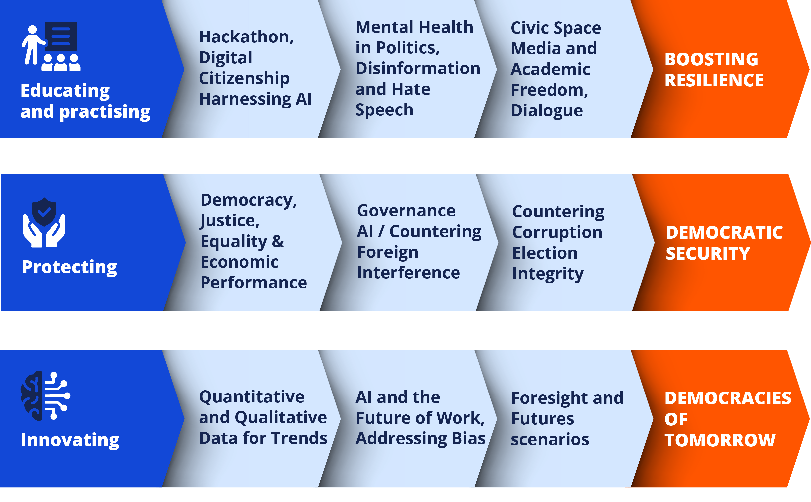
3 pillars towards

Slide 6
Pillar 1: Educating and practicing democracy
Foster dialogue across divides: political, cultural, and generational
Build a shared vision of democracy - placing human dignity, equality and pluralism at the heart of the process ex working against hate speech
Empower citizens through education: civic education, media literacy, digital literacy, developing new narratives
Encourage youth leadership and participation, fostering civic engagement through innovative tools – connecting new generations to democratic life.
Notes:
1 Foster dialogue: safeguard space for dissent, encouraging critical thinking, and amplifying diverse voices
2 Shared vision: rooted in the values of the European Convention on Human Rights and the parameters of the Reykjavík Declaration with its 10 Principles of Democracy ex work of CDDEM on participation in elections
3 Civic education: to equip people with the tools to navigate today’s complex information landscape.

Slide 7
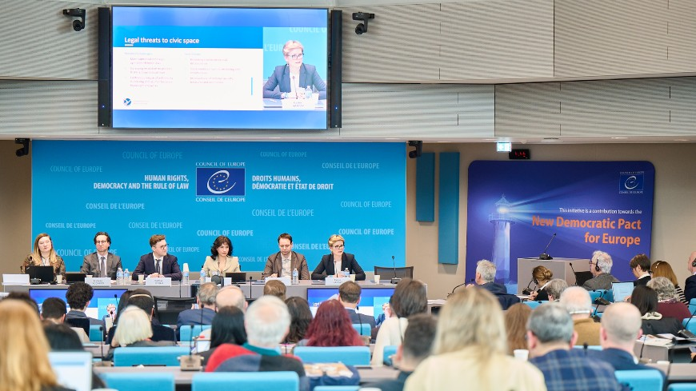
Conference: Shaping democratic renewal: civic space
and the path to a New Democratic Pact for Europe
(February 2026)
Notes:
The report of the conference tracks the shrinking of civic space, the monitoring of this dangerous trend, the strategies to mitigate the negative consequences of shrinking civic space, the perils and potential of new technologies for civic space, and finally, the opportunities for action to foster, protect and increase civic space. It includes concrete recommendations emanating from the conference.

Slide 8
Pillar 2 Protecting Democracy
Council of Europe strong acquis and network of conventions and intergovernmental recommendations with monitoring and implementation mechanisms
Ensuring that women and under-represented groups participate and contribute equally
Safeguarding elections and democratic processes
Countering hybrid threats : information manipulation, disinformation and foreign information manipulation and interference
Ensuring judicial independence and freedom of speech
Notes:
Work on the impacts of AI in different sectors: freedom of expression & media, equality
Feasibility Study on Foreign Information Manipulation and Interference.

Slide 9
Conference on Media Literacy and Information Integrity: Building Resilience to Disinformation and FIMI in Europe
(Chisinau, March 2026)
Collectively find innovative ways to build a healthier, more resilient, and trustworthy information environment in Europe.
Help member states develop national media and information literacy strategies.
CoE work to address foreign interference manipulation of information (FIMI)
(Announcement of a new CoE instrument on FIMI at Ministerial meeting in May 2026)
Notes:
Discuss specific mechanisms to collectively find innovative ways in which to build a healthier, more resilient, and trustworthy information environment across Europe.
The Council of Europe has already made significant efforts to counter the threat of disinformation and promote a healthy information environment.
help member states develop national MIL strategies and provide actionable steps to counter disinformation and promote information integrity.
+ CoE work to address foreign interference manipulation of information (FIMI).
[FIMI = coordinated, deceptive behaviour by foreign actors designed to manipulate the information environment of another state.
In simple terms: FIMI refers to foreign, hostile, and covert campaigns that try to shape what people think, believe, or fear, without their knowledge.]

Slide 10
Pillar 3: Innovating for democracy
Harness digital technologies for good – while combating their misuse and harmful impacts
Promote democratic innovation & showcase promising democratic practices worldwide
Use creative tools to imagine, explore, and co-shape the future of democracy
Notes:
1: Work on AI, promote digital inclusion, standards to combat tech facilitated violence against women
2: engage citizens through deliberative and participatory models that renew and adapt democracy to today’s challenges ex Kristiansand & WFD
3 ex communicate differently: work on positive narratives

Slide 11
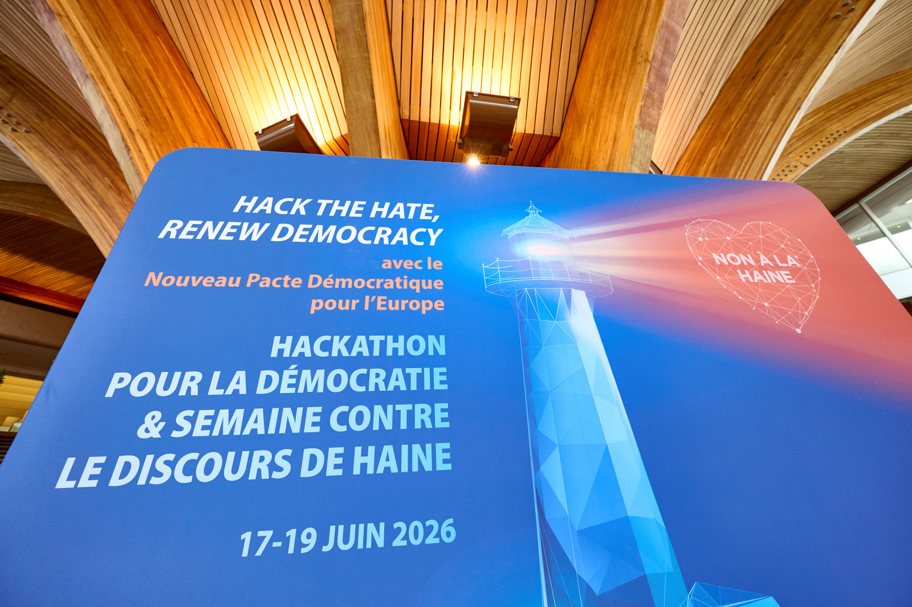
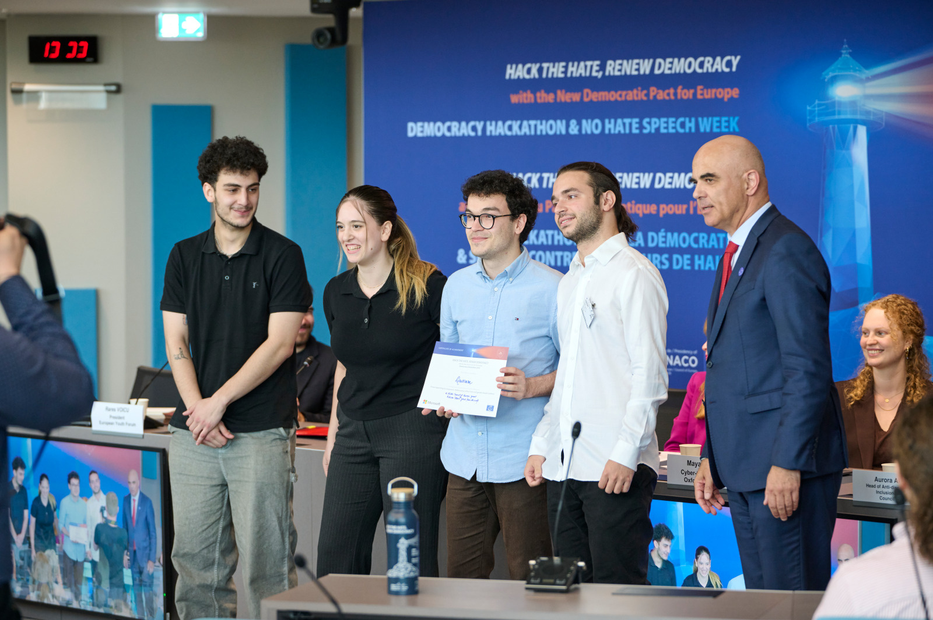
Hack the Hate, Renew Democracy: Hackathon & No Hate Speech Week June 2026
Notes:
In June 2025 the Council of Europe brought innovators, activists, policymakers, and creatives together in Strasbourg for a high-energy hackathon.
Their goal: to engage with and co-design practical, forward-thinking solutions that counter disinformation, protect free speech, and strengthen democratic resilience in a rapidly evolving digital landscape.
Among the many excellent proposals – from a tool by Echobreaker from Georgia addressing the risks of echo chambers, to the Fact-checking Foxes from Italy, who took the prize home with a game-based pre-bunking platform to help develop critical-thinking.

Slide 12
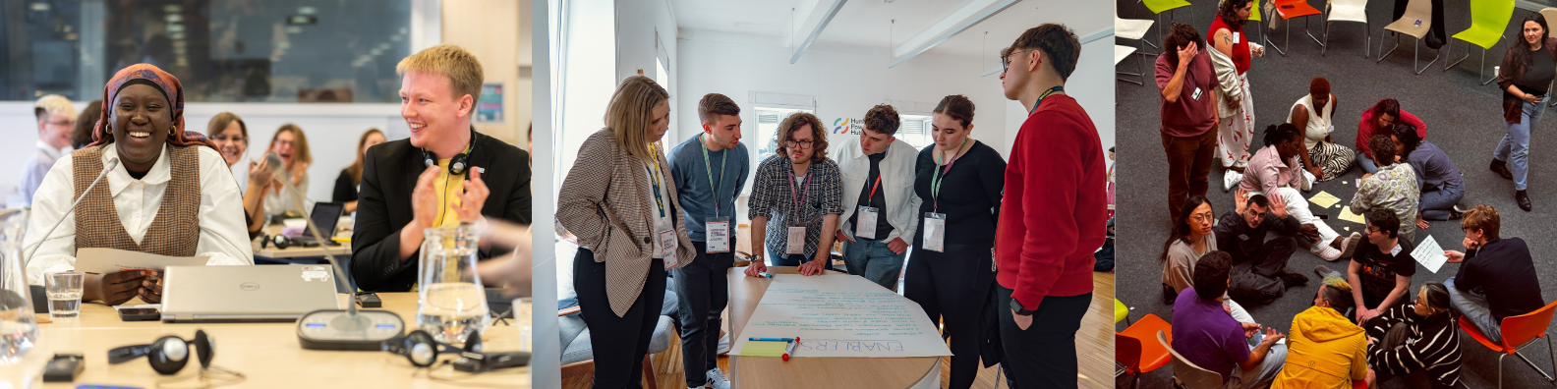
Youth Innovating Democracy
Strasbourg, 24-26 June 2026
Discussing the aspirations, challenges and proposals of young people to innovate and renew democracy
Notes:
The key youth event of the consultation phase leading towards the New Democratic Pact for Europe,
The youth event will further strengthen the ties between the Council of Europe, its mission, and young people.
The event is designed to discuss the aspirations, challenges and proposals of young people to innovate and renew democracy, building on the commitment and experience of a long-standing partnership in the field of youth.

Slide 13
Emerging strategic orientations from the consultations
Strengthening democratic participation
2) Reinforcing trust in public instti utions and democratic safeguards
3) Innovation is a key driver of democratic resilience
Notes:
SG report 26 identifies Emerging Strategic Orientations from the Consultations - Broad consensus that democratic participation must be a whole-of-society effort.
Shared understanding that democratic resilience relies on informed, inclusive and meaningful participation.
Key priorities include:
Protecting and expanding civic space;
Promoting democratic and digital citizenship education;
Developing new forms of citizen engagement that complement traditional democratic processes.
Enhancing the professionalism and integrity of public administration
Safeguarding the independence of the judiciary
Protecting media independence
Ensuring an enabling environment for civil society
Defending academic freedom and freedom of expression.
Enhancing the professionalism and integrity of public administration
Innovation:
Emerging technologies, especially AI, can support new democratic practices and improve citizen engagement.
Risks must be addressed, including algorithmic bias, unequal impacts, and broader societal changes caused by technology.
Stronger governance frameworks are needed to manage technological threats and safeguard democratic values.
Democratic innovations such as deliberative processes, multilevel governance, and peer-to-peer cooperation among states help rebuild trust, reduce institutional fatigue, and meet evolving public expectations.

Slide 14
Emerging strategic orientations from the consultations
Promoting democratic security
Consultations highlight democratic security as a central concept for democratic resilience
While security continues to be predominantly understood in military or economic terms, contributions underline the need to place human rights, democracy and the rule of law at the centre of security strategies
Build resilient institutions that people trust and that protect people
Includes the promotion of education, social justice,, informed participation for all, gender equality and non-discrimination, protection of fair elections
Notes:
An established concept and reality of the work of the Council of Europe since the 90s
Higher military spending – what if an extremist government comes to power?
Address current trends
Anticipate new challenges

Slide 15
Outputs of the Pact
The Pact is a process, its results will depend on the content of contributions and political decisions
Results of the process:
An AI powered platform with the possibility to search and aggregate all the material
A toolbox containing innovative policies or measures
A political outcome agreed by Council of Europe member states in 2027
The process will shape the work of the Council of Europe in the future
Notes:
In the next phase, the Pact process will focus on two objectives. First, it will expand participation to additional actors, including think tanks, the private sector, multilateral organisations and the European Union, as well
as groups of citizens less engaged in existing Council of Europe networks or in public life. Second, it will test, refine and operationalise proposals through targeted initiatives and milestone events, including thematic
workshops, hackathons and the World Forum for Democracy, using forward-looking methodologies such as collective foresight.
Consolidating the outcomes of the consultation phase will help identify priorities for the next Programme and Budget (2028-2031) and clarify the Organisation’s strategic positioning in the field of democratic security.

Slide 16
Contributions
To make a contributions, write to
pact@coe.int
by 11 September 2026
Notes:
All contributions from the grassroots are encouraged. You can send your ideas (a short message or a longer text) about how this democratic imperative can be addressed by the Pact, in very concrete terms, to democratic.pact.@coe.int by 30 May 2026.

