Slide 1




HELP module on child safeguarding in sports
2026 HELP (Human Rights Education for Legal Professionals) Annual Network Conference
Elena Casero
Programme Manager
Sport Division, Council of Europe
02/07/2026 - Strasbourg
#CoE4Sport
#StartToTalk
#SafeSport

Slide 2
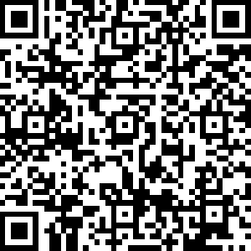
Module on child safeguarding in sports within the HELP course on Human Rights in Sport
Developed thanks to the financial support of Monaco
Goals:
Enhance knowledge of the CoE legal and policy framework on child safeguarding in sport
A better understanding can increase adherence to and implementation of the CoE standards
#CoE4Sport
#StartToTalk
#SafeSport

Slide 3
      Collaborative Process
Consultant: Professor Melanie Lang, Edge Hill University, UK
HELP, Secretariat of the Lanzarote Committee, GREVIO, the European Social Charter, the Anti-trafficking Convention, the CoE sports-related conventions.
Registry of the European Court of Human Rights
1 hour
Languages: English, French
On progress: Greek
#CoE4Sport
#StartToTalk
#SafeSport

Slide 4

Definitions
#CoE4Sport
#StartToTalk
#SafeSport

Slide 5

Module Structure
Target audience:
Legal professionals
Ministry officials, sports administrators, (child) safeguarding officers, coaches and other professionals and volunteers in contact with children
#CoE4Sport
#StartToTalk
#SafeSport

Slide 6
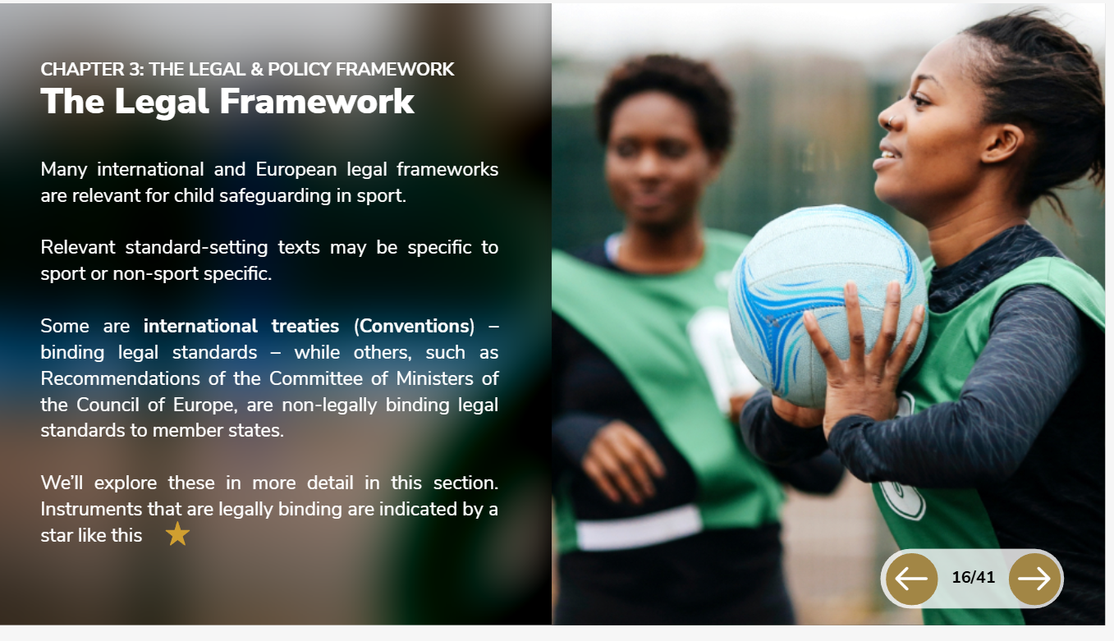
Legal Framework
#CoE4Sport
#StartToTalk
#SafeSport

Slide 7
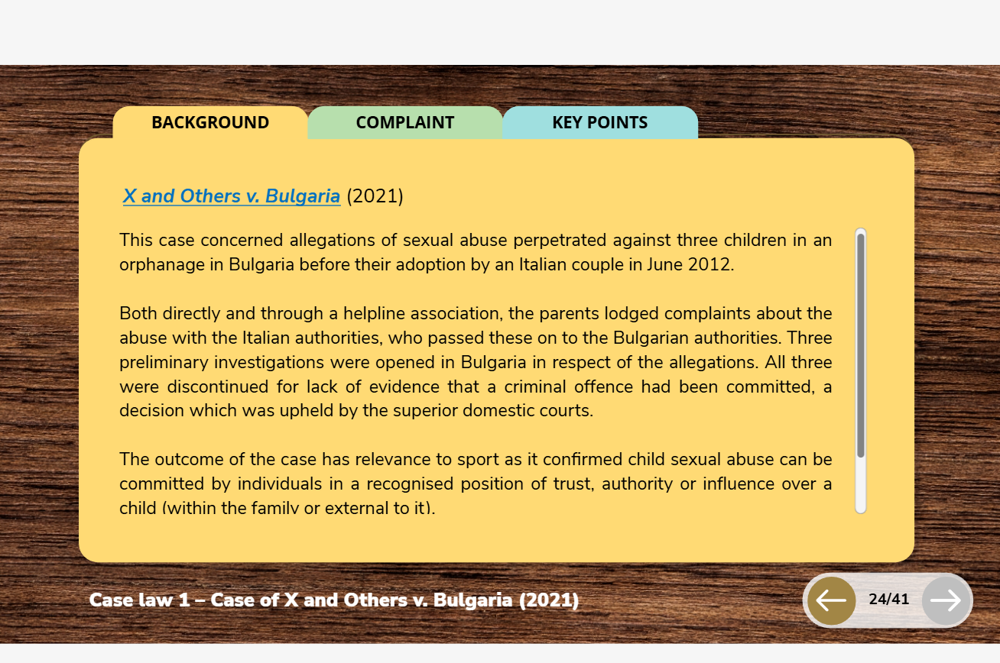
European Court of Human Rights Case-Law
#CoE4Sport
#StartToTalk
#SafeSport

Slide 8
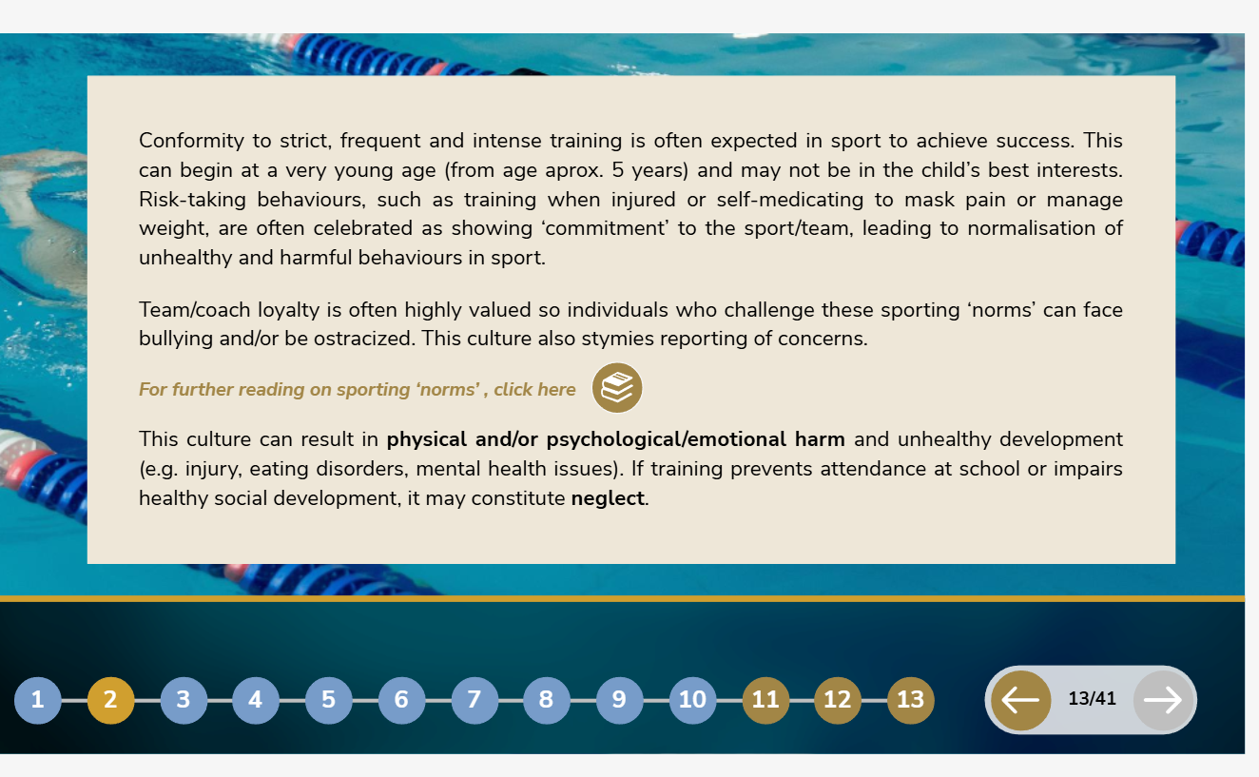
The Sport Context
#CoE4Sport
#StartToTalk
#SafeSport

Slide 9

Prevention and Protection
#CoE4Sport
#StartToTalk
#SafeSport

Slide 10
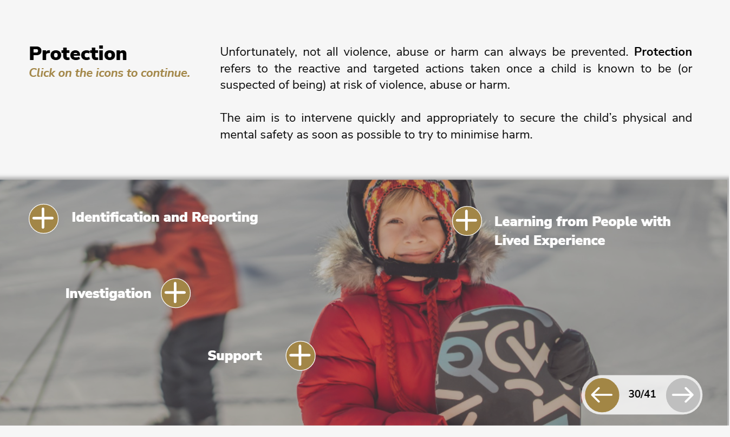
Prevention and Protection
#CoE4Sport
#StartToTalk
#SafeSport

Slide 11


Other related training tools
Toolkit on how to identify and react to child sexual abuse
#CoE4Sport
#StartToTalk
#SafeSport

Slide 12
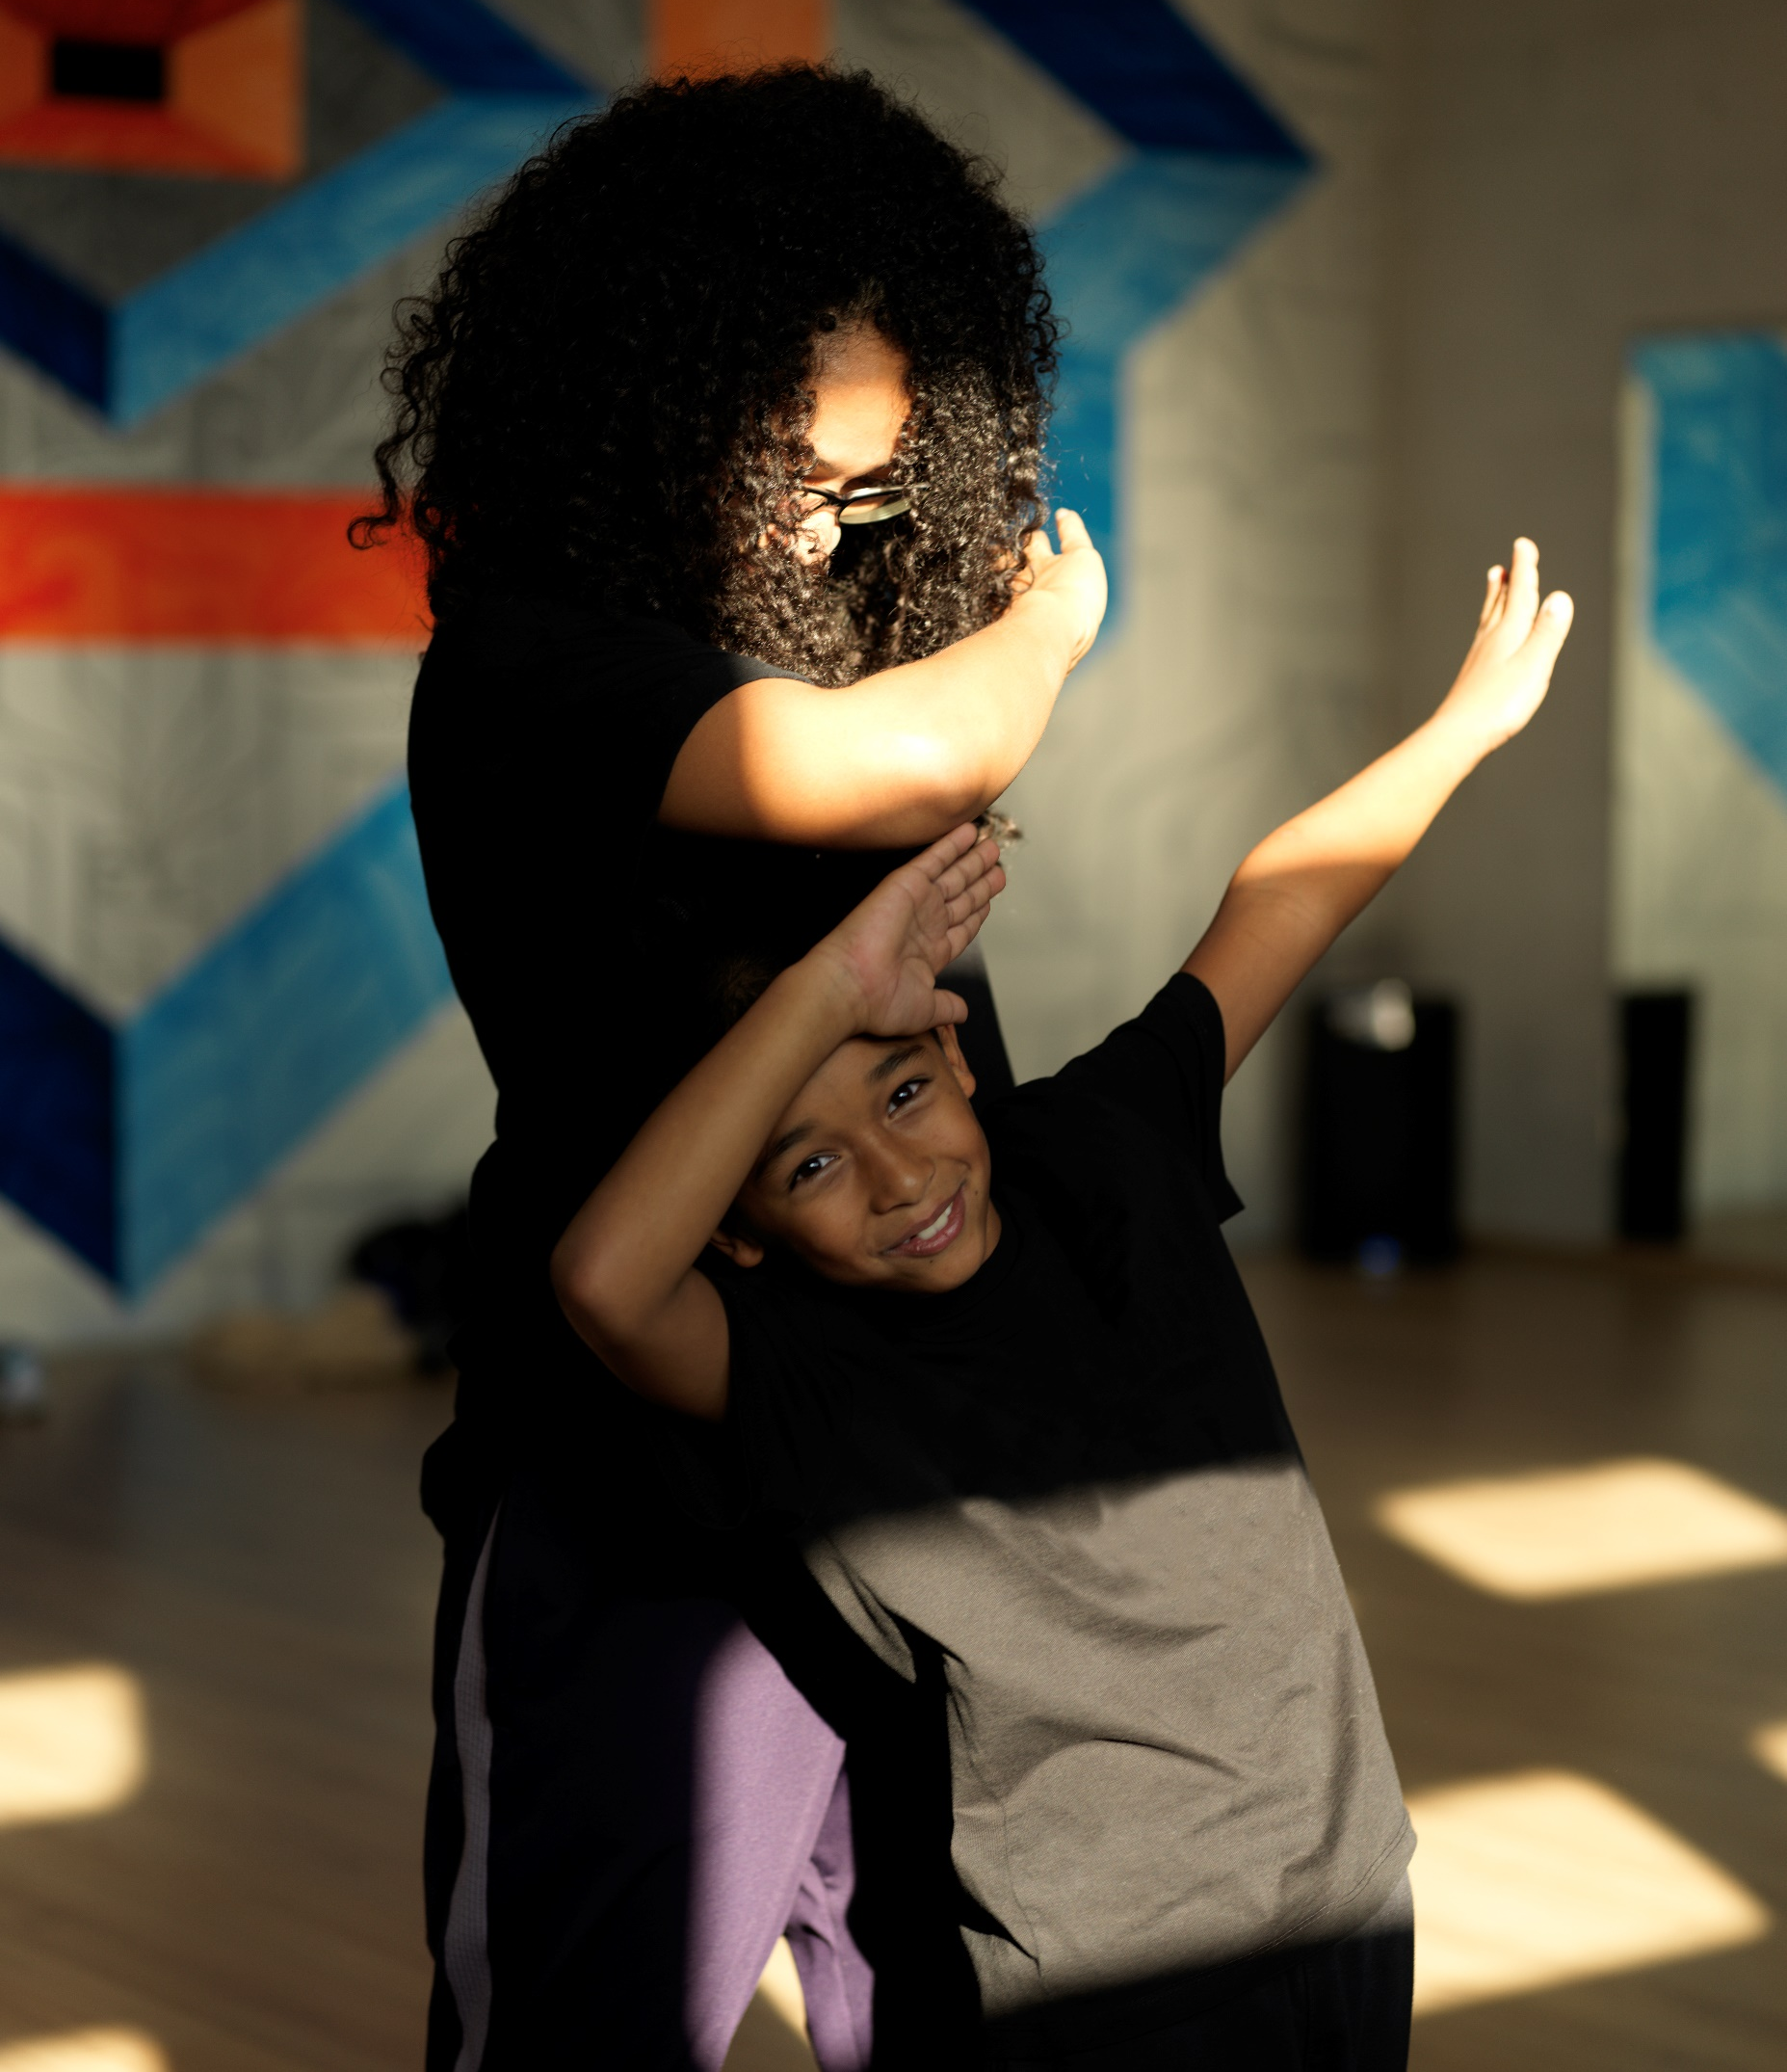
Maria-elena.casero@coe.int
https://www.coe.int/en/web/sport/start-to-talk
https://www.coe.int/en/web/sport/epas
LinkedIn: Sport at the Council of Europe
#CoE4Sport
#StartToTalk
#SafeSport

