Slide 1
Genomic medicine horizon
For CDBIO Horizon Scanning event, 4 April 2024, Paris
Pete Mills

Slide 2
When we refer to ‘a biotechnology’ we mean a productive conjunction of knowledges, practices, products and applications. ‘Emerging’ is the assembling of this conjunction.
― Nuffield Council on Bioethics (2012) Emerging Biotechnologies (unedited)

Slide 3
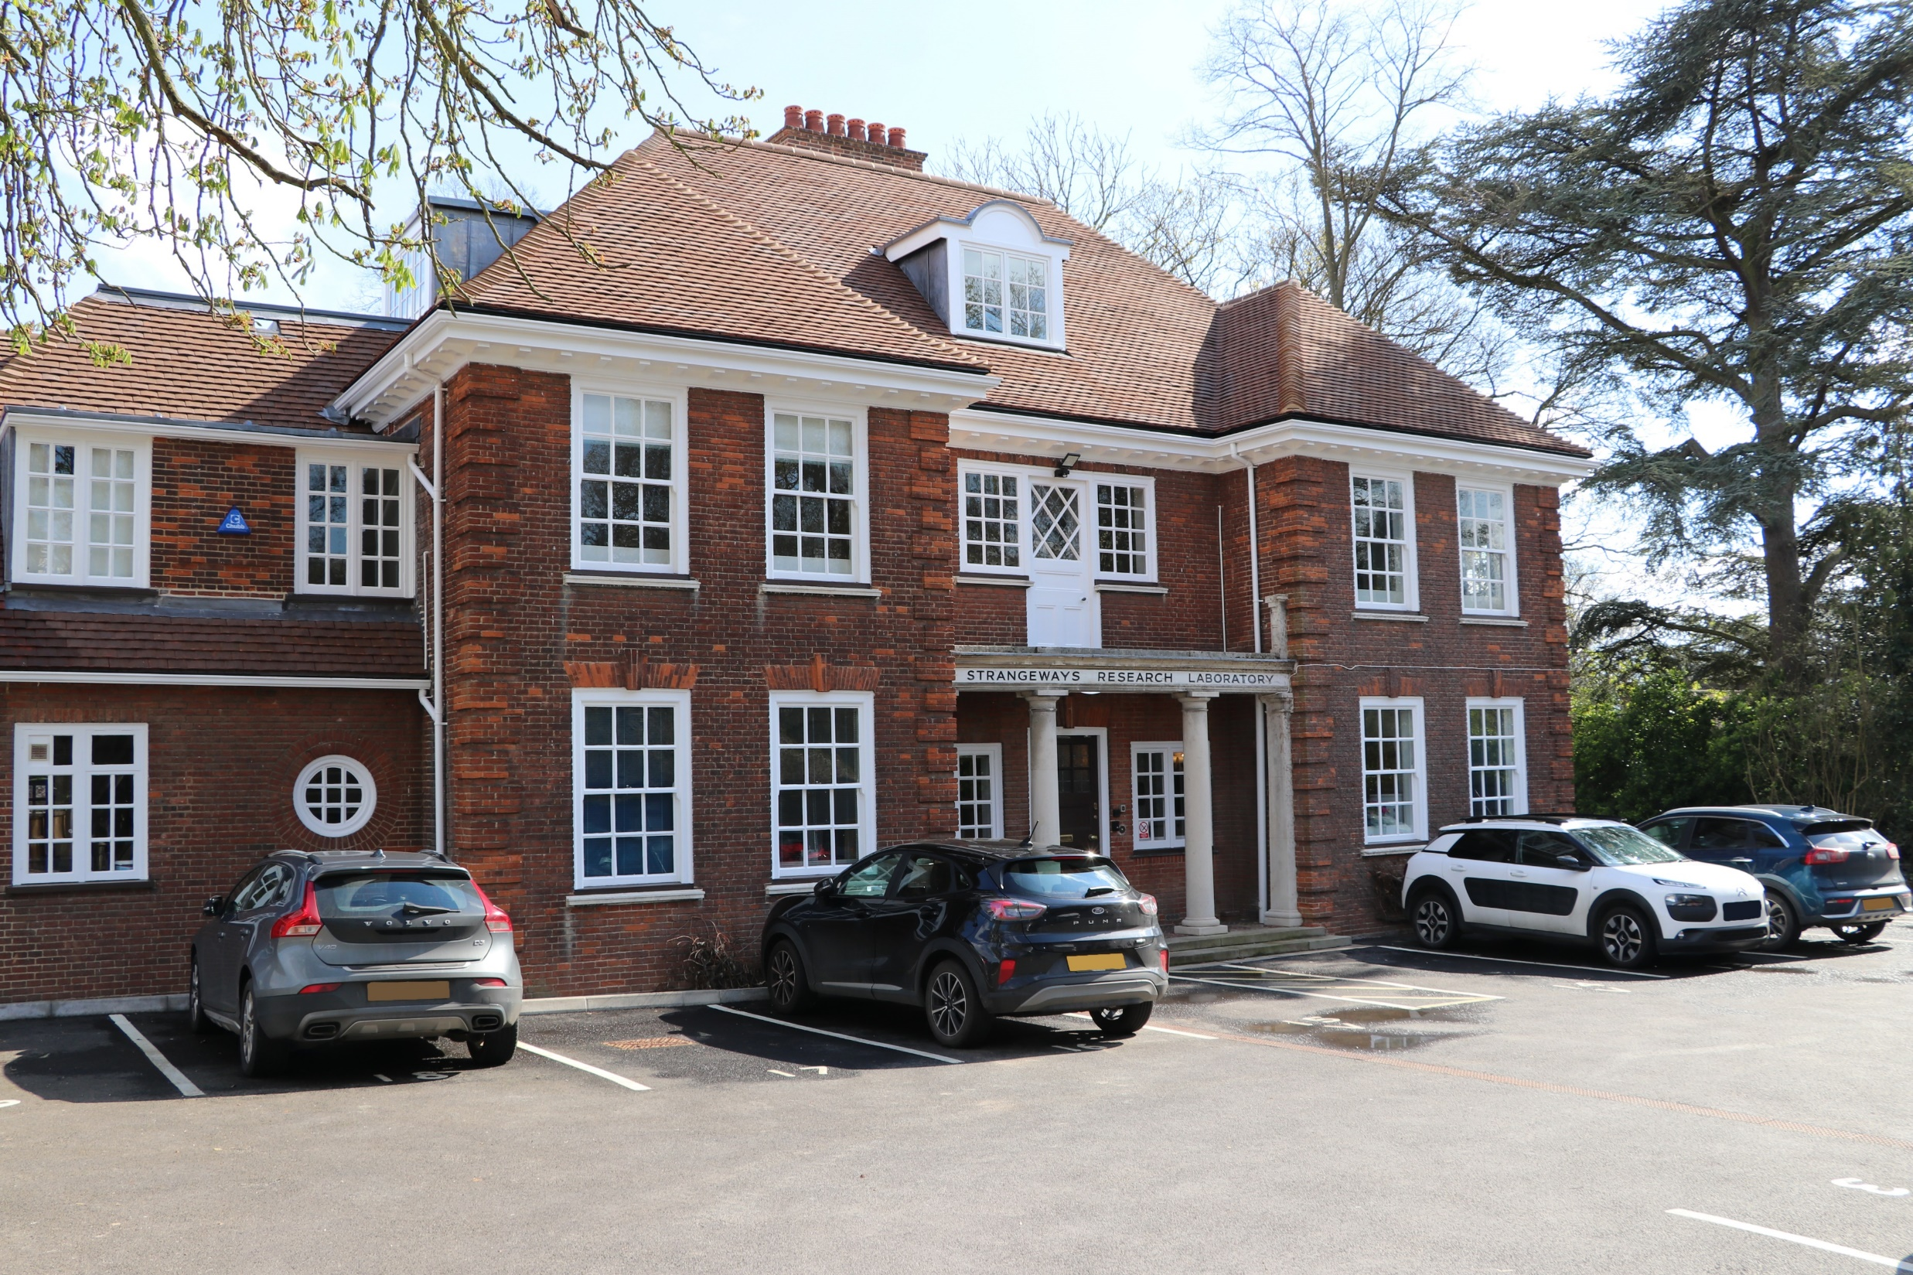




Slide 4
Genes and disease
RARE
COMMON
Small number of highly penetrant genetic variants
Multiple low penetrance genetic variants
Mendelian
disorders
Chromosomal disorders
Single gene subsets of common disorders
Common complex disorders

Slide 5
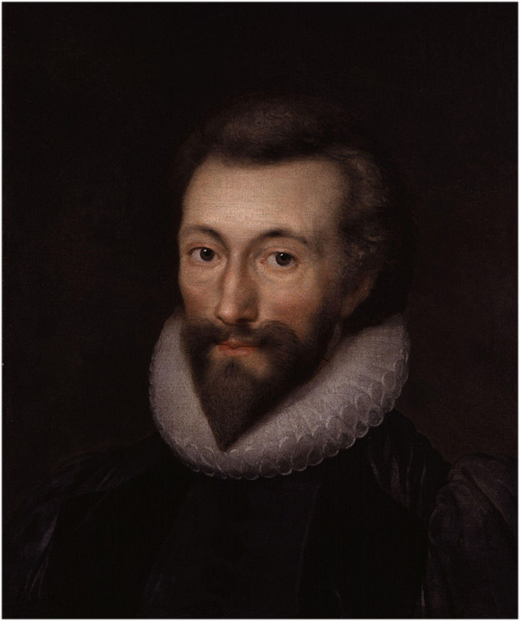
Knowledge
Information
Data
Information
the effectiveness with which we can care for any one person depends upon the quantity, quality and variety of information we can obtain from a great number of other people…

Slide 6


Data and computational intelligence
Data generation: NGS, LRS/Single molecule, WES, TS, OGM
Data integration: TREs/SDEs, EHDS, EHRs
Data analysis: algorithms, machine learning, AI/computational intelligence

Slide 7
Prediction, diagnosis, prognosis
Technology | Use case | Healthcare setting
Genomics | Disease diagnosis | Primary care
Genomics | Testing for disease risk | Primary care, public health
Pharmacogenomics | Preemptive testing | primary/ secondary/ hospitals before admission
Transcriptomics | Gene expression panel tests (GEPs) for early detection of disease (majority in breast cancer) | Primary care
Transcriptomics | Whole transcriptome analysis for diagnosis | Primary care
Epigenomics | Early disease diagnosis | Primary care
Metabolomics | Early detection - pre-cancer Primary care | Primary care
Metabolomics | Systematic metabolome analysis for screening and diagnosis | Primary care
Technology | Use case | Healthcare setting
Proteomics | Clinical proteome analysis for diagnosis | Primary care
Proteomics | Targeted protein analysis | Primary care
Multiomics | Diagnosis | Primary care
Single cell ’omics | Disease diagnosis | Primary care
Fluxomics | Prevention and diagnosis | Primary care
Fragmentomics | Early detection of cancer | Primary care
Pathogen genomics | Disease diagnosis and outbreak management | Primary care, public health
Microbiome analysis | early detection and prevention | Primary care
ctDNA (liquid biopsy) | early detection or screening | Primary care, public health
Risk assessment and stratification
Polygenic scores | Polygenic scores (PGS) Informing disease screening programmes | Primary prevention within secondary care/ public health

Slide 8
Multiomics
use case Diagnosis | Timeframe Visionary
healthcare setting Primary care | population affected All populations at risk
description Provides comprehensive analysis of an individual’s physiological state by combining data from multiple ’omic technologies for faster and more precise diagnosis. ‘Proteogenomics’ combines genomic and proteomic analysis to improve understanding of the molecular mechanisms. WGS and whole transcriptome analysis could identify a larger number of actionable variants for diagnosis. Combining ’omic data with health records could help to link physiological phenotypes with molecular mechanisms. Liquid biopsy RNA-based tests are beginning to emerge and companies are developing AI diagnostics support tools. ML has been used in research to combine pathogen, airway microbiome and host response for accurate LRTI diagnosis in critically ill patients.
anticipated impacts Incremental: Liquid biopsy RNA tests Potentially transformative: advancing personalised medicine for multifactorial diseases (e.g. host and pathogen genomics) but capacity to generate ’omics data currently outstripping ability to manage, analyse, and interpret it.
* Timeframe/ stage of development / readiness for adoption: Now (0-2 years); near (2-5 years); visionary (5+years)

Slide 9
Fluxomics
use case Prevention and diagnosis | Timeframe Visionary
healthcare setting Primary care | population affected Disease/individual dependent
description Novel systems biology method using a combination of genomics, transcriptomics, proteomics, and metabolomics to study the ‘fluxome’, the entirety of metabolic fluxes in a cell (i.e. rate at which different biochemical reactions occur) to provide insight into the flow of metabolites through various pathways. Fluxomics offers a dynamic representation of cellular processes instead of the static representations of other ’omic methods. Fluxomics could identify a ‘molecular fingerprint’ unique to an individual to predict their risk or provide early diagnosis of diseases in that patient. It requires, first, characterization of healthy cell metabolism as a reference to compare patient molecular pathways.
anticipated impacts Potentially transformative in the longer term: currently being investigated for CVD but much work is needed to understand the basic science, develop relevant reference databases, instruments and software. Once tests are developed, cost-effectiveness and clinical utility of these tests will have to be evaluated before clinical applications can be considered at scale.
* Timeframe/ stage of development / readiness for adoption: Now (0-2 years); near (2-5 years); visionary (5+years)

Slide 10
Fragmentomics
use case Early detection of cancer | Timeframe Near
healthcare setting Primary care | population affected Disease dependent (e.g. liver cancer is third leading cause of cancer death worldwide)
description Fragment size of ctDNA or cfDNA differs between cancer and non-cancer cells. Fragmentomics can help to infer cancer status and tissue of origin of cfDNA (by analysing methylation patterns on fragments), e.g. a fragmentomics-based blood test developed to detect liver cancer. Fragmentation analysis of cfDNA in maternal plasma can be used in NIPT. ML models to analyse fragmentation data of nuclear circular DNA (cirDNA) could also be used in cancer screening tools. However diagnostic potential is limited by amounts of detectable ctDNA or cfDNA from tissue of origin for some applications
anticipated impacts Incremental: early diagnosis of cancer e.g. liver cancer; refinements to non-invasive prenatal testing. Potentially transformative: non-invasive cancer screening could offer more accessible and potentially cheaper testing, at scale.
* Timeframe/ stage of development / readiness for adoption: Now (0-2 years); near (2-5 years); visionary (5+years)

Slide 11
Polygenic scores (PGS)
use case Informing disease screening programmes | timeframe Near (use of PGS risk stratified screening for certain cancers being explored as part of cancer risk prediction tools)
healthcare setting Primary prevention within secondary care/public health | population affected All populations at risk of disease for which screening is available (e.g. women for breast cancer)
description Genomic test to stratify populations at risk and enable screening of those at higher risk sooner and/or more frequently. Likely to be most effective/appropriate in combination with other risk factors.
anticipated impacts Incremental: stratification of the top 1-5% of symptomatic patients/existing referrals at highest risk to stratify interventions/prevention effort. Potentially transformative: unsolicited screening for cancer risk factors within primary care; however, for many applications/conditions, the polygenic element of total disease risk is small so requires careful assessment of additional clinical utility. PGS could also be used – and is offered commercially – in reproductive medicine.
* Timeframe/ stage of development / readiness for adoption: Now (0-2 years); near (2-5 years); visionary (5+years)

Slide 12
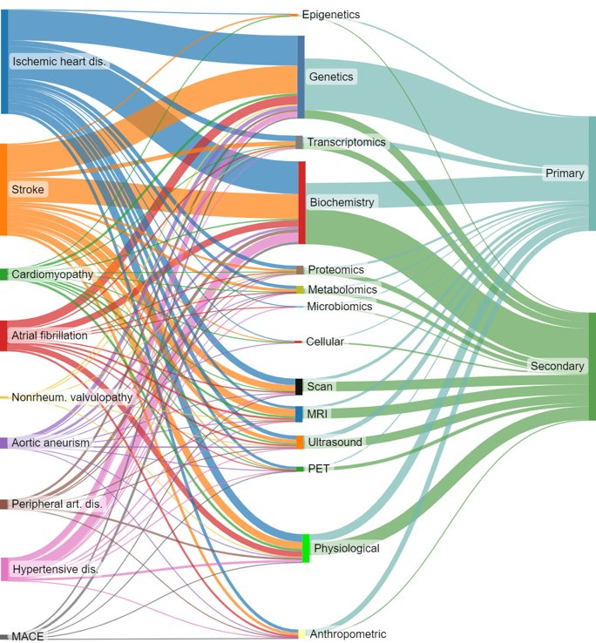
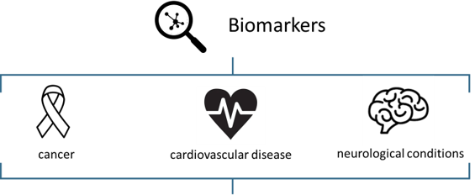

Biomarkers for prevention
843 | 775 | 286

Slide 13
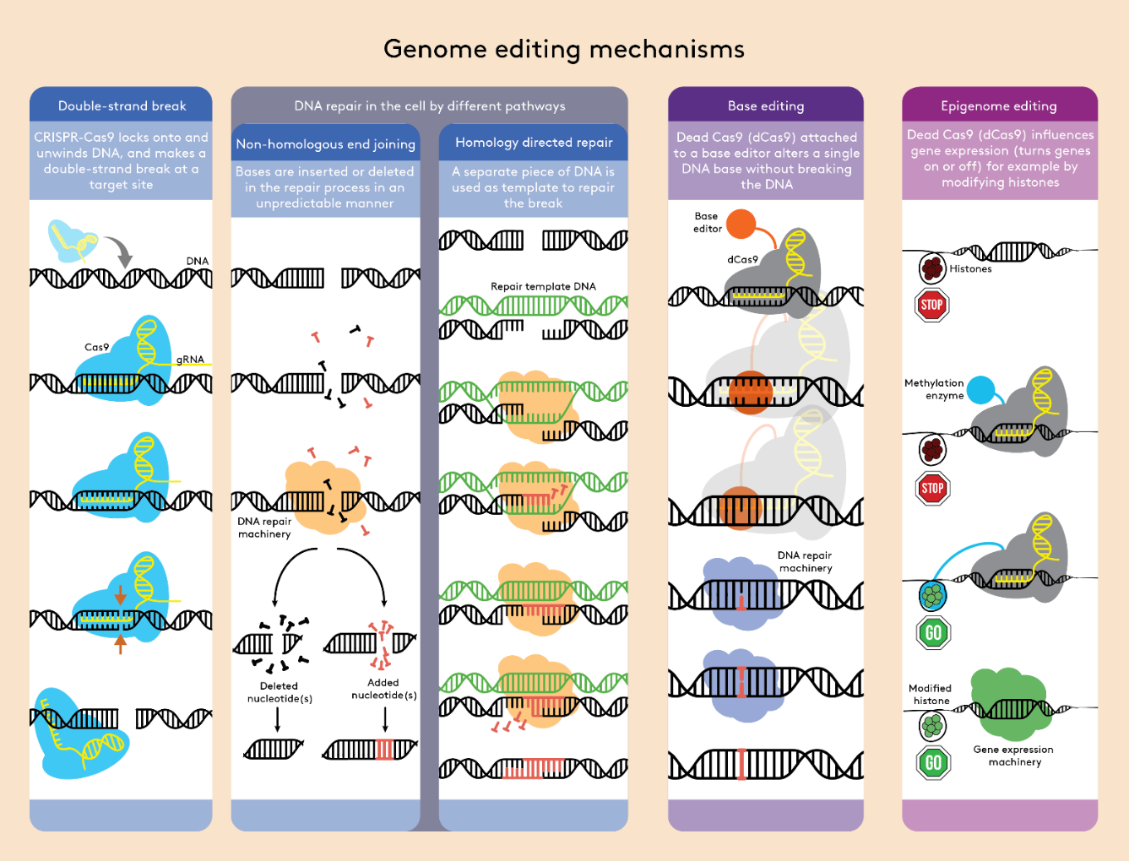
Molecular interventions
Oligonucleotide therapies for rare diseases (e.g. DMD, SMA)
RNA vaccines
Immunotherapies (e.g. CAR-T) for NCDs, e.g. Kymriah (ALL), Yescarta, Carteyva (lymphoma)
Genome editing for hereditary disease (e.g. SCD, β-thalassaemia)
Xenotransplantation (PERVs)
Heritable genome editing (genetic relatedness)
Credit: Nuffield Council on Bioethics (2018) Genome editing and human reproduction

Slide 14

Lift, square, extend
Lift
Enhance average quality of life
Square
Improve portion of life spent in good health
Wellbeing
Average course of life today
Extend
Increase global life expectancy
Life Course
Adapted from: Karolinska Institute, Sweden

Slide 15
Mortality rates from avoidable causes, 2021 (or nearest year)
Age-standardised mortality rate per 100,000 people across OECD countries. Source: OECD Health Statistics 2023, based on WHO Mortality Database
Note: 1. Most recent data point corresponds to 2016-19.

Slide 16
Credit: Ingrid Kockum, Carl-Johan Sundberg, Karolinska Institutet, Stockholm, Sweden

Slide 17
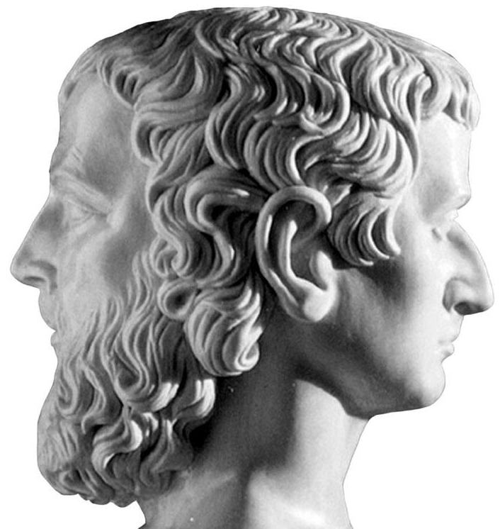
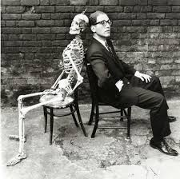
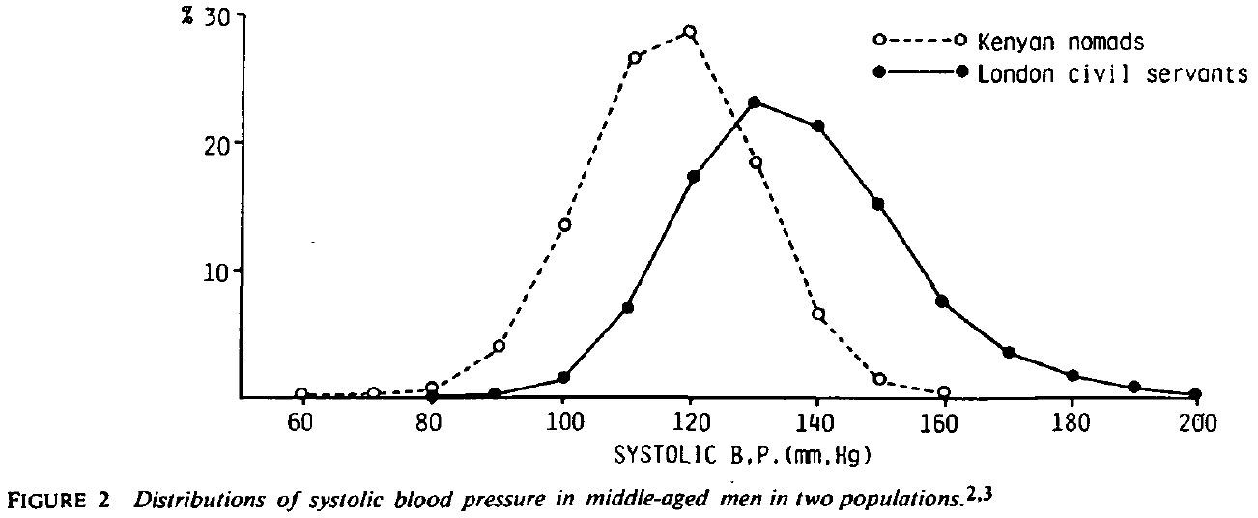
Moral and economic equity
Rose Geoffrey (1985) Sick individuals and sick populations, International Journal of Epidemiology 14(1): 32-38.
Tom Lehrer (1959) An Evening (Wasted) With Tom Lehrer (Reprise/Warner Bros. Records)

Slide 18
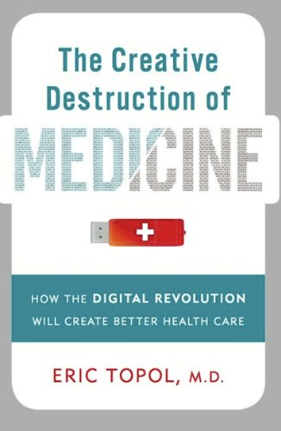

Fundamental freedoms

Slide 19



Slide 20
Just two questions
If the effectiveness with which we can care for any one person depends upon the quantity, quality and variety of information we can obtain from a great number of other people, what might this mean we have reason to expect of others and what might they expect of us in return?
If providing effective health care for all means that people should be treated differently, how can we satisfy principles of justice and fairness that require that all people should be treated the same?

Slide 21
Thank you
peter.mills@phgfoundation.org

